Slide 1
Mikroişlemci Sistemleri
Yrd. Doç. Dr. Erkan Uslu
2017/1-Ders 1
YTÜ-CE

Slide 2
Ders Sayfası
https://www.ce.yildiz.edu.tr/personal/erkan

Slide 3
Dersin Konusu
Genel tanımlar ve karşılaştırmalar
8086 μP minimum mod kullanımında:
İç yapı
Uç tanımları
Yardımcı devreler
Hafıza erişimi
Arayüzler
8255
8251
8254
DAC, ADC
8259

Slide 4
μP Tarihçesi
https://www.youtube.com/watch?v=-ReL9JnWA1A

Slide 5
Genel Tanımlar ve Karşılaştırmalar
ALU
Register
CPU
μP
μC
SoC
Harvard arc.
Von Neumann arc.
CISC
RISC
EPIC
Little endian
Big endian
Data bus
Address bus
Control bus
Accumulator

Slide 6
Genel Tanımlar ve Karşılaştırmalar
8086 (1978)
16 bit veri yolu, 16 bit register, 20 bit adres yolu
8088 (1979)
8 bit veri yolu, 16 bit register, 20 bit adres yolu
80286 (1982)
16 bit veri yolu, 16 bit register, 24 bit adres yolu
80386 (1985)
32 bit veri yolu, 32 bit register, 32 bit adres yolu

Slide 7
Genel Tanımlar ve Karşılaştırmalar
Real mode
Protected mode
Virtual mode
Prefetch queue
Pipeline
Offset memory model
Time multiplexing
Coprocessor
Cache

Slide 8
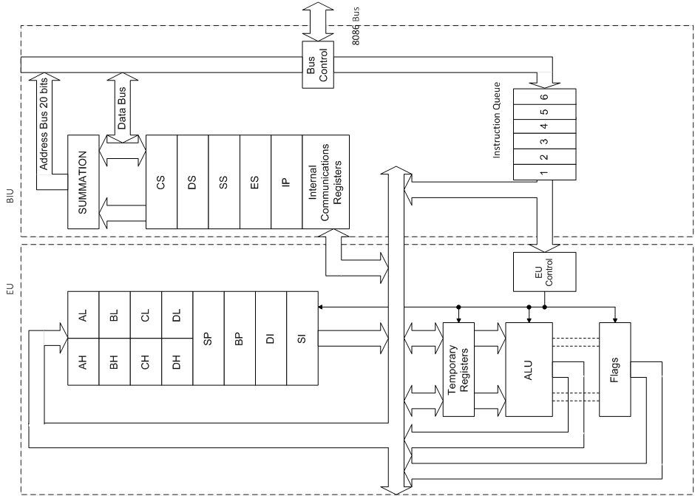
8086 İç Yapısı

Slide 9
Yazmaçlar
AX
AL
AH
BX
BL
BH
CX
CL
CH
DX
DL
DH
SP
BP
SI
DI
SS
CS
DS
IP
ES

Slide 10
8086 Uç Tanımları

Slide 11
8086 Uç Tanımları
AD₁₅-AD₀: (I/O-3)
The 8086 address/data bus lines compose the upper multiplexed address/data bus on 8086. These lines contains address bits whenever ALE is logic 1. These pins enter a high-impedance state whenever a hold acknowledge occurs.

Slide 12
8086 Uç Tanımları
A₁₉/S₆-A₁₆/S₃: (O-3)
The address/status bus bits are multiplexed to provide address signals A₁₉-A₁₆ and also status bits S₆-S₃. The pins also attain a high-impedance state during the hold acknowledge. S4 and S3 show which segment is accessed during the current bus cycle.

Slide 13
8086 Uç Tanımları
: (O-3)
Whenever the read signal is logic 0, the data bus is receptive to data from the memory or I/O devices connected to system.
READY: (I)
This input is controlled to insert wait states into the timing of the microprocessor.
READY=0: μP enters into wait states and remain idle
READY=1: It has no effect on operation of μP

Slide 14
8086 Uç Tanımları
: (I)
The test pin is an input that is tested by the WAIT instruction
NMI: (I)
The non-maskable interrupt input is similar to INTR except that the NMI does not check to see if IF flag bit is a logic 1. This interrupt input uses interrupt vector 2.

Slide 15
8086 Uç Tanımları
RESET: (I)
The reset input causes the μP to reset itself if this pin is held high for a minimum four clocking periods. It begins executing instructions at memory location FFFF0H and disables future interrupts by clearing the IF flag bit.

Slide 16
8086 Uç Tanımları
: (I)
Minimum/maximum mode pin select.
: (O-3)
BHE pin is used to enable the most sig. data bus bits (D₁₅-D₈) during a read or write operation.

Slide 17
8086 Uç Tanımları
: (O-3)
The pin selects memory or I/O. This pin indicates that the microprocessor address bus contains either a memory address or an I/O port address.
: (O-3)
This line indicates that 8086 is outputting data to a memory or I/O device.

Slide 18
8086 Uç Tanımları
: (O-3)
The interrupt acknowledge signal is a response to the INTR input pin. This pin is normally used to gate the interrupt vector number onto the data bus in response to an interrupt request.
: (O)
Address latch enable shows that the 8086 address/data bus contains address information. This address can be a memory address or an I/O port number.

Slide 19
8086 Uç Tanımları
:(O-3)
The data transmit/receive signal shows that the microprocessor data bus is transmitting or receiving data.
: (O-3)
Data bus enable activates external data bus buffers.

Slide 20
8086 Uç Tanımları
HOLD : (I)
The hold input requests a direct memory access (DMA). If the HOLD signal is logic 1, the microprocessor stops executing software and places its address, data and control bus at the high-impedance state.
HLDA : (O)
Hold acknowledge indicates that the 8086 microprocessor entered the hold state.

Slide 21
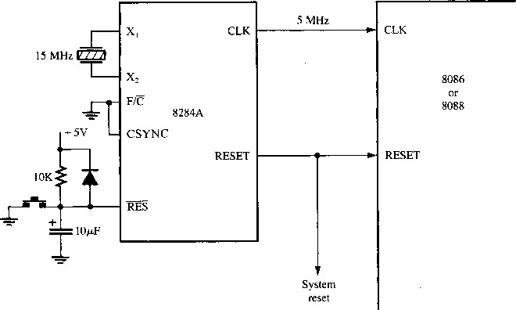
Clock Generator (8284A)

Slide 22
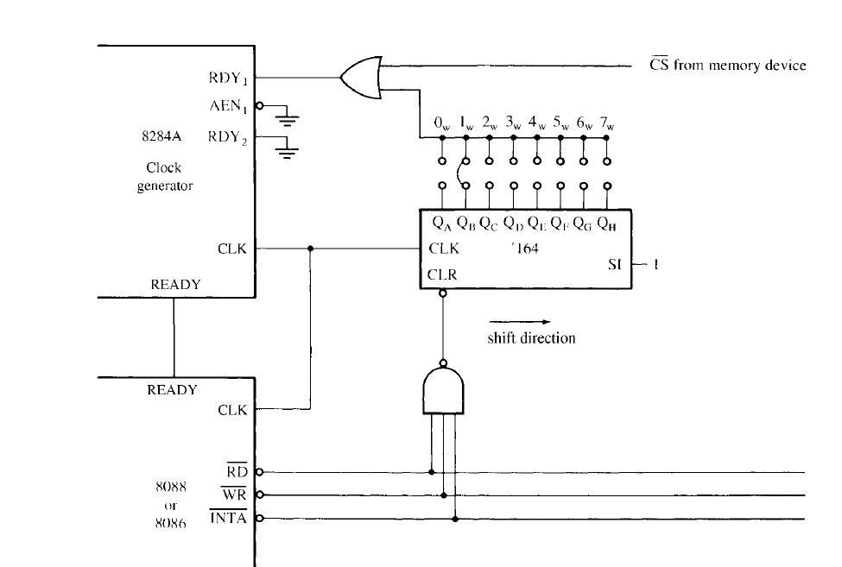
Clock Generator (8284A)

Slide 23
Bus Buffering & Latching
The address/data bus of the 8086/8088 is multiplexed (shared) to reduce the number of pins required for the integrated circuit.
Memory & I/O require the address remain valid and stable throughout a read/write cycle.
If buses are multiplexed, the address changes at the memory and I/O, causing them to read or write data in the wrong locations

Slide 24
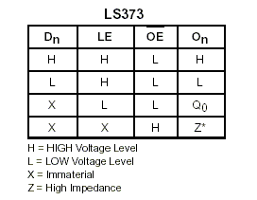
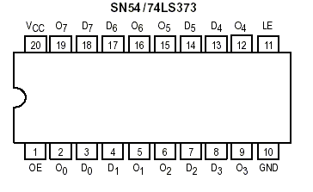
Bus Buffering & Latching
74LS373 Octal Transparent Latch with 3-state Outputs

Slide 25
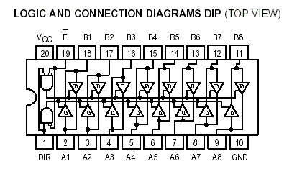
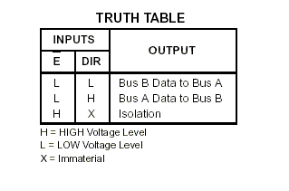
Bus Buffering & Latching
74LS245 Octal Bus Tranceiver

Slide 26
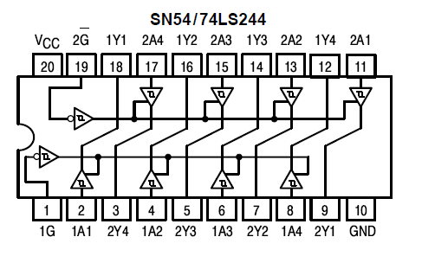
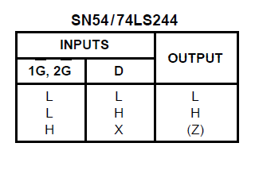
Bus Buffering & Latching
74LS244 Octal Buffer

Slide 27
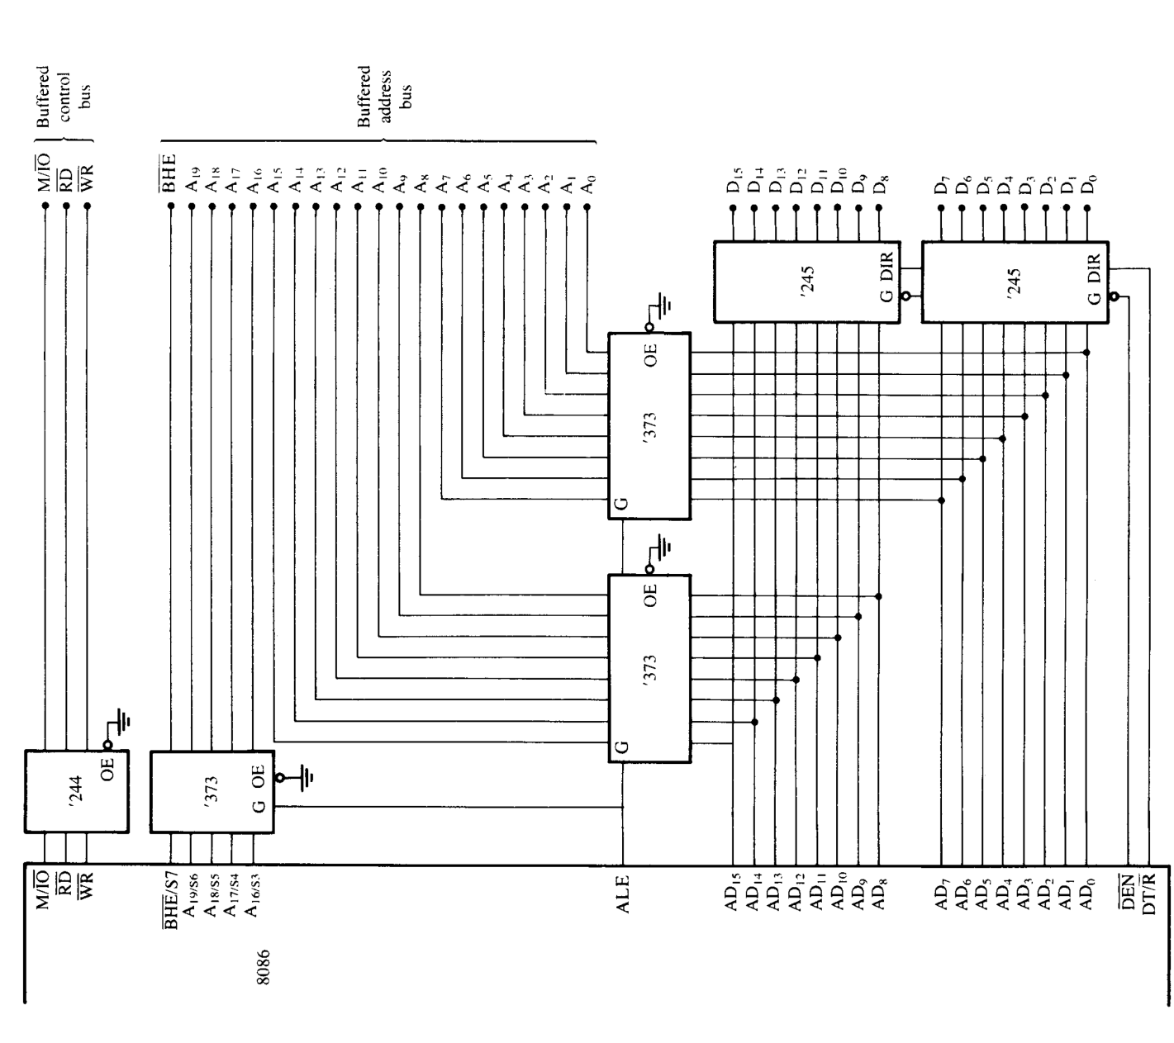
Bus Buffering & Latching

Slide 28
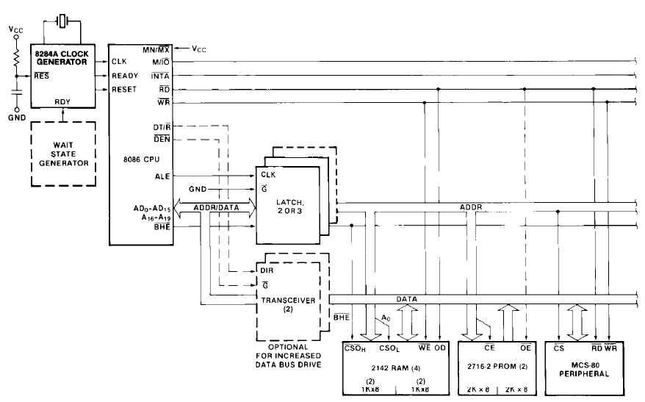
Bus Buffering &Latching

Slide 29
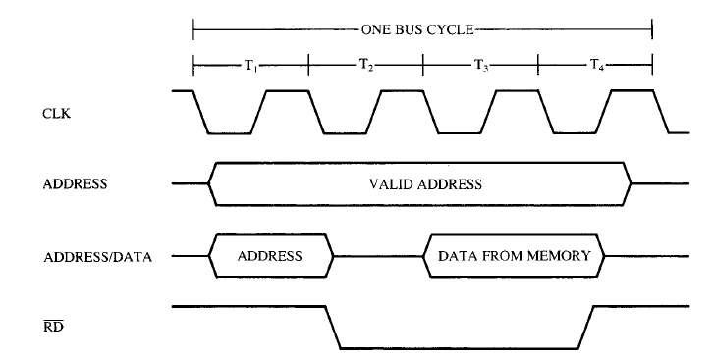
Bus Timing – Simplified Read

Slide 30
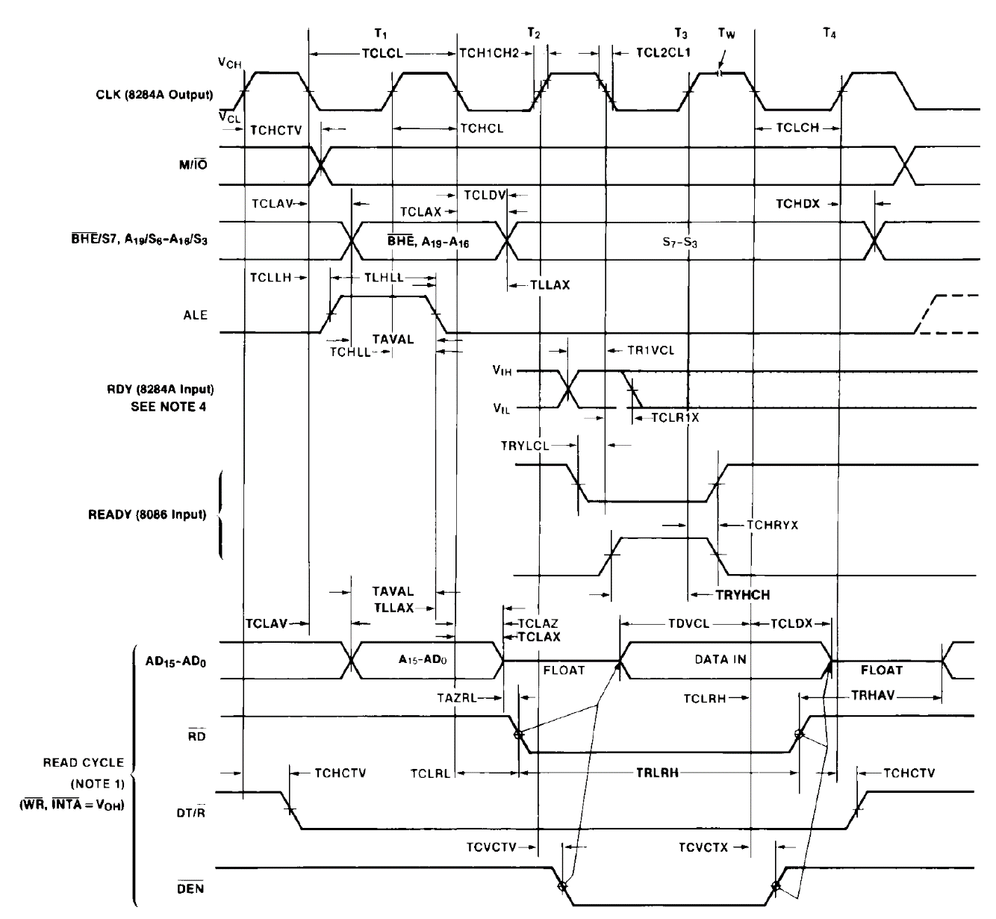
Bus Timing Read

Slide 31
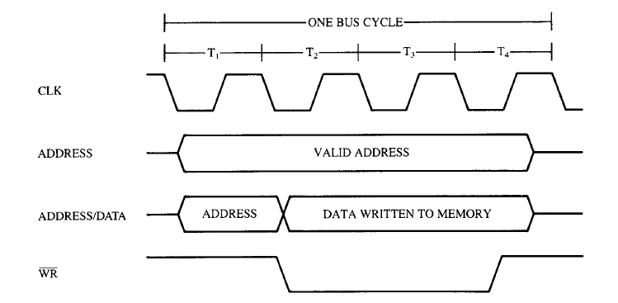
Bus Timing – Simplified Write

Slide 32
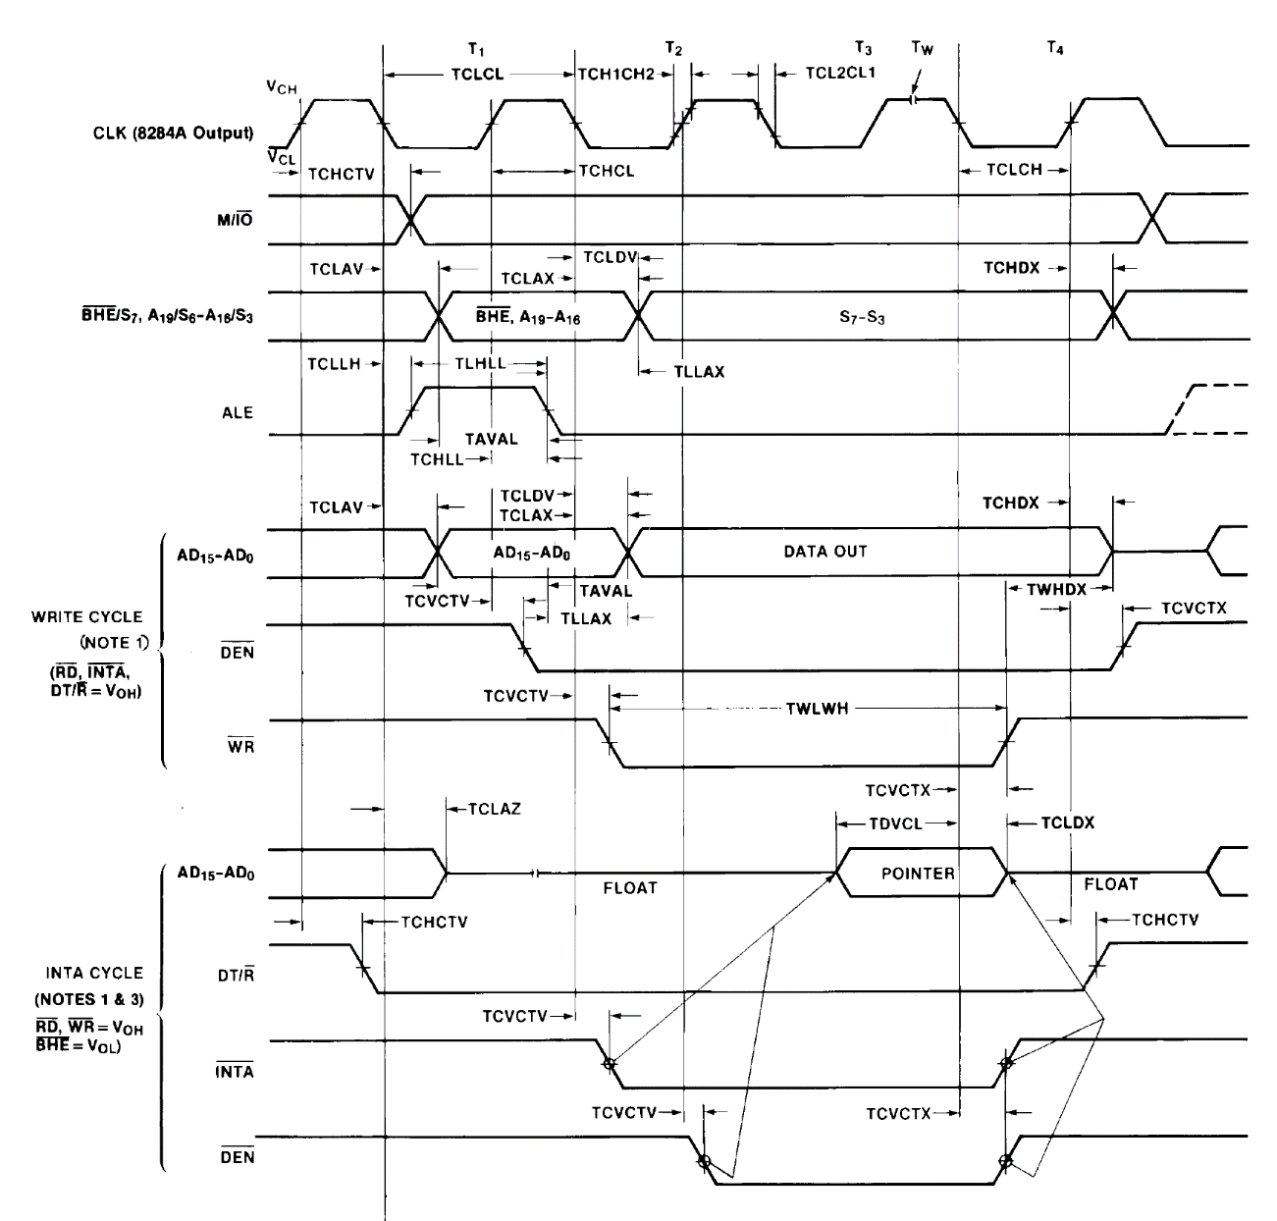
Bus Timing Write

