Slide 1
Robot Teknolojisine Giriş Yrd. Doç. Dr. Erkan Uslu, Doç. Dr. Sırma Yavuz, Doç. Dr. Fatih Amasyalı, Ar. Grv. Nihal Altuntaş, Ar. Grv. Furkan Çakmak D011 Cuma 14:00-17:00 02

Slide 2
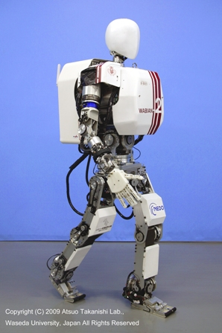
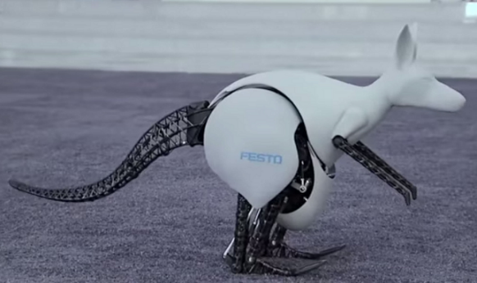
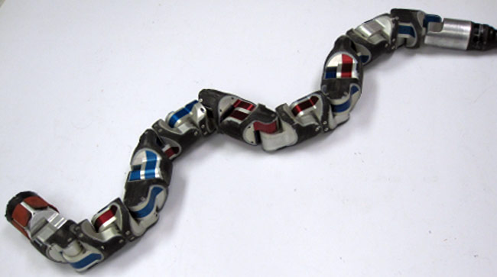
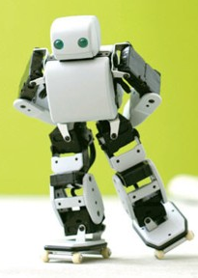
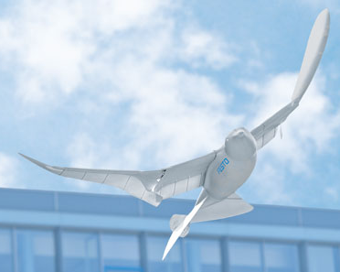
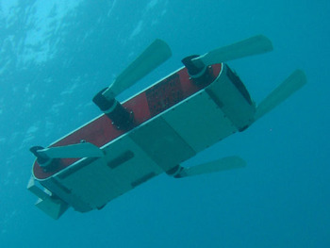
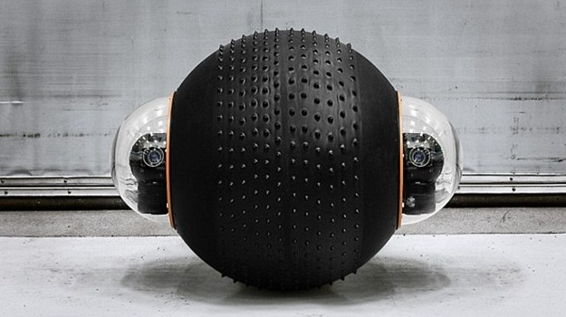
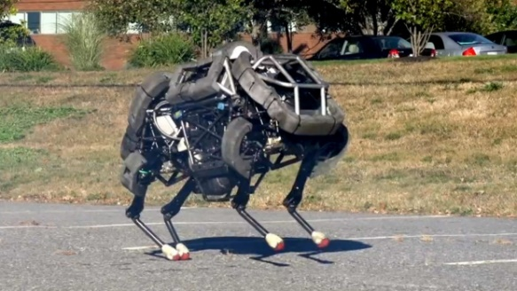
Locomotion
Locomotion is the process of causing an autonomous robot to move
Bioinspired locomotion mechanisms: walk, jump, run, slide, skate, swim, fly, roll

Slide 3
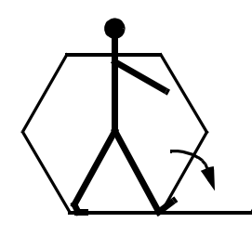
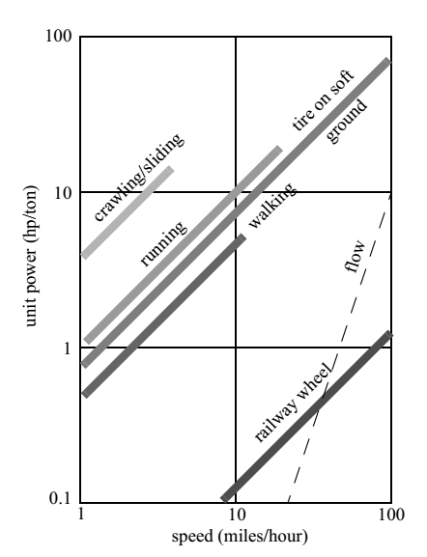
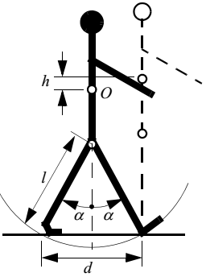
Locomotion – Legged vs. Wheeled
Requires higher degrees of freedom → mechanical complexity
Wheeled locomotion depends on flatness and hardness of the ground
Wheeled locomotion is inefficient on soft surfaces due to rolling friction
Human environment consists of engineered, smooth surfaces → industrial applications of mobile robotics utilize wheeled locomotion

Slide 4
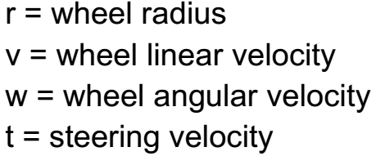
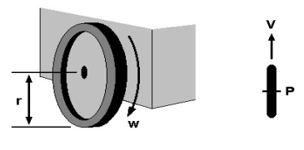
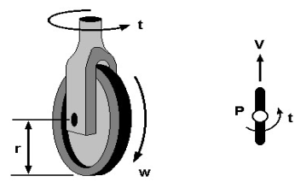
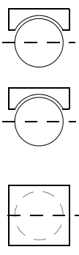
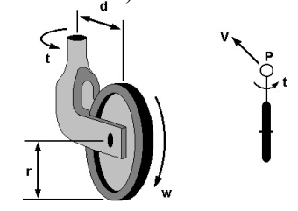
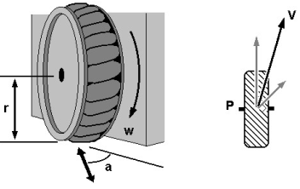
Wheel Types
Fixed Wheel | Centered Orientable Wheel | Spherical Wheel
Off-centered Orientable Wheel | Swedish Wheel

Slide 5

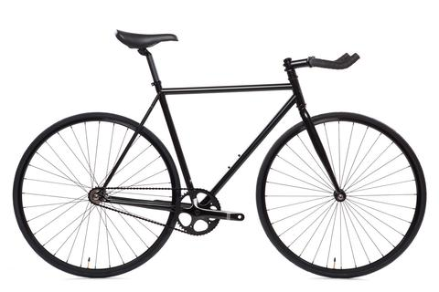





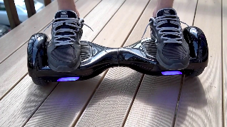



Wheel Configurations
Wheel Icon | Wheel Type
 | Unpowered Spherical
 | Motorized Swedish
 | Unpowered Standard
 | Motoroized Standard
 | Motorized Castor
 | Steered Standard
 | Connected Standart
# of wheels | Arrangement | Description | Examples
2 |  | Front steering, rear traction
2 |  | Two-wheel differential drive

Slide 6
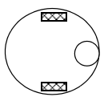
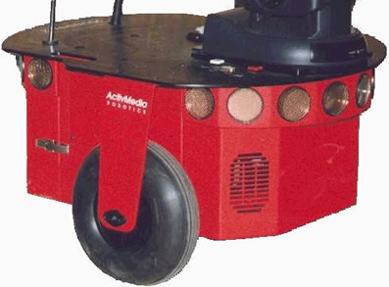
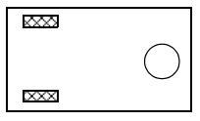
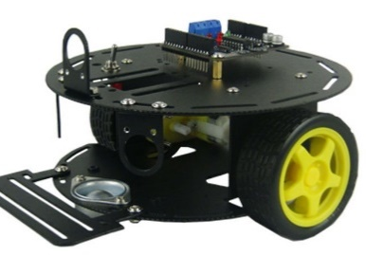
Wheel Configurations
Wheel Icon | Wheel Type
 | Unpowered Spherical
 | Motorized Swedish
 | Unpowered Standard
 | Motoroized Standard
 | Motorized Castor
 | Steered Standard
 | Connected Standart
# of wheels | Arrangement | Description | Examples
3 |  | Two-wheel centered differential drive with third contact point
3 |  | Two-wheel off-centered differential drive with third contact point

Slide 7
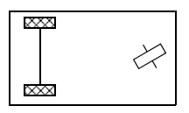
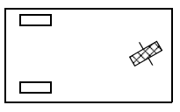
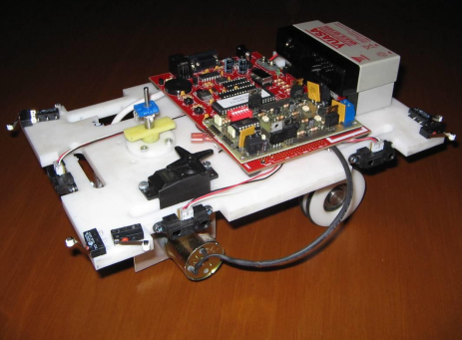
Wheel Configurations
Wheel Icon | Wheel Type
 | Unpowered Spherical
 | Motorized Swedish
 | Unpowered Standard
 | Motoroized Standard
 | Motorized Castor
 | Steered Standard
 | Connected Standart
# of wheels | Arrangement | Description | Examples
3 |  | Connected traction wheels with differential and steering free wheel
3 |  | Steered traction wheel in front and two free wheels in rear

Slide 8
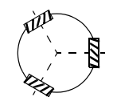
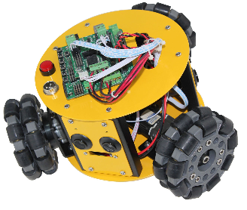
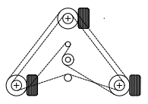
Wheel Configurations
Wheel Icon | Wheel Type
 | Unpowered Spherical
 | Motorized Swedish
 | Unpowered Standard
 | Motoroized Standard
 | Motorized Castor
 | Steered Standard
 | Connected Standart
# of wheels | Arrangement | Description | Examples
3 |  | Three motorized Swedish wheels
4 |  | Three synchronously motorized and steered wheels

Slide 9
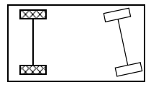
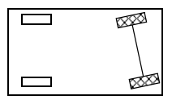
Wheel Configurations
Wheel Icon | Wheel Type
 | Unpowered Spherical
 | Motorized Swedish
 | Unpowered Standard
 | Motoroized Standard
 | Motorized Castor
 | Steered Standard
 | Connected Standart
# of wheels | Arrangement | Description | Examples
4 |  | Two motorized in rear, two steered wheels in front | Car with rear -wheel drive
4 |  | Two motorized and steered wheels in front, two free wheels in rear | Car with front-wheel drive

Slide 10
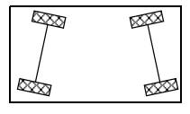
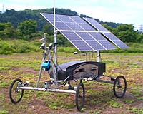
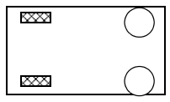
Wheel Configurations
Wheel Icon | Wheel Type
 | Unpowered Spherical
 | Motorized Swedish
 | Unpowered Standard
 | Motoroized Standard
 | Motorized Castor
 | Steered Standard
 | Connected Standart
# of wheels | Arrangement | Description | Examples
4 |  | Four motorized and steered wheels
4 |  | Two traction wheels in front/rear, two omni wheels in rear/front

Slide 11
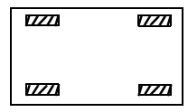
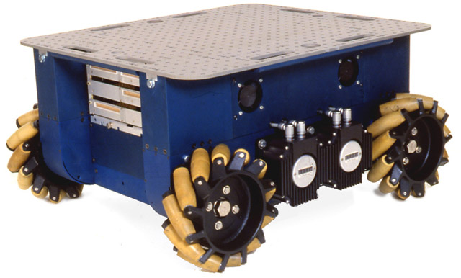
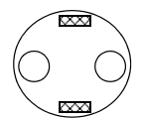
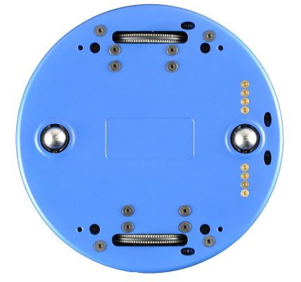
Wheel Configurations
Wheel Icon | Wheel Type
 | Unpowered Spherical
 | Motorized Swedish
 | Unpowered Standard
 | Motoroized Standard
 | Motorized Castor
 | Steered Standard
 | Connected Standart
# of wheels | Arrangement | Description | Examples
4 |  | Four omnidirectional wheels
4 |  | Two wheel differentail drive with two onmi wheels

Slide 12
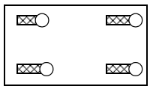
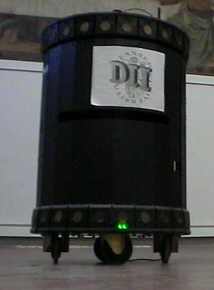
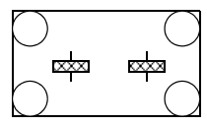
Wheel Configurations
Wheel Icon | Wheel Type
 | Unpowered Spherical
 | Motorized Swedish
 | Unpowered Standard
 | Motoroized Standard
 | Motorized Castor
 | Steered Standard
 | Connected Standart
# of wheels | Arrangement | Description | Examples
4 |  | Four motorized and steered castor wheels
6 |  | Two motorized and steered wheels, total of 4 omni wheels at corners

Slide 13
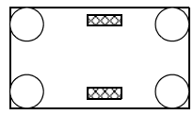
Wheel Configurations
Wheel Icon | Wheel Type
 | Unpowered Spherical
 | Motorized Swedish
 | Unpowered Standard
 | Motoroized Standard
 | Motorized Castor
 | Steered Standard
 | Connected Standart
# of wheels | Arrangement | Description | Examples
6 |  | Two traction wheels in center, total 4 omni wheels at corners

Slide 14
Differential Drive - Locomotion
two driving wheels (plus roller-ball for balance)
simplest drive mechanism
sensitive to the relative velocity of the two wheels

Slide 15
Steered Wheels - Locomotion
Steering wheel + rear wheels
Cannot turn ±90°
Limited radius of curvature
Car Drive (Ackerman Steering) – Locomotion
Synchronous Drive – Locomotion
Omni-directional – Locomotion

Slide 16
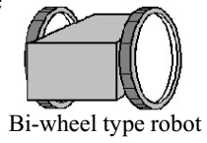
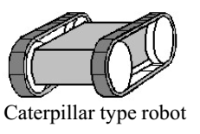
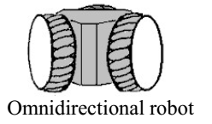
Examples of WMR
 | Smooth motion Risk of slipping Some times use roller-ball to make balance
 | Exact straight motion Robust to slipping Inexact modeling of turning
 | Free motion Complex structure Weakness of the frame

Slide 17
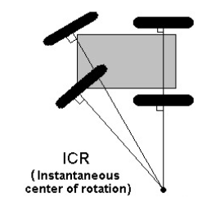
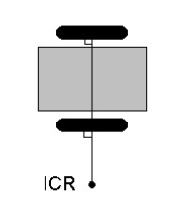
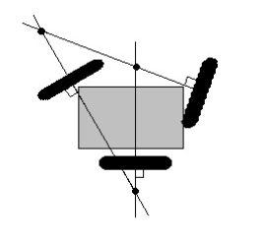
Mobile Robot Locomotion
Instantaneous center of rotation (ICR) or Instantaneous center of curvature (ICC) for no steering wheel robots:

Slide 18
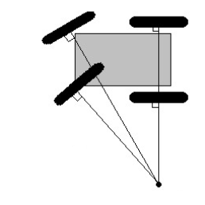
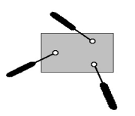
Degree of Mobility
The degree of freedom of the robot motion → Degree of Mobility
No ICR Cannot move anywhere Degree of mobility = 0 | Only one ICR Fixed arc motion Degree of mobility = 1
Line of ICR points Varible arc motion Degree of mobility = 2 | ICR can be located at any position Fully free motion Degree of mobility = 3

Slide 19
Degree of Steerability
The number of centered orientable wheels that can be steered independently → Degree of steerability
Degree of Maneuverability
$δ_{M}=δ_{m}+δ_{s}$

Slide 20

Degree of Maneuverability

Slide 21
Mobile Robot Kinematics
The process of understanding the motions of a robot
Describing each wheel’s contribution for robot motion
Describing each wheels’s constraint on robot motion
Robot motion by means of global reference frame and robot’s local reference frame
Describing how whole robot moves as a function of its geometry and wheel behavior → forward kinematics
Forward kinematics → evaluate paths and trajectories (robot’s maneuverability)

Slide 22


Robot Pose
Robot is a:
Rigid body on wheels
Operates on horizantal plane
Total dimensionality of a robot is 3
Position (x,y)
Orientation – rotation along z-axis ($θ$)
Global reference frame $O:\{X_{I},Y_{I}\}$
Robot’s local reference $\{X_{R},Y_{R}\}$
$ξ_{I}=\left[\begin{matrix}x \\ y \\ θ\end{matrix}\right]$
$ξ_{I}$ : Robot pose on global frame
y
x

Slide 23
Global Frame – Local Frame : Differential D. R.
Corresponding global frame coordinate calculation for motions defined in local frame:
If a robot moves T meters forward with respect to its local frame what happens in global reference frame

Slide 24



$$\left[\begin{matrix}x′ \\ y′ \\ θ′\end{matrix}\right]=\left[\begin{matrix}x \\ y \\ θ\end{matrix}\right]+\left[\begin{matrix}Tcos\left(θ\right) \\ Tsin\left(θ\right) \\ 0\end{matrix}\right]$$
Special Case
$$r_{ICR}=∞$$
$$V_{R}=V_{L}$$

Slide 25
Global Frame – Local Frame : Differential D. R.
Corresponding global frame coordinate calculation for motions defined in local frame:
If a robot rotates α radians with respect to its local frame (in place rotation) what happens in global reference frame

Slide 26



Special Case
$$r_{ICR}=0$$
$$V_{R}=−V_{L}$$
$$\left[\begin{matrix}x′ \\ y′ \\ θ′\end{matrix}\right]=\left[\begin{matrix}x \\ y \\ θ+α\end{matrix}\right]$$

Slide 27
Global Frame – Local Frame : Differential D. R.
Corresponding global frame coordinate calculation for motions defined in local frame:
If a robot moves with different wheel linear velocites with respect to its local frame what happens in global reference frame

Slide 28



$$V_{R}>V_{L}$$
b
ICRy
R
$\left[\begin{matrix}x′ \\ y′ \\ θ′\end{matrix}\right]$=?
ICR = ?
$α$ = ?
ICRx

Slide 29


$$x=Rcos\left(θ\right)$$
$$y=Rsin\left(θ\right)$$
$$x^{′}=Rcos\left(θ+α\right)=Rcos\left(θ\right)\cos\left(α\right)−Rsin\left(θ\right)\sin\left(α\right)$$
$$y^{′}=Rsin\left(θ+α\right)=Rsin\left(α\right)\cos\left(θ\right)+Rsin\left(θ\right)\cos\left(α\right)$$
$$x^{′}=x\cos\left(α\right)−y\sin\left(α\right)$$
$$y^{′}=xsin\left(α\right)+y\cos\left(α\right)$$
$$\left[\begin{matrix}x′ \\ y′\end{matrix}\right]=\left[\begin{matrix}\cos\left(α\right) & −\sin\left(α\right) \\ \sin\left(α\right) & \cos\left(α\right)\end{matrix}\right]\left[\begin{matrix}x \\ y\end{matrix}\right]$$

Slide 30

Forward Kinematics
Calculation of new robot pose $P′=\left[\begin{matrix}x′ \\ y′ \\ θ′\end{matrix}\right]$ given that robot pose $P=\left[\begin{matrix}x \\ y \\ θ\end{matrix}\right]$ and control signals (wheel linear velocities) $ν_{L}$, $ν_{R}$ to be applied for $Δt$ amount of time → forward kinematics
$ν=f\left(r,ω\right)$ → linear velocities depend on wheel radius and wheel angular velocities

Slide 31


Differential Drive Robot

Slide 32



Differential Drive Robot
$$ω\left(R+\frac{L}{2}\right)=V_{R}$$
$$ω\left(R−\frac{L}{2}\right)=V_{L}$$
$$R=\frac{L\left(V_{L}+V_{R}\right)}{2\left(V_{L}−V_{R}\right)}$$
$$ω=\frac{V_{R}−V_{L}}{L}$$
$$V=\frac{V_{R}+V_{L}}{2}$$

Slide 33


$$\left[\begin{matrix}ICR_{x} \\ I{CR}_{y}\end{matrix}\right]=\left[\begin{matrix}x−Rsin\left(θ\right) \\ y+Rcos\left(θ\right)\end{matrix}\right]$$

Slide 34

Differential Drive Robot
$$P^{′}=\left[\begin{matrix}x^{′} \\ y^{′} \\ θ^{′}\end{matrix}\right]=\left[\begin{matrix}\cos\left(ω.Δt\right) & −sin\left(ω.Δt\right) & 0 \\ \sin\left(ω.Δt\right) & \cos\left(ω.Δt\right) & 0 \\ 0 & 0 & 1\end{matrix}\right]\left[\begin{matrix}x−ICR_{x} \\ y−ICR_{y} \\ θ\end{matrix}\right]+\left[\begin{matrix}ICR_{x} \\ ICR_{y} \\ ω.Δt\end{matrix}\right]$$

Slide 35

Differential Drive Robot
Forward Kinematics Special Cases:
$V_{L}=V_{R}⇒ω=0⇒R=∞⇒\left[\begin{matrix}x′ \\ y′ \\ θ′\end{matrix}\right]=\left[\begin{matrix}x+V.Δt.\cos\left(θ\right) \\ y+V.Δt.\sin\left(θ\right) \\ θ\end{matrix}\right]$
$V_{L}={−V}_{R}⇒V=0⇒R=$0$⇒\left[\begin{matrix}x′ \\ y′ \\ θ′\end{matrix}\right]=\left[\begin{matrix}x \\ y \\ θ+\frac{2V_{R}.Δt}{L}\end{matrix}\right]$
$\left(V_{L}=0\right)or\left(V_{R}=0\right)⇒R=\frac{L}{2}$

Slide 36

Inverse Kinematics
Given an initial pose $P=\left[\begin{matrix}x \\ y \\ θ\end{matrix}\right]$ and target pose $P′=\left[\begin{matrix}x′ \\ y′ \\ θ′\end{matrix}\right]$, calculating the control signals $V_{L}$, $V_{R}$ that enables this motion → Inverse Kinematics
Because of constraints on wheel properties solution domain is limited
Basic navigation solution :
Translation form $\left[\begin{matrix}x \\ y\end{matrix}\right]$ to $\left[\begin{matrix}x′ \\ y′\end{matrix}\right]$
Rotation from $θ$ to $θ′$

Slide 37
Uygulama 2’ye Hazırlık

Slide 38

Çizgisel Hız
Düzgün dairesel hareket yapan bir cismin (yarıçapı r) birim zamanda aldığı yola çizgisel hız denir
$ν$ sembolü ile gösterilir
Birimi m/s ‘dir
Tam turda dairesel cismin yere temas noktası 2$π$r yer değiştrir
Tam devir boyunca bir periyot (T) kadar zaman geçer
$ν=\frac{2πr}{T}$

Slide 39

Açısal Hız
Düzgün dairesel hareket yapan cismin yarıçapının, birim zamanda, radyan cinsinden taradığı açıya açısal hız denir
$ω$ sembolü ile gösterilir
Birimi rad/s ‘dir
Tam devir boyunca 2$π$ radyan açı taranır
Tam devir boyunca bir periyot (T) kadar zaman geçer
$ω=\frac{2π}{T}$

Slide 40

Derece - Radyan
360 derece = 2$π$ radyan (= 400 gradyan)
1 derece = 0.01745329252 radyan
Açısal hız birim : rad/s
Çizgisel hız birimi : m/s

Slide 41



Sağ El Sarımlı Motor

Slide 42



Sağ El Sarımlı Motorlarla Oluşturulmuş Diferansiyel Sürüşlü Robot
Sağ motor açısal hızı ve sol motor açısal hızı pozitif olursa
robot olduğu yerde döner
$$ω_{ℓ}>0$$
$$ω_{r}>0$$

Slide 43

Sağ El Sarımlı Motorlarla Oluşturulmuş Diferansiyel Sürüşlü Robot
Sağ motor açısal hızı negatif ve sol motor açısal hızı pozitif
olursa robot ileri gider
$$ω_{ℓ}>0$$
$$ω_{r}<0$$

