Slide 1
Robot Teknolojisine Giriş Yrd. Doç. Dr. Erkan Uslu, Doç. Dr. Sırma Yavuz, Doç. Dr. Fatih Amasyalı, Ar. Grv. Nihal Altuntaş, Ar. Grv. Furkan Çakmak D011 Cuma 14:00-17:00 03

Slide 2
Robotic Arm
Link : Individual rigid bodies that make up the robot
Joint : Contacts connecting two links
Manipulator : Main body of the robot = links + joint + oth. stuctural elmnts.
Wrist : Joints, links between forearm and end effector
End-Effector : Part mounted on the last link
Actuators : Drivers that modify geometric location/position of joints
Sensors : Elements that detect and collect info. about internal, external states
Controller : Collects sensor info., plan geometric motion, control comm. between robot and its environment

Slide 3
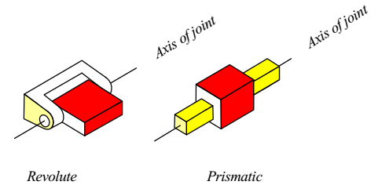
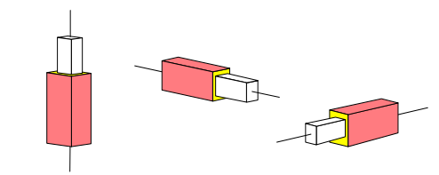
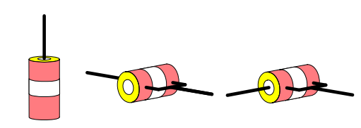
Robotic Arm : Joint types
Active – Passive
Active : Controlled by actuator
Revolute – Prismatic
Passive :
Revolute – Prismatic – Cylindrical – Screw – Spherical - Planar

Slide 4
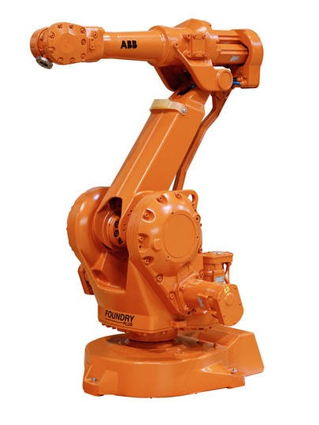
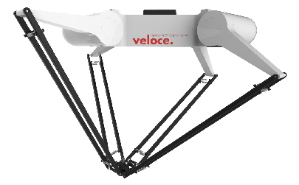
Robot Classification - Geometry
Open-loop (serial) robot : kinematic structure doesn’t make a loop chain
Closed-loop (parallel) robot : kinematic structure makes a loop chain
Hybrid robot = serial + parallel

Slide 5

Robot Classification - Geometry
Open looped robots are classified according to their first 3 joints starting from the base → total of 72 configurations
Revolute (R) or Prismatic (P)
Revolute or Prismatic
Revolute or Prismatic
Joint1
Joint2
Joint3
Base
Link1
Link2
Link3
Parallel ($∥$) or
Orthogonal ($⊢$) or
Perpendicular ($⊥$)
Parallel or
Orthogonal or
Perpendicular

Slide 6
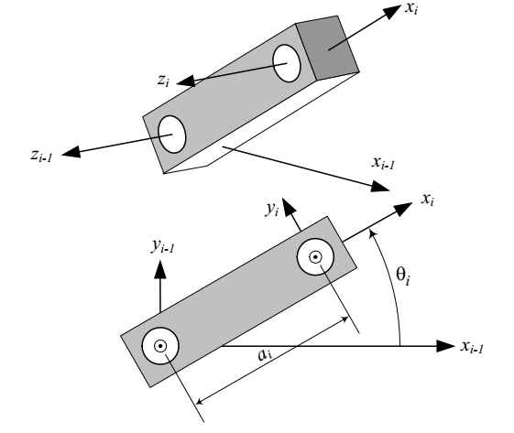
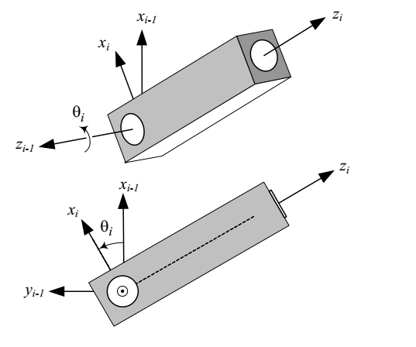
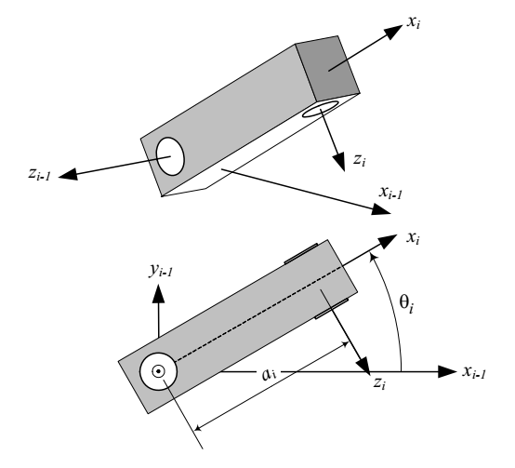




Robot Classification - Geometry
Parallel link ($∥$): If adjacent joint axes on a link are parallel
Orthogonal link ($⊢$): If adjacent joint axes on a link intersect at 90°
Perpendicular link ($⊥$): If adjacent joint axes on a link are at 90° with respect to their common normal
$$R∥R$$
$$R⊢R$$
$$R⊥R$$

Slide 7
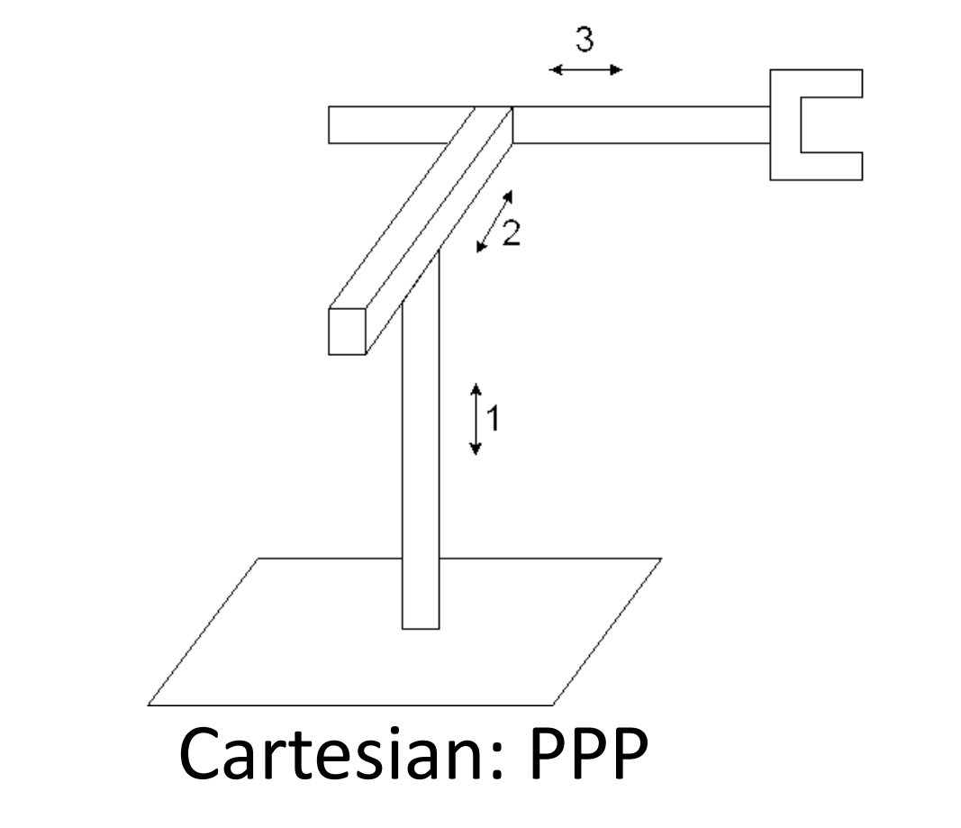
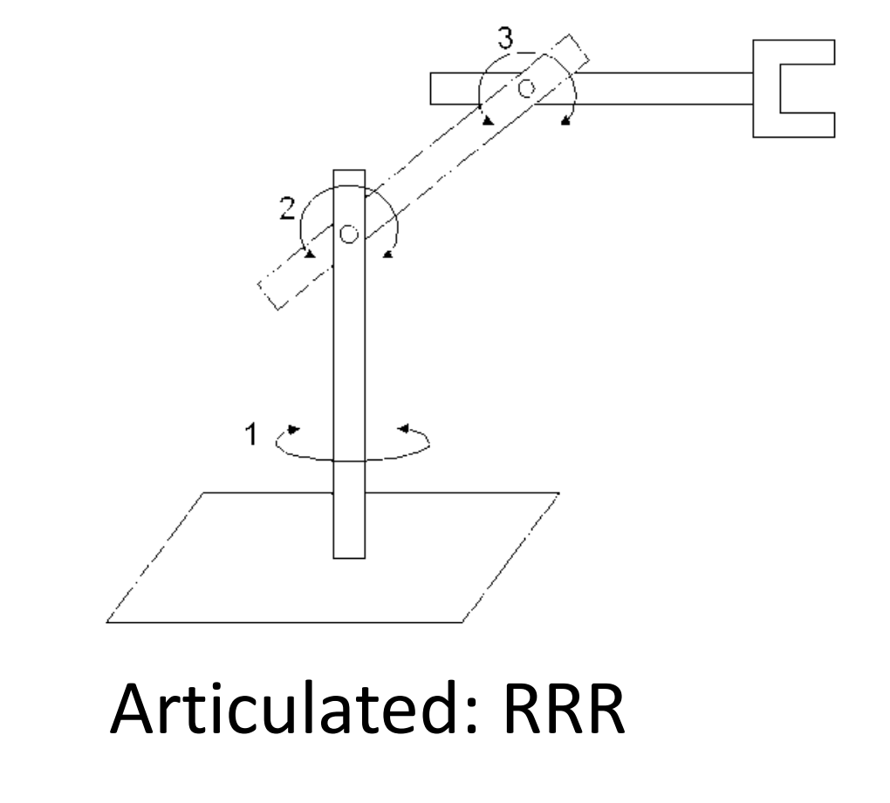
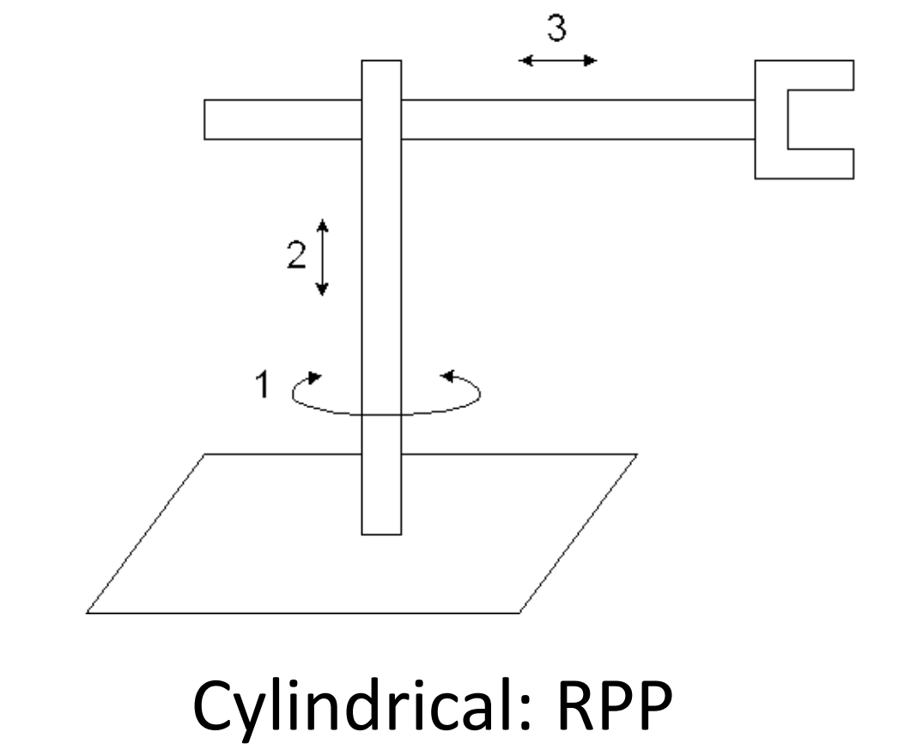
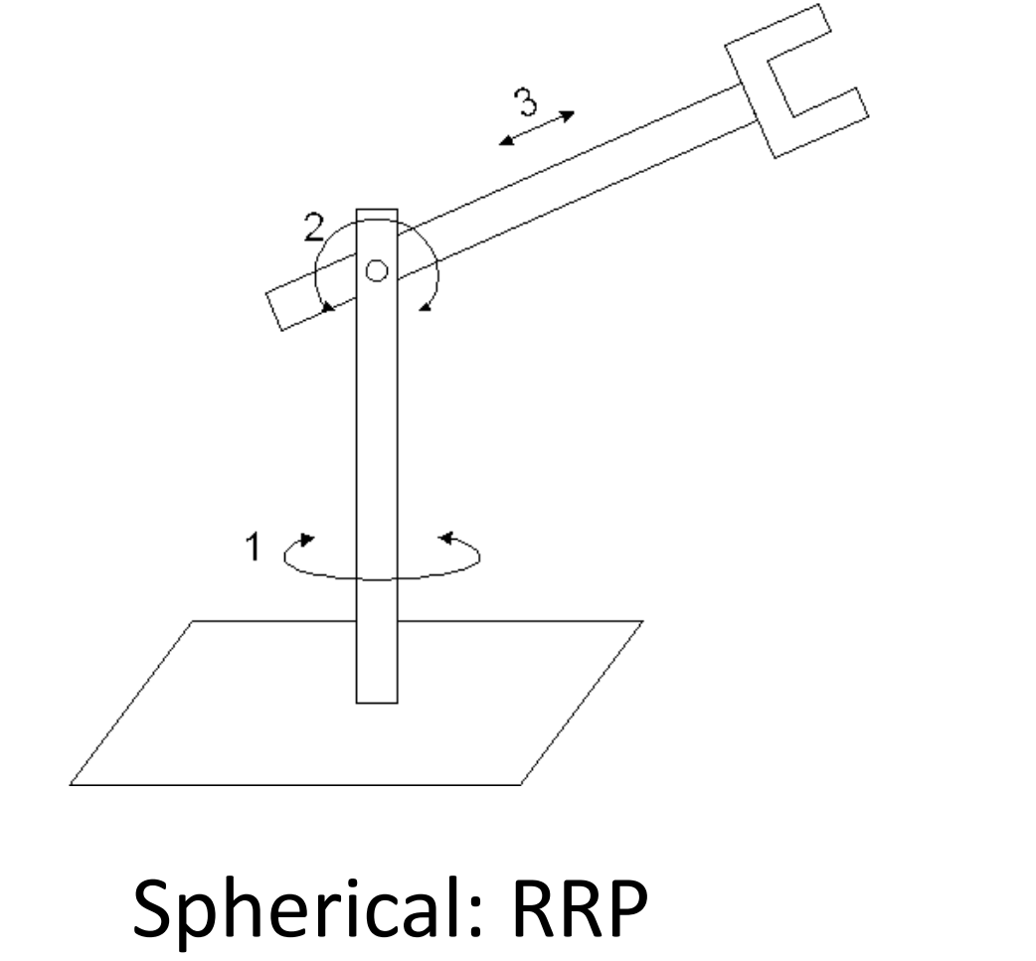
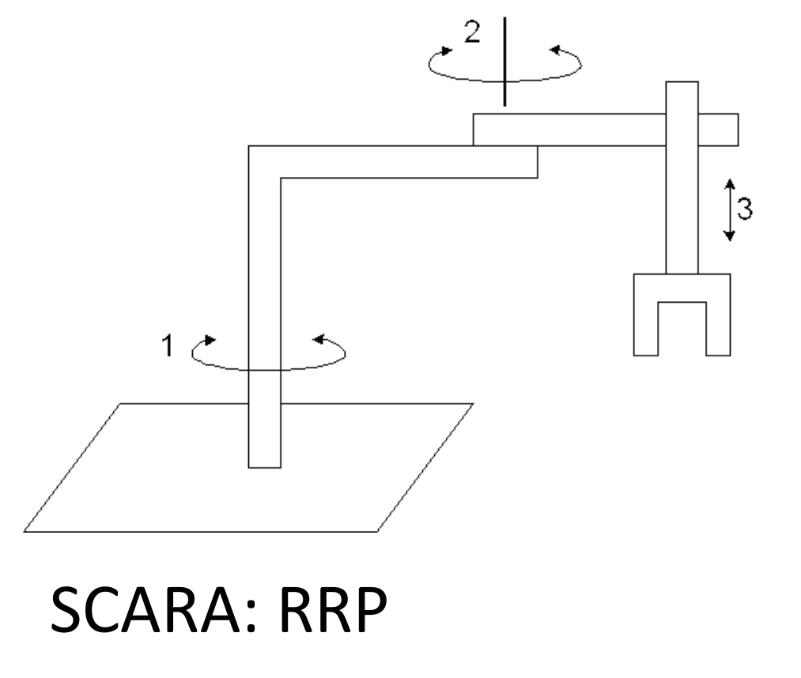
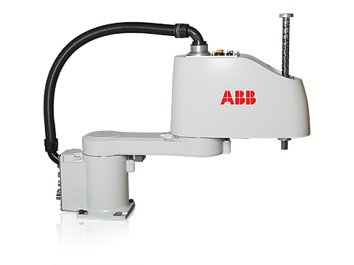
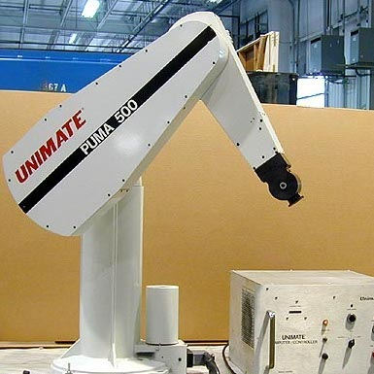
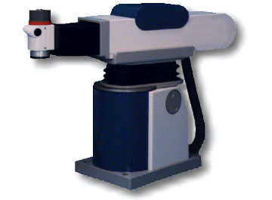
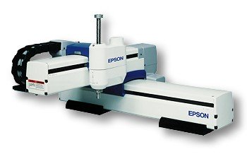
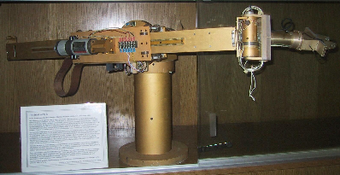

Robot Classification - Geometry
$R∥R∥P$ (Selective compliance assembly robot arm - SCARA)
$R⊢R∥R$ (Articulated)
$R⊢R⊢P$(Spherical)
$R∥P⊢P$ (Cylindrical)
$P⊢P⊢P$ (Cartesian)

Slide 8
Robot Classification –Degree of Freedom-DoF
The number of joints of a manipulator → DoF
Typical manipulator has 6 DoF : 3 DoF for positioning, 3 DoF for orientation
Manipulator with more than 6 DoF → redundant manipulator

Slide 9
Robot Classification – Workspace
Workspace → total volume of space that the end-effector can reach
Rechable workspace → volume of space where each point can be reached at least in one orientation
Dexterous workspace → volume of space where each point can be reached in all possible orientations

Slide 10
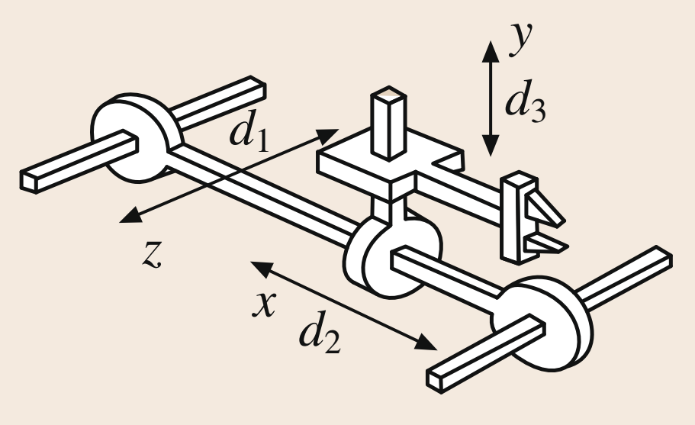
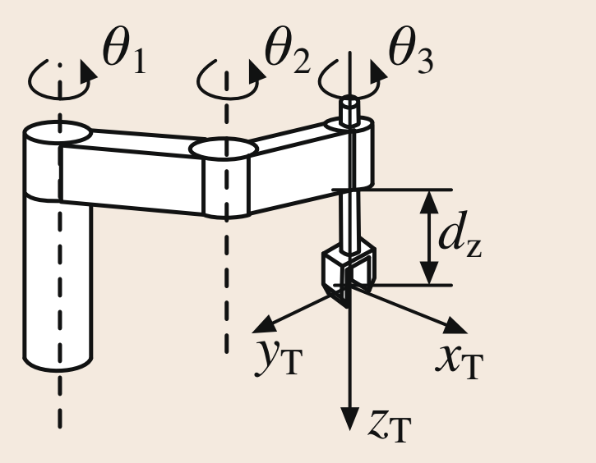
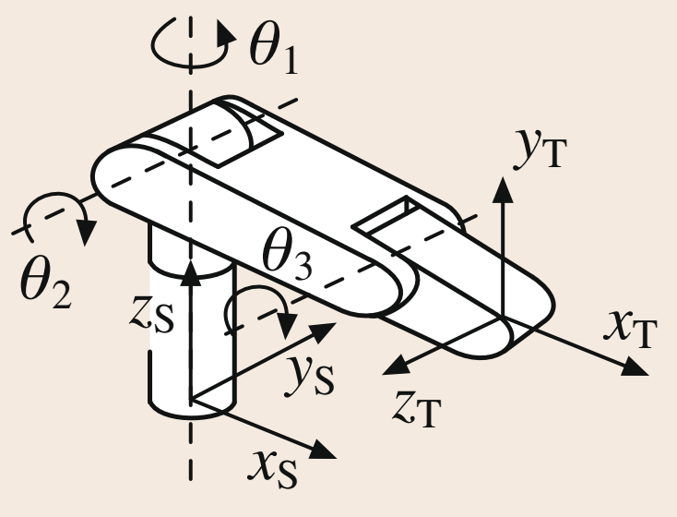
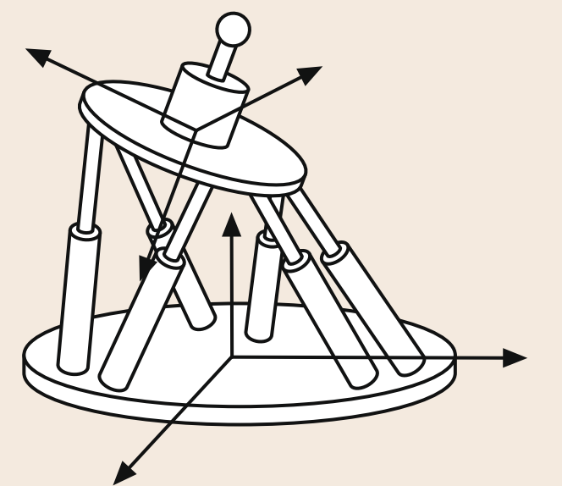
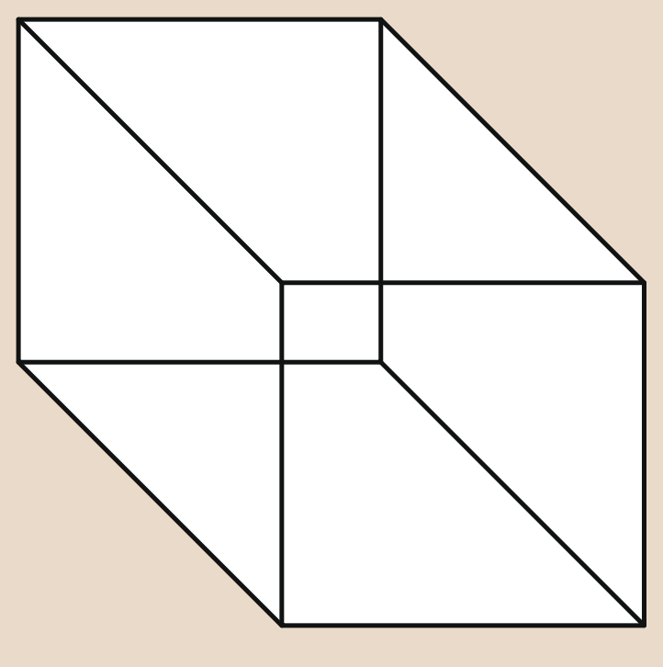


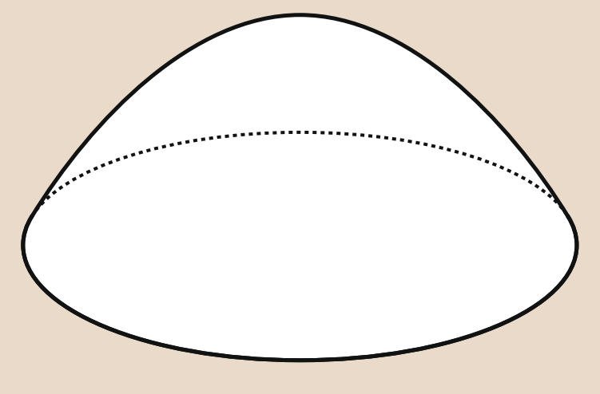
Robot Classification – Workspace
Cartesian | SCARA | Articulated | Parallel

Slide 11
Robot Classification – Actuation
Electric, hydrolic, pneumatic, magnetic,...
Robot Classification – Control
Open-loop control
Closed-loop control : Point-to-point control, Continuous path control
Robot Classification – Application
machine loading, pick and place, welding, painting, assembling, inspecting, sampling, manufacturing, biomedical, assisting, remote controlled mobile, telerobot, ...

Slide 12
Preliminary for Forward Kinematics

Slide 13
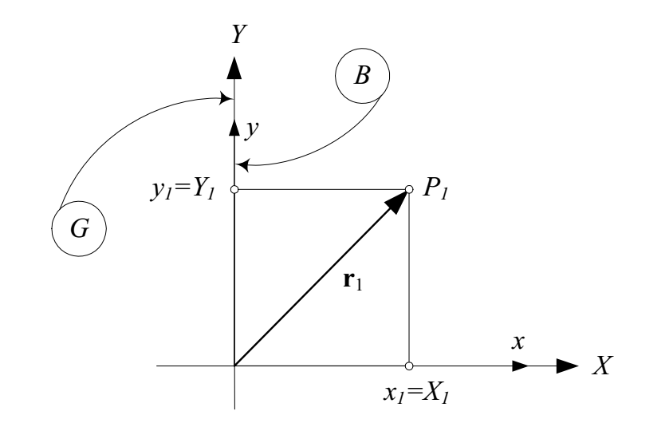

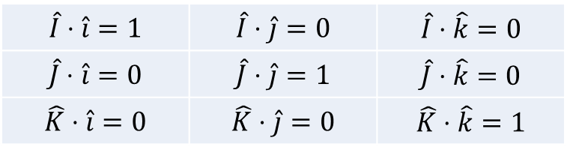

Rotation Kinematics – Rotation About Global Coordinates – Rotation About Z-axis – Vector Math
G: Global frame, B: Rigid body frame,
$(\hat{i},\hat{j},\hat{k})$: unit vectors in B, $\left(\hat{I},\hat{J},\hat{K}\right)$: unit vectors in G
$${}_{}^{B}{r_{1}=}x_{1}\hat{i}+y_{1}\hat{j}+z_{1}\hat{k}$$
$${}_{}^{G}{r_{1}=}X_{1}\hat{I}+Y_{1}\hat{J}+Z_{1}\hat{K}$$
$$\hat{I}⋅r_{1}=X_{1}⟹x_{1}=X_{1}$$
$$\hat{J}⋅r_{1}=Y_{1}⟹y_{1}=Y_{1}$$
$$\hat{K}⋅r_{1}=Z_{1}⟹z_{1}=Z_{1}$$
$$\hat{I}⋅\hat{i}=1$$ | $$\hat{I}⋅\hat{j}=0$$ | $$\hat{I}⋅\hat{k}=0$$
$$\hat{J}⋅\hat{i}=0$$ | $$\hat{J}⋅\hat{j}=1$$ | $$\hat{J}⋅\hat{k}=0$$
$$\hat{K}⋅\hat{i}=0$$ | $$\hat{K}⋅\hat{j}=0$$ | $$\hat{K}⋅\hat{k}=1$$

Slide 14
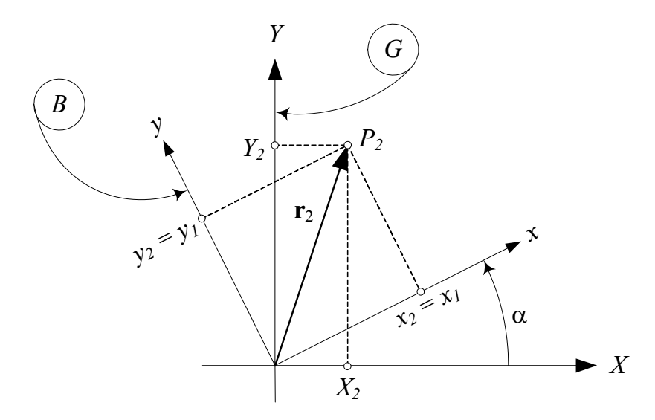
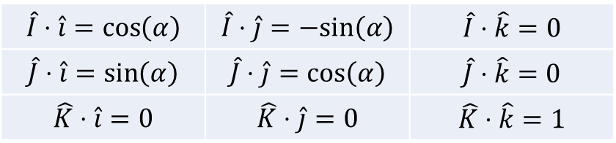
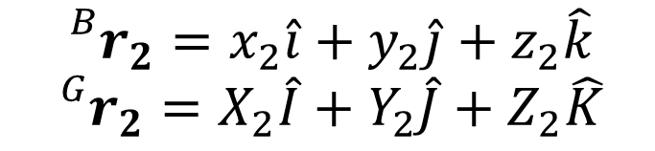
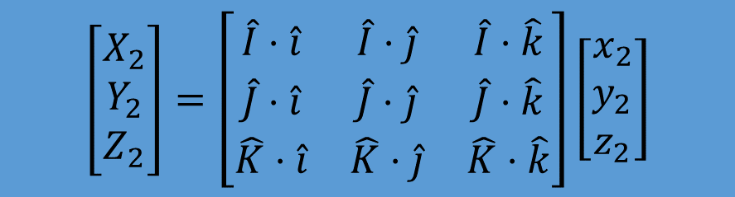

Rotation Kinematics – Rotation About Global Coordinates – Rotation About Z-axis– Vector Math
$${}_{}^{B}{r_{2}}=x_{2}\hat{i}+y_{2}\hat{j}+z_{2}\hat{k}$$
$${}_{}^{G}{r_{2}}=X_{2}\hat{I}+Y_{2}\hat{J}+Z_{2}\hat{K}$$
$$\hat{I}⋅\hat{i}=\cos\left(α\right)$$ | $$\hat{I}⋅\hat{j}=−sin\left(α\right)$$ | $$\hat{I}⋅\hat{k}=0$$
$$\hat{J}⋅\hat{i}=\sin\left(α\right)$$ | $$\hat{J}⋅\hat{j}=\cos\left(α\right)$$ | $$\hat{J}⋅\hat{k}=0$$
$$\hat{K}⋅\hat{i}=0$$ | $$\hat{K}⋅\hat{j}=0$$ | $$\hat{K}⋅\hat{k}=1$$
$$\hat{I}⋅r_{2}=X_{2}$$
$$\hat{J}⋅r_{2}=Y_{2}$$
$$\hat{K}⋅r_{2}=Z_{2}$$
$$X_{2}=\cos\left(α\right)x_{2}−\sin\left(α\right)y_{2}$$
$$Y_{2}=\sin\left(α\right)x_{2}+\cos\left(α\right)y_{2}$$
$$Z_{2}=z_{2}$$
$$\left[\begin{matrix}X_{2} \\ Y_{2} \\ Z_{2}\end{matrix}\right]=\left[\begin{matrix}cosα & −sinα & 0 \\ sinα & cosα & 0 \\ 0 & 0 & 1\end{matrix}\right]\left[\begin{matrix}x_{2} \\ y_{2} \\ z_{2}\end{matrix}\right]$$
$$\left[\begin{matrix}X_{2} \\ Y_{2} \\ Z_{2}\end{matrix}\right]=\left[\begin{matrix}\hat{I}⋅\hat{i} & \hat{I}⋅\hat{j} & \hat{I}⋅\hat{k} \\ \hat{J}⋅\hat{i} & \hat{J}⋅\hat{j} & \hat{J}⋅\hat{k} \\ \hat{K}⋅\hat{i} & \hat{K}⋅\hat{j} & \hat{K}⋅\hat{k}\end{matrix}\right]\left[\begin{matrix}x_{2} \\ y_{2} \\ z_{2}\end{matrix}\right]$$

Slide 15
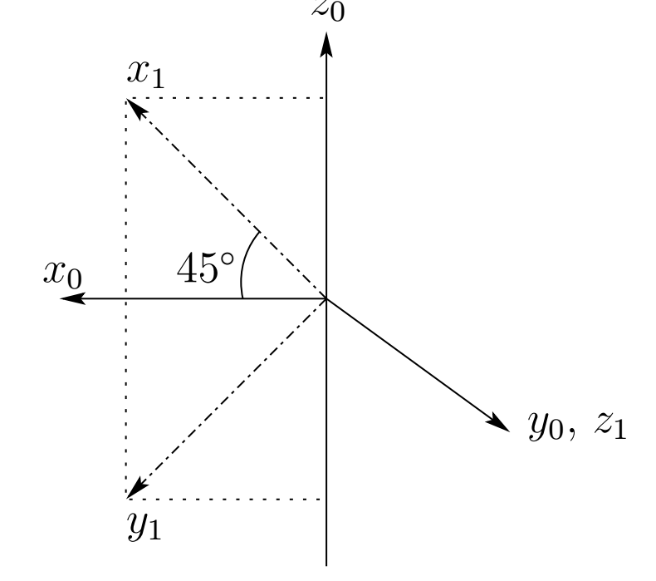
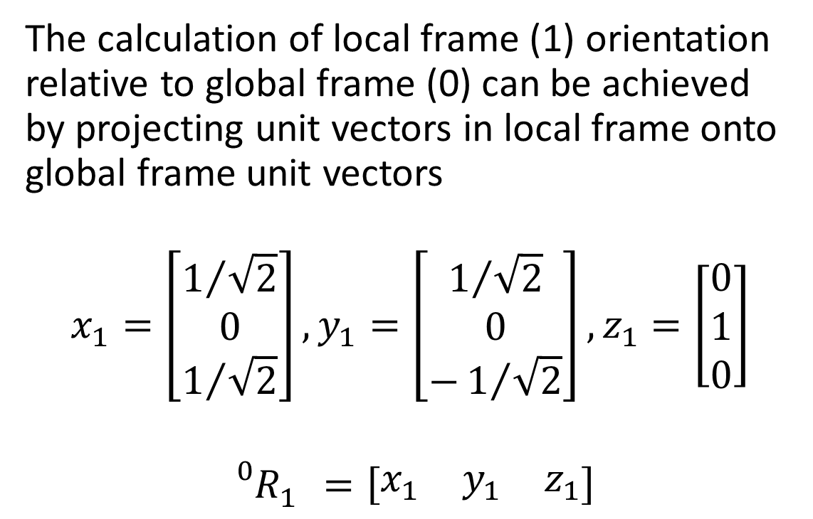
Rotation Kinematics – Rotation About Global Coordinates– Vector Math
The calculation of local frame (1) orientation relative to global frame (0) can be achieved by projecting unit vectors in local frame onto global frame unit vectors
$$x_{1}=\left[\begin{matrix}1/{\sqrt{2}} \\ 0 \\ 1/{\sqrt{2}}\end{matrix}\right],y_{1}=\left[\begin{matrix}1/{\sqrt{2}} \\ 0 \\ −1/{\sqrt{2}}\end{matrix}\right],z_{1}=\left[\begin{matrix}0 \\ 1 \\ 0\end{matrix}\right]$$
$${}_{}^{0}{R_{1}^{}}=\left[\begin{matrix}x_{1} & y_{1} & z_{1}\end{matrix}\right]$$

Slide 16
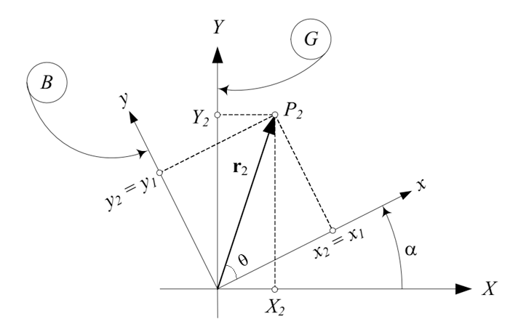
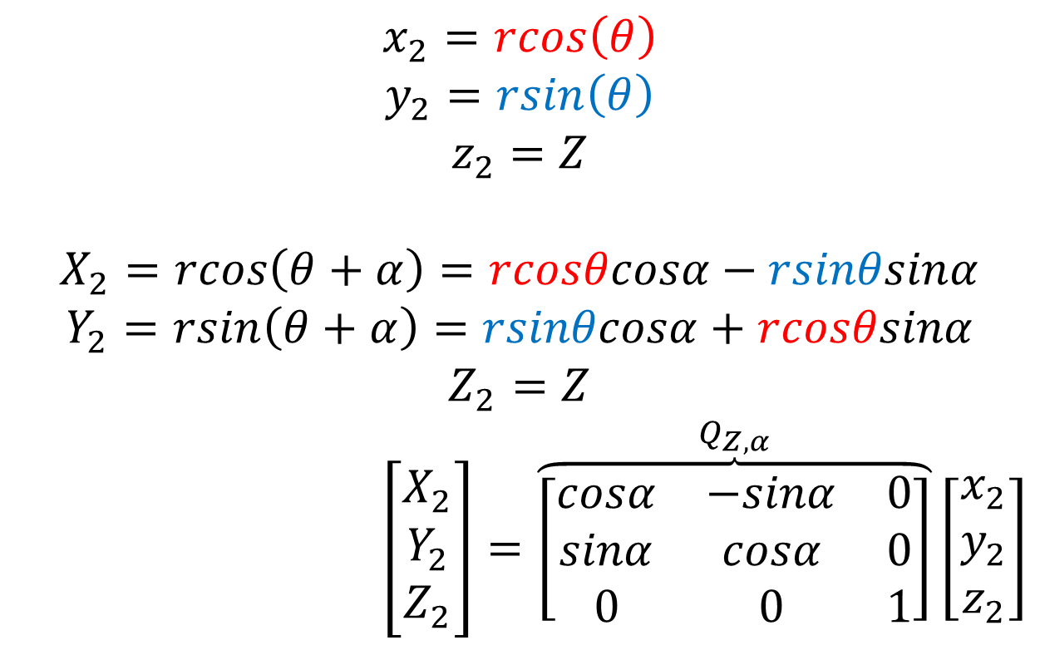
Rotation Kinematics – Rotation About Global Coordinates – Rotation About Z-axis– Geometric
$$x_{2}=rcos\left(θ\right)$$
$$y_{2}=rsin\left(θ\right)$$
$$z_{2}=Z$$
$$X_{2}=rcos\left(θ+α\right)=rcosθcosα−rsinθsinα$$
$$Y_{2}=rsin\left(θ+α\right)=rsinθcosα+rcosθsinα$$
$$Z_{2}=Z$$
$$\left[\begin{matrix}X_{2} \\ Y_{2} \\ Z_{2}\end{matrix}\right]=\overset{Q_{Z,α}}{\overbrace{\left[\begin{matrix}cosα & −sinα & 0 \\ sinα & cosα & 0 \\ 0 & 0 & 1\end{matrix}\right]}}\left[\begin{matrix}x_{2} \\ y_{2} \\ z_{2}\end{matrix}\right]$$

Slide 17
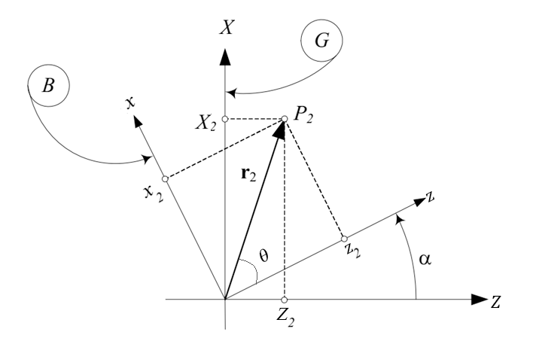
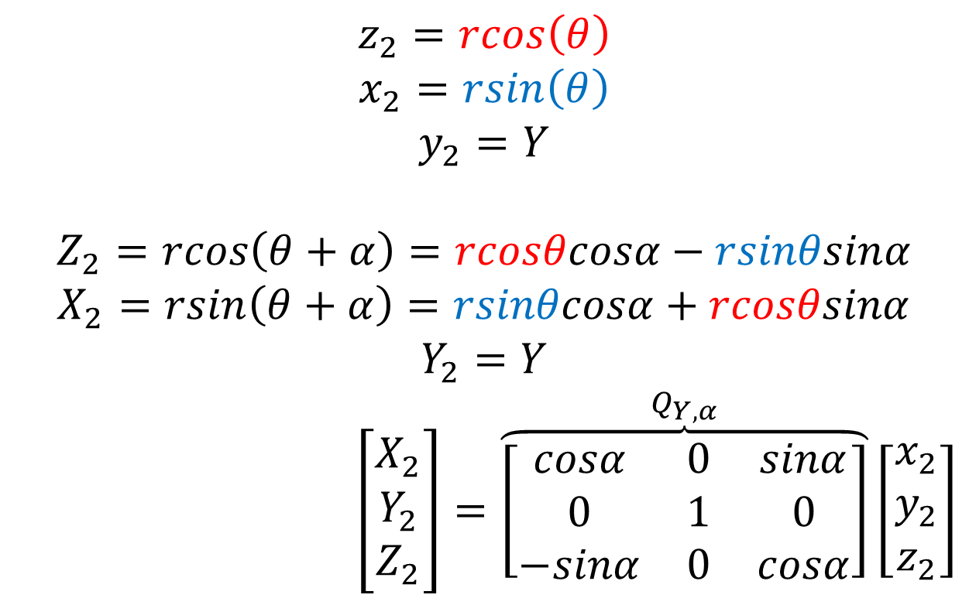
Rotation Kinematics – Rotation About Global Coordinates – Rotation About Y-axis
$$z_{2}=rcos\left(θ\right)$$
$$x_{2}=rsin\left(θ\right)$$
$$y_{2}=Y$$
$$Z_{2}=rcos\left(θ+α\right)=rcosθcosα−rsinθsinα$$
$$X_{2}=rsin\left(θ+α\right)=rsinθcosα+rcosθsinα$$
$$Y_{2}=Y$$
$$\left[\begin{matrix}X_{2} \\ Y_{2} \\ Z_{2}\end{matrix}\right]=\overset{Q_{Y,α}}{\overbrace{\left[\begin{matrix}cosα & 0 & sinα \\ 0 & 1 & 0 \\ −sinα & 0 & cosα\end{matrix}\right]}}\left[\begin{matrix}x_{2} \\ y_{2} \\ z_{2}\end{matrix}\right]$$

Slide 18
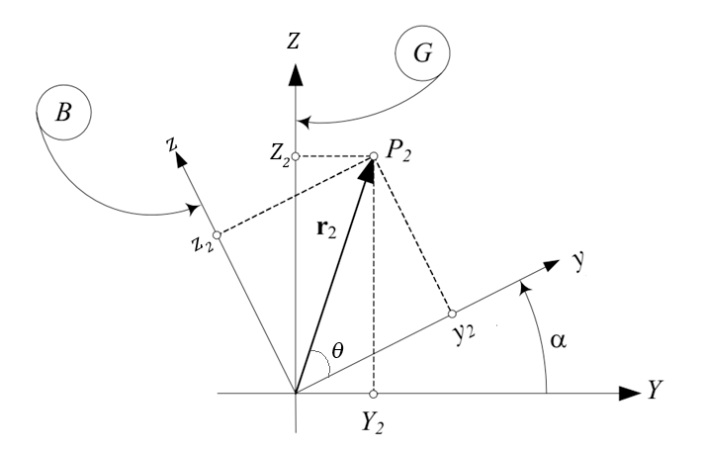
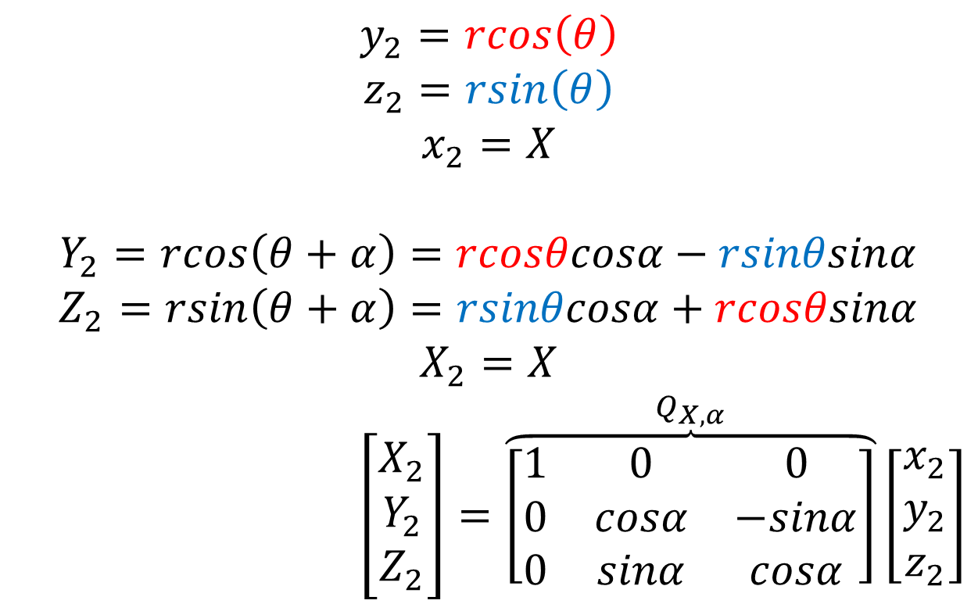
Rotation Kinematics – Rotation About Global Coordinates – Rotation About X-axis
$$y_{2}=rcos\left(θ\right)$$
$$z_{2}=rsin\left(θ\right)$$
$$x_{2}=X$$
$$Y_{2}=rcos\left(θ+α\right)=rcosθcosα−rsinθsinα$$
$$Z_{2}=rsin\left(θ+α\right)=rsinθcosα+rcosθsinα$$
$$X_{2}=X$$
$$\left[\begin{matrix}X_{2} \\ Y_{2} \\ Z_{2}\end{matrix}\right]=\overset{Q_{X,α}}{\overbrace{\left[\begin{matrix}1 & 0 & 0 \\ 0 & cosα & −sinα \\ 0 & sinα & cosα\end{matrix}\right]}}\left[\begin{matrix}x_{2} \\ y_{2} \\ z_{2}\end{matrix}\right]$$

Slide 19
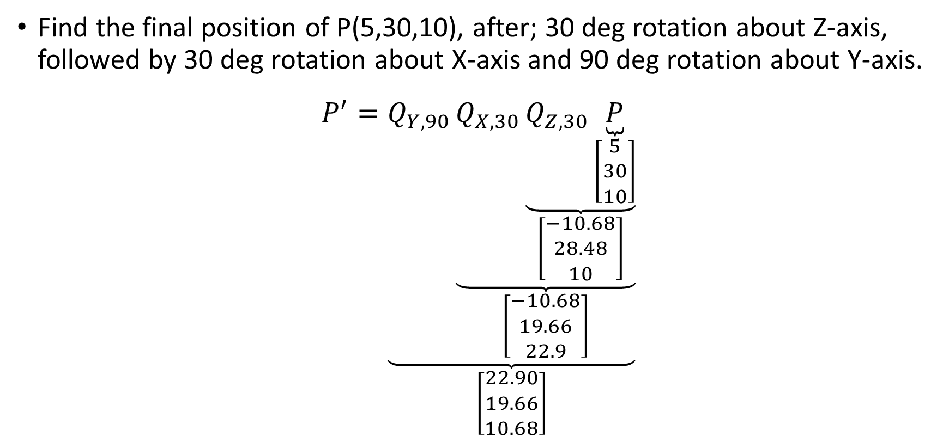
Rotation Kinematics – Rotation About Global Coordinates – Successive Rotations
Find the final position of P(5,30,10), after; 30 deg rotation about Z-axis, followed by 30 deg rotation about X-axis and 90 deg rotation about Y-axis.
$$P^{′}=\underset{\left[\begin{matrix}22.90 \\ 19.66 \\ 10.68\end{matrix}\right]}{\underbrace{Q_{Y,90}\underset{\left[\begin{matrix}−10.68 \\ 19.66 \\ 22.9\end{matrix}\right]}{\underbrace{Q_{X,30}\underset{\left[\begin{matrix}−10.68 \\ 28.48 \\ 10\end{matrix}\right]}{\underbrace{Q_{Z,30}\underset{\left[\begin{matrix}5 \\ 30 \\ 10\end{matrix}\right]}{\underbrace{P}}}}}}}}$$

Slide 20
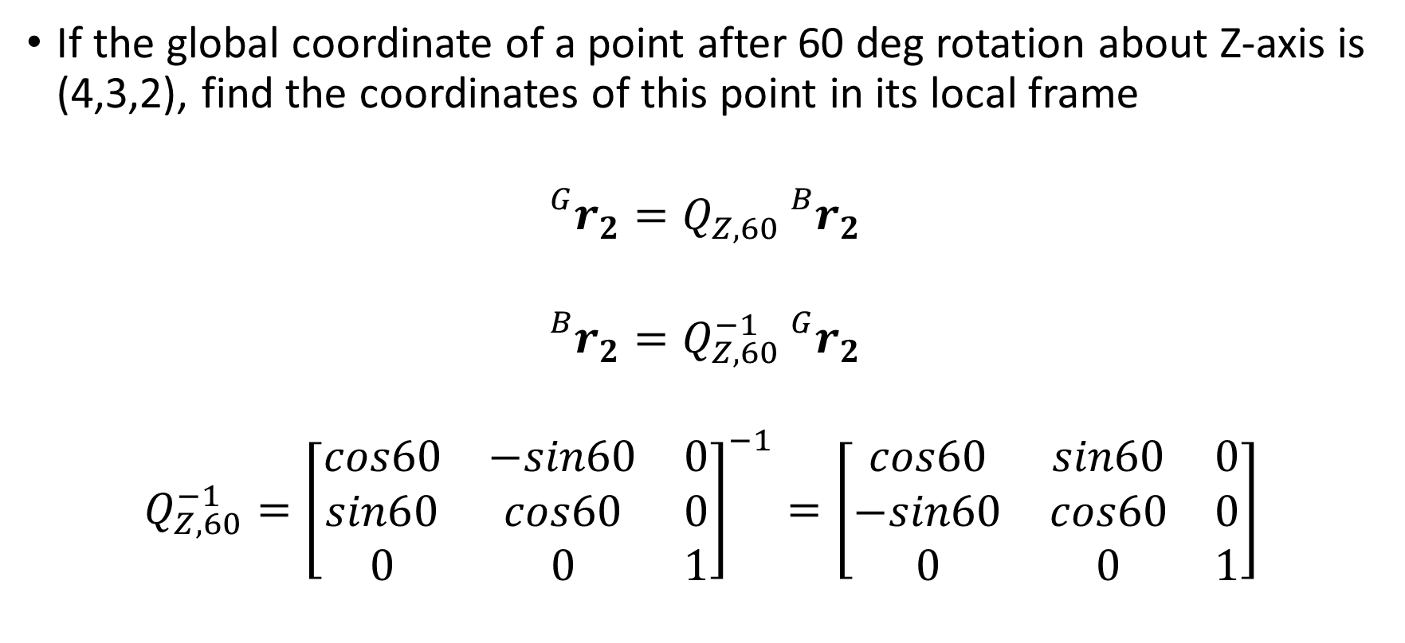
Rotation Kinematics – Rotation About Global Coordinates – Global rot., local pos.
If the global coordinate of a point after 60 deg rotation about Z-axis is (4,3,2), find the coordinates of this point in its local frame
$${}_{}^{G}{r_{2}}=Q_{Z,60}{}_{}^{B}{r_{2}}$$
$${}_{}^{B}{r_{2}}=Q_{Z,60}^{−1}{}_{}^{G}{r_{2}}$$
$$Q_{Z,60}^{−1}={\left[\begin{matrix}cos60 & −sin60 & 0 \\ sin60 & cos60 & 0 \\ 0 & 0 & 1\end{matrix}\right]}^{−1}=\left[\begin{matrix}cos60 & sin60 & 0 \\ −sin60 & cos60 & 0 \\ 0 & 0 & 1\end{matrix}\right]$$
?

Slide 21
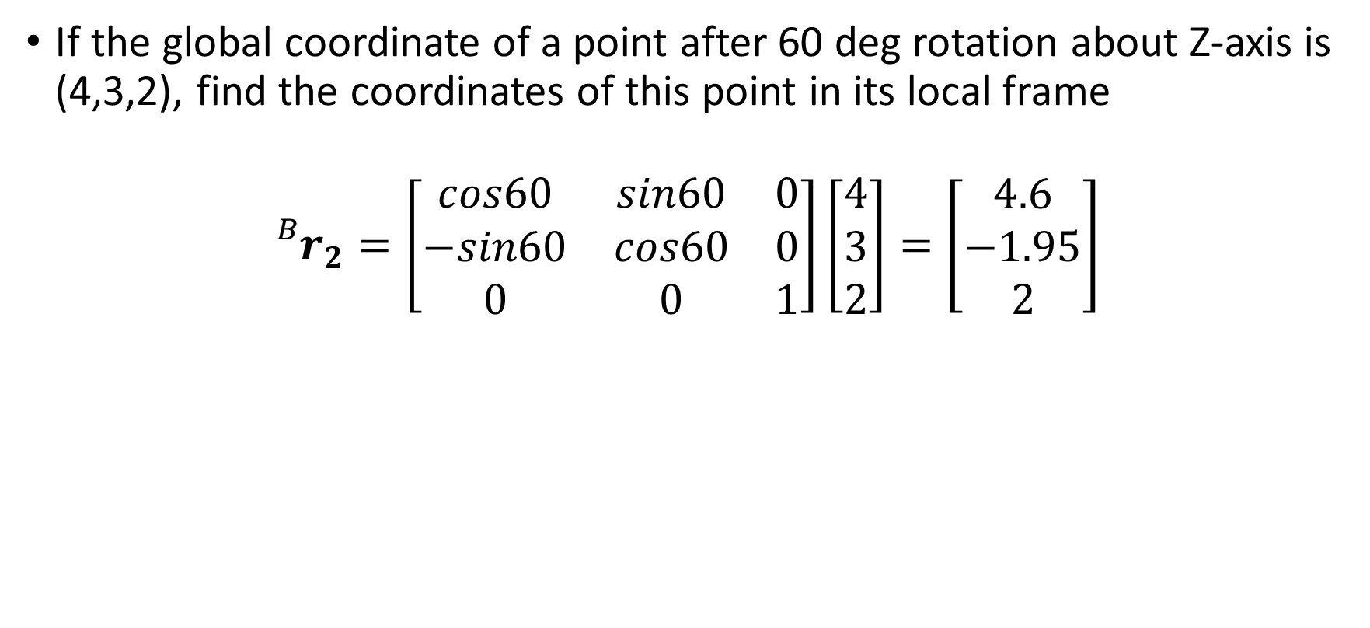
Rotation Kinematics – Rotation About Global Coordinates – Global rot., local pos.
If the global coordinate of a point after 60 deg rotation about Z-axis is (4,3,2), find the coordinates of this point in its local frame
$${}_{}^{B}{r_{2}}=\left[\begin{matrix}cos60 & sin60 & 0 \\ −sin60 & cos60 & 0 \\ 0 & 0 & 1\end{matrix}\right]\left[\begin{matrix}4 \\ 3 \\ 2\end{matrix}\right]=\left[\begin{matrix}4.6 \\ −1.95 \\ 2\end{matrix}\right]$$

Slide 22


Rotation Kinematics – Rotation About Local Coordinates
Defining the position of a point located in the global frame with respect to a local frame:
${}_{}^{B}r={}_{}^{B}{A_{G}^{}}{}_{}^{G}r$
If global frame and local frame
has a relative rotation among
local axes:
$$A_{z,φ}^{}=\left[\begin{matrix}cosφ & sinφ & 0 \\ −sinφ & cosφ & 0 \\ 0 & 0 & 1\end{matrix}\right]$$
$$A_{y,θ}^{}=\left[\begin{matrix}cosθ & 0 & −sinθ \\ 0 & 1 & 0 \\ sinθ & 0 & cosθ\end{matrix}\right]$$
$$A_{x,ψ}^{}=\left[\begin{matrix}1 & 0 & 0 \\ 0 & cosψ & sinψ \\ 0 & −sinψ & cosψ\end{matrix}\right]$$

Slide 23
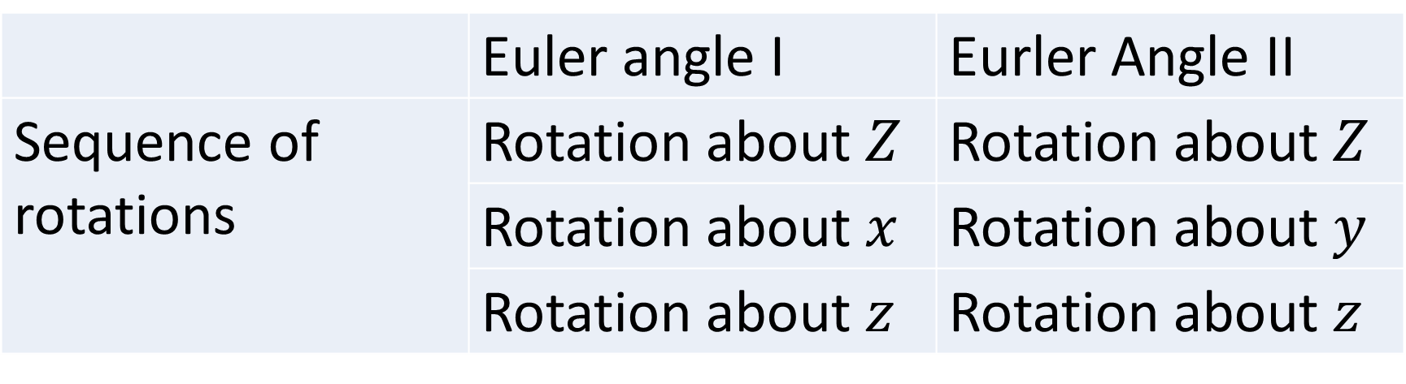
Eurler Angles
 | Euler angle I | Eurler Angle II
Sequence of rotations | Rotation about $Z$ | Rotation about $Z$
 | Rotation about $x$ | Rotation about $y$
 | Rotation about $z$ | Rotation about $z$

Slide 24
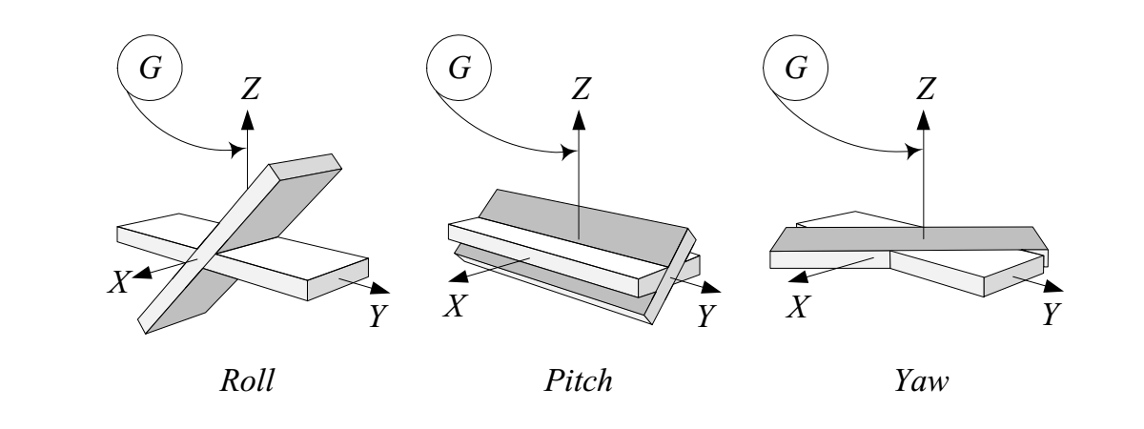

Global Roll – Pitch – Yaw Angles: (45 deg examples)
Rotation about global X-axis is called roll, rotation about global Y-axis is called pitch and rotation about global Z-axis is called yaw.
The global roll-pitch-yaw rotation matrix is given as
$${}_{}^{G}{Q_{B}^{}}=Q_{z,γ}Q_{y,β}Q_{X,α}$$

Slide 25


Local Roll – Pitch – Yaw Angles
Rotation about local x-axis is called roll/bank, rotation about local y-axis is called pitch/attitude and rotation about local z-axis is called yaw/spin.
The local roll-pitch-yaw rotation matrix is given as
$${}_{}^{B}{A_{G}^{}}=A_{z,ψ}A_{y,θ}A_{x,φ}$$

Slide 26

Local vs. Global Rotation
Global rotation matrix ${}_{}^{G}{Q_{B}^{}}$ is the inverse of local rotation ${}_{}^{B}{A_{G}^{}}$
$${}_{}^{G}r={}_{}^{G}{Q_{B}^{}}{}_{}^{B}r$$
$${}_{}^{B}r={}_{}^{B}{A_{G}^{}}{}_{}^{G}r$$
$${}_{}^{G}r={}_{}^{G}{Q_{B}^{}}{}_{}^{B}{A_{G}^{}}{}_{}^{G}r⟹{}_{}^{G}{Q_{B}^{}}{}_{}^{B}{A_{G}^{}}=Ι$$
$${}_{}^{B}r={}_{}^{B}{A_{G}^{}}{}_{}^{G}{Q_{B}^{}}{}_{}^{B}r⟹{}_{}^{B}{A_{G}^{}}{}_{}^{G}{Q_{B}^{}}=Ι$$

Slide 27

Local vs. Global Rotation
Global rotation matrix ${}_{}^{G}{Q_{B}^{}}$ is the inverse of local rotation ${}_{}^{B}{A_{G}^{}}$
$${}_{}^{B}{A_{G}^{}}=A_{n}…A_{3}A_{2}A_{1}$$
$${}_{}^{G}{Q_{B}^{}}=Q_{n}…Q_{3}Q_{2}Q_{1}$$
$${}_{}^{G}{Q_{B}^{}}={}_{}^{B}{A_{G}^{−1}}⇒Q_{n}…Q_{3}Q_{2}Q_{1}=A_{1}^{−1}A_{2}^{−1}A_{3}^{−1}…A_{n}^{−1}$$
$${}_{}^{B}{A_{G}^{}}={}_{}^{G}{Q_{B}^{−1}}⇒A_{n}…A_{3}A_{2}A_{1}=Q_{1}^{−1}Q_{2}^{−1}R_{3}^{−1}…Q_{n}^{−1}$$

Slide 28

General Transformation
There is always a transformation matrix that maps components of a vector $r$ from reference frame $B$ to reference frame $G$, where $B$ and $G$ shares a common origin $O$.
$${}_{}^{G}r={}_{}^{G}{R_{B}^{}}{}_{}^{B}r$$
$${}_{}^{B}r={}_{}^{G}{R_{B}^{−1}}{}_{}^{G}r={}_{}^{B}{R_{G}^{}}{}_{}^{G}r$$
$$\left|{}_{}^{G}{R_{B}^{}}\right|=\left|{}_{}^{B}{R_{G}^{}}\right|=1$$
$${}_{}^{B}{R_{G}^{}}={}_{}^{G}{R_{B}^{−1}}={}_{}^{G}{R_{B}^{T}}$$

Slide 29

Rotation Matrix Properties
$$Q_{\left\{.\right\},0}^{}=I$$
$$Q_{\left\{.\right\},α}^{−1}=Q_{\{.\},α}^{T}=Q_{\left\{.\right\},−α}^{}$$
$$Q_{\{. \},α}^{}Q_{\{. \},β}^{}=Q_{\left\{.\right\},α+β}^{}$$

Slide 30


Homogeneous Transformations – Rigid Motion
Global coordinates (${}_{}^{G}r$) of a point in a rigid body (${}_{}^{B}r$) with freely moving local coordinate frame can be given as:
$${}_{}^{G}r={}_{}^{G}{R_{B}^{}}{}_{}^{B}r+{}_{}^{G}d$$
Where ${}_{}^{G}d$ is the displacement between local and global frames, and ${}_{}^{G}{R_{B}^{}}$is the transformation matrix that maps B to G.

Slide 31

Homogeneous Transformations
Rigid motion can also be written with a $4×4$ homogeneous transformation matrix ${}_{}^{G}{T_{B}^{}}$ as:
$${}_{}^{G}{T_{B}^{}}=\left[\begin{matrix}{}_{}^{G}{R_{B}^{}} & {}_{}^{G}d \\ 0 & 1\end{matrix}\right]$$
$$\left[\begin{matrix}{}_{}^{G}r \\ 1\end{matrix}\right]={}_{}^{G}{T_{B}^{}}\left[\begin{matrix}{}_{}^{B}r \\ 1\end{matrix}\right]=\left[\begin{matrix}{}_{}^{G}{R_{B}^{}} & {}_{}^{G}d \\ 0 & 1\end{matrix}\right]\left[\begin{matrix}{}_{}^{B}r \\ 1\end{matrix}\right]=\left[\begin{matrix}{}_{}^{G}{R_{B}^{}}{}_{}^{B}r+{}_{}^{G}d \\ 1\end{matrix}\right]$$

Slide 32

Homogeneous Transformations
Translation only homogeneous transform : Axes of B and G are parallel
$${}_{}^{G}d=0$$
Rotation only homogeneous transform : Origins of B and G are coincident
$${}_{}^{G}{R_{B}^{}}=I$$

Slide 33

Homogeneous Transformations
Find the global coordinates of a point in a rigid body which started coincident with global frame origin then rotated 45 deg about X-axis and then tranlated to (3,5,7):
Global coordinates of a point $P={\left[x y z\right]}^{T}$in the rigid body with the defined motion is:
$$\left[\begin{matrix}X \\ Y \\ \begin{matrix}Z \\ 1\end{matrix}\end{matrix}\right]=\left[\begin{matrix}1 & 0 & 0 & 3 \\ 0 & cos⁡45 & −sin45 & 5 \\ 0 & sin45 & cos45 & 7 \\ 0 & 0 & 0 & 1\end{matrix}\right]\left[\begin{matrix}x \\ y \\ \begin{matrix}z \\ 1\end{matrix}\end{matrix}\right]$$

Slide 34

Homogeneous Transformations
The most general form of homogeneous transformation matrix
$${}_{}^{A}{T_{B}^{}}=\left[\begin{matrix}{}_{}^{A}{R_{B}^{}\left(3×3\right)} & {}_{}^{A}{d\left(3×1\right)} \\ p\left(1×3\right) & w\left(1×1\right)\end{matrix}\right]$$
$$=\left[\begin{matrix}rotation & translation \\ perspective & scale\end{matrix}\right]$$

Slide 35
Forward Kinematics

Slide 36

Forward Kinematics
The coordinates of a point $P$ relative to the base frame (${}_{}^{0}{r_{P}^{}}$) can be calculated by the combined transformation matrix (${}_{}^{0}{T_{n}^{}}$) of a $n$ link robot arm and the point’s coorinates at the final frame (${}_{}^{n}{r_{P}^{}}$)
$${}_{}^{0}{r_{P}^{}}={}_{}^{0}{T_{n}^{}}{}_{}^{n}{r_{P}^{}}$$
$${}_{}^{0}{T_{n}^{}}={}_{}^{0}{T_{1}^{}}{}_{}^{1}{T_{2}^{}}…{}_{}^{n−1}{T_{n}^{}}$$

Slide 37

Forward Kinematics - R∥R∥R Robot

Slide 38

Forward Kinematics - R∥R∥R Robot
$${}_{}^{2}{T_{3}^{}}=\left[\begin{matrix}cosθ_{3} & −sinθ_{3} & 0 & ℓ_{3}cosθ_{3} \\ sinθ_{3} & cosθ_{3} & 0 & ℓ_{3}sinθ_{3} \\ 0 & 0 & 1 & 0 \\ 0 & 0 & 0 & 1\end{matrix}\right]$$

Slide 39

Forward Kinematics - R∥R∥R Robot
$${}_{}^{1}{T_{2}^{}}=\left[\begin{matrix}cosθ_{2} & −sinθ_{2} & 0 & ℓ_{2}cosθ_{2} \\ sinθ_{2} & cosθ_{2} & 0 & ℓ_{2}sinθ_{2} \\ 0 & 0 & 1 & 0 \\ 0 & 0 & 0 & 1\end{matrix}\right]$$

Slide 40

Forward Kinematics - R∥R∥R Robot
$${}_{}^{0}{T_{1}^{}}=\left[\begin{matrix}cosθ_{1} & −sinθ_{1} & 0 & ℓ_{1}cosθ_{1} \\ sinθ_{1} & cosθ_{1} & 0 & ℓ_{1}sinθ_{1} \\ 0 & 0 & 1 & 0 \\ 0 & 0 & 0 & 1\end{matrix}\right]$$

Slide 41

Forward Kinematics - R∥R∥R Robot
$${}_{}^{0}{T_{3}^{}}={}_{}^{0}{T_{1}^{}}{}_{}^{1}{T_{2}^{}}{}_{}^{2}{T_{3}^{}}$$
Position of the tip of the robot relative to the base is:
$${}_{}^{0}{T_{3}^{}}\left[\begin{matrix}0 \\ 0 \\ 0 \\ 1\end{matrix}\right]$$

Slide 42

Forward Kinematics - R∥R∥R Robot
At rest position: $θ_{3}=0,θ_{2}=0,θ_{1}=0$
$${}_{}^{0}{T_{3}^{}}=\left[\begin{matrix}1 & 0 & 0 & ℓ_{1}+ℓ_{2}+ℓ_{3} \\ 0 & 1 & 0 & 0 \\ 0 & 0 & 1 & 0 \\ 0 & 0 & 0 & 1\end{matrix}\right]$$

Slide 43

Forward Kinematics - R∥P⊢P Robot

Slide 44

Forward Kinematics - R∥P⊢P Robot
$${}_{}^{2}{T_{3}^{}}=\left[\begin{matrix}1 & 0 & 0 & 0 \\ 0 & 1 & 0 & 0 \\ 0 & 0 & 1 & d_{3} \\ 0 & 0 & 0 & 1\end{matrix}\right]$$

Slide 45

Forward Kinematics - R∥P⊢P Robot
$${}_{}^{1}{T_{2}^{}}=\left[\begin{matrix}1 & 0 & 0 & 0 \\ 0 & 0 & 1 & 0 \\ 0 & −1 & 0 & d_{2} \\ 0 & 0 & 0 & 1\end{matrix}\right]$$

Slide 46

Forward Kinematics - R∥P⊢P Robot
$${}_{}^{0}{T_{1}^{}}=\left[\begin{matrix}cosθ_{1} & −sinθ_{1} & 0 & 0 \\ sinθ_{1} & cosθ & 0 & 0 \\ 0 & 0 & 1 & d_{1} \\ 0 & 0 & 0 & 1\end{matrix}\right]$$

Slide 47

Forward Kinematics - R∥R∥P SCARA and wrist

Slide 48



Forward Kinematics - R∥R∥P SCARA and wrist
x3
x4
$$θ_{4}$$
y3
$$θ_{4}$$
y4
$${}_{}^{3}{T_{4}^{}}=\left[\begin{matrix}cosθ_{3} & −sinθ_{3} & 0 & 0 \\ sinθ_{3} & cosθ_{4} & 0 & 0 \\ 0 & 0 & 1 & d_{4} \\ 0 & 0 & 0 & 1\end{matrix}\right]$$

Slide 49

Forward Kinematics - R∥R∥P SCARA and wrist
$${}_{}^{2}{T_{3}^{}}=\left[\begin{matrix}1 & 0 & 0 & 0 \\ 0 & 1 & 0 & 0 \\ 0 & 0 & 1 & d_{3} \\ 0 & 0 & 0 & 1\end{matrix}\right]$$

Slide 50


Forward Kinematics - R∥R∥P SCARA and wrist
y1
x2
a2
$$θ_{2}$$
x1
y2
$${}_{}^{1}{T_{2}^{}}=\left[\begin{matrix}cosθ_{2} & sinθ_{2} & 0 & 0 \\ sinθ_{2} & −cosθ_{2} & 0 & 0 \\ 0 & 0 & −1 & 0 \\ 0 & 0 & 0 & 1\end{matrix}\right]\left[\begin{matrix}1 & 0 & 0 & a_{2} \\ 0 & 1 & 0 & 0 \\ 0 & 0 & 1 & 0 \\ 0 & 0 & 0 & 1\end{matrix}\right]=\left[\begin{matrix}cosθ_{2} & sinθ_{2} & 0 & a_{2}cosθ_{2} \\ sinθ_{2} & −cosθ_{2} & 0 & a_{2}sinθ_{2} \\ 0 & 0 & −1 & 0 \\ 0 & 0 & 0 & 1\end{matrix}\right]$$

Slide 51

Forward Kinematics - R∥R∥P SCARA and wrist
$${}_{}^{0}{T_{1}^{}}=\left[\begin{matrix}cosθ_{1} & −sinθ_{1} & 0 & 0 \\ sinθ_{1} & cosθ_{1} & 0 & 0 \\ 0 & 0 & 1 & 0 \\ 0 & 0 & 0 & 1\end{matrix}\right]\left[\begin{matrix}1 & 0 & 0 & a_{1x} \\ 0 & 1 & 0 & 0 \\ 0 & 0 & 1 & a_{1z} \\ 0 & 0 & 0 & 1\end{matrix}\right]$$
$$=\left[\begin{matrix}cosθ_{1} & −sinθ_{1} & 0 & a_{1x}cosθ_{1} \\ sinθ_{1} & cosθ_{1} & 0 & a_{1x}sinθ_{1} \\ 0 & 0 & 1 & a_{1z} \\ 0 & 0 & 0 & 1\end{matrix}\right]$$

Slide 52
Inverse Kinematics

Slide 53
Inverse Kinematics
Inverse kinematics : determination of joint parameters for a given set of kinematic chain, transformation matrices and desired end-effector position/orientation.
Inverse kinematics:
Closed form solutions
Geometric
Algebric
Numerical Methods

Slide 54


Inverse Kinematics - R⊢P
Given that $\left(x,y\right)$ determine $Y$ and $S$
$$Y=\arctan\left(\frac{y}{x}\right)$$
$$S=\sqrt{x^{2}+y^{2}}$$

Slide 55



Inverse Kinematics - R∥R
Given that $\left\{ℓ_{1},ℓ_{2},\left(x,y\right)\right\}$ determine $\left\{Y_{1},Y_{2}\right\}$
There may be two, one or no solution to the problem

Slide 56

Inverse Kinematics - R∥R
Law of cosines:
$$\left(x^{2}+y^{2}\right)=ℓ_{1}^{2}+ℓ_{2}^{2}−2ℓ_{1}ℓ_{2}\cos\left(180−Y_{2}\right)$$
$$\cos\left(180−Y_{2}\right)=−\cos\left(Y_{2}\right)$$
$$Y_{2}=\arccos\left(\frac{x^{2}+y^{2}−ℓ_{1}^{2}−ℓ_{2}^{2}}{2ℓ_{1}ℓ_{2}}\right)$$

Slide 57

Inverse Kinematics - R∥R
Law of sines:
$$\frac{\sin\left(Y_{1}−α\right)}{ℓ_{2}}=\frac{\sin\left(180−Y_{2}\right)}{\sqrt{x^{2}+y^{2}}}=\frac{\sin\left(Y_{2}\right)}{\sqrt{x^{2}+y^{2}}}$$
$$Y_{1}=\arcsin\left(\frac{ℓ_{2}\sin\left(Y_{2}\right)}{\sqrt{x^{2}+y^{2}}}\right)+\underset{α}{\underbrace{\arctan\left(\frac{y}{x}\right)}}$$

