Slide 1
Robot Teknolojisine Giriş Yrd. Doç. Dr. Erkan Uslu, Doç. Dr. Sırma Yavuz, Doç. Dr. Fatih Amasyalı, Ar. Grv. Nihal Altuntaş, Ar. Grv. Furkan Çakmak 05

Slide 2
Dead (deduced) Reckoning
Estimating the entire trajectory of a moving robot
Dead-reckoning systems are based on estimating position relative to sensors. These sensors can be accelerometers, gyroscopes, wheel encoders, infrared sensors, cameras etc.
Odometry is a sub topic of dead-reckoning and based on wheel displacement calculations

Slide 3
Dead (deduced) Reckoning
Kinematic Model
Open loop motion model, position update with given linear/angular velocity
Wheel Odometry
Position update by wheel encoders
Laser Scan Matcher
Position update with matching consecutive laser scans
Visual Odometry
Position update with matching consecutive images
Inertial Odometry
Position update with motion (accelerometer), rotation (gyroscope) and heading (magnetometer) sensors
Combined Odometry
Position update with combined sources of odometries and sensors

Slide 4
Odometry Errors
different wheel diameters
ideal case
and many more …
bump
carpet

Slide 5
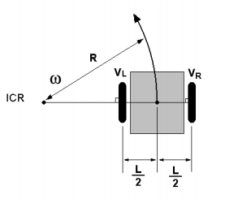
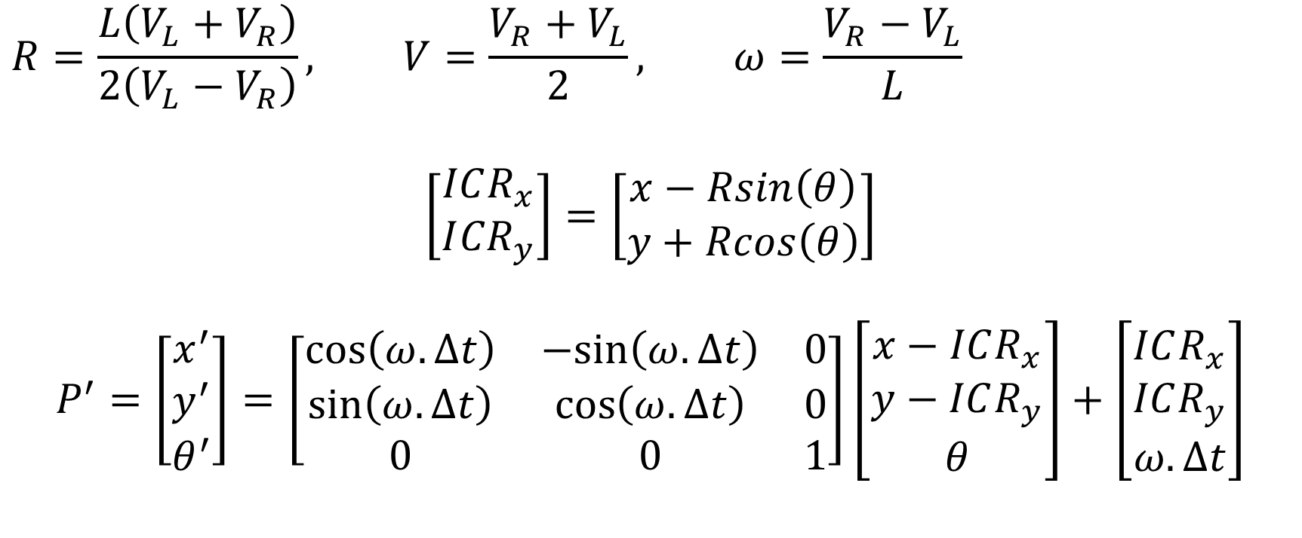
Kinematic Model (Velocity Model)
$$R=\frac{L\left(V_{L}+V_{R}\right)}{2\left(V_{L}−V_{R}\right)}, V=\frac{V_{R}+V_{L}}{2}, ω=\frac{V_{R}−V_{L}}{L}$$
$$\left[\begin{matrix}ICR_{x} \\ I{CR}_{y}\end{matrix}\right]=\left[\begin{matrix}x−Rsin\left(θ\right) \\ y+Rcos\left(θ\right)\end{matrix}\right]$$
$$P^{′}=\left[\begin{matrix}x^{′} \\ y^{′} \\ θ^{′}\end{matrix}\right]=\left[\begin{matrix}\cos\left(ω.Δt\right) & −sin\left(ω.Δt\right) & 0 \\ \sin\left(ω.Δt\right) & \cos\left(ω.Δt\right) & 0 \\ 0 & 0 & 1\end{matrix}\right]\left[\begin{matrix}x−ICR_{x} \\ y−ICR_{y} \\ θ\end{matrix}\right]+\left[\begin{matrix}ICR_{x} \\ ICR_{y} \\ ω.Δt\end{matrix}\right]$$

Slide 6

Kinematic Model (Velocity Model)
$$x\left(t\right)=\int_{0}^{t}{V\left(τ\right)}\cos\left(θ\left(τ\right)\right)ⅆτ$$
$$y\left(t\right)=\int_{0}^{t}{V\left(τ\right)}\sin\left(θ\left(τ\right)\right)ⅆτ$$
$$θ\left(t\right)=\int_{0}^{t}{ω\left(τ\right)}ⅆτ$$

Slide 7

Kinematic Model (Velocity Model)
$$x\left(t\right)=\frac{1}{2}\int_{0}^{t}{\left[V_{R}\left(τ\right)+V_{L}\left(τ\right)\right]\cos\left(θ\left(τ\right)\right)ⅆτ}$$
$$y\left(t\right)=\frac{1}{2}\int_{0}^{t}{\left[V_{R}\left(τ\right)+V_{L}\left(τ\right)\right]\sin\left(θ\left(τ\right)\right)ⅆτ }$$
$$θ\left(t\right)=\frac{1}{L}\int_{0}^{t}{\left[V_{R}\left(τ\right)−V_{L}\left(τ\right)\right]τ}$$

Slide 8
Wheel Odometry
Odometry is obtained integrating sensor reading from wheel encoders
Pose estimation is carried out similar to kinematic model, except that distances traveled by the wheels are calculated from sensor reading

Slide 9
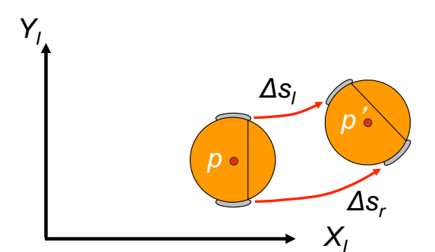

Wheel Odometry
If a robot starts from a position $p$, and the right and left wheels move respective distances $Δs_{r}$ and $Δs_{l}$, what is the resulting new position $p’$?

Slide 10
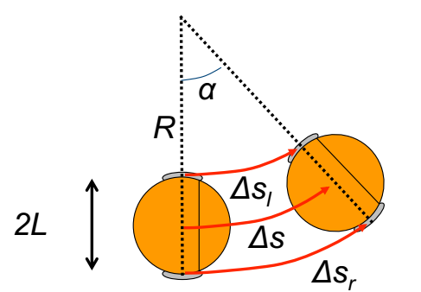

Wheel Odometry
Let’s model the change in angle $Δθ$ and distance travelled $Δs$ by the robot
$Δs_{l} = Rα$ $Δs_{r} = (R+2L)α$
$Δs = (R+L)α$ $Δs=\frac{(Δs_{r}+Δs_{l})}{2}$

Slide 11
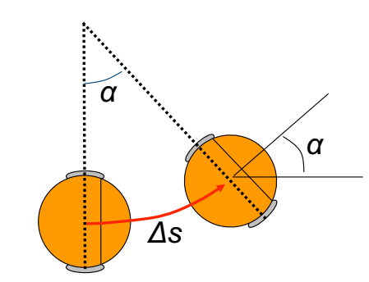

Wheel Odometry
$Δθ = α$
$R=\frac{2LΔs_{l}}{Δs_{r}− Δs_{l}}$
$α =\frac{(Δs_{r}− Δs_{l})}{2L}$
$Δθ =\frac{(Δs_{r}− Δs_{l})}{2L}$

Slide 12
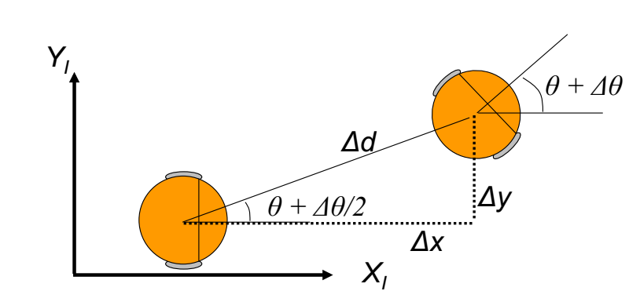

Wheel Odometry
Average orientation is $θ+\frac{Δθ}{2}$
$Δx = Δd\cos\left(θ +\frac{Δθ}{2}\right)$
$Δy = Δd\sin\left(θ +\frac{Δθ}{2}\right)$
$Δd ≈ Δs$
$Δx = Δs\cos\left(θ +\frac{Δθ}{2}\right)$
$Δy = Δs\sin\left(θ +\frac{Δθ}{2}\right)$

Slide 13
Laser Scan Matcher
Scan-matching tries to incrementally align two scans or a map to a scan, without revising the past/map
Types
Iterative Closest Point
Scan-to-scan
Scan-to-map
Map-to-map
Feature based

Slide 14
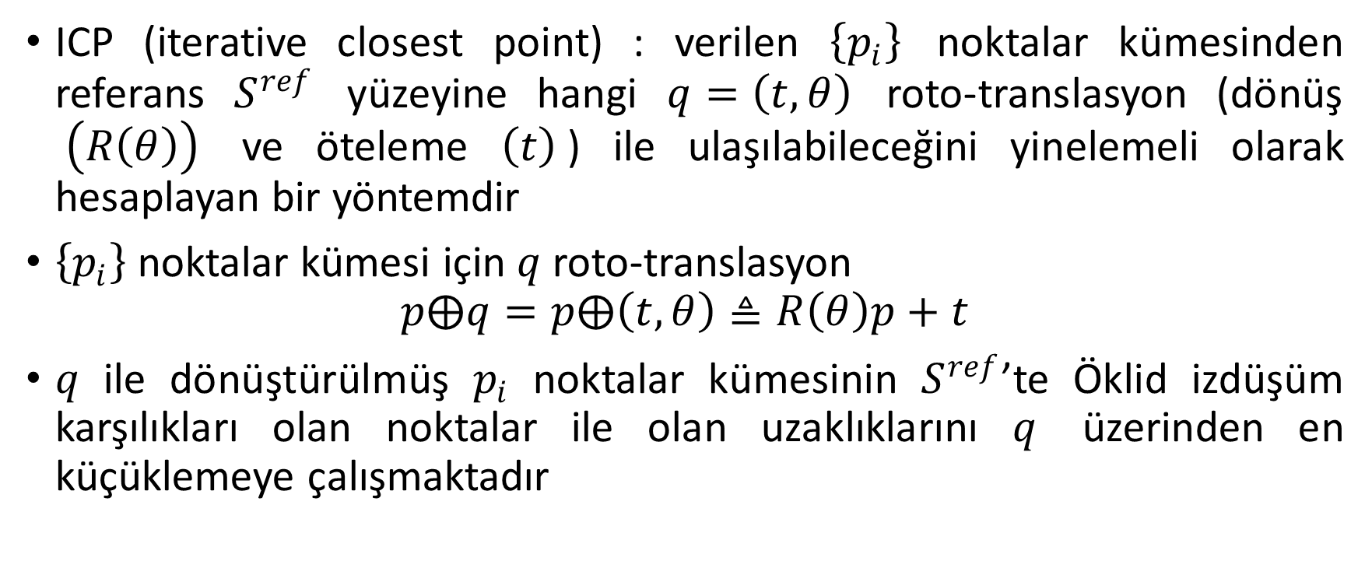
Laser Scan Matcher
ICP (iterative closest point) : verilen $\left\{p_{i}\right\}$ noktalar kümesinden referans $S^{ref}$ yüzeyine hangi $q=\left(t,θ\right)$ roto-translasyon (dönüş $\left(R\left(θ\right)\right)$ ve öteleme $\left(t\right)$) ile ulaşılabileceğini yinelemeli olarak hesaplayan bir yöntemdir
$\left\{p_{i}\right\}$ noktalar kümesi için $q$ roto-translasyon
$$p⨁q=p⨁\left(t,θ\right)≜R\left(θ\right)p+t$$
$q$ ile dönüştürülmüş $p_{i}$ noktalar kümesinin $S^{ref}$’te Öklid izdüşüm karşılıkları olan noktalar ile olan uzaklıklarını $q$ üzerinden en küçüklemeye çalışmaktadır

Slide 15
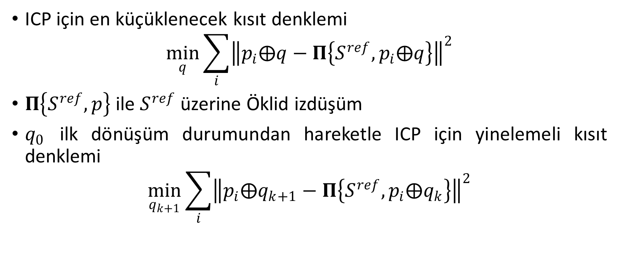
Laser Scan Matcher
ICP için en küçüklenecek kısıt denklemi
$$\min_{q}{\sum_{i}{{\left\|p_{i}⨁q−Π\left\{S^{ref},p_{i}⨁q\right\}\right\|}^{2}}}$$
$Π\left\{S^{ref},p\right\}$ ile $S^{ref}$ üzerine Öklid izdüşüm
$q_{0}$ ilk dönüşüm durumundan hareketle ICP için yinelemeli kısıt denklemi
$$\min_{q_{k+1}}{\sum_{i}{{\left\|p_{i}⨁q_{k+1}−Π\left\{S^{ref},p_{i}⨁q_{k}\right\}\right\|}^{2}}}$$

Slide 16
Visual Odometry
A camera (or an array of cameras) rigidly attached to a robot
Construct a 6-DOF trajectory using the video stream coming from this camera(s)
Using just one camera → Monocular Visual Odometry
Using two (or more) cameras → Stereo Visual Odometry
In monocular VO, trajectory estimation can be given in scale factor
In stereo VO, exact trajectory estimation can be carried out (in meters)
If (distance to objects)/(stereo distance) >> → degenerates to monocular VO

Slide 17
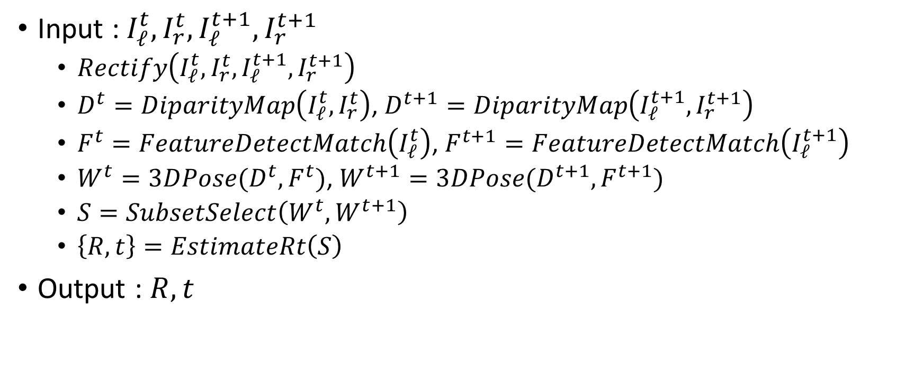
Visual Odometry – Stereo VO - Algorithm
Input : $I_{ℓ}^{t},I_{r}^{t},I_{ℓ}^{t+1},I_{r}^{t+1}$
$Rectify\left(I_{ℓ}^{t},I_{r}^{t},I_{ℓ}^{t+1},I_{r}^{t+1}\right)$
$D^{t}=DiparityMap\left(I_{ℓ}^{t},I_{r}^{t}\right)$, $D^{t+1}=DiparityMap\left(I_{ℓ}^{t+1},I_{r}^{t+1}\right)$
$F^{t}=FeatureDetectMatch\left(I_{ℓ}^{t}\right)$, $F^{t+1}=FeatureDetectMatch\left(I_{ℓ}^{t+1}\right)$
${W^{t}=3DPose(D}^{t},F^{t})$, ${W^{t+1}=3DPose(D}^{t+1},F^{t+1})$
$S=SubsetSelect\left(W^{t},W^{t+1}\right)$
$\left\{R,t\right\}=EstimateRt\left(S\right)$
Output : $R,t$

Slide 18
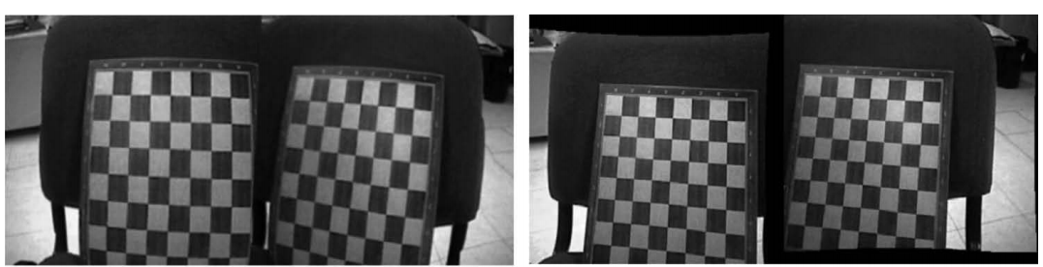
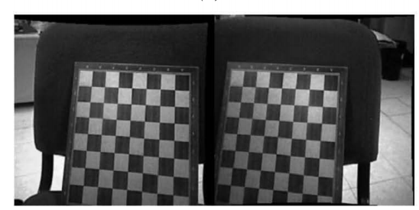
Visual Odometry – Stereo VO - Rectification
Two cameras are used
Intrinsic callibration (lens distortion, imaging plane orienteation)
Extrinsic callibration (position & orientation of two cameras with respect to a global frame)

Slide 19
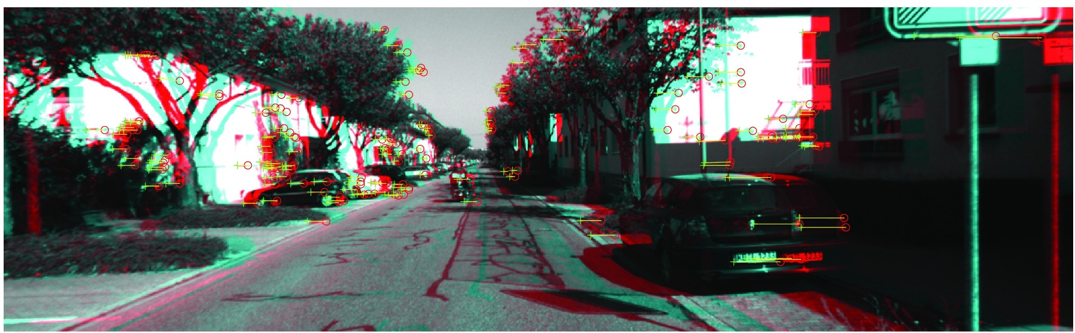
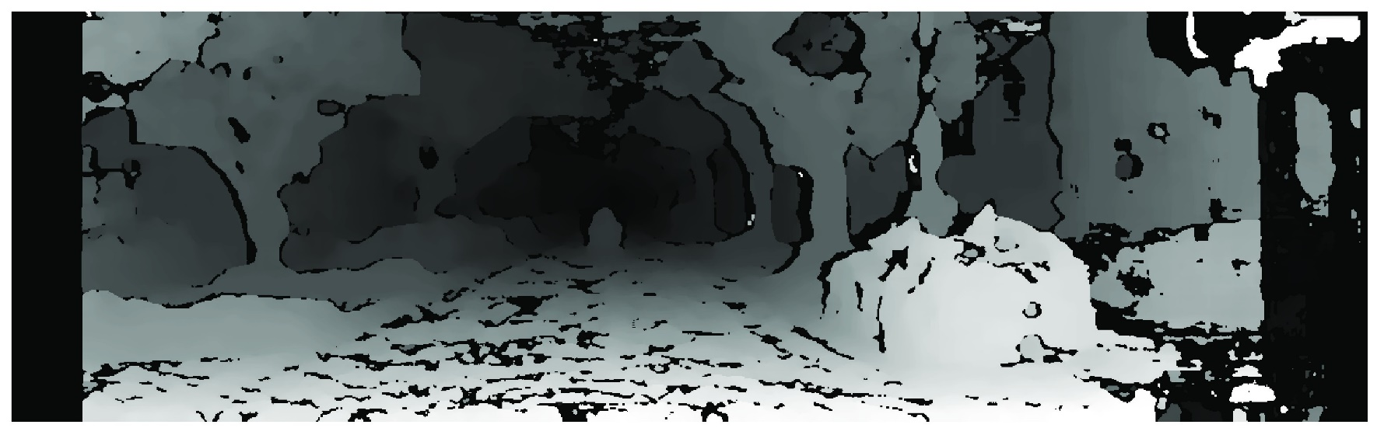
Visual Odometry – Stereo VO – Disparity Map

Slide 20
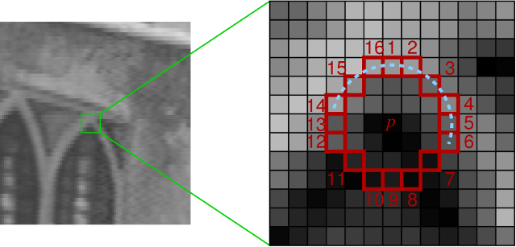
Visual Odometry – Stereo VO – Feature Detection
Features from accelerated segment test (FAST)
A corner point has either of the following at 16 neighborhood circle
Set of N contiguous pixels that are brighter than (center + threshold)
Set of N contiguous pixels that are darker than (center – threshold)

Slide 21
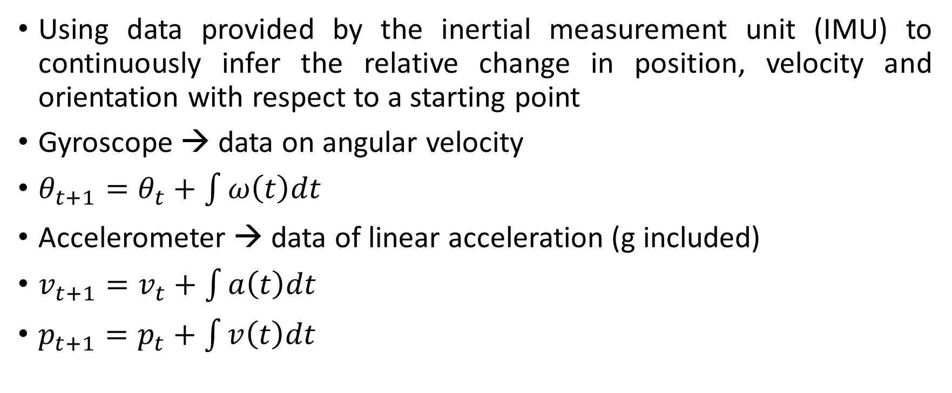
Inertial Odometry
Using data provided by the inertial measurement unit (IMU) to continuously infer the relative change in position, velocity and orientation with respect to a starting point
Gyroscope → data on angular velocity
$θ_{t+1}=θ_{t}+\int{ω\left(t\right)dt}$
Accelerometer → data of linear acceleration (g included)
$v_{t+1}=v_{t}+\int{a\left(t\right)dt}$
$p_{t+1}=p_{t}+\int{v\left(t\right)dt}$

Slide 22
Inertial Odometry - Pitfalls
Integration drift : Small errors in the measurements of acceleration and angular velocity cause progressively larger errors in velocity—and even greater errors in position
Gravity : The dominating component in the accelerometer data is gravity, even slight errors in orientation make the gravity ‘leak’ into the estimates
The sequential nature of the problem makes the errors accumulate

Slide 23
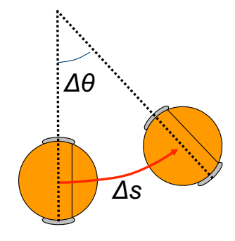
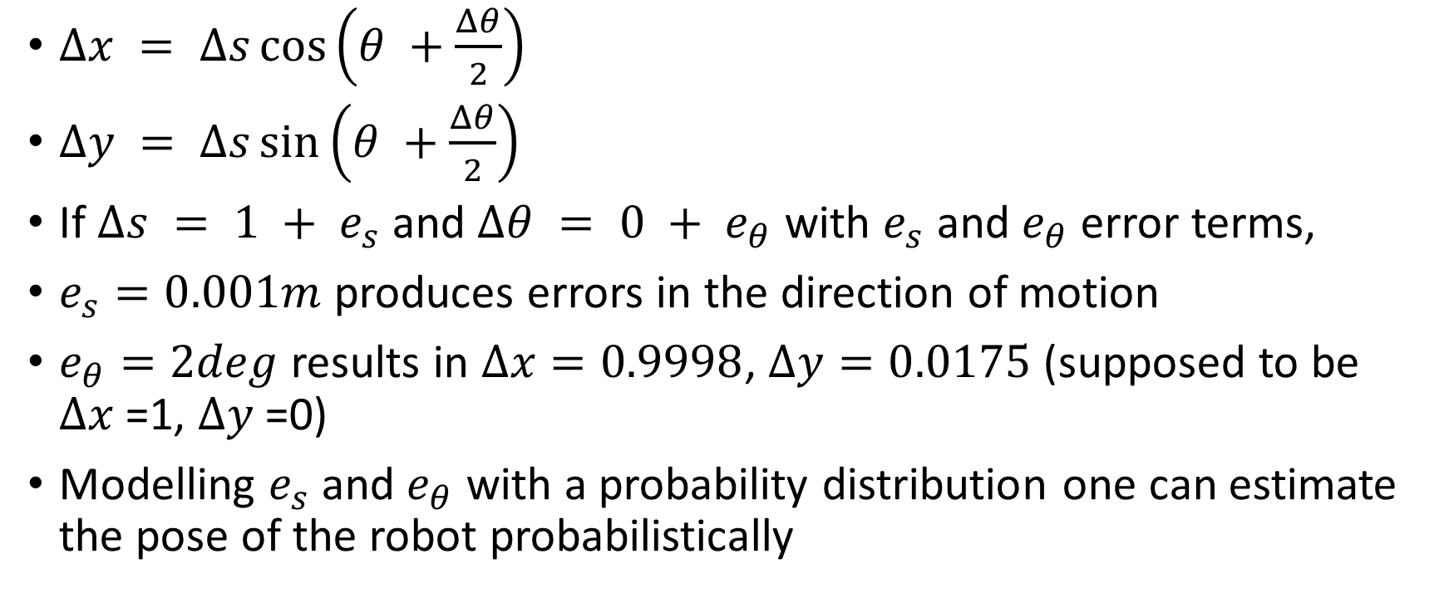
Modeling Uncertainty in Motion
$Δx = Δs\cos\left(θ +\frac{Δθ}{2}\right)$
$Δy = Δs\sin\left(θ +\frac{Δθ}{2}\right)$
If $Δs = 1 + e_{s}$ and $Δθ = 0 + e_{θ}$ with $e_{s}$ and $e_{θ}$ error terms,
$e_{s}=0.001m$ produces errors in the direction of motion
$e_{θ}=2deg$ results in $Δx=0.9998$, $Δy=0.0175$ (supposed to be $Δx$=1, $Δy$=0)
Modelling $e_{s}$ and $e_{θ}$ with a probability distribution one can estimate the pose of the robot probabilistically

Slide 24
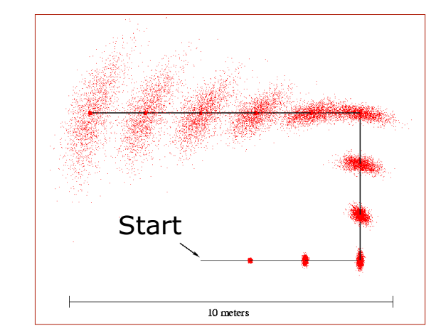
Modeling Uncertainty in Motion

Slide 25
Preliminary for Kalman F. and Extended K.F.

Slide 26
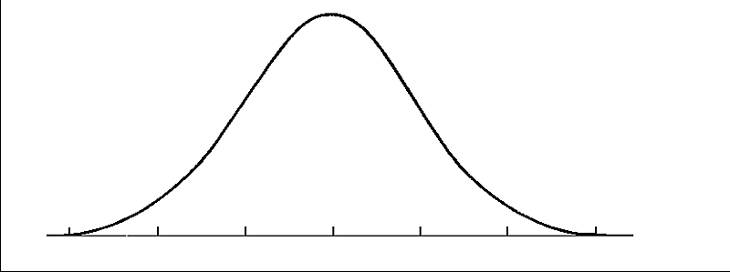





Gauss (Normal) Distribution
Gauss distribution can be described by $𝒩\left(μ,σ^{2}\right)$ where
$μ$ is the mean and
$σ$ is the standart deviation, $σ^{2}$ is called variance
$$p\left(x|μ,σ\right)=\frac{1}{σ\sqrt{2π}}e^{−\frac{{\left(x−μ\right)}^{2}}{2σ^{2}}}$$
$$34.1\%$$
$μ$- $σ$
$$μ$$
$μ$-+$σ$

Slide 27
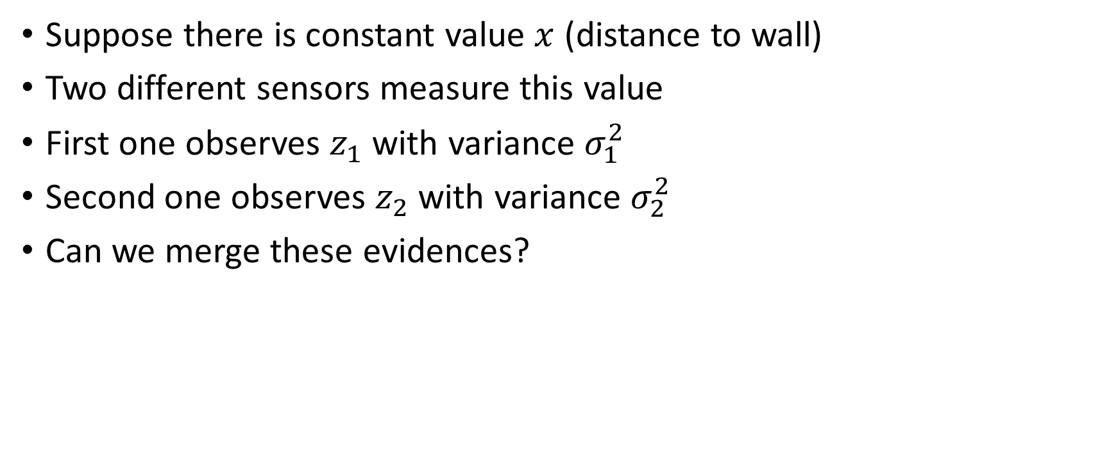
Estimating a Value
Suppose there is constant value $x$ (distance to wall)
Two different sensors measure this value
First one observes $z_{1}$ with variance $σ_{1}^{2}$
Second one observes $z_{2}$ with variance $σ_{2}^{2}$
Can we merge these evidences?

Slide 28






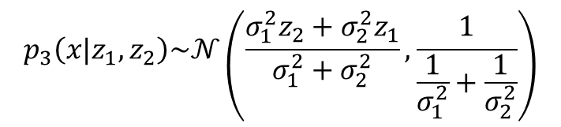
Estimating a Value
$$p_{3}\left(x|{z_{1},z}_{2}\right)\sim 𝒩\left(\frac{σ_{1}^{2}z_{2}+σ_{2}^{2}z_{1}}{σ_{1}^{2}+σ_{2}^{2}},\frac{1}{\frac{1}{σ_{1}^{2}}+\frac{1}{σ_{2}^{2}}}\right)$$
$$p_{1}\left(x|z_{1}\right)$$
$$p_{2}\left(x|z_{2}\right)$$
$$z_{1}$$
$$z_{1}+σ_{1}$$
$$z_{2}$$
$$z_{2}+σ_{2}$$

Slide 29
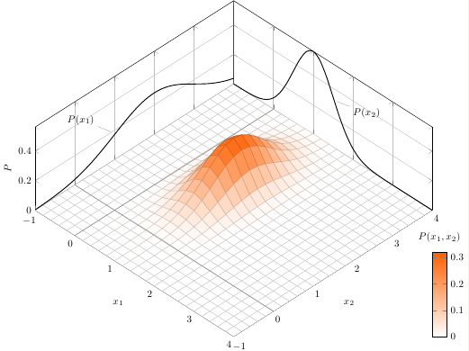
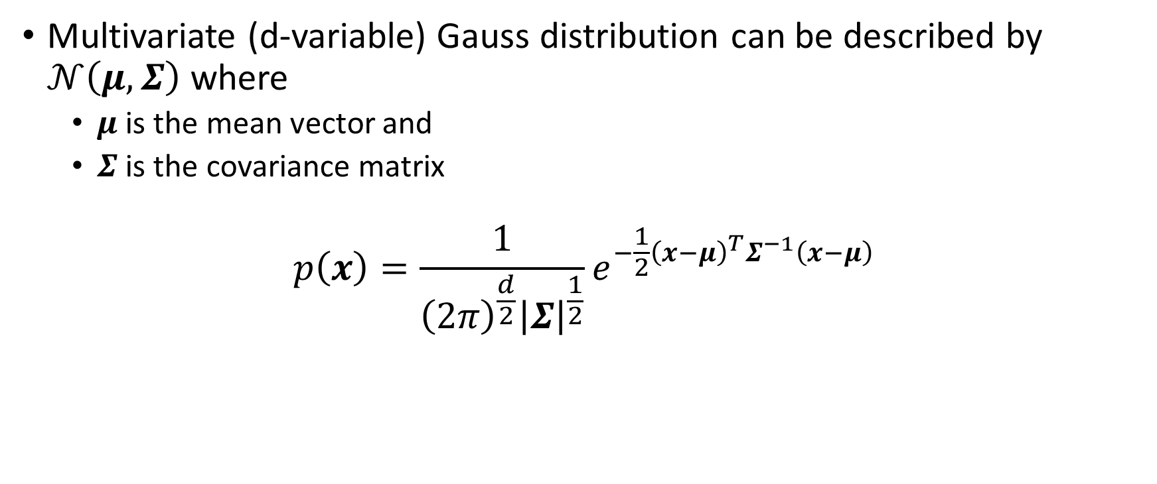
Multivariate Gauss Distribution
Multivariate (d-variable) Gauss distribution can be described by $𝒩\left(μ,Σ\right)$ where
$μ$ is the mean vector and
$Σ$ is the covariance matrix
$$p\left(x\right)=\frac{1}{{\left(2π\right)}^{\frac{d}{2}}{\left|Σ\right|}^{\frac{1}{2}}}e^{−\frac{1}{2}{\left(x−μ\right)}^{T}Σ^{−1}\left(x−μ\right)}$$

Slide 30

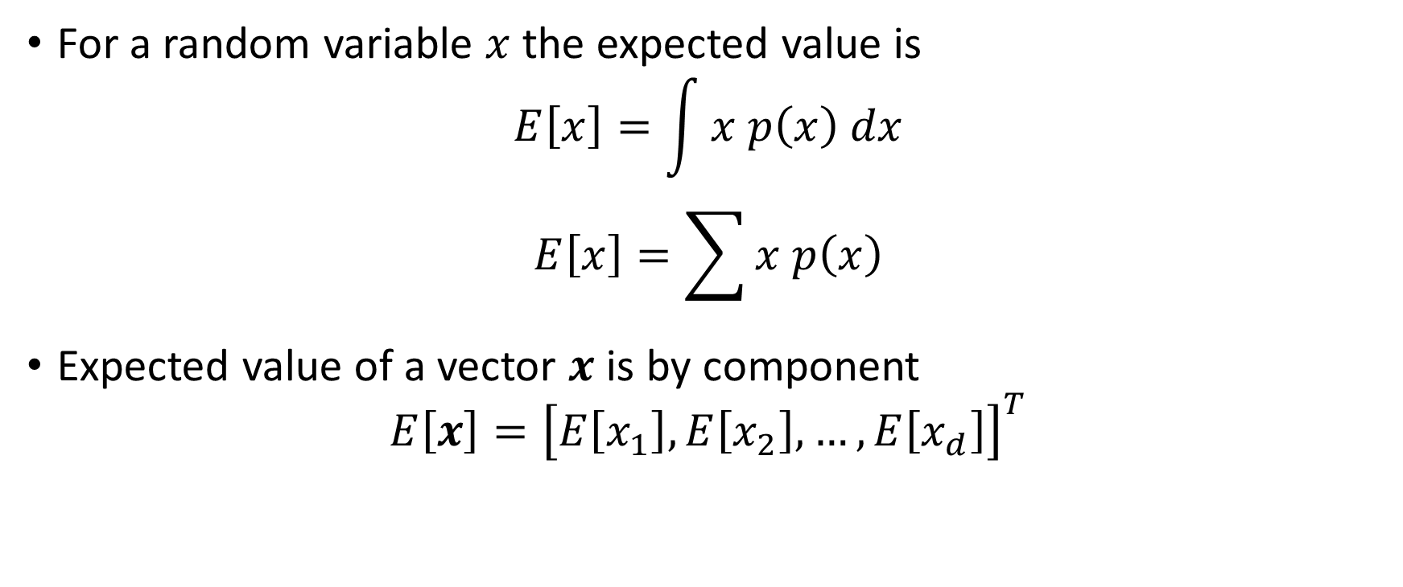
Expectations
For a random variable $x$ the expected value is
$$E\left[x\right]=\int{x p\left(x\right) dx}$$
$$E\left[x\right]=\sum{x p\left(x\right)}$$
Expected value of a vector $x$ is by component
$$E\left[x\right]={\left[E\left[x_{1}\right], E\left[x_{2}\right],…, E\left[x_{d}\right]\right]}^{T}$$
For uniform distribution
$$E\left[x\right]=\overline{x}=\frac{1}{N}\sum_{1}^{N}{x_{i}}$$

Slide 31
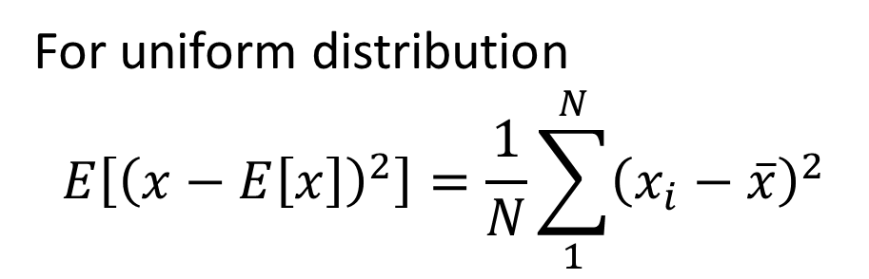

Variance and Covariance
For uniform distribution
$$E\left[{\left(x−E\left[x\right]\right)}^{2}\right]=\frac{1}{N}\sum_{1}^{N}{{\left(x_{i}−\overline{x}\right)}^{2}}$$
Variance of a random variable $x$ is
$$σ^{2}=E\left[{\left(x−E\left[x\right]\right)}^{2}\right]$$
Covarince matrix is
$$Σ=E\left[\left(x−E\left[x\right]\right){\left(x−E\left[x\right]\right)}^{T}\right]$$

Slide 32
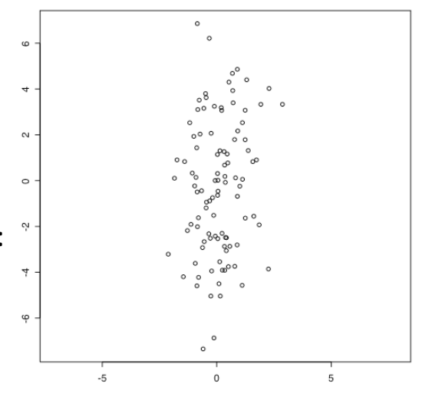

Independent Variation
Generate 100 samples duples for x and y Gaussian random variables with $σ_{x}=1$ and $σ_{y}=3$
$$C_{xy}=\left[\begin{matrix}0.9 & 0.44 \\ 0.44 & 8.82\end{matrix}\right]$$

Slide 33
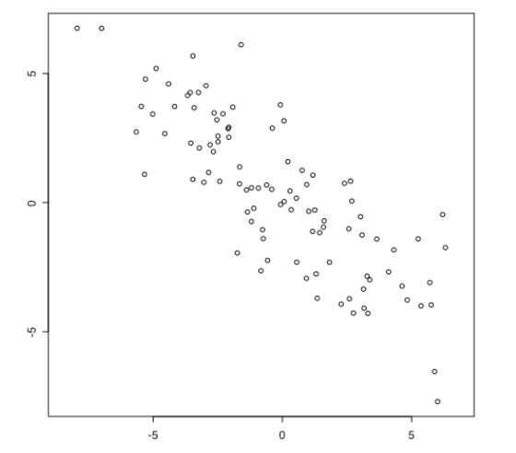

Dependent Variation
c and d are random variables generated by c=x+y and d=x-y
$$C_{xy}=\left[\begin{matrix}10.62 & −7.93 \\ −7.93 & 8.84\end{matrix}\right]$$

Slide 34
Kalman Filter

Slide 35
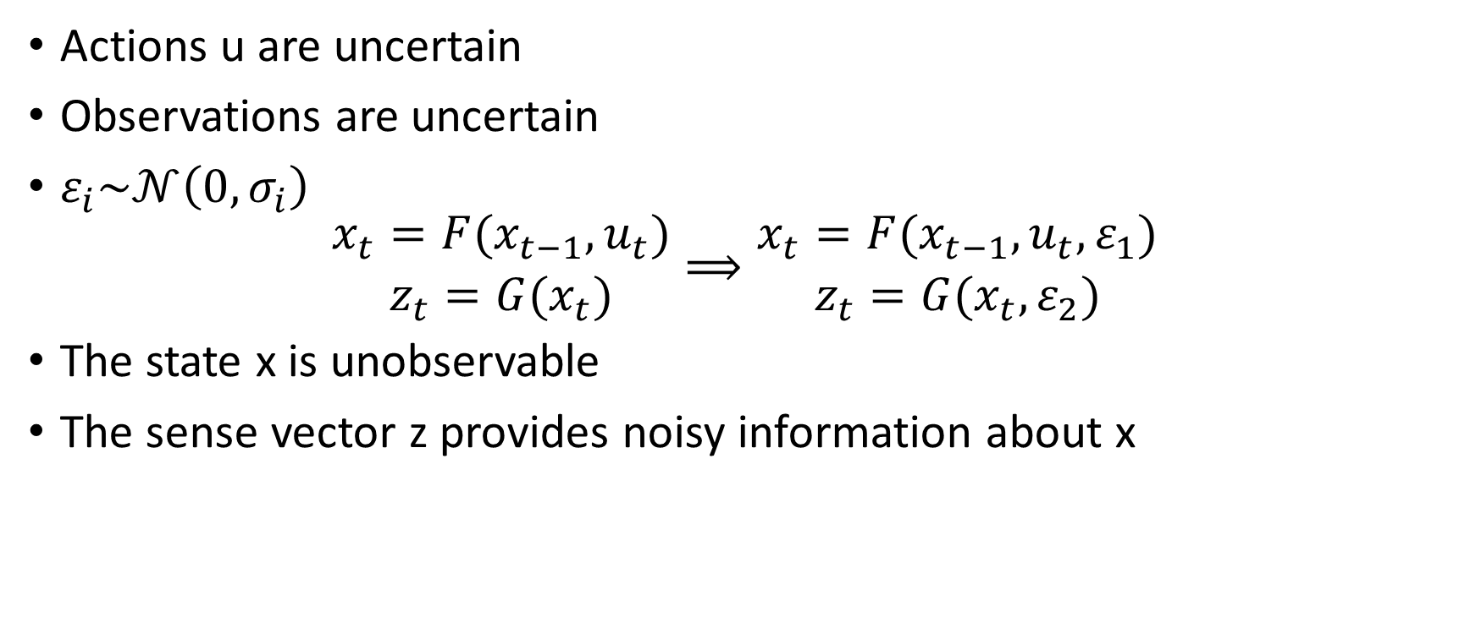
Stocastic Models of Uncertain World
Actions u are uncertain
Observations are uncertain
$ε_{i}\sim 𝒩\left(0,σ_{i}\right)$
$$\begin{matrix}x_{t}=F(x_{t−1},u_{t}) \\ z_{t}=G(x_{t})\end{matrix}⟹\begin{matrix}x_{t}=F(x_{t−1},u_{t},ε_{1}) \\ z_{t}=G(x_{t},ε_{2})\end{matrix}$$
The state x is unobservable
The sense vector z provides noisy information about x

Slide 36
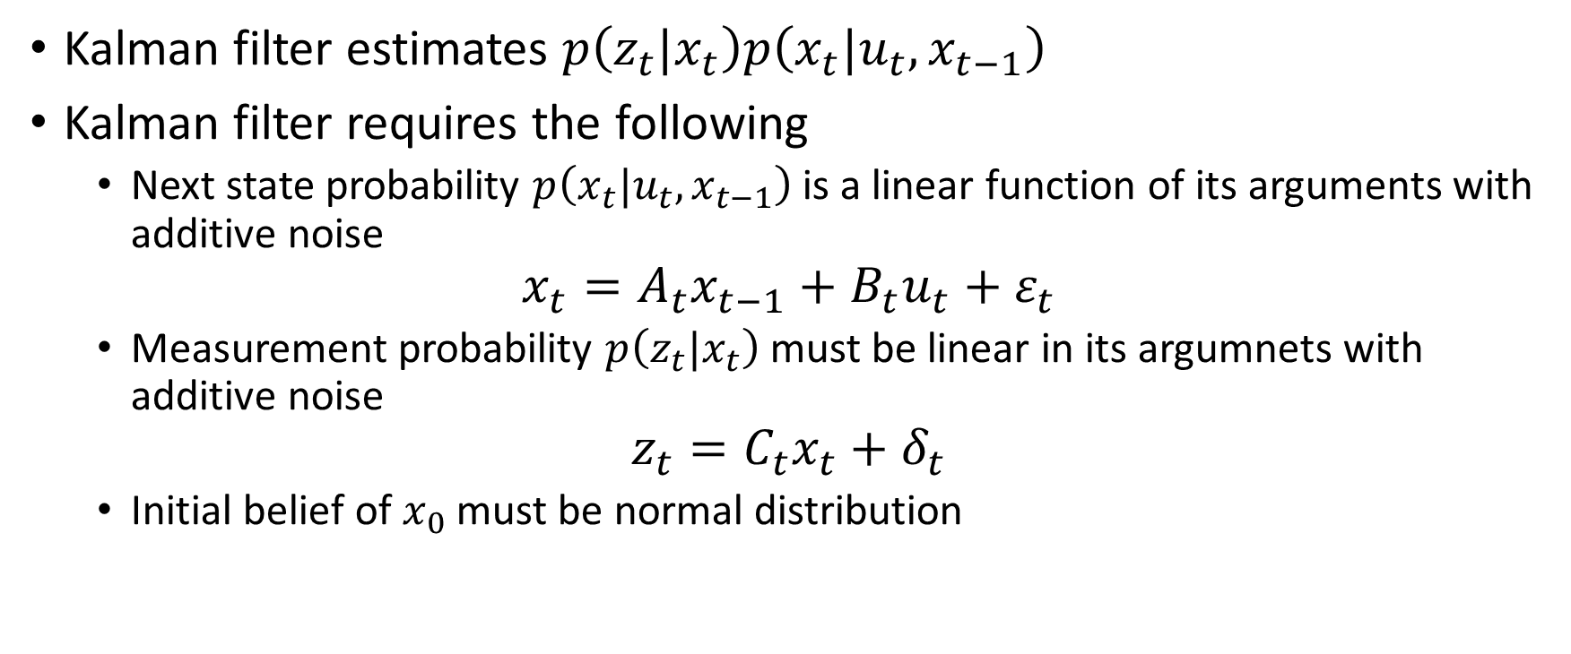
Kalman Filter
Kalman filter estimates $p\left(z_{t}|x_{t}\right)p\left(x_{t}|u_{t},x_{t−1}\right)$
Kalman filter requires the following
Next state probability $p\left(x_{t}|u_{t},x_{t−1}\right)$ is a linear function of its arguments with additive noise
$$x_{t}=A_{t}x_{t−1}+B_{t}u_{t}+ε_{t}$$
Measurement probability $p\left(z_{t}|x_{t}\right)$ must be linear in its argumnets with additive noise
$$z_{t}=C_{t}x_{t}+δ_{t}$$
Initial belief of $x_{0}$ must be normal distribution

Slide 37
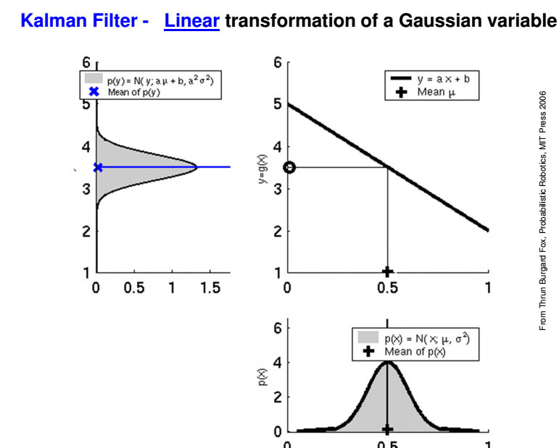

Slide 38
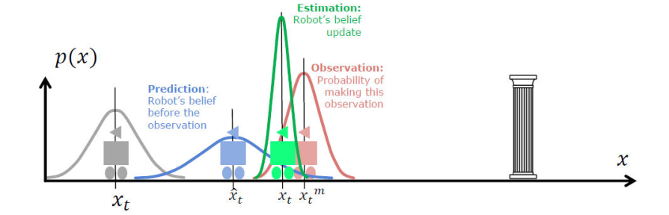
Kalman Filter
Prediction (ACT) based on previous estimate and odometry
Observation (SEE) with on-board sensors
Measurement Prediction based on prediction and map
Matching of observation and map
Estimation position update

Slide 39
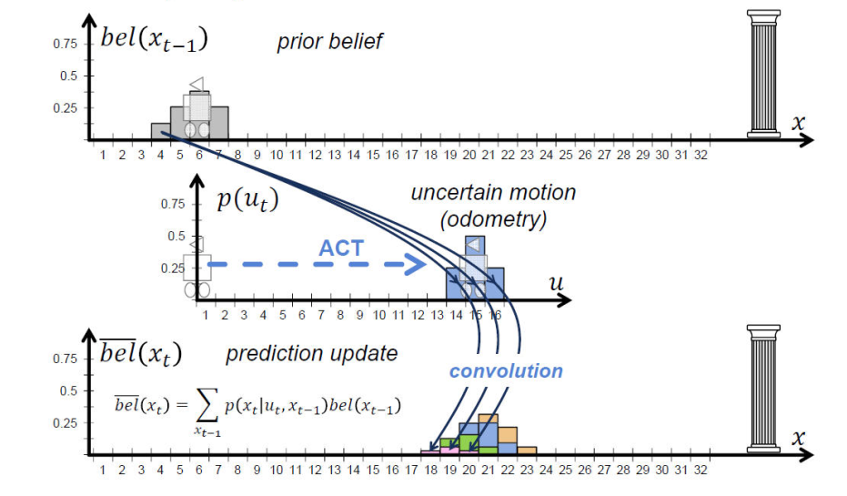
Kalman Filter – ACT – using motion model and its uncertainities

Slide 40
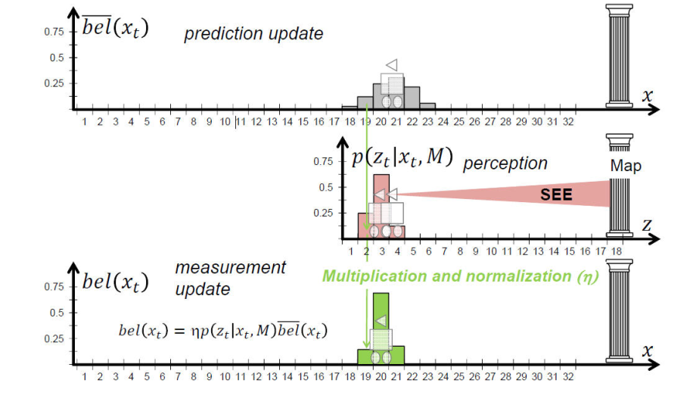
Kalman Filter – SEE – estimation of position based on perception and map

Slide 41
EKF
The assumptions of linear state transitions and linear measurements with added Gaussian noise are rarely fulfilled in practice
For example, a robot that moves with constant translational and rotational velocity typically moves on a circular trajectory, which cannot be described by linear next state transitions
Extended Kalman filter (EKF) overcomes the linearity assumption

Slide 42
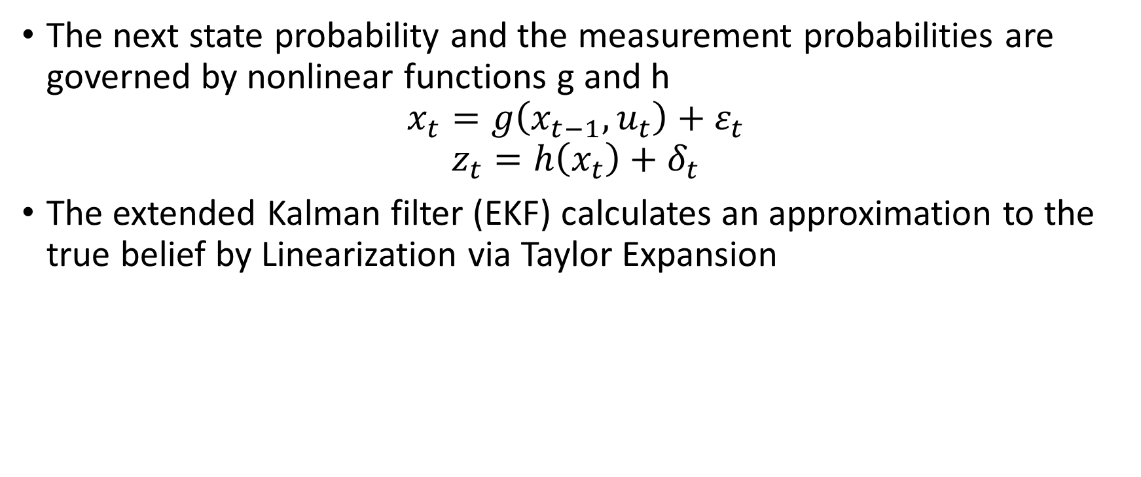
EKF
The next state probability and the measurement probabilities are governed by nonlinear functions g and h
$$x_{t}=g\left(x_{t−1},u_{t}\right)+ε_{t}$$
$$z_{t}=h\left(x_{t}\right)+δ_{t}$$
The extended Kalman filter (EKF) calculates an approximation to the true belief by Linearization via Taylor Expansion

Slide 43
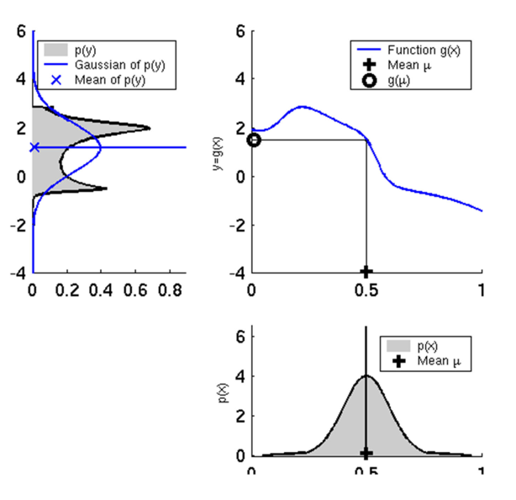
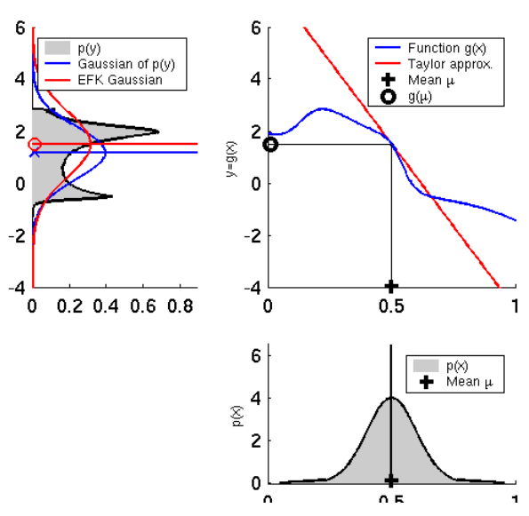
Non-Linear transformation of Gaussian variable
EKF approximation

Slide 44
Combined Odometry
Estimete robot pose based on partial pose measurements from different sources
robot_pose_ekf ROS package uses Extended Kalman filter with 6D model to combine measurements from wheel odometry, IMU sensor and visual odometry

Slide 45
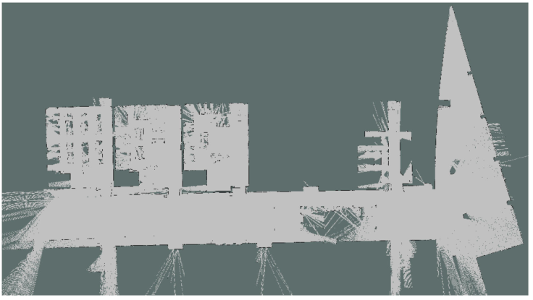
RPE – Laser Scan Matcher - No IMU

Slide 46
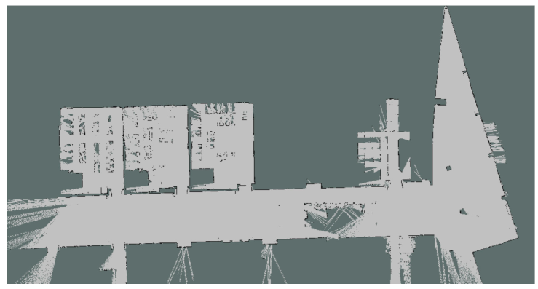
RPE – Laser Scan Matcher + IMU

