Slide 1
Robot Teknolojisine Giriş Yrd. Doç. Dr. Erkan Uslu, Doç. Dr. Sırma Yavuz, Doç. Dr. Fatih Amasyalı, Ar. Grv. Nihal Altuntaş, Ar. Grv. Furkan Çakmak 06

Slide 2
Localization
The robot determines its position in the environment → localization
If one can attach an accurate positioning sensor (For instance a GPS that gives exact position, works indoor/outdoor) to a mobile robot → there would be no such problem as localization
Sensor accuracy is not suffecient, some sensor doesn’t work outdoors, some doesn’t work indoors
Concern can be on global position or relative position

Slide 3
Localization – Odometric Model
Deterministic error sources: (can be eliminated by proper calibration)
Limited resolution (time increment, measurement resolution...)
Misalignment of wheels
Unequal wheel diameter
Wheel contact point variation
Unequal floor contact (slipping, nonplanar surface...)
Non-deterministic error sources :
Range error
Turn error
Drift error
Over time {turn error, drift error} >> {range error}

Slide 4

Localization – Odometric Error Model
Odometric position updates can give only a very rough estimate of the actual position
Owing to integration errors of the uncertainties of $p$ and the motion errors during the incremental motion $\left(Δs_{r}, Δs_{l}\right)$ , the position error based on odometry integration grows with time

Slide 5
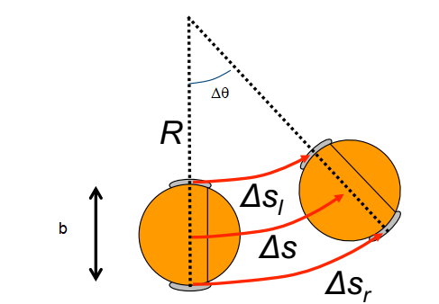
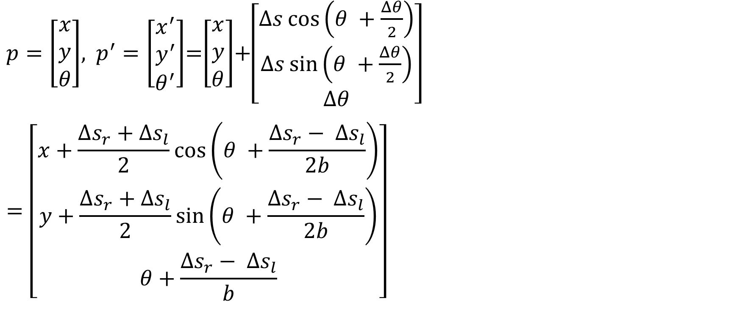
Localization – Odometric Error Model
$p=\left[\begin{matrix}x \\ y \\ θ\end{matrix}\right]$, $p^{′}=\left[\begin{matrix}x^{′} \\ y^{′} \\ θ^{′}\end{matrix}\right]$=$\left[\begin{matrix}x \\ y \\ θ\end{matrix}\right]$+$\left[\begin{matrix}Δs\cos\left(θ +\frac{Δθ}{2}\right) \\ Δs\sin\left(θ +\frac{Δθ}{2}\right) \\ Δθ\end{matrix}\right]$
$$=\left[\begin{matrix}x+\frac{Δs_{r}+Δs_{l}}{2}\cos\left(θ +\frac{Δs_{r}− Δs_{l}}{2b}\right) \\ y+\frac{Δs_{r}+Δs_{l}}{2}\sin\left(θ +\frac{Δs_{r}− Δs_{l}}{2b}\right) \\ θ+\frac{Δs_{r}− Δs_{l}}{b}\end{matrix}\right]$$

Slide 6
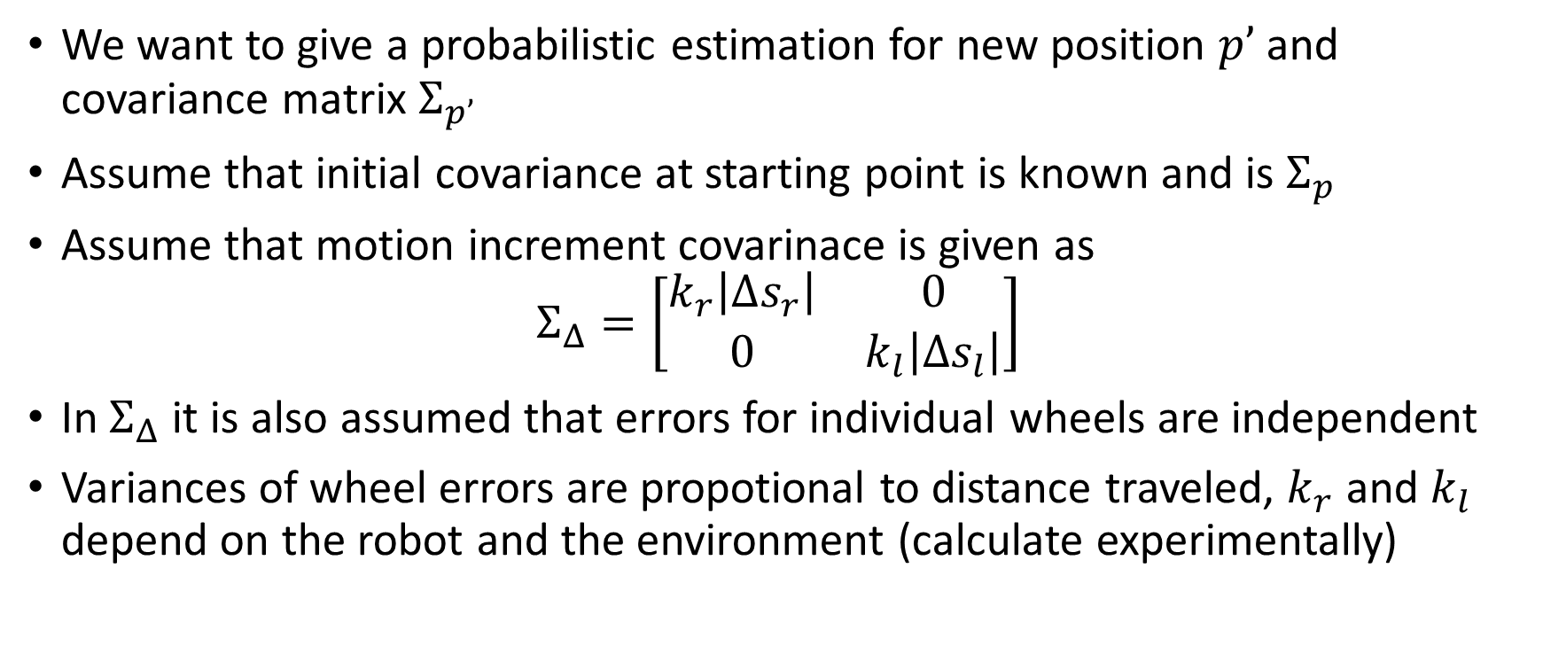
Localization – Odometric Error Model
We want to give a probabilistic estimation for new position $p’$ and covariance matrix $Σ_{p’}$
Assume that initial covariance at starting point is known and is $Σ_{p}$
Assume that motion increment covarinace is given as
$$Σ_{Δ}=\left[\begin{matrix}k_{r}\left|Δs_{r}\right| & 0 \\ 0 & k_{l}\left|Δs_{l}\right|\end{matrix}\right]$$
In $Σ_{Δ}$ it is also assumed that errors for individual wheels are independent
Variances of wheel errors are propotional to distance traveled, $k_{r}$ and $k_{l}$ depend on the robot and the environment (calculate experimentally)

Slide 7
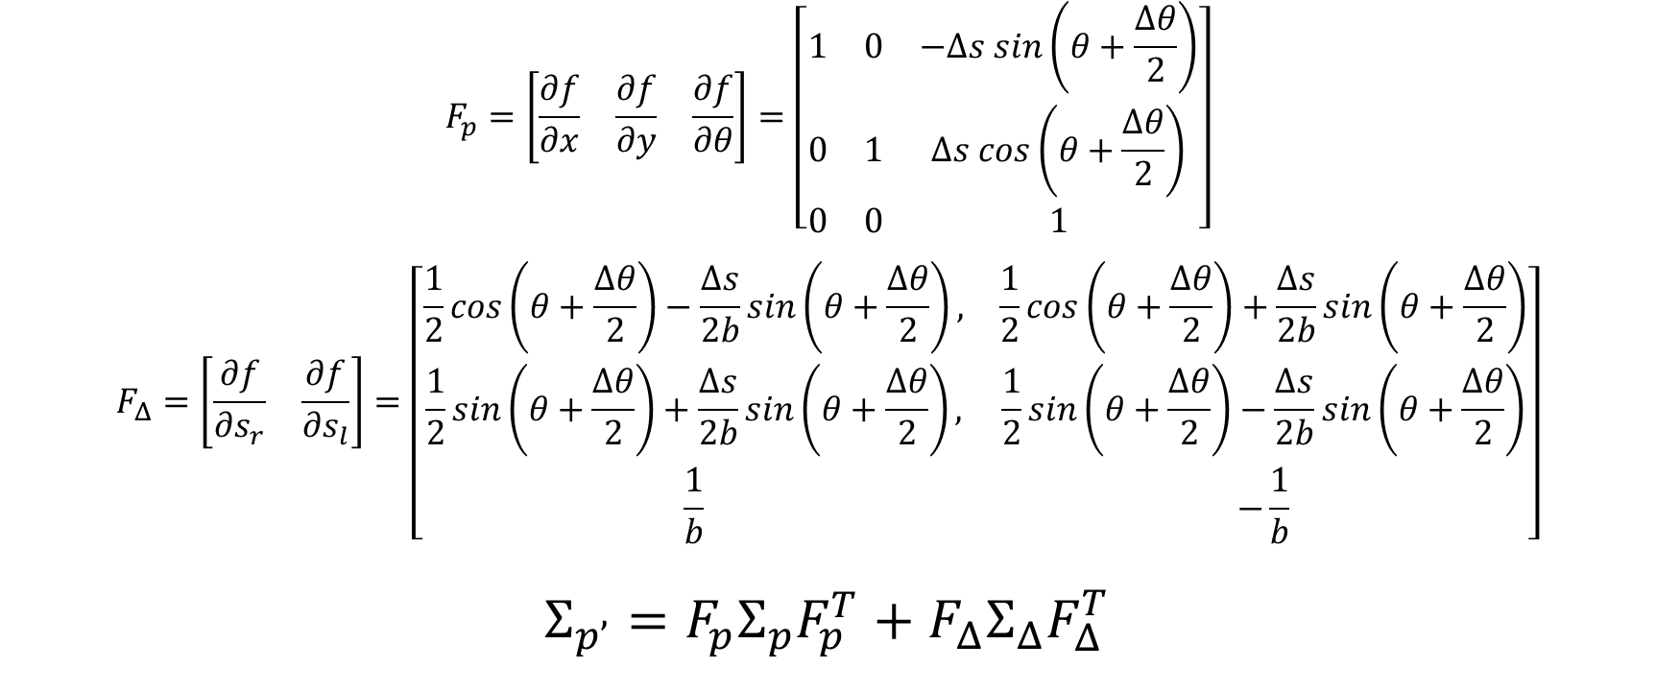
Localization – Odometric Error Model
$$F_{p}=\left[\begin{matrix}\frac{∂f}{∂x} & \frac{∂f}{∂y} & \frac{∂f}{∂θ}\end{matrix}\right]=\left[\begin{matrix}1 & 0 & −Δs sin\left(θ+\frac{Δθ}{2}\right) \\ 0 & 1 & Δs cos\left(θ+\frac{Δθ}{2}\right) \\ 0 & 0 & 1\end{matrix}\right]$$
$$F_{Δ}=\left[\begin{matrix}\frac{∂f}{∂s_{r}} & \frac{∂f}{∂s_{l}}\end{matrix}\right]=\left[\begin{matrix}\frac{1}{2}cos\left(θ+\frac{Δθ}{2}\right)−\frac{Δs}{2b}sin\left(θ+\frac{Δθ}{2}\right), & \frac{1}{2}cos\left(θ+\frac{Δθ}{2}\right)+\frac{Δs}{2b}sin\left(θ+\frac{Δθ}{2}\right) \\ \frac{1}{2}sin\left(θ+\frac{Δθ}{2}\right)+\frac{Δs}{2b}sin\left(θ+\frac{Δθ}{2}\right), & \frac{1}{2}sin\left(θ+\frac{Δθ}{2}\right)−\frac{Δs}{2b}sin\left(θ+\frac{Δθ}{2}\right) \\ \frac{1}{b} & −\frac{1}{b}\end{matrix}\right]$$
$$Σ_{p’}=F_{p}Σ_{p}F_{p}^{T}+F_{Δ}Σ_{Δ}F_{Δ}^{T}$$

Slide 8
Localization – Odometric Error Model – Preliminary

Slide 9
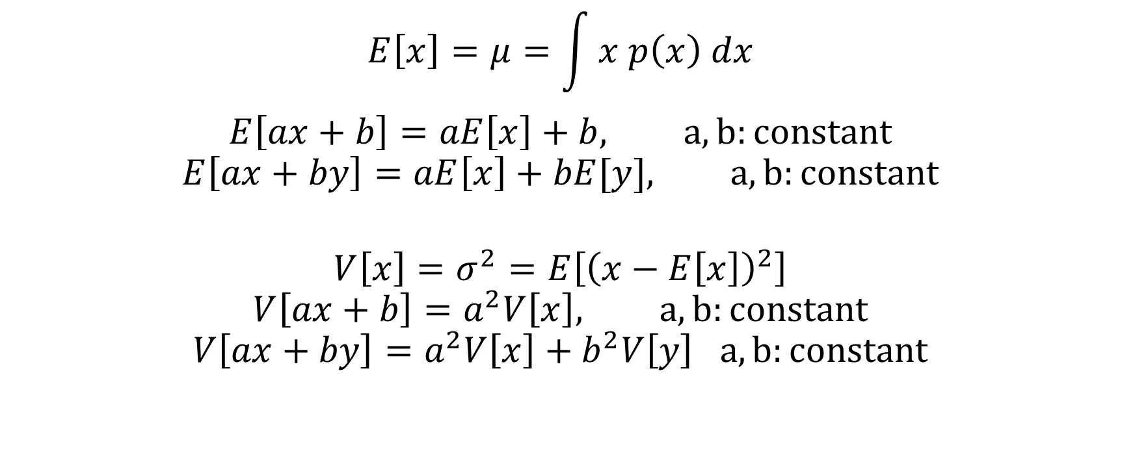

Expected Value and Variance of Linear Functions of Independent Random Variables $x, y$
$$E\left[x\right]=μ=\int{x p\left(x\right) dx}$$
$$E\left[ax+b\right]=aE\left[x\right]+b, a,b:constant$$
$$E\left[ax+by\right]=aE\left[x\right]+bE[y], a,b:constant$$
$$V\left[x\right]=σ^{2}=E\left[{\left(x−E\left[x\right]\right)}^{2}\right]$$
$$V\left[ax+b\right]=a^{2}V\left[x\right], a,b:constant$$
$$V\left[ax+by\right]=a^{2}V\left[x\right]+b^{2}V\left[y\right] a,b:constant$$

Slide 10


Taylor Series Expansion of a Infinitely Differentiable Function at $a$
$$f{\left(x\right)}_{x=a}=f\left(a\right)+\frac{f^{′}\left(a\right)}{1!}\left(x−a\right)+\frac{f^{′′}\left(a\right)}{2!}{\left(x−a\right)}^{2}+\frac{f^{′′′}\left(a\right)}{3!}{\left(x−a\right)}^{3}+…$$
$$f{\left(x\right)}_{x=a}=\sum_{n=0}^{∞}{{\frac{f^{\left(n\right)}\left(a\right)}{n!}\left(x−a\right)}^{n}}$$
$$f{\left(x\right)}_{x=a}≅f\left(a\right)+f^{′}\left(a\right)\left(x−a\right)$$

Slide 11

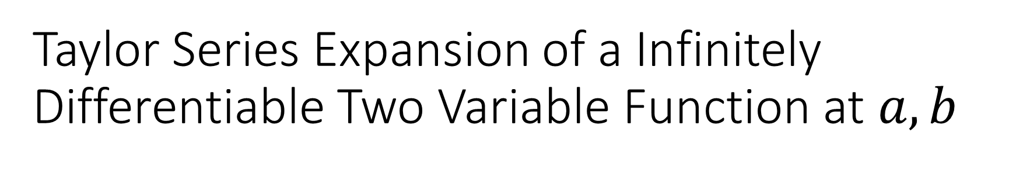
Taylor Series Expansion of a Infinitely Differentiable Two Variable Function at $a,b$
$$f{\left(x,y\right)}_{x=a,y=b}≅f\left(a,b\right)+f_{x}\left(a,b\right)\left(x−a\right)+f_{y}\left(a,b\right)\left(y−b\right)$$

Slide 12
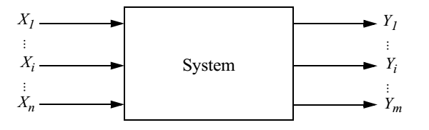
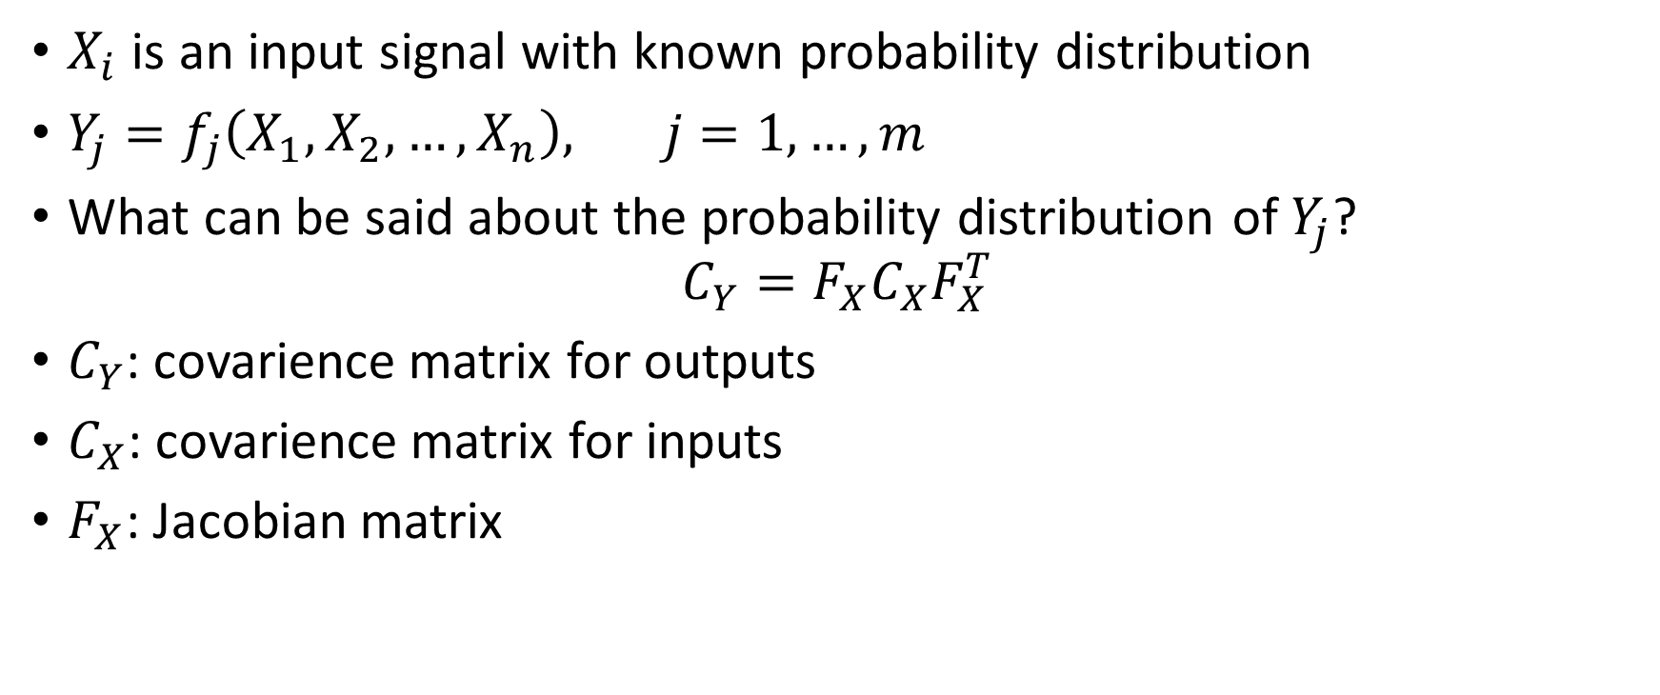

Error propagation: Combining uncertain measurements
$X_{i}$ is an input signal with known probability distribution
$Y_{j}=f_{j}\left(X_{1},X_{2},…,X_{n}\right), j=1,…,m$
What can be said about the probability distribution of $Y_{j}$?
$$C_{Y}=F_{X}C_{X}F_{X}^{T}$$
$C_{Y}$: covarience matrix for outputs
$C_{X}$: covarience matrix for inputs
$F_{X}$: Jacobian matrix
$$F_{X}=\left[\begin{matrix}\frac{∂f_{1}}{∂X_{1}} & ⋯ & \frac{∂f_{1}}{∂X_{n}} \\ ⋮ & ⋱ & ⋮ \\ \frac{∂f_{m}}{∂X_{1}} & ⋯ & \frac{∂f_{m}}{∂X_{n}}\end{matrix}\right]$$

Slide 13
Robot Localization Problem
Robot starts from a precisely known location
Robot is moving in a known environment
Robot can track its motion using odometry (proprioceptive sensor)
Due to odometry uncertainity, robot will become very uncertain about its position
To keep position uncertainity from growing unbounded, robot must localize itself in relation to the map
To localize robot might use its exteroceptive sensors (map+sensor)
Odometry and map+sensor can be combined for localization

Slide 14
Robot Localization Problem
Two step update : prediction (odometry) + perception (map+sensor)
Prediction contributes uncertainity to robots belief
Perception refines belief
Why not only use perception? → Perception optimization would take too long
Probabilistic map-based localization methods:
Markov Localization
Kalman Filter Localization

Slide 15
Robot Localization Problem
Probabilistic map-based localization methods - PDF
Markov Localization
Robot’s belief state can be represented by any arbitrary probability density function
Kalman Filter Localization
Robot’s belief state is represented using a single Gaussian pdf

Slide 16
Robot Localization Problem
Probabilistic map-based localization methods – pro/con
Markov Localization
Starts form any unknown position
Robot tracks multiple position hypothesis
Discrete representation of space
Can recover from any ambiguous situation
Kalman Filter Localization
Starts from an initially known position
Robot can get lost if uncertainity becomes too large
Continuous world representation

Slide 17
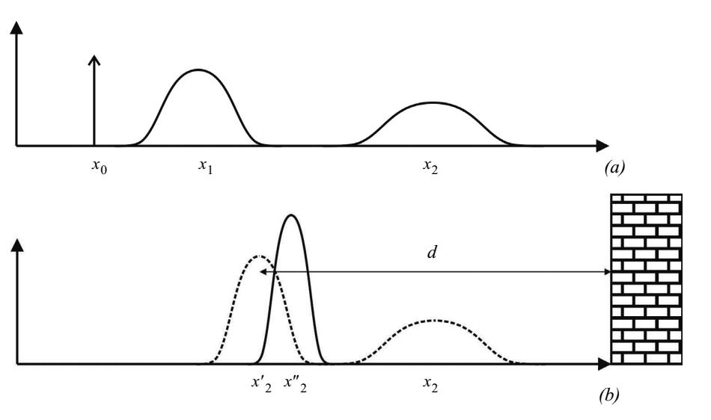
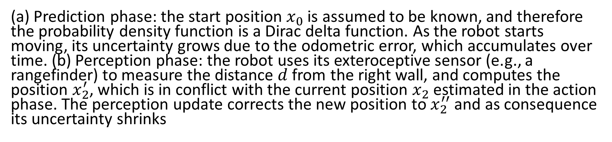
(a) Prediction phase: the start position $x_{0}$ is assumed to be known, and therefore the probability density function is a Dirac delta function. As the robot starts moving, its uncertainty grows due to the odometric error, which accumulates over time. (b) Perception phase: the robot uses its exteroceptive sensor (e.g., a rangefinder) to measure the distance $d$from the right wall, and computes the position $x_{2}^{′}$, which is in conflict with the current position $x_{2}$ estimated in the action phase. The perception update corrects the new position to $x_{2}^{′′}$ and as consequence its uncertainty shrinks

Slide 18
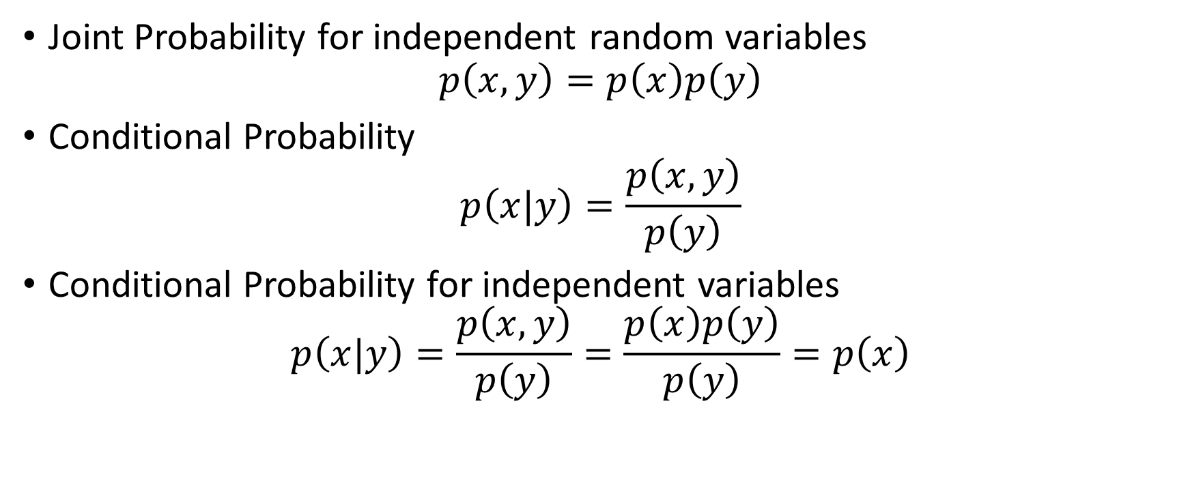
Joint Probability for independent random variables
$$p\left(x,y\right)=p\left(x\right)p\left(y\right)$$
Conditional Probability
$$p\left(x|y\right)=\frac{p\left(x,y\right)}{p\left(y\right)}$$
Conditional Probability for independent variables
$$p\left(x|y\right)=\frac{p\left(x,y\right)}{p\left(y\right)}=\frac{p\left(x\right)p\left(y\right)}{p\left(y\right)}=p\left(x\right)$$

Slide 19
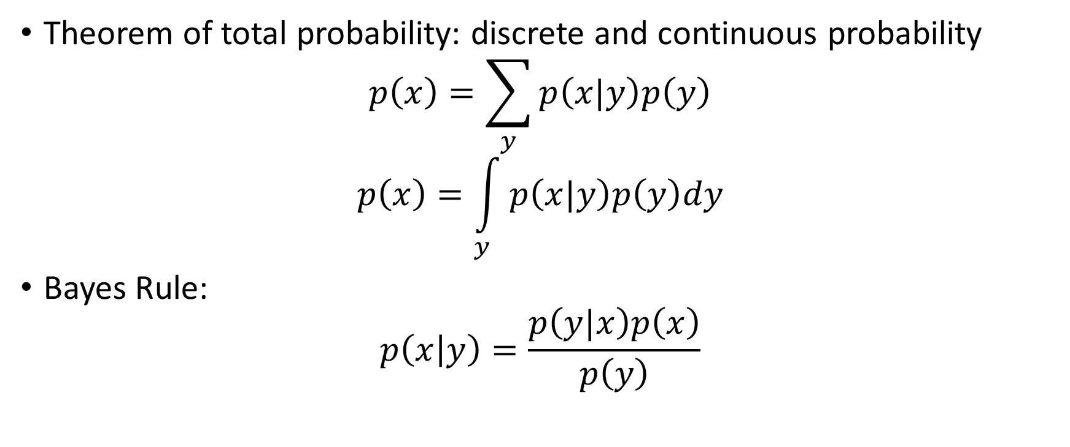
Theorem of total probability: discrete and continuous probability
$$p\left(x\right)=\sum_{y}{p\left(x|y\right)p\left(y\right)}$$
$$p\left(x\right)=\int_{y}^{ }{p\left(x|y\right)p\left(y\right)dy}$$
Bayes Rule:
$$p\left(x | y\right)=\frac{p\left(y|x\right)p\left(x\right)}{p\left(y\right)}$$

Slide 20
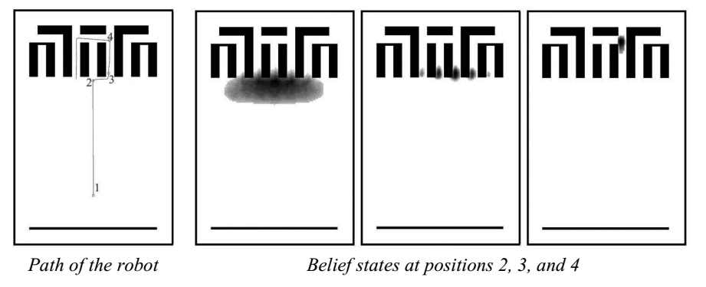
Belief Representation
Robot’s belief model regarding its position on the map → Belief Representaion
Single-hypothesis belief : Robot’s belief about position on the map is a single unique point
Multiple-hypothesis belief : The robot tracks not only just a single possible position but a possibly infinite set of positions

Slide 21
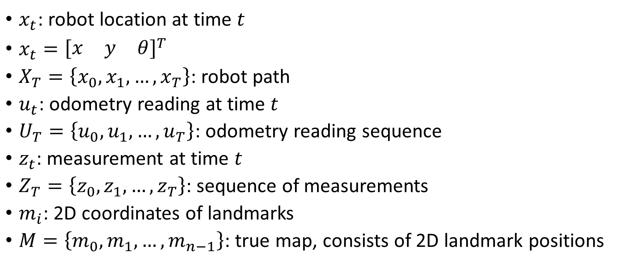
Terminology
$x_{t}$: robot location at time $t$
$x_{t}={\left[\begin{matrix}x & y & θ\end{matrix}\right]}^{T}$
$X_{T}=\left\{x_{0},x_{1},…,x_{T}\right\}$: robot path
$u_{t}$: odometry reading at time $t$
$U_{T}=\left\{u_{0},u_{1},…,u_{T}\right\}$: odometry reading sequence
$z_{t}$: measurement at time $t$
$Z_{T}=\left\{z_{0},z_{1},…,z_{T}\right\}$: sequence of measurements
$m_{i}$: 2D coordinates of landmarks
$M=\left\{m_{0},m_{1},…,m_{n−1}\right\}$: true map, consists of 2D landmark positions

Slide 22
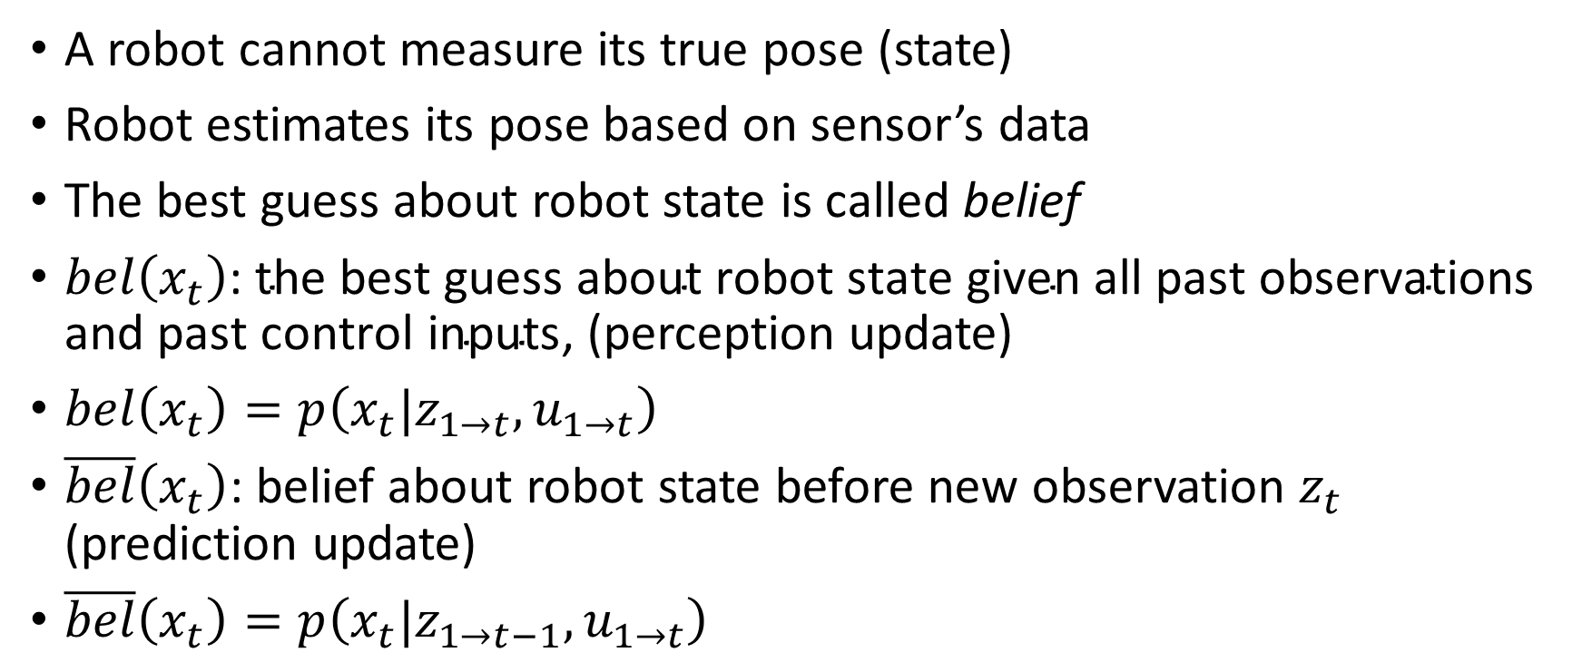
Belief Distributions
A robot cannot measure its true pose (state)
Robot estimates its pose based on sensor’s data
The best guess about robot state is called belief
$bel\left(x_{t}\right)\text{: }\text{the} \text{best} \text{guess} \text{about} \text{robot} \text{state} \text{given} \text{all} \text{past} \text{observations} \text{and} \text{past} \text{control} \text{inputs}$, (perception update)
$bel\left(x_{t}\right)=p\left(x_{t}|z_{1→t},u_{1→t}\right)$
$\overline{bel}\left(x_{t}\right)$: belief about robot state before new observation $z_{t}$ (prediction update)
$\overline{bel}\left(x_{t}\right)=p\left(x_{t}|z_{1→t−1},u_{1→t}\right)$

Slide 23
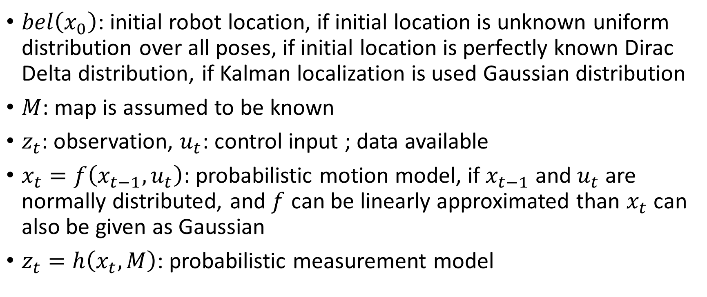
Probabilistic Map-Based Localization Terminology
$bel\left(x_{0}\right)$: initial robot location, if initial location is unknown uniform distribution over all poses, if initial location is perfectly known Dirac Delta distribution, if Kalman localization is used Gaussian distribution
$M$: map is assumed to be known
$z_{t}$: observation, $u_{t}$: control input ; data available
$x_{t}=f\left(x_{t−1},u_{t}\right)$: probabilistic motion model, if $x_{t−1}$ and $u_{t}$ are normally distributed, and $f$ can be linearly approximated than $x_{t}$ can also be given as Gaussian
$z_{t}=h\left(x_{t},M\right)$: probabilistic measurement model

Slide 24
Classification of Localization Problems
Position tracking : initial location is assumed to be known, position is updated based on previous position
Global localization : initial location may be unknown, localize globally
Kidnapped robot problem : problem defined when robot is kidnapped and moved to another location, same as global localization if robot realizes having been kidnapped, it is difficult to realize being moved

Slide 25
Markov Localization
Markov localization can use an arbitrary probability density function for robot’s pose belief
This is achieved with discrete number of possibel robot poses
Markov localization addresses global localization, position tracking and kidnapped robot problem
Markov localization = Bayes Filter

Slide 26
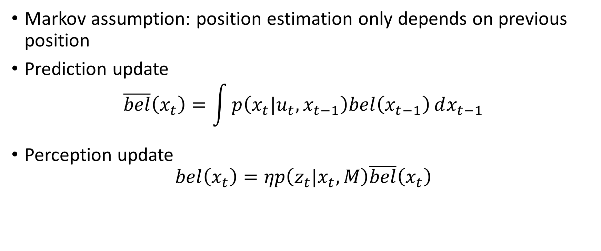
Markov Localization
Markov assumption: position estimation only depends on previous position
Prediction update
$$\overline{bel}\left(x_{t}\right)=\int{p\left(x_{t}|u_{t},x_{t−1}\right)bel\left(x_{t−1}\right)ⅆx_{t−1}}$$
Perception update
$$bel\left(x_{t}\right)=ηp\left(z_{t}|x_{t},M\right)\overline{bel}\left(x_{t}\right)$$

Slide 27
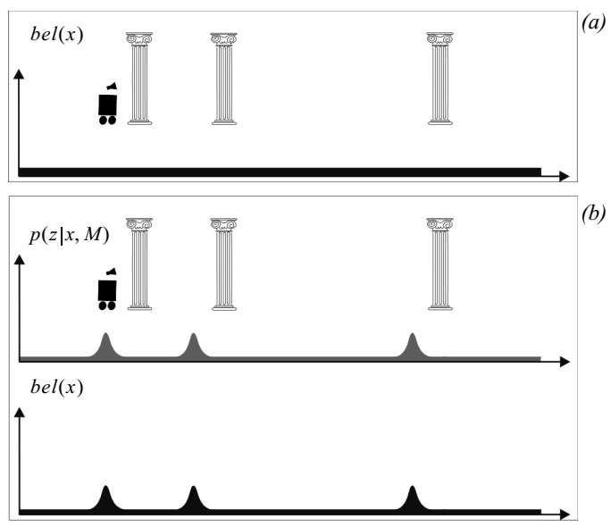
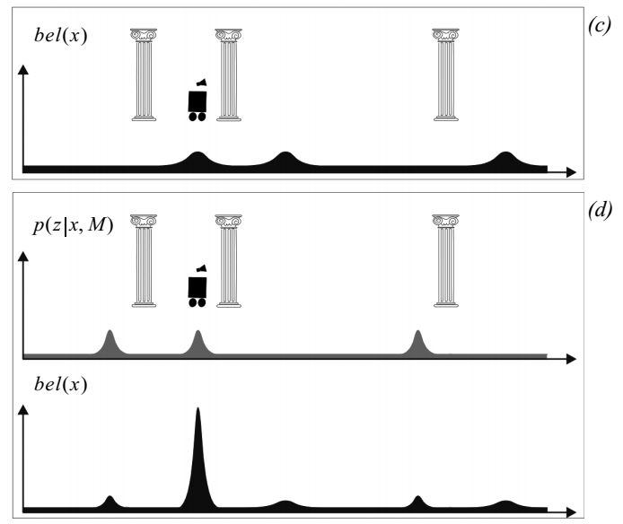
Illustration of Markov Localization

Slide 28
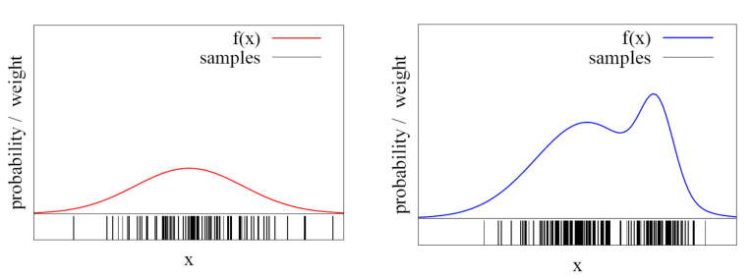

Monte Carlo Localization
Represent belief by a set of discrete weighted samples
$bel\left(x\right)=\left\{\left(ℓ_{1},ω_{1}\right),\left(ℓ_{2},ω_{2}\right),…,\left(ℓ_{m},ω_{m}\right)\right\}$
$ℓ_{i}$: represent location
$ω_{i}$: importance factor

Slide 29
Monte Carlo Localization - MCL
Markov localization is the foundation of MCL
MCL uses random weighted samples
Each particel is a potential pose of the robot
Proposal distribution is the motion model of the robot
Observation model is used to compute importance weight
Example MCL

Slide 30
Kalman Filter Localization
Prediction update: Gaussian error motion model
Measuremement update :
Observation step
Measurement prediction
Matching step
Estimation step

Slide 31

Kalman Filter Localization - Prediction update
$\hat{x_{t}}=f\left(x_{t−1},u_{t}\right)$ : the position is estimated by the motion model,
$\hat{P_{t}}=F_{x}P_{t−1}F_{x}^{T}+F_{u}Q_{t}F_{u}^{T}$ : variance of the estimated position

Slide 32
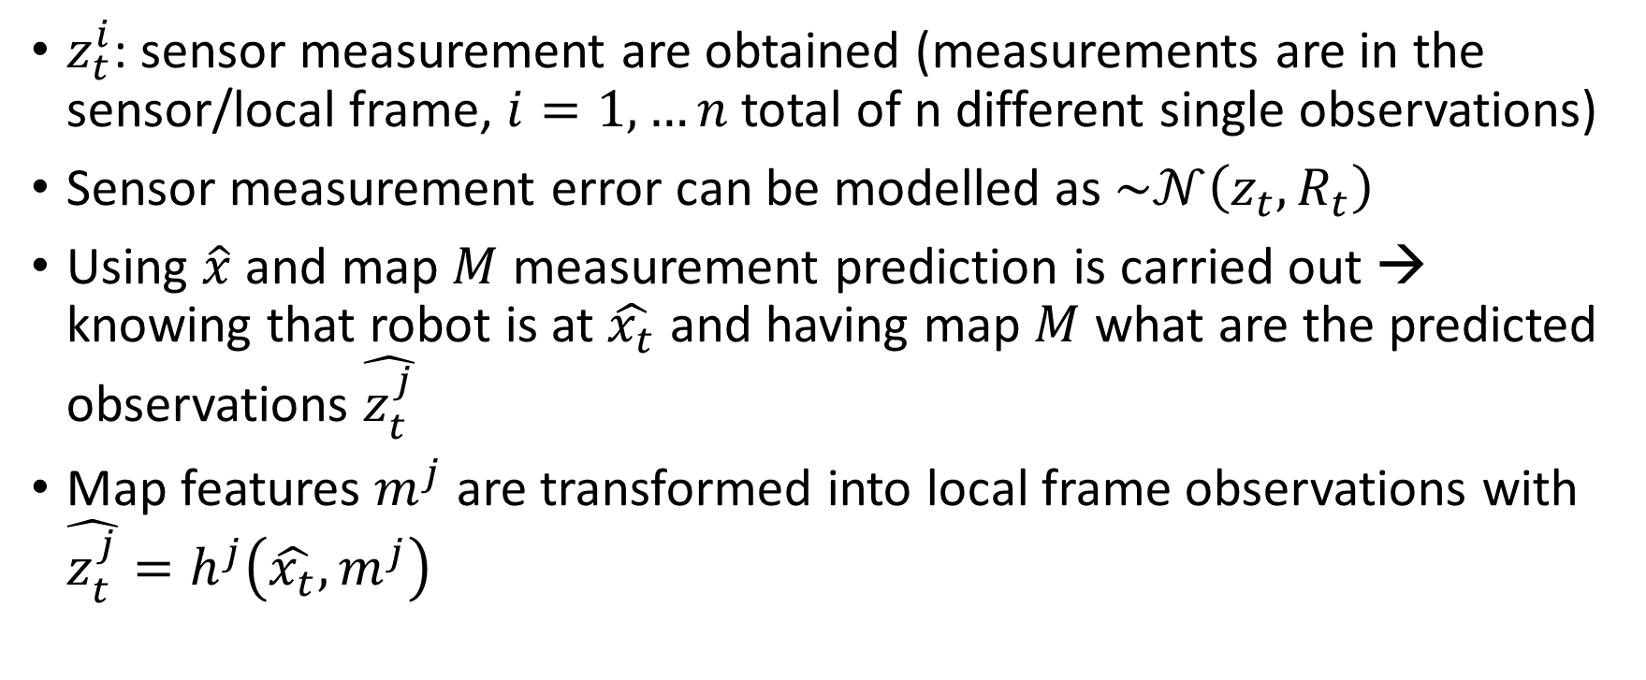
Kalman Filter Localization - Measurement Update
$z_{t}^{i}$: sensor measurement are obtained (measurements are in the sensor/local frame, $i=1,…n$ total of n different single observations)
Sensor measurement error can be modelled as $\sim 𝒩\left(z_{t},R_{t}\right)$
Using $\hat{x}$ and map $M$ measurement prediction is carried out → knowing that robot is at $\hat{x_{t}}$ and having map $M$ what are the predicted observations $\hat{z_{t}^{j}}$
Map features $m^{j}$ are transformed into local frame observations with $\hat{z_{t}^{j}}=h^{j}\left(\hat{x_{t}},m^{j}\right)$

Slide 33
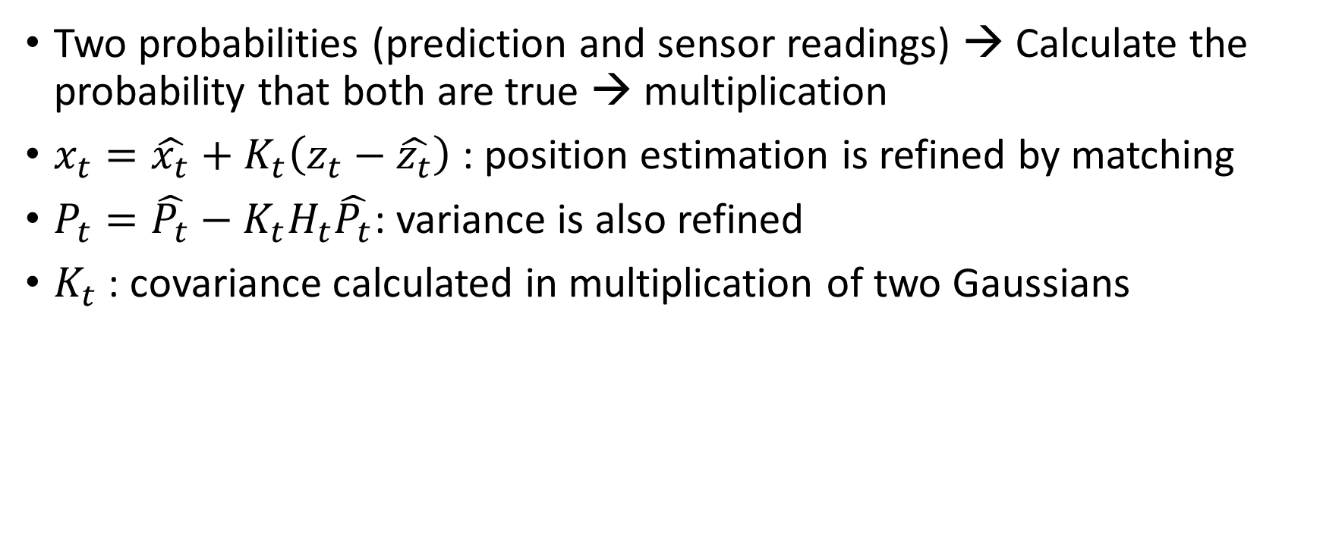
Kalman Filter Localization - Measurement Update
Two probabilities (prediction and sensor readings) → Calculate the probability that both are true → multiplication
$x_{t}=\hat{x_{t}}+K_{t}\left(z_{t}−\hat{z_{t}}\right)$ : position estimation is refined by matching
$P_{t}=\hat{P_{t}}−K_{t}H_{t}\hat{P_{t}}$: variance is also refined
$K_{t}$ : covariance calculated in multiplication of two Gaussians

Slide 34
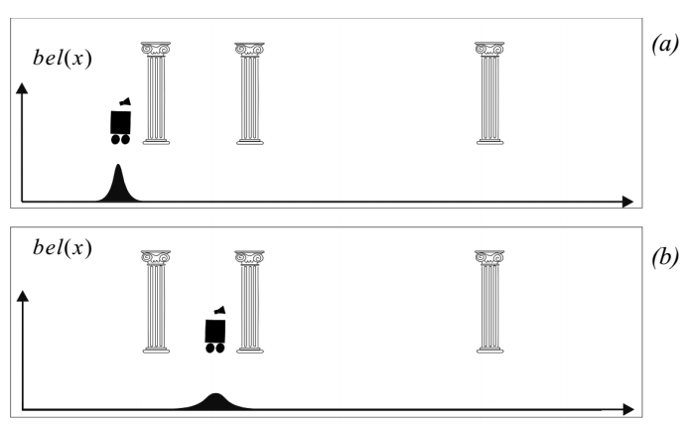
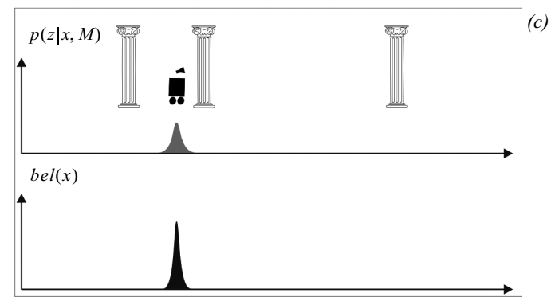
Illustration of Kalman Filter Localization

Slide 35
Landmark-based Localization
Requires significant environmental modification → placement of predefined landmarks
When a landmark is in the field of view of the robot localization is frequent and accurate
Between landmarks robot uses dead-reckoning

Slide 36
Globally Unique Localization
Robot with camera can use bag of features (local features) and search the dataset for the most similar image
Robot with a laser scanner can use angular histogram and search the dataset for the most similar position

Slide 37
Positioning Beacon Systems
Requires deploying an active beacon system or retroreflective markers
Given known position of the active/passive beacons one can identify its position

Slide 38
Route-based Localization
In cases robot moves only within a predefined path, markings on the path (magnetic, reflective,...) enable localization

