Slide 1
Robot Teknolojisine Giriş Yrd. Doç. Dr. Erkan Uslu, Doç. Dr. Sırma Yavuz, Doç. Dr. Fatih Amasyalı, Ar. Grv. Nihal Altuntaş, Ar. Grv. Furkan Çakmak 07

Slide 2
Path Planning
Given
a START pose,
a desired GOAL pose,
a geometric description of the ROBOT and
a geometric description of the WORLD
find a path that moves the robot gradually from start to goal.

Slide 3
Configuration Space – Robot Arm
Suppose a robot arm has k degrees of freedom
Every state of the robot arm can be described with k-real values
K-values representing a point in the k dimensional space : configuration space

Slide 4
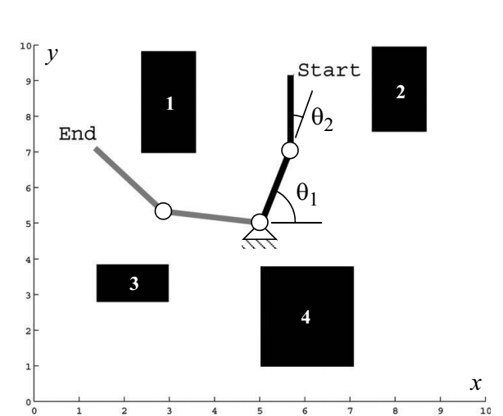
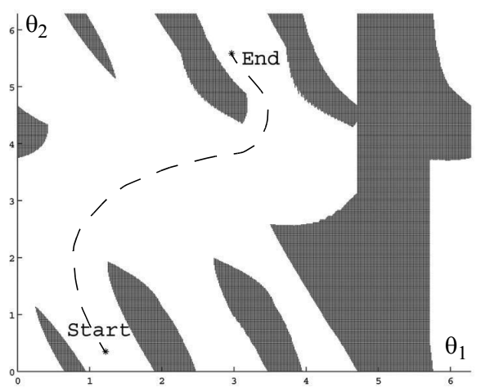
Configuration Space – Robot Arm

Slide 5
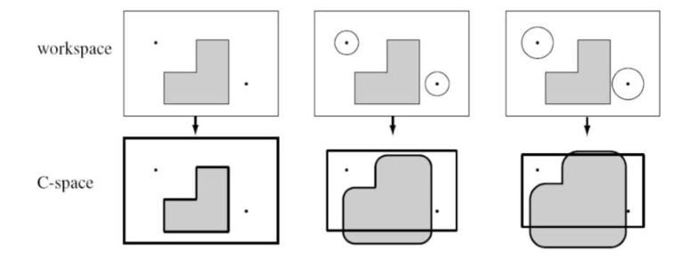
Configuration Space – Mobile Robot
Assume robot is simply a point
Each obstacle is inflated by the size of robots radius

Slide 6
Path Planning
Graph Search
Graph Construction
Visibility Graph
Voronoi Diagram
Exact Cell Decomposition
Approximate Cell Decomposition
Deterministic Graph Search
Breadth-First Search
Depth-First Search
Dijkstra’s Algorithm
A*
D*
Randomized Graph Search
Rapidly Exploring Random Trees
Potential Field Path Planning

Slide 7
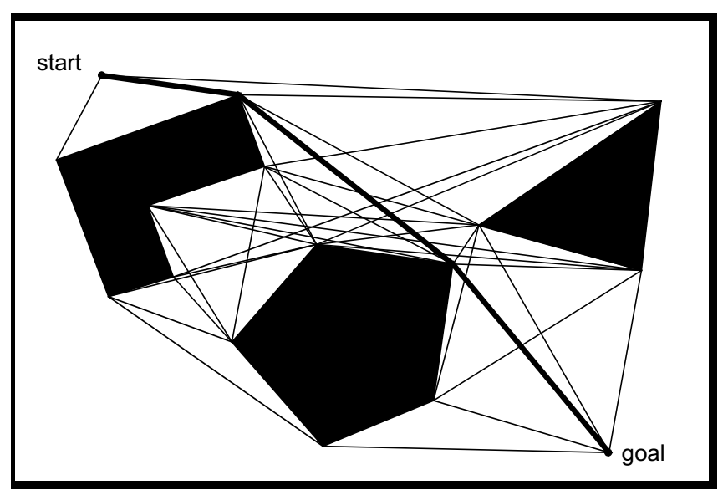
Visibility Graph
Vertices of the graph are:
Start
Goal
Vertices of the obstacles visible from each other
Visibility graphs are optimal in terms of path length

Slide 8
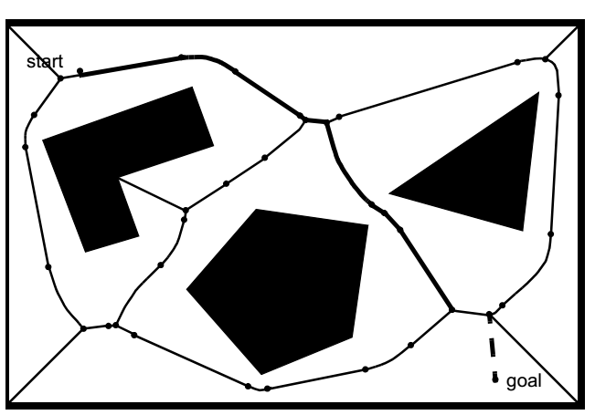
Voronoi Digram
Maximize the distance between the robot and the obstacles
Diagram points are equidistant from two or more obstacles

Slide 9
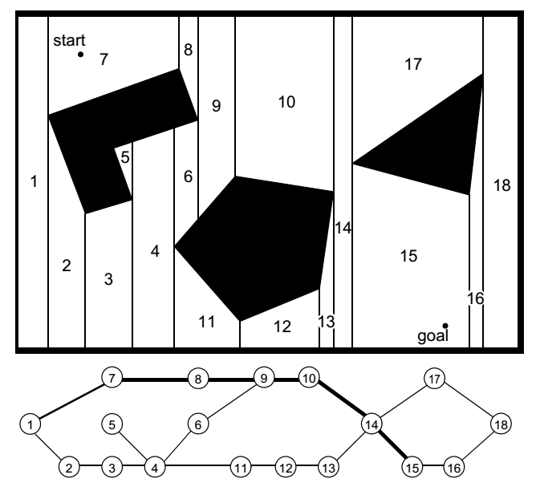
Exact Cell Decomposition
Cell boundaries are based geometric criticality
In extremely sparse environmets representation is efficient

Slide 10
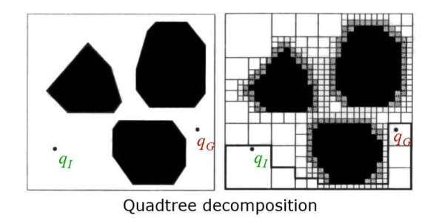
Approximate Cell Decomposition
Approximate Cell Decomposition uses cells with the same simple pre defined shape in different scale

Slide 11
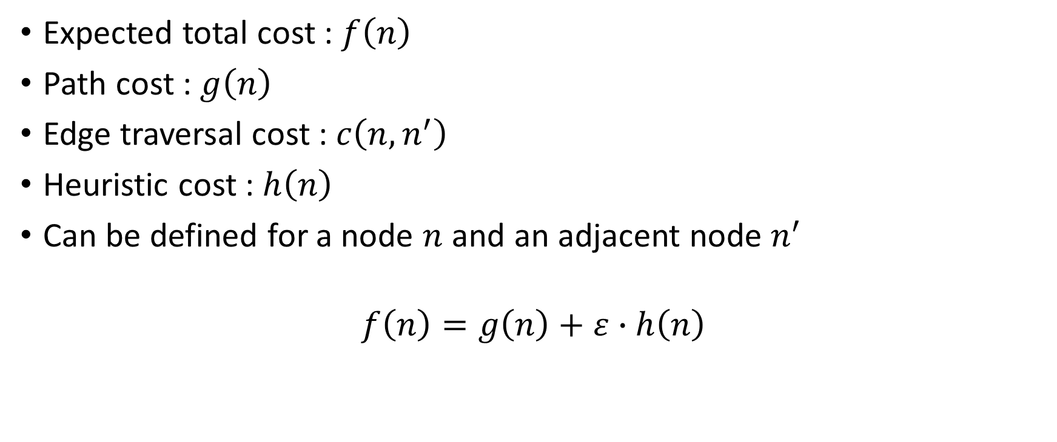
Deterministic Graph Search
Expected total cost : $f\left(n\right)$
Path cost : $g\left(n\right)$
Edge traversal cost : $c\left(n,n^{′}\right)$
Heuristic cost : $h\left(n\right)$
Can be defined for a node $n$ and an adjacent node $n^{′}$
$$f\left(n\right)=g\left(n\right)+ε∙h\left(n\right)$$

Slide 12
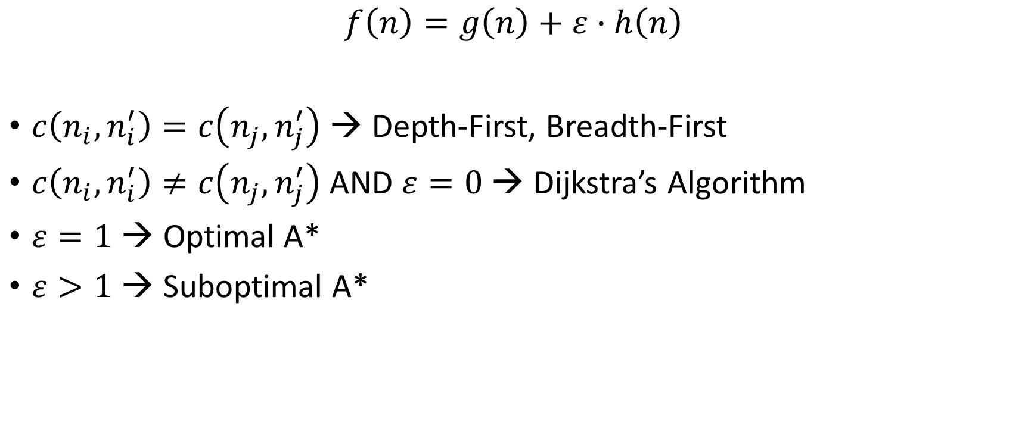
Deterministic Graph Search
$$f\left(n\right)=g\left(n\right)+ε∙h\left(n\right)$$
$c\left(n_{i},n_{i}^{′}\right)=c\left(n_{j},n_{j}^{′}\right)$ → Depth-First, Breadth-First
$c\left(n_{i},n_{i}^{′}\right)≠c\left(n_{j},n_{j}^{′}\right)$ AND $ε=0$ → Dijkstra’s Algorithm
$ε=1$ → Optimal A*
$ε>1$ → Suboptimal A*

Slide 13
Breadth-First Search
Algorithm begins with the start node
Explores all of its neighboring nodes
Then, for each of these nodes, it explores all their unexplored neighbors and so on.
This process goes as, marking a node “active”, exploring each of its neighbors and marking them “open”, and finally marking the parent node “visited
The algorithm proceeds until it reaches the goal node where it terminates.

Slide 14
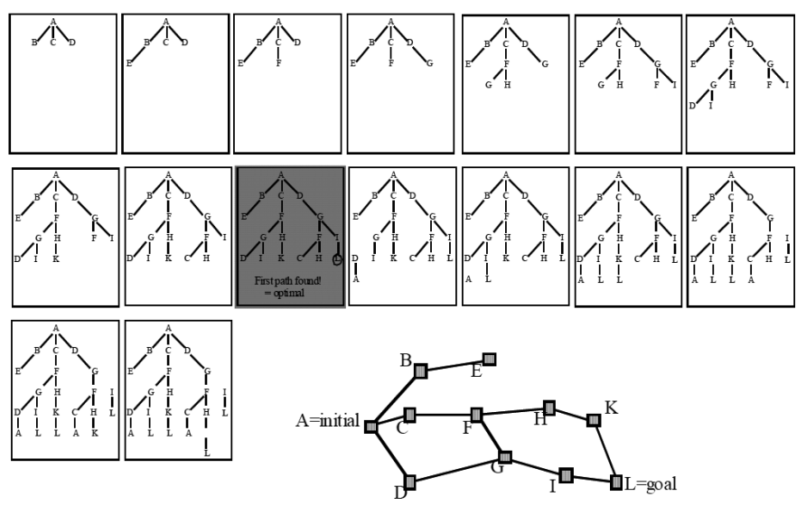
Breadth-First Search

Slide 15
Depth-First Search
Depth-first search expands each node up to the deepest level of the graph
May provide non optimal solutions
May have better space complexity compared to breadth-first search

Slide 16
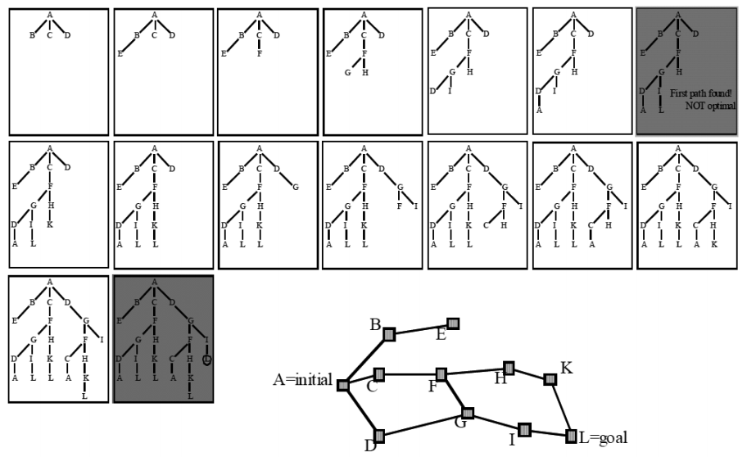
Depth-First Search

Slide 17
Dijkstra’s Algorithm
Similar to breadth-first search
Edge costs may assume any positive value
Guarantees solution optimality
No heuristic is used
Is a greedy algorithm yet produces an optimal solution

Slide 18
Dijkstra’s Algorithm

Slide 19
A*
Similar to Dijkstra
Includes an underestimated function of the cost to go
Heuristic function is the distance from any node to goal

Slide 20
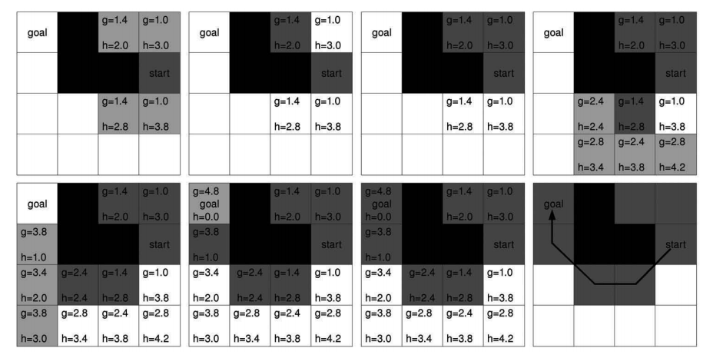

Slide 21
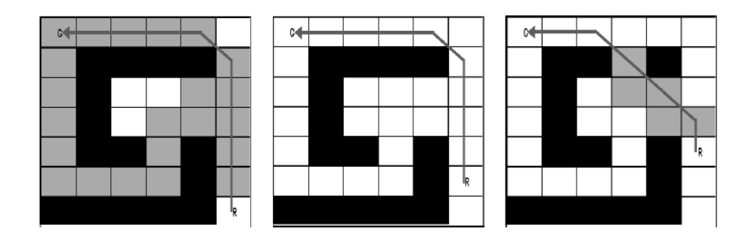
D*
Incremental replanning version of A*
From start to goal A* path is calculated
If a change occures, instead of calculating path from scratch, only effected states are recomputed

Slide 22
Rapidly Exploring Random Trees
Doesn’t require graph decomposition
Obstacle map is required
RRTs grow a graph online during search
Random nodes are generated and edges are grown from nearest nodes to randomly generated nodes
Solution optimality is not guaranteed
Deterministic completeness is not guaranteed

Slide 23
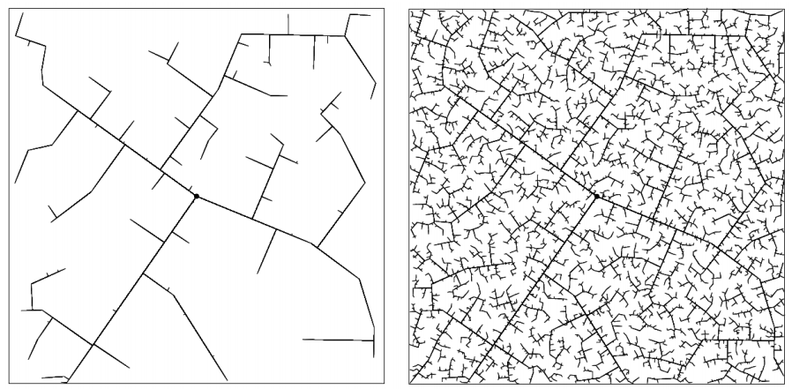
Rapidly Exploring Random Trees

Slide 24
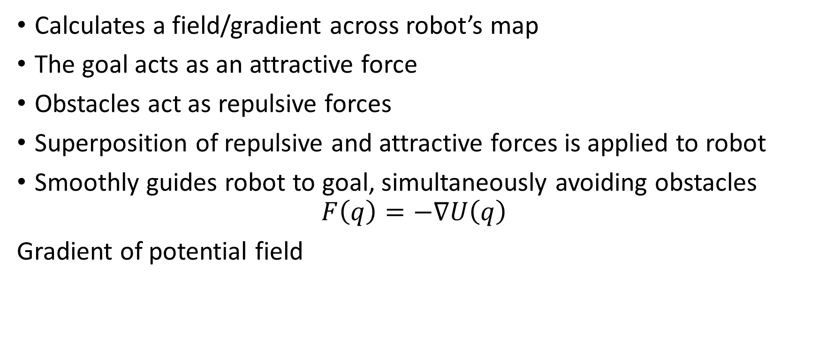
Potential Field Path Planning
Calculates a field/gradient across robot’s map
The goal acts as an attractive force
Obstacles act as repulsive forces
Superposition of repulsive and attractive forces is applied to robot
Smoothly guides robot to goal, simultaneously avoiding obstacles
$$F\left(q\right)=−∇U\left(q\right)$$
Gradient of potential field

Slide 25
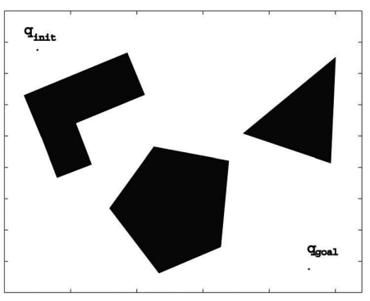
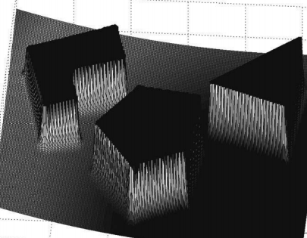
Potential Field Path Planning

