Slide 1
Robot Teknolojisine Giriş Yrd. Doç. Dr. Erkan Uslu, Doç. Dr. Sırma Yavuz, Doç. Dr. Fatih Amasyalı, Ar. Grv. Nihal Altuntaş, Ar. Grv. Furkan Çakmak 09

Slide 2
Obstacle Avoidance
Obstacle avoidance: move the vehicle towards the target free of collisions
Changing robots trajectory according to sensors during robot motion
New trajectory is calculated as a function of current and recent sensor readings, goal position and relative location to the goal
Compared to path planning, obstacle avoidance introduces sensor data within the control loop
Obstacle avoidance is the local point of view for motion planning

Slide 3
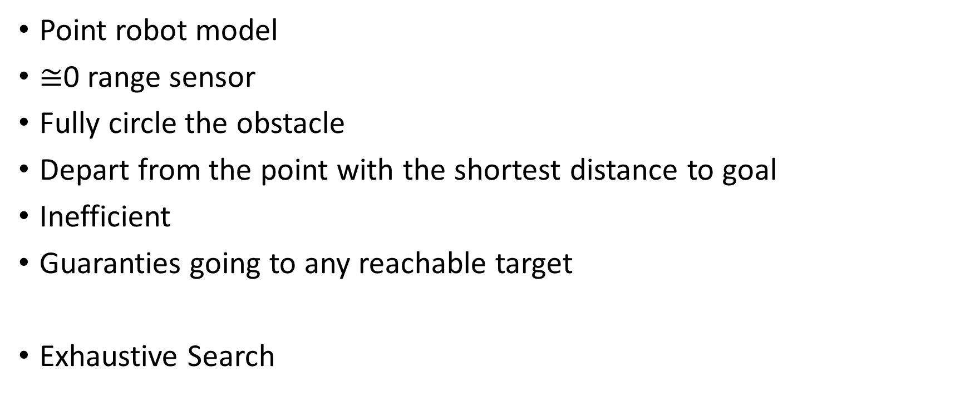
Bug 1
Point robot model
$≅$0 range sensor
Fully circle the obstacle
Depart from the point with the shortest distance to goal
Inefficient
Guaranties going to any reachable target
Exhaustive Search

Slide 4
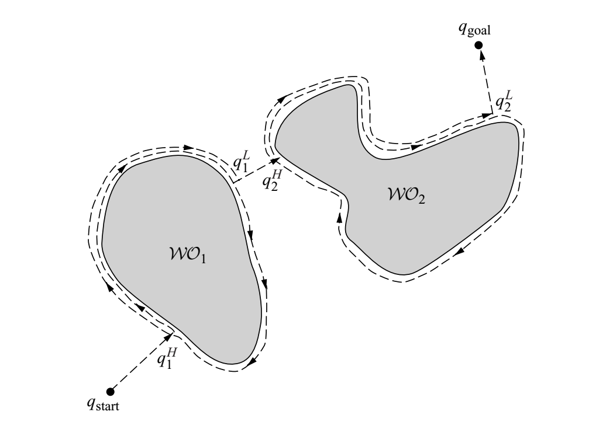
Bug 1

Slide 5
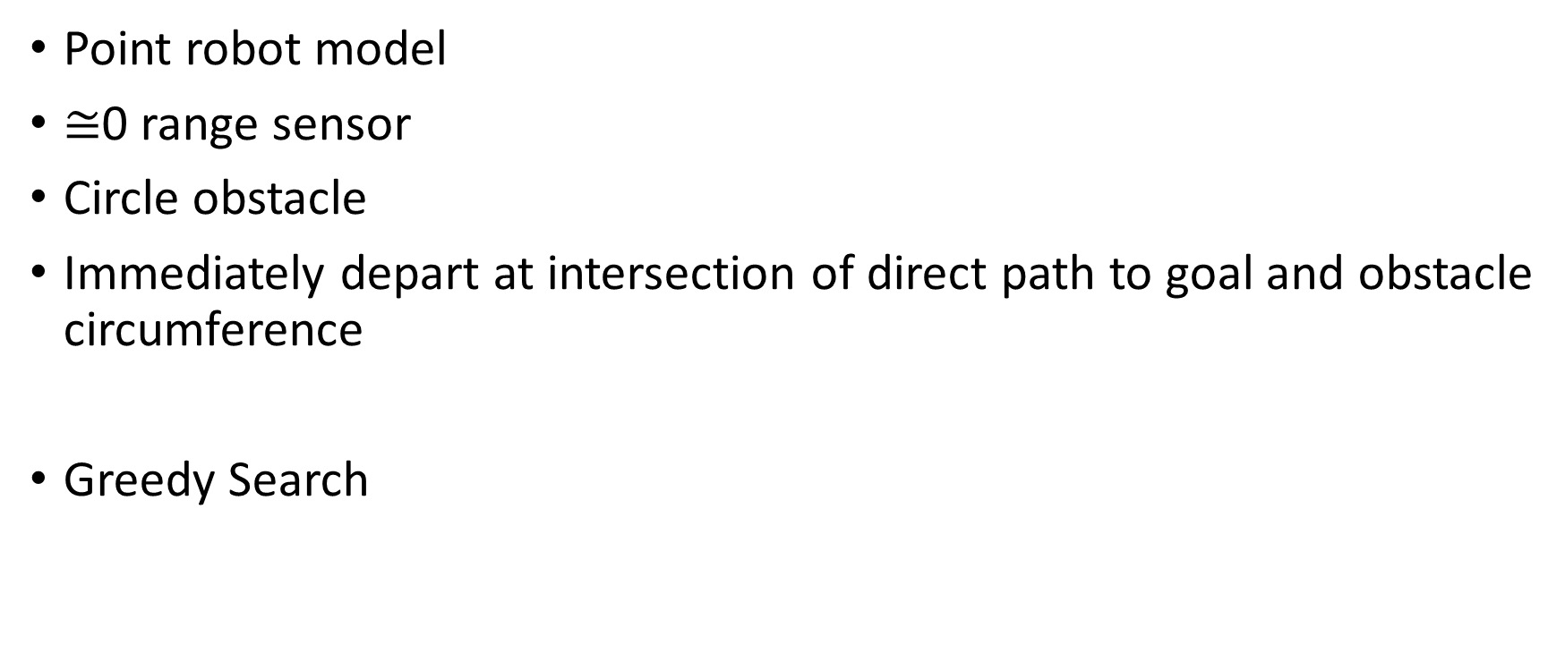
Bug 2
Point robot model
$≅$0 range sensor
Circle obstacle
Immediately depart at intersection of direct path to goal and obstacle circumference
Greedy Search

Slide 6
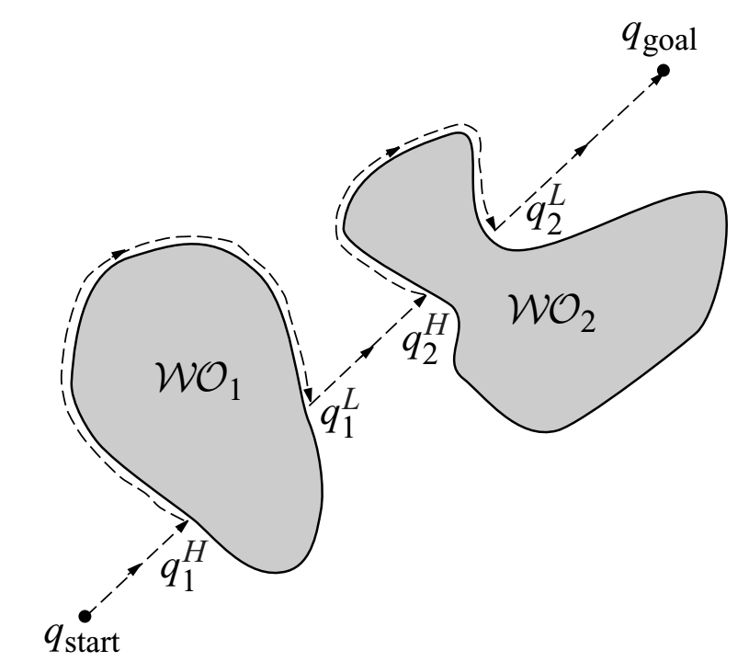
Bug 2

Slide 7
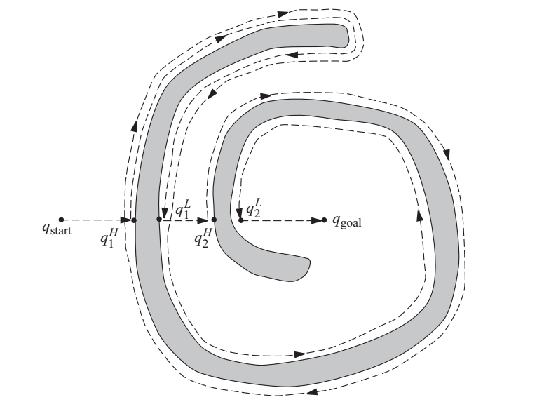
Bug 2

Slide 8

Tangent Bug
Point robot model
360 degree, infinite orientation resolution sensor with range $d$
Circulate obstacle with move-to-goal approach
Leave the obstacle at target-obstacle tangent point

Slide 9
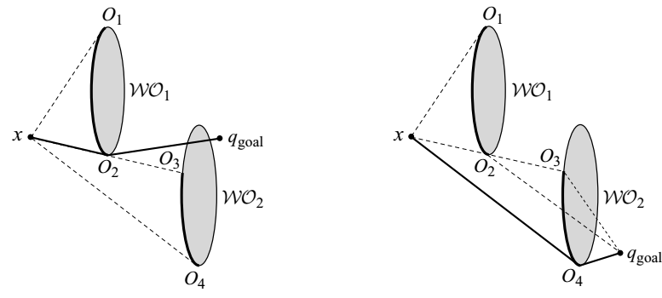
Tangent Bug - Subgoal

Slide 10
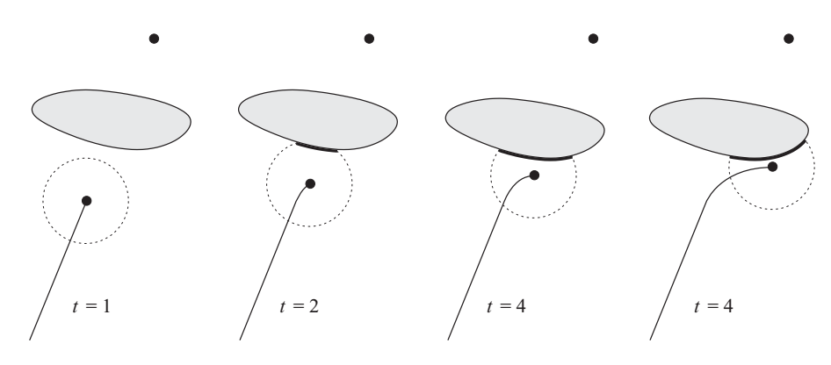
Tangent Bug – Move-to-Goal
3

Slide 11
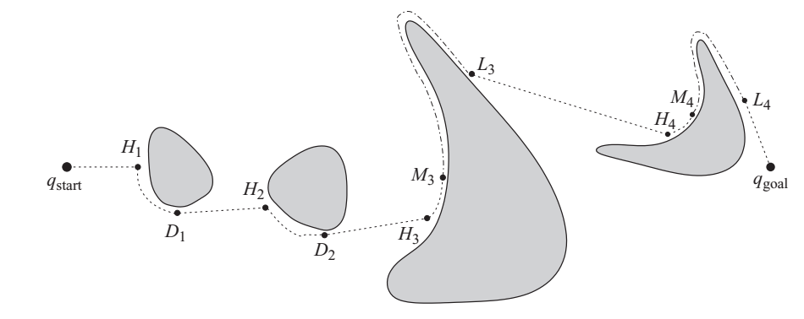

Tangent Bug (range $d≅0$)

Slide 12
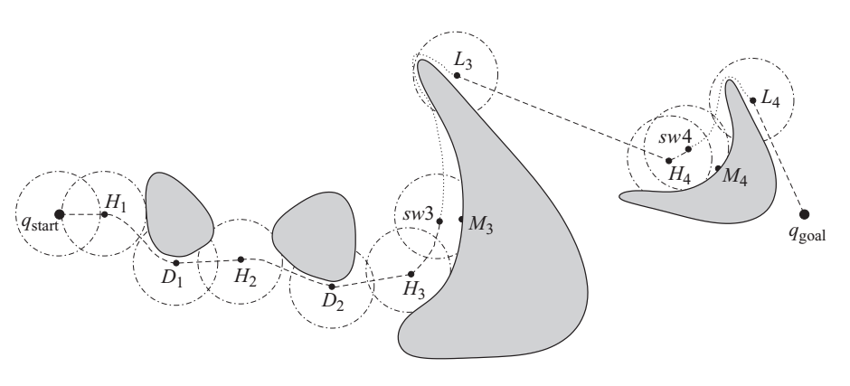

Tangent Bug (range $d$)

Slide 13
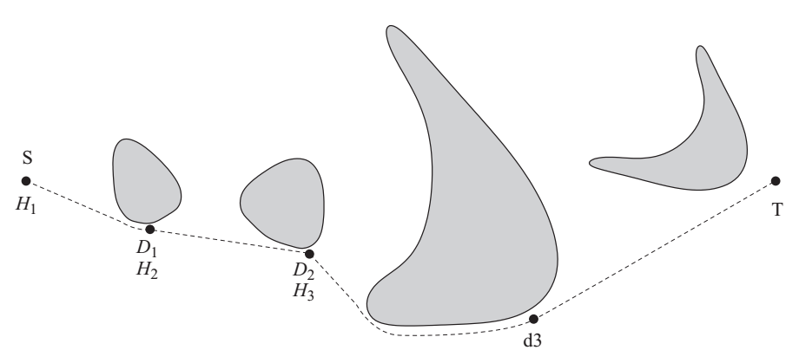

Tangent Bug (range $d≅∞$)

Slide 14
Potential Field Method
Robot is a particle that moves in the configuration space under influence of a force field
Target exerts a force that attracts the robot
Obstacles exert repulsive force for the robot
Widely used because easy to understand and has clear mathematical formulation

Slide 15
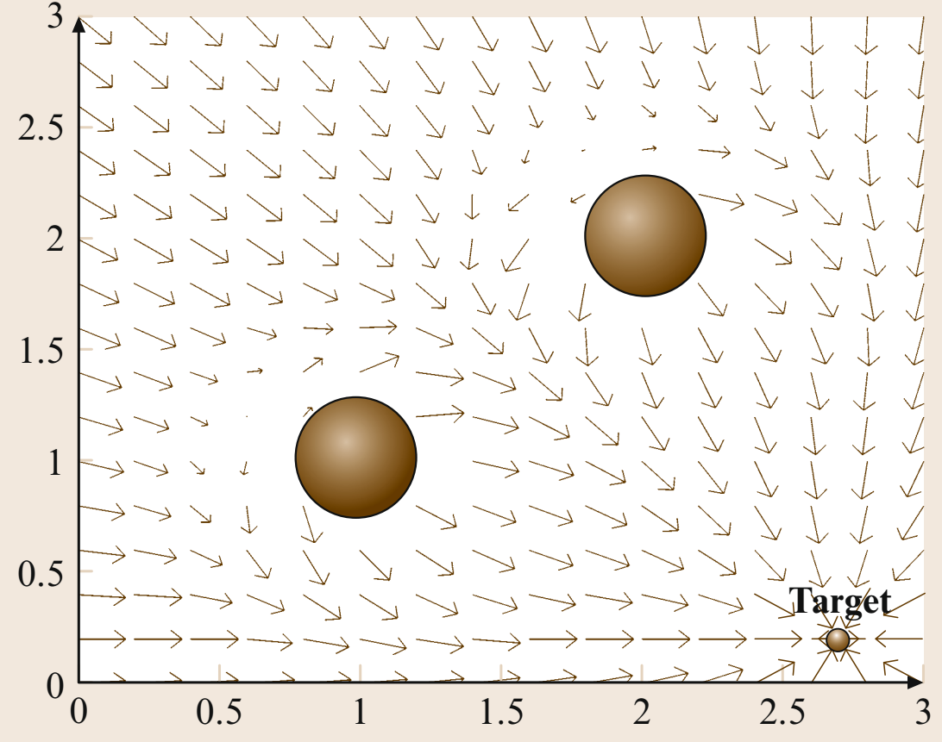
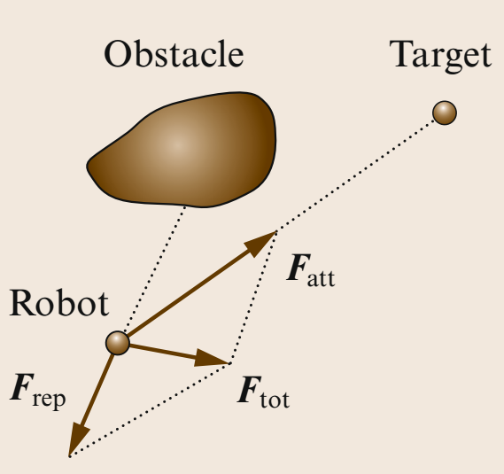
Potential Field Method

Slide 16
Vector Field Histogram
Create a local map around the robot from recent sensor reading
Generate polar histogram (sensor angle to obstacle probability)
Identify openings large enough for vehicle to pass
Openning closest to the target direction is selected

Slide 17
Vector Field Histogram
Motion Computation:
Case1: target in the selected valley → target direction is selected
Case2: target is not in the selected valley and # of sectors > m → ki + m/2 direction is selected
Case3: target is not in the selected valley and # of sectors <= m → (ki + kj )/2 direction is selected
Velocity is selected to be inversely propotional to the distance to the closest obstacle

Slide 18
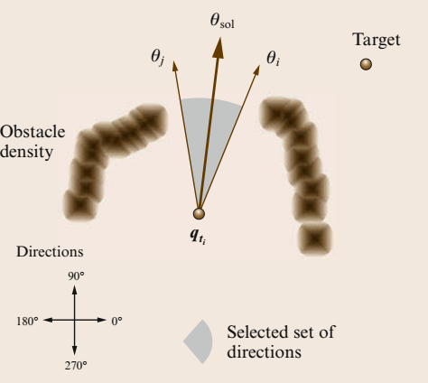
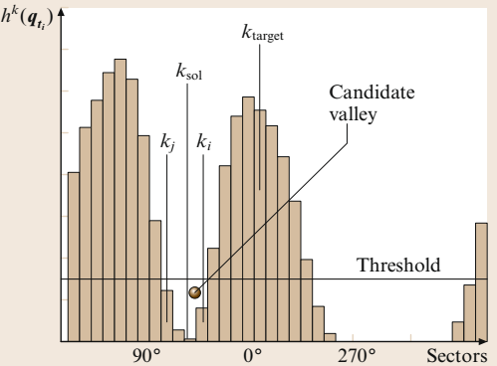
Vector Field Histogram

Slide 19
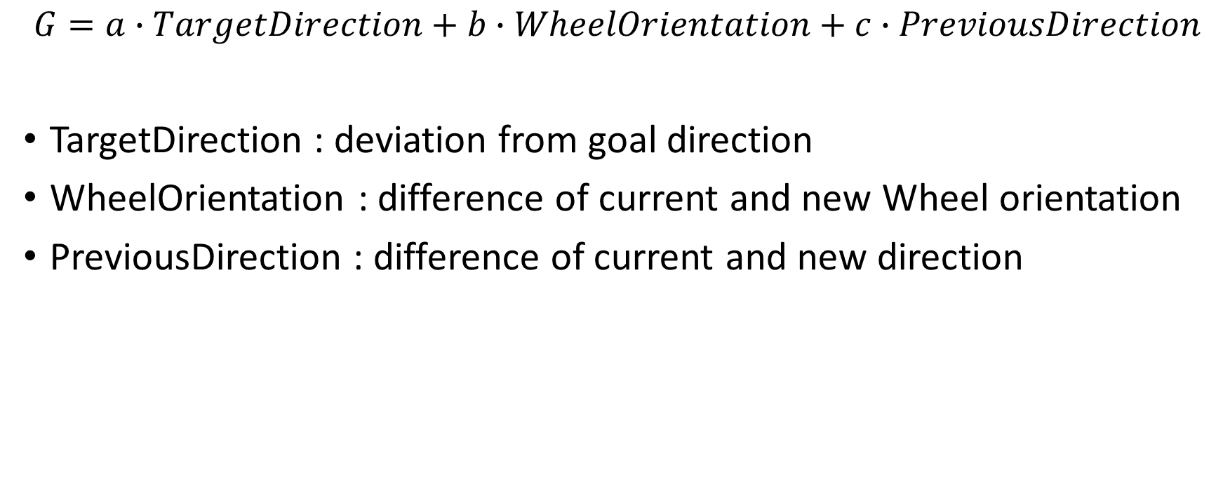
Vector Field Histogram
$$G=a∙TargetDirection+b∙WheelOrientation+c∙PreviousDirection$$
TargetDirection : deviation from goal direction
WheelOrientation : difference of current and new Wheel orientation
PreviousDirection : difference of current and new direction

Slide 20
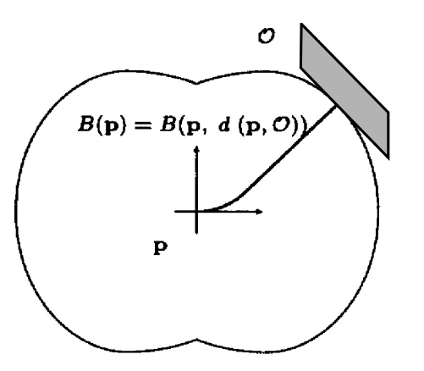
Bubble Band
Bubble : maximum local subset of the free space around a given configuration of the robot that can be traveled without collision

Slide 21
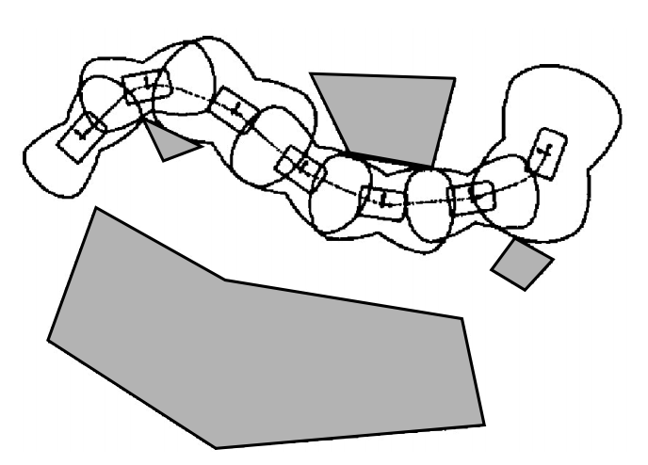
Bubble Band
Path calculation and obstacle avoidance can be carried out with bubble band method
Any newly encountered obstacle is taken into account to alter the path with a minimum band tension

Slide 22
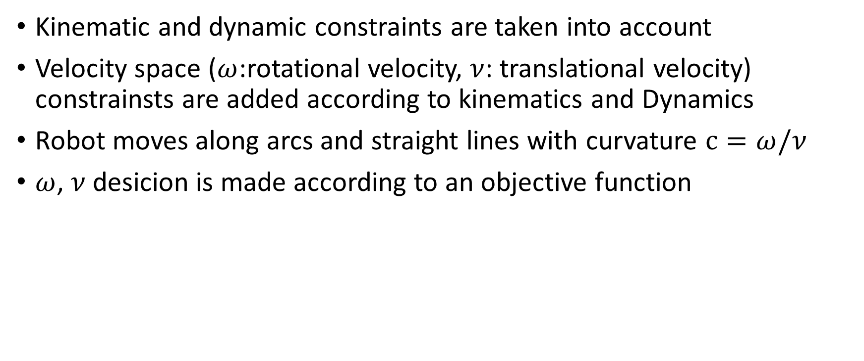
Curvature Velocity Method
Kinematic and dynamic constraints are taken into account
Velocity space ($ω$:rotational velocity, $ν$: translational velocity) constrainsts are added according to kinematics and Dynamics
Robot moves along arcs and straight lines with curvature $c=ω/ν$
$ω$, $ν$desicion is made according to an objective function

Slide 23
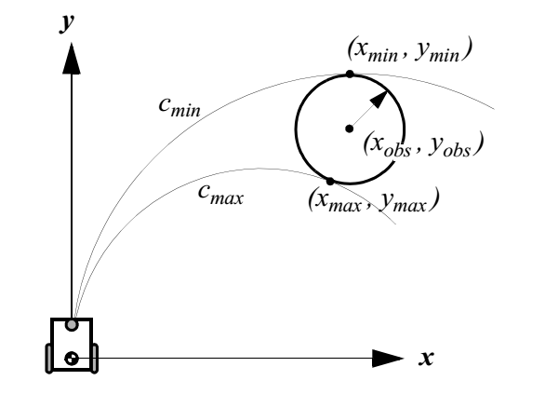
Curvature Velocity Method

Slide 24
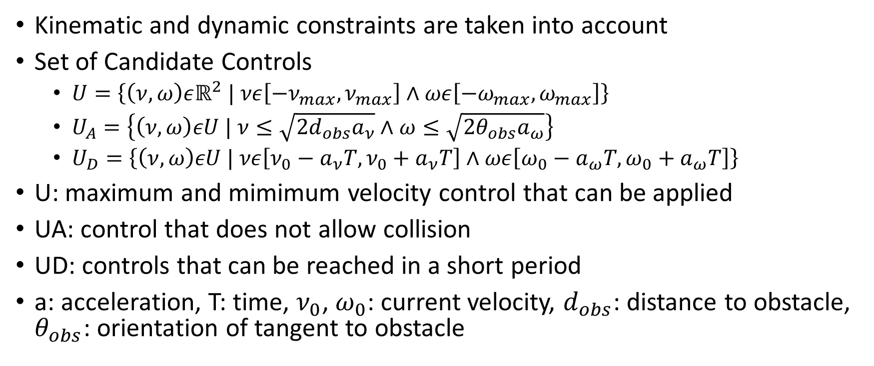
Dynamic Window Approach
Kinematic and dynamic constraints are taken into account
Set of Candidate Controls
$U=\left\{\left(ν,ω\right)εℝ^{2} | νε\left[−ν_{max},ν_{max}\right]∧ωε\left[−ω_{max},ω_{max}\right]\right\}$
$U_{A}=\left\{\left(ν,ω\right)εU | ν≤\sqrt{2d_{obs}a_{ν}}∧ω≤\sqrt{2θ_{obs}a_{ω}}\right\}$
$U_{D}=\left\{\left(ν,ω\right)εU | νε\left[ν_{0}−a_{ν}T,ν_{0}+a_{ν}T\right]∧ωε\left[ω_{0}−a_{ω}T,ω_{0}+a_{ω}T\right]\right\}$
U: maximum and mimimum velocity control that can be applied
UA: control that does not allow collision
UD: controls that can be reached in a short period
a: acceleration, T: time, $ν_{0}$, $ω_{0}$: current velocity, $d_{obs}$: distance to obstacle, $θ_{obs}$: orientation of tangent to obstacle

Slide 25
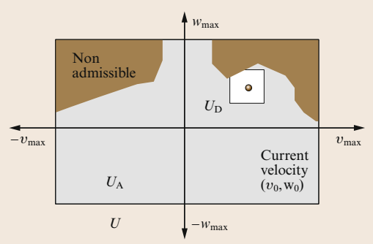
Dynamic Window Approach

Slide 26
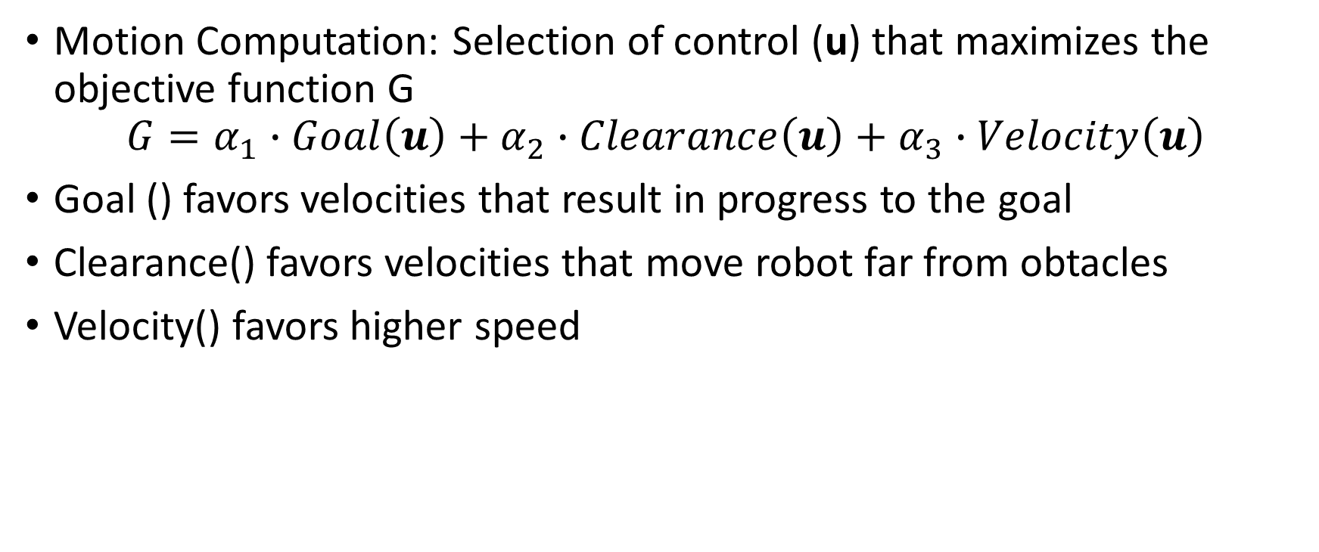
Dynamic Window Approach
Motion Computation: Selection of control (u) that maximizes the objective function G
$$G=α_{1}∙Goal\left(u\right)+α_{2}∙Clearance\left(u\right)+α_{3}∙Velocity\left(u\right)$$
Goal () favors velocities that result in progress to the goal
Clearance() favors velocities that move robot far from obtacles
Velocity() favors higher speed

