Slide 1
Robot Teknolojisine Giriş Yrd. Doç. Dr. Erkan Uslu, Doç. Dr. Sırma Yavuz, Doç. Dr. Fatih Amasyalı, Ar. Grv. Nihal Altuntaş, Ar. Grv. Furkan Çakmak D109 – DB028 Pazartesi 13:00-16:00 12

Slide 2
SLAM
Simultaneous localization and mapping
If odometry is perfect
Since odometry is not perfect
SLAM
map
odometry
sensor
SLAM
map
localization
odometry
sensor

Slide 3

Online – Full SLAM
Online SLAM
$$p\left(x_{t},m|z_{1:t},u_{1:t}\right)$$
Full SLAM
$$p\left(x_{1:t},m|z_{1:t},u_{1:t}\right)$$
$$p\left(x_{t},m|z_{1:t},u_{1:t}\right)=\int{…\int{p\left(x_{1:t},m|z_{1:t},u_{1:t}\right)}d_{x_{1}}…d_{x_{t−1}}}$$

Slide 4

Incremental Mapping
Full SLAM can be approximated as
$$p\left(x_{1:t},m|z_{1:t},u_{1:t}\right)$$
$$=p\left(m_{t}|x_{1:t},z_{1:t}\right)∙p\left(x_{1:t}|z_{1:t},u_{1:t}\right)$$
$$=p\left(m_{t}|x_{t},z_{t},m_{t−1}\right)∙p\left(x_{t}|x_{t−1},z_{t},u_{t},m_{t−1}\right)$$

Slide 5
Mapping with Perfect Odometry
input: odometry (position, orinetation), sensor data (polar laser range), previous map (grid map)
output: updated map (grid map)

Slide 7
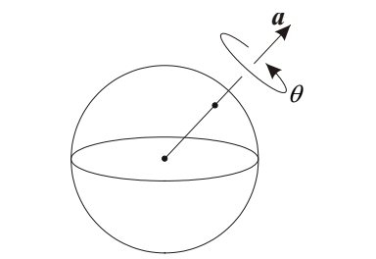
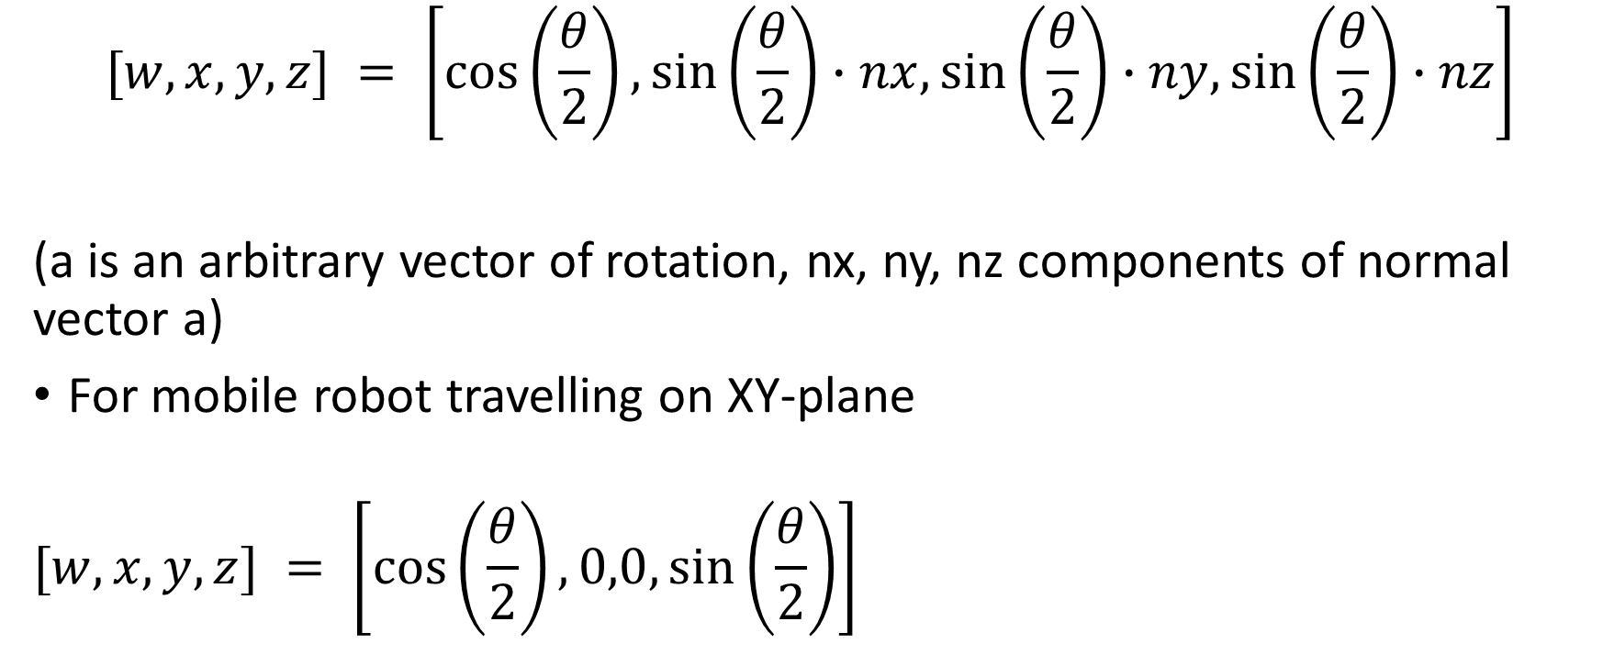
Quaternion – Orientation format
$$[w, x, y, z] = \left[\cos\left(\frac{θ}{2}\right),\sin\left(\frac{θ}{2}\right)∙nx,\sin\left(\frac{θ}{2}\right)∙ny,\sin\left(\frac{θ}{2}\right)∙nz\right]$$
(a is an arbitrary vector of rotation, nx, ny, nz components of normal vector a)
For mobile robot travelling on XY-plane
$$[w, x, y, z] = \left[\cos\left(\frac{θ}{2}\right),0,0,\sin\left(\frac{θ}{2}\right)\right]$$

