Slide 1
Parallel computer architecture classification

Slide 2
Hardware Parallelism
Computing: execute instructions that operate on data.
Flynn’s taxonomy (Michael Flynn, 1967) classifies computer architectures based on the number of instructions that can be executed and how they operate on data.
Computer
Instructions
Data

Slide 3
Flynn’s taxonomy
Single Instruction Single Data (SISD)
Traditional sequential computing systems
Single Instruction Multiple Data (SIMD)
Multiple Instructions Multiple Data (MIMD)
Multiple Instructions Single Data (MISD)
Computer Architectures
SISD
SIMD
MIMD
MISD

Slide 4
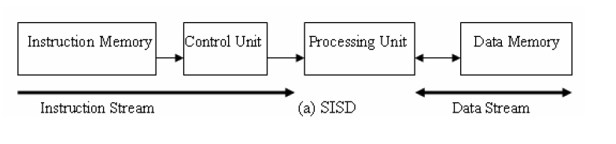
SISD
At one time, one instruction operates on one data
Traditional sequential architecture

Slide 5
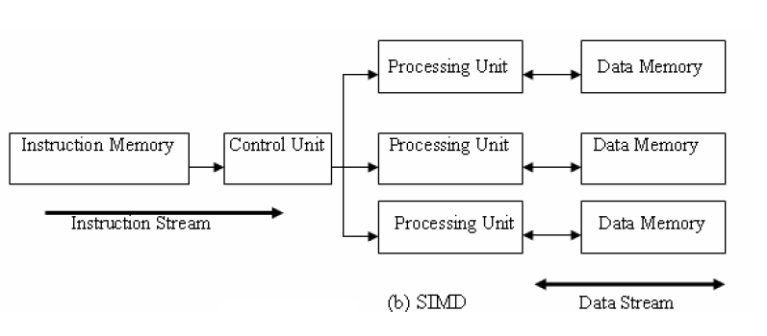
SIMD
At one time, one instruction operates on many data
Data parallel architecture
Vector architecture has similar characteristics, but achieve the parallelism with pipelining.
Array processors

Slide 6
Array processor (SIMD)
IP
MAR
MEMORY
OP
ADDR
MDR
A1
B1
C1
A2
B2
C2
AN
BN
CN
DECODER
ALU
ALU
ALU

Slide 7
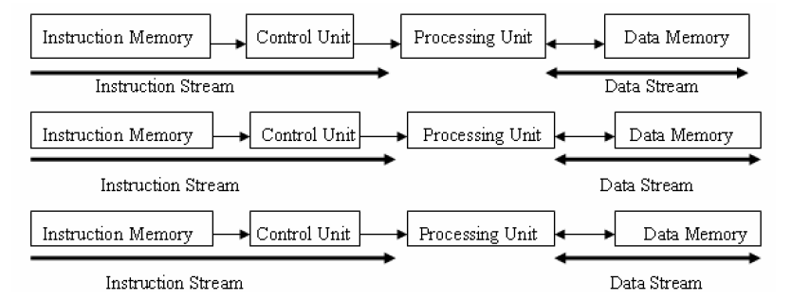
MIMD
Multiple instruction streams operating on multiple data streams
Classical distributed memory or SMP architectures

Slide 8
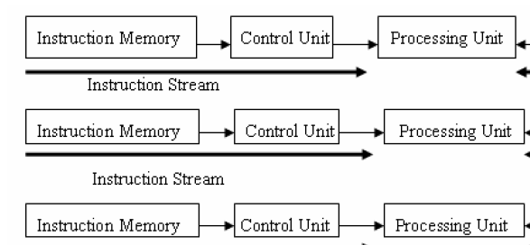

MISD machine
Not commonly seen.
Systolic array is one example of an MISD architecture.

Slide 9
Flynn’s taxonomy summary
SISD: traditional sequential architecture
SIMD: processor arrays, vector processor
Parallel computing on a budget – reduced control unit cost
Many early supercomputers
MIMD: most general purpose parallel computer today
Clusters, MPP, data centers
MISD: not a general purpose architecture.

Slide 10
Flynn’s classification on today’s architectures
Multicore processors
Superscalar: Pipelined + multiple issues.
SSE (Intel and AMD’s support for performing operation on 2 doubles or 4 floats simultaneously).
GPU: Cuda architecture
IBM BlueGene

Slide 11
Modern classification (Sima, Fountain, Kacsuk)
Classify based on how parallelism is achieved
by operating on multiple data: data parallelism
by performing many functions in parallel: function parallelism
Control parallelism, task parallelism depending on the level of the functional parallelism.
Parallel architectures
Data-parallel
architectures
Function-parallel
architectures

Slide 12
Data parallel architectures
Vector processors, SIMD (array processors), systolic arrays.
IP
MAR
Vector processor (pipelining)
MEMORY
A
B
C
OP
ADDR
MDR
DECODER
ALU

Slide 13
Data parallel architecture: Array processor
IP
MAR
MEMORY
OP
ADDR
MDR
A1
B1
C1
A2
B2
C2
AN
BN
CN
DECODER
ALU
ALU
ALU

Slide 14
Control parallel architectures
Function-parallel architectures
Thread level Parallel Arch
Process level Parallel Arch
Instruction level Parallel Arch
(ILPs)
(MIMDs)
Distributed Memory MIMD
Pipelined processors
Superscalar processors
Shared Memory MIMD
VLIWs

Slide 15
Classifying today’s architectures
Multicore processors?
Superscalar?
SSE?
GPU: Cuda architecture?
IBM BlueGene?

Slide 16
Performance of parallel architectures
Common metrics
MIPS: million instructions per second
MIPS = instruction count/(execution time x 10⁶)
MFLOPS: million floating point operations per second.
MFLOPS = FP ops in program/(execution time x 10⁶)
Which is a better metric?
FLOP is more related to the time of a task in numerical code
# of FLOP / program is determined by the matrix size

Slide 17
Performance of parallel architectures
FlOPS units
kiloFLOPS (KFLOPS) 10^3
megaFLOPS (MFLOPS) 10^6
gigaFLOPS (GFLOPS) 10^9 ← single CPU performance
teraFLOPS (TFLOPS) 10^12
petaFLOPS (PFLOPS) 10^15 ← we are here right now
10 petaFLOPS supercomputers
exaFLOPS (EFLOPS) 10^18 ← the next milestone

Slide 18
Peak and sustained performance
Peak performance
Measured in MFLOPS
Highest possible MFLOPS when the system does nothing but numerical computation
Rough hardware measure
Little indication on how the system will perform in practice.

Slide 19
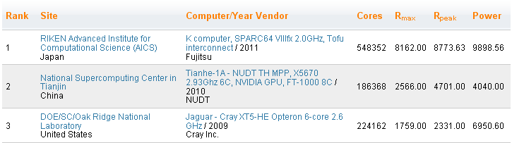
Peak and sustained performance
Sustained performance
The MFLOPS rate that a program achieves over the entire run.
Measuring sustained performance
Using benchmarks
Peak MFLOPS is usually much larger than sustained MFLOPS
Efficiency rate = sustained MFLOPS / peak MFLOPS

Slide 20
Measuring the performance of parallel computers
Benchmarks: programs that are used to measure the performance.
LINPACK benchmark: a measure of a system’s floating point computing power
Solving a dense N by N system of linear equations Ax=b
Use to rank supercomputers in the top500 list.

Slide 21
Other common benchmarks
Micro benchmarks suit
Numerical computing
LAPACK
ScaLAPACK
Memory bandwidth
STREAM
Kernel benchmarks
NPB (NAS parallel benchmark)
PARKBENCH
SPEC
Splash

Slide 22
Summary
Flynn’s classification
SISD, SIMD, MIMD, MISD
Modern classification
Data parallelism
function parallelism
Instruction level, thread level, and process level
Performance
MIPS, MFLOPS
Peak performance and sustained performance

Slide 23
References
K. Hwang, "Advanced Computer Architecture : Parallelism, Scalability, Programmability", McGraw Hill, 1993.
D. Sima, T. Fountain, P. Kacsuk, "Advanced Computer Architectures : A Design Space Approach", Addison Wesley, 1997.

