Slide 1
Dimensionality Reduction

Slide 2
Why Reduce Dimensionality?
Reduces time complexity: Less computation
Reduces space complexity: Less parameters
Saves the cost of observing the feature
Simpler models are more robust on small datasets
More interpretable; simpler explanation
Data visualization (structure, groups, outliers, etc) if plotted in 2 or 3 dimensions

Slide 3
Feature Selection vs Extraction
Feature selection: Choosing k<d important features, ignoring the remaining d – k
Subset selection algorithms
Feature extraction: Project the
original x_{i} , i =1,...,d dimensions to
new k<d dimensions, z_{j} , j =1,...,k
Principal components analysis (PCA), linear discriminant analysis (LDA), factor analysis (FA)

Slide 4
Subset Selection
There are 2^{d} subsets of d features
Forward search: Add the best feature at each step
Set of features F initially Ø.
At each iteration, find the best new feature
j = argmin_{i} E ( F ∪ x_{i} )
Add x_{j} to F if E ( F ∪ x_{j} ) < E ( F )
Hill-climbing O(d²) algorithm
Backward search: Start with all features and remove one at a time, if possible.
Floating search (Add k, remove l)

Slide 5
Principal Components Analysis (PCA)
Find a low-dimensional space such that when x is projected there, information loss is minimized.
The projection of x on the direction of w is: z = w^{T}x
Find w such that Var(z) is maximized
Var(z) = Var(w^{T}x) = E[(w^{T}x – w^{T}μ)²]
= E[(w^{T}x – w^{T}μ)(w^{T}x – w^{T}μ)]
= E[w^{T}(x – μ)(x – μ)^{T}w]
= w^{T} E[(x – μ)(x –μ)^{T}]w = w^{T} ∑ w
where Var(x)= E[(x – μ)(x –μ)^{T}] = ∑

Slide 6
Maximize Var(z) subject to ||w||=1
∑w₁ = αw₁ that is, w₁ is an eigenvector of ∑
Choose the one with the largest eigenvalue for Var(z) to be max
Second principal component: Max Var(z₂), s.t., ||w₂||=1 and orthogonal to w₁
∑ w₂ = α w₂ that is, w₂ is another eigenvector of ∑
and so on.

Slide 7
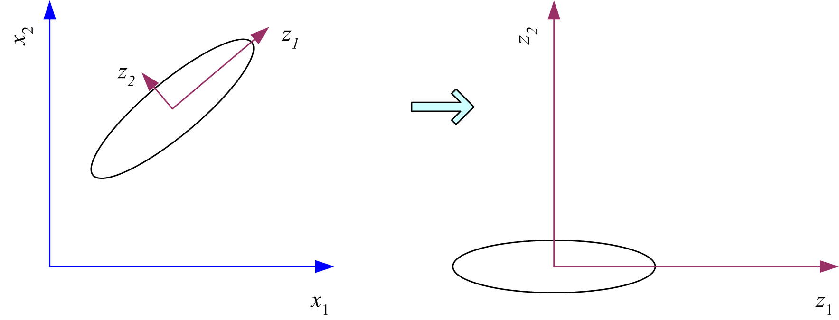
What PCA does
z = W^{T}(x – m)
where the columns of W are the eigenvectors of ∑, and m is sample mean
Centers the data at the origin and rotates the axes

Slide 8
How to choose k ?
Proportion of Variance (PoV) explained
when λ_{i} are sorted in descending order
Typically, stop at PoV>0.9
Scree graph plots of PoV vs k, stop at “elbow”

Slide 9
