Slide 1
Software Quality and Testing Software Testing Types
Hatice Hasoğlu
Işıl Özkan Budakoğlu
30.10.2012

Slide 2


Quality Characteristics – 1
Categorization of software testing according to ISO 9126 (2001) wihich provides six perspectives of quality:
Functionality, which consists of five sub-characteristics: suitability, accuracy, security, interoperability and compliance; this characteristic deals with functional testing.
Reliability, which is defined further into the sub-characteristics maturity (robustness), fault-tolerance, recoverability and compliance
Usability, which is divided into the sub-characteristics understandability, learnability, operability, attractiveness and compliance

Slide 3
Quality Characteristics – 2
Efficiency, which is divided into time behavior (performance), resource utilization and compliance
Maintainability, which consists of five sub-characteristics: analyzability, changeability, stability, testability and compliance
Portability, which also consists of five sub-characteristics: adaptability, installability, co-existence, replaceability and compliance.

Slide 4

FUNCTIONAL TESTING TYPES Objectives and Methods

Slide 5
Functional Testing
Testing the functionality according to the specified requirements
Earlier functional testing can display the sofware maturity level and enable early bug fixing activities
Functional testing can be done in any software testing level

Slide 6
Web Services Testing
Ensuring functional quality for a set of services by eliminating error or failure
Testing Web Services Description Language (WSDL) interfaces
WSDL/SOAP-based messaging
Verifying compliance with Web Service standards (SOAP, HTTP(S), JSON, JMS, WS-Security, UDDI, etc.)
Security perspective
Message security validation
Penetration test

Slide 7
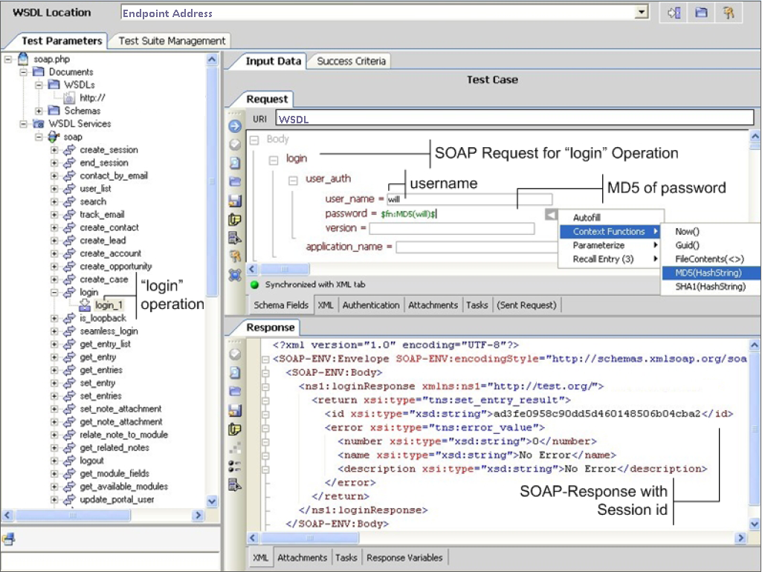
Web Services Testing Example

Slide 8
Migration Testing
Conduct testing for software version changes
Validation of the preserved functionality for newer versions
Prepare data migration testing approach in order to copy of data from one system to another
Misspelled data
Duplicate data occurence
Null data presence
Missing data records
Aggregated data etc.

Slide 9
Maintenance Testing
Software maintenance is the modification of a software product after delivery to correct faults, to improve performance or other attributes, or to adapt the product to a modified environment. (IEEE 1219)
The software product undergoes modification to code and associated documentation due to a problem or the need for improvement. The objective is to modify the existing software product while preserving its integrity. ISO/IEC [ISO95]

Slide 10
NON – FUNCTIONAL TESTING TYPES Objectives and Methods

Slide 11

Various Types Non-Functional Testing
Performance Testing
Load Testing
Stress Testing
Compatibility Testing
Security Testing
Usability Testing
Localization Testing

Slide 12

Performance Testing
Ensure the system achieving the specified performance levels.
Identify bottlenecks in the given network
Investigate speed characteristics of system under test
Determine how fast a given system performs under load
Reduce overall costs by finding bugs at earlier stages
Analyze average server measurements
Demonstrate if network meets the performance criteria

Slide 13
Performance Metrics
Decide measurement types for the real system
Classify metrics by identifying related application components
Identifying priorities on speed measurement
Resource utilization requirements different platforms
Identify concurrent usage definitions for each channel
Latency, jitter, throughput, packet loss

Slide 14
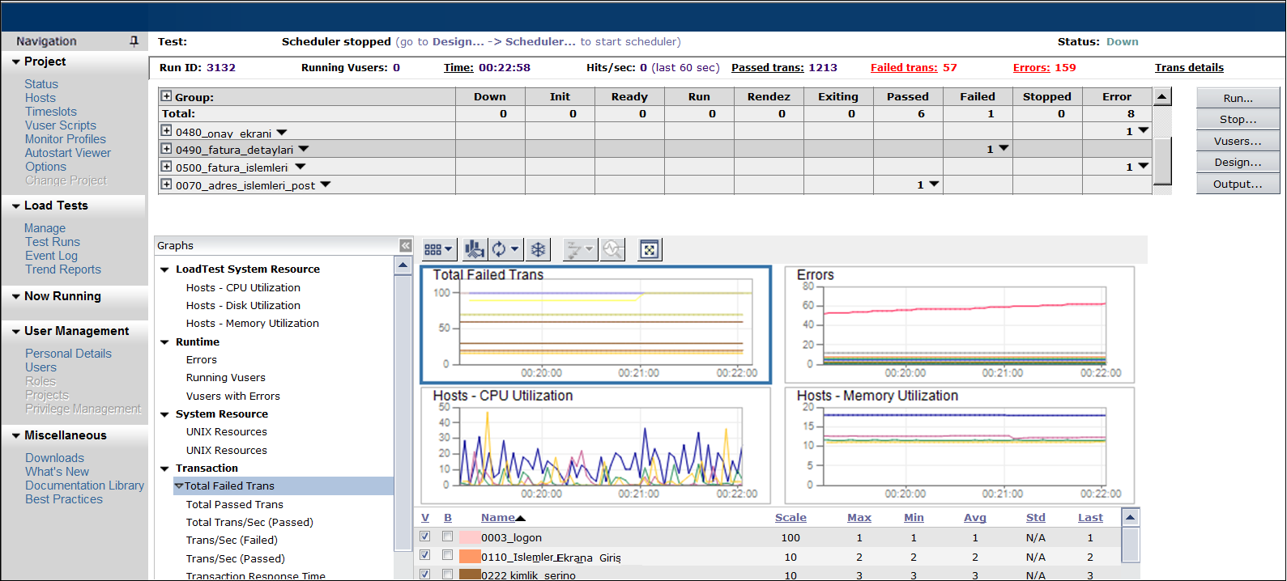
Sample Performance Test Run Result

Slide 15
Load Testing
Simulate actions of real users
Create mix scenarios for various workloads
Realistic workload on system interfaces
Identify system responses for a period of time (Response time, Hits per second, throughput, resource utilization etc.)
Determine end-to-end capacity
Expose unexpected behaviour between subsystems
Validate specification limits

Slide 16
Stress Testing
Testing the system or entity as a perspective of excessive operational capacity
Determine acceptable system behaviour under heavy load
Detecting memory leaks, thread deadlocks, unresponsive software entities, data corruption, process anomalies, runtime errors, etc.
Develop corrective action models in order to mitigate the risks

Slide 17
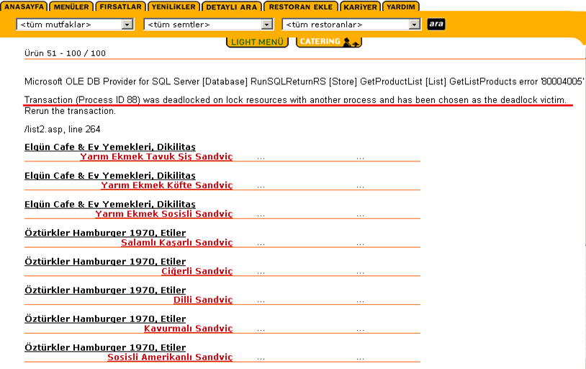
Deadlock Example

Slide 18
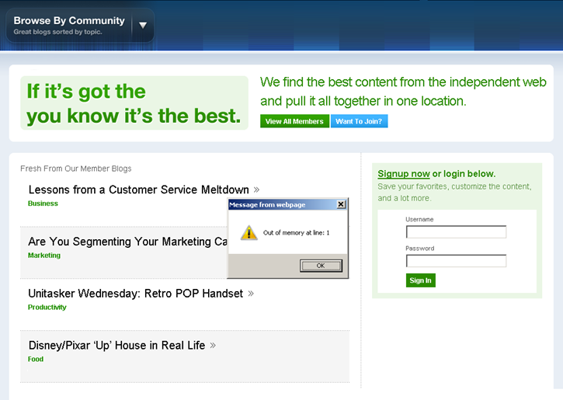
Memory Exception Example

Slide 19
Compatibility Testing
Ensure the application's compatibility with the computing environment.
Testing the application by considering different environments
Generate a compatibility testing matrix according to technical requirements
Consider backward/forward compatibility
Code written for version 2.3 may not work on version 3.1

Slide 20
Compatibility Testing Matrix Items
Operating System
Microsoft Windows 98/Me/NT/2000/XP/Vista/Windows 7
Unix/Linux (Pardus, Debian, Ubuntu, Gentoo, FreeBSD, CentOS, OpenSUSE)
Android, iPad, iPhone
Browser Compatibility
Internet Explorer, Firefox, Google Chrome, Opera, Camino, Netscape, Safari, etc.
Database
Oracle, MSSQL, MySQL, DB2, Sybase, Postgre SQL, etc.
Hardware Platform
CPU, RAM, Hard Disk, Screen Resolution
Network
Bandwidth, speed, capacity

Slide 21
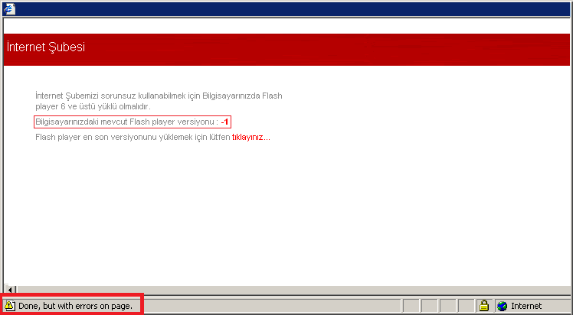
Compatibility Testing Example

Slide 22
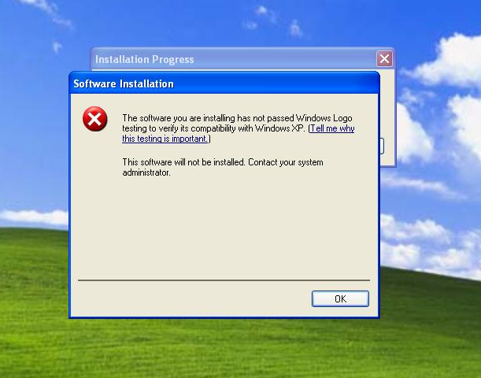
Compatibility Testing Example

Slide 23
Security Testing-1
Adopt routine security procedures to be performed for each release/build
Probe vulnerabilities of the system by using security tools
Automatic test genaration to simulate specific network attacks

Slide 24
Security Testing-2
Conduct security assessments:
Data Validation Errors (Client-side validation)
Cross Site Scripting
Buffer Overflows
Improper File Access
SQL, LDAP, XPATH, OS command injection
Sensitive data in unsecured pages

Slide 25
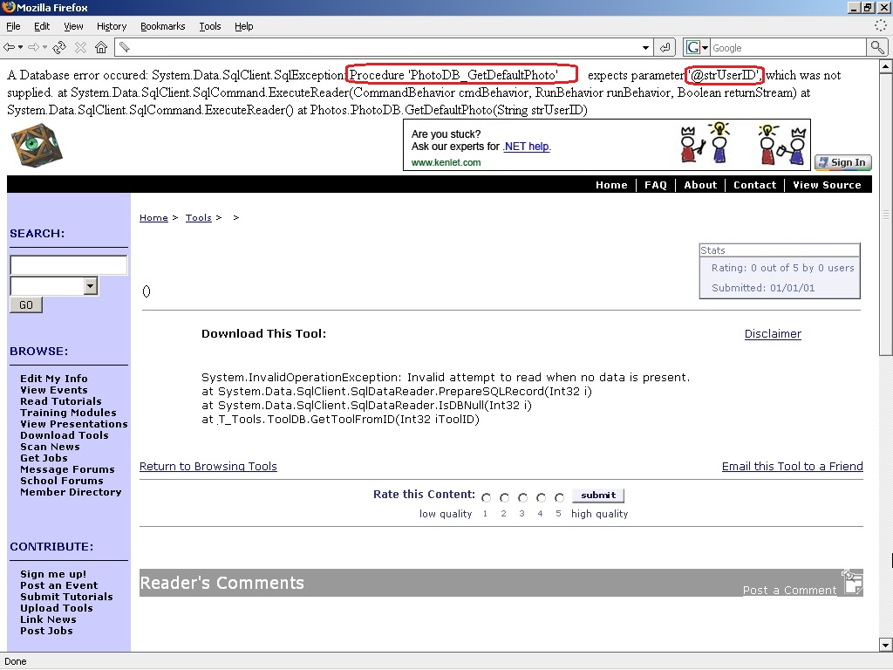
SQL Exception Example

Slide 26
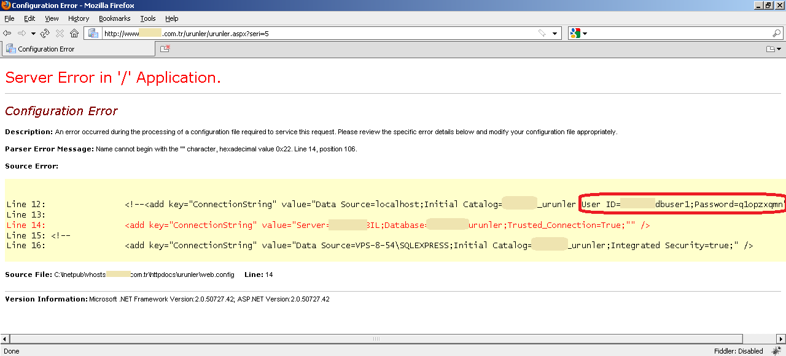
DB Configuration Error

Slide 27
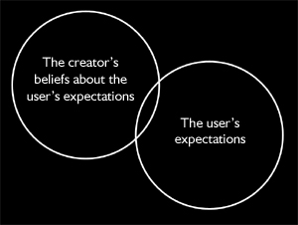
Usability Testing
Evaluating product or service by considering the end-user point of view
A part of system unit may function correctly however, may not provide ease of use
Focus on the intended groups and increase overall user satisfaction

Slide 28
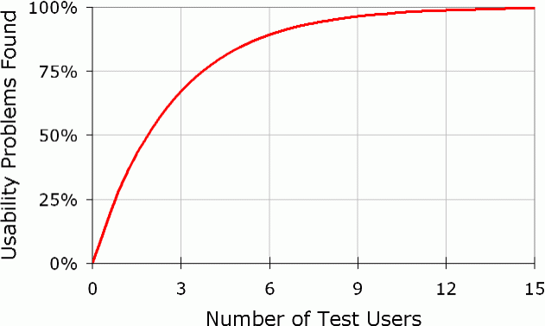
A Mathematical Model of the Finding of Usability Problems
N(1-(1-L)^{n})
N : the total number of usability problems in the design
L: the proportion of usability problems discovered while testing a single user
Notes:
Ref: Jakob Nielsen describes "A mathematical model of the finding of usability problems"

Slide 29

Turkcell 7. His – Müşteri Öngörü Merkezi
Gözleme dayalı araştırmaların yapıldığı merkezde ev, sokak ve ofis gibi simülasyon alanları bulunuyor. Merkezde, kullanım alışkanlıkları hakkında önemli ipuçları elde ediliyor.
Üniversite Çalışmaları:
Mobil servislerde kullanılabilirlik ve mobil kullanıcı deneyimi
Nöropazarlama ölçümleme teknikleri

Slide 30
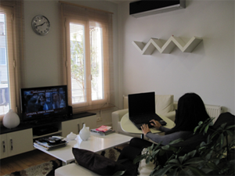
Turkcell 7. His – Müşteri Öngörü Merkezi
Ev Simülasyonu
Notes:
Ref: Jakob Nielsen describes "A mathematical model of the finding of usability problems"

Slide 31
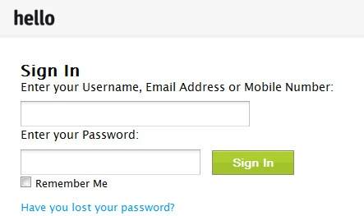
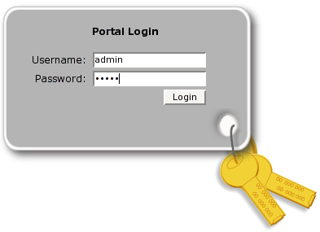
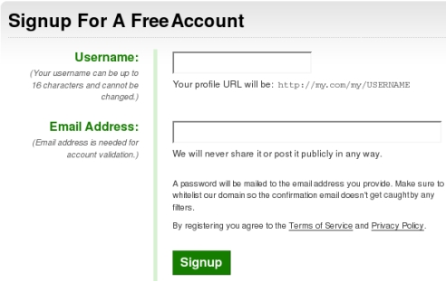
Usability on Different Login/Signup Pages

Slide 32
Localization Testing
Testing the customized software product according to targeted software market
Discovering cultural or grammatical potential failure points
Ensuring compatibility and functional consistency across all localized software versions
Determining adaptation level of a software unit for multiple configurations on different locales

Slide 33
Localization Focus Items
Accuracy of translation
Text direction
Bi-directional text :
Right-to-left (RTL)
Left-to-right (LTR)
Date Time Parsing
Turkey format : 23.5.2011
US format : 5/23/2011
Digits
Text Encoding
Turkish Alphabet Dotted & Dotless I

Slide 34
Testing Types - Sample Question
Which of these is a functional test?
Measuring response time on an airline reservation system
Checking the effect of high volumes of traffic in a CRM software
Checking the on-line bookings screen information and the database contents against the customer bill information
Checking how easy the system is to use

Slide 35
Happy testing ☺
Thank you...
Işıl Özkan Budakoğlu
isil.budakoglu@turkcellteknoloji.com.tr
Hatice Hasoğlu
hatice.hasoglu@turkcellteknoloji.com.tr

