Slide 1
Optimization Techniques
M. Fatih Amasyalı

Slide 2
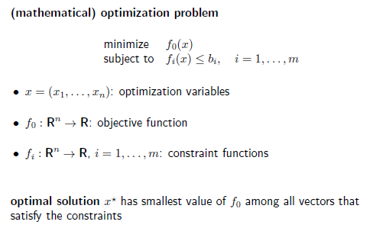
What is optimization?

Slide 3
Optimization example (Constraint Optimization)
Find the largest possible rectangular area you can enclose, assuming you have L meters of fencing.
f(x)=x*((L/2)-x)

Slide 4
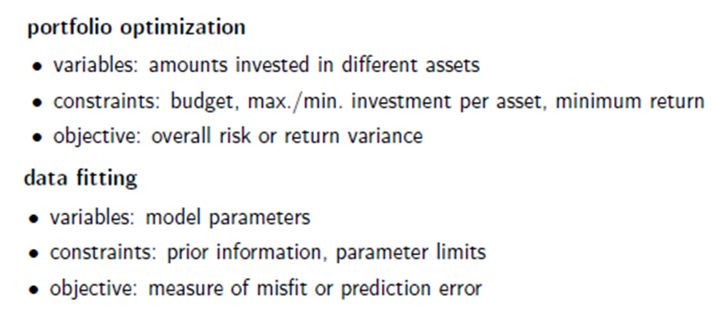
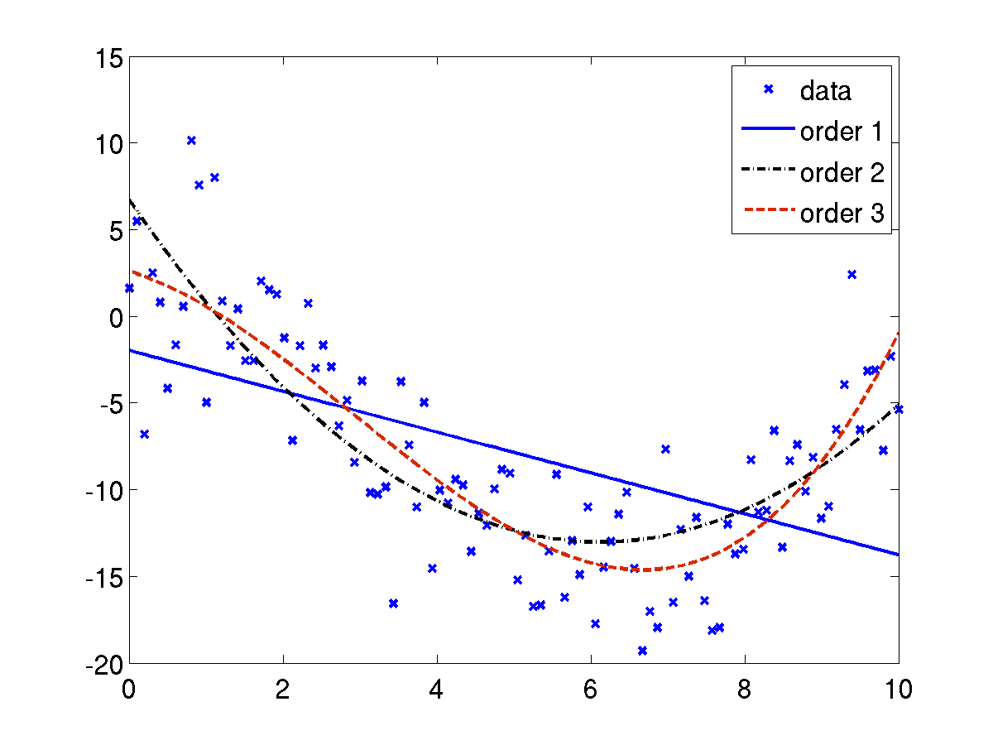
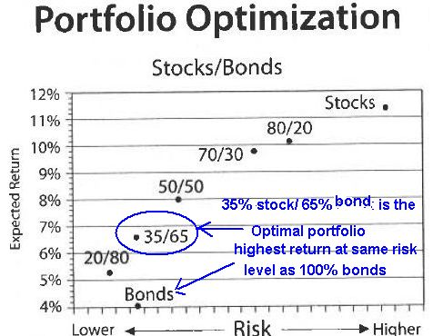
Optimization examples

Slide 5
Optimization Techniques
Derivative Techniques
Gradient descent
Newton Raphson
LM
BFGS
Non Derivative Techniques
Hill climbing
Genetic algorithms
Simulated annealing

Slide 6
Linear, nonlinear, convex functions
f is a function R^{n}→R
For every x1,x2 ∈ R^{n} (x1, x2 are n dimensional points)
f is linear if
f(x1+x2)=f(x1)+f(x2) and f(r*x1)=r*f(x1)
f(x)=2*x is linear and affine.
f(x)=2*x+3 is affine but not linear.
A linear function fixes the origin, whereas an affine function need not do so. An affine function is the composition of a linear function with a translation.
f(x)=3 is constant, but not linear.

Slide 7
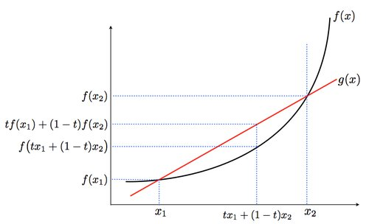
Linear, nonlinear, convex functions
f is convex if
λ*f(x1) + β*f(x2) ≥ f(λ*x1 + β*x2). where λ+β=1, λ≥0, β≥0

Slide 8
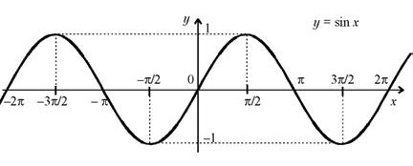
Linear, nonlinear, convex functions
f(x1)=3*x1+3
f(x1,x2)=a*x1+b*x2+c
f(x1,x2)=x2^2+x1^2+3*x1
f(x)=sin(x) is convex when x ∈ [?,?]
Concave?

Slide 9
Commonsense
Use derivative
Go to the negative direction of derivative
But, step size?

Slide 10
General Algorithm
initial guess
While (improvement is significant) and (maximum number of iterations is not exceeded)
improve the result

Slide 11
Gradient Descent
Using only derivative sign
Using also magnitude of the derivative
Effect of the step size
Effect of the starting point
Local minimum problem

Slide 12
% The gradient descent algorithm with constant stepsize
% f(x)=x^2, with derivative f'(x)=2x
clear all;
close all;
% plot objective function
x=-5:0.01:5;
y=zeros(1,length(x));
for i=1:length(x)
y(i)=x(i)^2;
end
plot(x,y);
x_old = 0;
x_new = -4.9;
% The algorithm starts at x=-4.9
eps = 0.05; % step size
precision = 0.00001; % stopping condition1
max_iter=200; % stopping condition2
Xs=zeros(1,max_iter);
Ys=zeros(1,max_iter);
i=1;
while abs(x_new - x_old) > precision && max_iter>=i
Xs(i)=x_new;
Ys(i)=x_new^2;
hold on;
plot(Xs(i),Ys(i),'r*');
text(Xs(i),Ys(i),int2str(i));
x_old = x_new;
df= 2 * x_old;
x_new = x_old - eps * sign(df); % gradient sign
i=i+1;
end
figure;
plot(Xs(1:i-1));
xlabel('iteration');
ylabel('x values');
gradient_desc_1.m

Slide 13
Result
f(x)=x^2
f’(x)=2*x
Max_iter=200
Constant step size =0.05
Starting point=-4.9

Slide 14
It reaches the maximum iteration number
It reached 0 at 100.iteration , then zig-zag.
It selects 0 or 0.05 as the point f is minimum.

Slide 15
Starting point=4.9

Slide 16
Step size=0.1
It reaches the maximum iteration number
It reached 0 at 50.iteration , then zig-zag.
It selects 0 or 0.1 as the point f is minimum.

Slide 17
Step size=0.01
It reaches the maximum iteration number
It does not reached to 0.
It selects -2.91 as the minimum point.
It will zig-zag.

Slide 18
Gradient Descent
Using also the magnitude of the derivative
x_new = x_old - eps * df;
instead of x_new = x_old - eps * sign(df);
Can we reduce the required number of iterations?

Slide 19
gradient_desc_2.m
Step size=0.05
Max_iter=200
The number of iteration is 120.
It does not zig-zag.
It selects 0±10⁻⁵ the point f is minimum.

Slide 20
gradient_desc_2.m
Step size=0.1
Max_iter=200
The number of iteration is 60.
It does not zig-zag.
It selects 0±10⁻⁵ the point f is minimum.

Slide 21
gradient_desc_2.m
Step size=0.01
Max_iter=200
It reaches the maximum iteration number.
It does not zig-zag.
It selects 0±10⁻² as the point f is minimum.
It requires the more iteration.

Slide 22
gradient_desc_2.m
Step size=0.7
Max_iter=200
The number of iteration is 16.
It does not zig-zag.
It selects 0±10⁻⁵ the point f is minimum.

Slide 23
gradient_desc_2.m
Step size=0.99
Max_iter=200
It reached the maximum iteration number.
It zig-zag, but zig-zag magnitude decreases.
It selects 0±10⁻¹ the point f is minimum.
It requires more iteration.

Slide 24
gradient_desc_2.m
Step size=1
Max_iter=200
It reached the maximum iteration number.
It does not converge.

Slide 25
Starting point matters?
f(x)=f(x)=x^4-3x^3+2 with derivative f'(x)=4x^3-9x^2
It has two extreme points x=0, x=9/4
gradient_desc_3.m

Slide 26
Starting point=3.9
Step size=0.01
Starting point=-1.9

Slide 27
Step size=0.05 can handle plateau, but not guaranteed.
Step size=0.1 is very big for this function, it does not converge

Slide 28
Gradient descent
Static zig-zag (hopeless) vs. slow converge (with hope)
Very Small step size → slow converge, plateau problem
Very big step size → do not converge
Big and small step sizes depend on the objective function.

Slide 29
References
http://math.tutorvista.com/calculus/newton-raphson-method.html
http://math.tutorvista.com/calculus/linear-approximation.html
http://en.wikipedia.org/wiki/Newton's_method
http://en.wikipedia.org/wiki/Steepest_descent
http://www.pitt.edu/~nak54/Unconstrained_Optimization_KN.pdf
http://mathworld.wolfram.com/MatrixInverse.html
http://lpsa.swarthmore.edu/BackGround/RevMat/MatrixReview.html
http://www.cut-the-knot.org/arithmetic/algebra/Determinant.shtml
Matematik Dünyası, MD 2014-II, Determinantlar
http://www.sharetechnote.com/html/EngMath_Matrix_Main.html
Advanced Engineering Mathematics , Erwin Kreyszig, 10th Edition, John Wiley & Sons, 2011
http://en.wikipedia.org/wiki/Finite_difference
http://ocw.usu.edu/Civil_and_Environmental_Engineering/Numerical_Methods_in_Civil_Engineering/NonLinearEquationsMatlab.pdf
http://www-math.mit.edu/~djk/calculus_beginners/chapter09/section02.html
http://stanford.edu/class/ee364a/lectures/intro.pdf
http://2020insight.com/chasing-returns-risk-getting-burned/
http://jitkomut.lecturer.eng.chula.ac.th/matlab/eng_probs.html

