Slide 1
Optimization Techniques
M. Fatih Amasyalı

Slide 2
Steepest Descent
Exact step size
x_new = x_old - eps * df;
Eps is calculated as:
z(eps)=x – eps*df
Find eps point where f’(z(eps))=0

Slide 3
Steepest Descent
Find the minimum point of f(x)=x^2
z(eps)=x-eps*2*x=x(1-2*eps) = search direction
f(z(eps))= the value of f at a point on the search direction
Find eps value which is minimum of f(z(eps)), f’(z(eps))=0
f(z(eps))=(x(1-2*eps))^2=x^2*(1-2*eps)^2
f(z(eps))=x^2*(1-4*eps+4*eps^2)
f’(z(eps))=x^2*(-4+8*eps)=0
eps=1/2
X_{n+1}=X_{n}-eps*df=X_{n}-eps*2*X_{n}=X_{n}-X_{n}=0
Wherever you start, the minimum point is found at one iteration !

Slide 4
Steepest Descent
Find the minimum point of f(x)=x^4
z(eps)=x-eps*4*x^3= search direction
If we know that the minimum point of f(z(eps)) is 0 ( But, we do not know, in reality)
eps*4*x^3=x than,
eps=1/(4*x^2)
X_{n+1}=X_{n}-epx*4*x^3=X_{n}-*(1/(4*X_{n}^2))*4*X_{n}^3=
X_{n}-X_{n}=0
Wherever you start, the minimum point is found at one iteration !

Slide 5
Steepest Descent in 2 dims.
Find the iteration equation to find the minimum of f(x1,x2)=x1^2+3*x2^2
df=[2*x1 ; 6*x2]
t=eps
z(t) have 2 dims as x
z(t)=[x1 ; x2]-t*df
z(t)=[x1;x2]-[2*x1*t; 6*x2*t]
z(t)=[x1*(1-2*t) ; x2*(1-6*t)]
f(z(t))= (x1^2)*(1-2*t) ^2+3*(x2^2)(1-6*t)^2

Slide 6
Steepest Descent in 2 dims.
f(z(t))= (x1^2)*(1-2*t) ^2+3*(x2^2)(1-6*t)^2
df(z(t))/dt=f’(z(t))=
=(x1^2)*2*(1-2*t)*(-2)+3*(x2^2)*2*(1-6*t)*(-6)
=(x1^2)*(-4)*(1-2*t)-36*(x2^2)*(1-6*t)
=(x1^2)*(-4+8*t)- (x2^2)*(36-216*t)
=-4*(x1^2)+(x1^2)*8*t-36*(x2^2)+216*t*(x2^2)
=0 because f’(z(t))=0
(x1^2)*8*t+216*t*(x2^2)=4*(x1^2)+36*(x2^2)
t= (4*(x1^2)+36*(x2^2)) / ( (x1^2)*8+216*(x2^2) )
t= ((x1^2)+9*(x2^2)) / ( 2*(x1^2)+54*(x2^2) )

Slide 7
Steepest Descent in 2 dims.
So the iteration equation is
X_{n+1}=X_{n}-t*[2*x1; 6*x2] where
t= ((x1^2)+9*(x2^2)) / ( 2*(x1^2)+54*(x2^2) )

Slide 8
Steepest Descent Examples
f(x)=x1^2+x2^2
df=[2*x1 ; 2*x2]
z(t)=[x1 ; x2]-t*df
z(t)=[x1;x2]-[2*x1*t; 2*x2*t]
z(t)=[x1*(1-2*t) ; x2*(1-2*t)]
f(z(t))= (x1^2)*(1-2*t) ^2+(x2^2)(1-2*t)^2
f(z(t))=((1-2*t) ^2)(x1^2+ x2^2)
f’(z(t))=(x1^2 + x2^2)*(8*t - 4)=0
t=1/2
z(t)=[x1 ; x2]-t* [2*x1 ; 2*x2]
z(t)=[x1 ; x2]-[x1 ; x2]= [0 0]
Wherever you start, the minimum point is found at one iteration !

Slide 9
Steepest Descent Examples
f(x)=x1^2+x2^2, t=1/2
f(x) =x1^2-x2, t= 0.5+1/(8*x1^2)
steepest_desc_2dim_2.m
where is the 3rd,4th, iterations…?

Slide 10
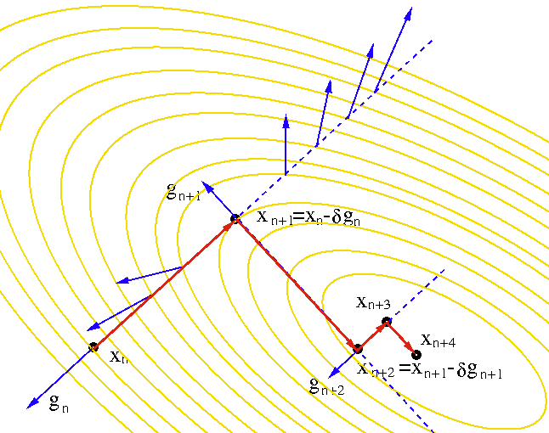
the new search direction will always be perpendicular to the previous direction.

Slide 11
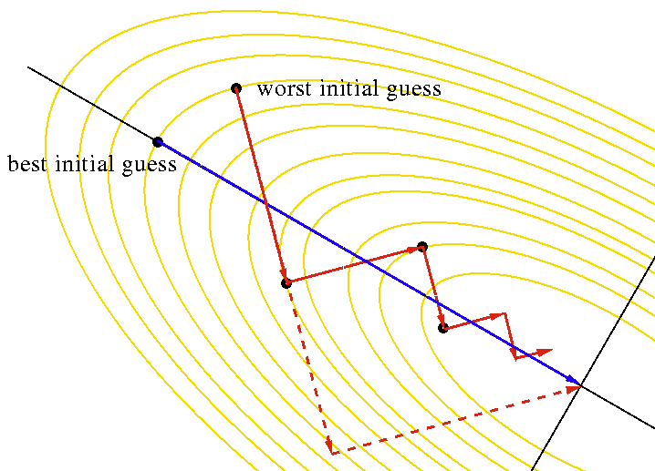
the new search direction will always be perpendicular to the previous direction.

Slide 12
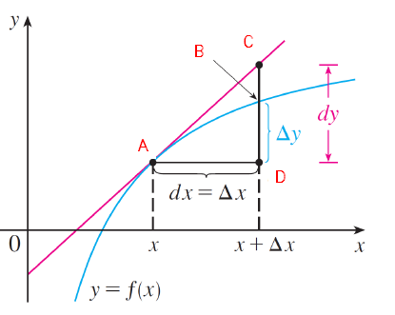
Linear Approximation
Assuming the function is linear at a point.
L=f’(x)
f(x+Δx) ≈ L(x+Δx)
lim _{(Δx→0)} ( f(x+Δx) - L(x+Δx) ) = 0
L(x+Δx) =f(x) + dy = f(x) + Δx f'(x) since f’(x)=dy/dx
New point: domx=x+Δx,
Δx=domx-x, f(domx) ≈ f(x)+(domx-x)f’(x)

Slide 13
Linear Approximation Example 1
(1.0002)⁵⁰ ≈?
f(x)=x⁵⁰
f(x+Δx) ≈ f(x) + Δx f'(x)
domx=1.0002, x=1 , Δx=0.0002
f(1+0.0002) ≈ f(1) + 0.0002 f'(1)
f(1+0.0002) ≈ f(1) + 0.0002 * 50 * 1⁴⁹
f(1+0.0002) ≈ 1 + 0.0002 * 50 * 1 = 1.01

Slide 14
Linear Approximation Example 2
Find the linear approximation for x tends to 1 where f(x) = ln x.
f(x+Δx) ≈ f(x) + Δx f'(x)
domx=x+Δx , Δx = domx-x , x=1, f’(x)=1/x
f(domx) ≈ ln 1 + f'(1) (domx - 1) = domx -1
ln x ≈ x-1 , for x close to 1
For x tends to 2
Δx = domx-x, x=2
f(domx) ≈ ln 2 + f'(2) (domx - 2) = ln 2 + (domx-2)/2
ln x ≈ ln 2+ (x-2)/2 , for x close to 2

Slide 15
For a better approximation
1st order Taylor: (linear approx.)
f(x+Δx) ≈ f(x) + Δx f'(x)
2nd order Taylor: (non-linear approx.)
f(x+Δx) ≈ f(x) + Δx f'(x) + ½ f''(x) Δx²
…
N^{th} order Taylor: (non-linear approx.)
f(x+Δx) ≈ ∑ (f ^{(i)’}(x) Δx^{i} )/ i! i=0…N

Slide 16
Function approx. with Taylor
All approximations passes
from (0.25, f(0.25))
f(x)=exp(x), N=0:5, X=0.25
Red: real f, Blues and green: approximations
Green: The last approx.
approx_taylor.m

Slide 17
Function approx. with Taylor
All approximations passes
from (1.25, f(1.25))
f(x)=exp(x), N=0:5, X=1.25
Red: real f, Blues and green: approximations
Green: The last approx.
approx_taylor.m

Slide 18
Function approx. with Taylor
f(X)=sin(x)
X=1.25
N=0:15
Red: real f
Blues and green: approximations
Green: The last approx.
approx_taylor.m

Slide 19
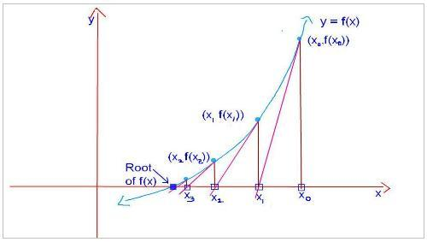
Finding a root of f(x) iteratively (find a point x where f(x)=0) Newton Raphson 1st order
f′(x_{n}) = f(x_{n}) / (x_{n} - x_{n+1})
x_{n} - x_{n+1}= f(x_{n}) / f′(x_{n})
x_{n+1} = x_{n} - f(x_{n}) / f′(x_{n}) n = 0,1,2,3....
If we require the root correct up to 6 decimal places, we stop when the digits in x_{n+1} and x_{n} agree till the 6th decimal place.

Slide 20
Newton Raphson- 1st order

Slide 21
Example
Find sqrt(2)
Means find the root of x²-2=0
x₀=1
x_{n+1}= x_{n}-f(x_{n})/f’(x_{n})
x_{n+1}= x_{n} - (x_{n}*x_{n}-2)/(2*x_{n})
x₀=1 x₁=1.5 x₂=1.41667 x₃=1.41422 x₄=1.41421 if the current improvement (0.00001) is insignificant, we can say sqrt(2) =1.41421, if not go on the iterations.

Slide 22
Taylor Series - Newton Raphson 2nd order
1st order Taylor:
f(x+Δx) ≈ f(x) + Δx f'(x) (1)
According to 1st order Taylor, to find f(x+Δx)=0,
Δx=-f(x)/f’(x)
To find f(x+Δx)’=0, take derivative of (1)
f'(x+Δx) ≈ f’(x) + Δx f‘’(x)
Δx=-f’(x)/f’’(x) ← Newton Raphson 2nd order
x_{n+1} = x_{n} - f(x_{n}) / f′(x_{n})
Δx = x_{n+1} - x_{n}

Slide 23
Newton Raphson
Generally faster converge, because it uses more information (2nd derivative)
No explicit step size selection
1st order : x_new = x_old - f/df; (f(x)=0)
2nd order : x_new = x_old - df/ddf; (f’(x)=0)
instead of x_new = x_old - eps * df; (gradient descent)

Slide 24
Gradient Descent
Step size=0.01
Starting point=-1.9
Newton Raphson 2nd order
Does not converge with 200 iterations
Converged at 20 iterations
newton_raphson_1.m

Slide 25
newton_raphson_1.m 2nd order finds f’(x)=0
Blue f
Red f’
Green f’’

Slide 26
newton_raphson_1.m 1nd order finds f(x)=0
Blue f
Red f’
Green f’’

Slide 27
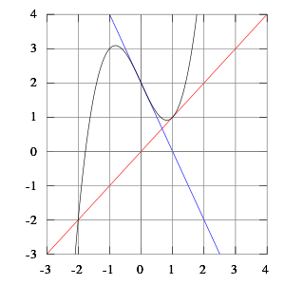
Newton Raphson 1st order -Cycle problem
The tangent lines of x³ - 2x + 2 at 0 and 1 intersect the x-axis at 1 and 0 respectively.
What happened if we start at a point in (0,1) interval?
If we start at 0.1, it goes to 1, then it goes to 0, then it goes to 1 …

Slide 28
Newton Raphson
Faster convergence (lower iteration number)
But, more calculation for each iteration

Slide 29
References
http://math.tutorvista.com/calculus/newton-raphson-method.html
http://math.tutorvista.com/calculus/linear-approximation.html
http://en.wikipedia.org/wiki/Newton's_method
http://en.wikipedia.org/wiki/Steepest_descent
http://www.pitt.edu/~nak54/Unconstrained_Optimization_KN.pdf
http://mathworld.wolfram.com/MatrixInverse.html
http://lpsa.swarthmore.edu/BackGround/RevMat/MatrixReview.html
http://www.cut-the-knot.org/arithmetic/algebra/Determinant.shtml
Matematik Dünyası, MD 2014-II, Determinantlar
http://www.sharetechnote.com/html/EngMath_Matrix_Main.html
Advanced Engineering Mathematics , Erwin Kreyszig, 10th Edition, John Wiley & Sons, 2011
http://en.wikipedia.org/wiki/Finite_difference
http://ocw.usu.edu/Civil_and_Environmental_Engineering/Numerical_Methods_in_Civil_Engineering/NonLinearEquationsMatlab.pdf
http://www-math.mit.edu/~djk/calculus_beginners/chapter09/section02.html
http://stanford.edu/class/ee364a/lectures/intro.pdf
http://fourier.eng.hmc.edu/e176/lectures/NM/node28.html

