Slide 1
Data Modelling and Regression Techniques
M. Fatih Amasyalı

Slide 2
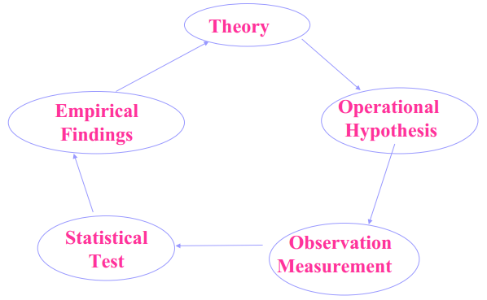
The traditional scientific approach

Slide 3
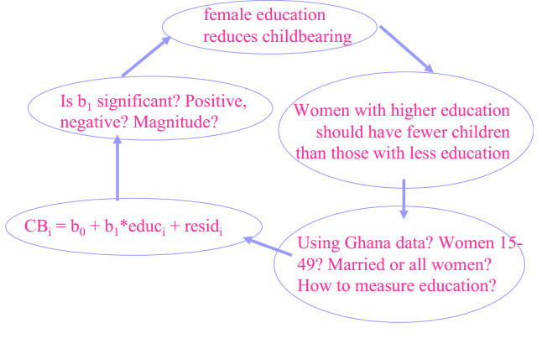
Example of a scientific approach
Mathematical Model
How much data should be collected?
What data should be collected?
What happens if your model does not fit
your theory/hypothesis?

Slide 4
A model is an underlying theory about how the world works. It includes:
Assumptions
Key players (independent variables)
Interactions between variables
Outcome set (dependent variables)
CB=x1+educ*x2+resid
Assumptions?, variables?, interactions?

Slide 5
Regression Models
Relationship between one dependent variable and explanatory variable(s)
Use equation to set up relationship
Numerical Dependent (Response) Variable
1 or More Numerical or Categorical Independent (Explanatory) Variables

Slide 6
Regression Modeling Steps
1. Hypothesize Deterministic Component
Estimate Unknown Parameters
2. Evaluate the fitted Model
3. Use Model for Prediction & Estimation

Slide 7
Specifying the deterministic component
1. Define the dependent variable and independent variable(s)
2. Hypothesize Nature of Relationship
Expected Effects (i.e., Coefficients’ Signs)
Functional Form (Linear or Non-Linear)
Interactions

Slide 8
Model Specification Is Based on Theory
Previous Research
‘Common Sense’
Data (which variables, linear/non-linear etc.)

Slide 9
Thinking Challenge: Which Is More Logical? X: How many hours did you study in the night before the exam? Y: your exam grade
Notes:
17

Slide 10
Types of Regression Models
The linear first order model Y=β₀+ β₁X+ε
The linear second order model Y=β₀+ β₁X+ β₂X²+ ε
The linear n order model Y=β₀+ β₁X+ β₂X²+ … + β_{n}X^{n}+ ε
ε is random error.
The word linear refers to the linearity of the parameters β_{i} .
The order (or degree) of the model refers to
the highest power of the predictor variable X.
Notes:
24

Slide 11
Types of Regression Models
If the parameters are linear related to the each other the model is linear. A non-linear first order model: Y=(β₀X) / (β₁+X)+ε
If X has d dimensions, a linear first order model: Y=β₀+ β₁X₁+ β₂X₂+ … + β_{d}X_{d}+ ε

Slide 12
A linear first order model Y=β₀+ β₁X+ε
To get the model, we need to estimate the parameters β₀ and β₁
Thus, the estimate of our model is
Y_{hat} denotes the predicted value of Y for some value of X, and β_{0hat} and β_{1hat} are the estimated parameters.

Slide 13
An Old Friend
Notes:
28

Slide 14
Population & Sample Regression Models
Population
Random Sample
Unknown Relationship
☺
☺
☺
☺
☺
☺
☺
Mostly, you can not reach the all population.
Notes:
34

Slide 15
Population Linear Regression Model
Observed value
ε_{i} = Random error
Observed value
Notes:
35

Slide 16
Sample Linear Regression Model
ε_{i} = Random error
^
Unsampled observation
Observed value
Notes:
36

Slide 17
Estimating Parameters: Least Squares Method
Notes:
40

Slide 18
Least Squares
1. ‘Best Fit’ means difference between actual Y values & predicted Y values are a minimum. But positive differences off-set negative. So square errors!
2. LS Minimizes the Sum of the Squared Differences (errors) (SSE)
Mean squared error (MSE)=
Notes:
51

Slide 19
Least Squares Graphically
Notes:
52

Slide 20
Interpretation of Coefficients
^
1. Slope (β₁)
Estimated Y Changes by β₁ for Each 1 Unit Increase in X
If β₁ = 2, then Y Is Expected to Increase by 2 for Each 1 Unit Increase in X
2. Y-Intercept (β₀)
Average Value of Y When X = 0
If β₀ = 4, then Average Y Is Expected to Be 4 When X Is 0
^
^
^
^

Slide 21
Assume that our model is Y=β
How can we estimate β using LS?
Least Squares Minimize squared error

Slide 22
A new look
A linear first order model (X has d dim.)
Y=β₀+ β₁X₁+ β₂X₂+ … + β_{d}X_{d}+ ε
This can be written in matrix form as
Y_{n*1}=X _{n*(d+1)}β_{(d+1)*1}+ ε_{n*1}
n is the sample size

Slide 23
Example-1
Y_{n*1}=X _{n*(d+1)}β_{(d+1)*1}+ ε_{n*1}
n =4, d=1

Slide 24
Example-2
Y_{n*1}=X _{n*(d+1)}β_{(d+1)*1}+ ε_{n*1}
n =4, d=2

Slide 25
Example-3
n =4, d=1(2), order=2

Slide 26
All examples have the following form:
Y=Xβ
How can we estimate β?
X⁻¹Y=X⁻¹Xβ (X⁻¹X=I)
β=X⁻¹Y (OK, but what if X is not square matrix?)
X^{T}Y=X^{T}Xβ (X^{T}X is always a square matrix)
(X^{T}X)⁻¹(X^{T}Y)=(X^{T}X)⁻¹(X^{T}X)β [(X^{T}X)⁻¹(X^{T}X)=I]
β=(X^{T}X)⁻¹(X^{T}Y)

Slide 27
Lin_reg1.m

Slide 28
Sample size effect lin_reg1.m
N=6
N=600

Slide 29
Error rate effect lin_reg1.m
e=randn/10
e=randn/2

Slide 30
Y=b0+b1*x+b2*x^2 Lin_reg2.m

Slide 31
Real 2nd order, estimated 1st and 2nd order Lin_reg3.m

Slide 32
Real 1st order, estimated 1st and 2nd order Lin_reg4.m
← What happens in these areas? →

Slide 33
% real model Y=B0+B1*X+B2*X^2+B3*X^3 % estimated model1 Y=B0+B1*X % estimated model2 Y=B0+B1*X+B2*X^2 % estimated model3 Y=B0+B1*X+B2*X^2+B3*X^3
B = [ 1 -4 4 -1]’
fBhat = [ 16.3823 -9.4018 ]’
sBhat = [ 10.3682 -11.4712 1.1441 ]’
tBhat = [ 1.0170 -4.0199 3.9625 -0.9901 ]’
Lin_reg5.m

Slide 34
X-error graph
If there is a pattern in X-error graph, there is something unmodeled.
If the model degree is sufficient,
the errors have the same variances along X.

Slide 35
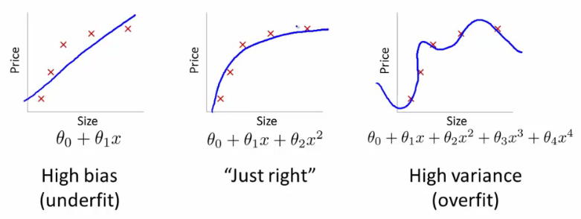
Overfitting
Overfitting occurs when a statistical model describes random error or noise instead of the underlying relationship.

Slide 36
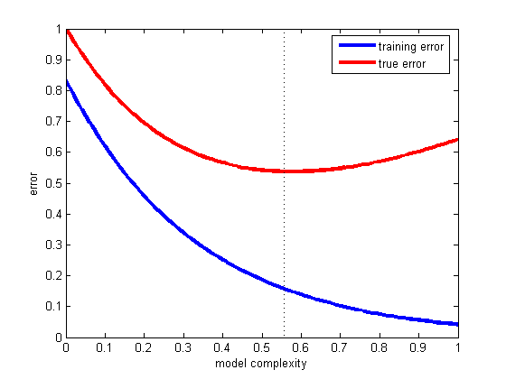
Model Validation
Training set MSE is not reliable. WHY?
Because, we can not determine the overfitting with training set MSE.
Training set is used for parameter estimation.
Test set is used for model validation.

Slide 37
Model Validation
Training and test sets are seperated data samples.
Lin_reg6.m

Slide 38
Y=X*β Linear System Construction
Data= (X_{n*d},Y_{n*1})
n: number of data, d: dimension of data
Model Y= β1 + β2*X
X_{n*2}=[1_{n*1} X_{n*1}] β_{2*1}=[β1 ; β2]
Model Y= β1*X + β2*X^2
X_{n*2}=[X_{n*1} X²_{n*1}] β_{2*1}=[β1 ; β2]
Model Y= β1 + β2*X1^2 + β3*X1^3
X_{n*3}=[1_{n*1} X1²_{n*1} X1³_{n*1}] β_{3*1}=[β1 ; β2 ; β3]

Slide 39
Y=X*β Linear System Construction
Model Y= β1*X + β2*cos(X^2)
X_{n*2}=[X_{n*1} cos(X²)_{n*1}] β_{2*1}=[β1 ; β2]
Model Y= β1*X1 + β2*cos(X2^2) + β3*sin(X1)
X_{n*3}=[X1_{n*1} cos(X2²)_{n*1} sin(X1)_{n*1}] β_{3*1}=[β1 ; β2 ; β3]
Model Y= β1 + β2*X1*X2*X3 + β3*X1
X_{n*3}=[1_{n*1} X1*X2*X3_{n*1} X1_{n*1}] β_{3*1}=[β1 ; β2 ; β3]

Slide 40
model Y=B0+B1*X1+B2*X2 multivariate first order
B = [ 3 -3 1]’
Bhat =[ 3.0216 -3.0439 1.0387]’
Lin_reg7.m

Slide 41
model Y=B0+B1*X1+B2*X2+B3*X1^2+B4*X2^2+B5*X1*X2 multivariate second order
Lin_reg8.m
B= [1.3666 -0.2511 0.5365 -0.4343 1.4466 0.8925]’
Bhat = [1.3656 -0.2548 0.5247 -0.4571 1.4572 0.9054]’

Slide 42
What if we can not write linear equation system?
(linear according to b)
Y=b1*sin(X)
Y=X1*b1*sin(X2)
Y=b1*sin(X) +b2*cos(X)
Y=b1*exp(X) +b2*cos(X)
Y=b1*exp(X1) +b2*cos(X2)+b3*cos(X1)
(non-linear according to b)
Y=sin(b1*X)
Y=b1+sin(b2*X)
Y=exp(b1*X)
Y=(b1*X)/(b2+X)
Y=b1*(exp −((X−b2)^2 /(b3^2))

Slide 43
Non-linearity
A parameter β of the function f appears nonlinearly if the derivative ∂f/∂β is a function of β.
The model M(β, x) is nonlinear if at least one of the parameters in β appear nonlinearly.
f(x)= β*sin(x), ∂f/∂β =sin(x), which is independent of β, so the model M(β,x) is linear.
f(x)=sin(β*x), ∂f/∂β =x*cos(β*x), which is dependent of β, so the model M(β,x) is non-linear.

Slide 44
Non-linearity
f(x)= β1*sin(x) + β2*cos(x) , ∂f/∂β1 =sin(x), which is independent of β1, ∂f/∂β2 =cos(x), which is independent of β2, so the model M(β,x) is linear.
f(x)= β1+ cos(β2*x) , ∂f/∂β1 =1, which is independent of β1, but ∂f/∂β2 = -x*sin(b2*x), which is dependent of β2, so the model M(β,x) is non-linear.

Slide 45
What if we can not write linear equation system?
There are two ways:
Transformations to achieve linearity
Nonlinear regression (iterative estimation)

Slide 46
Transformations to achieve linearity
Some tips:
ln(e)=1, ln(1)=0
ln(x^r)=r*ln(x)
ln(e^A)=e^ln(A)=A
ln(A*B)=ln(A)+ln(B)
ln(A/B)=ln(A)-ln(B)
e^(A*B)=(e^A) ^B
e^(A+B)=(e^A) *(e^B)
e^(A-B)=(e^A) /(e^B)

Slide 47
Transformations to achieve linearity
Original Y=b0*exp(b1*X)
ln (Y)= ln(b0)+(b1*X)
Z=ln(Y), b2=ln(b0)
Z=b2+b1*X (linear)
Original Y=exp(b0)*exp(b1*X)
ln(Y)=b0+b1*X
Z=ln(Y)
Z=b0+b1*X (linear)

Slide 48
Transformations to achieve linearity
Original Y=(b0+b1*X)^2
sqrt(Y)= b0+b1*X
Z=sqrt(Y),
Z=b0+b1*X (linear)
Original Y=1/(b0+b1*X)
1/Y=b0+b1*X
Z=1/Y
Z=b0+b1*X (linear)

Slide 49
Nonlinear regression (iterative estimation)
Data={x_{i} , y_{i} } i=1..n (n= number of data points)
y=f(β,x)
x = n*d matrix
y= n*1 matrix
r_{i}=y_{i}-f(β,x_{i}) r= residuals (n*1 matrix)
β = parameters to be optimized
E(β)=∑(r_{i})^2 i=1..n
min_{β} E(β)
dE(β)/dβ = 0 (optimize E according to β)

Slide 50
Nonlinear regression (iterative estimation)
dE(β)/dβ= 2*r*dr/dβ
dr/dβ= n*d matrix = [dr₁/dβ₁ dr₁/dβ₂ … dr₁/dβ_{d}
dr₂/dβ₁ dr₂/dβ₂ … dr₂/dβ_{d}
…
dr_{n}/dβ₁ dr_{n}/dβ₂ … dr_{n}/dβ_{d}]
dr/dβ is called Jacobian matrix (J)
β_{k+1}= β_{k}-eps*dE(β)/dβ (Gradient descent)
β_{k+1}= β_{k}-eps*J^{T}*r (Gradient descent)
(d*1)=(d*1)-eps(d*n)*(n*1)

Slide 51
Nonlinear regression (iterative estimation)
β_{k+1}= β_{k}-eps*dE(β)/dβ (Gradient descent)
β_{k+1}= β_{k}-(dE(β)/dβ) / (ddE(β)/ddβ) (Newton Raphson)
ddE(β)/ddβ ≈ J^{T}*J
β_{k+1}= β_{k}-(J^{T}*r ) / (J^{T}*J)
β_{k+1}= β_{k}- inv(J^{T}*J)*(J^{T}*r)
pinv(J)=inv(J^{T}*J)*J^{T}
β_{k+1}= β_{k}- pinv(J)*r (Newton Raphson)
β_{k+1}= β_{k}-eps*J^{T}*r (Gradient descent)

Slide 52
Y=sin(b1*X)
Blue points: data
Green line: initial guess
Blue lines: iterative guesses
Red line: last guess
Gradient descent
Eps=0.0005
Real b=-0.5
initial b=-1
Non_lin_reg0.m

Slide 53
Y=sin(b1*X)
Gradient descent
Eps=0.01
Real b=-0.5
initial b=-1
Non_lin_reg0.m

Slide 54
Y=sin(b1*X)
Newton raphson
Real b=-0.5
initial b=-1
Non_lin_reg0.m

Slide 55
Y=sin(b1*X)
Newton raphson
Real b=-0.5
initial b=-2
Non_lin_reg0.m

Slide 56
Y=sin(b1*X) b1 vs. error
B1=-0.5
Non_lin_reg1.m

Slide 57
Y=exp(-(X-B1)^2/(2*B2^2))
Blue points: data
Green line: initial guess
Blue lines: iterative guesses
Red line: last guess
Gradient descent
Eps=0.1
Real B=[-0.2 ; 1.5]
initial B= [-2; -0.2]
Non_lin_reg2.m

Slide 58
Y=exp(-(X-B1)^2/(2*B2^2))
Blue points: data
Green line: initial guess
Blue lines: iterative guesses
Red line: last guess
Gradient descent
Eps=0.01
Real B=[-0.2 ; 1.5]
initial B= [-2; -0.2]
Non_lin_reg2.m

Slide 59
Y=exp(-(X-B1)^2/(2*B2^2))
Blue points: data
Green line: initial guess
Blue lines: iterative guesses
Red line: last guess
Newton raphson
Real B=[-0.2 ; 1.5]
initial B= [-2; -0.2]
Non_lin_reg2.m

Slide 60
Y=exp(-(X-B1)^2/(2*B2^2)) b vs. error
B=[-0.2 ; 1.5]
Why symmetric?
Non_lin_reg3.m

Slide 61
Modeling Interactions
Statistical Interaction: When the effect of one predictor (on the response) depends on the level of other predictors.
Can be modeled (and thus tested) with cross-product terms (case of 2 predictors):
Y = β₀ + β₁X₁ + β₂X₂ + β₃X₁X₂

Slide 62
Regression Picture
y_{i}
C
A
B
y
B
A
C
y_{i}
*Least squares estimation gave us the line (β) that minimized C²
x
A² B² C²
SS_{total}
Total squared distance of observations from naïve mean of y
Total variation
SS_{reg}
Distance from regression line to naïve mean of y
Variability due to x (regression)
SS_{residual}
Variance around the regression line
Additional variability not explained by x—what least squares method aims to minimize
R²=SSreg/SStotal

Slide 63
References
http://www.columbia.edu/~so33/SusDev/Lecture3.pdf
http://www.msu.edu/~fuw/teaching/Fu_Ch11_linear_regression.ppt
http://www.holehouse.org/mlclass/10_Advice_for_applying_machine_learning.html
http://www.imm.dtu.dk/~pcha/LSDF/NonlinDataFit.pdf
http://fourier.eng.hmc.edu/e176/lectures/NM/node34.html
http://fourier.eng.hmc.edu/e176/lectures/NM/node21.html
http://www.kenbenoit.net/courses/ME104/logmodels2.pdf
http://stattrek.com/regression/linear-transformation.aspx
http://en.wikipedia.org/wiki/Data_transformation_(statistics)

