Slide 1
8251 -USART
Serial I/O - Programmable Communication Interface

Slide 2
Data Communications
Data communications refers to the ability of one computer to exchange data with another computer or a peripheral
Physically, the data comm. path may be a short, 5 to 10 feet ribbon cable connecting a microcomputer and parallel printer; or it might be a high speed telecommunications port connecting two computers thousands of miles apart.
Standard data communication interfaces and standards are needed
Centronic’s parallel printer interface
RS-232 defines a serial communications standard
We focus on serial I/O this week
8251 USART (Universal Synchronous/Asynchronous Receiver/Transmitter) is the key component for converting parallel data to serial form and vice versa
Two types of serial data communications are widely used
Asynchronous communications
Synchronous communications

Slide 3
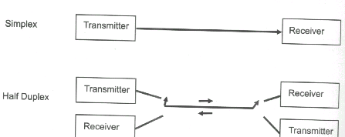
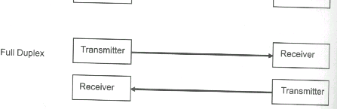
Types of Transmission

Slide 4
Asynchronous Communications
Eliminates the need for a clock signal between two microprocessor based systems
System 1
Transmit data
System 2
Receive data
Signal common

Slide 5
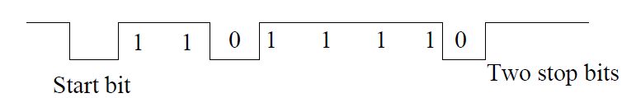
Asynchronous Communications
Data to be transmitted is sent out one character at a time and the receiver end of the communication line synchronization is performed by examining synchronization bits that are included at the beginning and at the end of each character

Slide 6
Examples
What is the data rate in bits/sec and character rate if the bit time is 3.33 ms
Bit rate = 1 / 3.33 ms = 300 bits/sec
11 x 3.33 ms = 36.63 ms required to transmit a character so character rate = 1/36.63 ms = 27.3 char/sec
Modems typically transmit data over the telephone network at 9600, 14400, 28800 or 56K bps.
Ex: If 1 MByte file is to be transmitted to another computer using a modem calculate the transmission time
9600 bps: 1048576x10/ 9600 bits/sec = 1092 s = 18 minutes and 12 sec
28800 bps: 364 s = 6 minutes and 4 sec

Slide 7
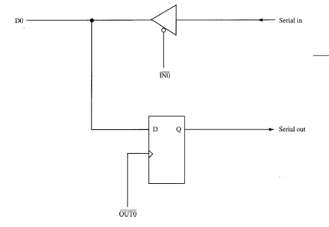
Building a Serial I/O port –Transmitter section
This program serializes data through software

Slide 8
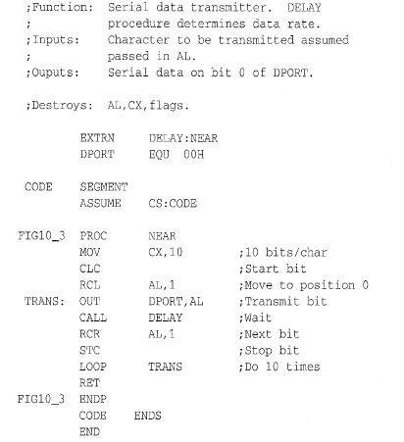
Building a Serial I/O port –Transmitter

Slide 9
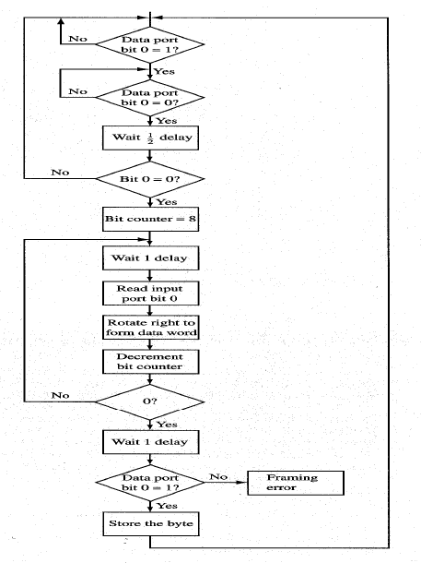
Building a Serial I/O port
Receiver- Flowchart

Slide 10
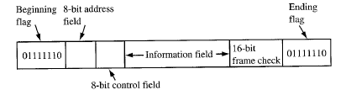
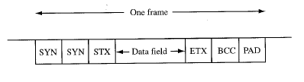
Synchronous Communications
System 1
Transmit data
System 2
Receive data
clk
Signal common
Serial Data Link Control: Developed by IBM used for computer networking (Token Ring). After Flag byte the network address is sent. Control Byte stores information about sequence of data etc. Data is thousands of bits. 16 bit field is used for error checking.
BISYNC: Each block of data has synch characters. The size of block data can be 100 or more bytes. BCC checks for errors.

Slide 11
USART
It is possible to use either of the two methods.
There are special IC chips for serial data communication
UART: universal asynchronous receiver transmitter
USART: universal Synchronous/Asynchronous Receiver/Transmitter
COM port in the original IBM PC uses 8250 UART
INTEL has USART 8251
National Semiconductor’s improved version of 8250A is 16450.
16450, 16550, 16552 (dual 16550)
Data Transmission
simplex
half duplex
full duplex

Slide 12
8251 receiver
The receiver section: whenever RxD line goes low, control assumes it is a start bit, waits for half bit time and samples again.
responsible for reading the serial bit stream of data atRxD(receive data) input and converting it into parallel form.
RxRDY(receive ready) output switched to logic 1 level to tell the microprocessor that a char. is available and is sitting inside the USART and should be read from the receive –buffer register.
RxC Receiver Clock. Controls the rate which bits are received by the USART. In Asynchronous Mode, the clock can be set to 1,16 or 64 times the baud.

Slide 13
8251 transmitter
Transmitter section receives parallel data from the microprocessor over the data bus. The character is then automatically framed with the start bit, parity bit, correct number of stop bits, and put into the transmit data buffer register.
Finally, it is shifted out of this register to produce a bit serial output on the TxD line.
TxRDY is switched to logic 1 when the transmit buffer register is empty.
TxE transmitter Empty –This is an output signal. Logic 1 on this line indicates the output register is empty. Reset when a byte is transferred from the buffer to output registers.
TxC Transmitter Clock. Controls the rate which bits are transmitted by the USART. The clock can be set to 1,16 or 64 times the baud (using Mode Word –next slide)

Slide 14
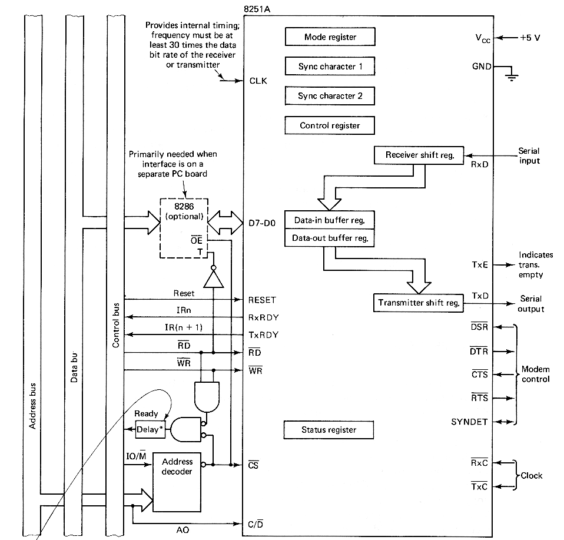
8251A serial com. inter- face

Slide 15
Initializing the 8251
To implement serial communication the MPU must inform the 8251 about the mode, baud, stop bits, parity etc. A set of control words must be loaded.
Mode Words
Specifies general characteristics of the operation.
Command Words
Enables the data transmission and/or reception
Status Word provides the information concerning register status and transmission errors.
Any control word written into the control register after a mode word is interpreted as a command word; that means a command word can be changed anytime, however 8251 should be reset prior to writing a Mode word.
8251 can be reset internally by using the Internal Reset Bit D6.

Slide 16
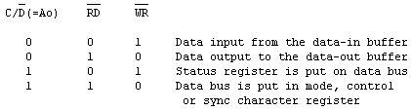
8251 A Serial Communication Interface
The 8251A internally interprets the C/D,RD and WR signals as follow:
Whether the mode, control or sync character register is selected depends on the accessing sequence.
A flowchart of the sequencing is given in Fig.

Slide 17
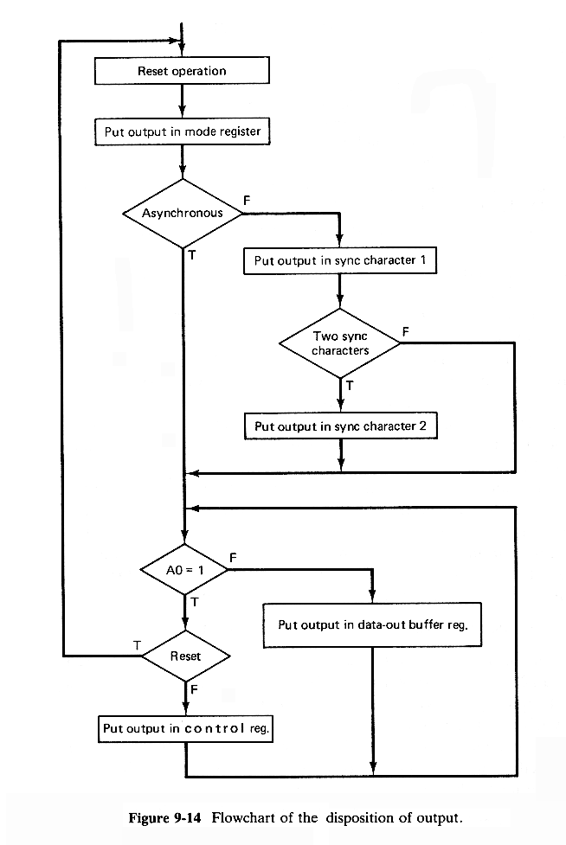

Slide 18
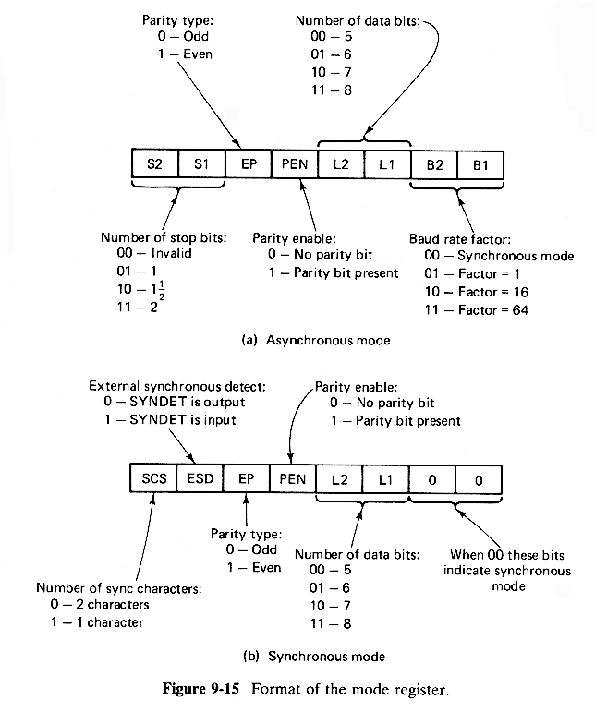
Format of the mode register
What value must be written into the mode control register with baud rate divided by 16, char. Size 16 bits, odd parity, one stop bit ?
------------------------------------
01011110 b = 5Eh

Slide 19
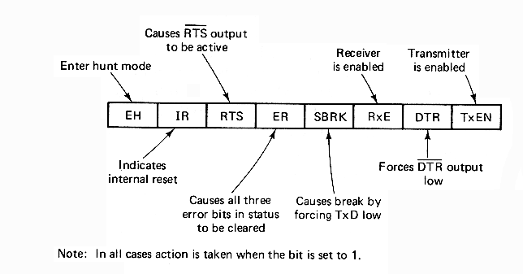
Format of the control register

Slide 20
Example 1
A program sequence which initializes the mode register and gives a command to enable the transmitter and begin an asynchronous transmission of 7-bit characters followed by an even-parity bit and 2 stop bits is:
MOV AL,11111010B
OUT 51H,AL
MOV AL,00110011B
OUT 51H,AL

Slide 21
Example 2
This sequence assumes that the mode and control registers are at address 51H and the clock frequencies are to be 16 times the corresponding baud rates.
The sequence:
MOV AL,00111000B
OUT 51H,AL
MOV AL,16H
OUT 51H,AL
OUT 51H,AL
MOV AL,10010100B
OUT 51H,AL
would cause the same 8251A to be put in synchronous mode and to begin searching for two successive ASCII sync characters

Slide 22
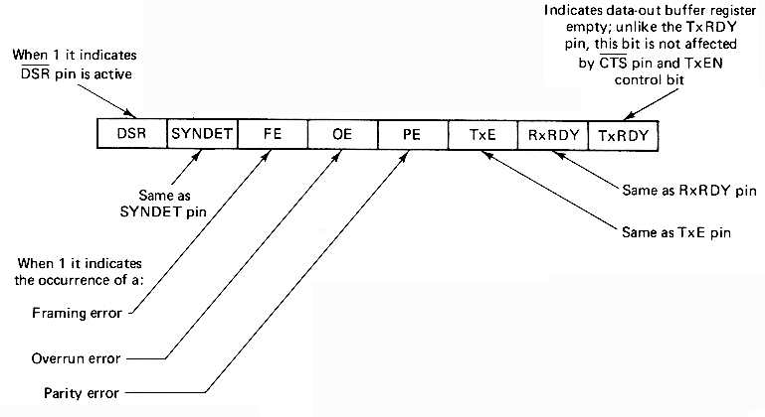
Format of the status register

Slide 23
Example 3
A typical program sequence which uses programmed I/O to input 80 characters from the 8251A, whose data buffer register's address is 0050, and put them in the memory buffer beginning at LINE.

Slide 24
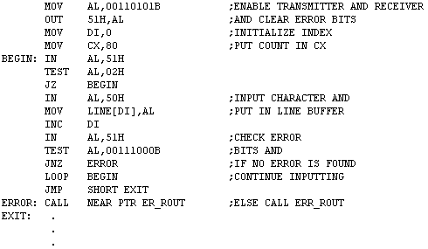

Slide 25
Example 4
1000 000 0 : data register address: xx80h
1000 000 1: control or status register address: xx81h
Mode word:
2 stop bits. no parity, 8 bit characters. Baud rate factor of 16 (1200 Kbps)
1110 1110 =EEh
Command Word:
0001 0101 = 15h ; enable TxRDY and RxRDY and reset all flags first

Slide 26
INIT8251:MOV AL,0EEh
OUT 81h, AL
MOV AL, 15h
OUT 81h, AL
CHKRX:IN AL,81h
ROR AL,1
ROR AL,1
JNC CHKRX
IN AL,80h
NOT AL
MOV BL,AL
CHKTX:IN AL,81h
ROR AL,1
JNC CHKTX
OUT 80h,AL
JMP CHKRX
Initialize the Mode Word andCommand Word
Receive Ready?
If Ready get data
Send data if the T buffer register is available

