Slide 1

Uptime Guard
Preventive Maintenance & Lubrication Tracking
From paper BF / CF / DF checklists to one live, permanent record.

Slide 2
The Problem With Paper Checklists
Every corrugator plant running BF / CF / DF units on weekly paper sheets runs into the same walls.
No live visibility
Nothing is provable
A “Not Working” point can sit unnoticed for days until someone happens to flip to that page.
Paper can be filled in late, backdated, or simply not filled in — there's no way to tell.
No searchable history
No accountability trail
“When was this last greased?” means digging through binders, unit by unit, week by week.
Shared pens and shared sheets mean it's rarely clear who actually checked what.
UPTIME GUARD
2

Slide 3
One System, One Continuous Loop
Four role tiers, one workflow -- from a tap on the floor to a permanent record.
1
2
3
4
Operator checks a point
Not Working → instant alert
Admin / Engineer follows up
Permanently recorded
→
→
→
Marks it OK or Not Working, right at the machine.
Fires immediately, no waiting for a scheduled sweep.
Sees it, comments, and clears it once resolved.
Timestamped, attributed, and reportable -- forever.
Four roles map to who does which step: Operator → Admin / Lead Operator → Production Engineer → Super Admin, each scoped to their own unit(s).
UPTIME GUARD
3

Slide 4

Every Person Has Their Own Login
No shared accounts, no shared pens.
Every check-off is tied to a real, individual name
Four role tiers: Super Admin, Production Engineer, Admin / Lead Operator, Operator
Each account only ever sees the unit(s) it's assigned to
UPTIME GUARD
4

Slide 5
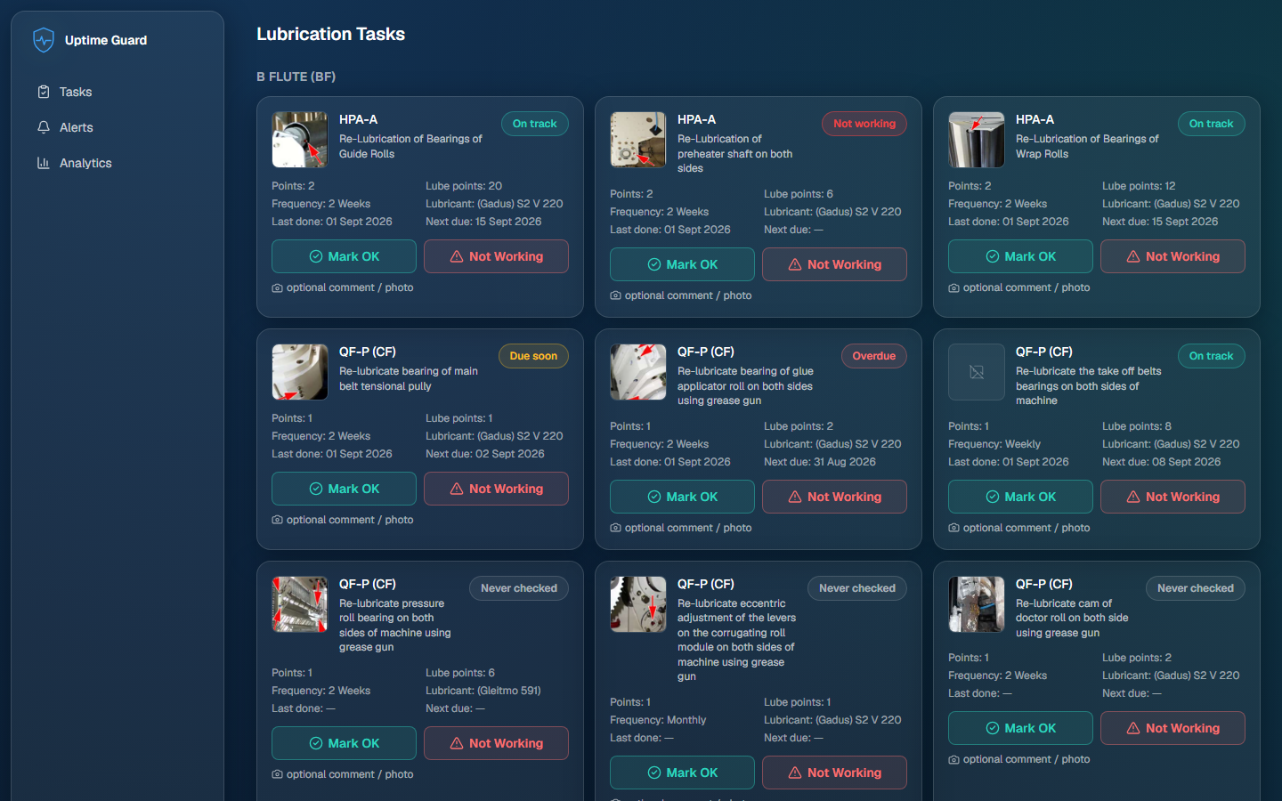
The Daily Checklist, Built From the Real Machines
Every point straight off the BF / CF / DF sheets.
Every lubrication point, with its own reference photo
One tap: Mark OK or Not Working, with an optional comment and photo
Status badges show at a glance what's on track, due soon, overdue, or critical
UPTIME GUARD
5

Slide 6
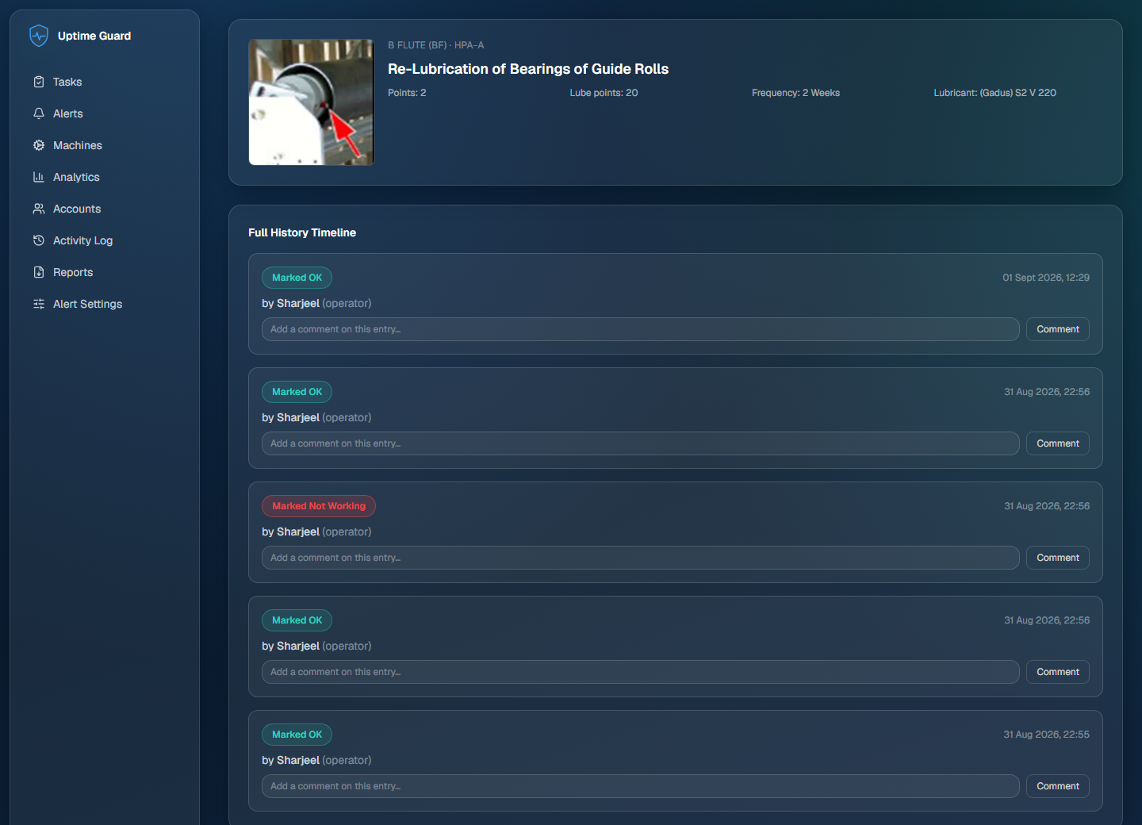
A Permanent Record for Every Lubrication Point
Click into any point to see its whole story.
Full timeline: every check-off, who did it, and exactly when
Nothing is ever edited or deleted — corrections happen by adding a new entry
Comments and photos attach to the exact moment in history they belong to
UPTIME GUARD
6

Slide 7
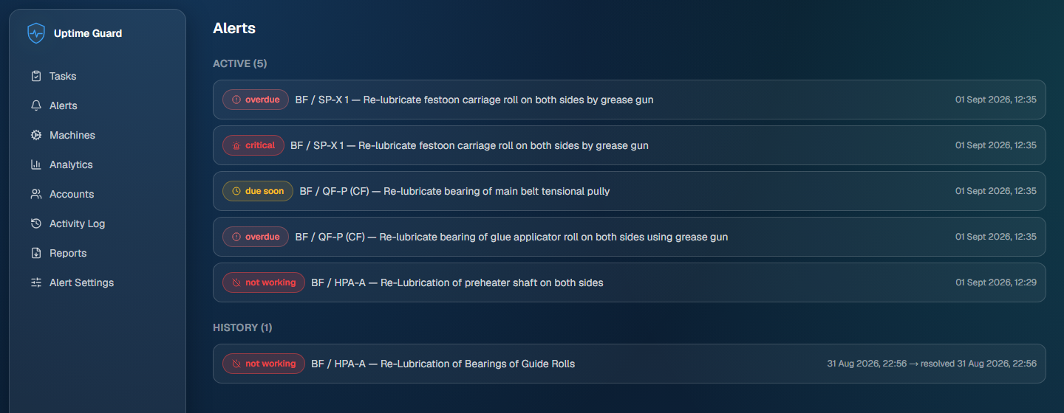
Problems Don't Wait for the Next Shift
Four alert types, escalating automatically.
Marking a point “Not Working” raises an alert immediately
Due-soon, overdue, and critical alerts escalate automatically over time
Alerts stay open until someone with the right access clears them
UPTIME GUARD
7

Slide 8
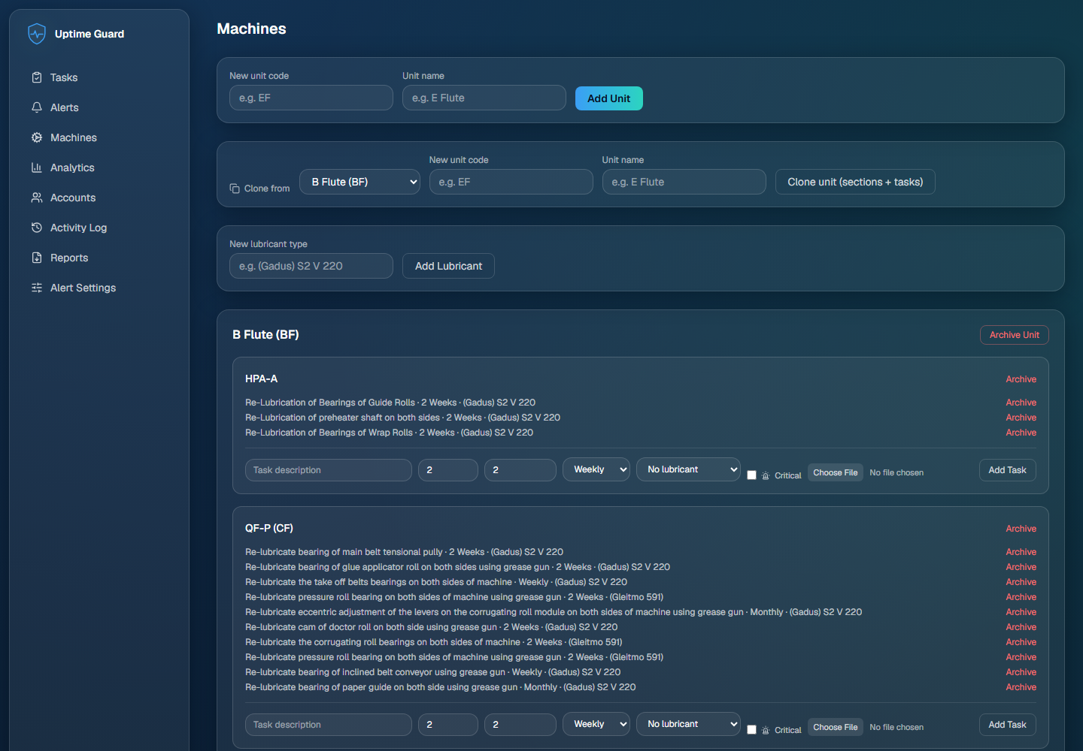
Machines, Sections & Tasks -- All Configurable
The whole plant structure, editable without touching code.
Add or edit units, sections, and individual lubrication points
Clone an entire unit's structure when a new line is added
Attach a reference photo to every task so nobody has to guess which point it means
UPTIME GUARD
8

Slide 9
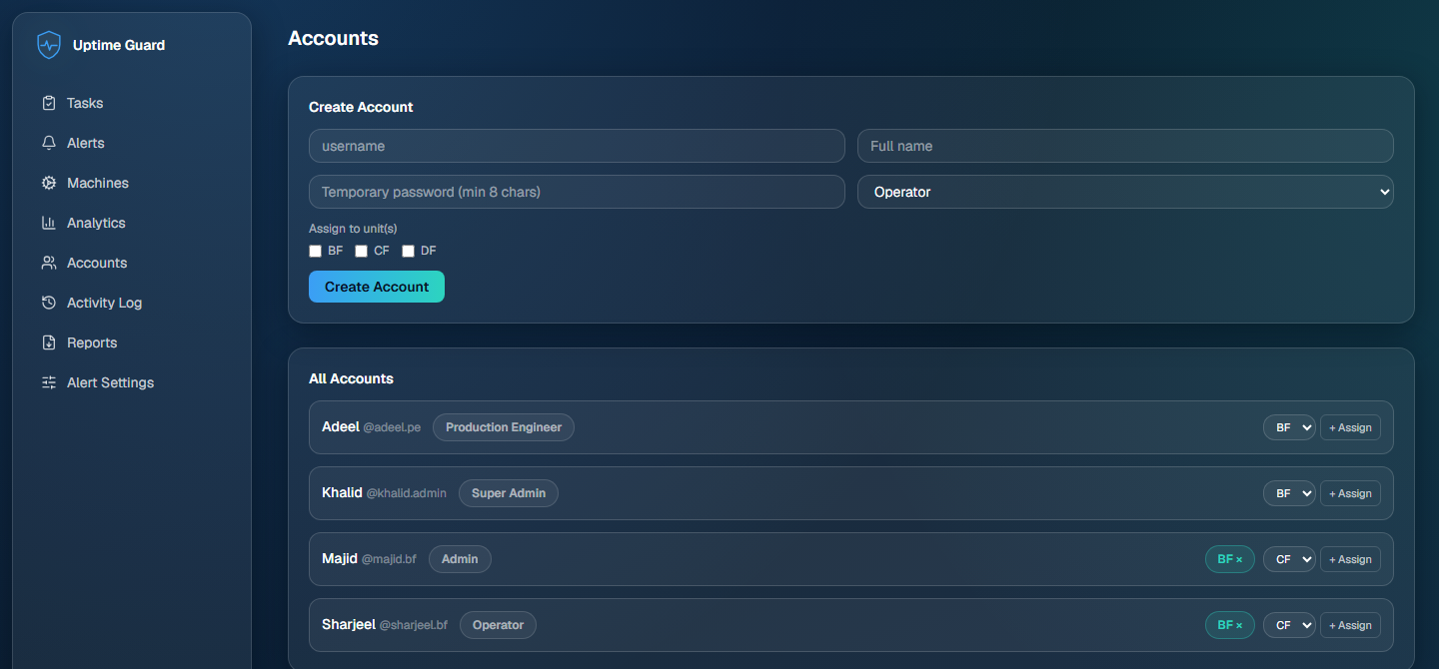
Control Exactly Who Can See and Do What
Access follows the org chart, not shared logins.
Create accounts and assign them to one, several, or all units
Access can be revoked without deleting that person's history
Scoped automatically — Operators and Admins only ever see their own units
UPTIME GUARD
9

Slide 10
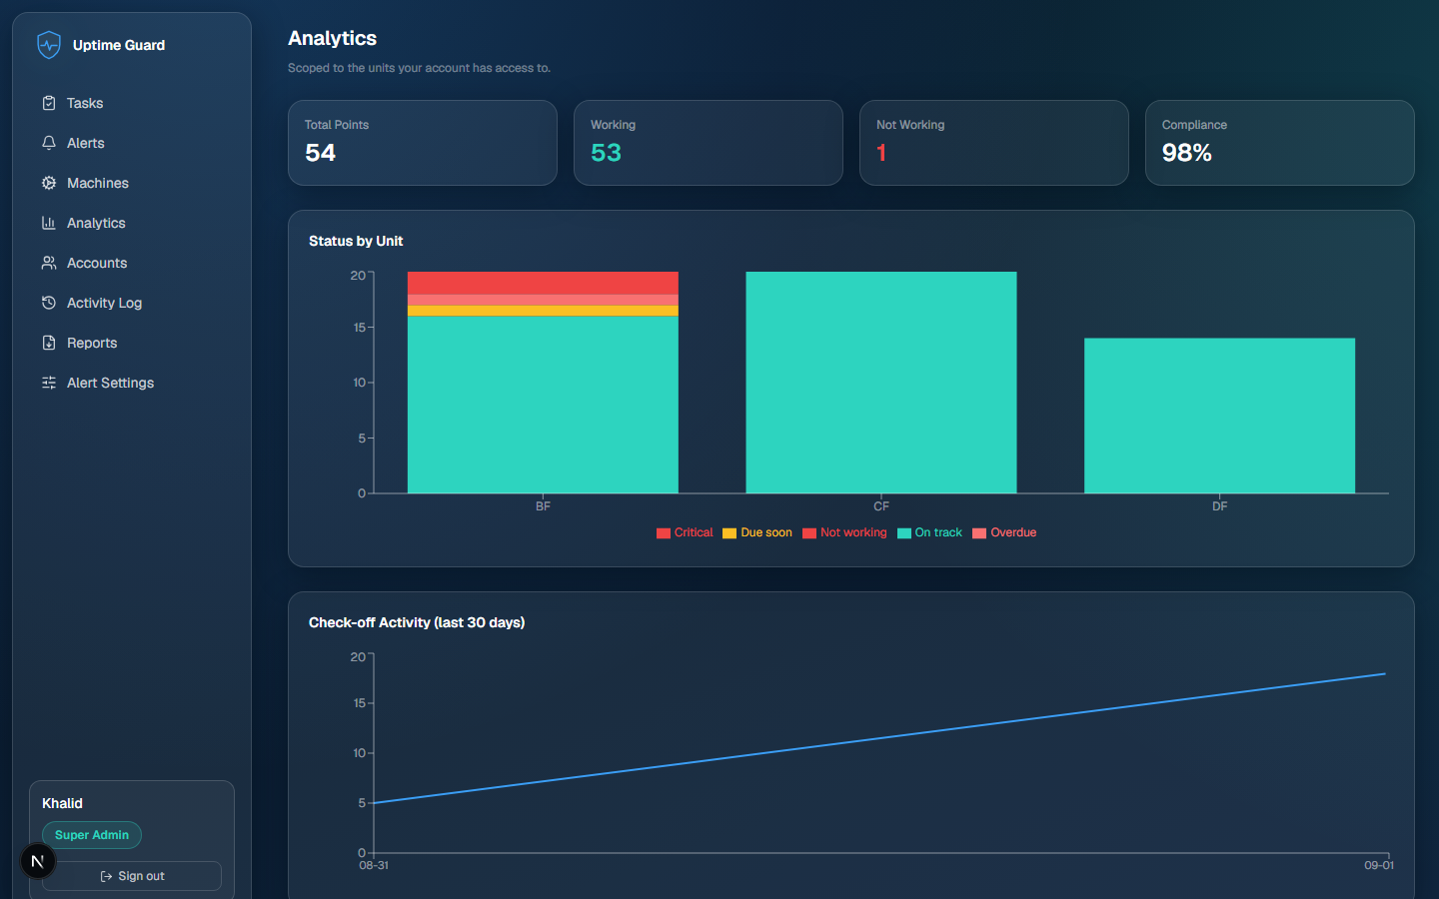
See Compliance at a Glance
The health of every unit, on one screen.
Live compliance percentage and status breakdown, per unit
30-day check-off activity trend
Automatically scoped to whatever the viewer has access to
UPTIME GUARD
10

Slide 11
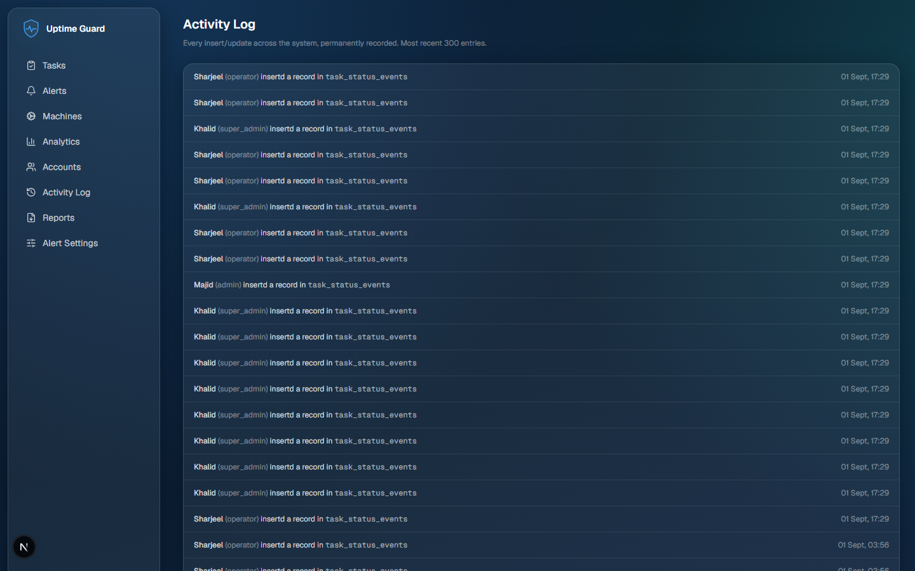
Every Change, Permanently Recorded
One feed, the whole system, no exceptions.
Who changed what, and when — across the entire system
Covers accounts, machines, and settings, not just check-offs
Nothing in this log can be edited or deleted, by anyone
UPTIME GUARD
11

Slide 12
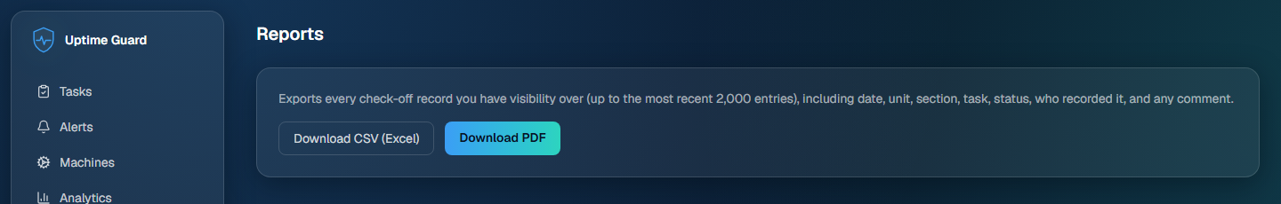
Export Anything, Anytime
Your data, out the door in one click.
One-click CSV export, ready for Excel
One-click PDF report, ready to print or share
Covers every check-off record the viewer has access to
UPTIME GUARD
12

Slide 13
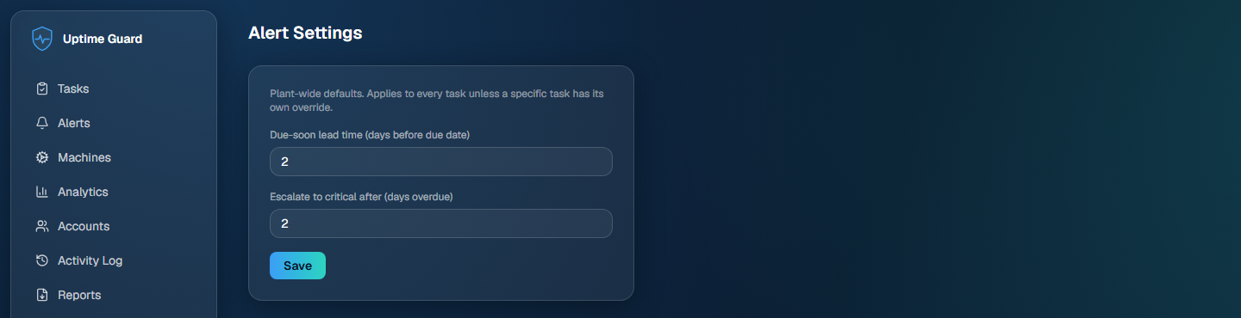
Tune the Warning Windows to Your Plant
Set once, applies everywhere.
Set how many days ahead a “due soon” warning should appear
Set how many days overdue before an item escalates to critical
Plant-wide defaults, controlled by the Super Admin
UPTIME GUARD
13

Slide 14
From Paper to a Living System
Every check-off, every alert, every photo — recorded the moment it happens, and never lost.
1
2
3
Load the real crew accounts
Pick a go-live date
Retire the paper sheets for good
UPTIME GUARD
14

