Slide 1

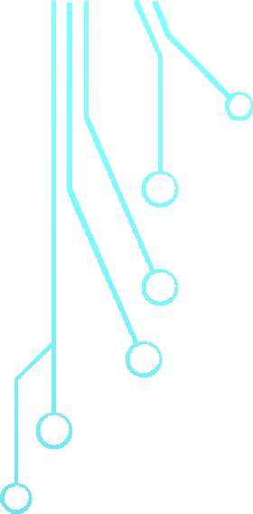










DATA WAREHOUSING
&
Sir Syed University of Engineering & Technology, Karachi
DATA MINING
CS-414 / IT-413
Department of Computer Science & Information Technology
Batch - 2018

Slide 2
Chapter No.07
Cluster Analysis
Book
Data mining and Data warehousing, Principal and practical techniques by
Parteek Bhatia, Cambridge university press.
2

Slide 3
Clustering in Data Mining
Clustering is an unsupervised Machine Learning-based Algorithm that comprises a group of data points into clusters so that the objects belong to the same group.
3

Slide 4
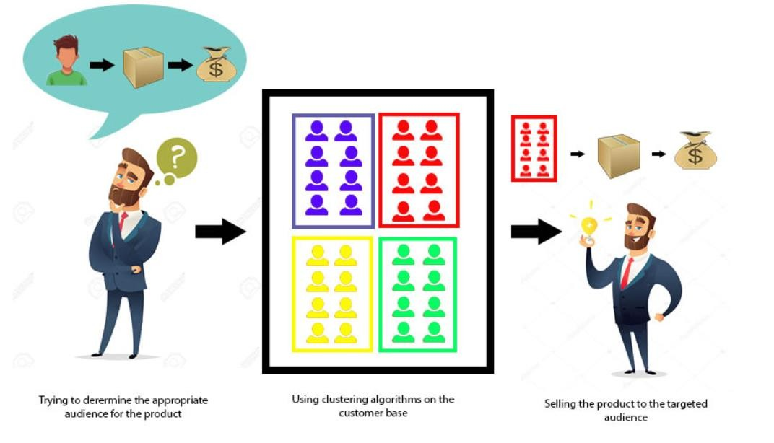
Clustering in Data Mining Continue
Clustering helps to splits data into several subsets. Each of these subsets contains data similar to each other, and these subsets are called clusters. Now that the data from our customer base is divided into clusters, we can make an informed decision about who we think is best suited for this product.
4

Slide 5
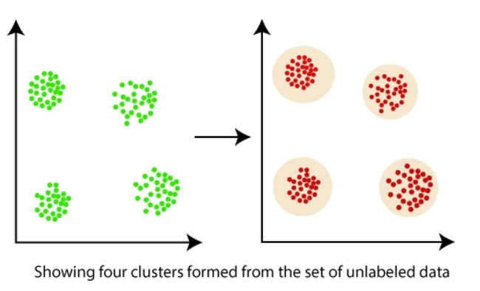
Clustering in Data Mining Continue
Let's understand this with an example, suppose we are a market manager, and we have a new tempting product to sell. We are sure that the product would bring enormous profit, as long as it is sold to the right people. So, how can we tell who is best suited for the product from our company's huge customer base?
5

Slide 6
Clustering in Data Mining Continue
Clustering, falling under the category of unsupervised machine learning, is
one of the problems that machine learning algorithms solve.
Clustering only utilizes input data, to determine patterns, anomalies, or
similarities in its input data.
A good clustering algorithm aims to obtain clusters whose:
The intra-cluster similarities are high, It implies that the data present inside
the cluster is similar to one another.
The inter-cluster similarity is low, and it means each cluster holds data that is not similar to other data.
6

Slide 7
What is a Cluster?
A cluster is a subset of similar objects
A subset of objects such that the distance between any of the two objects in the cluster is less than the distance between any object in the cluster and any object that is not located inside it.
A connected region of a multidimensional space with a comparatively high
density of objects.
7

Slide 8
What is clustering in Data Mining?
Clustering is the method of converting a group of abstract objects into classes of similar objects.
Clustering is a method of partitioning a set of data or objects into a set of
significant subclasses called clusters.
It helps users to understand the structure or natural grouping in a data set and used either as a stand-alone instrument to get a better insight into data distribution or as a pre-processing step for other algorithms
8

Slide 9
Important points:
Data objects of a cluster can be considered as one group.
We first partition the information set into groups while doing cluster analysis. It is based on data similarities and then assigns the levels to the groups.
The over-classification main advantage is that it is adaptable to modifications, and it helps single out important characteristics that differentiate between distinct groups.
9

Slide 10
Applications of cluster analysis in data mining
In many applications, clustering analysis is widely used, such as data analysis, market
research, pattern recognition, and image processing.
It assists marketers to find different groups in their client base and based on the purchasing
patterns. They can characterize their customer groups.
It helps in allocating documents on the internet for data discovery.
Clustering is also used in tracking applications such as detection of credit card fraud.
As a data mining function, cluster analysis serves as a tool to gain insight into the distribution of data to analyze the characteristics of each cluster.
In terms of biology, It can be used to determine plant and animal taxonomies, categorization
of genes with the same functionalities and gain insight into structure inherent to populations.
It helps in the identification of areas of similar land that are used in an earth observation database and the identification of house groups in a city according to house type, value, and₁₀ geographical location.

Slide 11
Why is clustering used in data mining?
Clustering analysis has been an evolving problem in data mining due to its
variety of applications.
It’s comprehensive use in a broad range of applications, including
image processing, computational biology, mobile communication, medicine, and economics

Slide 12
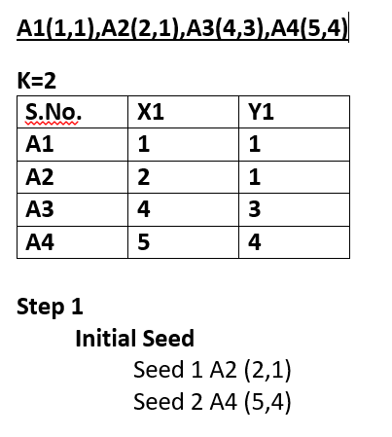
Example

Slide 13
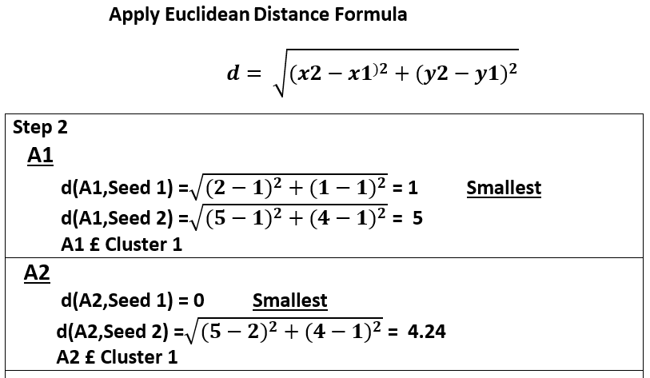
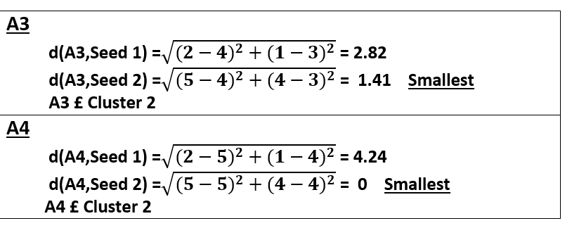

Slide 14
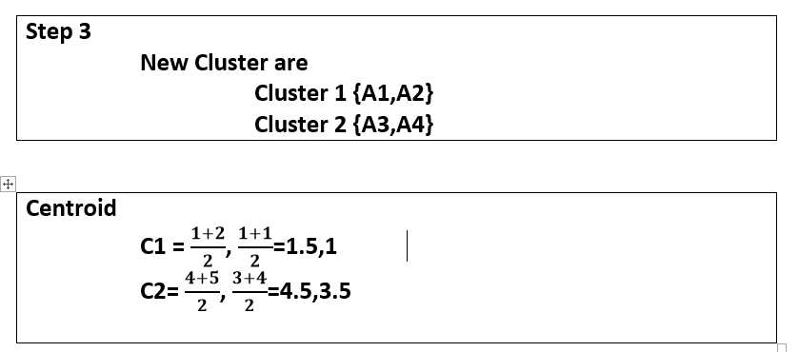

Slide 15
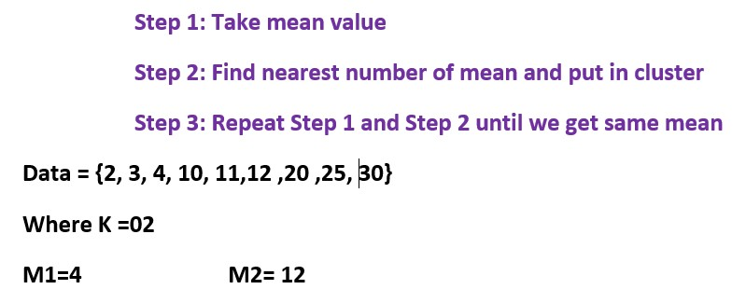
2nd method K Means

Slide 16
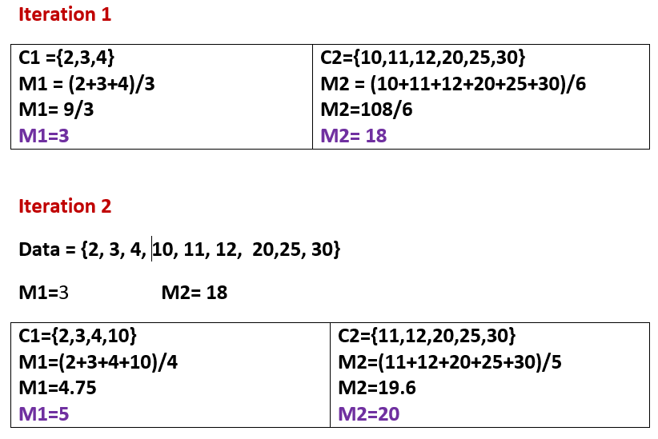

Slide 17
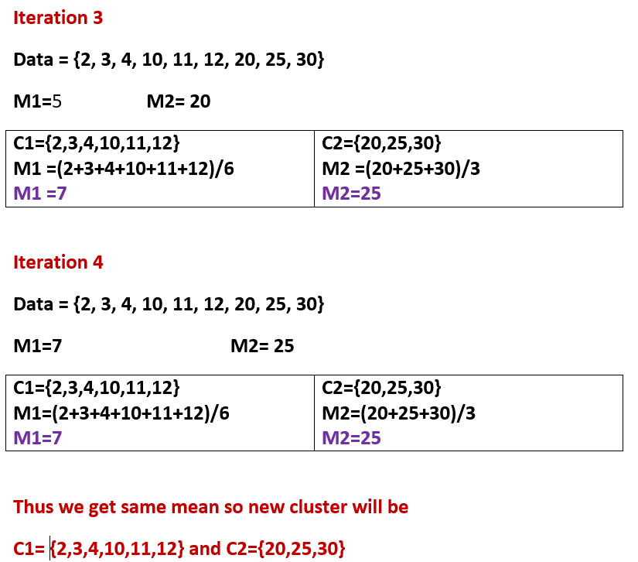

Slide 18
Agglomerative clustering
Agglomerative clustering works in a “bottom-up” manner. That is, each object is initially considered as a single-element cluster (leaf). At each step of the algorithm, the two clusters that are the most similar are combined into a new bigger cluster (nodes). This procedure is iterated until all points are member of just one single big cluster (root).

Slide 19
Steps to agglomerative hierarchical clustering
We’ll follow the steps below to perform agglomerative hierarchical clustering : 1.Preparing the data
Computing (dis)similarity information between every pair of objects in the data set.
Using linkage function to group objects into hierarchical cluster tree, based on the distance information generated at step 1. Objects/clusters that are in close proximity are linked together using the linkage function.
Determining where to cut the hierarchical tree into clusters. This creates a partition of the data.

Slide 20
Linkage
The linkage function takes the distance information, returned by the function dist(), and groups pairs of objects into clusters based on their similarity. Next, these newly formed clusters are linked to each other to create bigger clusters. This process is iterated until all the objects in the original data set are linked together in a hierarchical tree.

Slide 21
Method
Maximum or complete linkage: The distance between two clusters is defined as the maximum value of all pairwise distances between the elements in cluster 1 and the elements in cluster 2. It tends to produce more compact clusters.
Minimum or single linkage: The distance between two clusters is defined as the minimum value of all pairwise distances between the elements in cluster 1 and the elements in cluster 2. It tends to produce long, “loose” clusters.
Mean or average linkage: The distance between two clusters is defined as the
average distance between the elements in cluster 1 and the elements in cluster 2.
Centroid linkage: The distance between two clusters is defined as the distance between the centroid for cluster 1 (a mean vector of length p variables) and the centroid for cluster 2.
Ward’s minimum variance method: It minimizes the total within-cluster variance. At each
step the pair of clusters with minimum between-cluster distance are merged
21

Slide 22
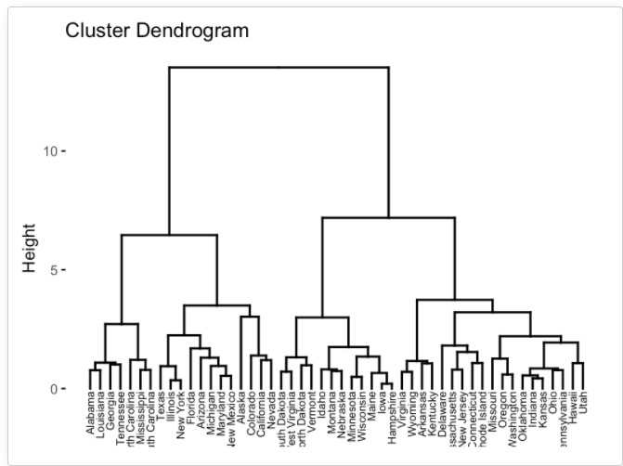
Dendrogram
Dendrograms correspond to the graphical representation of the hierarchical tree.

Slide 23
Dendrogram Continue
In the dendrogram displayed above, each leaf corresponds to one object. As we move up the tree, objects that are similar to each other are combined into branches, which are themselves fused at a higher height.
The height of the fusion, provided on the vertical axis, indicates the (dis)similarity/distance between two objects/clusters. The higher the height of the fusion, the less similar the objects are. This height is known as
the cophenetic distance between the two objects.

Slide 24
Example
Item | E | A | C | B | D
E | 0 | 1 | 2 | 2 | 3
A | 1 | 0 | 2 | 5 | 3
C | 2 | 2 | 0 | 1 | 6
B | 3 | 5 | 1 | 0 | 3
D | 3 | 3 | 6 | 3 | 0
It is found that smallest value found at (E,A)
1

Slide 25




(EA)
Item | E | A | C | B | D
E | 0 | 1 | 2 | 2 | 3
A | 1 | 0 | 2 | 5 | 3
C | 2 | 2 | 0 | 1 | 6
B | 3 | 5 | 1 | 0 | 3
D | 3 | 3 | 6 | 3 | 0
C = min(EC,AC]
= min (2,2)
= 2
(EA)
B = min[EB,AB]
= [2,5]
= 2
(EA)
D = min[ED,AD]
= min[3,3]
=3
Item | E,A | C | B | D
E,A | 0
C | 2 | 0
B | 2 | 1 | 0
D | 3 | 6 | 3 | 0
We found that next min value at (BC)
1

Slide 26
Item | E | A | C | B | D
E | 0 | 1 | 2 | 2 | 3
A | 1 | 0 | 2 | 5 | 3
C | 2 | 2 | 0 | 1 | 6
B | 3 | 5 | 1 | 0 | 3
D | 3 | 3 | 6 | 3 | 0
BC
EA = min[BE,BA,CE,CA]
= min [3,5,2,2]
= 2
D = min[ED,AD]
= min[3,3]
= 3
D = min[BD,CD]
= min [3,6]
=3
EA
BC
Item | EA | BC | D
EA | 0
BC | 2 | 0
D | 3 | 3 | 0
Now check again, you will find minimum value i.e. 02,it exist at Pair (EA) and (BC)
02

Slide 27
Item | (EA),(BC) | D
(EA),(BC) | 0
D | 3 | 0
Item | E | A | C | B | D
E | 0 | 1 | 2 | 2 | 3
A | 1 | 0 | 2 | 5 | 3
C | 2 | 2 | 0 | 1 | 6
B | 3 | 5 | 1 | 0 | 3
D | 3 | 3 | 6 | 3 | 0
(EA),(BC)
D =min [ED,AD,BD,CD]
= min[3,3,3,6]
= 3
We found minimum value at (EA),(BC) and D
03

Slide 28
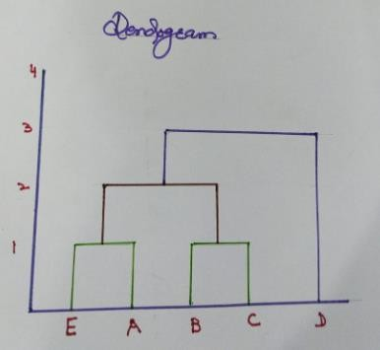



We found that
1
2
3
4

Slide 29
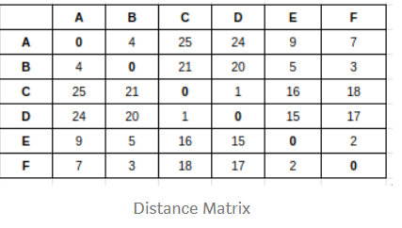
Complete Linkage
Its slow :: complicated :: repeatable :: not suited for big data sets.
Complete Link Clustering:
Considers Max of all distances. Leads to many small clusters.

Slide 30
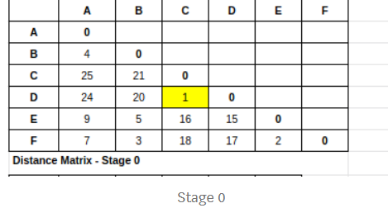
Diagonals will be 0 and values will be symmetric.
Distance Matrix:

Slide 31
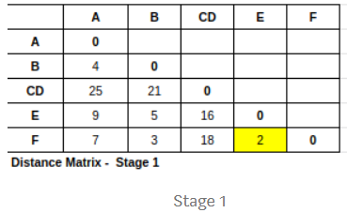
Step a
Step a: The shortest distance in the matrix is 1 and the vectors associated with that are C & D
So the first cluster is C — D
Distance between other vectors and CD
A to CD = max(A->C, A->D) = max(25,24) = 25 B to CD = max(B-<C, B->D) = max(21,20) = 21
and similarly find for E -> CD & F -> CD

Slide 32
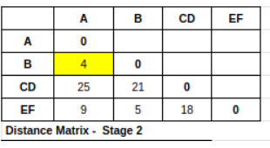
Step b
Step b : Now 2 is the shortest distance and the vectors associated with that are E & F Second cluster is E — F
A to EF = max(A->E, A->F) = max(9,7) = 9
CD to EF = max(CD->E, CD->F) = max(15,17) = 17

Slide 33
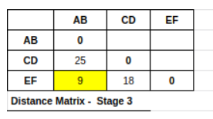
Step c
Step c : Now 4 is the shortest distance and vectors associated are A & B Third cluster is A — B
CD to AB = max(CD -> A, CD ->B) = max(25,21) = 25 EF to AB = max(EF -> A, EF ->B) = max(9,5) = 9

Slide 34
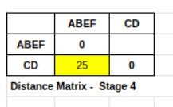
Step d
Step d : Now 9 is the shortest distance and vectors associated are AB and EF
Fourth cluster is AB — EF
CD to ABEF = max(CD->AB, CD->EF) = max(25,18) = 25

Slide 35
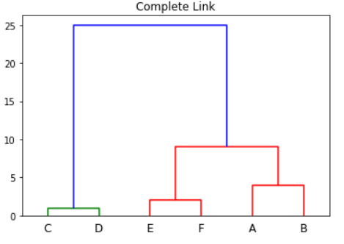
Step e : Last cluster is CD — ABEF
Lets look at the Dendrogram for the complete link cluster.
Step e

