Slide 1












Sir Syed University of Engineering & Technology, Karachi
DATA WAREHOUSING
&
DATA MINING
CS-414
Department of Computer Science & Information Technology
Batch - 2018

Slide 2
Chapter No.9
Association Mining
Book
Data mining and Data warehousing, Principal and practical techniques by
Parteek Bhatia, Cambridge university press.
2

Slide 3
Defining Association Rule Mining
Association rule mining can be defined as identification of frequent patterns, correlations, associations, or causal structures among sets of objects or items in transactional databases, relational databases, and other information repositories.
3

Slide 4
Association rules are generally if/then statements that help in discovering relationships between
seemingly unrelated data in a relational database or other information repository.
For example, ‘If a customer buys a dozen eggs, he is 80% likely to also purchase milk.’
An association rule consists of two parts, i.e., an antecedent (if) and a consequent (then).
An antecedent is an object or item found in the data while a consequent is an object or item found in the
combination with the antecedent.
Association rules are often written as X → Y meaning that whenever X appears Y also tends to appear. X and Y may be single items or sets of items. Here, X is referred to as the rule’s antecedent and Y as its consequent.
For example, the rule found in the sales data of a supermarket could specify that if a customer buys onions and potatoes together, he or she will also like to buy burgers. This rule will be represented as onions, potatoes → burger.
The concept of association rules was formulated by two Indian scientists Dr Rakesh Agrawal and
Dr R. Srikant.
4

Slide 5
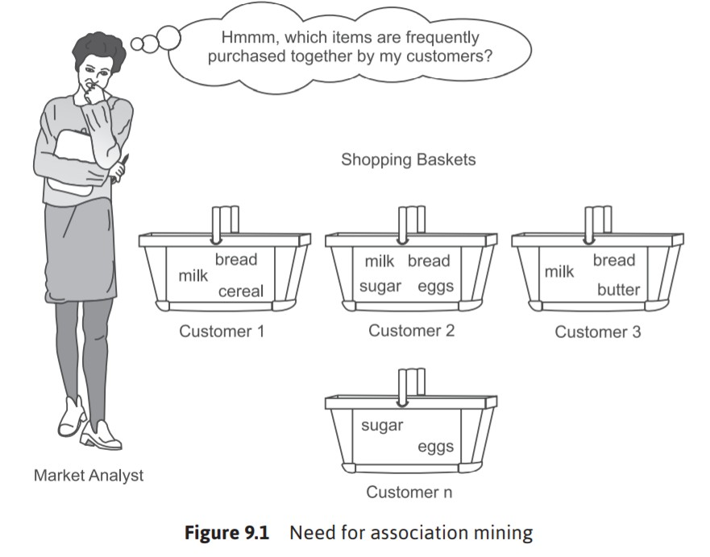
5

Slide 6
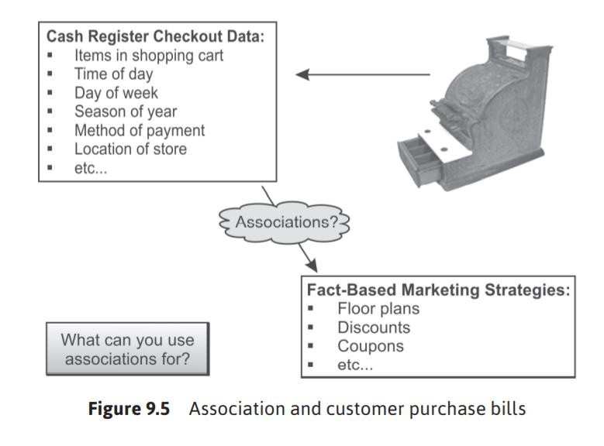
6

Slide 7
Finding Frequent Item Sets
Apriori Algorithm
(Support, Confidence)
Candidate generation
Frequent Growth
(Support)
FP Tree
7

Slide 8

FIRST LET’S LOOK BACK TO THE APRIORI
ALGORITHM
 Apriori is an algorithm for frequent item set mining and association rule learning over transactional databases.
It proceeds by identifying the frequent individual items in the database and extending them to larger and larger item sets as long as those item sets appear sufficiently often in the database.
The frequent item sets determined by Apriori can be used to determine association rules which highlight general trends in the database: this has applications in domains such as market basket analysis.

Slide 9


IS APRIORI FAST ENOUGH?
Basics of Apriori algorithm
Use frequent (k-1)-itemsets to generate k-itemsets
candidates
Scan the databases to determine frequent k-itemsets

Slide 10

If there are 10⁴ frequent 1-items ts, the Apriori algorithm will
 It is costly to handle a huge number of candidate sets
need to generate more than 10 ⁷
frequencies
2-itemsets
and test their

Slide 11
SUPPORT AND CONFIDENCE
Support (A -> B) =
No. of transactions containing A & B
No. of total transactions
Confidence (A -> B) =
No. of transactions containing A & B
No. of transactions containing A

Slide 12
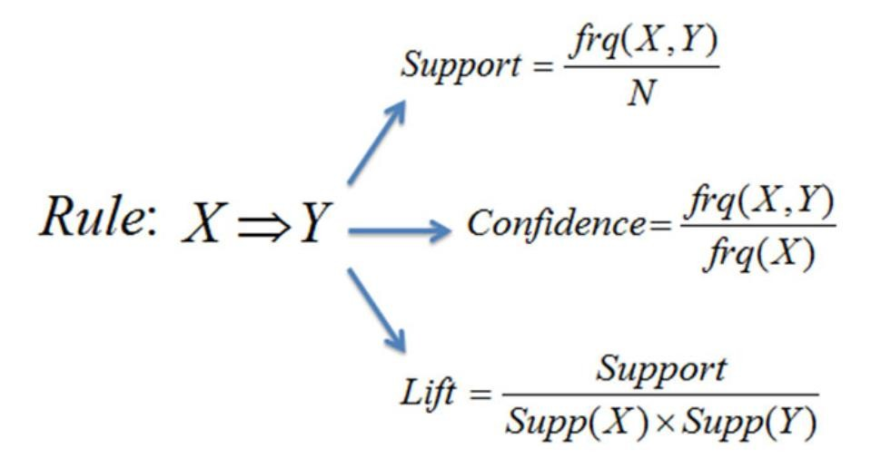
Support provides us with an estimation of how often the item set appears in the
dataset.
Confidence gives us an indication of how many times the rule analyzed has been found to be accurate.
The lift of a rule represents the ratio of the discovered support to that expected if X
and Y are independent.
12

Slide 13
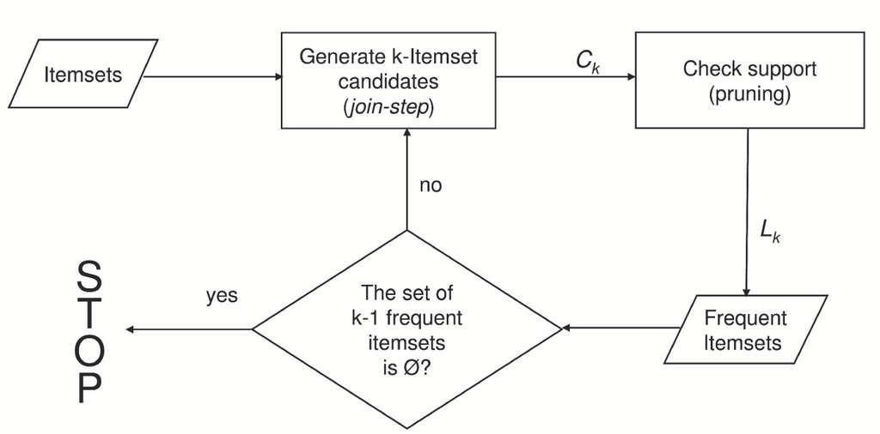
ORIGINAL APRIORI ALGORITHM

Slide 14
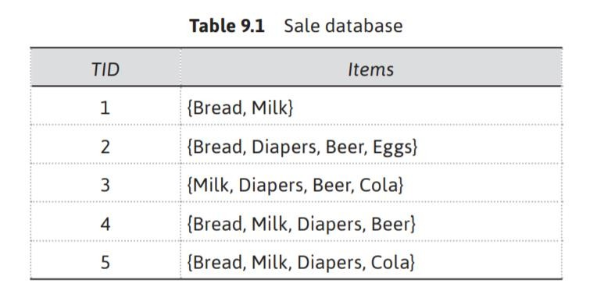
Representations of Items for Association Mining
Let us assume that the number of items in the shop stocks is n. In Table 9.1, there are 6 items in stock, namely, bread, milk, diapers, beer, eggs, cola, thus n = 6 for this shop. The item list is represented by I and its items are represented by {i1,i2,…in}.
The number of transactions are represented by N transactions, i.e., N = 5 for the
shop data as given in Table 9.1.

Slide 15
The Metrics to Evaluate the Strength of Association Rules
The metrics to judge the strength and accuracy of the rule are as follows:
Support
Confidence
Lift

Slide 16
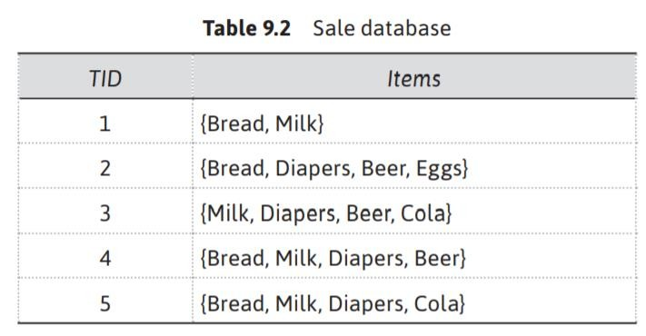
Support
Support Let N is the total number of transactions. Support of X is represented as the number of times X appears in the database divided by N, while the support for X and Y together is represented as the number of times they appear together divided by N as given below.
Support(X) = (Number of times X appears) / N = P(X)
Support(XY) = (Number of times X and Y appear together) / N = P(X ∩ Y)
Thus, Support of X is the probability of X while the support of XY is the probability of X ∩ Y. Table 9.1, has been reproduced as Table 9.2 to calculate the supports for each item as given below:

Slide 17
Support(Bread) = Number of times Bread appears / total number of
translations = 4/5 = P(Bread)
Support(Milk) = Number of times Milk appears / total number of translations =
4/5 = P(Milk)
Support(Diapers) = Number of times Diapers appears / total number of
translations = 4/5 = P(Diapers)
Support(Beer) = Number of times Beer appears / total number of translations
=3/5 = P(Beer)
Support(Eggs) = Number of times Eggs appears / total number of translations
=1/5 = P(Eggs)
Support(Cola) = Number of times Cola appears / total number of translations
= 2/5 = P(Cola)
Support(Bread, Milk) = Number of times Bread, Milk appear together / total number of translations = 3/5 = P(Bread ∩ Milk)
Support(Diapers, Beer) = Number of times Diapers, Beer appears together /
total number of translations = 3/5 = P(Diapers ∩ Beer)
17

Slide 18
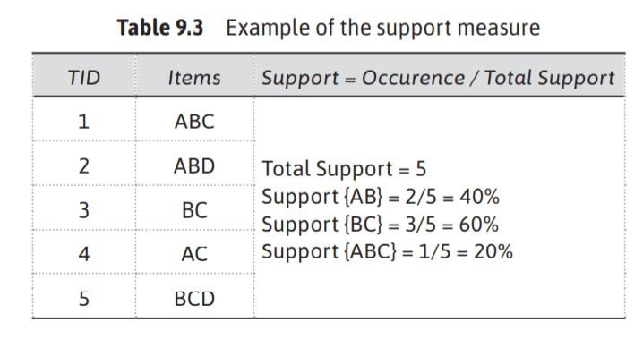
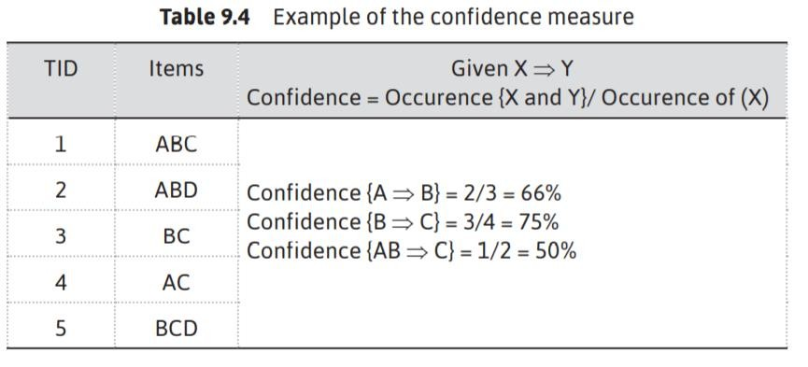
Confidence
Confidence of (X→Y) = Support(XY) / Support(X) = P(X ∩ Y) / P(X) = P(Y|X)

Slide 19
Example
Transaction | Item Set
I1 | A,B,C
I2 | A,C
I3 | A,D
I4 | B,E,F
Minimum Support Minimum confidence
: 50%
: 50%

Slide 20
Item | Support
A | 3
B | 2
C | 2
D | 1
E | 1
F | 1
C1
L1
Item | Support
A | 3
B | 2
C | 2
Minimum Support
Minimum confidence
: 50%
: 50%
Support
50/100 * 4 = 2

Slide 21
C2
Items | Support
A,B | 1
B,C | 1
A,C | 2
Items | Support
A,C | 2
L2

Slide 22
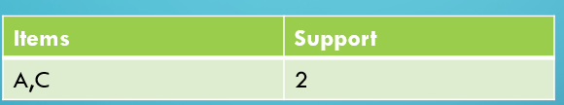
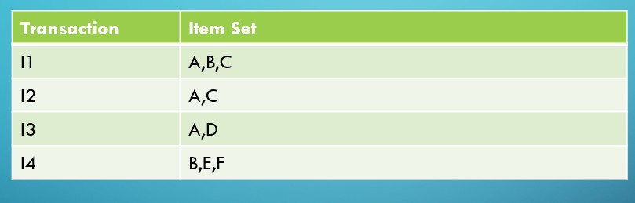
Association Rule | Support | Confidence | Confidence %
A C | 2 | 2/3=0.66 | 66%
C A | 2 | 2/2=1 | 100
A
C = Support /Occurrence of A

Slide 23
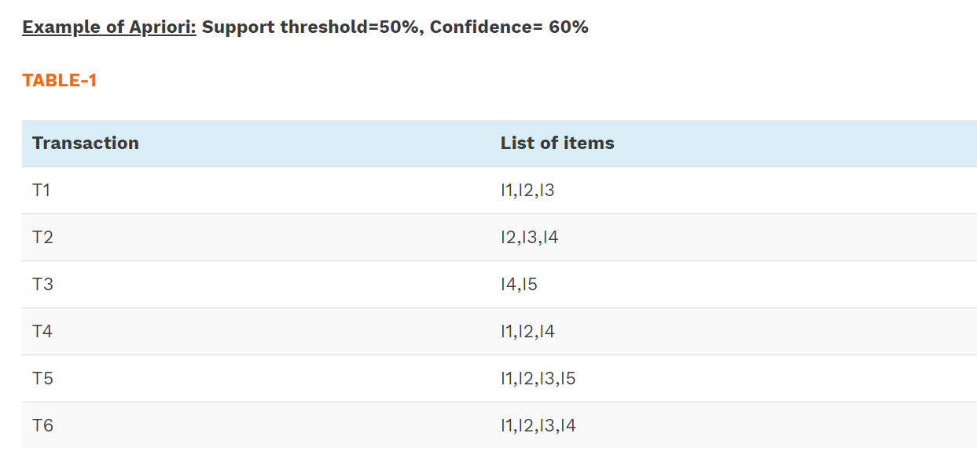
Example No.02

Slide 24
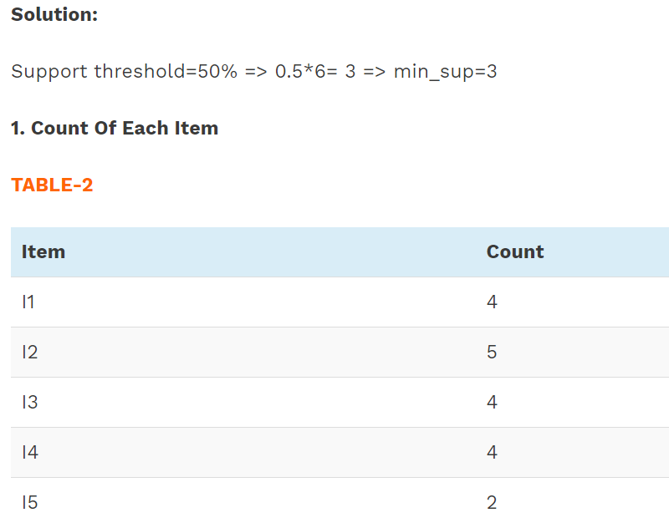

Slide 25
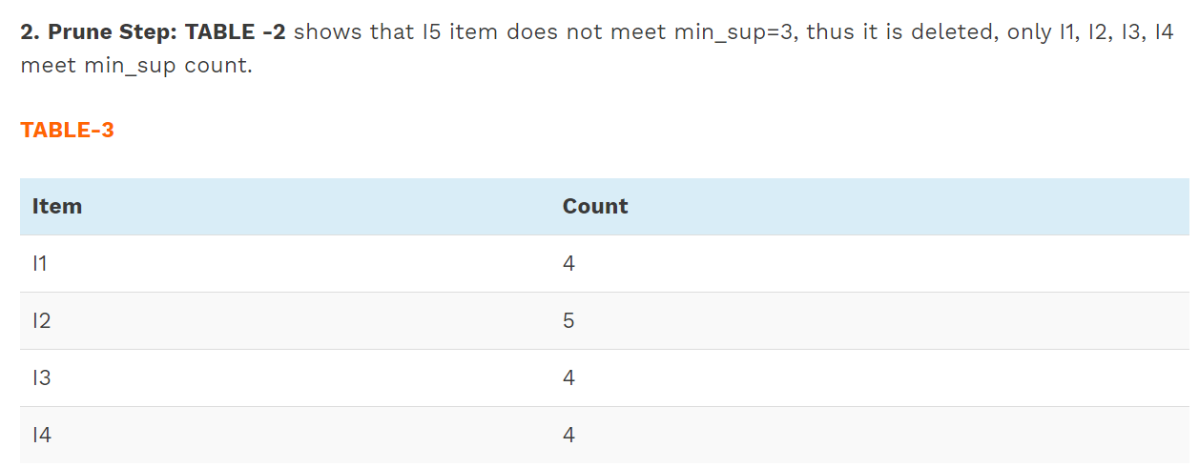

Slide 26
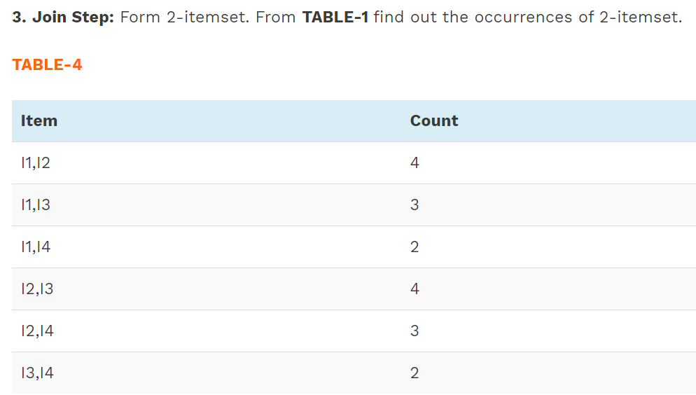

Slide 27
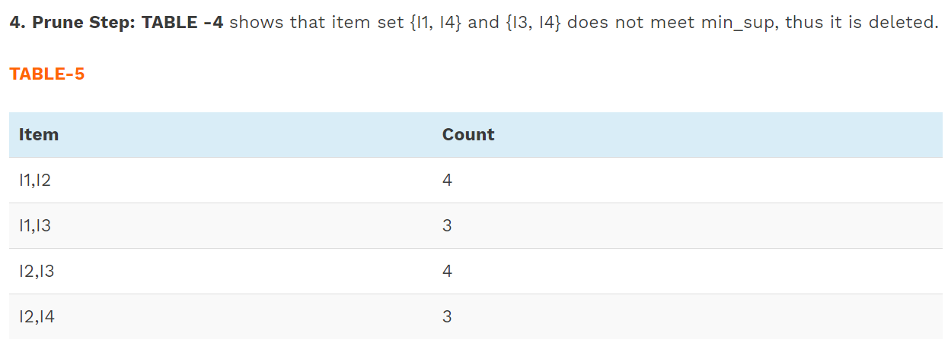

Slide 28
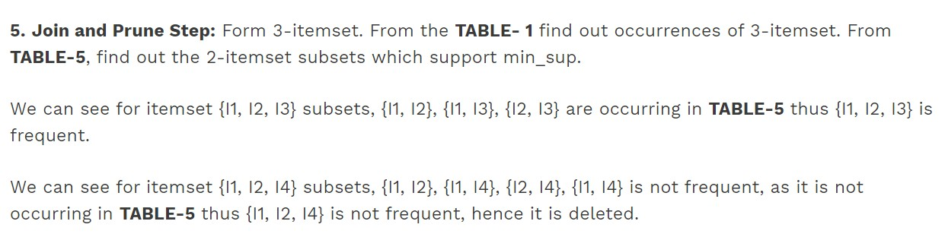

Slide 29
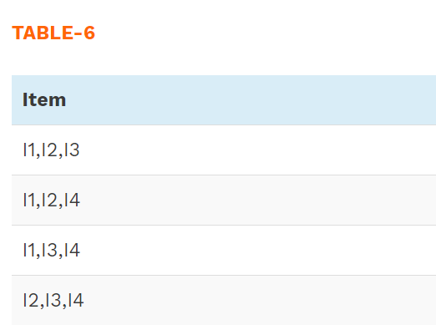


Slide 30
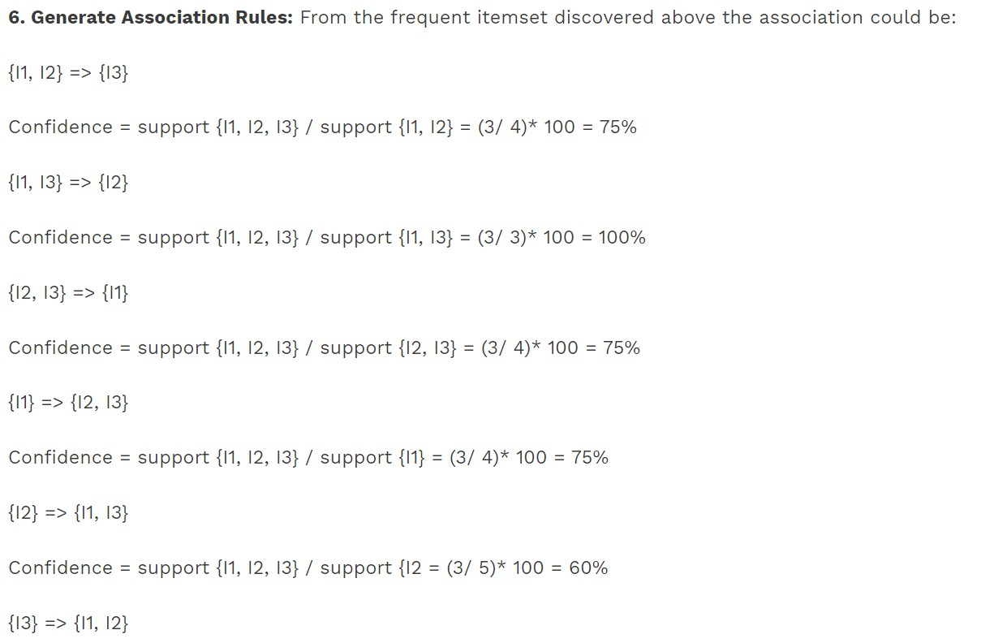

Slide 31
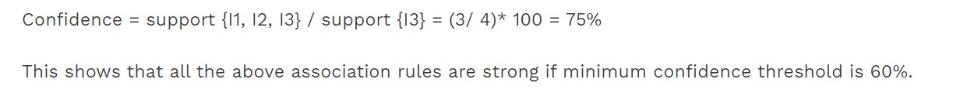

Slide 32
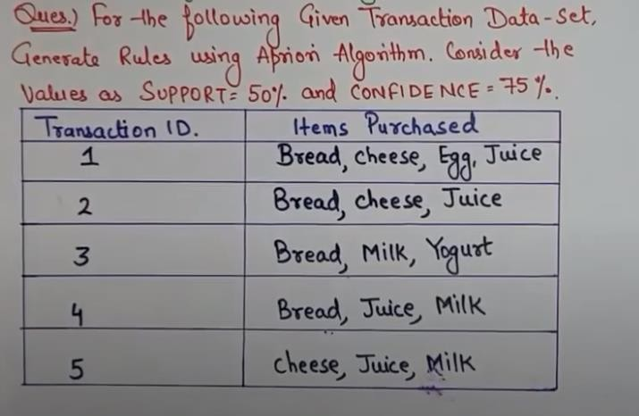

Slide 33
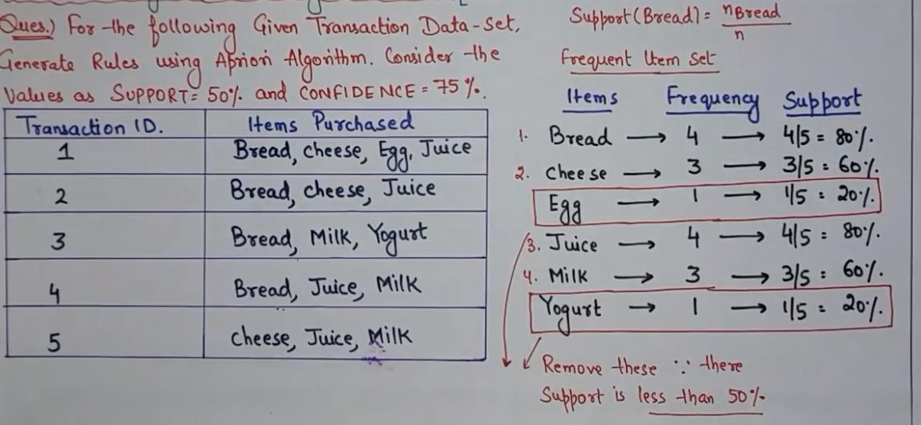

Slide 34
