Slide 1












DATA WAREHOUSING
&
Sir Syed University of Engineering & Technology, Karachi
DATA MINING
CS-414
Department of Computer Science & Information Technology
Batch - 2018

Slide 2
Chapter No.11
Web Mining and Search Engines
Book
Data mining and Data warehousing, Principal and practical techniques by
Parteek Bhatia, Cambridge university press.
2

Slide 3
Chapter Objectives
To understand what is meant by web mining and its types
To understand the working of the HITS algorithm
To know the brief history of search engines
To understand a search engine’s architecture and its working
To understand the PageRank algorithm and its working
3

Slide 4
WHAT IS MINING?
The practice of examining large pre-existing databases in order to generate
new information.
Mining in terms of data mining refers to discovering trends and patterns from large datasets to gain valuable insights and actionable knowledge of the data.

Slide 5
NEED FOR MINING
Large amounts of data are produced everyday.
Since the creation of first webpage in 1991, exponential growth is witnessed for the number of websites.
1.8 billion websites (2018)
It is estimated around 2.5 trillion bytes are generated each day.
1.7 million pictures are liked on Instagram every minute.
204 million emails are sent every minute, etc.

Slide 6
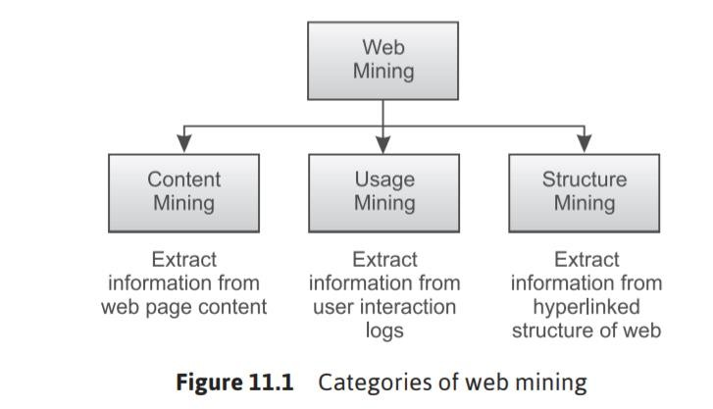
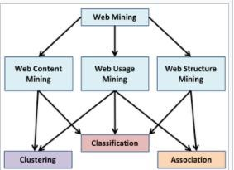
WEB MINING
Web mining is the application of data mining techniques and machine learning to find useful information from the data present in web pages.
It is divided into 3 parts.
Content – text, images, records
Usage – http log, app server logs
Structure – hyperlinks, tags

Slide 7
WEB CONTENT MINING
Web content mining deals with extracting relevant knowledge from the
contents of a web page.
We totally ignore how other web pages link to a given web page or how users interact
with it!
A trivial approach to web content mining is based on location and frequency of keywords.
But this gives rise to two problems: first, the problem of scarcity and second, the problem of abundance.

Slide 8
WEB DOCUMENT CLUSTERING
Web document clustering is an approach to manage large number of
documents based on keywords.
Cluster analysis techniques, namely K-means and agglomerative clustering can be used to achieve this goal.
Another approach to web document clustering is based on Suffix Tree Clustering.

Slide 9
SUFFIX TREE CLUSTERING (STC)
STC does clustering based upon phrases rather than frequency of keywords.
Step 1: Obtain text from the web page. For every sentence, filter out common words and punctuations. Convert the remaining words into their root form.
Step 2: Make a tree based on the list of words obtained in step 1.
Step 3: Compare trees obtained from various documents. Tree having same root to leaf node sequence of words are grouped into same cluster.

Slide 10
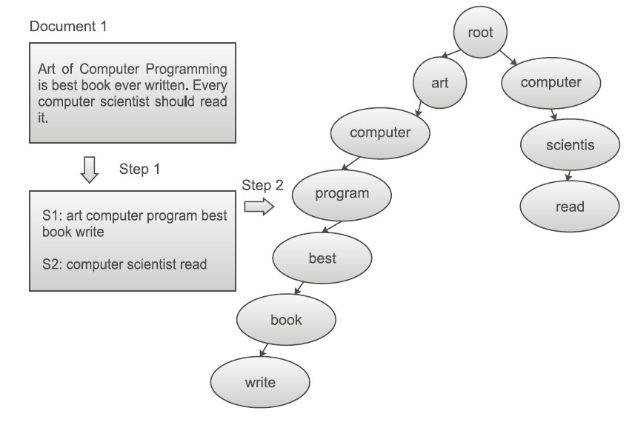
SUFFIX TREE CLUSTERING (STC)

Slide 11

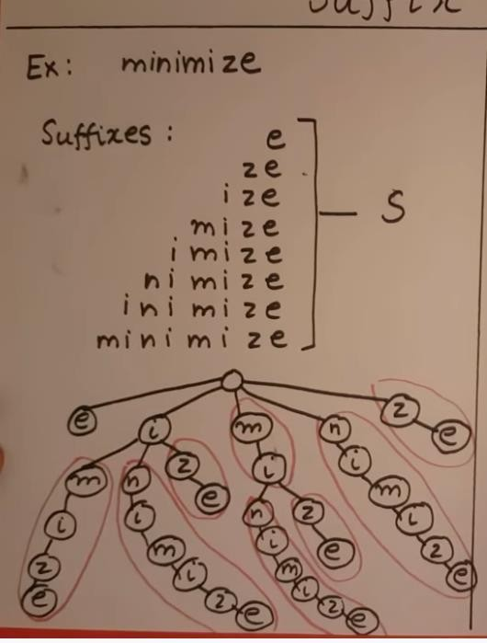
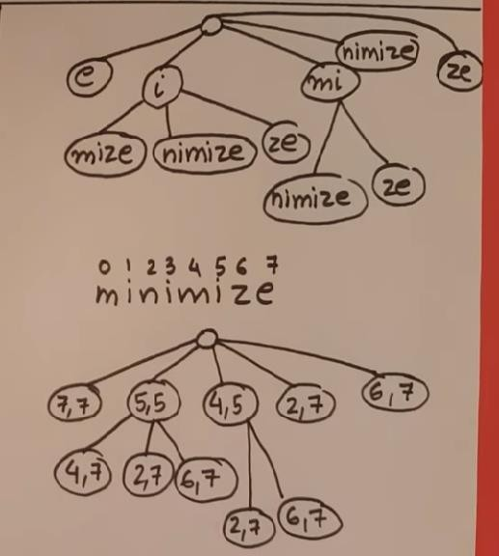

Slide 12

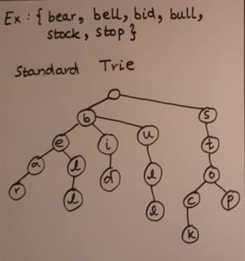

Slide 13
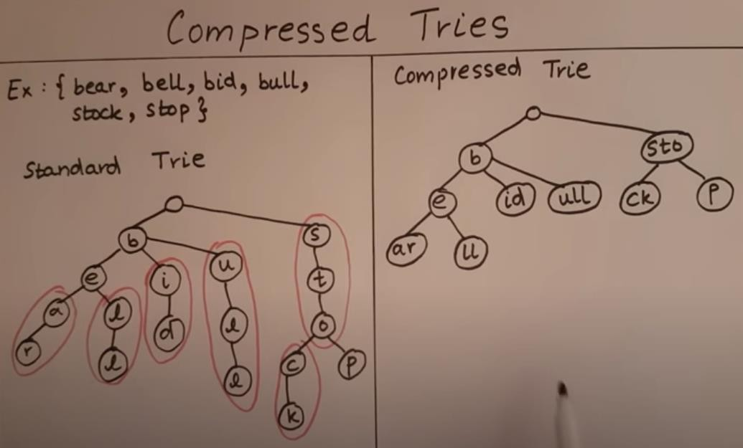
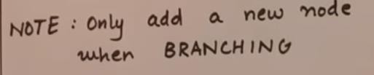

Slide 14
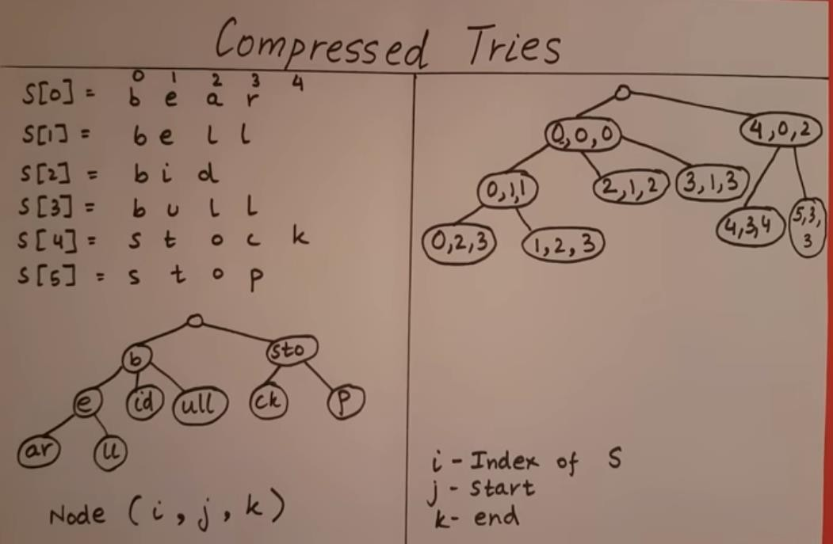

Slide 15
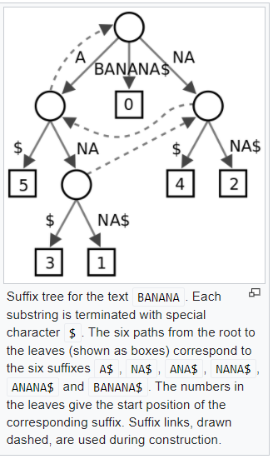

Slide 16
RESEMBLANCE AND CONTAINMENT
In order to improve query results, there is a need to remove duplicate web
pages or pages which are almost identical from the search results.
Resemblance is the term for how similar two documents are to each other. It has a value between 0 and 1 (both inclusive).
Containment is the term for the existence of one document inside another. It also has value between 0 and 1 with value of 1 representing that the first document is present inside the second.

Slide 17
FINGERPRINTING
Fingerprinting is used to find similarity between two documents.
It works by dividing a document into a continuous sequence of words of every possible length.
This method is seldom used because it is very inefficient for documents with
large numbers of words.
Document 1: I love
machine learning
Document 2: I love
artificial intelligence.
Document 1 | Document 2
I love | I love
love machine | love artificial
machine learning | artificial intelligence

Slide 18
WEB USAGE MINING
Web usage mining deals with extracting useful information from log data about a user’s interaction with the web pages.
To predict user behavior while interacting with a web page in order to make the web
page more customer centric and profitable.
The data collected above is analyzed either using association mining or clustering in
order to obtain hidden knowledge.
For example, whenever a user visits page A then he/she also visits page B with 75% confidence or more.

Slide 19
WEB USAGE MINING
Important parameters | Description
Number of hits | Total number of times a web page has been requested within a specific time duration
Number of visitors | Total number of visitors of the website within a specific time duration
Referer | The website from which the user came to the current web page
Landing page | The web page which served as entry point for the user
Session duration | Time spent by the user on the website
Path analysis | Pages that the user visited on the website
Cookies | Cookie is the term for a small amount of data that can be stored within user’s browser. It is generally used to identify user, save authentication tokens and so on.
Browser/Device/OS | Browser, type of devices, and OS being used by the user.

Slide 20
Introduction to Modern Search Engines
Search engines are software that allow us to search information based on some input.
The first search engine was created in the year 1990 by Alan Emtage, a
student at McGill University in Montreal.

Slide 21
Working of a Search Engine
Generally every search engine consists of the following modules:
a web crawler
an indexer and
a query processor.

Slide 22
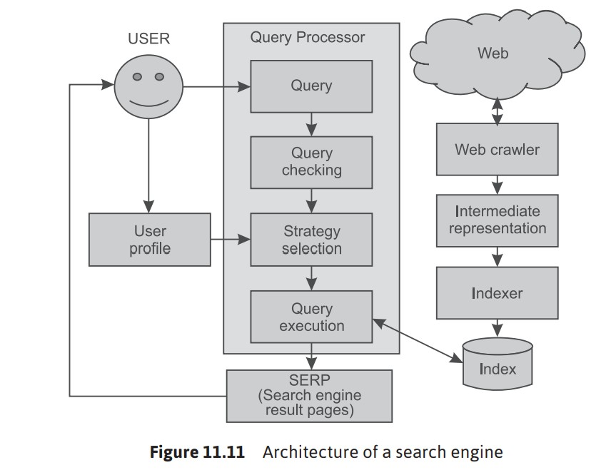
Architecture of Search Engine

Slide 23
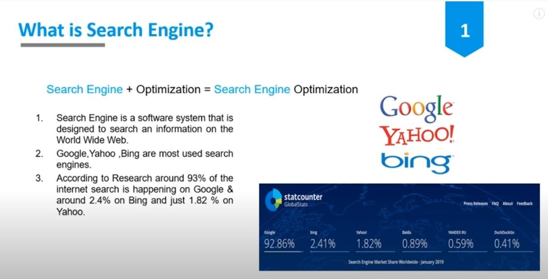

Slide 24
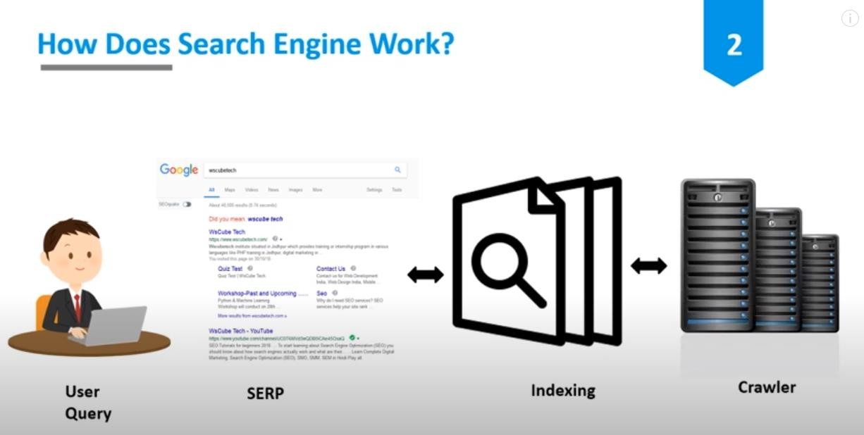

Slide 25
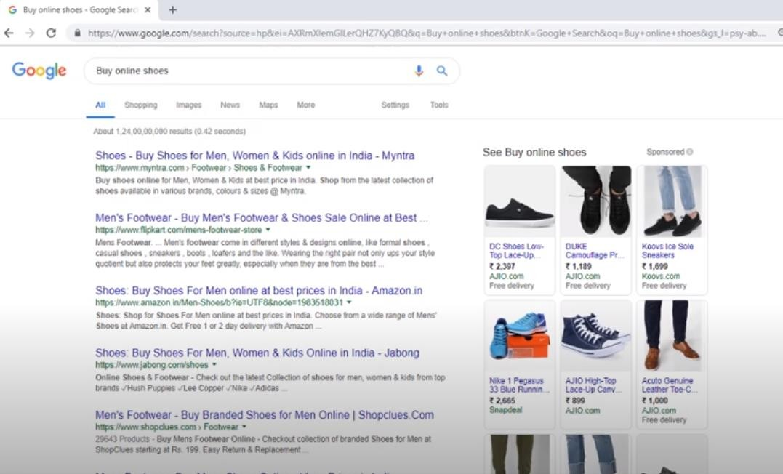

Slide 26
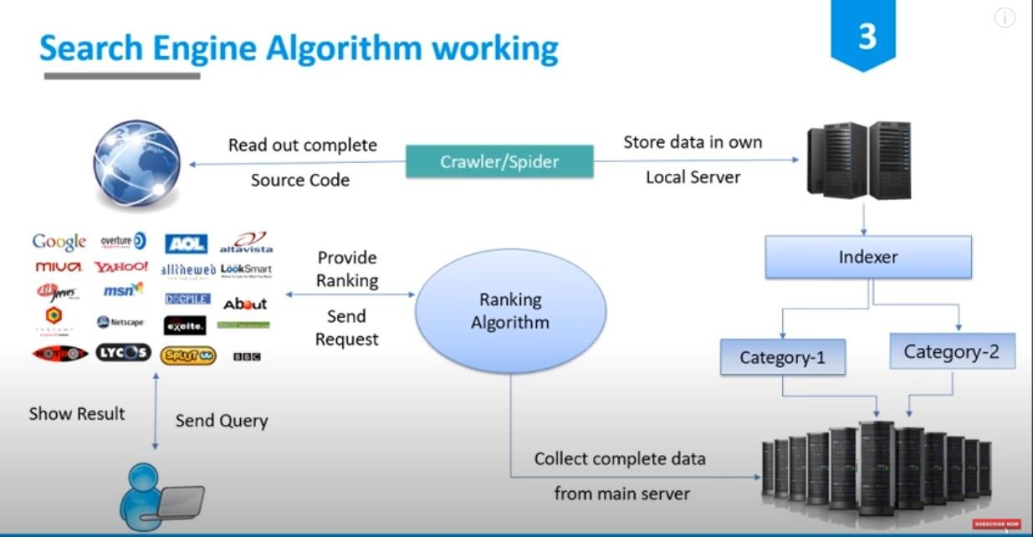

Slide 27
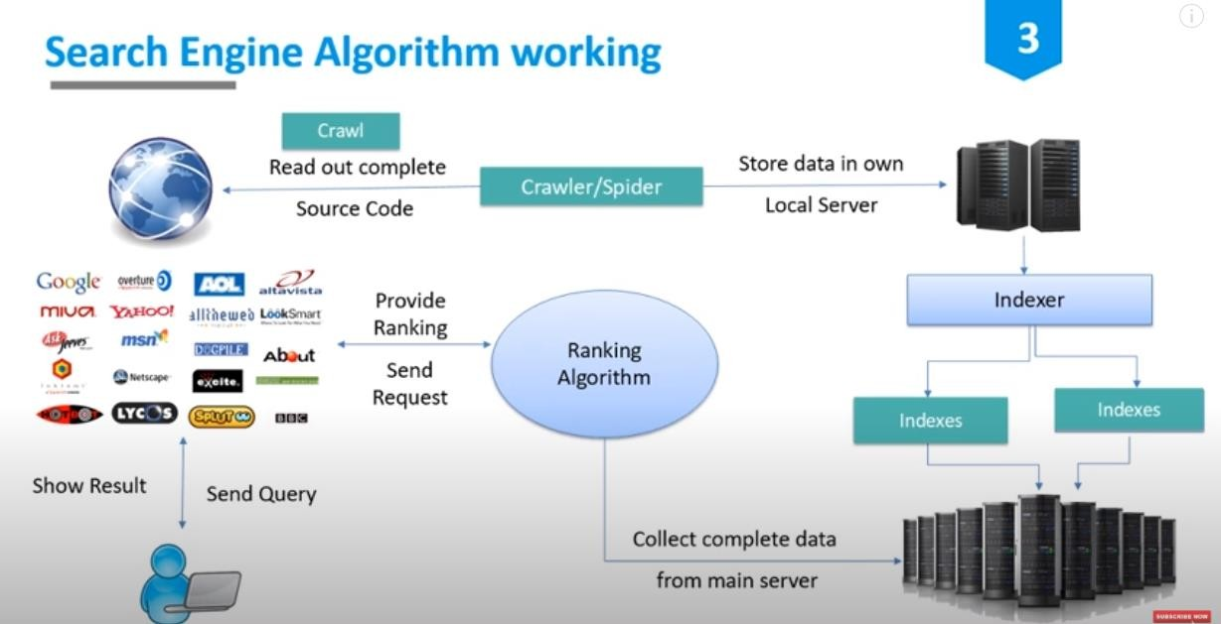

Slide 28
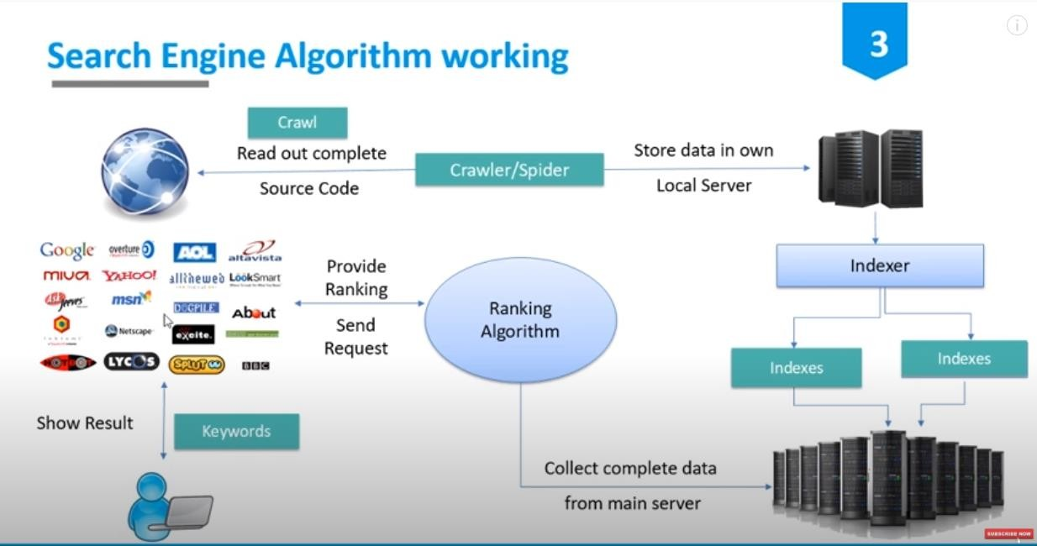

Slide 29
TEXT MINING
The process of deriving meaningful information and to draw out patterns from
the Natural Language (day-to-day written or spoken) text.
Examples: Word docs, Presentations, emails, chats, pictures etc.
Applications:
Autocomplete, Spell checker, Spam detection, Predictive typing, keyword search, Advertisement matching etc.

Slide 30










Creating a corpus
Pre-Processing
Remove tags
Remove stop words
Remove punctuations
Remove whitespaces
Stemming / Lemmatization
Corpus – structured collection of
text
Importing data
Text Visualization
Histogram
Word cloud
Text Analysis
Word frequency
Correlation
Create a Document Term Matrix (DTM)
Matrix to show the frequency of words occurring in a document

Slide 31
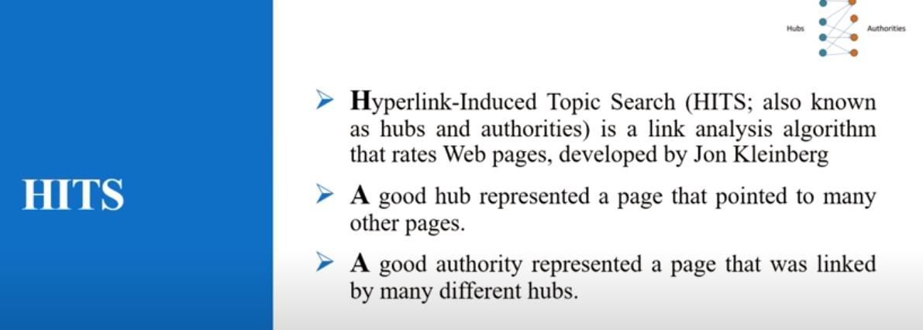

Slide 32

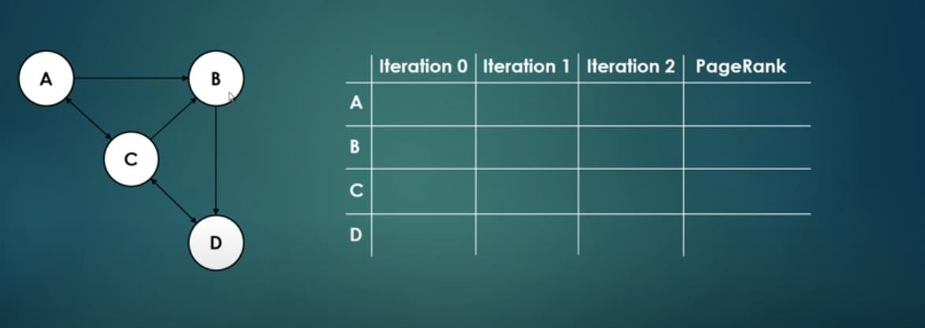

Slide 33
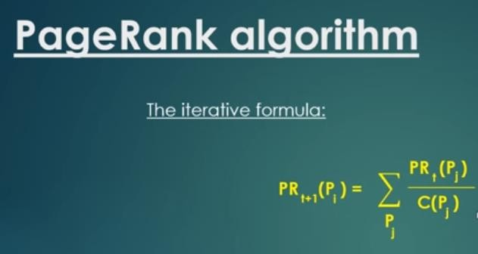

Slide 34
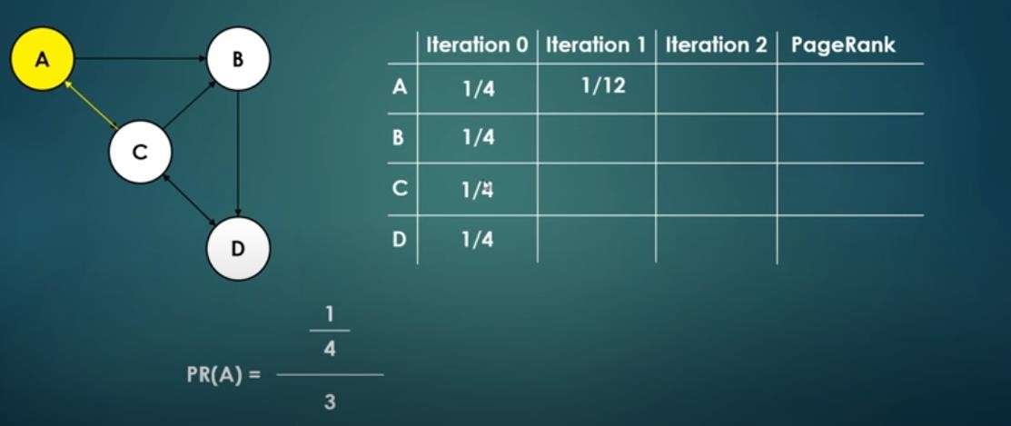

Slide 35
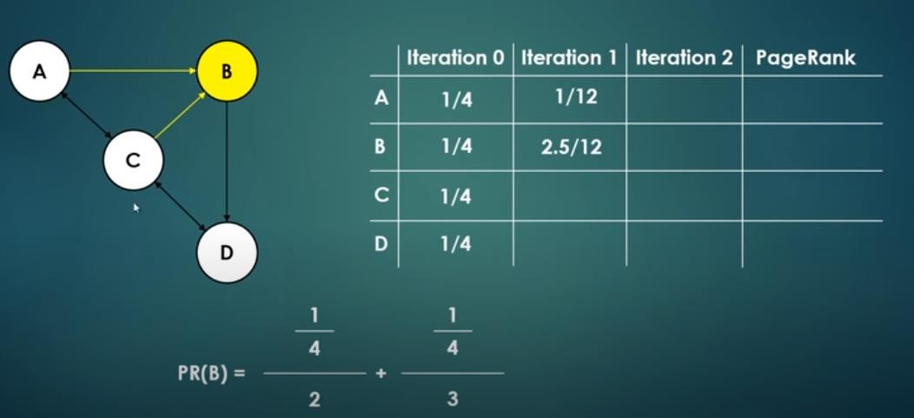

Slide 36
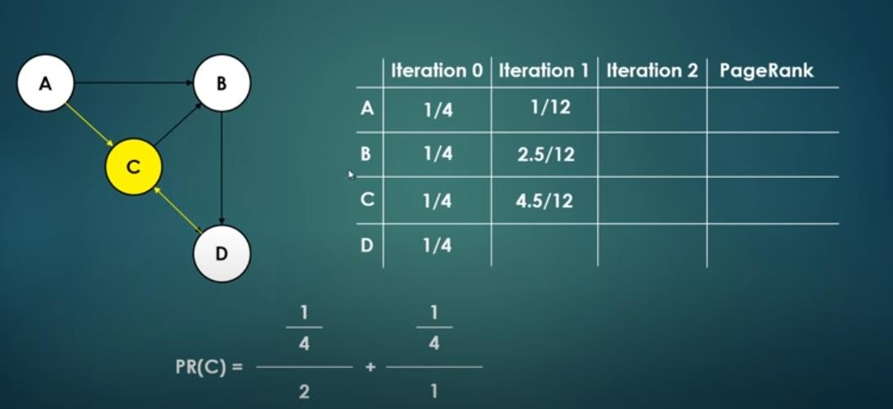

Slide 37
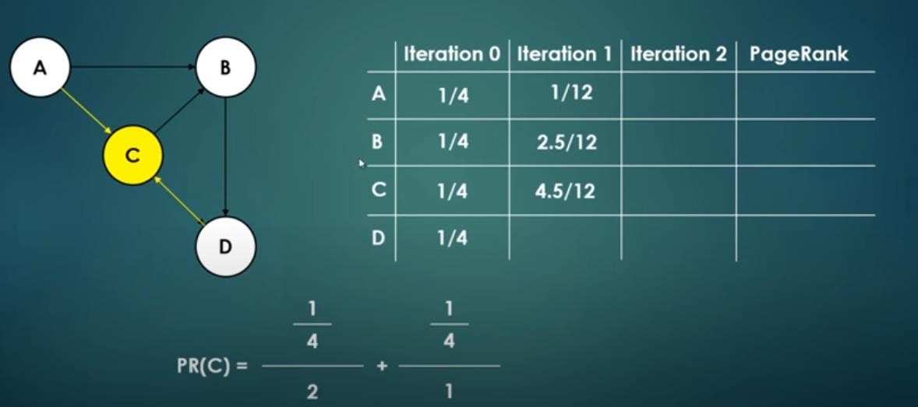

Slide 38
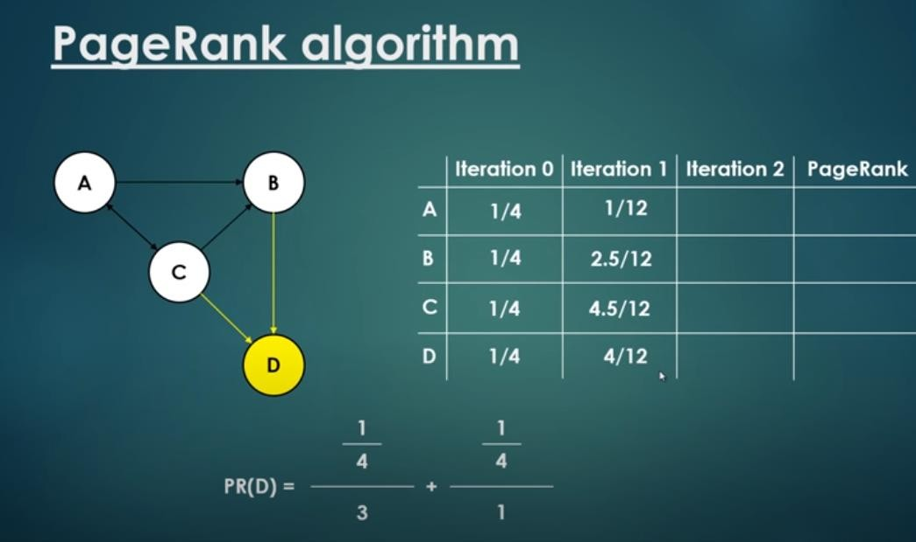

Slide 39
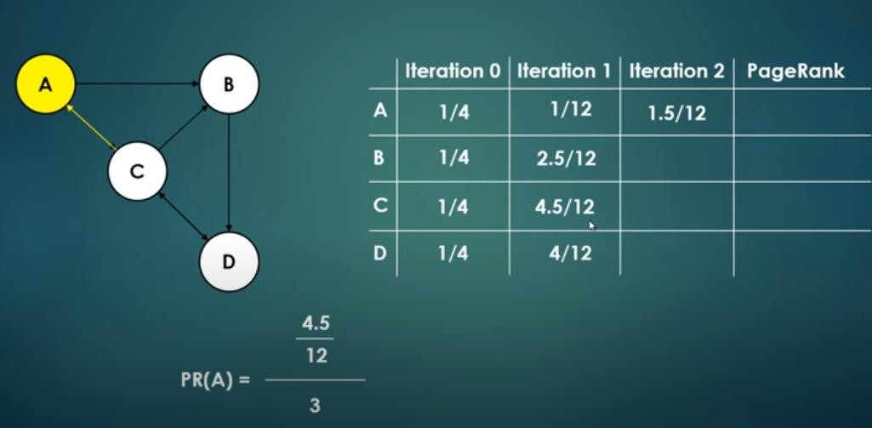

Slide 40
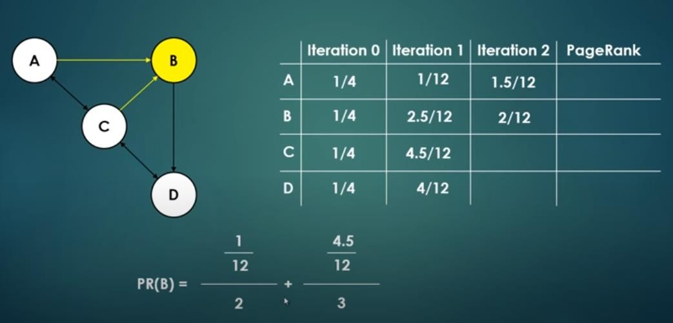

Slide 41
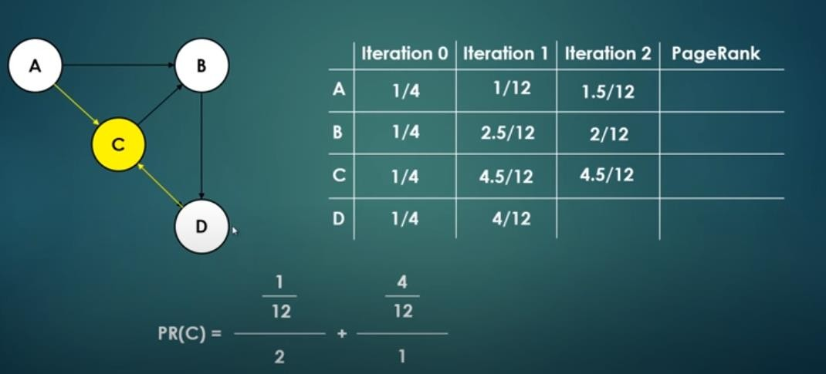

Slide 42
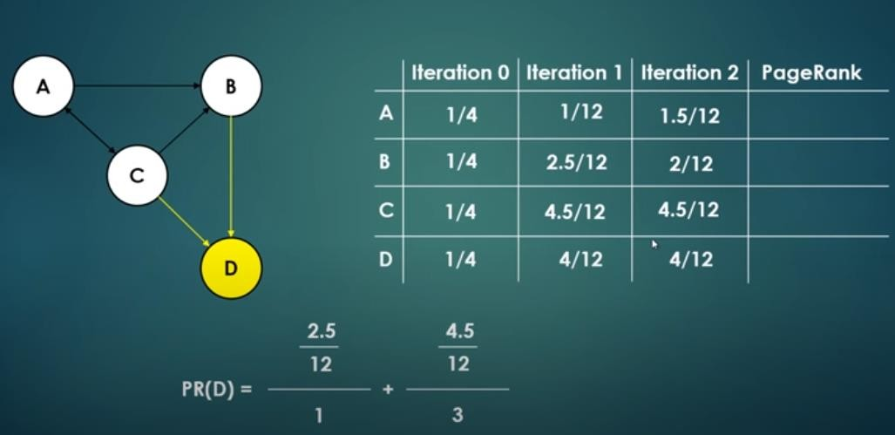

Slide 43
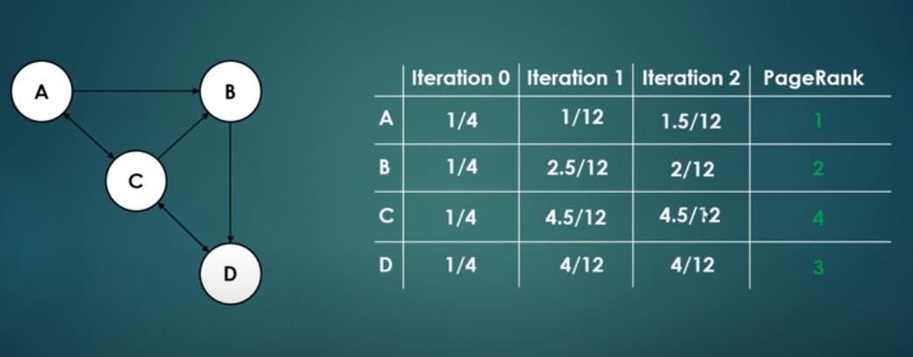

Slide 44
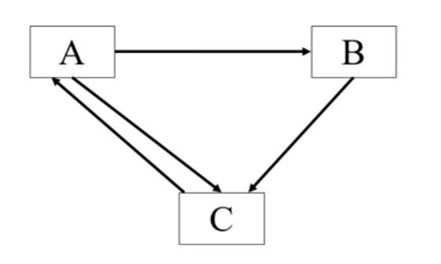
Find out page with highest rank

