Slide 1












DATA WAREHOUSING
&
Sir Syed University of Engineering & Technology, Karachi
DATA MINING
CS-414
Department of Computer Science & Information Technology
Batch - 2018

Slide 2
Chapter No.9
Association Mining
Book
Data mining and Data warehousing, Principal and practical techniques by
Parteek Bhatia, Cambridge university press.
2

Slide 3
FP-GROWTH
3

Slide 4
WHAT IS FP-GROWTH
An efficient and scalable method to complete set of frequent patterns.
It allow frequent item set discovery without candidate item set generation.
 Two step approach:
Build a compact data structure called the FP-Tree.
Extracts frequent item set directly from the FP-Tree.

Slide 5
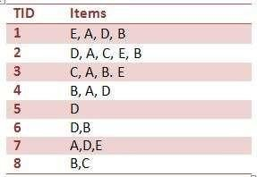
FP TREE EXAMPLE (HOW TO IDENTIFY FREQUENT
patterns using FP tree algorithm
Suppose we have the following DataBase

Slide 6
STEP 1 - CALCULATE MINIMUM SUPPORT
 First should calculate the minimum support count. Question says minimum support should be 30%. It calculate as follows:
Minimum support count(30/100 * 8) = 2.4
As a result, 2.4 appears but to empower the easy calculation it can be
rounded to to the ceiling value. Now,
Minimum support count is ceiling(30/100 * 8) = 3

Slide 7
STEP 2 - FIND FREQUENCY OF OCCURRENCE
 Now time to find the frequency of occurrence of each item in the Database table. For example, item A occurs in row 1,row 2,row 3,row 4 and row 7. Totally 5 times occurs in the Database table. You can see the counted frequency of occurrence of each item in Table 2
TID frequency
A 5
6
3
6
4
Table2 -Frequency of Occurrence
Table 1 - Snapshot of the Database

Slide 8
STEP 3 - PRIORITIZE THE ITEMS
In Table 2 you can see the numbers written in Red pen. Those are the priority of each item according to it's frequency of occurrence. Item B got the highest priority (1) due to it's highest number of occurrences. At the same time you have opportunity to drop the items which not fulfill the minimum support requirement. For instance, if Database contain F which has frequency 1, then you can drop it.
TID frequency priority
5 3
6 1
3 5
6 2
4 4
Table2 -Frequency of Occurrence

Slide 9
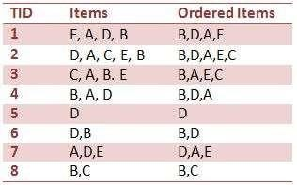
STEP 4 -ORDER THE ITEMS ACCORDING TO PRIORITY
 As you see in the Table 3 new column added to the Table 1. In the Ordered Items column all the items are queued according to it's priority, which mentioned in the Red ink in Table 2. For example, in the case of ordering row 1, the highest priority item is B and after that D, A and E respectively.
Table 3 - New version of the Table 1

Slide 10
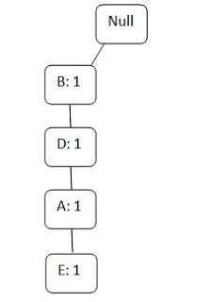
STEP 5 -ORDER THE ITEMS ACCORDING TO
PRIORITY
 As a result of previous steps we got a ordered items
table (Table 3). Now it's time to draw the FP tree. We
will mention it row by row
 Row 1:
Note that all FP trees have 'null' node as the root node. So draw the root node first and attach the items of the row 1 one by one respectively. (See the Figure 1) And write their occurrences in front of it.
Figure 1- FP tree for Row 1

Slide 11
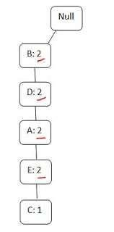
 ROW 2:
Then update the above tree (Figure 1) by entering the items of row 2. The items of row 2 are B,D,A,E,C. Then without creating another branch you can go through the previous branch up to E and then you have to create new node after that for C. This case same as a scenario of traveling through a road to visit the towns of the country. You should go through the same road to achieve another town near to the particular town.
When you going through the branch second time you should erase one and write two for indicating the two times you visit to that node. If you visit through three times then write three after erase
two
Figure 2- FP tree for Row 1,2

Slide 12
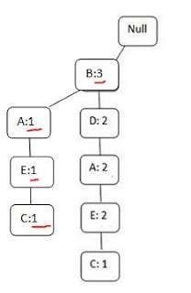
 ROW 3:
In row 3 you have to visit B,A,E and C respectively. So you may think you can follow the same branch again by replacing the values of B,A,E and C . But you can't do that you have opportunity to come through the B. But can't connect B to existing A overtaking D. As a result you should draw another A and connect it to B and then connect new E to that A and new C to new E.
Figure 3 - After adding third row

Slide 13
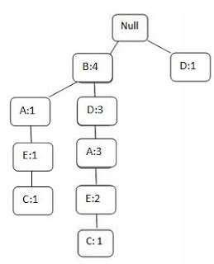
 ROW 4:
Then row 4 contain B,D,A. Now we can just rename
the frequency of occurrences in the existing branch.
As B:4,D,A:3.
 Row 5:
n fifth raw have only item D. Now we have opportunity draw new branch from 'null' node. See Figure 4.
Figure 4- Connect D to null node

Slide 14
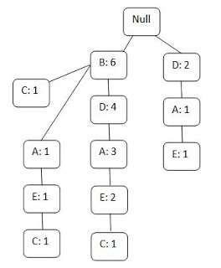
 ROW 6:
B and D appears in row 6. So just change the B:4 to B:5 and D:3 to D:4.
 Row 7:
Attach two new nodes A and E to the D node which hanging Then mark D,A,E as D:2,A:1 and E:1.
 Row 8 :(Ohh.. last row)
Attach new node C to B. Change the traverse
on the null node.
times.(B:6,C:1
Figure - Final

Slide 15
STEP 6 - VALIDATION
 After the five steps the final FP tree as follows: Figure 5.
How we know is this correct?
Now count the frequency of occurrence of each item of the FP tree and compare it with Table 2. If both counts equal, then it is positive point to indicate your tree is correct.

Slide 16


BENEFITS OF THE FP-TREE STRUCTURE
 Completeness
Preserve complete information for frequent pattern mining
Never break a long pattern of any transaction
Compactness
Reduce irrelevant info—infrequent items are gone
Itemsi frequ e ncy des ce nd in g ord er : themore frequently
occ urring, t hem ore l ike lyt ob esh a red
N e ver be largerth anthe original database (not count node-links
and the co un tfield )
T here ex is ts ex a m plesof databases, where compression ratio
couldb eove r 1 0 0

Slide 17
FP-GROWTH COMPLEXITY
Therefore, each path in the tree will be at least partially traversed the number of items existing in that tree path (the depth of the tree path) * the number of items in the header.
Complexity of se₂arching through all paths is then bounded by O(header_count * depth of tree)

Slide 18
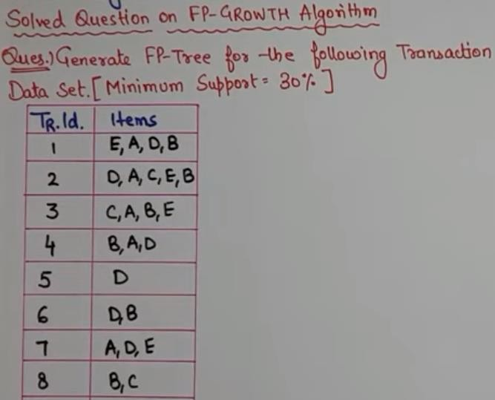
18

Slide 19
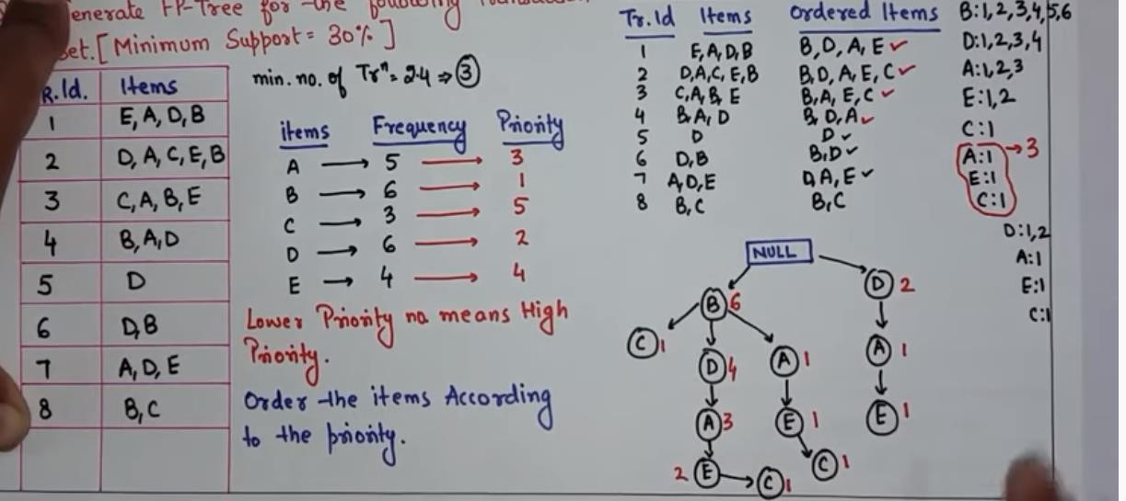
19

Slide 20
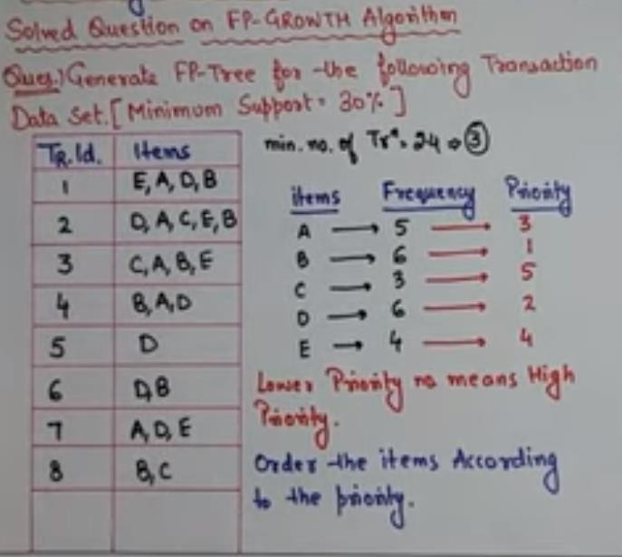
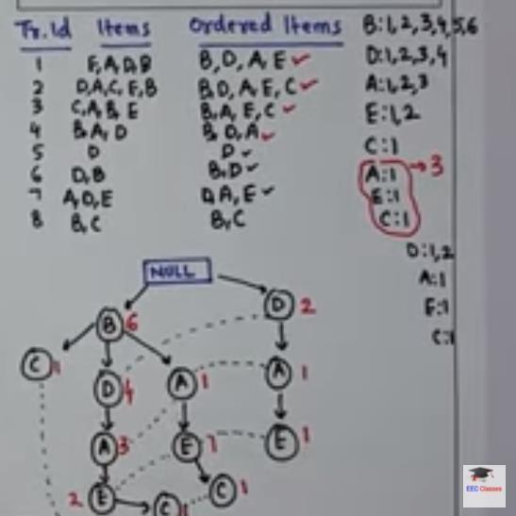
20

