Slide 1

Streaming Services Application
Ali Aun Haider

Slide 2
What Does This Program Do?
The Streaming Services Application helps users explore and manage streaming content. Users can search for movies and TV shows based on title, genre, platform, and year, and maintain a personalized watchlist.
It also includes features like random title suggestions and dynamic data display using tables.

Slide 3

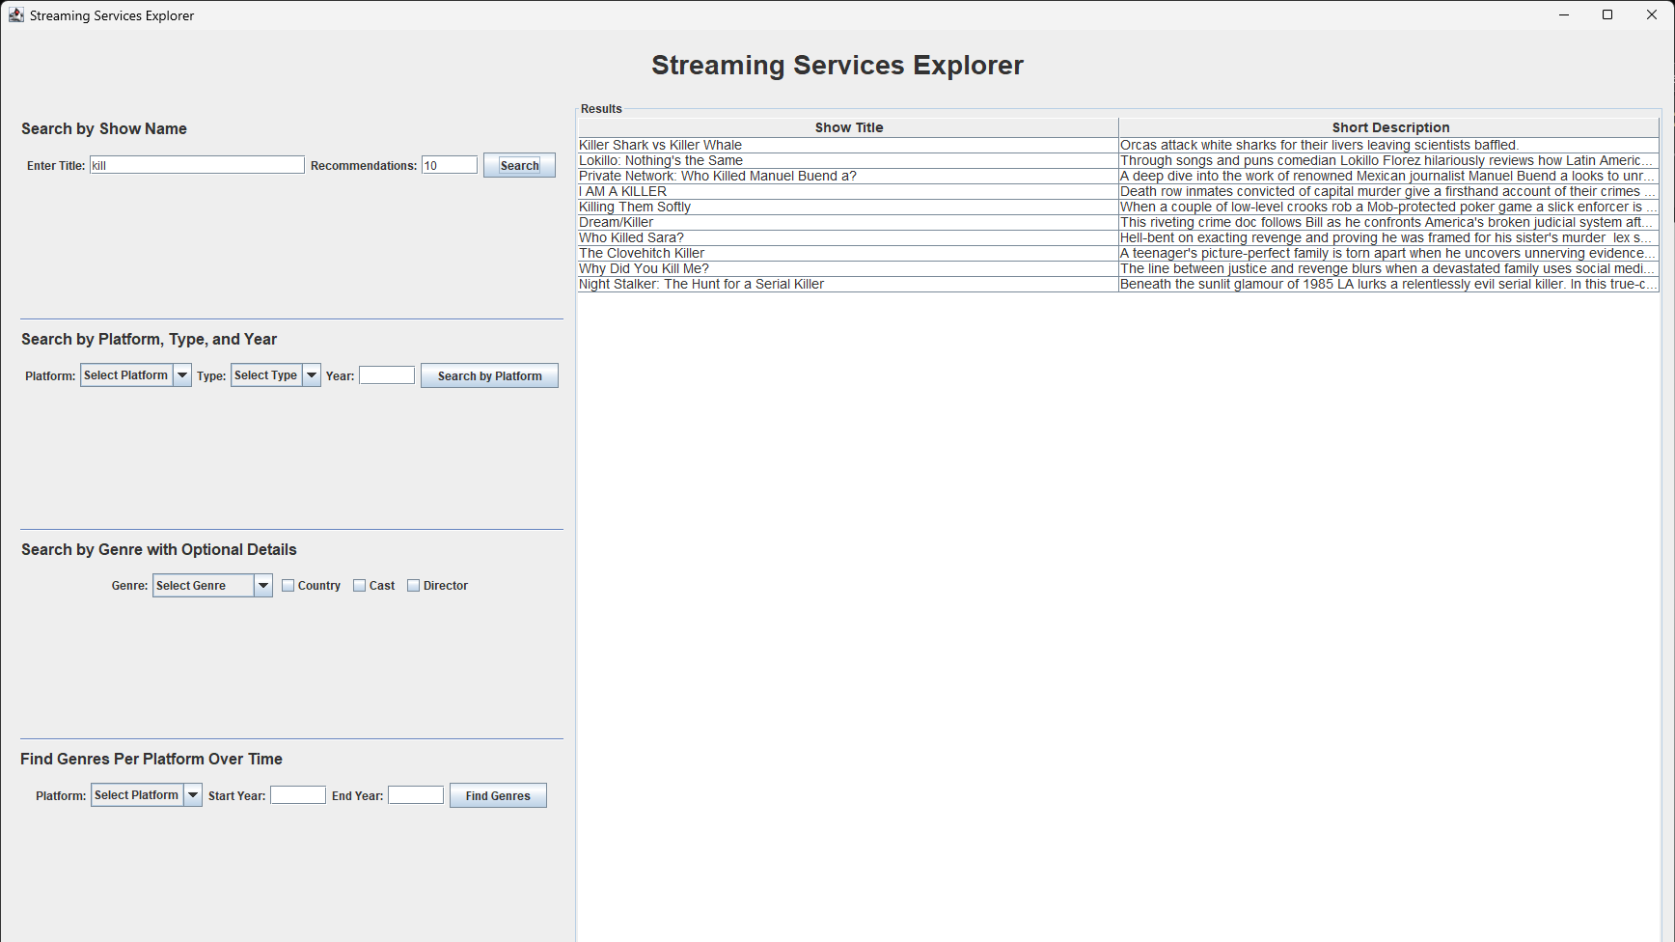
Search by Title and limit recommendations

Slide 4
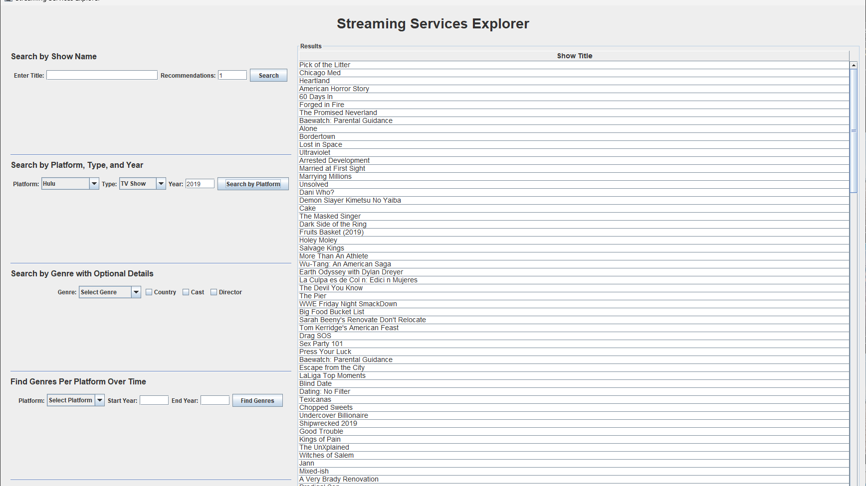
Search by platform, Type and Year

Slide 5
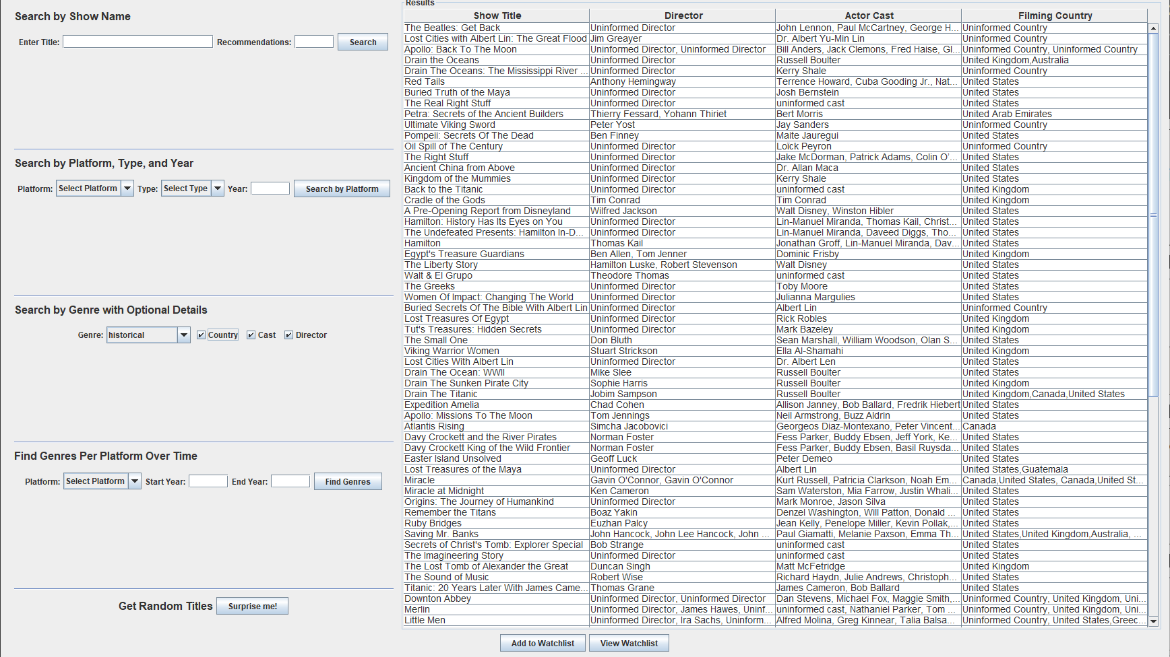
Search by Genre with custom details

Slide 6
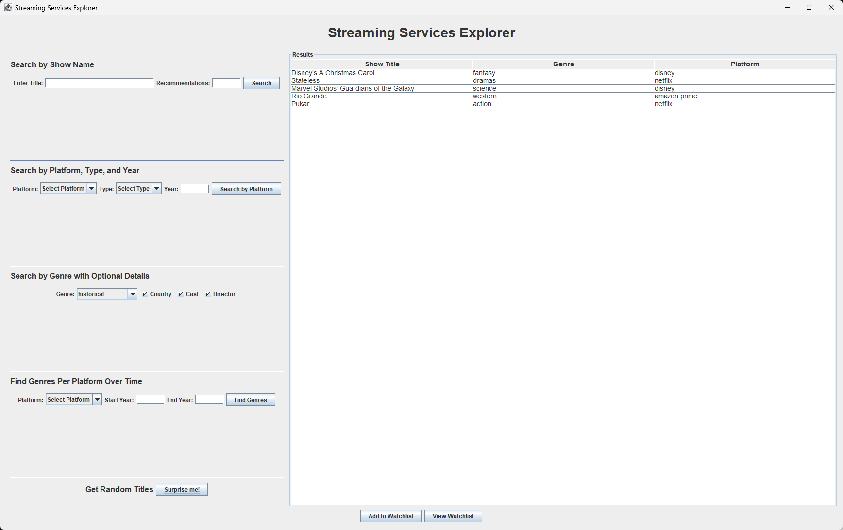

Slide 7
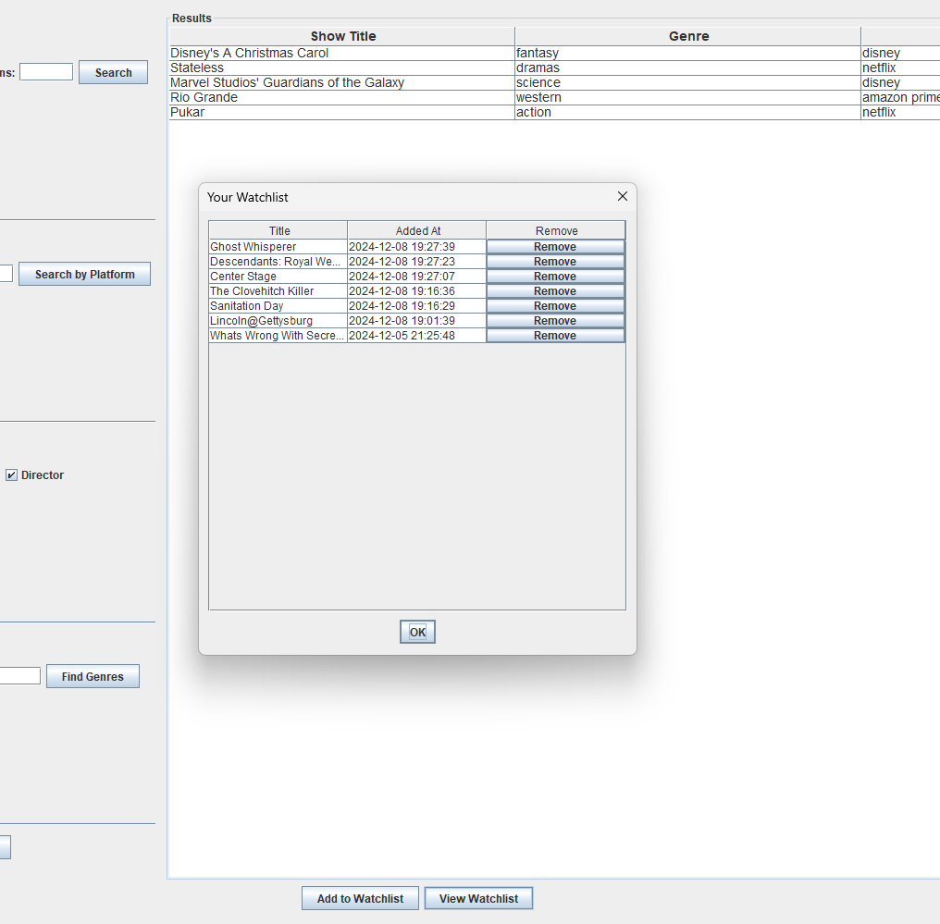
Watchlist

