Slide 1

A Learning based Adaptive Cruise and Lane Control System
Master thesis presentation
Peng Xu
Supervisor: Professor Wyatt Newman

Slide 2
Overview
1. Background
2. Deep Q-Learning
3. System Design
4. Online Training
5. Results
6. Conclusion
7. Future Work

Slide 3
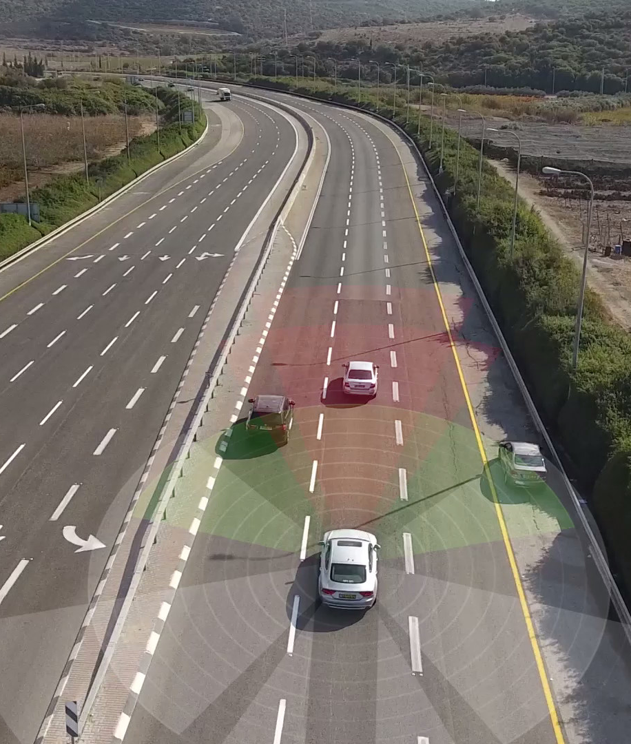
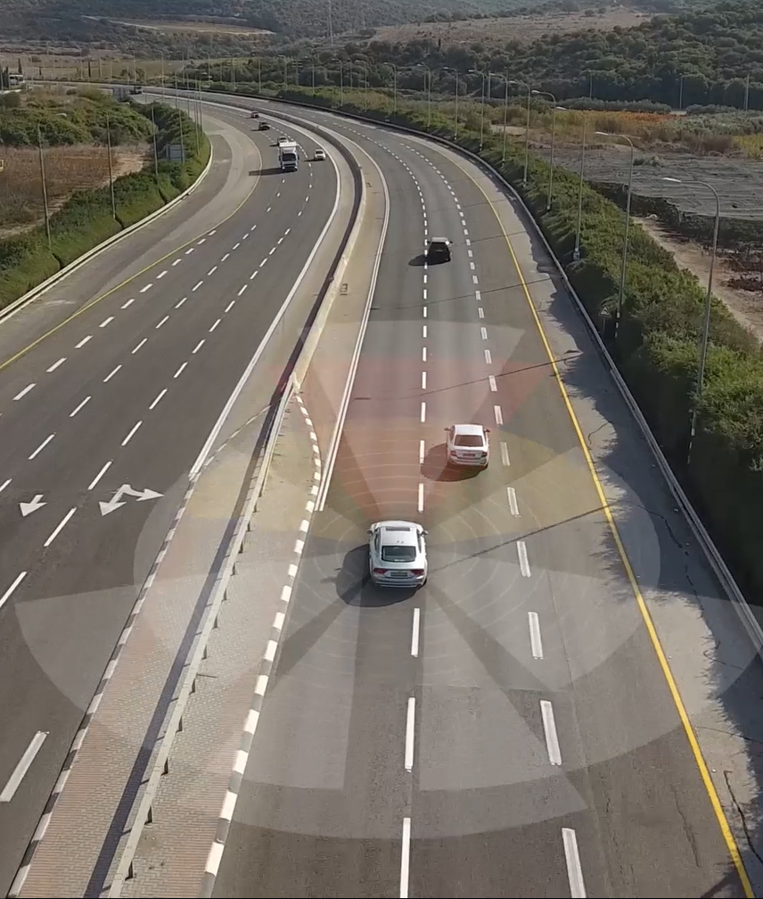
1. Background

Slide 4
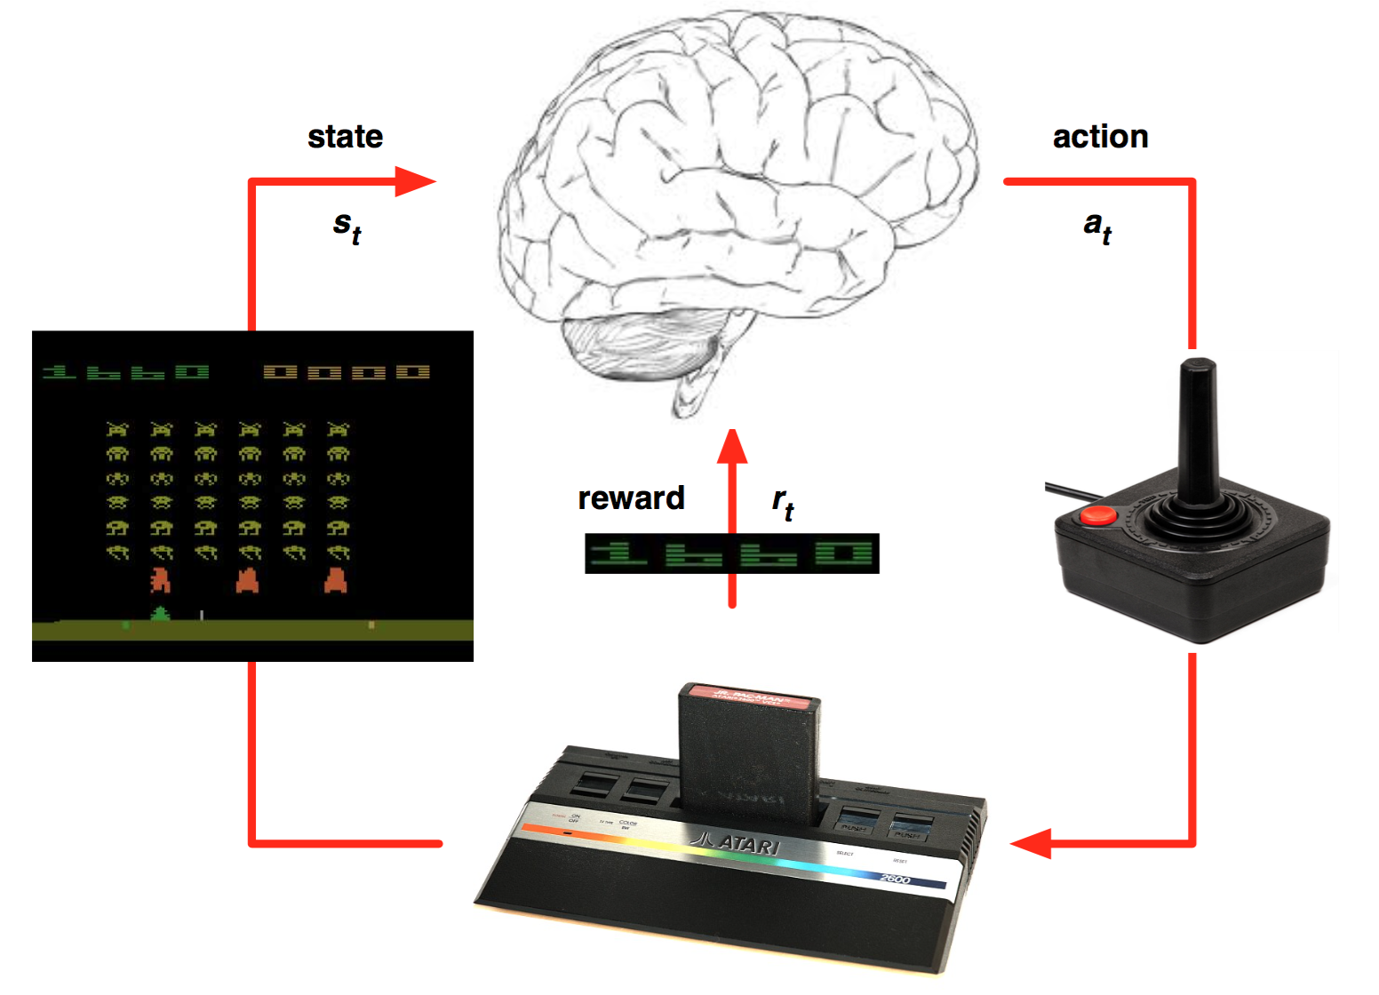
2. Deep Q-Learning

Slide 6
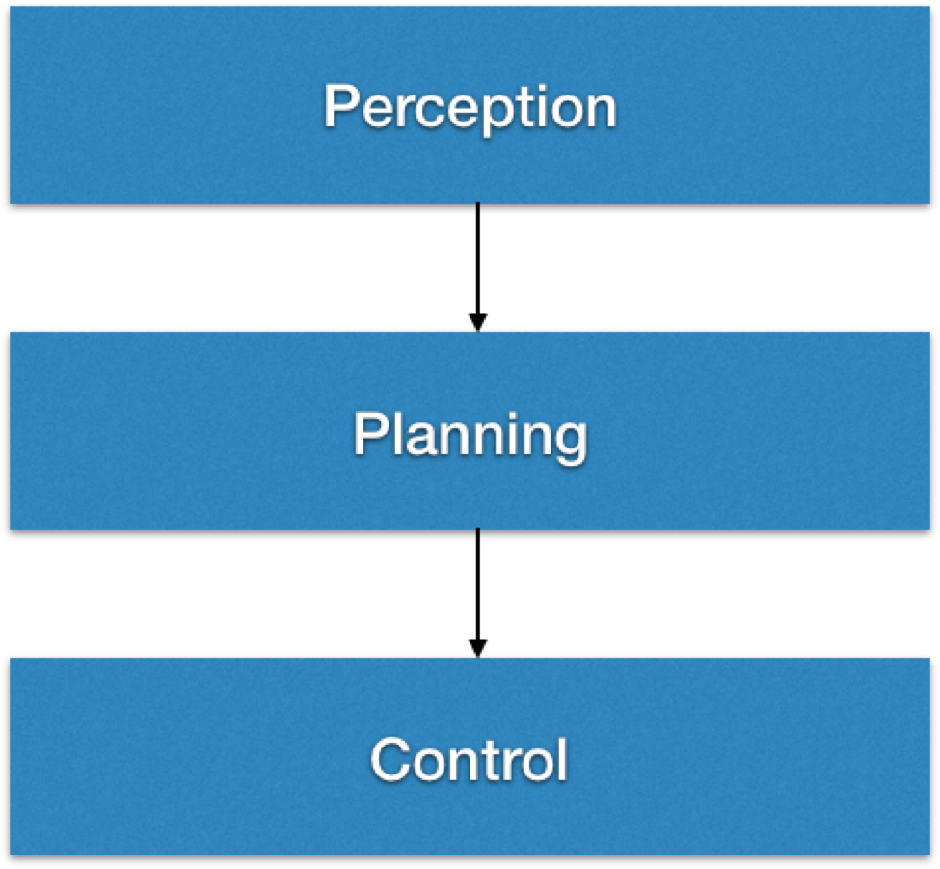
3. System Design
Autonomous System Architecture

Slide 7
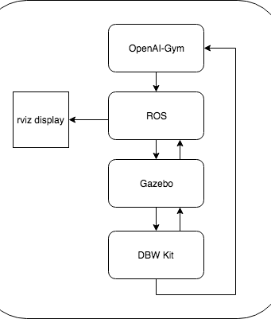
Perception
Simulated by Gazebo

Slide 8
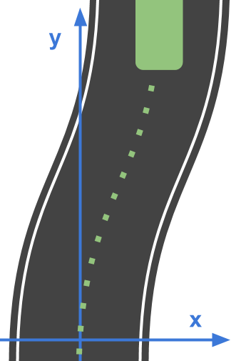
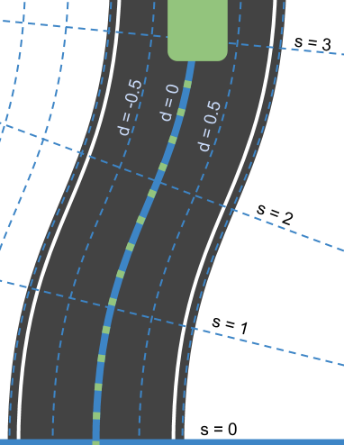
Notes:
Trajectory Planning
Waypoint Following (pose & velocity)
Lane Keep
Lane Change

Slide 9
Drive-by-wire
Implemented by ROS
PID control on throttle and brake
Steering torque control

Slide 10
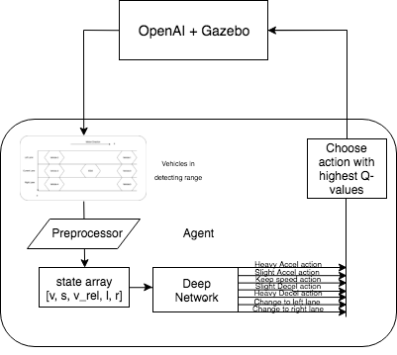
4. Online Training
Architecture

Slide 11
State space:
Action space:

Slide 12
Reward Function

Slide 13
5. Results
ACC Agent: Longitudinal Motion
ACC & LC Agent: Longitudinal and Lateral Motion

Slide 14
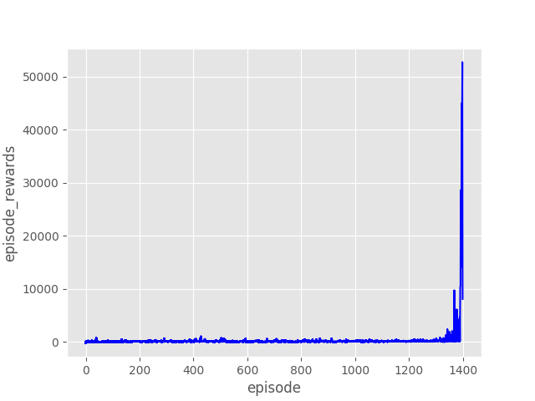
Train an ACC agent

Slide 15
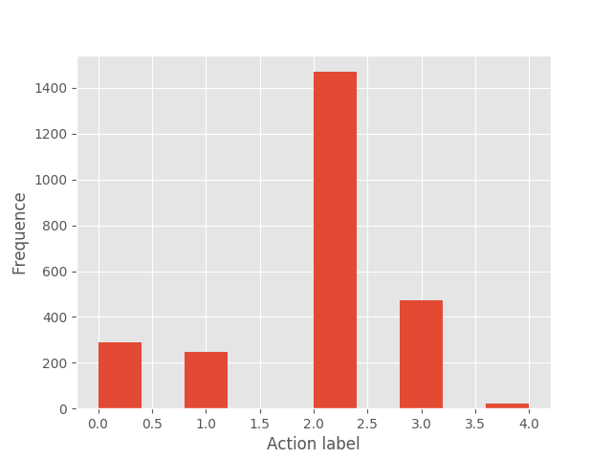
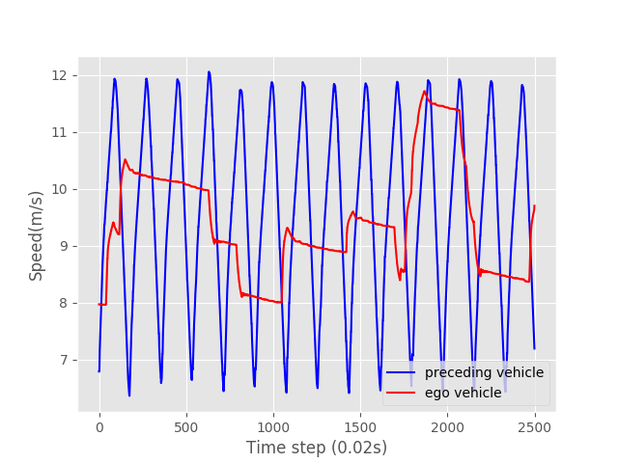

Slide 16
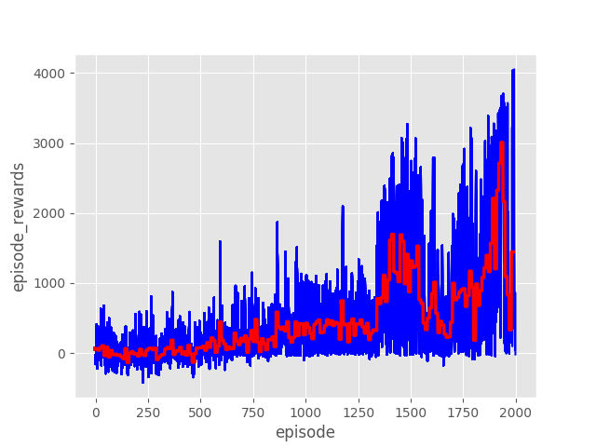
Train an ACC & LC agent

Slide 17
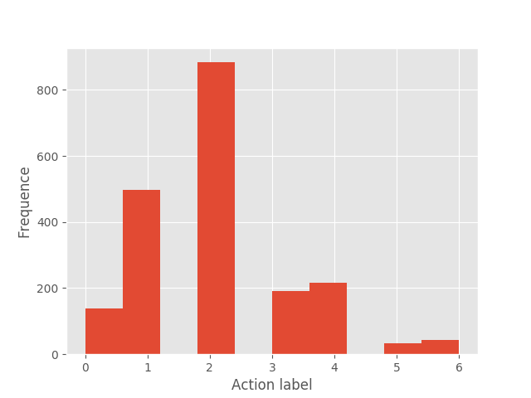
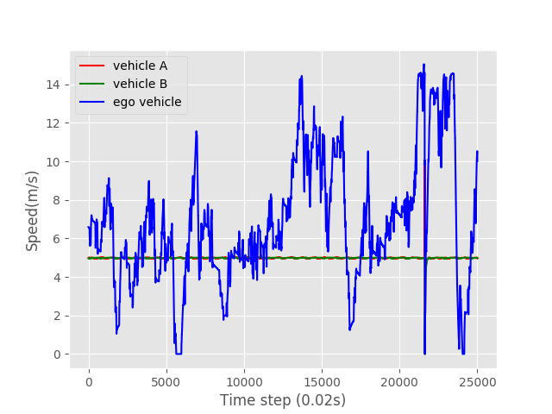

Slide 18
6. Conclusion

Slide 19
7. Future Work

Slide 20
Thank you!

