Slide 1


Research landscape, methodology & future-direction
Meeting presentation
Dynamic resource allocation for 5G and future 6G
A summary
PhD student Ben Cheikh Ali
Supervisors Hakima Chaouchi · Anis Laouiti · Nour-El-Houda Yellas
RS2M Department · Télécom SudParis · Palaiseau, France
Notes:
Title slide. This work learns a resource-allocation policy for O-RAN entirely offline from real network traces, with an explicit safety constraint on URLLC latency violations. No online exploration on a live network.

Slide 2
Presentation overall structure
WHAT IS BEING DONE
HOW I WILL EXPERIMENT
WHAT ARE THE NEXT STEPS
1
Research landscape
3
ns-3 5G-LENA & setup
5
Future research ideas
Three recent surveys considered: URLLC in 5G/6G, DRL for AI-RAN, eMBB–URLLC coexistence.
Simulation stack, scenarios and the setup still needed.
Directions opened by the landscape and desired contributions.
2
Positioning decisions
4
Potentially relevant datasets
6
Publication strategy
How my thesis work will reduce E2E URLLC latency while meeting the very challenging reliability goals.
Candidate traces for offline pre-training and their limits.
Target venues, contributions and timeline
RS2M Department · Télécom SudParis · Palaiseau, France
2
Notes:
Six parts in three phases. First, where the field stands: the landscape from three recent surveys and where I position my thesis. Second, how I will experiment: the ns-3 5G-LENA simulation setup and candidate datasets for offline training. Third, where it goes next: future research ideas and the publication strategy.

Slide 3
Research landscape
Three complementary surveys
1
5G URLLC & 6G challenges
2
DRL for 6G AI-RAN
3
eMBB–URLLC coexistence
Haque et al. · IEEE COMST · 2025
Lu et al. · arXiv · 2026
Adhikari et al. · IEEE Access · 2024
WHAT MUST BE GUARANTEED
HOW AN AI AGENT CONTROLS THE RAN
HOW THE SERVICES SHARE RESOURCES
The most comprehensive coverage of URLLC: spans PHY, MAC and cross-layer design, and integrates machine learning and 6G perspectives.
End-to-end DRL for O-RAN: RL fundamentals and MDP modelling, multi-agent and federated DRL, foundation models, trustworthy DRL and the training-to-deployment lifecycle.
Shows that earlier surveys treat eMBB and URLLC separately or partially, the first survey dedicated to their coexistence and joint resource allocation in 6G.
PHY · MAC · Cross-layer · ML · 6G
MDP · MARL / FL · Safe RL · Deployment
Puncturing · Slicing · TTI · ML / FL · RIS-UAV
Slide 4 →
Slide 5 →
Slide 6 →
Together: what must be guaranteed end-to-end · how a learning agent can control the RAN safely · how eMBB and URLLC share the same resources
RS2M Department · Télécom SudParis · Palaiseau, France
3
Notes:
I read three recent surveys, each looking at the problem through a different lens. Haque et al. tell us what must be guaranteed: URLLC requirements across PHY, MAC and cross-layer design, with ML and 6G perspectives. Lu et al. tell us how a DRL agent can actually control the RAN in O-RAN, from MDP modelling to safe deployment. Adhikari et al. focus on how eMBB and URLLC share the same resources, which is exactly my application setting. The next three slides go through each survey's structure in that order.

Slide 4
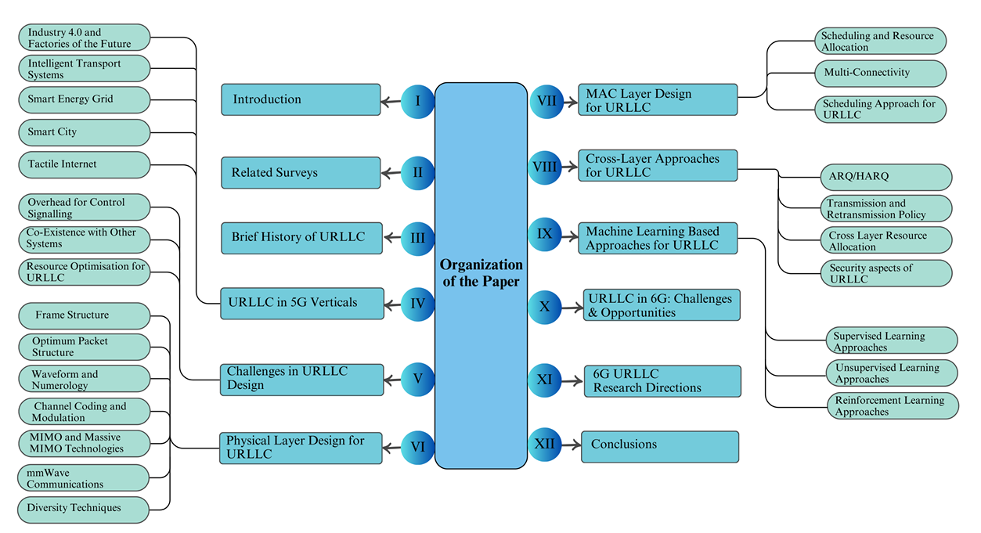
4

Slide 5
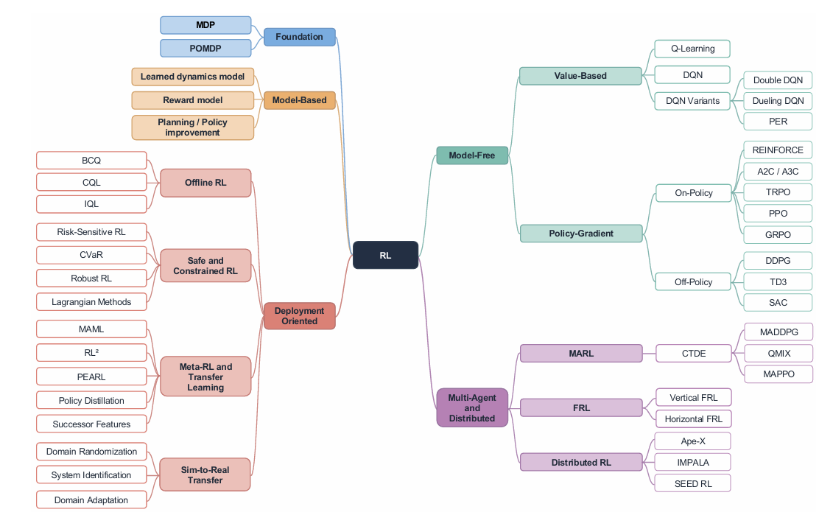
5

Slide 6
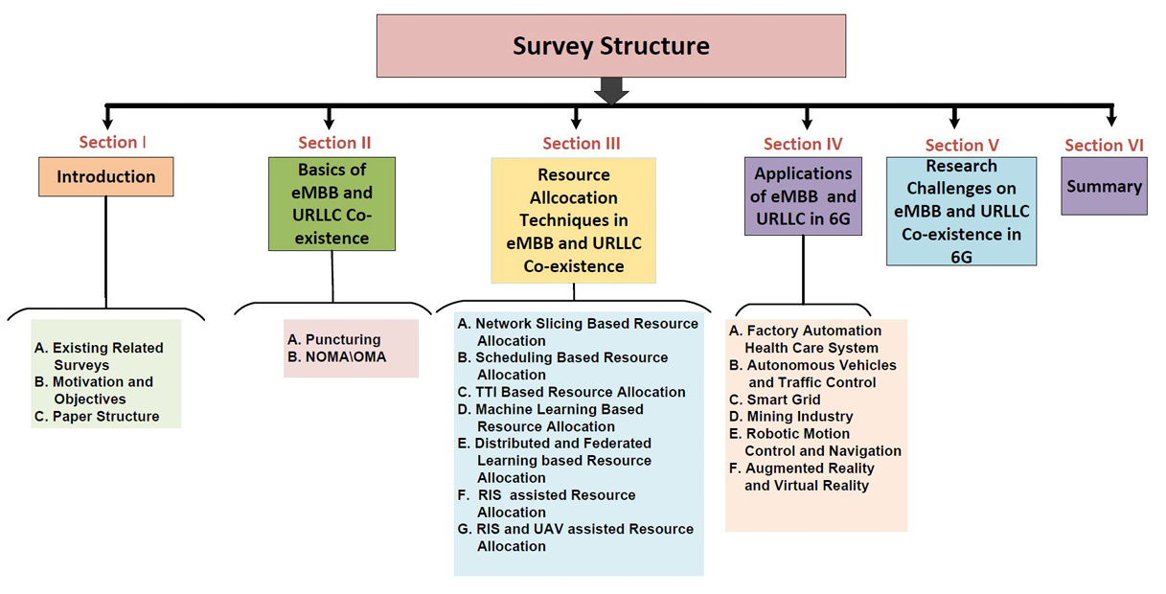
6

Slide 7
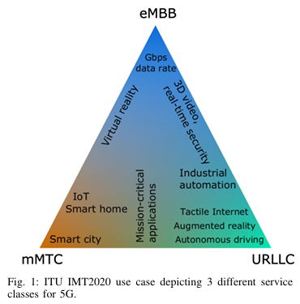
Survey 1 · Haque et al. · 5G URLLC & 6G era
Why URLLC is a different kind of service
From human to machine traffic
VoIP tolerates 50 ms and 2×10⁻² errors; automation control needs 1 ms and 99.9999 %
Two definitions (NGMN)
Reliability: share of packets delivered within the deadline · Latency: measured between application service access points
FROM URC AND ULL TO URLLC
1996
Ultra-low latency in wired links
2003–05
Ultra-reliability in optical networks
2011
URC in wireless (diversity)
Rel-15
Scenarios: edge, slicing
Rel-16
Redundancy, sub-slot HARQ, compact DCI
Rel-17
Feedback, prioritisation, intra-UE mux
Takeaway Latency and reliability pull against each other: URLLC needs a new design, not a tuned 4G.
RS2M Department · Télécom SudParis · Palaiseau, France
7
Notes:
Machine-type traffic changes the requirements: VoIP tolerates 50 ms, automation needs 1 ms. NGMN defines reliability as packets delivered within the deadline. The core tension is that short packets lower latency but lose coding gain, while redundancy adds reliability but costs latency. Figure: Haque Fig. 1 (ITU triangle), PDF p. 2. The timeline summarises Fig. 3 (p. 4); paste Fig. 3 instead if you prefer the original.

Slide 8
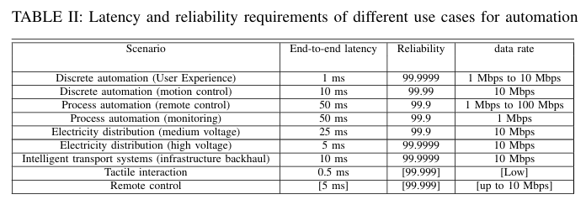
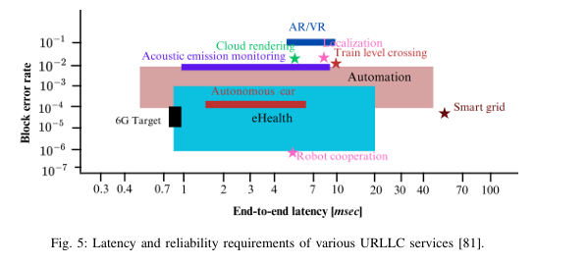
Survey 1 · Haque et al. · 5G URLLC & 6G era
URLLC as a family of requirements
WHY IT IS HARD
Short packets
20 bytes cut latency but remove coding gain.
Redundancy
Retransmissions and parity buy reliability at the cost of latency.
End-to-end
The link is manageable; E2E sums UL/DL, processing, queuing, backhaul and core delays.
General 3GPP targets (1 ms, 1−10⁻⁵) are a baseline but each use case fixes its own latency–reliability point.
RS2M Department · Télécom SudParis · Palaiseau, France
8

Slide 9
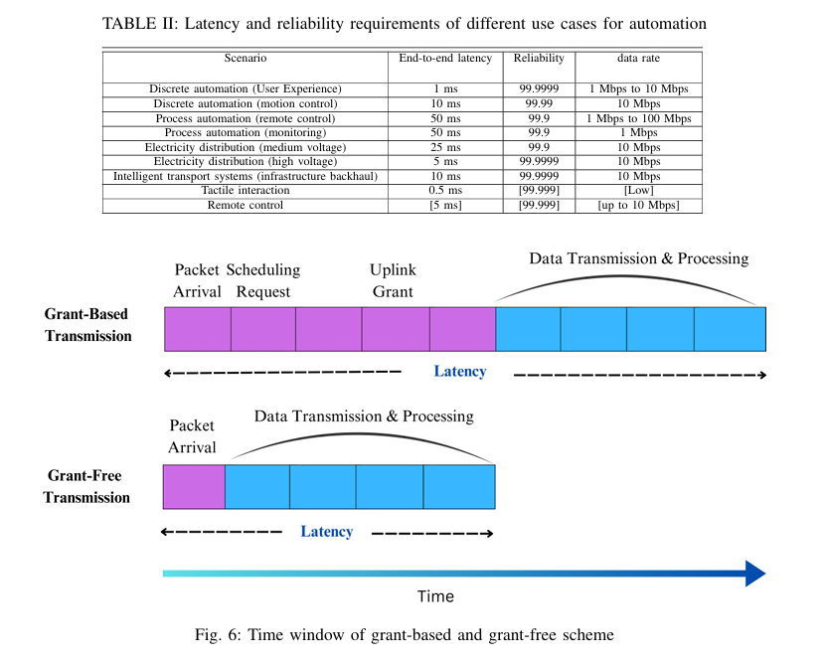
Survey 1 · Haque et al. · 5G URLLC & 6G era
Three design challenges: overhead, coexistence, resource use
1
Control-signalling overhead
A request–grant handshake delays every packet. Options: SPS (periodic traffic only), grant-free access, NOMA, SDMA or RSMA
2
Coexistence with eMBB
URLLC pre-empts eMBB immediately and without notification: the "coexistence problem", mostly studied as eMBB–URLLC
3
Resource optimisation
Fixed allocation wastes spectrum; retransmissions waste it on good channels; joint queue–delay–error models are missing
Takeaway Coexistence with eMBB is named as a core URLLC challenge: survey 3 is dedicated to it.
RS2M Department · Télécom SudParis · Palaiseau, France
9
Notes:
Section V. Fig. 6 (PDF p. 9) shows why grant-free access is faster: no scheduling request or grant before data. Coexistence: under the 3GPP framework URLLC interrupts eMBB immediately and without notification, which the survey calls the coexistence problem. Resource optimisation: the authors ask for joint models of queuing delay, end-to-end delay and error probability.

Slide 10
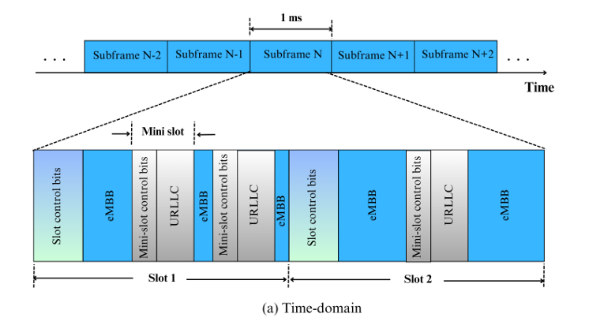
Survey 1 · Haque et al. · 5G URLLC & 6G era
PHY layer: every tool shortens or protects, at a cost
Mini-slots and wider numerology (15×2ᵘ kHz)
Transmit mid-slot with shorter symbols · price: more control overhead
Short-packet design (JPLLO, sparse vector coding)
Less pilot overhead · price: harder detection without CSI
Polar codes
No error floor at short lengths; SC decoding ≈ 1.5 % of turbo complexity, SCL ≈ 100 % (Table IV)
Massive MIMO and diversity
Channel hardening makes the link near-deterministic · price: antennas and resources
OTFS waveforms, mmWave
Robust to Doppler, huge bandwidth · price: complexity, blockage
Takeaway PHY tools buy latency or reliability with control overhead, complexity or extra resources.
RS2M Department · Télécom SudParis · Palaiseau, France
10
Notes:
Section VI. Paste Fig. 7(a) from PDF p. 12: URLLC mini-slots with their own control bits cut into the eMBB data, which is puncturing seen at the frame level. Decoding complexity figures are from Table IV (p. 14), relative to turbo = 100 %. Field trial worth quoting: 60 kHz spacing with 0.25 ms slots reached 99.999 % at under 1 ms.

Slide 11
Survey 1 · Haque et al. · 5G URLLC & 6G era
MAC and cross-layer: where scheduling decides the trade-off
SCHEDULING
ACCESS AND CONNECTIVITY
CROSS-LAYER
eMBB on slots, URLLC on mini-slots
1 ms slots vs 0.125 ms mini-slots
Puncturing loss models
Linear, convex or threshold
LTE schedulers fall short
M-LWDF, EXP/PF, FLS react too coarsely to deadlines
Grant-free access, SPS
No handshake, but waste on sporadic traffic
Preemptive scheduling
URLLC served at once, eMBB pays
Multi-connectivity
>10× better outage for ~2× resources
HARQ
Only 1 retransmission fits in 1 ms
Proactive packet dropping
Keeps power finite when the deadline is below the coherence time
Queue + CSI-aware allocation
Joint models, high complexity
Takeaway Reliability is always paid for in latency, spectrum or eMBB throughput, so the trade-off must be optimised jointly.
RS2M Department · Télécom SudParis · Palaiseau, France
11

Slide 12
Survey 1 · Haque et al. · 5G URLLC & 6G era
ML for URLLC: predictive, constrained, but online
1
Supervised: predict before it happens
Early HARQ (predict decoding failure), random-forest TTI selection, XGBoost forecasts of URLLC arrivals for proactive scheduling
No offline learning, no explicit safety during training
2
Unsupervised: learn constrained allocations
DNN trained primal-dual to learn Lagrange multipliers for power and bandwidth; k-means access control
3
Reinforcement: adapt to dynamics
DDPG for eMBB/URLLC bandwidth and overlap; model-free DRL to limit puncturing; POMDP for NOMA uplink; O-RAN actor-critic
4
Federated RL: learn across sites
ASTEROID: offloading under long-term URLLC constraints; coordination of two O-RAN xApps
Takeaway Every RL work in this survey learns online, in simulation: none learns from network logs.
RS2M Department · Télécom SudParis · Palaiseau, France
12
Notes:
Section IX and Table IX (PDF p. 25). Stress row 2: a DNN trained with a primal-dual method that learns Lagrange multipliers is the closest conceptual cousin of my Lagrangian approach, but it learns a static allocation, not a sequential policy. ASTEROID is the only work that handles a long-term URLLC constraint explicitly, and it is online.

Slide 13
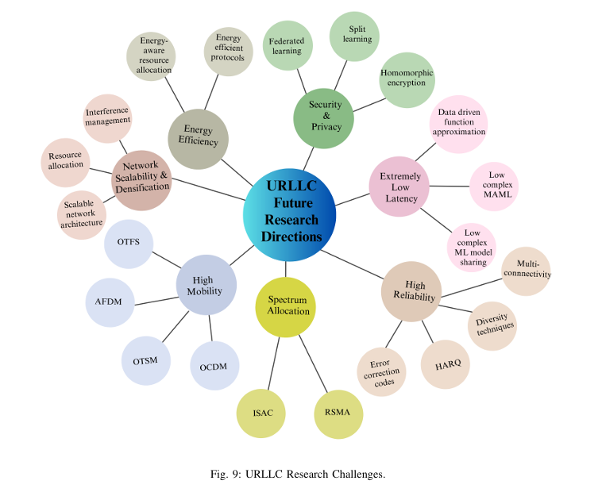
Survey 1 · Haque et al. · 5G URLLC & 6G era
ML is the main lever for 6G URLLC
6G
6G RAISES THE BAR
Move from reactive to proactive: add predicted URLLC arrivals and queue trends to the state
0.1 ms
99.99999 %
user-plane latency
reliability
1 Tbps
peak rate
Directions named by the survey
From reactive to proactive design
Data-driven approximation of receiver blocks
Fast adaptation to topology change (MAML)
Communication–control co-design
RS2M Department · Télécom SudParis · Palaiseau, France
13

Slide 14
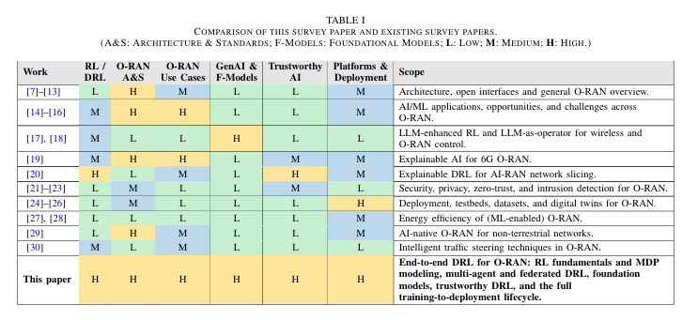
Survey 2 · Lu et al. · DRL for 6G AI-RAN
Why DRL for 6G AI-RAN
1
6G makes the RAN a control platform
Competing objectives: throughput, latency, reliability, energy, sensing, SLA; slicing, massive MIMO and ISAC couple the decisions
2
Rule-based control does not keep up
Hard to design and maintain when dynamics and objectives keep changing
3
O-RAN opens the control loop
Disaggregation, open interfaces, RICs running loops above 1 s and from 10 ms to 1 s
4
DRL fits the problem
Sequential, stochastic, partially observable, multi-objective, and no optimal-action labels
Takeaway Earlier surveys treat RL as one AI tool among many: this is the first survey dedicated to DRL for O-RAN.
RS2M Department · Télécom SudParis · Palaiseau, France
14
Notes:
Section I. Paste Table I (PDF p. 3): earlier survey groups rated Low/Medium/High on RL/DRL, O-RAN architecture, use cases, foundation models, trustworthy AI and deployment; this paper is High on all six. Point 4 is the core argument: RAN control is sequential decision-making, not prediction.

Slide 15
Survey 2 · Lu et al. · DRL for 6G AI-RAN
Five contributions, from method to deployment
1
2
3
4
5
O-RAN-aware MDP
Use-case taxonomy
Advanced methods
Trustworthy DRL
Deployment pipeline
States, actions, rewards, constraints, timing, plus multi-agent and federated variants
Nine domains classified by control loop and timescale
Set and graph encoders for variable entities; foundation models as policy, reward or world model
Safety, fairness, explainability, robustness, verification, mapped to O-RAN, 3GPP, ETSI
Sim-to-real, sample efficiency, continual learning, RLOps, benchmarks
Takeaway It covers the full path from MDP design to certification, not just algorithms.
RS2M Department · Télécom SudParis · Palaiseau, France
15
Notes:
Section I-C. Paste only the top row of Fig. 1 (PDF p. 4), which shows the survey structure: Context, Methodology, Application, Advanced paradigms, Deployment, Path forward. The middle and bottom rows (use cases and O-RAN stack) come back on later slides.

Slide 16
Survey 2 · Lu et al. · DRL for 6G AI-RAN
DRL foundations: MDP, POMDP and model-free learning
DECISION MODELS
VALUE-BASED
POLICY-GRADIENT
MDP (S, A, P, r)
Maximise J(π) = E[Σ γᵗ r(sₜ, aₜ)]; Bellman optimality for V* and Q*
POMDP
Agent sees o ~ O(·|s); belief approximated by an RNN or transformer
In O-RAN
E2/O1 telemetry is sampled, aggregated, delayed: a Near-RT agent faces a POMDP
DQN
Replay buffer + target network stabilise deep Q-learning
Variants
Double DQN (overestimation), Dueling (V + advantage), PER (TD-error sampling)
Fit
Discrete, enumerable choices; breaks on continuous or combinatorial actions
On-policy
REINFORCE, A2C/A3C, TRPO (KL bound), PPO (clipped; most used in O-RAN), GRPO (no critic)
Off-policy
DDPG, TD3 (twin critics, delayed updates), SAC (entropy; standard continuous baseline)
Fit
Off-policy reuses past data: key when exploration is costly
Takeaway Off-policy and offline methods matter because RAN interaction data is expensive and risky to collect.
RS2M Department · Télécom SudParis · Palaiseau, France
16
Notes:
Section II-A to II-C. Keep it brisk: the supervisors know RL. The O-RAN-specific point is the POMDP: RICs see telemetry that is sampled, aggregated and delayed, so the agent never sees the true state. PPO is the most used algorithm in the DRL-for-O-RAN literature; SAC is the standard continuous-control baseline.

Slide 17
Survey 2 · Lu et al. · DRL for 6G AI-RAN
Offline RL and constrained RL, in detail
OFFLINE RL
CONSTRAINED MDP + LAGRANGIAN
Setting
Learn only from a fixed dataset D = {(s, a, r, s′)} collected by a behaviour policy πβ
Central risk: distribution shift
The critic overestimates actions absent from D; bootstrapping amplifies the error
Answers
BCQ restricts actions to πβ support · CQL lowers Q of unsupported actions · IQL never queries unseen actions
O-RAN fit
RICs log E2/O1 telemetry continuously; live exploration risks SLA violations
max_{π} J(π) s.t. J_{C}(π) = E[Σ γᵗ c(sₜ, aₜ)] ≤ d
L(π, ν) = J(π) − ν ( J_{C}(π) − d )
θ ← θ + α∇_{θ}L , ν ← [ ν + α_{ν}( J_{C} − d ) ]⁺
Why a CMDP
SLA limits stay explicit instead of hand-tuned penalty weights
Limit
Constraint met only in expectation and at convergence: intermediate policies may violate it
Takeaway Training offline removes the main weakness of Lagrangian methods: unsafe intermediate policies never touch live users.
RS2M Department · Télécom SudParis · Palaiseau, France
17
Notes:
Sections II-G and II-H, equations (24)–(26). Left: the central risk of offline RL is distribution shift: the critic overestimates actions that the dataset barely contains, and bootstrapping amplifies the error. CQL answers by lowering Q-values of unsupported actions. Right: the CMDP avoids hand-tuned penalty weights, but Lagrangian methods satisfy the constraint only in expectation and at convergence. Combining both is exactly the gap Safe-CQL targets.

Slide 18
Survey 2 · Lu et al. · DRL for 6G AI-RAN
Beyond one agent and one simulator
Multi-agent RL
Federated RL
Stochastic games and Dec-POMDPs. CTDE: MADDPG, QMIX (individual-global-max), MAPPO as a strong default. Each agent sees a non-stationary world.
Horizontal: same task, different sites (one xApp, many gNBs). Vertical: same network, different views (RAN + core/OSS). Issues: non-IID data, privacy leakage, policy-driven shift.
Meta-RL and transfer
Sim-to-real gap
MAML (a few gradient steps), RL² (adaptation inside an RNN), PEARL (latent task z); policy distillation and successor features. Fewer interactions per new cell or slice.
ΔS2R = J_{real}(π*_{real}) − J_{real}(π*_{sim}) ≥ 0. Remedies: domain randomisation, system identification (calibrate the simulator), domain adaptation (shared features).
Takeaway Real RANs are multi-agent, multi-site and never identical to the simulator.
RS2M Department · Télécom SudParis · Palaiseau, France
18
Notes:
Sections II-E, II-F, II-I and II-J. Horizontal FRL: the same xApp trained at many base stations. Vertical FRL: different stakeholders see different parts of the same network, such as RAN telemetry at the RIC and core data at the SMO. The sim-to-real gap is defined as the return lost on the real network by the simulator-optimal policy; it is always non-negative.

Slide 19
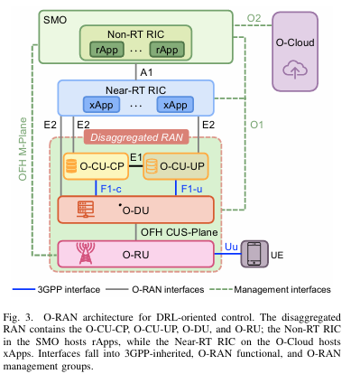
Survey 2 · Lu et al. · DRL for 6G AI-RAN
O-RAN as the DRL environment
> 1 s
Non-RT RIC · rApp
A1 policies, O1 telemetry, R1 services · slice SLA planning
10 ms – 1 s
Near-RT RIC · xApp
Observe E2 KPM, act E2 RAN Control · PRB split, steering
< 10 ms
O-CU / O-DU · dApp
Local MAC/PHY state, research stage · scheduling, beams
Splits: Option 2 (CU | DU over F1) and 7.2x (DU | RU over Open Fronthaul); O2 manages the O-Cloud
Telemetry is sampled, aggregated and delayed: the agent faces a POMDP
Takeaway Where the agent runs decides what it can observe and act on: Safe-CQL is a Near-RT xApp.
RS2M Department · Télécom SudParis · Palaiseau, France
19
Notes:
Section III. Paste Fig. 3 (PDF p. 13). Table II (p. 15) is the textual version of the three rows on the right. E2 is the key interface for an xApp: the KPM service model defines observations and the RC (RAN Control) service model defines feasible actions. O2 manages the O-Cloud, which is the compute substrate, not an interface itself.

Slide 20
Survey 2 · Lu et al. · DRL for 6G AI-RAN
Turning RAN problems into MDPs
1
2
3
4
5
Decision model
Observations
Actions
Reward & constraints
Temporal structure
MDP/POMDP for one controller; CMDP when SLAs are explicit; MARL or federated when coupled
CQI, SINR, queues, PRB usage, slice KPIs, SLA margin; GNN or attention for variable entities
Discrete (steering), continuous (SAC power vector), hybrid (EExAPP: RU sleep + PRB ratios)
Weighted KPI sums dominate; constraint-aware works keep SLAs as costs
Decision period matched to the loop; horizon and interval reported
EVIDENCE FROM THE SURVEY
PandORA: changing the reward, action space or decision period changes which agent comes out best
Two studies with the same algorithm but different decision periods are solving different problems
Takeaway Keep SLAs as explicit constraints and report the decision period: the formulation matters as much as the algorithm.
RS2M Department · Télécom SudParis · Palaiseau, France
20
Notes:
Section IV and Table III (PDF p. 16). The survey compares the literature along these five dimensions. PandORA is the key evidence: changing only the reward, the action space or the decision period changes which DRL agent comes out best, so formulation choices must be reported.

Slide 21
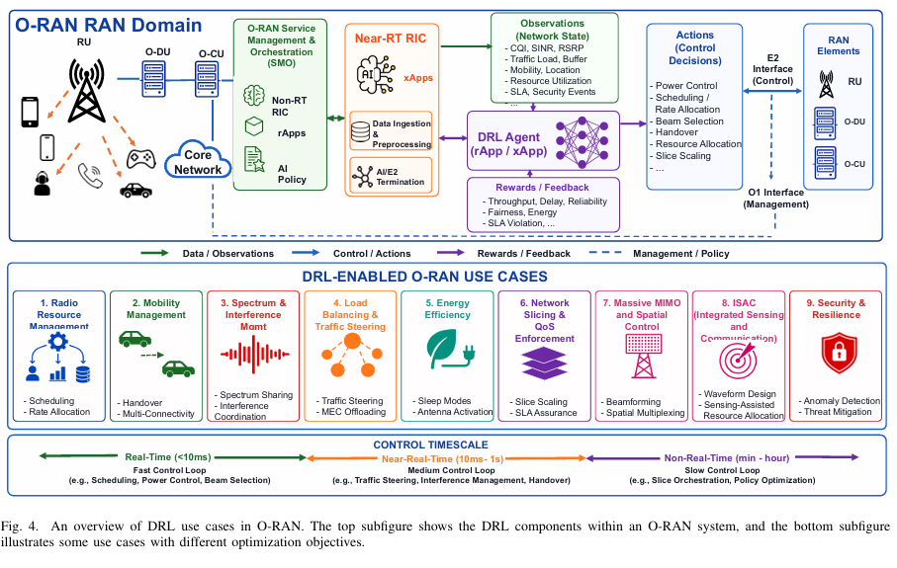
Survey 2 · Lu et al. · DRL for 6G AI-RAN
Use cases: nine domains, slicing and RRM lead
RRM · network slicing · traffic steering
maturity
mobility · energy · interference · security
ISAC · massive MIMO
CLOSEST TO MY SETTING
Sohaib et al.
Distributed Thompson-sampling DRL for joint eMBB/URLLC scheduling
Eskandari et al.
SAC power control for eMBB/URLLC slices in cell-free O-RAN
SafeSlice · Zangooei et al.
Safe slicing with action projection · constrained multi-agent slicing
Takeaway Slicing is the most active domain, and every eMBB/URLLC work cited here is trained online.
RS2M Department · Télécom SudParis · Palaiseau, France
21
Notes:
Section V. Paste Fig. 4 (PDF p. 20), the bottom panel shows use cases by timescale. Table V (p. 26) gives the state, action and reward template per domain if a supervisor asks. The four works on the right are the closest to my setting and the ones I must position against.

Slide 22
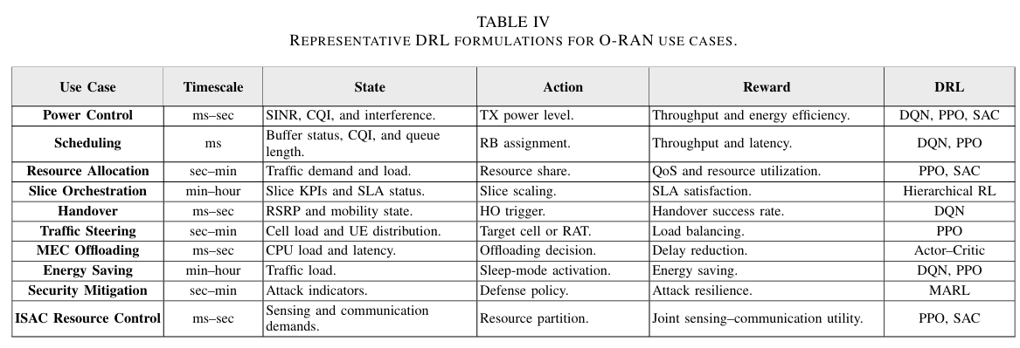
22

Slide 23
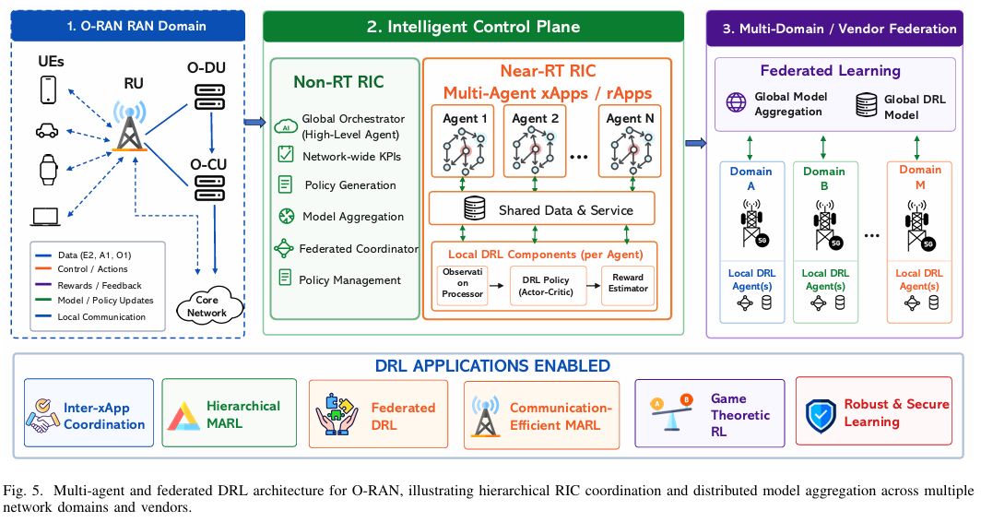
Survey 2 · Lu et al. · DRL for 6G AI-RAN
Multi-agent and federated DRL in O-RAN
The xApp conflict problem
e.g., traffic steering vs energy saving on the same resources. Answers: heterogeneous-agent PPO, digital-twin testing, xApp distillation
Hierarchical MARL
rApp sets budgets or goals, xApp executes; LLM-hRIC puts an LLM at the Non-RT level
Federated DRL across vendors
Slicing, offloading, anti-jamming. Risks: non-IID data, synchronisation overhead, poisoning
Game-theoretic warning
Matching, auctions, Stackelberg: high local rewards do not imply stable or fair joint behaviour
Takeaway Several learning xApps on shared resources need coordination by design.
RS2M Department · Télécom SudParis · Palaiseau, France
23
Notes:
Section VI. Paste Fig. 5 (PDF p. 27). Example of the xApp conflict problem: a traffic-steering xApp and an energy-saving xApp issue contradictory decisions on the same radio resources. The game-theoretic warning is useful for a multi-cell extension of my work: agents that each look good in isolation can be unstable or unfair together.

Slide 24
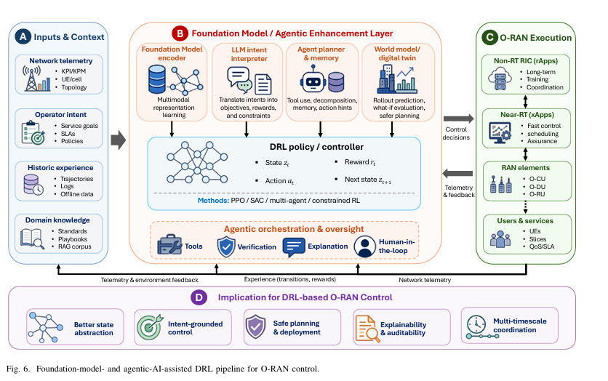
Survey 2 · Lu et al. · DRL for 6G AI-RAN
Foundation models and agentic AI: around DRL, not instead of it
State representation
IQFM on raw I/Q; set and graph encoders; causal O-RAN world model
LLM-augmented DRL
Intent → states, actions, rewards, constraints; RAG grounding (ORAN-GUIDE)
Agentic control
AgentRAN, LLM-hRIC; memory, tools, conflict-aware rApp orchestration
Trajectory and world models
Decision Transformer, Mamba: learn from logs, plan before acting on the live RAN
Takeaway LLMs reason and orchestrate; latency-critical radio actions stay with deterministic, auditable policies.
RS2M Department · Télécom SudParis · Palaiseau, France
24
Notes:
Section VII. Paste Fig. 6 (PDF p. 31): inputs, then the foundation-model layer, then the DRL controller, then RIC actions with verification. The survey insists that these models augment DRL. Relevant for later work: world models and decision transformers are another way to exploit offline logs.

Slide 25
Survey 2 · Lu et al. · DRL for 6G AI-RAN
Trustworthy DRL: five complementary dimensions
Safety
Fairness
Explainability
Robustness
Verification
Fails: constraint violations
Fails: starved edge UEs or slices
Fails: no accountability
Fails: shift, poisoned telemetry
Fails: undetected runtime faults
CMDP, CVaR, barrier certificates, shields
α-fairness, Jain index, welfare objectives
Attribution, explanation-guided training, symbolic policies
Randomisation, adversarial training, anomaly detection
Formal checks, runtime shields, fallback, conflict detection
e.g., SafeSlice; 2OffRAN (offline + OPE)
e.g., PPO vs TD3: throughput vs evenness
e.g., EXPLORA, SymbXRL
e.g., Malicious-xApp attacks
e.g., PRISM-checked cell-switching xApp
Takeaway Keep operational limits as explicit constraints and let the reward carry only the objective.
RS2M Department · Télécom SudParis · Palaiseau, France
25
Notes:
Section VIII, Table VIII (PDF p. 36). Optional: paste Fig. 7 (p. 36) on a backup slide. Safety is the dimension that concerns me most: SafeSlice uses a risk-sensitive reward plus action projection online, and 2OffRAN trains a handover policy fully offline and validates it with off-policy evaluation before deployment.

Slide 26
Survey 2 · Lu et al. · DRL for 6G AI-RAN
From training to deployment
Offline
Online
Hybrid
Logs → policy. Needs trajectory reconstruction, delay alignment, behaviour-policy provenance (2OffRAN, SafeSlice)
Only in simulators, emulators or testbeds (ns-O-RAN, ColO-RAN, OpenRAN Gym), never on a live RAN
Pre-train offline or in simulation, validate on a testbed, adapt under constraints and shields
Sim-to-real in four stages: domain randomisation → system identification → digital twin (OpenTwin about 96 % KPM accuracy) → shadow deployment
RECOMMENDED PIPELINE
Network logs
Offline pre-training
Off-policy evaluation
Shadow mode
Constrained fine-tuning + shield
Inference: measure end-to-end loop latency on target hardware, not FLOPs · RLOps: version data, environment and model; staged rollout; rollback
Takeaway The survey's first research direction: conservative offline RL, then constrained online fine-tuning.
RS2M Department · Télécom SudParis · Palaiseau, France
26
Notes:
Section IX. Offline training needs more than a dataset: telemetry, control commands and outcomes must be re-aligned into transitions, and the behaviour policy recorded. Sim-to-real runs in four stages. Shadow mode lets a candidate policy read live observations while the incumbent keeps control. RLOps adds versioning of data, environment and model, staged rollout and rollback.

Slide 27
Survey 2 · Lu et al. · DRL for 6G AI-RAN
From paper to deployment: what the survey asks of every DRL study
Sim-to-real
Data
Domain randomisation, system identification, calibrated digital twins, shadow deployment
Log (s, a, r, s′, Δt, z) with delays and context; record the behaviour policy; include stress cases
Reproducibility
Standards
Several seeds with confidence intervals, full MDP spec, measured inference latency on target hardware
Actions must be expressible through E2 RAN Control; declare fallback, latency budget and conflict domain
Takeaway Top research direction: conservative offline RL, then constrained online fine-tuning.
RS2M Department · Télécom SudParis · Palaiseau, France
27

Slide 28
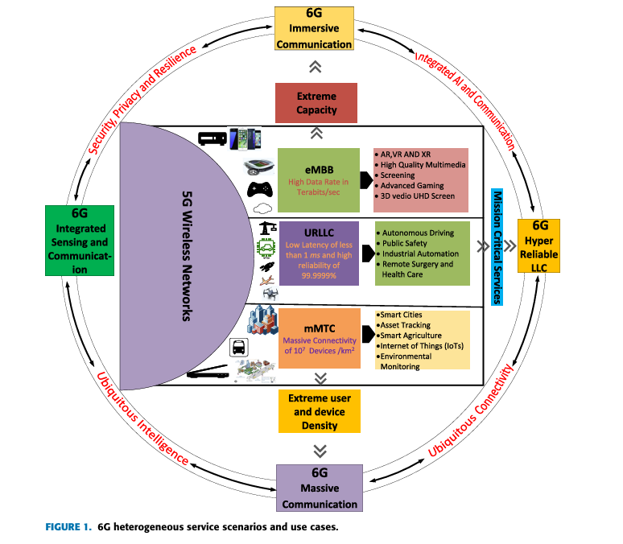
Survey 3 · Adhikari et al. · eMBB–URLLC coexistence
Why coexistence deserves its own survey
 | eMBB | URLLC
Traffic | Large payloads, continuous | Small, sporadic
Priority | Data rate | Latency + reliability
Packets | Long (Shannon capacity) | Short (finite blocklength)
Target | Gbps to Tbps | ≤ 1 ms, PER ≤ 10⁻⁵
6G makes it harder
mURLLC (many URLLC devices) and MBRLLC (rate and reliability: XR, vehicles)
The gap
Earlier surveys treat URLLC alone or the two services separately (Table 2, p. 5)
Takeaway The first survey dedicated to joint eMBB/URLLC resource allocation.
RS2M Department · Télécom SudParis · Palaiseau, France
28
Notes:
Section I. Paste FIGURE 1 (PDF p. 3), the 6G service scenarios. Table 2 (p. 5) shows that earlier surveys cover URLLC alone or the two services separately; only this one covers both coexistence and resource allocation. mURLLC means massive URLLC; MBRLLC combines high rate with low latency and high reliability.

Slide 29
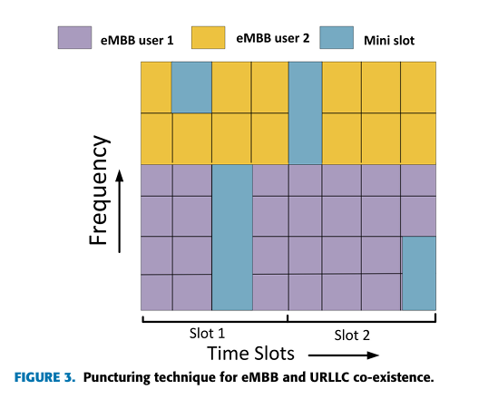
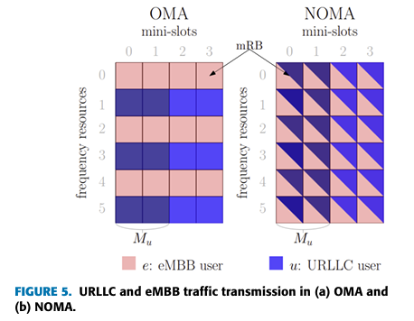
Survey 3 · Adhikari et al. · eMBB–URLLC coexistence
Sharing a slot: puncturing, superposition, OMA vs NOMA
Slots and mini-slots
eMBB is scheduled per slot; URLLC arrives in mini-slots inside it
Puncturing
eMBB power set to zero in the mini-slot: no interference, but eMBB loses rate
Superposition
Both share the mini-slot; URLLC power factor 0.5–1 (puncturing = 1)
OMA vs NOMA
OMA: no interference, low efficiency · NOMA: efficient, but SIC delay conflicts with URLLC
RSMA
Decodes part of the interference: robust to imperfect CSI
Takeaway No sharing mechanism is free: puncturing hurts eMBB, NOMA adds interference and SIC delay.
RS2M Department · Télécom SudParis · Palaiseau, France
29
Notes:
Section II. Paste FIGURE 3 (p. 6, puncturing) in the top frame and FIGURE 5 (p. 7, OMA vs NOMA) in the bottom one. Puncturing is the special case of superposition where the URLLC power factor equals 1. NOMA is more spectrally efficient, but successive interference cancellation at the receiver adds delay that conflicts with URLLC latency.

Slide 30
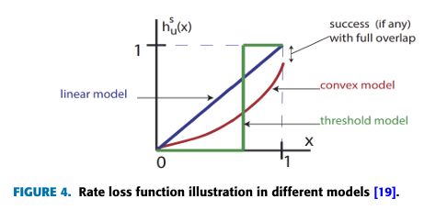
Survey 3 · Adhikari et al. · eMBB–URLLC coexistence
The rate-loss model: how URLLC load is charged to eMBB
Linear h(x) = x
Loss proportional to the punctured fraction; the joint scheduler decomposes cleanly; any URLLC arrival distribution
Convex
Loss grows faster than linearly; needs an approximation algorithm; eMBB users spread across the whole slot
Threshold (0–1)
g = r · ψ · ( 1 − h( L / ψ ) )
r: mean eMBB rate · ψ: eMBB allocation · L: URLLC load
No loss until a threshold, then the codeword is lost entirely; URLLC placed proportionally to rate
Takeaway The choice of h(·) is a modelling assumption that every coexistence study, mine included, should state.
RS2M Department · Télécom SudParis · Palaiseau, France
30
Notes:
Section II-A, from Anand et al. Paste FIGURE 4 (PDF p. 6), cropping the caption. The linear model is the only one where the joint scheduler decomposes cleanly. Under the threshold model, eMBB loses nothing until puncturing passes a level, then loses the whole codeword. Each eMBB user's QoS therefore caps how much URLLC load the cell can carry.

Slide 31
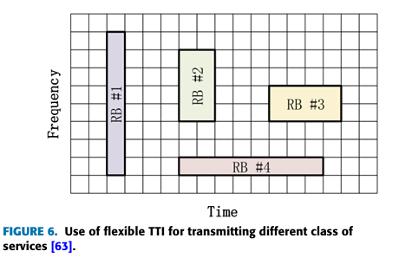
Survey 3 · Adhikari et al. · eMBB–URLLC coexistence
Optimisation-based allocation: slicing, scheduling, flexible TTI
General optimisation
Network slicing
Matching, BCD, Lyapunov, MINLP. DDGSP error 48.2 → 4.1 %; multi-connectivity up to +49 % throughput
OMA, NOMA and RSMA slices; RSMA has the largest rate region and tolerates imperfect CSI
Scheduling
Flexible TTI
Null-space pre-emption (eNSBPS). Joint link adaptation: URLLC 1.3 → 1 ms at 99.999th pct for −10 % eMBB
Short TTIs help only at low URLLC load; under heavy load, control overhead favours longer TTIs
Takeaway URLLC QoS depends on the URLLC load itself: results must be reported across loads.
RS2M Department · Télécom SudParis · Palaiseau, France
31
Notes:
Section III-A to III-C, Tables 4–7. Paste FIGURE 6 (PDF p. 13), which shows resource blocks of different time–frequency shapes per service. The scheduling result is the one to remember: joint link adaptation and scheduling bring URLLC from 1.3 to 1 ms at the 99.999th percentile, for about 10 % less eMBB throughput.

Slide 32
Survey 3 · Adhikari et al. · eMBB–URLLC coexistence
Learning-based allocation: ML, distributed and federated
ML-BASED WORKS AND RESULTS
Distributed and federated
Method | Result
RF-ETDA (random-forest TTI) | −45.6 % URLLC delay
Alsenwi et al. (DRL, URLLC constraints) | eMBB reliability > 90 %
DRSA (MDP-DRL, flexible numerology) | +7–24 % throughput
DDPG | URLLC overlap position + bandwidth
PPO puncturing + water-filling | assumes perfect CSI
DRL-NS with action elimination | +19 / 27 % rate
URLLC at the edge, eMBB in the cloud; multi-agent actor-critic, mean-field DRL; FL slicing across gNBs and operators; faster convergence than centralised
Vocabulary check
"Offline" in this survey means offline optimisation with perfect CSI, not offline RL
Takeaway All learning-based coexistence work is trained online: none learns from network logs.
RS2M Department · Télécom SudParis · Palaiseau, France
32
Notes:
Sections III-D and III-E, Table 8 (PDF p. 18) and Table 9 (p. 20). Alsenwi et al. is the closest work to mine: DRL maximising eMBB rate under URLLC constraints, but trained online in simulation. Careful with vocabulary: when this survey says offline, it means offline optimisation with perfect CSI, not offline reinforcement learning.

Slide 33
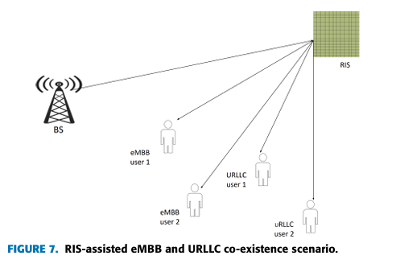
Survey 3 · Adhikari et al. · eMBB–URLLC coexistence
Better channels and target applications
APPLICATION REQUIREMENTS (SECTION IV)
Application | Latency | Error rate | Rate
Factory automation | 1–10 ms | 10⁻⁹ | ≤ 100 Mbps
Robotic motion | 4–8 ms | 10⁻⁹ | ≤ 100 Mbps
Smart grid, high voltage | 5 ms | 10⁻⁶ | ≤ 10 Mbps
Smart grid, medium voltage | 25 ms | 10⁻³ | ≤ 10 Mbps
Autonomous vehicles | < 5 ms | – | –
RIS
99.99 % URLLC admission (vs 95.6 % without), +70 % eMBB; phase optimisation adds URLLC delay
UAV + RIS
Line-of-sight coverage, finite-blocklength design, aerial RIS
Healthcare, mining and AR/VR also need both services at once.
Takeaway Channel improvement mainly helps eMBB: its URLLC latency cost is still unanalysed.
RS2M Department · Télécom SudParis · Palaiseau, France
33
Notes:
Sections III-F, III-G and IV. Paste FIGURE 7 (PDF p. 21), the RIS-assisted coexistence scenario. The RIS result is strong for eMBB, but optimising the phase shifts and estimating CSI adds latency that matters for URLLC. The table gives the application requirements quoted in Section IV.

Slide 34
Survey 3 · Adhikari et al. · eMBB–URLLC coexistence
Open challenges, and the opening for my thesis
CHALLENGES RAISED BY THE SURVEY
1
Under-utilisation
Reserving resources for sporadic URLLC wastes spectrum
Safe-CQL: a joint, low-complexity (8-action) policy, learned offline, with URLLC as an explicit constraint
2
Missing low-complexity models
Most proposals are framework-level or too complex to run
3
eMBB loss cannot be nullified
Only minimised: joint optimisation is required
4
Channel helpers have costs
RIS and UAV add delay, positioning and battery limits
5
ML validity
DRL beats NN predictors but is complex and simulator-bound
Takeaway Within these three surveys, no work learns an eMBB/URLLC policy from logs under explicit URLLC constraints.
RS2M Department · Télécom SudParis · Palaiseau, France
34
Notes:
Section V. The five challenges are the survey's own. On the right is my position and three concrete changes I take from this survey: state which rate-loss model my simulator implies, sweep the URLLC load, and add coexistence baselines including an online constrained DRL in the style of Alsenwi et al. Next section: positioning decisions.

