Slide 1


Research landscape · audit · next steps
Meeting presentation
Dynamic resource allocation for 5G and future 6G
Landscape, paper audit and next steps
PhD student Ben Cheikh Ali
Supervisors Hakima Chaouchi · Anis Laouiti · Nour-El-Houda Yellas
RS2M Department · Télécom SudParis · Palaiseau, France
Notes:
Title slide. This work learns a resource-allocation policy for O-RAN entirely offline from real network traces, with an explicit safety constraint on URLLC latency violations. No online exploration on a live network.
Revised deck. Storyline: why the problem matters, what the three surveys jointly say, what my rejected Offline Safe-CQL paper shows and misses, what the reviewers reveal, which directions are worth pursuing, how to validate them, and the decisions I need from you today. Detailed survey slides are in the appendix.

Slide 2
Today's storyline
WHERE I STAND
WHAT I WILL BUILD
VALIDATE & DECIDE
1
Research landscape
3
Research directions
5
Evaluation protocol
Three surveys, read for what they imply for my work, not summarised one by one.
Ranked directions; recommended core: constrained offline→online learning.
Baselines per claim, tail metrics, seeds and confidence intervals.
2
Paper & reviewer audit
4
Datasets & simulators
6
Decisions & publication
What Offline Safe-CQL shows, what it does not, and what three reviewers flagged.
What each dataset supports; ns-3 5G-LENA staged set-up.
What I need you to decide today; target venues.
RS2M Department · Télécom SudParis · Palaiseau, France
2
Notes:
Six parts. First, where I stand: what the three surveys jointly imply, then a critical audit of my rejected paper and of the reviews. Second, what I will build: ranked research directions and the datasets/simulators to support them. Third, how I will validate and what I need decided today. The survey details from the previous version are kept in the appendix.

Slide 3
Executive diagnosis
Five conclusions that should drive the next six months
1
The data, not the algorithm, is the binding limit
Configurations are fixed for each reservation: no action switch is ever observed (paper p. 5; Lu p. 48).
2
“Safe” means a CMDP constraint met on average, by proxy
No tail, per-window or deployment guarantee, and λ has not converged in Fig. 3.
3
A static configuration may match the agent
(39 PRB, RR) stays at or below 3 % violations at every load in Fig. 1: test it first.
4
Two positioning errors are cheap to fix
5 s steps form a Non-RT loop (Lu p. 14); a 20 ms / 97 % slice is not URLLC (Haque p. 1–2).
5
Thesis core: constrained offline→online learning on decision-logged data
ns-3 5G-LENA with logged switching policies; traces become traffic and calibration inputs.
Takeaway Fix the claims now; move the RL contribution to data I can control.
RS2M Department · Télécom SudParis · Palaiseau, France
3
Notes:
These five points summarise the whole deck. One: the decisive weakness is the dataset, where each reservation keeps one configuration, so sequential effects cannot be learned. Two: safety is a constraint in the optimisation, met on average and measured with off-policy proxies. Three: from my own Fig. 1, the static (39, RR) configuration is already within budget at every load, so it may match the agent; this is a one-day check. Four: the timescale and URLLC claims must be corrected. Five: my recommended thesis core is constrained offline-to-online learning in a simulator where I log decisions myself.
Likely question: is the paper dead? Not necessarily; it depends on the static-baseline result (slide 20).

Slide 4
Research landscape
Three complementary surveys
1
5G URLLC & 6G challenges
2
DRL for 6G AI-RAN
3
eMBB–URLLC coexistence
Haque et al. · IEEE COMST · 2025
Lu et al. · arXiv · 2026
Adhikari et al. · IEEE Access · 2024
WHAT MUST BE GUARANTEED
HOW AN AI AGENT CONTROLS THE RAN
HOW THE SERVICES SHARE RESOURCES
The most comprehensive coverage of URLLC: spans PHY, MAC and cross-layer design, and integrates machine learning and 6G perspectives.
End-to-end DRL for O-RAN: RL fundamentals and MDP modelling, multi-agent and federated DRL, foundation models, trustworthy DRL and the training-to-deployment lifecycle.
Shows that earlier surveys treat eMBB and URLLC separately or partially, the first survey dedicated to their coexistence and joint resource allocation in 6G.
PHY · MAC · Cross-layer · ML · 6G
MDP · MARL / FL · Safe RL · Deployment
Puncturing · Slicing · TTI · ML / FL · RIS-UAV
Slide 32 →
Slide 33 →
Slide 34 →
Together: what must be guaranteed end-to-end · how a learning agent can control the RAN safely · how eMBB and URLLC share the same resources
RS2M Department · Télécom SudParis · Palaiseau, France
4
Notes:
I read three recent surveys, each looking at the problem through a different lens. Haque et al. tell us what must be guaranteed: URLLC requirements across PHY, MAC and cross-layer design, with ML and 6G perspectives. Lu et al. tell us how a DRL agent can actually control the RAN in O-RAN, from MDP modelling to safe deployment. Adhikari et al. focus on how eMBB and URLLC share the same resources, which is exactly my application setting. The next three slides go through each survey's structure in that order.

Slide 5
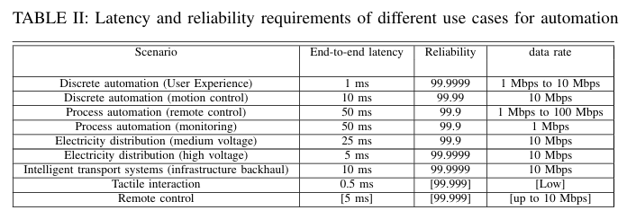
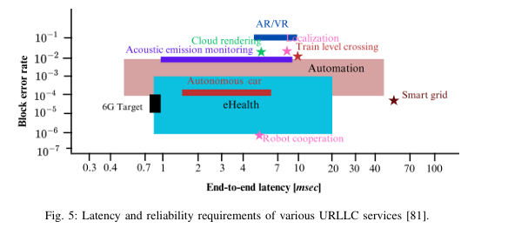
Survey 1 · Haque et al. · 5G URLLC & 6G era
URLLC as a family of requirements
WHY IT IS HARD
Short packets
20 bytes cut latency but remove coding gain.
Redundancy
Retransmissions and parity buy reliability at the cost of latency.
End-to-end
The link is manageable; E2E sums UL/DL, processing, queuing, backhaul and core delays.
3GPP targets (1 ms, 1−10⁻⁵) are a baseline; my paper's slice (20 ms, 3 % budget) is latency-sensitive, not URLLC-grade.
RS2M Department · Télécom SudParis · Palaiseau, France
5
Notes:
Link to my paper: the 'URLLC' slice in the Colosseum dataset has a 20 ms threshold and I allowed 3 % violations, i.e. 97 % reliability. Haque gives 99.999 % at 1 ms (PDF p. 1) and 1−10⁻⁵ to 1−10⁻⁹ (p. 2). In the revision I will call it a latency-sensitive slice, or justify the URLLC label.

Slide 6
Survey 1 · Haque et al. · 5G URLLC & 6G era
ML for URLLC: predictive, constrained, but online
1
Supervised: predict before it happens
Early HARQ (predict decoding failure), random-forest TTI selection, XGBoost forecasts of URLLC arrivals for proactive scheduling
No offline learning, no explicit safety during training
2
Unsupervised: learn constrained allocations
DNN trained primal-dual to learn Lagrange multipliers for power and bandwidth; k-means access control
3
Reinforcement: adapt to dynamics
DDPG for eMBB/URLLC bandwidth and overlap; model-free DRL to limit puncturing; POMDP for NOMA uplink; O-RAN actor-critic
4
Federated RL: learn across sites
ASTEROID: offloading under long-term URLLC constraints; coordination of two O-RAN xApps
Takeaway The RL works reviewed here are trained online, in simulation: none learns from network logs under a URLLC constraint.
RS2M Department · Télécom SudParis · Palaiseau, France
6
Notes:
Section IX and Table IX (PDF p. 25). Stress row 2: a DNN trained with a primal-dual method that learns Lagrange multipliers is the closest conceptual cousin of my Lagrangian approach, but it learns a static allocation, not a sequential policy. ASTEROID is the only work that handles a long-term URLLC constraint explicitly, and it is online.

Slide 7
Survey 2 · Lu et al. · DRL for 6G AI-RAN
Offline RL and constrained RL, in detail
OFFLINE RL
CONSTRAINED MDP + LAGRANGIAN
Setting
Learn only from a fixed dataset D = {(s, a, r, s′)} collected by a behaviour policy πβ
Central risk: distribution shift
The critic overestimates actions absent from D; bootstrapping amplifies the error
Answers
BCQ restricts actions to πβ support · CQL lowers Q of unsupported actions · IQL never queries unseen actions
O-RAN fit
RICs log E2/O1 telemetry continuously; live exploration risks SLA violations
max_{π} J(π) s.t. J_{C}(π) = E[Σ γᵗ c(sₜ, aₜ)] ≤ d
L(π, ν) = J(π) − ν ( J_{C}(π) − d )
θ ← θ + α∇_{θ}L , ν ← [ ν + α_{ν}( J_{C} − d ) ]⁺
Why a CMDP
SLA limits stay explicit instead of hand-tuned penalty weights
Limit
Constraint met only in expectation and at convergence: intermediate policies may violate it
Takeaway Offline training protects users while learning, but the constraint still holds only in expectation and on the data's support.
RS2M Department · Télécom SudParis · Palaiseau, France
7
Notes:
Sections II-G and II-H, equations (24)–(26). Left: the central risk of offline RL is distribution shift: the critic overestimates actions that the dataset barely contains, and bootstrapping amplifies the error. CQL answers by lowering Q-values of unsupported actions. Right: the CMDP avoids hand-tuned penalty weights, but Lagrangian methods satisfy the constraint only in expectation and at convergence. Combining both is exactly the gap Safe-CQL targets.
Revision note: this is exactly the limit of Safe-CQL. Being offline removes training-time exposure, but the final Lagrangian policy satisfies the budget only on average (Lu, Section II-H, PDF p. 11), and only for actions the logs support.

Slide 8
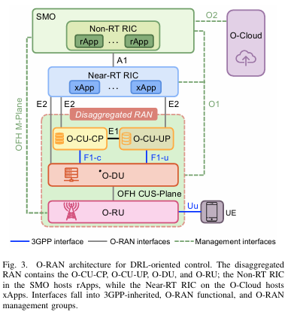
Survey 2 · Lu et al. · DRL for 6G AI-RAN
O-RAN as the DRL environment
> 1 s
Non-RT RIC · rApp
A1 policies, O1 telemetry, R1 services · slice SLA planning
10 ms – 1 s
Near-RT RIC · xApp
Observe E2 KPM, act E2 RAN Control · PRB split, steering
< 10 ms
O-CU / O-DU · dApp
Local MAC/PHY state, research stage · scheduling, beams
Splits: Option 2 (CU | DU over F1) and 7.2x (DU | RU over Open Fronthaul); O2 manages the O-Cloud
Telemetry is sampled, aggregated and delayed: the agent faces a POMDP
Takeaway Placement fixes what the agent sees and controls: a 5 s decision period is a Non-RT (rApp) loop, not a Near-RT xApp.
RS2M Department · Télécom SudParis · Palaiseau, France
8
Notes:
Section III. Paste Fig. 3 (PDF p. 13). Table II (p. 15) is the textual version of the three rows on the right. E2 is the key interface for an xApp: the KPM service model defines observations and the RC (RAN Control) service model defines feasible actions. O2 manages the O-Cloud, which is the compute substrate, not an interface itself.
Revision note: Reviewer 2 is right. Lu (PDF p. 14) gives 10 ms to 1 s for the Near-RT RIC and more than 1 s for the Non-RT RIC. My decision step is 5 s, so either I present the agent as an rApp (slice configuration through A1/O1) or I redesign the loop for 1 s or less.

Slide 9
Survey 2 · Lu et al. · DRL for 6G AI-RAN
Turning RAN problems into MDPs
1
2
3
4
5
Decision model
Observations
Actions
Reward & constraints
Temporal structure
MDP/POMDP for one controller; CMDP when SLAs are explicit; MARL or federated when coupled
CQI, SINR, queues, PRB usage, slice KPIs, SLA margin; GNN or attention for variable entities
Discrete (steering), continuous (SAC power vector), hybrid (EExAPP: RU sleep + PRB ratios)
Weighted KPI sums dominate; constraint-aware works keep SLAs as costs
Decision period matched to the loop; horizon and interval reported
EVIDENCE FROM THE SURVEY
PandORA: changing the reward, action space or decision period changes which agent comes out best
Two studies with the same algorithm but different decision periods are solving different problems
Takeaway Keep SLAs as explicit constraints and report the decision period: the formulation matters as much as the algorithm.
RS2M Department · Télécom SudParis · Palaiseau, France
9
Notes:
Section IV and Table III (PDF p. 16). The survey compares the literature along these five dimensions. PandORA is the key evidence: changing only the reward, the action space or the decision period changes which DRL agent comes out best, so formulation choices must be reported.
Revision note: Reviewer 1's Markov comment belongs here. My state excludes the current configuration; in my logs the configuration never changes within a reservation, so the previous action cannot be learned from. I must state the decision model explicitly (contextual bandit or POMDP with history).

Slide 10
Survey 2 · Lu et al. · DRL for 6G AI-RAN
From training to deployment
Offline
Online
Hybrid
Logs → policy. Needs trajectory reconstruction, delay alignment, behaviour-policy provenance (2OffRAN, SafeSlice)
Only in simulators, emulators or testbeds (ns-O-RAN, ColO-RAN, OpenRAN Gym), never on a live RAN
Pre-train offline or in simulation, validate on a testbed, adapt under constraints and shields
Sim-to-real in four stages: domain randomisation → system identification → digital twin (OpenTwin about 96 % KPM accuracy) → shadow deployment
RECOMMENDED PIPELINE
Network logs
Offline pre-training
Off-policy evaluation
Shadow mode
Constrained fine-tuning + shield
Inference: measure end-to-end loop latency on target hardware, not FLOPs · RLOps: version data, environment and model; staged rollout; rollback
Takeaway The survey's first research direction: conservative offline RL, then constrained online fine-tuning.
RS2M Department · Télécom SudParis · Palaiseau, France
10
Notes:
Section IX. Offline training needs more than a dataset: telemetry, control commands and outcomes must be re-aligned into transitions, and the behaviour policy recorded. Sim-to-real runs in four stages. Shadow mode lets a candidate policy read live observations while the incumbent keeps control. RLOps adds versioning of data, environment and model, staged rollout and rollback.

Slide 11
Survey 3 · Adhikari et al. · eMBB–URLLC coexistence
Open challenges, and the opening for my thesis
CHALLENGES RAISED BY THE SURVEY
1
Under-utilisation
Reserving resources for sporadic URLLC wastes spectrum
Safe-CQL: a joint, low-complexity (8-action) policy, learned offline, with URLLC as an explicit constraint
2
Missing low-complexity models
Most proposals are framework-level or too complex to run
3
eMBB loss cannot be nullified
Only minimised: joint optimisation is required
WHAT THE AUDIT ADDS
– Learned from static configuration logs: one-step effects only
– Constraint met on average (3 % budget), not per window or on the tail
– Offline O-RAN work exists outside these surveys (Yang et al. 2024; 2OffRAN 2025)
4
Channel helpers have costs
RIS and UAV add delay, positioning and battery limits
5
ML validity
DRL beats NN predictors but is complex and simulator-bound
Takeaway Within these three surveys, no work learns an eMBB/URLLC policy from logs under explicit URLLC constraints.
RS2M Department · Télécom SudParis · Palaiseau, France
11
Notes:
Section V. The five challenges are the survey's own. On the right is my position and three concrete changes I take from this survey: state which rate-loss model my simulator implies, sweep the URLLC load, and add coexistence baselines including an online constrained DRL in the style of Alsenwi et al. Next section: positioning decisions.
Revision note: the dark card was missing in the previous version, which made the white text invisible. The bottom of the card lists what the audit changes in my claim.

Slide 12
Cross-survey synthesis
Three lenses on one problem, and what each one gives me
Survey | Scope and methods | Architecture and evidence | Open problems | Use for my work
Haque et al. 2025 | URLLC across PHY, MAC and cross-layer: mini-slots, grant-free, HARQ, multi-connectivity; ML mostly supervised, RL online (Table IX) | 3GPP Rel-15 to 17; 6G: ≤ 0.1 ms, 99.99999 %; analytical and simulation evidence | Sub-ms latency; latency–reliability trade-off analysis; fast adaptation (§XI, p. 29) | Defines the target: shows my 20 ms / 97 % slice is latency-sensitive, not URLLC
Lu et al. 2026 | DRL for O-RAN: MDP / POMDP / CMDP, offline (BCQ, CQL, IQL), safe RL, MARL, deployment | RIC loops (> 1 s, 10 ms–1 s, < 10 ms); Colosseum, ns-O-RAN, OpenRAN Gym; decision-centred data (Eq. 32) | Offline→online under constraints; runtime assurance; trustworthy twins; benchmarks (§XII) | Backs Reviewer 2 (timescale, static data) and sets my core direction
Adhikari et al. 2024 | eMBB/URLLC sharing: puncturing, superposition, OMA/NOMA/RSMA, slicing, flexible TTI, DRL, FL | Slot / mini-slot multiplexing; simulation-based; “offline” means optimisation | Low-complexity models, joint optimisation, ML validity under change (§V, p. 25–26) | Coexistence assumptions to state; report across loads; Alsenwi et al. as a baseline
Takeaway None of the three covers constraint-aware learning from logged RAN decisions; Yang et al. 2024 and 2OffRAN must still be cited.
RS2M Department · Télécom SudParis · Palaiseau, France
12
Notes:
One row per survey, with the columns reduced to what drives decisions. Page numbers refer to the supplied PDFs. Haque fixes what must be guaranteed, Adhikari how services share resources, Lu who decides, when, and from which data. The full comparison table, with limitations and datasets, is in docs/research_review.md, Deliverable 2.
Caveat: absence from a survey is not a gap. Yang et al. (2024) already apply CQL/IQL to RAN slicing offline, and 2OffRAN (ICMLCN 2025) does offline RL with off-policy evaluation for handover.

Slide 13
Cross-survey synthesis
Four implications for my research decisions
1
Configure, don't schedule
2
Keep constraints explicit, and on the tail
URLLC decisions live at ≤ 1 ms (Haque, Adhikari); RIC loops start at 10 ms (Lu p. 14). An xApp or rApp can only set the slice quotas and scheduler policies that shape the URLLC tail.
Lu (§II-H, §VIII-A) favours CMDPs over penalties; Haque (§XI) asks for latency–reliability analysis. Constrain P(ℓ > L) or a CVaR, not a window mean.
3
Data must be decision-centred
4
Report across loads and seeds
Logs need (s, a, r, s′, Δt, z), the behaviour policy and the control location (Lu Eq. 32, p. 48). KPM-only traces calibrate simulators; they do not train sequential policies.
URLLC QoS depends on its own load (Adhikari §III-C); the formulation changes the winner (PandORA, Lu p. 16); benchmarks need seeds and CIs (Lu p. 56).
Takeaway Implication: a configuration-level controller with tail constraints, trained on decision logs I generate.
RS2M Department · Télécom SudParis · Palaiseau, France
13
Notes:
These are my synthesis, not statements of any single survey. Point 1 is the structural tension the surveys expose: the URLLC literature decides per TTI or mini-slot, while RIC applications act at 10 ms or slower. The defensible role of my agent is to configure, not to schedule. Point 3 is Lu's own requirement for DRL datasets, and it is the reason the Colosseum traces are not enough.

Slide 14
Part D · My rejected paper
Offline Safe-CQL: what was built and claimed
Colosseum twinning traces (225k transitions)
Audit: scheduler drives the tail
CMDP: max eMBB s.t. E[c] ≤ 0.03
CQL Q_r + tabular ĉ(a, load) + adaptive λ
OPE on the held-out cluster
FORMULATION
RESULT ON THE HELD-OUT CLUSTER (TABLE II)
– State: 12 KPM features; current configuration excluded
– Action: 4 PRB splits × {RR, PF} = 8
– Step: 5 s window; γ = 0.7; cost treated as immediate (γ_c = 0)
– Cost: share of URLLC packets above 20 ms; budget d = 0.03
– Data: 1 BS, 50 PRB, 8 UEs; train on clusters 2–3, test on 1
Method | Thr. matching | Cost matching | Thr. tabular | Cost tabular
BC | 7.76 ± 0.10 | 0.041 ± 0.002 | 7.49 ± 0.05 | 0.057 ± 0.002
CQL (λ = 0) | 7.81 ± 0.04 | 0.040 ± 0.002 | 7.40 ± 0.03 | 0.049 ± 0.002
Safe-CQL | 7.65 ± 0.05 | 0.030 ± 0.000 | 7.31 ± 0.05 | 0.030 ± 0.001
Throughput in Mbps; cost = URLLC violation rate. Safe-CQL: 2 seeds; BC and CQL: 5 seeds.
Takeaway Claim: 25–47 % fewer violations for 1–2 % less eMBB throughput, with no online exploration.
RS2M Department · Télécom SudParis · Palaiseau, France
14
Notes:
Reminder of the rejected paper. The pipeline audits the Colosseum commercial traffic twinning traces, finds that the scheduler (not the PRB split) drives the URLLC latency tail, formulates a CMDP and trains CQL with a tabular cost model and an adaptive Lagrange multiplier. Numbers are copied from Table II of the paper. Note the asymmetry in seeds and the cost sitting exactly at the budget.

Slide 15
Part D · Audit
Which claims the evidence actually supports
Claim in the paper | Evidence available | Verdict
No unsafe exploration during training | Trained only on logged transitions (§V) | Supported
25–47 % fewer URLLC violations | OPE proxies only; Safe-CQL with 2 seeds; no CIs; cost exactly at the budget | Partly
λ “converges near 12.9” | Fig. 3: λ still rising and training cost ≈ 0.032 > d at epoch 100 | Not supported
Near-RT RIC xApp | 5 s decision period; the Near-RT loop is 10 ms–1 s (Lu p. 14) | Not supported
URLLC SLA | L_max = 20 ms, 3 % budget, LTE 10 MHz testbed (Haque p. 1–2) | Overstated
Sequential RL is needed | γ_c = 0, “near-immediate” effects, no action switch in the data | Not shown
Beats simple configuration rules | No static baseline; (39, RR) ≤ 0.03 in every load bin of Fig. 1 | Untested
Takeaway The strongest claims rest on off-policy proxies and on a missing static baseline.
RS2M Department · Télécom SudParis · Palaiseau, France
15
Notes:
My own reviewer-style audit, in addition to the three reviews. The λ point comes from Fig. 3 of the paper: the curve in (a) is still increasing at epoch 100 and the cost in (b) is still above the 0.03 budget, so the text should not say 'converges'. The 'sequential RL is needed' row matters: with an immediate cost and no observed action switches, a contextual-bandit formulation may be the honest one.
Likely question: why not just rerun Safe-CQL with more seeds? Yes, that is part of the plan (P1), but it does not fix the data problem.

Slide 16
Part D · Audit
What “safe” means in Safe-CQL, and what it does not
YES
Constraint inside the optimisation
CMDP with an adaptive Lagrange multiplier (Eq. 7, 8, 12)
SUGGESTED WORDING
No exposure of users during training
Offline by construction
“Constraint-aware offline policy learning with empirical, average-case constraint satisfaction on held-out traces.”
YES
PARTLY
Constraint met on held-out data
On average, by OPE proxy: 0.030 ± 0.001 at d = 0.03
WHY
NO
Converged primal–dual solution
Fig. 3: λ still rising at epoch 100
Lagrangian methods satisfy the constraint only in expectation and only at convergence (Lu §II-H, p. 11). A safety claim at deployment needs a shield, a fallback or an online test.
NO
Per-window or tail-latency guarantee
Expected-rate constraint only (Eq. 6–7)
NO
Safety at deployment
No shield, fallback, shadow mode or online test
Takeaway Safety holds at the optimisation level; it is not demonstrated at the deployment level.
RS2M Department · Télécom SudParis · Palaiseau, France
16
Notes:
The prompt for this slide: separate a reward penalty, a constraint in the optimisation, empirical satisfaction, a formal guarantee, and training versus deployment safety. Safe-CQL has the constraint in the optimisation and is trivially safe during training. Satisfaction is only average and measured through proxies; there is no guarantee and nothing at deployment time.
Likely question: is CQL itself a safety mechanism? No. CQL is conservative about value estimates of unsupported actions, which reduces extrapolation error but does not bound constraint violations.

Slide 17
Part E · Reviewers
Reviewers 1 and 2: formulation and data are the real issues
Comment | Concern | My verdict | Severity | Required change
R1 · State drops the PRB split and scheduler: Markov property violated (POMDP) | Mathematical formulation | Partly justified: aₜ₋₁ = aₜ in these logs, so it cannot be learned from | High | State the bandit vs POMDP choice; test aₜ₋₁ on data with switches
R1 · Tabular cost over 3 load bins is too coarse for URLLC tails | Safety modelling | Partly: robust for rare events, but not a tail metric | Medium | State-conditional cost model; bin sensitivity; p99/p99.9; CVaR variant
R2 · 5 s steps belong to the Non-RT RIC, not the Near-RT RIC (10 ms–1 s) | Architecture | Justified (Lu p. 14) | High | Reposition as an rApp / slow xApp, or redesign for ≤ 1 s
R2 · Static data: configuration fixed for each reservation, no causal effect of decisions | Dataset and methodology | Justified; the paper admits it (p. 5) | Critical | Reframe as a one-step policy, or generate switching data
Takeaway Reviewer 2's static-data point is the root cause; Reviewer 1's Markov point follows from it.
RS2M Department · Télécom SudParis · Palaiseau, France
17
Notes:
I do not simply agree with every comment. Reviewer 1's Markov point is formally right, but calling it fatal is overstated, and his fix (add the previous action) is impossible on these logs because the previous action always equals the current one. His tabular-cost point is partly contestable: the KPMs arrive at about 4 Hz, so high-resolution channel dynamics are not observable in this dataset anyway. Reviewer 2's two points are justified; the static data is the most fundamental issue, and Lu (p. 48) says the same about KPM-only traces.
Likely question: can we argue that the configurations were randomised per reservation, like an experiment? Partly. That supports one-step effect estimates, but the paper itself shows configuration–load confounding (p. 4), and it gives nothing about switching.

Slide 18
Part E · Reviewers
Reviewer 3: baselines, novelty and writing
Comment | Concern | My verdict | Severity | Required change
R3 · Only a BC baseline | Baselines | Justified: CQL with λ = 0 is an ablation, not a competitor | High | Static and oracle rules, CQL + penalty, BCQ-Lag, CPQ, COptiDICE
R3 · Offline and safe CQL well studied: incremental | Novelty | Justified: the paper says the algorithm is not novel (p. 2) | High | Narrow the claim, or move to offline→online
R3 · Writing errors; AI-style prose | Presentation | Justified: “γ = 0.7 (Fig. 2).” on p. 4; “[?]” not in my copy | Medium | Full proofreading; align the text with the figures
SCORES (1–5)
 | R1 | R2 | R3
Relevance | 4 | 4 | 3
Technical | 3 | 2 | 2
Novelty | 3 | 2 | 2
Presentation | 5 | 3 | 2
Technical and novelty scores agree across reviewers; presentation scores do not (5 vs 2).
Takeaway Technical scores of 3, 2 and 2 agree: the paper needs new evidence, not only rewriting.
RS2M Department · Télécom SudParis · Palaiseau, France
18
Notes:
Reviewer 3 is the harshest on writing. Two defects are visible in my copy: Section V-B starts with the fragment 'γ = 0.7 (Fig. 2).' and there is 'cost;In short' on p. 6. The missing reference '[?]' is not in the PDF I have, so the reviewed version may differ. On novelty: CPQ (Xu et al., AAAI 2022) is already a safe offline Q-learning method, and Yang et al. (2024) apply CQL and IQL to RAN slicing.

Slide 19
Part E · Root cause
Static logs cannot identify sequential decisions
WHAT THE LOGS CONTAIN VS WHAT A POLICY DOES
THE TRACES SUPPORT
Reservation A
(21, PF)
(21, PF)
(21, PF)
(21, PF)
(21, PF)
– Association between (configuration, load) and KPIs
– Scheduler dominance of the latency tail within logged configurations
– One-step policy value on the logged support
Reservation B
(39, RR)
(39, RR)
(39, RR)
(39, RR)
(39, RR)
THEY CANNOT SUPPORT
Learned policy
(21, PF)
(39, RR)
(39, RR)
(21, PF)
(39, RR)
– Transitions after a switch, hence multi-step value
– OPE of switching policies (matching covers ≈ 40 %)
– Causal claims under configuration–load confounding
?
?
?
? A switch between configurations: never observed in 1,116 reservations, so its transition and its value are extrapolated.
“A static set of KPMs is not enough to reconstruct a sequential decision problem.” (Lu §X-C, p. 48)
Takeaway Use these traces for one-step analysis and calibration; train sequential policies on data with logged switches.
RS2M Department · Télécom SudParis · Palaiseau, France
19
Notes:
This is the core scientific problem. Each reservation of the dataset keeps one configuration, which the paper acknowledges on p. 5: no estimator observes a mid-episode switch. A learned policy switches configurations from one window to the next, which is never in the data. The same property holds for the ColO-RAN dataset according to its maintainers. Lu writes that production traces are useful for system identification, calibration or traffic generation, but not as a complete DRL benchmark unless paired with decision logs (p. 48).

Slide 20
Part E · A missing baseline
A static configuration may already meet the budget
Action | low | med− | med+ | high
(9, RR) | 0.00 | 0.00 | 0.03 | 0.02
(9, PF) | 0.02 | 0.02 | 0.27 | 0.18
(21, RR) | 0.00 | 0.00 | 0.03 | 0.03
(21, PF) | 0.05 | 0.04 | 0.19 | 0.11
(30, RR) | 0.18 | 0.00 | 0.04 | 0.03
(30, PF) | 0.03 | 0.04 | 0.21 | 0.19
(39, RR) | 0.00 | 0.02 | 0.03 | 0.03
(39, PF) | 0.05 | 0.03 | 0.18 | 0.21
HYPOTHESIS TO VERIFY
1
(39, RR) stays ≤ 0.03 at every load level, so it is feasible for d = 0.03 under any load mix.
2
eMBB throughput rises with eMBB PRBs (r = +0.73), and RR matches or beats PF in throughput (paper p. 3–4).
3
So “always (39, RR)” is plausibly near-optimal under the paper's own tabular model.
P0 test (≈ 1 day): evaluate always-(39, RR) and a per-load constrained oracle on cluster 1 with the same estimators. If they match Safe-CQL, the paper becomes an audit paper.
URLLC violation rate per action and load, read from Fig. 1 of the paper. Green ≤ 0.03 (the budget).
Takeaway Before adding any algorithm, check that learning beats the best fixed configuration.
RS2M Department · Télécom SudParis · Palaiseau, France
20
Notes:
The table reproduces the values printed in Fig. 1 of my paper. Every RR row is within budget except (30, RR) at low load (0.18), which probably comes from few samples; the paper does not show cell counts. (39, RR) gives the most eMBB PRBs and is within budget everywhere. This is a hypothesis, not a result: I have not yet computed its throughput on the held-out cluster. The per-load oracle is a small linear programme over the empirical reward and cost tables (8 actions × load bins). Also note: Fig. 1 has four load levels while Eq. 10 describes three; this must be made consistent.

Slide 21
Part E · Revision plan
Prioritised revision plan
Priority | Action | Answers | Effort
P0 | Static and per-load oracle baselines on the held-out cluster | R3, audit | 1–2 days
P0 | Reposition: rApp / slow xApp; “latency-sensitive slice”; qualify “safe” | R2, audit | 2–3 days
P1 | Decision model: contextual bandit vs CMDP, with an empirical test | R1, R2 | 1 week
P1 | Safe offline baselines (BCQ-Lag, CPQ, COptiDICE via OSRL); CQL + penalty sweep | R3 | 1–2 weeks
P1 | ≥ 5 seeds for every method, bootstrap CIs, fix the Fig. 3 claim, state the selection protocol | Statistics | 3–5 days
P2 | State-conditional cost model, bin sensitivity, p99/p99.9, CVaR variant | R1 | 1–2 weeks
P2 | Full proofreading pass | R3 | 2 days
P3 | Data with configuration switches from ns-3 5G-LENA | R1, R2 | 1–3 months
Takeaway If P0 shows the static rule matches Safe-CQL, the paper becomes an audit paper and the RL moves to simulation.
RS2M Department · Télécom SudParis · Palaiseau, France
21
Notes:
Ordered by scientific importance and cost. P0 items can be done this month and decide the fate of the paper. P1 items answer the reviewers directly. P3 is the bridge to the thesis core. Effort estimates are mine, assuming the existing pipeline.
Likely question: which venue for a revised version? See slide 29.

Slide 22
Part F · Positioning
Where the paper stands in the research landscape
Research direction | Survey evidence | What my paper does | Remaining limitation | Opportunity
Offline RL for O-RAN | Lu §II-G, §IX-A; 2OffRAN | CQL trained on logs | Static configurations | Decision-logged data
Safe / constrained RL | Lu §II-H, §VIII-A; SafeSlice | CMDP + adaptive λ, offline | Mean-rate, myopic cost; no shield | Chance / CVaR constraint + shield
eMBB/URLLC coexistence | Adhikari §III, §V; Haque §V | Slice PRBs + scheduler | LTE, 20 ms, no mini-slots | NR numerologies in 5G-LENA
RIC placement and timescale | Lu §III, p. 14 | Claims Near-RT | 5 s is a Non-RT loop | 100 ms–1 s loop, or rApp framing
Offline→online adaptation | Lu §XII-A, p. 54 | Not addressed | — | Thesis core
Benchmarks and reproducibility | Lu §X-D, §XII-G | 2–5 seeds, one dataset | No CIs, no code release | ≥ 10 seeds, CIs, released code
Takeaway Addressed: offline RL with a constraint. Not addressed: switching dynamics, tails, timescale, offline→online.
RS2M Department · Télécom SudParis · Palaiseau, France
22
Notes:
Built from the three surveys plus verified related work. 2OffRAN (Navarro et al., ICMLCN 2025) trains a handover agent offline and evaluates it with off-policy methods; SafeSlice (Nagib et al., ICMLCN 2025) does safe slicing online with action projection. I have only read their abstracts and the survey descriptions, so I am not making detailed comparisons yet.

Slide 23
Part F · Research directions
Ranked research directions
# | Direction | Novelty | Importance | Feasibility | Credibility | Alignment | Total
1 | Constrained offline→online slice-configuration control with tail-latency constraints | 3 | 5 | 3 | 4 | 5 | 20
2 | Honest revision of Safe-CQL: constrained one-step policy from traces + audit | 2 | 3 | 5 | 3 | 5 | 18
3 | Trace-calibrated ns-3 5G-LENA twin with policy-level fidelity | 3 | 4 | 3 | 4 | 4 | 18
4 | Off-policy evaluation and support diagnostics for configuration policies | 3 | 3 | 4 | 3 | 4 | 17
SET ASIDE FOR NOW
Multi-xApp MARL (premature before single-cell credibility) · LLM / agentic control (weak alignment) · mini-slot puncturing dApp (sub-10 ms, outside RIC reach) · RIS/UAV coexistence (different expertise).
Takeaway Do 2 now, build 3 as the enabler, and make 1 the thesis core.
RS2M Department · Télécom SudParis · Palaiseau, France
23
Notes:
Scores are my judgement on a 1–5 scale: novelty evidence, scientific importance, feasibility, experimental credibility, alignment with my current work. Novelty scores are provisional until a systematic search is done. Details for each direction (question, contribution, data, baselines, risks, effort) are in docs/research_review.md, Deliverable 4.

Slide 24
Part F · Recommended core
Core direction: constrained offline-to-online control
RESEARCH QUESTION
FORMULATION CHANGES
Can a policy pre-trained on logged slice-configuration decisions be fine-tuned online with bounded cumulative tail-latency violations under traffic shift, faster than constrained RL from scratch?
– Constraint P(ℓ > L_max) ≤ ε, or a CVaR, instead of a mean rate
– Quantile cost critic with a pessimistic (upper-bound) estimate
– Decision period 100 ms–1 s; aₜ₋₁ and switching cost in the state
– Shield: choose among actions whose cost upper bound is ≤ d
EXPECTED CONTRIBUTIONS
RISKS
1
Decision-logged eMBB / latency-sensitive dataset generator with known behaviour propensities
– Simulated latency tail may differ from the testbed's
– Slicing in 5G-LENA needs custom scheduler code
– Tail metrics need many packets per condition
2
Support-aware shield and chance / CVaR latency constraint for offline→online fine-tuning
Novelty to verify: Nagib et al. 2023, SafeSlice 2025, Yang et al. 2024, 2OffRAN 2025, FISOR 2024.
3
Evidence on cumulative violations and sample efficiency against online baselines
Takeaway Lu names this pipeline as the first open direction (§XII-A, p. 54); Safe-CQL becomes its offline stage.
RS2M Department · Télécom SudParis · Palaiseau, France
24
Notes:
Why this direction: it reuses everything I built (audit, CQL, Lagrangian, cost model) as the offline stage, and it fixes the two fundamental objections, static data and timescale, by generating my own decision logs in ns-3 5G-LENA with randomised switching behaviour policies whose propensities I know. The online stage is where safety becomes measurable: cumulative violations while fine-tuning. Feasibility: four to six months for a first paper if the simulator set-up (slide 27) is ready in the first two. Main failure mode: offline pre-training gives little gain because online constrained learning is already fast in simulation; that would still be a reportable result.

Slide 25
Part G · Data
Datasets: what each one can and cannot support
Dataset | Content (checked against documentation) | Actions logged? | Best use
ns-3 5G-LENA decision logs (to build) | (s, a, r, s′, Δt, z) with behaviour propensities, as in Lu Eq. 32 | Yes, with switches | Offline RL; counterfactual evaluation
Open RAN Commercial Traffic Twinning (WINES) | 1 BS, 50 PRBs, 8 static UEs; 5 PRB splits × {RR, PF}; 3 clusters; PHY/MAC KPMs + MGEN latency; CC-BY-SA-4.0 | Static per reservation | Traffic driver, calibration, one-step analysis
ColO-RAN (Colosseum) | 3 slices (eMBB / MTC / URLLC); RR, WF or PF per slice; 250 ms logs | Static per experiment | Cross-dataset generalisation
Colosseum COMMAG | 4 BSs, 15 PRBs, 3 slices, 40 UEs; configurations tr0–tr5 | Static configurations | Multi-cell sanity checks
Public O-RAN dataset catalogue (Couto et al. 2024) | Survey of public O-RAN datasets | Varies | Search for further candidates
Slice labels in the Colosseum datasets are slice IDs assigned per UE; “URLLC” there is not 3GPP URLLC traffic.
Takeaway None of the datasets checked logs action switches: generate them in simulation, use the traces to calibrate.
RS2M Department · Télécom SudParis · Palaiseau, France
25
Notes:
Verified from the dataset documentation: the twinning dataset uses one base station with 10 MHz (50 PRBs), 8 static UEs, UEs 1–4 on the eMBB slice and UEs 5–8 on the URLLC slice, traffic twinned from LTE traces of three base stations in Madrid, and CC-BY-SA-4.0. The ColO-RAN and COMMAG details come from their repositories and maintainer comments; I still need to check their licences. Observational traces without logged scheduler actions only allow association and one-step analysis on the logged support.

Slide 26
Part G · Infrastructure
Five levels of experimental realism are not equivalent
OPTIONAL
JOURNAL VERSION
5 Software / physical testbed
NEXT PAPER (MINIMUM)
4 Simulator + RIC loop
CURRENT PAPER
3 Calibrated simulator
srsRAN or OAI + RIC, Colosseum. Real stacks; costly, small scale.
2 Trace-driven
NORI or ns-O-RAN with an OSC Near-RT RIC over E2. Real interfaces and loop delay.
1 Abstract RL environment
ns-3 + 5G-LENA with trace-driven traffic. Counterfactuals and NR models.
Replays logged KPMs. Real data, but no counterfactuals.
Analytical queues and rates. Fast, but no PHY/MAC realism.
Takeaway Minimum for the next paper: level 3, calibrated on level-2 traces; level 4 strengthens a journal version.
RS2M Department · Télécom SudParis · Palaiseau, France
26
Notes:
The levels must not be presented as interchangeable. My paper is at level 2. Level 3 gives counterfactuals and switching, which level 2 cannot. Level 4 adds the real E2 interface and loop timing: ns-O-RAN (Lacava et al., WNS3 2023) connects ns-3 to the OSC Near-RT RIC through e2sim but, at publication, only handover control; NORI (SBrT 2025) claims 5G-LENA support and E2 metric collection. I have only read their abstracts. Claiming O-RAN realism from level 3 alone would be wrong, since 5G-LENA does not implement the O-RAN architecture.

Slide 27
Part G · Infrastructure
Stage 1 set-up: ns-3 5G-LENA with a Python control loop
ns-3 + 5G-LENA (C++)
Python agent (PyTorch)
KPMs every 0.1–1 s
Traffic: eMBB video or full buffer + latency-sensitive Poisson small packets; load from the twinning traces
– Policy: CQL-Lagrangian, then online fine-tuning
– Shield: keep actions whose cost upper bound is ≤ d
– Logger: (s, a, r, s′, Δt, z, π_b) for every decision
– Inference time measured on the target CPU
gNB: Numerology μ = 1–2; two slices via RB masks or BWPs; RR / PF / QoS schedulers
ns3-ai / ns3-gym
Measurement: Per-packet latency, slice throughput, buffer occupancy
PRB quota, scheduler
Stage 0 · now–1 mo
Revise the paper on existing data
Stage 1 · 1–3 mo
This set-up; decision-logged datasets
Stage 2 · 3–6 mo
Offline→online under traffic shifts
Stage 3 · 6–12 mo
E2 via NORI / ns-O-RAN + OSC RIC
Engineering risks: run time for tail statistics, reconfiguration during a run, 5G-LENA / ns-3 version drift.
Takeaway This set-up produces decision logs with known propensities, exactly what the trace dataset lacks.
RS2M Department · Télécom SudParis · Palaiseau, France
27
Notes:
Verified facts: 5G-LENA v4.1 (July 2025) works with ns-3.45 and offers RR, PF and MR schedulers with temporal fairness, a 5QI-aware QoS scheduler, OFDMA and TDMA, and several numerologies. An RL scheduler example with ns3-gym came out of GSoC 2024. Slicing is not a built-in feature: it must be emulated with bandwidth parts or a custom RB-mask scheduler, which is engineering work. Data flow: ns-3 aggregates KPMs every decision period, passes them through shared memory to the Python agent, and applies the returned slice quota and scheduler at the next slot boundary.

Slide 28
Part G · Protocol
Evaluation protocol: each claim gets its comparison
Claim | Essential comparison
Learning beats configuration rules | Best static feasible configuration; per-load oracle; QoS scheduler
Better than existing safe offline RL | CQL-Lag, BCQ-Lag, CPQ, COptiDICE, CQL + penalty sweep
The constraint matters | Same method with λ = 0
Offline pre-training helps safe online learning | PPO-Lag / SAC-Lag from scratch; offline only; unconstrained fine-tuning
Each component matters | Ablations: cost model, shield, aₜ₋₁, history length
METRICS
– eMBB throughput: mean and 5th percentile
– Latency p50 / p99 / p99.9, with packet counts
– Deadline-miss rate P(ℓ > L_max)
– Violation frequency and severity: E[(c − d)⁺], CVaR
– Cumulative violations while fine-tuning
– Inference time on the target CPU
STATISTICS AND DATA HYGIENE
– ≥ 10 seeds (simulation), ≥ 5 (offline); bootstrap 95 % CIs
– Leave-one-cluster-out and time-block splits
– Hyperparameters chosen on validation data only
Takeaway Separate mean from tail performance, and empirical safety from guarantees.
RS2M Department · Télécom SudParis · Palaiseau, France
28
Notes:
Baselines are chosen per claim rather than all at once. OSRL (Liu et al. 2023) provides BCQ-Lag, CPQ and COptiDICE implementations. For statistics I will follow Agarwal et al. (NeurIPS 2021): interquartile mean and bootstrap confidence intervals, plus the fraction of seeds that violate the budget. p99.9 needs at least about 10⁴ packets per condition. Trace-driven results only support associational and one-step conclusions; causal statements require the simulator.

Slide 29
Part H · Next steps
Decisions and next steps to agree today
NOW · ≤ 4 WEEKS
MEDIUM TERM · 1–6 MONTHS
LONGER TERM · 6–18 MONTHS
– P0: static and oracle baselines
– Reposition: rApp, latency-sensitive slice, qualified “safe”
– ≥ 5 seeds, CIs; OSRL baselines
– Systematic related-work search
– ns-3 5G-LENA two-slice scenario with per-packet latency
– Decision-logged dataset generator
– Trace calibration with policy-level fidelity
– Offline→online constrained experiments
– E2 loop via NORI / ns-O-RAN + OSC RIC
– Testbed validation (srsRAN or Colosseum)
– Multi-cell and multi-xApp extension
– Runtime assurance: shield + fallback
QUESTIONS FOR MY SUPERVISORS
1. Quick revision of the paper, or fold it into the simulator paper? 2. Thesis scope: configuration level (rApp / xApp) or scheduling level (dApp)? 3. Is LTE-twinned data acceptable as the main evidence? 4. Colosseum access, or commit to ns-3 + NORI?
Venue fit (deadlines not checked): revised paper → ICMLCN, NetSoft, CNSM, ICC/Globecom workshops; core paper → IEEE TMLCN, TNSM, TCCN, OJ-COMS.
Takeaway Agree today on the thesis scope, and on the fate of the paper once the P0 test is done.
RS2M Department · Télécom SudParis · Palaiseau, France
29
Notes:
What I need from this meeting: a decision on the four questions. My recommendation: configuration-level scope; run P0 before deciding the paper's fate; use the LTE traces as traffic and calibration input, not as the main evidence; start with ns-3 5G-LENA and add E2 later. Venues are suggestions based on where comparable work appeared (SafeSlice and 2OffRAN at ICMLCN 2025); I have not checked current deadlines and acceptance is not guaranteed anywhere.

Slide 30
References
References
[1] Haque et al., “A Comprehensive Survey of 5G URLLC and Challenges in the 6G Era,” IEEE COMST, 2025.
[2] Lu et al., “Deep Reinforcement Learning for 6G AI-RAN: A Comprehensive Survey,” arXiv, 2026.
[3] Adhikari, Jaseemuddin, Anpalagan, “Resource Allocation for Co-Existence of eMBB and URLLC Services in 6G Wireless Networks: A Survey,” IEEE Access, vol. 12, 2024.
[4] Ben Cheikh, Chaouchi, Laouiti, Yellas, “Offline Safe RL for eMBB/URLLC Resource Allocation in O-RAN using Real Network Traces,” manuscript (rejected).
[5] Bonati et al., “Twinning Commercial Network Traces on Experimental Open RAN Platforms,” ACM WiNTECH (MobiCom), 2024.
[6] Polese et al., “ColO-RAN: Developing ML-based xApps for Open RAN Closed-loop Control,” IEEE TMC, 2022.
[7] Kumar et al., “Conservative Q-Learning for Offline RL,” NeurIPS, 2020.
[8] Xu et al., “Constraints Penalized Q-learning for Safe Offline RL,” AAAI, 2022.
[9] Liu et al., “Datasets and Benchmarks for Offline Safe RL” (OSRL/DSRL), 2023.
[10] Zheng et al., “Safe Offline RL with Feasibility-Guided Diffusion Model” (FISOR), ICLR, 2024.
[11] Yang et al., “Advancing RAN Slicing with Offline Reinforcement Learning,” 2024.
[12] Navarro et al., “2OffRAN: Offline Off-Policy RL for Safe Handover in O-RAN,” IEEE ICMLCN, 2025.
[13] Nagib et al., “SafeSlice: Enabling SLA-compliant O-RAN Slicing via Safe DRL,” IEEE ICMLCN, 2025.
[14] Nagib et al., “Safe and Accelerated DRL-based O-RAN Slicing: A Hybrid Transfer Learning Approach,” IEEE JSAC, 2023.
[15] Alsenwi et al., “Intelligent Resource Slicing for eMBB and URLLC Coexistence in 5G and Beyond: A DRL Based Approach,” IEEE TWC, 2021.
[16] Lacava et al., “ns-O-RAN: Simulating O-RAN 5G Systems in ns-3,” WNS3, 2023.
[17] “Enabling NS-3 Simulations Integrated with Latest Versions of Open RAN Near-RT RICs” (NORI), SBrT, 2025.
[18] CTTC, 5G-LENA ns-3 NR module, v4.1, 2025.
[19] Tsampazi et al., “PandORA: Automated Design and Comprehensive Evaluation of DRL Agents for Open RAN,” IEEE TMC, 2024.
[20] Agarwal et al., “Deep RL at the Edge of the Statistical Precipice,” NeurIPS, 2021.
[21] Couto et al., “A Survey of Public Datasets for O-RAN,” Annals of Telecommunications, 2024.
RS2M Department · Télécom SudParis · Palaiseau, France
30
Notes:
Survey page numbers cited on the slides refer to the PDF pages of the supplied files. References [11], [12], [16] and [17] were checked at abstract level only.

Slide 31
Appendix
Detailed survey material
Original slides kept intact for reference: survey structures, URLLC PHY/MAC detail, DRL methods and O-RAN use cases, coexistence mechanisms and results.
RS2M Department · Télécom SudParis · Palaiseau, France
31
Notes:
Everything after this divider is the survey material from the previous version, unchanged, for questions.

Slide 32
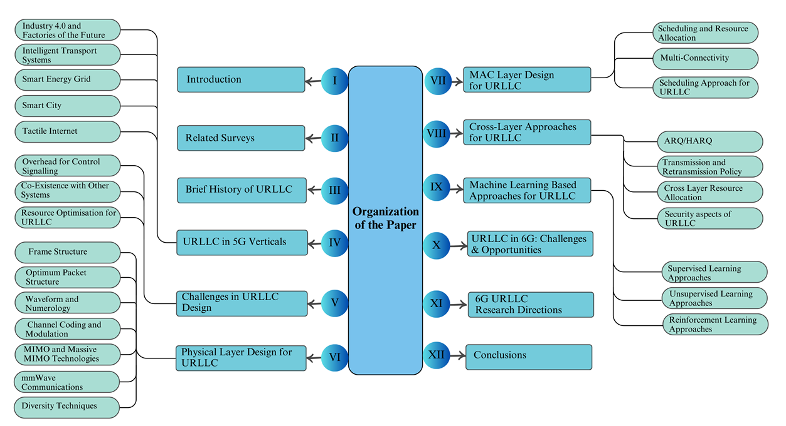
32

Slide 33
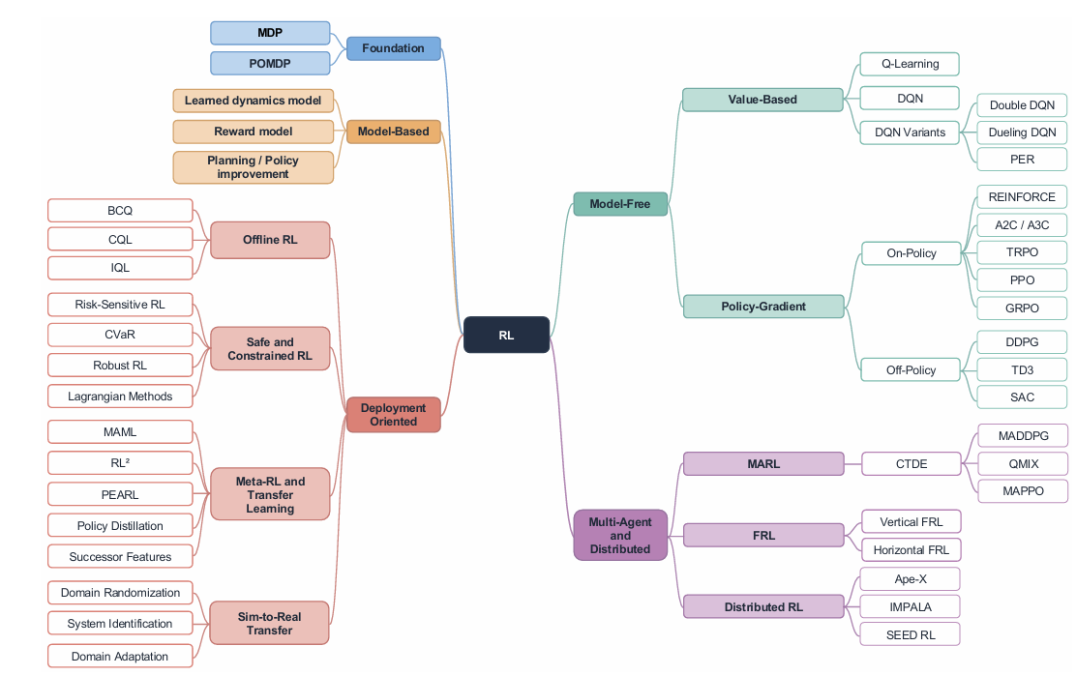
33

Slide 34
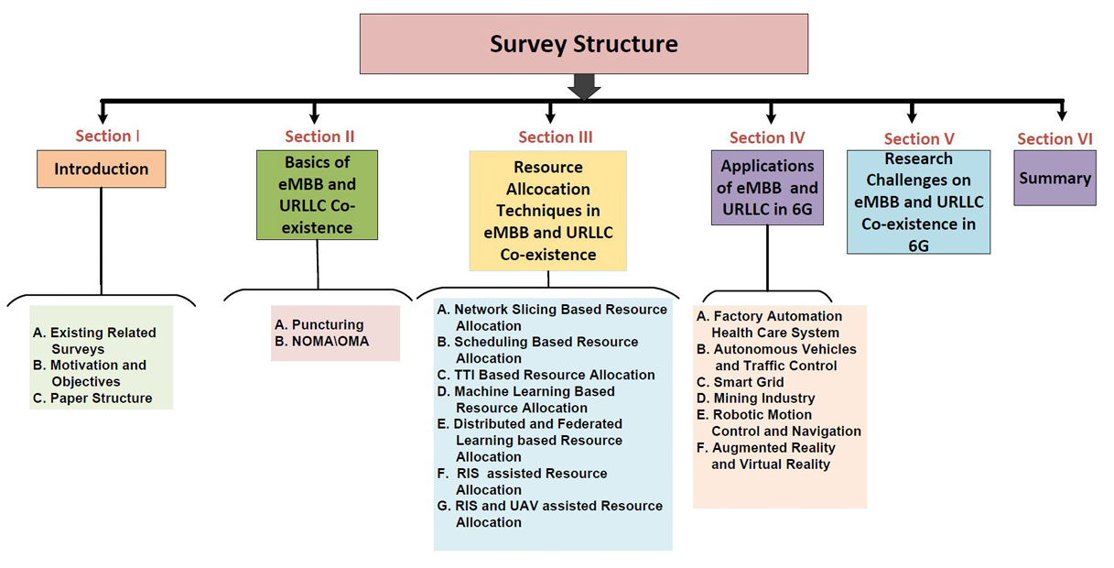
34

Slide 35
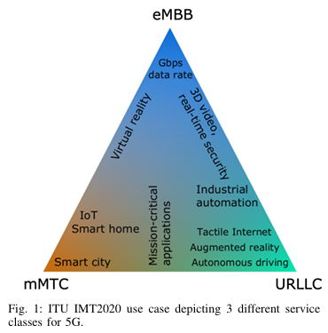
Survey 1 · Haque et al. · 5G URLLC & 6G era
Why URLLC is a different kind of service
From human to machine traffic
VoIP tolerates 50 ms and 2×10⁻² errors; automation control needs 1 ms and 99.9999 %
Two definitions (NGMN)
Reliability: share of packets delivered within the deadline · Latency: measured between application service access points
FROM URC AND ULL TO URLLC
1996
Ultra-low latency in wired links
2003–05
Ultra-reliability in optical networks
2011
URC in wireless (diversity)
Rel-15
Scenarios: edge, slicing
Rel-16
Redundancy, sub-slot HARQ, compact DCI
Rel-17
Feedback, prioritisation, intra-UE mux
Takeaway Latency and reliability pull against each other: URLLC needs a new design, not a tuned 4G.
RS2M Department · Télécom SudParis · Palaiseau, France
35
Notes:
Machine-type traffic changes the requirements: VoIP tolerates 50 ms, automation needs 1 ms. NGMN defines reliability as packets delivered within the deadline. The core tension is that short packets lower latency but lose coding gain, while redundancy adds reliability but costs latency. Figure: Haque Fig. 1 (ITU triangle), PDF p. 2. The timeline summarises Fig. 3 (p. 4); paste Fig. 3 instead if you prefer the original.

Slide 36
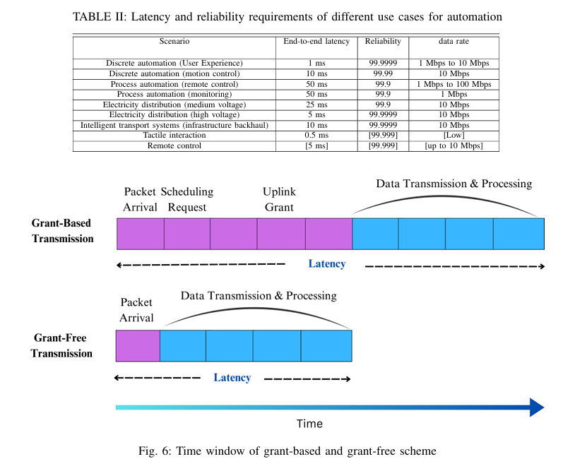
Survey 1 · Haque et al. · 5G URLLC & 6G era
Three design challenges: overhead, coexistence, resource use
1
Control-signalling overhead
A request–grant handshake delays every packet. Options: SPS (periodic traffic only), grant-free access, NOMA, SDMA or RSMA
2
Coexistence with eMBB
URLLC pre-empts eMBB immediately and without notification: the "coexistence problem", mostly studied as eMBB–URLLC
3
Resource optimisation
Fixed allocation wastes spectrum; retransmissions waste it on good channels; joint queue–delay–error models are missing
Takeaway Coexistence with eMBB is named as a core URLLC challenge: survey 3 is dedicated to it.
RS2M Department · Télécom SudParis · Palaiseau, France
36
Notes:
Section V. Fig. 6 (PDF p. 9) shows why grant-free access is faster: no scheduling request or grant before data. Coexistence: under the 3GPP framework URLLC interrupts eMBB immediately and without notification, which the survey calls the coexistence problem. Resource optimisation: the authors ask for joint models of queuing delay, end-to-end delay and error probability.

Slide 37
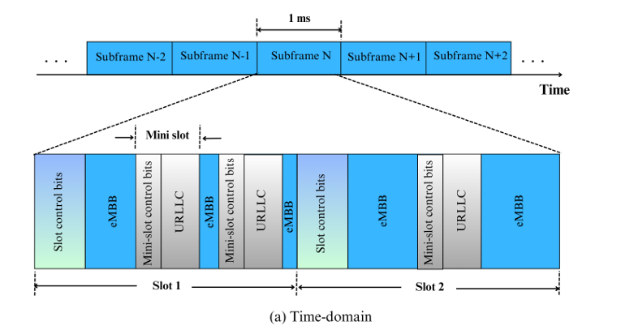
Survey 1 · Haque et al. · 5G URLLC & 6G era
PHY layer: every tool shortens or protects, at a cost
Mini-slots and wider numerology (15×2ᵘ kHz)
Transmit mid-slot with shorter symbols · price: more control overhead
Short-packet design (JPLLO, sparse vector coding)
Less pilot overhead · price: harder detection without CSI
Polar codes
No error floor at short lengths; SC decoding ≈ 1.5 % of turbo complexity, SCL ≈ 100 % (Table IV)
Massive MIMO and diversity
Channel hardening makes the link near-deterministic · price: antennas and resources
OTFS waveforms, mmWave
Robust to Doppler, huge bandwidth · price: complexity, blockage
Takeaway PHY tools buy latency or reliability with control overhead, complexity or extra resources.
RS2M Department · Télécom SudParis · Palaiseau, France
37
Notes:
Section VI. Paste Fig. 7(a) from PDF p. 12: URLLC mini-slots with their own control bits cut into the eMBB data, which is puncturing seen at the frame level. Decoding complexity figures are from Table IV (p. 14), relative to turbo = 100 %. Field trial worth quoting: 60 kHz spacing with 0.25 ms slots reached 99.999 % at under 1 ms.

Slide 38
Survey 1 · Haque et al. · 5G URLLC & 6G era
MAC and cross-layer: where scheduling decides the trade-off
SCHEDULING
ACCESS AND CONNECTIVITY
CROSS-LAYER
eMBB on slots, URLLC on mini-slots
1 ms slots vs 0.125 ms mini-slots
Puncturing loss models
Linear, convex or threshold
LTE schedulers fall short
M-LWDF, EXP/PF, FLS react too coarsely to deadlines
Grant-free access, SPS
No handshake, but waste on sporadic traffic
Preemptive scheduling
URLLC served at once, eMBB pays
Multi-connectivity
>10× better outage for ~2× resources
HARQ
Only 1 retransmission fits in 1 ms
Proactive packet dropping
Keeps power finite when the deadline is below the coherence time
Queue + CSI-aware allocation
Joint models, high complexity
Takeaway Reliability is always paid for in latency, spectrum or eMBB throughput, so the trade-off must be optimised jointly.
RS2M Department · Télécom SudParis · Palaiseau, France
38

Slide 39
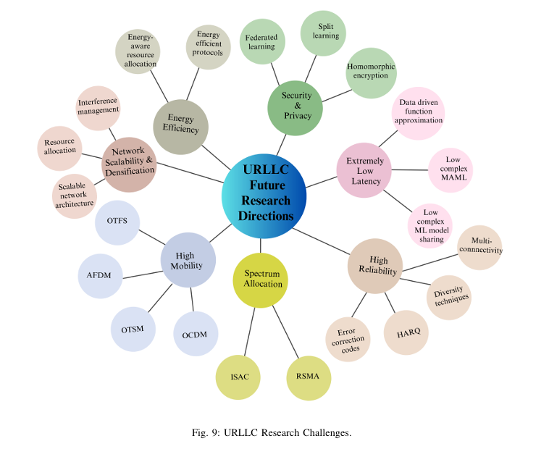
Survey 1 · Haque et al. · 5G URLLC & 6G era
ML is the main lever for 6G URLLC
6G
6G RAISES THE BAR
Move from reactive to proactive: add predicted URLLC arrivals and queue trends to the state
0.1 ms
99.99999 %
user-plane latency
reliability
1 Tbps
peak rate
Directions named by the survey
From reactive to proactive design
Data-driven approximation of receiver blocks
Fast adaptation to topology change (MAML)
Communication–control co-design
RS2M Department · Télécom SudParis · Palaiseau, France
39

Slide 40
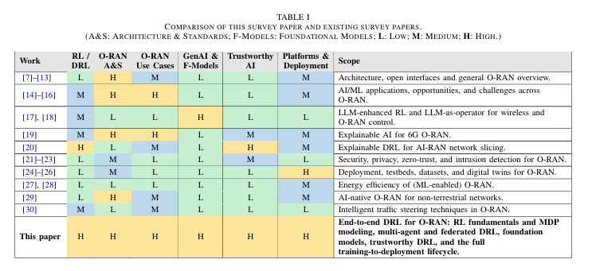
Survey 2 · Lu et al. · DRL for 6G AI-RAN
Why DRL for 6G AI-RAN
1
6G makes the RAN a control platform
Competing objectives: throughput, latency, reliability, energy, sensing, SLA; slicing, massive MIMO and ISAC couple the decisions
2
Rule-based control does not keep up
Hard to design and maintain when dynamics and objectives keep changing
3
O-RAN opens the control loop
Disaggregation, open interfaces, RICs running loops above 1 s and from 10 ms to 1 s
4
DRL fits the problem
Sequential, stochastic, partially observable, multi-objective, and no optimal-action labels
Takeaway Earlier surveys treat RL as one AI tool among many: this is the first survey dedicated to DRL for O-RAN.
RS2M Department · Télécom SudParis · Palaiseau, France
40
Notes:
Section I. Paste Table I (PDF p. 3): earlier survey groups rated Low/Medium/High on RL/DRL, O-RAN architecture, use cases, foundation models, trustworthy AI and deployment; this paper is High on all six. Point 4 is the core argument: RAN control is sequential decision-making, not prediction.

Slide 41
Survey 2 · Lu et al. · DRL for 6G AI-RAN
Five contributions, from method to deployment
1
2
3
4
5
O-RAN-aware MDP
Use-case taxonomy
Advanced methods
Trustworthy DRL
Deployment pipeline
States, actions, rewards, constraints, timing, plus multi-agent and federated variants
Nine domains classified by control loop and timescale
Set and graph encoders for variable entities; foundation models as policy, reward or world model
Safety, fairness, explainability, robustness, verification, mapped to O-RAN, 3GPP, ETSI
Sim-to-real, sample efficiency, continual learning, RLOps, benchmarks
Takeaway It covers the full path from MDP design to certification, not just algorithms.
RS2M Department · Télécom SudParis · Palaiseau, France
41
Notes:
Section I-C. Paste only the top row of Fig. 1 (PDF p. 4), which shows the survey structure: Context, Methodology, Application, Advanced paradigms, Deployment, Path forward. The middle and bottom rows (use cases and O-RAN stack) come back on later slides.

Slide 42
Survey 2 · Lu et al. · DRL for 6G AI-RAN
DRL foundations: MDP, POMDP and model-free learning
DECISION MODELS
VALUE-BASED
POLICY-GRADIENT
MDP (S, A, P, r)
Maximise J(π) = E[Σ γᵗ r(sₜ, aₜ)]; Bellman optimality for V* and Q*
POMDP
Agent sees o ~ O(·|s); belief approximated by an RNN or transformer
In O-RAN
E2/O1 telemetry is sampled, aggregated, delayed: a Near-RT agent faces a POMDP
DQN
Replay buffer + target network stabilise deep Q-learning
Variants
Double DQN (overestimation), Dueling (V + advantage), PER (TD-error sampling)
Fit
Discrete, enumerable choices; breaks on continuous or combinatorial actions
On-policy
REINFORCE, A2C/A3C, TRPO (KL bound), PPO (clipped; most used in O-RAN), GRPO (no critic)
Off-policy
DDPG, TD3 (twin critics, delayed updates), SAC (entropy; standard continuous baseline)
Fit
Off-policy reuses past data: key when exploration is costly
Takeaway Off-policy and offline methods matter because RAN interaction data is expensive and risky to collect.
RS2M Department · Télécom SudParis · Palaiseau, France
42
Notes:
Section II-A to II-C. Keep it brisk: the supervisors know RL. The O-RAN-specific point is the POMDP: RICs see telemetry that is sampled, aggregated and delayed, so the agent never sees the true state. PPO is the most used algorithm in the DRL-for-O-RAN literature; SAC is the standard continuous-control baseline.

Slide 43
Survey 2 · Lu et al. · DRL for 6G AI-RAN
Beyond one agent and one simulator
Multi-agent RL
Federated RL
Stochastic games and Dec-POMDPs. CTDE: MADDPG, QMIX (individual-global-max), MAPPO as a strong default. Each agent sees a non-stationary world.
Horizontal: same task, different sites (one xApp, many gNBs). Vertical: same network, different views (RAN + core/OSS). Issues: non-IID data, privacy leakage, policy-driven shift.
Meta-RL and transfer
Sim-to-real gap
MAML (a few gradient steps), RL² (adaptation inside an RNN), PEARL (latent task z); policy distillation and successor features. Fewer interactions per new cell or slice.
ΔS2R = J_{real}(π*_{real}) − J_{real}(π*_{sim}) ≥ 0. Remedies: domain randomisation, system identification (calibrate the simulator), domain adaptation (shared features).
Takeaway Real RANs are multi-agent, multi-site and never identical to the simulator.
RS2M Department · Télécom SudParis · Palaiseau, France
43
Notes:
Sections II-E, II-F, II-I and II-J. Horizontal FRL: the same xApp trained at many base stations. Vertical FRL: different stakeholders see different parts of the same network, such as RAN telemetry at the RIC and core data at the SMO. The sim-to-real gap is defined as the return lost on the real network by the simulator-optimal policy; it is always non-negative.

Slide 44
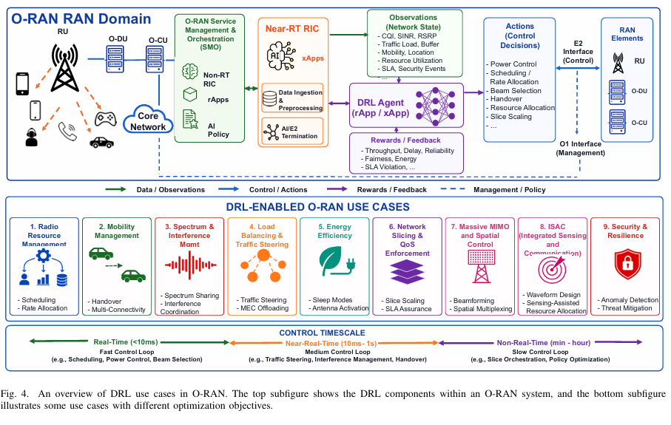
Survey 2 · Lu et al. · DRL for 6G AI-RAN
Use cases: nine domains, slicing and RRM lead
RRM · network slicing · traffic steering
maturity
mobility · energy · interference · security
ISAC · massive MIMO
CLOSEST TO MY SETTING
Sohaib et al.
Distributed Thompson-sampling DRL for joint eMBB/URLLC scheduling
Eskandari et al.
SAC power control for eMBB/URLLC slices in cell-free O-RAN
SafeSlice · Zangooei et al.
Safe slicing with action projection · constrained multi-agent slicing
Takeaway Slicing is the most active domain, and every eMBB/URLLC work cited here is trained online.
RS2M Department · Télécom SudParis · Palaiseau, France
44
Notes:
Section V. Paste Fig. 4 (PDF p. 20), the bottom panel shows use cases by timescale. Table V (p. 26) gives the state, action and reward template per domain if a supervisor asks. The four works on the right are the closest to my setting and the ones I must position against.

Slide 45
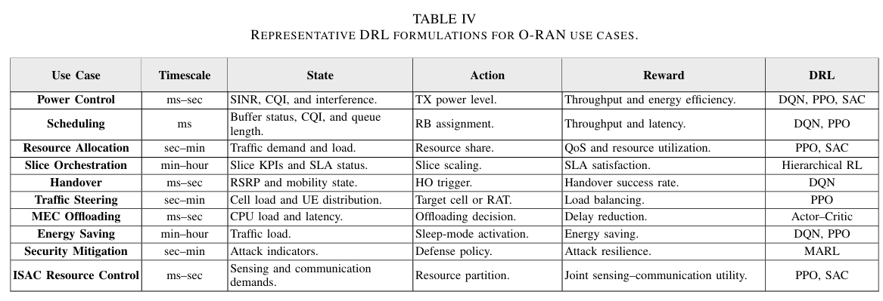
45

Slide 46
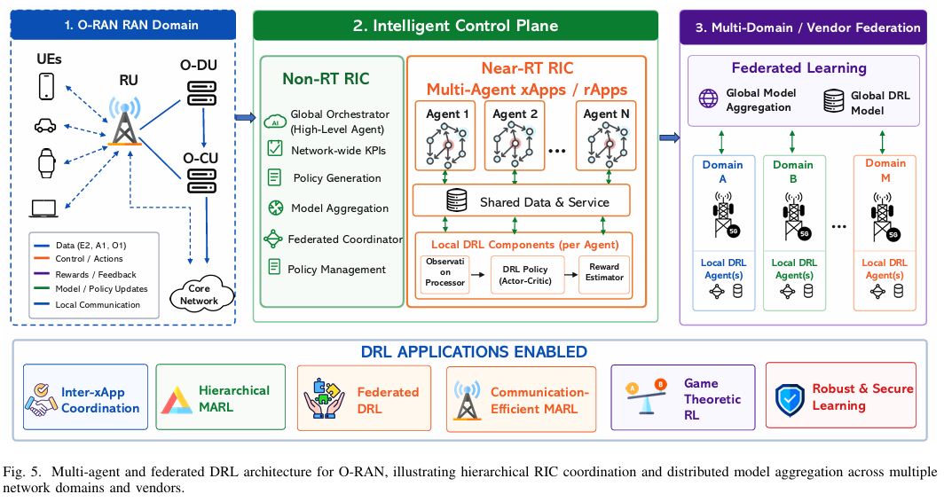
Survey 2 · Lu et al. · DRL for 6G AI-RAN
Multi-agent and federated DRL in O-RAN
The xApp conflict problem
e.g., traffic steering vs energy saving on the same resources. Answers: heterogeneous-agent PPO, digital-twin testing, xApp distillation
Hierarchical MARL
rApp sets budgets or goals, xApp executes; LLM-hRIC puts an LLM at the Non-RT level
Federated DRL across vendors
Slicing, offloading, anti-jamming. Risks: non-IID data, synchronisation overhead, poisoning
Game-theoretic warning
Matching, auctions, Stackelberg: high local rewards do not imply stable or fair joint behaviour
Takeaway Several learning xApps on shared resources need coordination by design.
RS2M Department · Télécom SudParis · Palaiseau, France
46
Notes:
Section VI. Paste Fig. 5 (PDF p. 27). Example of the xApp conflict problem: a traffic-steering xApp and an energy-saving xApp issue contradictory decisions on the same radio resources. The game-theoretic warning is useful for a multi-cell extension of my work: agents that each look good in isolation can be unstable or unfair together.

Slide 47
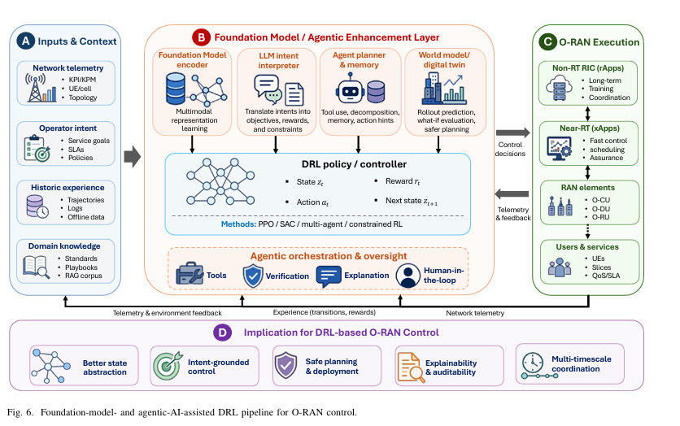
Survey 2 · Lu et al. · DRL for 6G AI-RAN
Foundation models and agentic AI: around DRL, not instead of it
State representation
IQFM on raw I/Q; set and graph encoders; causal O-RAN world model
LLM-augmented DRL
Intent → states, actions, rewards, constraints; RAG grounding (ORAN-GUIDE)
Agentic control
AgentRAN, LLM-hRIC; memory, tools, conflict-aware rApp orchestration
Trajectory and world models
Decision Transformer, Mamba: learn from logs, plan before acting on the live RAN
Takeaway LLMs reason and orchestrate; latency-critical radio actions stay with deterministic, auditable policies.
RS2M Department · Télécom SudParis · Palaiseau, France
47
Notes:
Section VII. Paste Fig. 6 (PDF p. 31): inputs, then the foundation-model layer, then the DRL controller, then RIC actions with verification. The survey insists that these models augment DRL. Relevant for later work: world models and decision transformers are another way to exploit offline logs.

Slide 48
Survey 2 · Lu et al. · DRL for 6G AI-RAN
Trustworthy DRL: five complementary dimensions
Safety
Fairness
Explainability
Robustness
Verification
Fails: constraint violations
Fails: starved edge UEs or slices
Fails: no accountability
Fails: shift, poisoned telemetry
Fails: undetected runtime faults
CMDP, CVaR, barrier certificates, shields
α-fairness, Jain index, welfare objectives
Attribution, explanation-guided training, symbolic policies
Randomisation, adversarial training, anomaly detection
Formal checks, runtime shields, fallback, conflict detection
e.g., SafeSlice; 2OffRAN (offline + OPE)
e.g., PPO vs TD3: throughput vs evenness
e.g., EXPLORA, SymbXRL
e.g., Malicious-xApp attacks
e.g., PRISM-checked cell-switching xApp
Takeaway Keep operational limits as explicit constraints and let the reward carry only the objective.
RS2M Department · Télécom SudParis · Palaiseau, France
48
Notes:
Section VIII, Table VIII (PDF p. 36). Optional: paste Fig. 7 (p. 36) on a backup slide. Safety is the dimension that concerns me most: SafeSlice uses a risk-sensitive reward plus action projection online, and 2OffRAN trains a handover policy fully offline and validates it with off-policy evaluation before deployment.

Slide 49
Survey 2 · Lu et al. · DRL for 6G AI-RAN
From paper to deployment: what the survey asks of every DRL study
Sim-to-real
Data
Domain randomisation, system identification, calibrated digital twins, shadow deployment
Log (s, a, r, s′, Δt, z) with delays and context; record the behaviour policy; include stress cases
Reproducibility
Standards
Several seeds with confidence intervals, full MDP spec, measured inference latency on target hardware
Actions must be expressible through E2 RAN Control; declare fallback, latency budget and conflict domain
Takeaway Top research direction: conservative offline RL, then constrained online fine-tuning.
RS2M Department · Télécom SudParis · Palaiseau, France
49

Slide 50
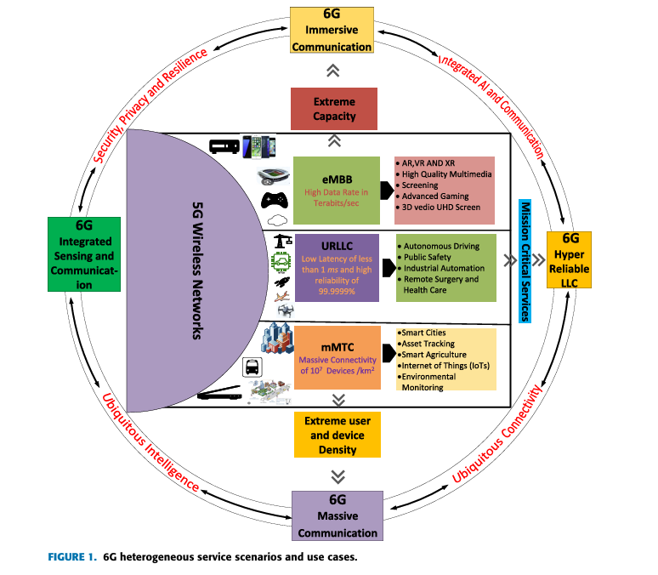
Survey 3 · Adhikari et al. · eMBB–URLLC coexistence
Why coexistence deserves its own survey
 | eMBB | URLLC
Traffic | Large payloads, continuous | Small, sporadic
Priority | Data rate | Latency + reliability
Packets | Long (Shannon capacity) | Short (finite blocklength)
Target | Gbps to Tbps | ≤ 1 ms, PER ≤ 10⁻⁵
6G makes it harder
mURLLC (many URLLC devices) and MBRLLC (rate and reliability: XR, vehicles)
The gap
Earlier surveys treat URLLC alone or the two services separately (Table 2, p. 5)
Takeaway The first survey dedicated to joint eMBB/URLLC resource allocation.
RS2M Department · Télécom SudParis · Palaiseau, France
50
Notes:
Section I. Paste FIGURE 1 (PDF p. 3), the 6G service scenarios. Table 2 (p. 5) shows that earlier surveys cover URLLC alone or the two services separately; only this one covers both coexistence and resource allocation. mURLLC means massive URLLC; MBRLLC combines high rate with low latency and high reliability.

Slide 51
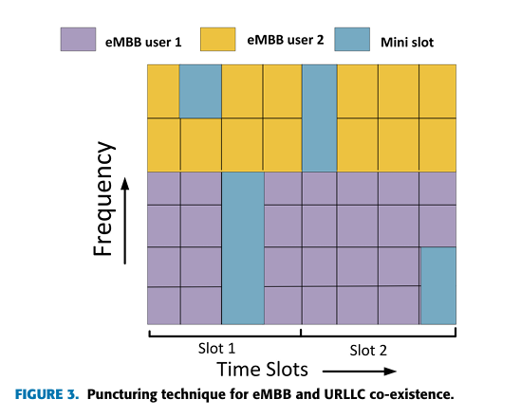
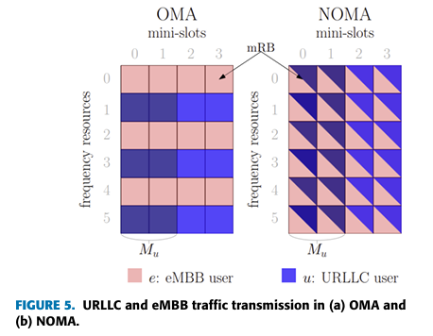
Survey 3 · Adhikari et al. · eMBB–URLLC coexistence
Sharing a slot: puncturing, superposition, OMA vs NOMA
Slots and mini-slots
eMBB is scheduled per slot; URLLC arrives in mini-slots inside it
Puncturing
eMBB power set to zero in the mini-slot: no interference, but eMBB loses rate
Superposition
Both share the mini-slot; URLLC power factor 0.5–1 (puncturing = 1)
OMA vs NOMA
OMA: no interference, low efficiency · NOMA: efficient, but SIC delay conflicts with URLLC
RSMA
Decodes part of the interference: robust to imperfect CSI
Takeaway No sharing mechanism is free: puncturing hurts eMBB, NOMA adds interference and SIC delay.
RS2M Department · Télécom SudParis · Palaiseau, France
51
Notes:
Section II. Paste FIGURE 3 (p. 6, puncturing) in the top frame and FIGURE 5 (p. 7, OMA vs NOMA) in the bottom one. Puncturing is the special case of superposition where the URLLC power factor equals 1. NOMA is more spectrally efficient, but successive interference cancellation at the receiver adds delay that conflicts with URLLC latency.

Slide 52
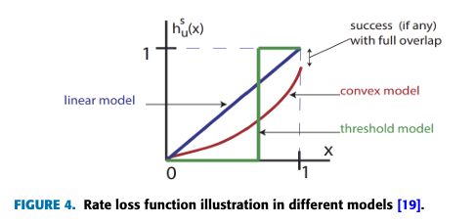
Survey 3 · Adhikari et al. · eMBB–URLLC coexistence
The rate-loss model: how URLLC load is charged to eMBB
Linear h(x) = x
Loss proportional to the punctured fraction; the joint scheduler decomposes cleanly; any URLLC arrival distribution
Convex
Loss grows faster than linearly; needs an approximation algorithm; eMBB users spread across the whole slot
Threshold (0–1)
g = r · ψ · ( 1 − h( L / ψ ) )
r: mean eMBB rate · ψ: eMBB allocation · L: URLLC load
No loss until a threshold, then the codeword is lost entirely; URLLC placed proportionally to rate
Takeaway The choice of h(·) is a modelling assumption that every coexistence study, mine included, should state.
RS2M Department · Télécom SudParis · Palaiseau, France
52
Notes:
Section II-A, from Anand et al. Paste FIGURE 4 (PDF p. 6), cropping the caption. The linear model is the only one where the joint scheduler decomposes cleanly. Under the threshold model, eMBB loses nothing until puncturing passes a level, then loses the whole codeword. Each eMBB user's QoS therefore caps how much URLLC load the cell can carry.

Slide 53
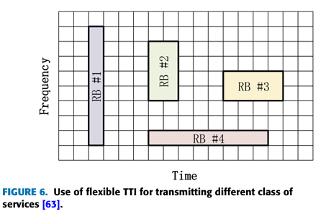
Survey 3 · Adhikari et al. · eMBB–URLLC coexistence
Optimisation-based allocation: slicing, scheduling, flexible TTI
General optimisation
Network slicing
Matching, BCD, Lyapunov, MINLP. DDGSP error 48.2 → 4.1 %; multi-connectivity up to +49 % throughput
OMA, NOMA and RSMA slices; RSMA has the largest rate region and tolerates imperfect CSI
Scheduling
Flexible TTI
Null-space pre-emption (eNSBPS). Joint link adaptation: URLLC 1.3 → 1 ms at 99.999th pct for −10 % eMBB
Short TTIs help only at low URLLC load; under heavy load, control overhead favours longer TTIs
Takeaway URLLC QoS depends on the URLLC load itself: results must be reported across loads.
RS2M Department · Télécom SudParis · Palaiseau, France
53
Notes:
Section III-A to III-C, Tables 4–7. Paste FIGURE 6 (PDF p. 13), which shows resource blocks of different time–frequency shapes per service. The scheduling result is the one to remember: joint link adaptation and scheduling bring URLLC from 1.3 to 1 ms at the 99.999th percentile, for about 10 % less eMBB throughput.

Slide 54
Survey 3 · Adhikari et al. · eMBB–URLLC coexistence
Learning-based allocation: ML, distributed and federated
ML-BASED WORKS AND RESULTS
Distributed and federated
Method | Result
RF-ETDA (random-forest TTI) | −45.6 % URLLC delay
Alsenwi et al. (DRL, URLLC constraints) | eMBB reliability > 90 %
DRSA (MDP-DRL, flexible numerology) | +7–24 % throughput
DDPG | URLLC overlap position + bandwidth
PPO puncturing + water-filling | assumes perfect CSI
DRL-NS with action elimination | +19 / 27 % rate
URLLC at the edge, eMBB in the cloud; multi-agent actor-critic, mean-field DRL; FL slicing across gNBs and operators; faster convergence than centralised
Vocabulary check
"Offline" in this survey means offline optimisation with perfect CSI, not offline RL
Takeaway All learning-based coexistence work is trained online: none learns from network logs.
RS2M Department · Télécom SudParis · Palaiseau, France
54
Notes:
Sections III-D and III-E, Table 8 (PDF p. 18) and Table 9 (p. 20). Alsenwi et al. is the closest work to mine: DRL maximising eMBB rate under URLLC constraints, but trained online in simulation. Careful with vocabulary: when this survey says offline, it means offline optimisation with perfect CSI, not offline reinforcement learning.

Slide 55
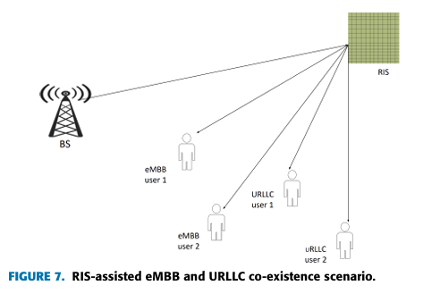
Survey 3 · Adhikari et al. · eMBB–URLLC coexistence
Better channels and target applications
APPLICATION REQUIREMENTS (SECTION IV)
Application | Latency | Error rate | Rate
Factory automation | 1–10 ms | 10⁻⁹ | ≤ 100 Mbps
Robotic motion | 4–8 ms | 10⁻⁹ | ≤ 100 Mbps
Smart grid, high voltage | 5 ms | 10⁻⁶ | ≤ 10 Mbps
Smart grid, medium voltage | 25 ms | 10⁻³ | ≤ 10 Mbps
Autonomous vehicles | < 5 ms | – | –
RIS
99.99 % URLLC admission (vs 95.6 % without), +70 % eMBB; phase optimisation adds URLLC delay
UAV + RIS
Line-of-sight coverage, finite-blocklength design, aerial RIS
Healthcare, mining and AR/VR also need both services at once.
Takeaway Channel improvement mainly helps eMBB: its URLLC latency cost is still unanalysed.
RS2M Department · Télécom SudParis · Palaiseau, France
55
Notes:
Sections III-F, III-G and IV. Paste FIGURE 7 (PDF p. 21), the RIS-assisted coexistence scenario. The RIS result is strong for eMBB, but optimising the phase shifts and estimating CSI adds latency that matters for URLLC. The table gives the application requirements quoted in Section IV.

