Slide 1
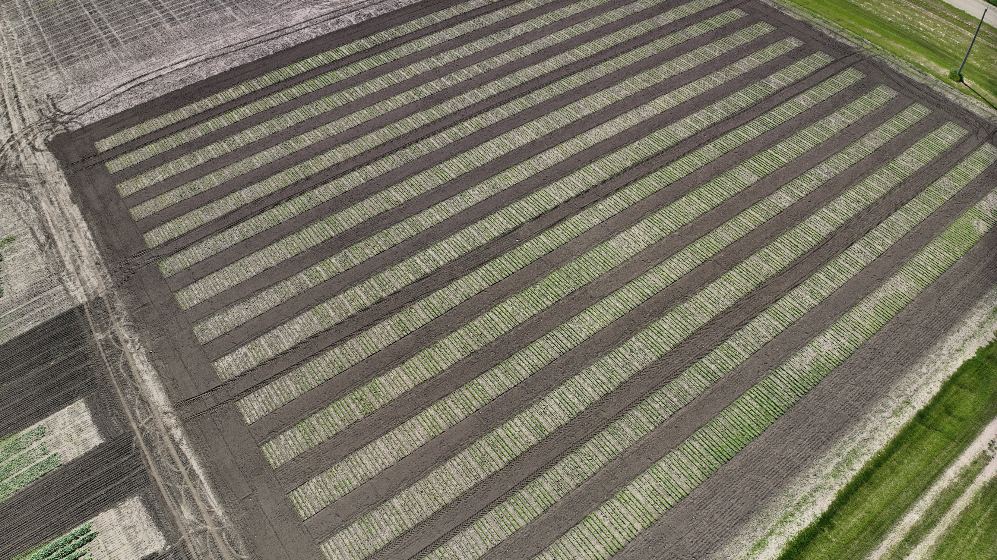
Modeling
Deciding
Sensing
Precision Agriculture
Ali Bazrafkan Lab

