Slide 1
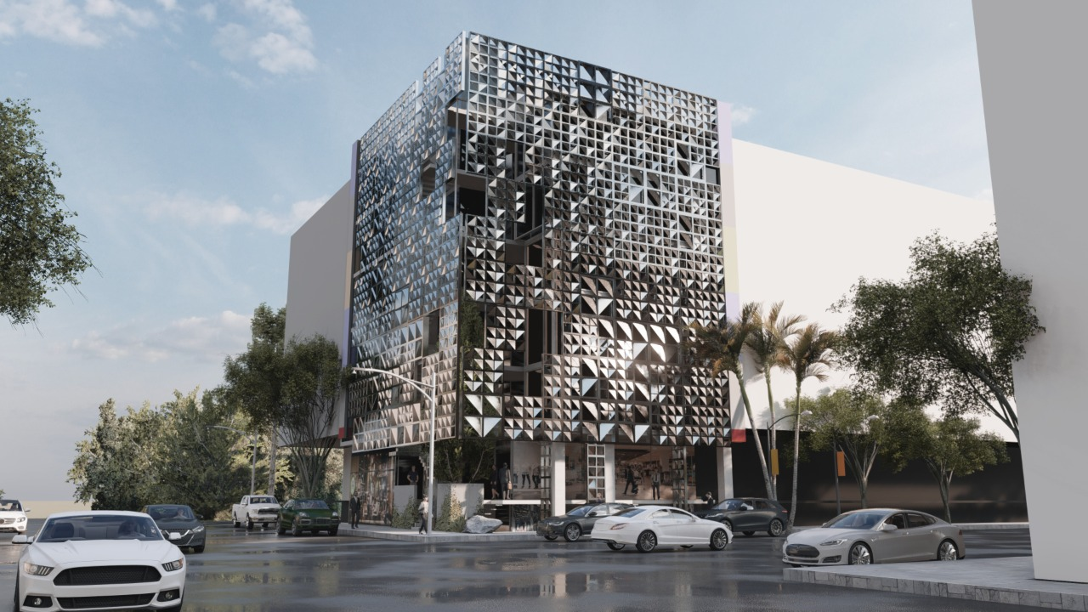

VISCON
ENGINEERING
COMPANY PROFILE
“BEYOND CONSTRUCTION, TURNING VISION INTO REALITY THROUGH SMART TECHNOLOGY”
Head office : F-98 First Floor, Gulberg Heights, Gulberg Green, Islamabad
Branch office: House No 2163, Street Neem wali opposite state life building D-I-Khan.
Contact : 0345,4696064, 0331-4380321 ,

Slide 2
VISCON ENGINEERING
To bring innovation and new perspectives to the world of engineering and construction, lead through
technological advancement, sustainable design, and engineering excellence, delivering intelligent, high
performance solutions across residential, commercial, and industrial sectors that improve the quality of
life and inspire progress.
Viscon Engineering is to deliver technology-driven engineering and construction solutions that
integrate civil structure works, architectural finishing, MEP systems, Chemical water proofing and
Intelligent Building Management Systems (IBMS) under a unified framework.
We are dedicated to:
Advancing the engineering landscape through innovation, precision, and continuous improvement.
Designing and implementing sustainable, energy-efficient systems that enhance functionality and
longevity.
Executing projects with technical integrity, safety, and superior quality standards.
Applying modern construction technologies to optimize performance and resource utilization.
Building trusted, long-term partnerships through professionalism, transparency, and consistent excellence.

Slide 3
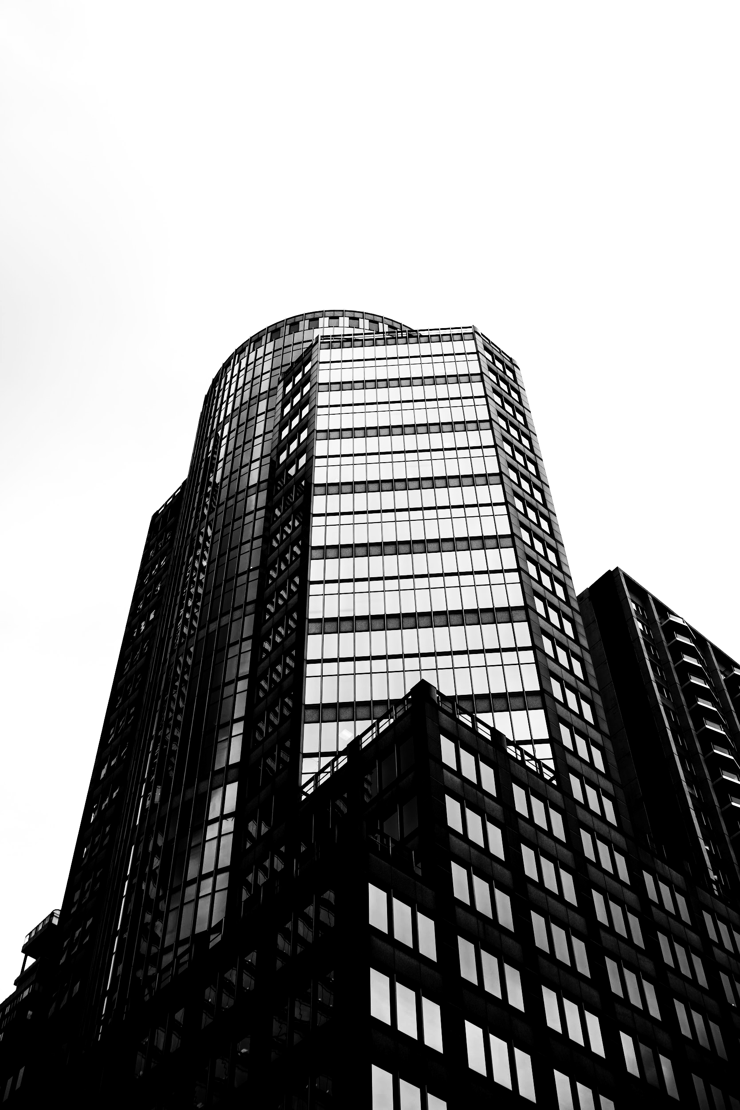
PROFESSIONAL AFFILIATIONS
Member Pakistan Engineering Council
Register with Gulberg Greens Authorities

Slide 4
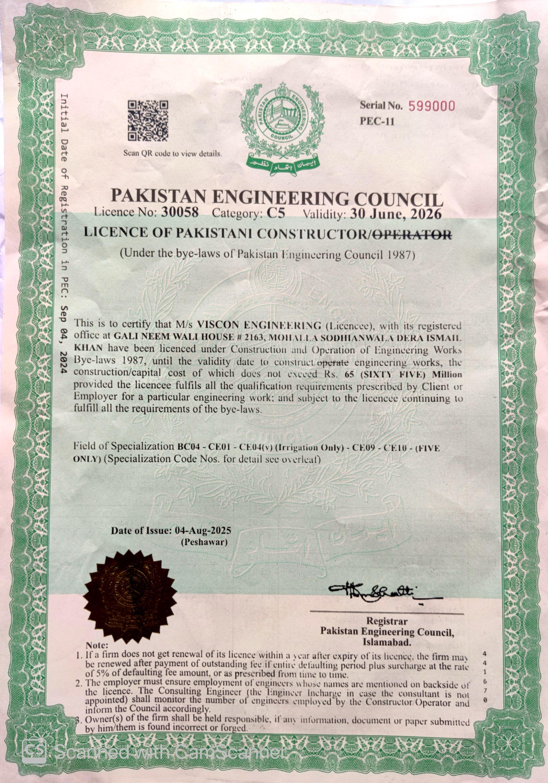
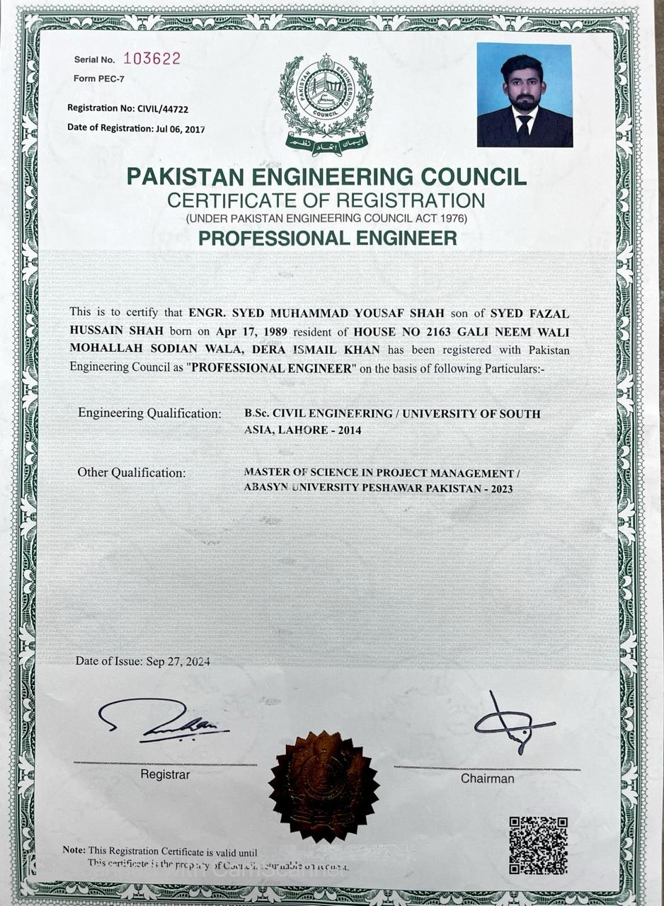

Slide 5
ORGANIZATION CHART
Executives
Zain Rasool
Director
Yousaf Shah
Director
Architecture
Civil/Structure
MEP & IBMS
M. Ikhtyar (B.Sc Architech)
M. Adnan M.Sc Structural Engineer
Ali Rehman M.Sc (Civil)
Dilshad Rehman (Manager)
Site Staff
Saqib Tufail (Construction Manager)
M. Arsalan Aman (Project Manager)
M. Fida (Site Supervisor)

Slide 6
SERVICES
Architectural
Preparation of architectural design for the residential, commercial, industrial, public, recreation institutional, buildings. The interior designing and the renovation of the buildings are also included.
Structural Design
Providing complete structural solution in steel and R.C.C buildings considering the stability of structure and economy of client.
Engineering Procurement & Construction (EPC)
Viscon Engineering operates as a complete EPC (Engineering, Procurement & Construction) service provider, delivering end-to-end solutions from concept to Project handover. Our integrated approach ensures seamless coordination between design, material sourcing, and construction execution enabling projects to be completed with precision, efficiency, and quality. Through advanced planning, smart technologies, and strong project management, we transform complex visions into sustainable realities.

Slide 7
SERVICES
Environmental Studies and Planning
Survey, investigation, and research on surveillance, monitoring, and control of pollution of air, water, solid waste, rain. Topographic and alignment surveys carrying out.
Public Health Engineering
Planning, investigation, design and supervision of the construction of water supply, sewerage, and drainage projects in urban and rural areas. The designs of drinking and wastewater treatment systems are also carried out.
Chemical Water Proofing
Specialized in chemical proofing and protective coating solutions to safeguard structures against corrosion, leakage, and chemical damage. Our services include applying epoxy, and polymer-based coatings for industrial floors, tanks, and containment areas. With precise application and durable materials, we ensure long-lasting protection and structural integrity in harsh environments.

Slide 8
SERVICES
Mechanical, Electrical, and Plumbing (MEP)
Viscon provides comprehensive (MEP) engineering services that form the foundation of modern infrastructure. Our expertise encompasses the design, supply, installation, testing, and commissioning of complete MEP systems for residential, commercial, and industrial developments.
We offer integrated solutions in HVAC systems, electrical power distribution, lighting and low-voltage systems, and plumbing and drainage networks. By combining technical excellence with innovation, we ensure that every system we deliver is energy-efficient, cost-effective, and fully compliant with international standards.

Slide 9
SERVICES
INTEGRATED BUILDING MANAGEMENT SYSTEM (IBMS)
Viscon Engineering & Tech provides comprehensive (IBMS) solutions designed to optimize building performance, enhance energy efficiency, and ensure occupant comfort and safety. Our IBMS integrates all major building services including HVAC, Lighting, Power, Safety, and Security into a single intelligent platform that allows centralized monitoring and control.
Heating Ventilation And Air Conditioning (HVAC)
Provides advanced smart solutions dedicated to optimizing HVAC performance through intelligent automation and centralized control. Also provide centralized control of chillers, AHUs, and ventilation systems, ensuring optimal performance with reduced energy consumption..
Fire Fighting & Alarm System
Design and installation of fire alarms, Smart coordination between fire alarms, smoke extraction, and emergency response systems.
CCTV & Access Control
Design and Installation of CCTV, access control, intrusion deduction & monitoring systems.

Slide 10
LIST OF COMPLETED PROJECTS
Sr No | Project Description | Status | Client / Owner | Contract Value | Project Value (Rs)
1 | Hassan Nawaz Khokhar Farmhouse Chakkri, M2, ISB Total Land=20 Kanal, Area= 15000 sft | On-going | Mr Hassan Nawaz Khokhar (Businessman) | 25 | 120 Million
2 | Zishan Kalim Farmhouse / No.241, Gulberg Greens, Islamabad | On-going | Mr. Zeshan Kalim (Businessman) | 15 | 150 Million
3 | Hills One, Behria Enclave, Islamabad (Hirise Building (1B+G+5) 1.2 kanal | On-going | Mr Hamayoun (Amanast Group ) | 50 | 250 Million
4 | Damcon Tower, Plot #73, Civic Center, Gulberg Greens, Islamabad (Hirise-Building (2B+G+6) | Completed | Mr. Tahir Iqbal (Businessman) | 30 | 150 Million
5 | Residential Building, House #46, I Block, Gulberg Greens ISB | Completed | Mr. Tahir Shah (Businessman) | 30 | 30 Million
6 | Berg-I Tower, Plot #C98, Business Square, Gulberg Greens, Islamabad (Hirise-Building (1B+G+6) | Completed | Mr Hamayoun Mr. Shahbaz (Eelaf Const.) | 28 | 110 Million
7 | Shopping Mall, Sector G8/4, Islamabad (1B+G+5) | Completed | Mr. Hassan Nawaz Khokhar (Businessman) | 20 | 65 Million
8 | Farm House, D-70, Gulberg Greens, Islamabad (Area 10 Kanal) | Completed | Mr. Saad Nazir | 26 | 120 Million
9 | Farm House, A241,Gulberg Greens, Islamabad (Area 05 Kanal) | Completed | Mr. Zeshan Kaleem (Businessman) | 7 | 7 Million

Slide 11
LIST OF COMPLETED PROJECTS
Sr No | Project Description | Status | Client / Owner | Contract Value | Project Value (Rs)
9 | Farm House, C114,Gulberg Greens, Islamabad (Area 05 Kanal) | Completed | Mr. Rashid Kamal (Ex-Air Marshal) | 10 | 70 Million
10 | Residential Building, House #201, L Block, Gulberg Greens ISB | Completed | Mr. Sohaib | 10 | 10 Million
11 | Residential Building, House #364, L Block, Gulberg Greens ISB | Completed | Mr. M Farooq | 14 | 14 Million
12 | Residential Building, House #405, L Block, Gulberg Greens ISB | Completed | Mr. M Abrar | 14 | 14 Million
13 | Residential Building, House #146, L Block, Gulberg Greens ISB | Completed | Mr. Farhan | 16 | 16 Million
14 | Residential Building, House #, M Block, Gulberg Greens ISB | Completed | Mr. Hassan | 2.5 | 15 Million
15 | Farm House, C-69, Boundary wall, Gulberg Greens, Islamabad ( Area 10 Kanal) | Completed | Mr. Anees | 10 | 10 Million
16 | Residential Building, House #899, A Block, Gulberg Greens ISB | Completed | Mr. Qasim | 16 | 16 Million
17 | Farm House, C170,Gulberg Greens, Islamabad ( Area 04 Kanal) | Completed | Mr. Humayo Fargham (oil & Gass,Iraq) | 25 | 110 Million
18 | Farm House, C05, Gulberg Greens, Islamabad ( Area 12 Kanal) | Completed | Mr. Ammad Ahmad Businessman | 12 | 12 Million

Slide 12
LIST OF COMPLETED PROJECTS
Sr No | Project Description | Status | Client / Owner | Contract Value | Project Value (Rs)
19 | Installation of 02 No of 900 GPM Sub-mersible sludge pumps , Nowshera KPK | Completed | NTDC | 14 | 14 Million
20 | Chemical proofing or UG water tank (2500m3) , Nowshera KPK | Completed | NTDC | 06 | 06 Million
21 | Rehabilitation of PAK PWD ( Drinking water Supply Scheme at U/C Hissam | Completed | PHE Division DIKhan | 4.5 | 4.5 Million
22 | Rehabilitation of PAK PWD ( Drinking water Supply Scheme at U/C Hissam | Completed | PHE Division DIKhan | 5.1 | 5.1 Million
23 | Construction of Flood Protection Band for Gandi Gaibullah & Looni District DIKhan | Completed | Gomal Zam Irrigation Division DIKhan | 10 | 10 Million
24 | Construction of Flood Protection Band for Gandi Tummani, & Looni District DIKhan | Inprogress | Gomal Zam Irrigation Division DIKhan | 10 | 10 Million
25 | Construction of Flood Protection Band Spar for Village Looni District DIKhan | Completed | Gomal Zam Irrigation Division DIKhan | 7.168 | 7.168 Million
26 | Providing and Installation of Kerb stone | Completed | Gulberg Green Islamabad | 20 | 20 Million
27 | Providing and Installation of Jinnah Garden | Completed | Jinnah Garden Islamabad | 10 | 10 Million

Slide 13
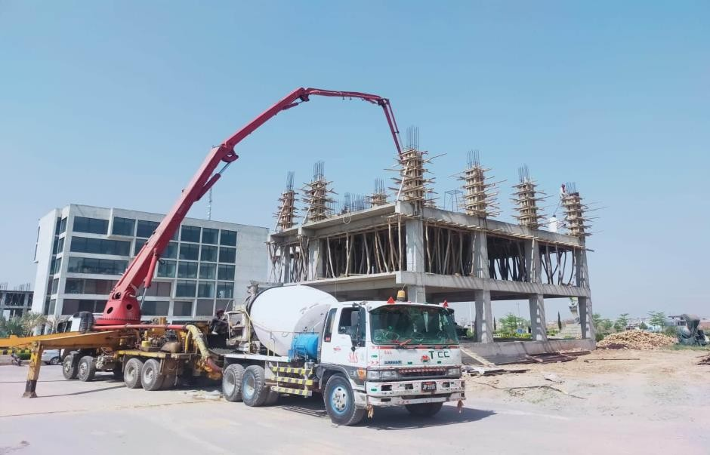
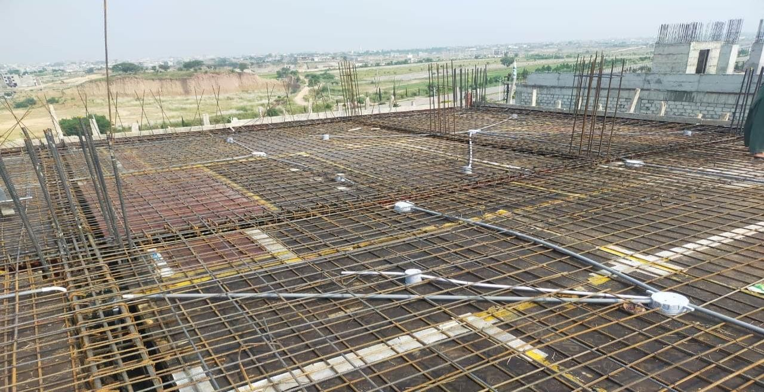
Commercial Project
BERG-1 BUSNIESS SQUARE, GULBERG GREENS, ISLAMABAD

Slide 14
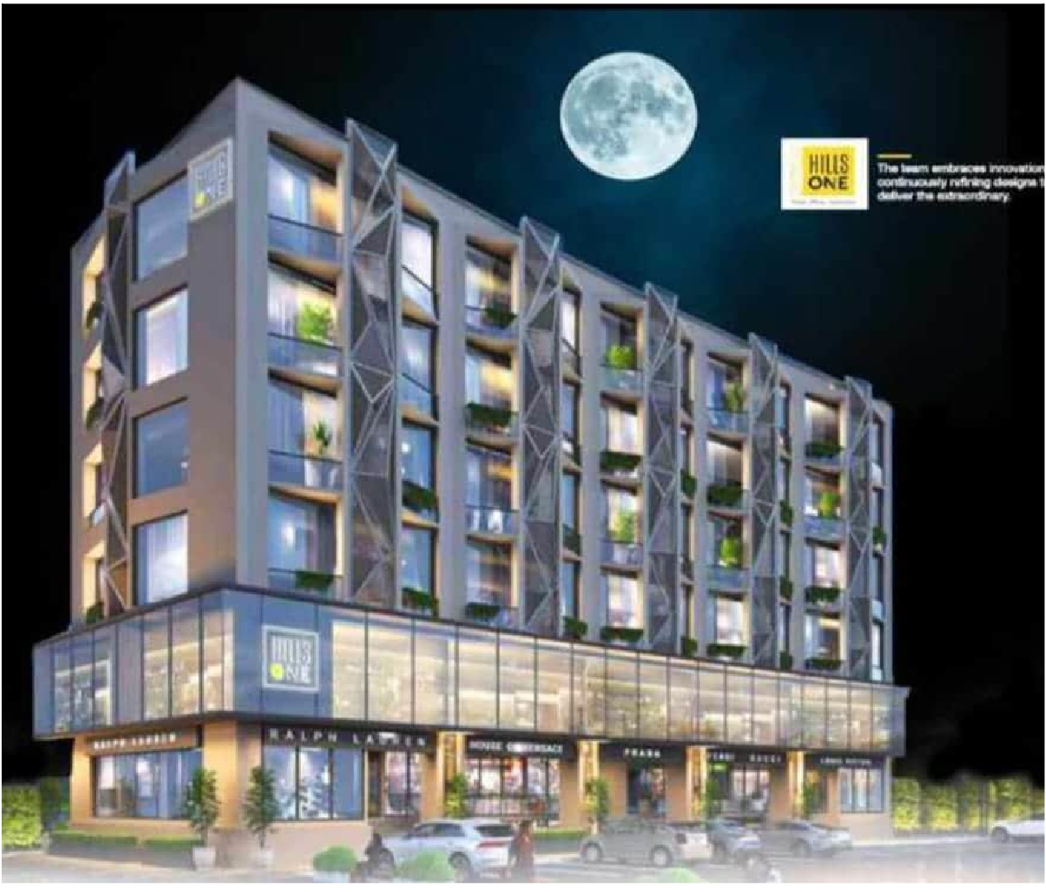
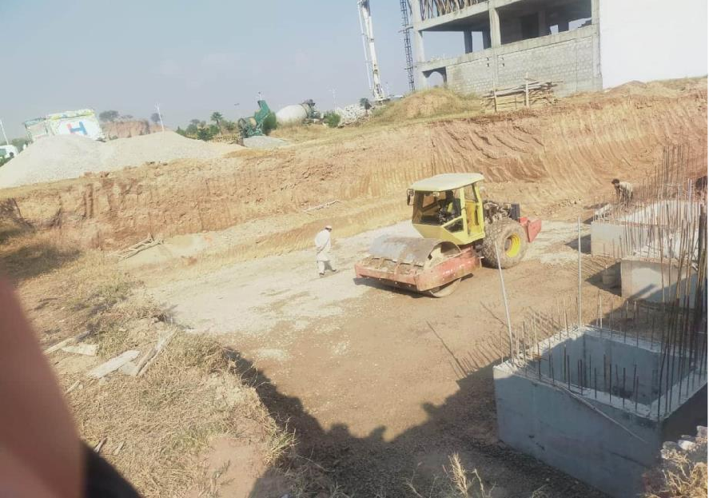
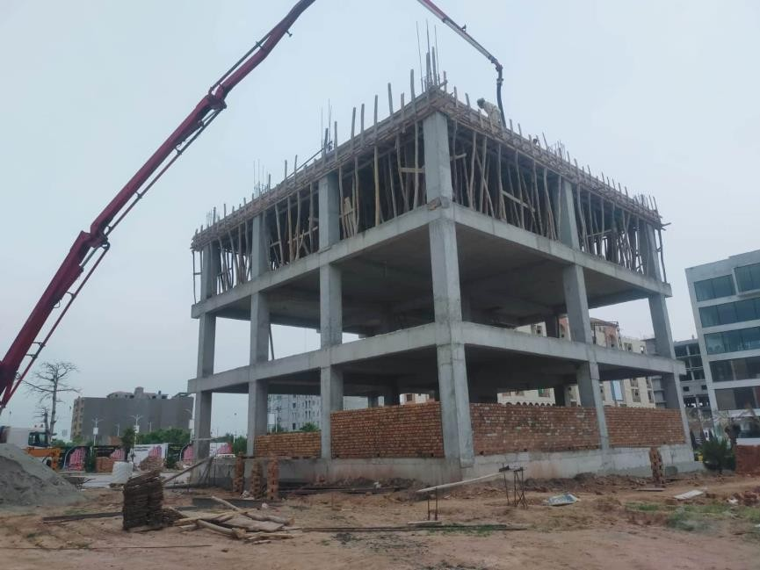
Commercial Project
HILLS ONE, BAHRIA ENCLAVE, ISLAMABAD

Slide 15
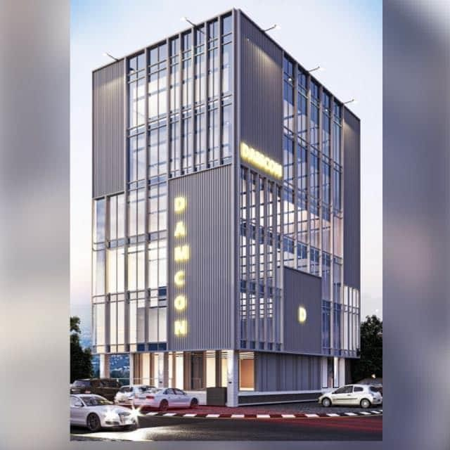
Commercial Project
DAMCON TOWER, CIVIC CENTER, GULBERG GREENS, ISLAMABAD

Slide 16
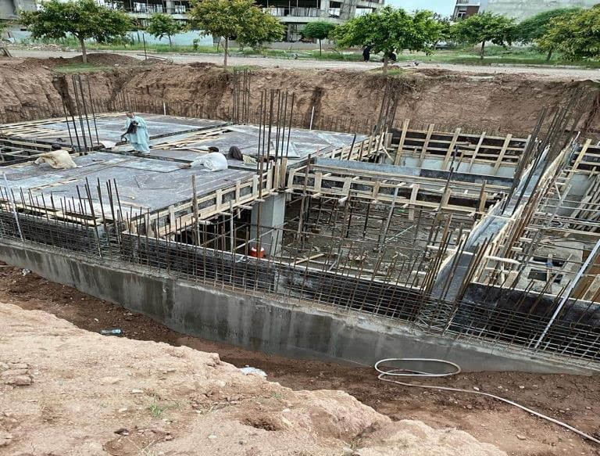
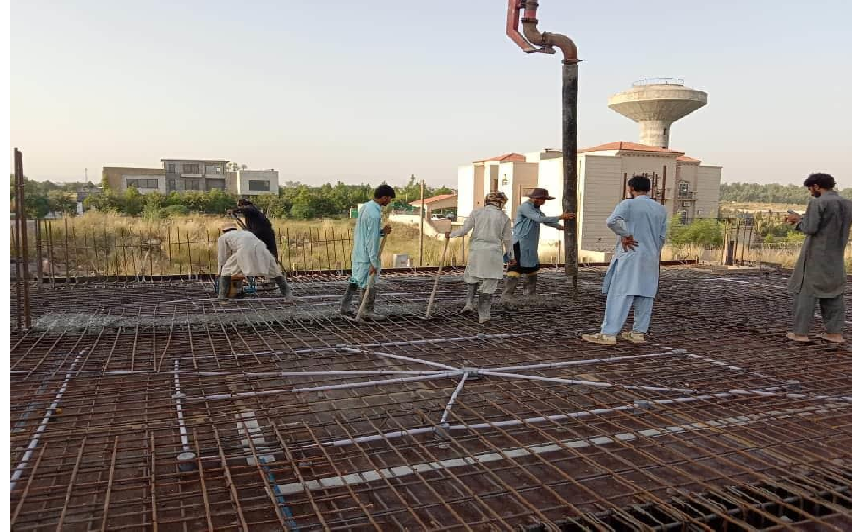
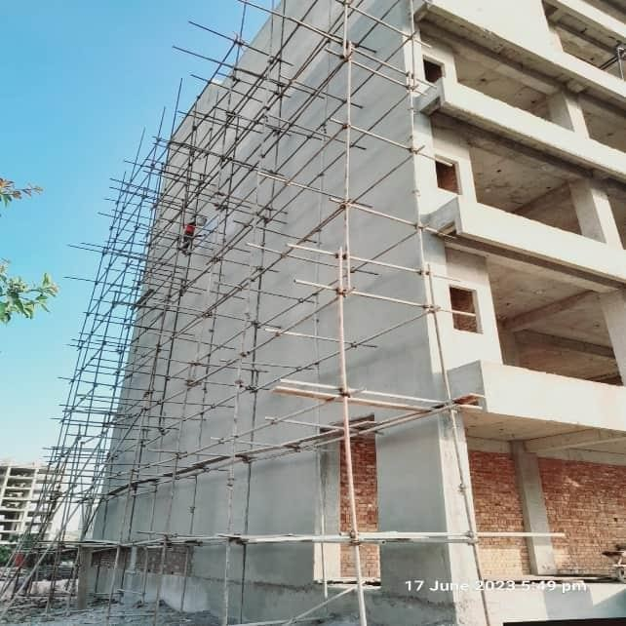
Commercial Project
DAMCON TOWER, CIVIC CENTER, GULBERG GREENS, ISLAMABAD

Slide 17
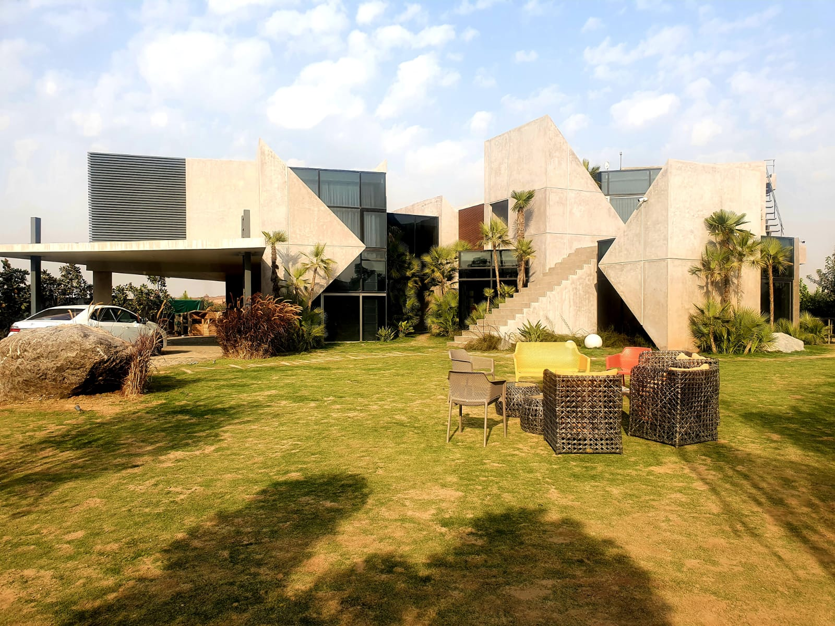
FARMHOUSE Project
C-170, GULBERG GREENS (05 KANAL)

Slide 18
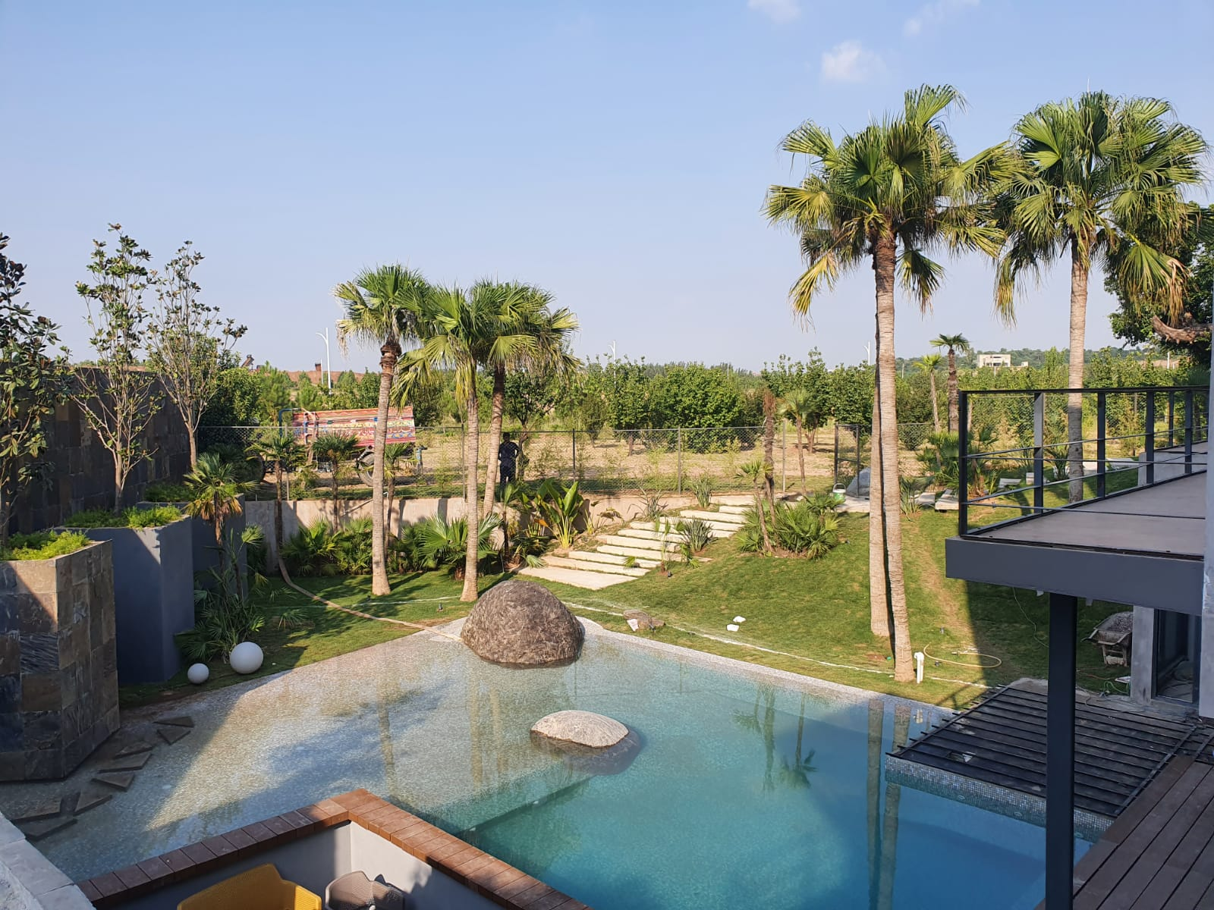
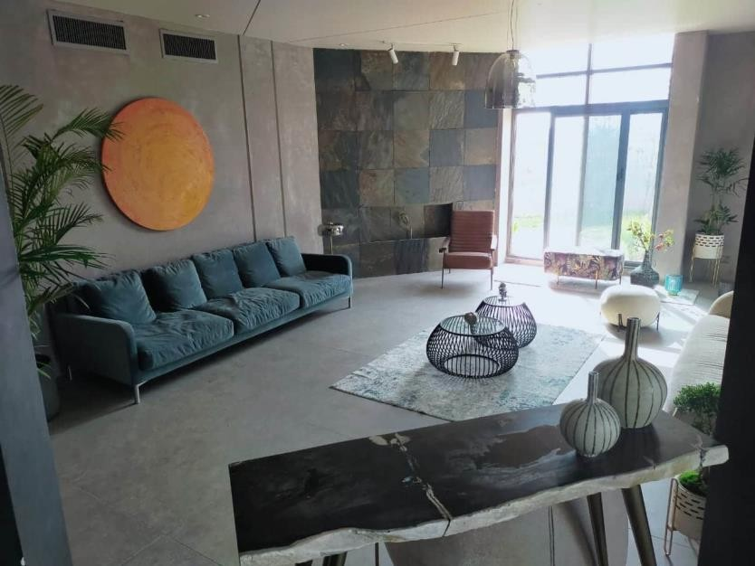
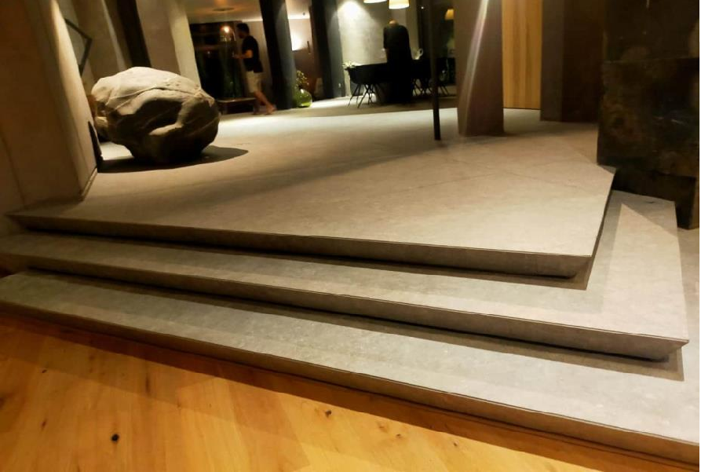
FARMHOUSE Project
C-170, GULBERG GREENS (05 KANAL)

Slide 19
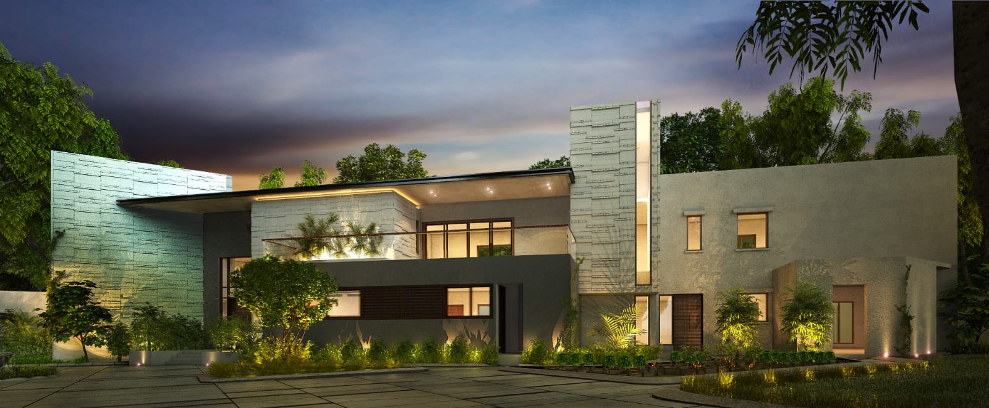
FARMHOUSE Project
C-05 FARM HOUSE ( 10 KANAL ) GULBERG GREEN ISLAMABAD

Slide 20
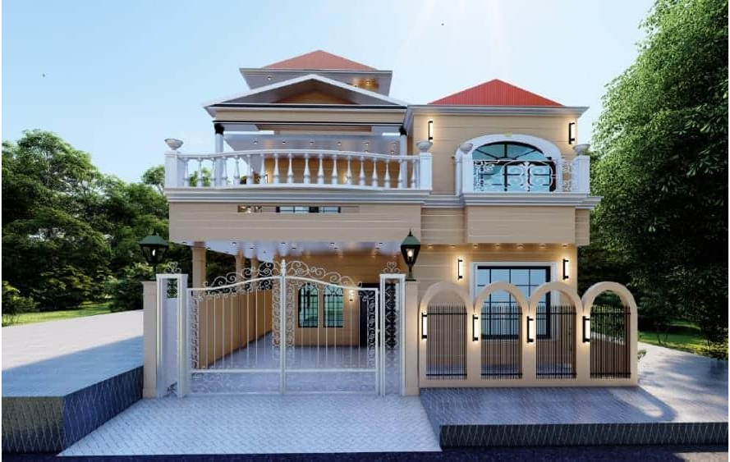
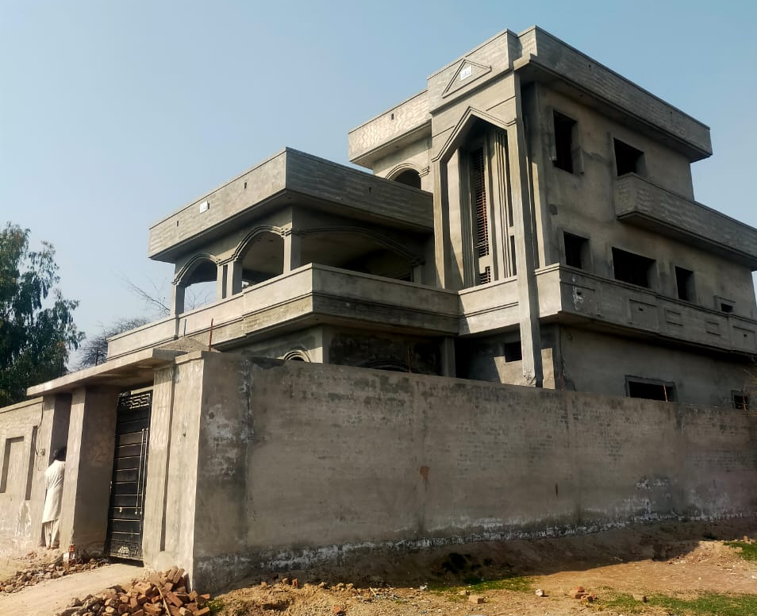
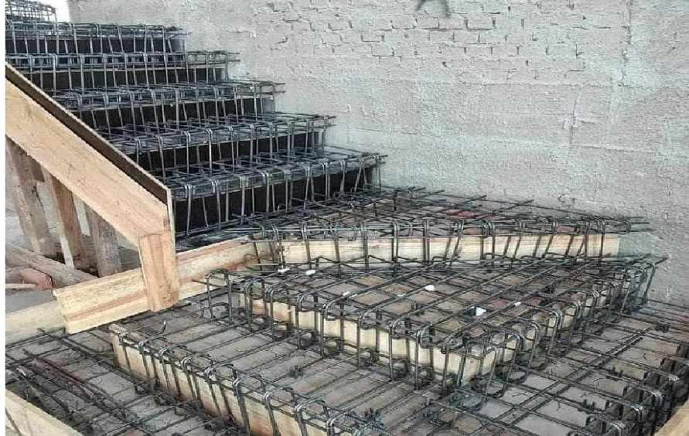
RESIDENTIAL Project
Gulberg Green

Slide 21
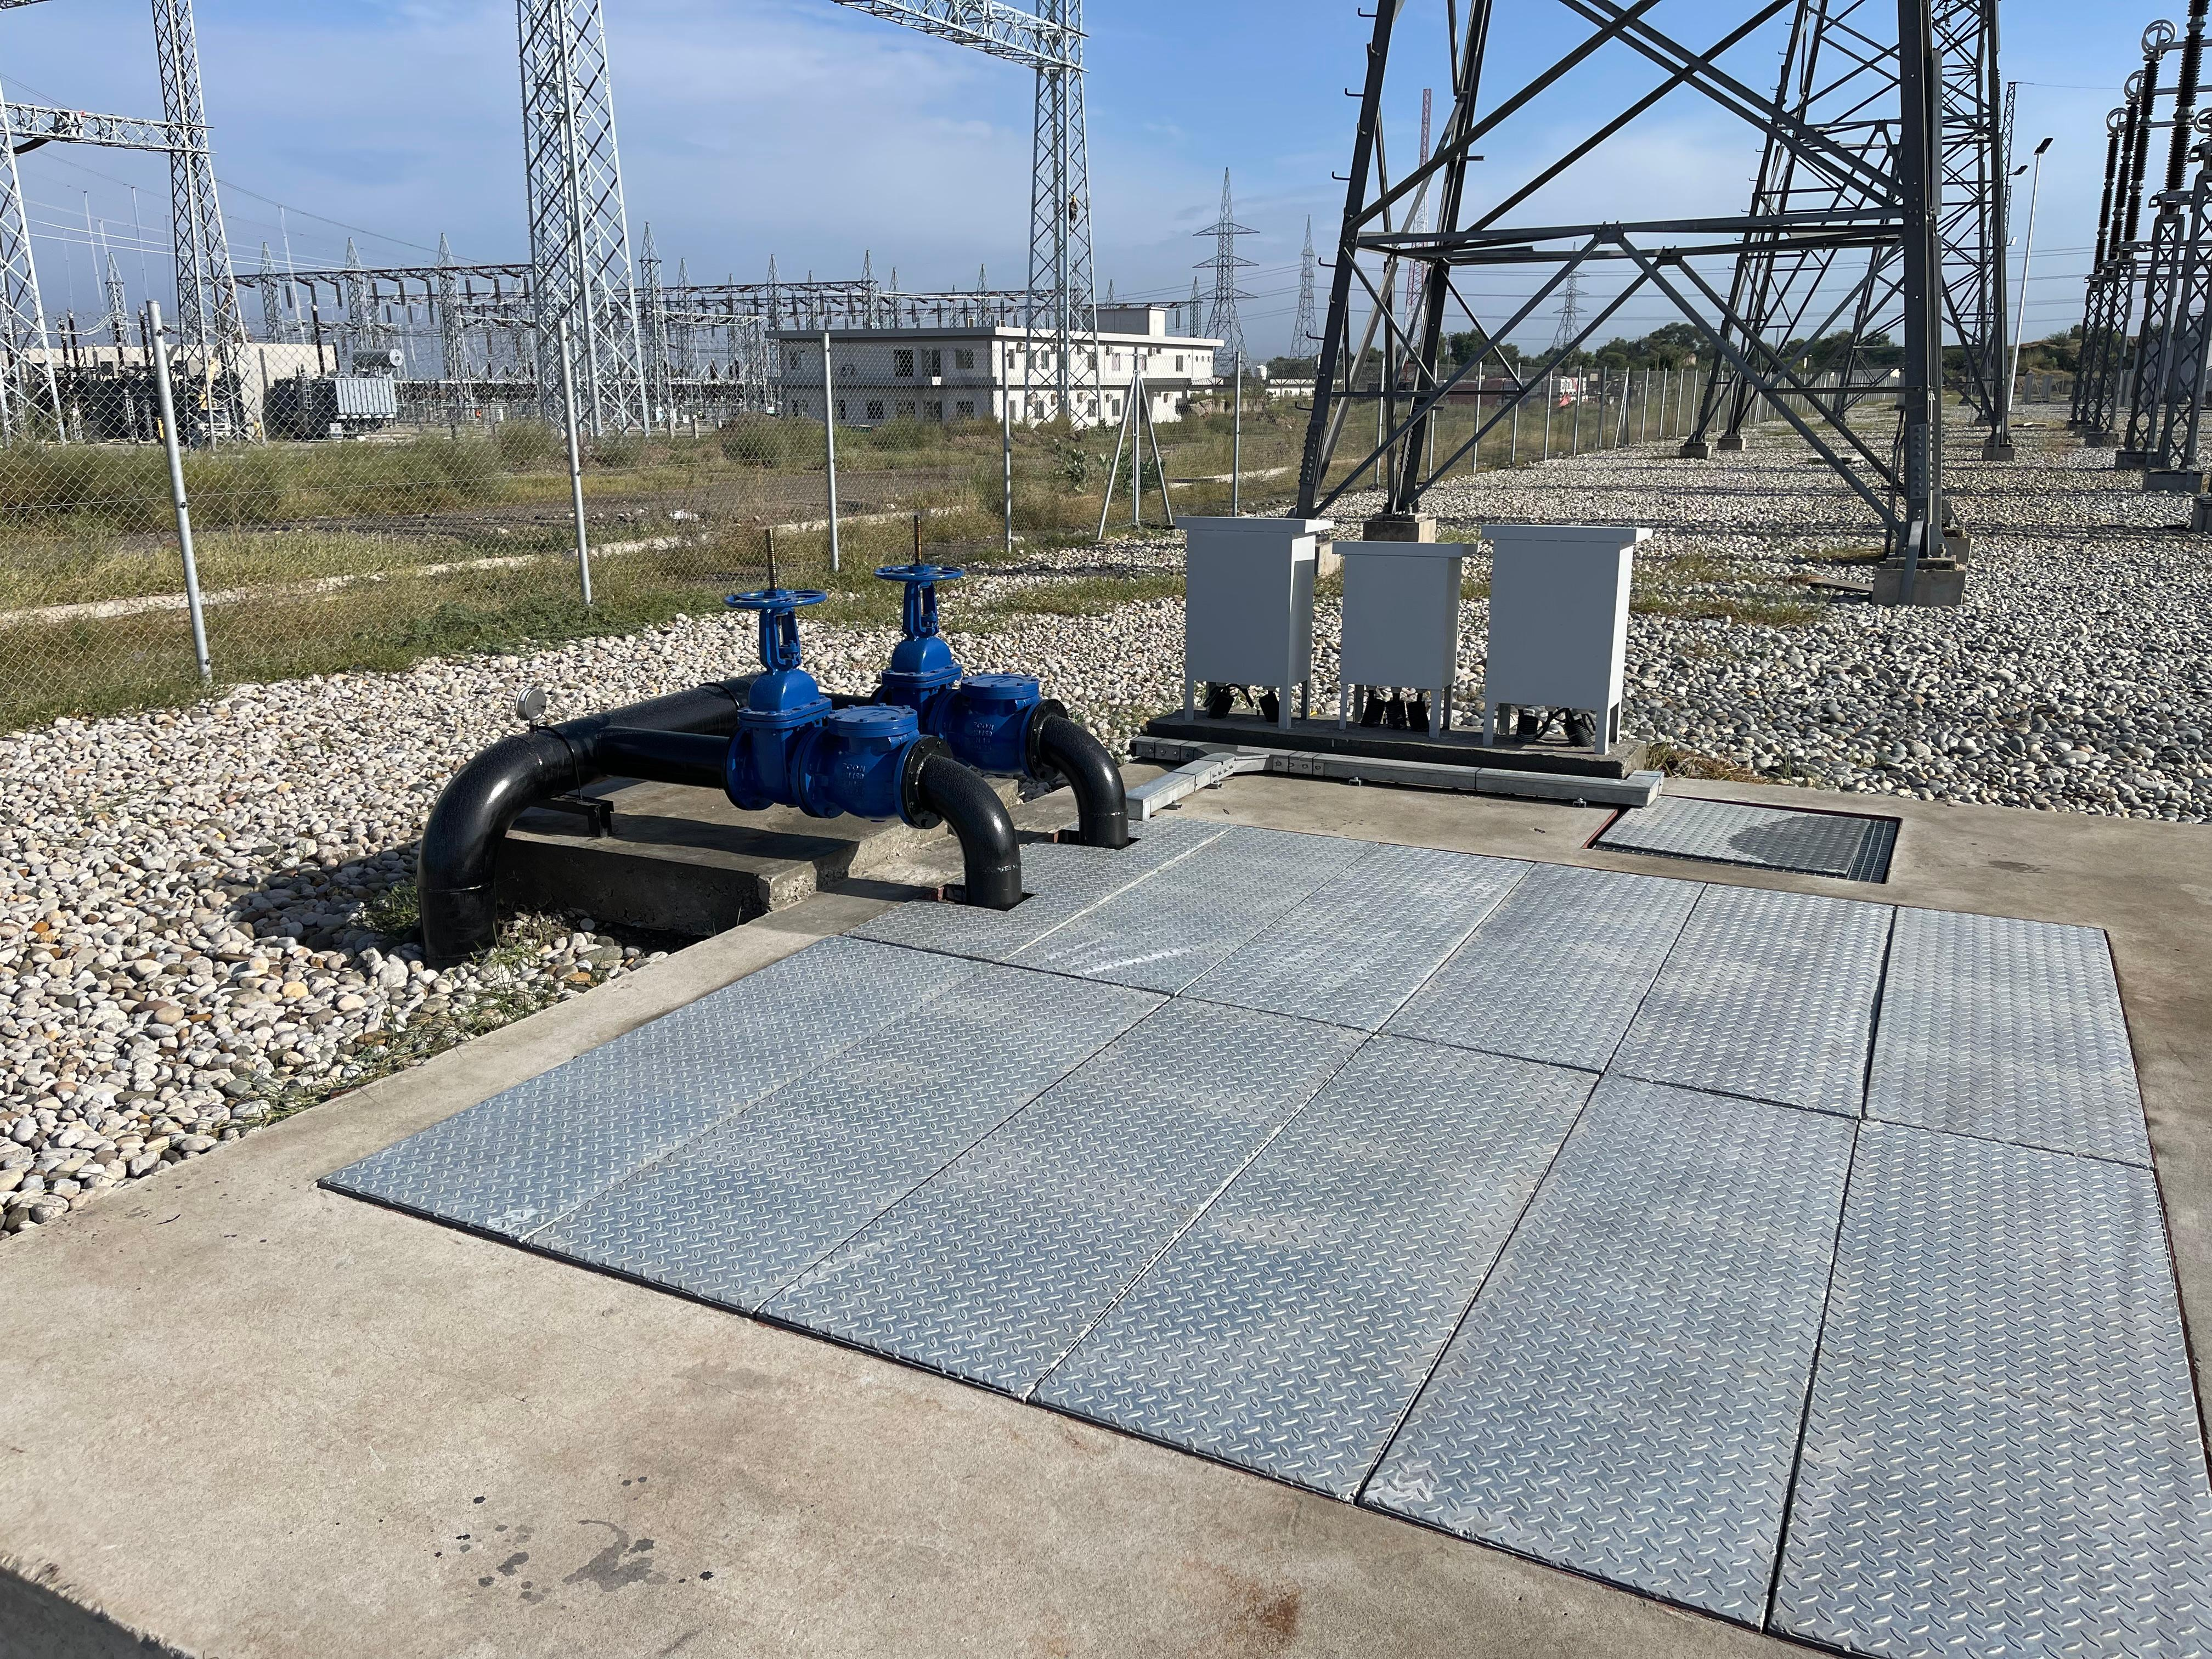
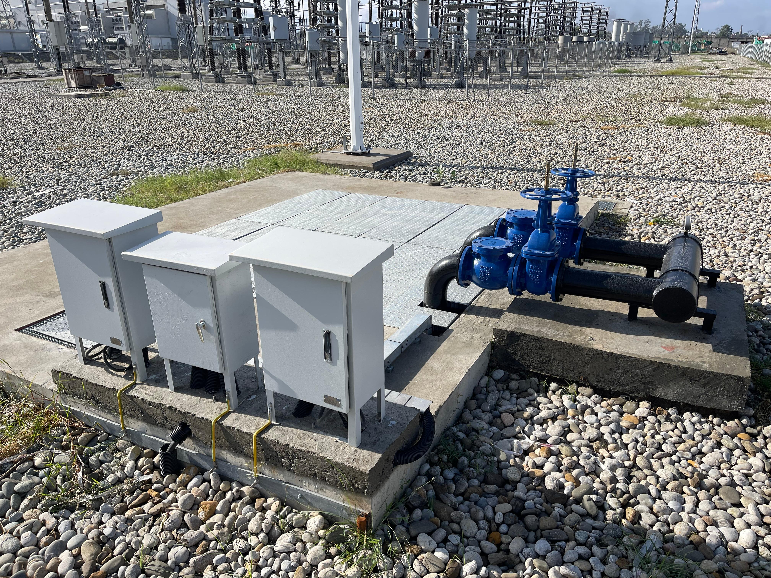
MEP Project
SUB MERSIBLE SLUDGE PUMPS (900 GPM)

Slide 22
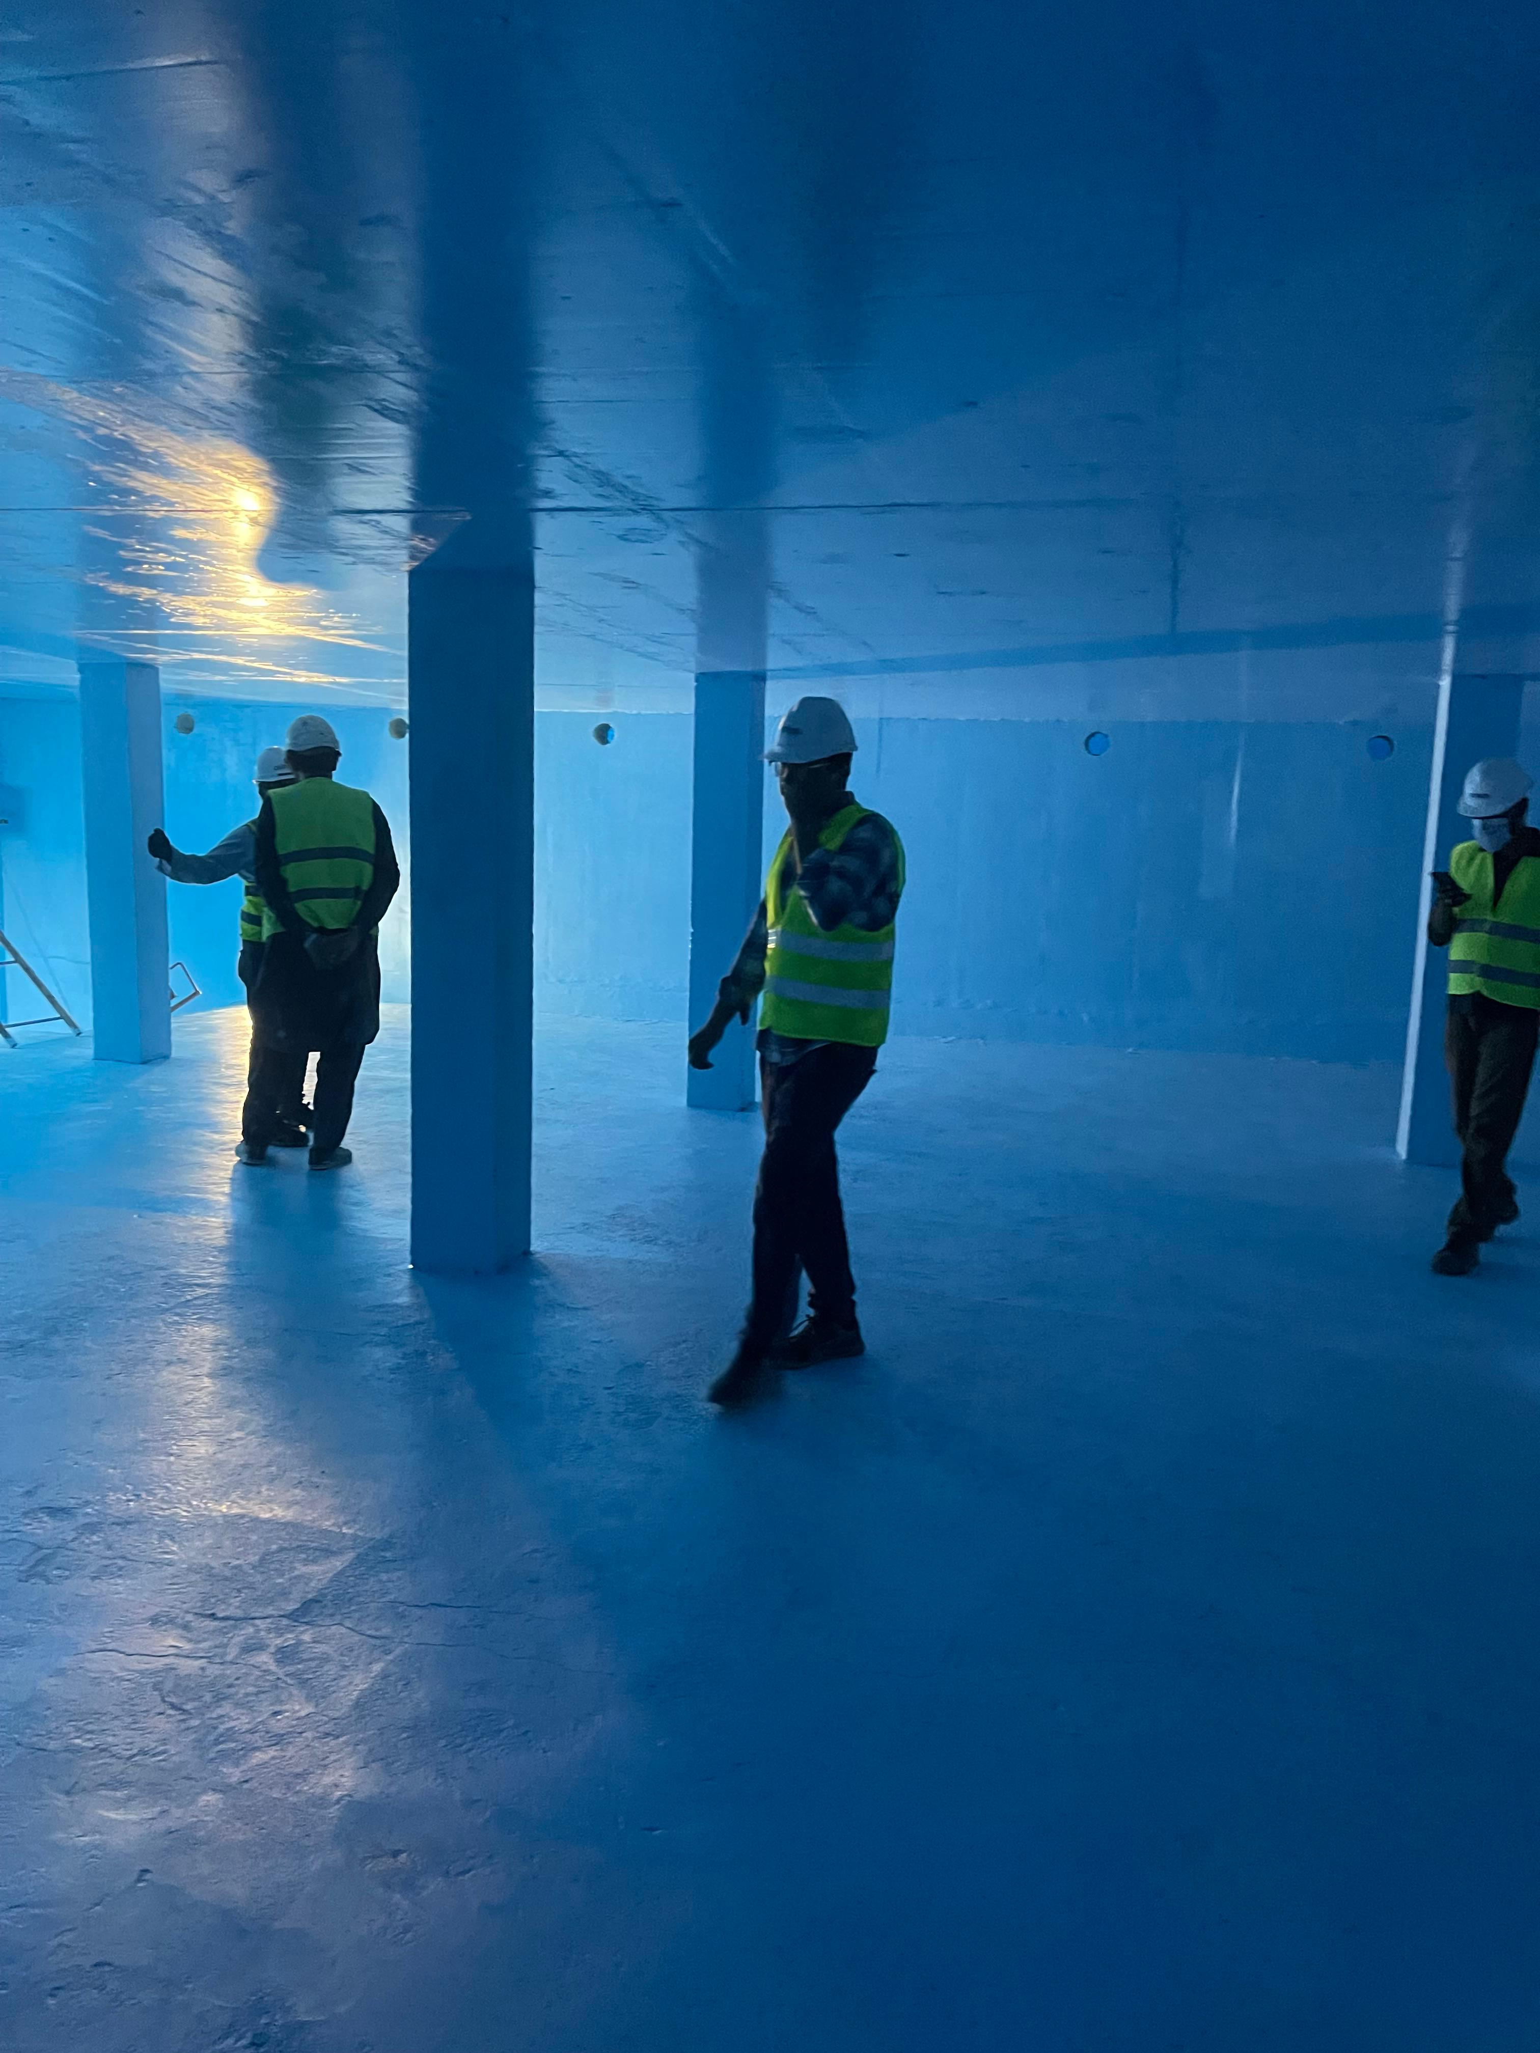
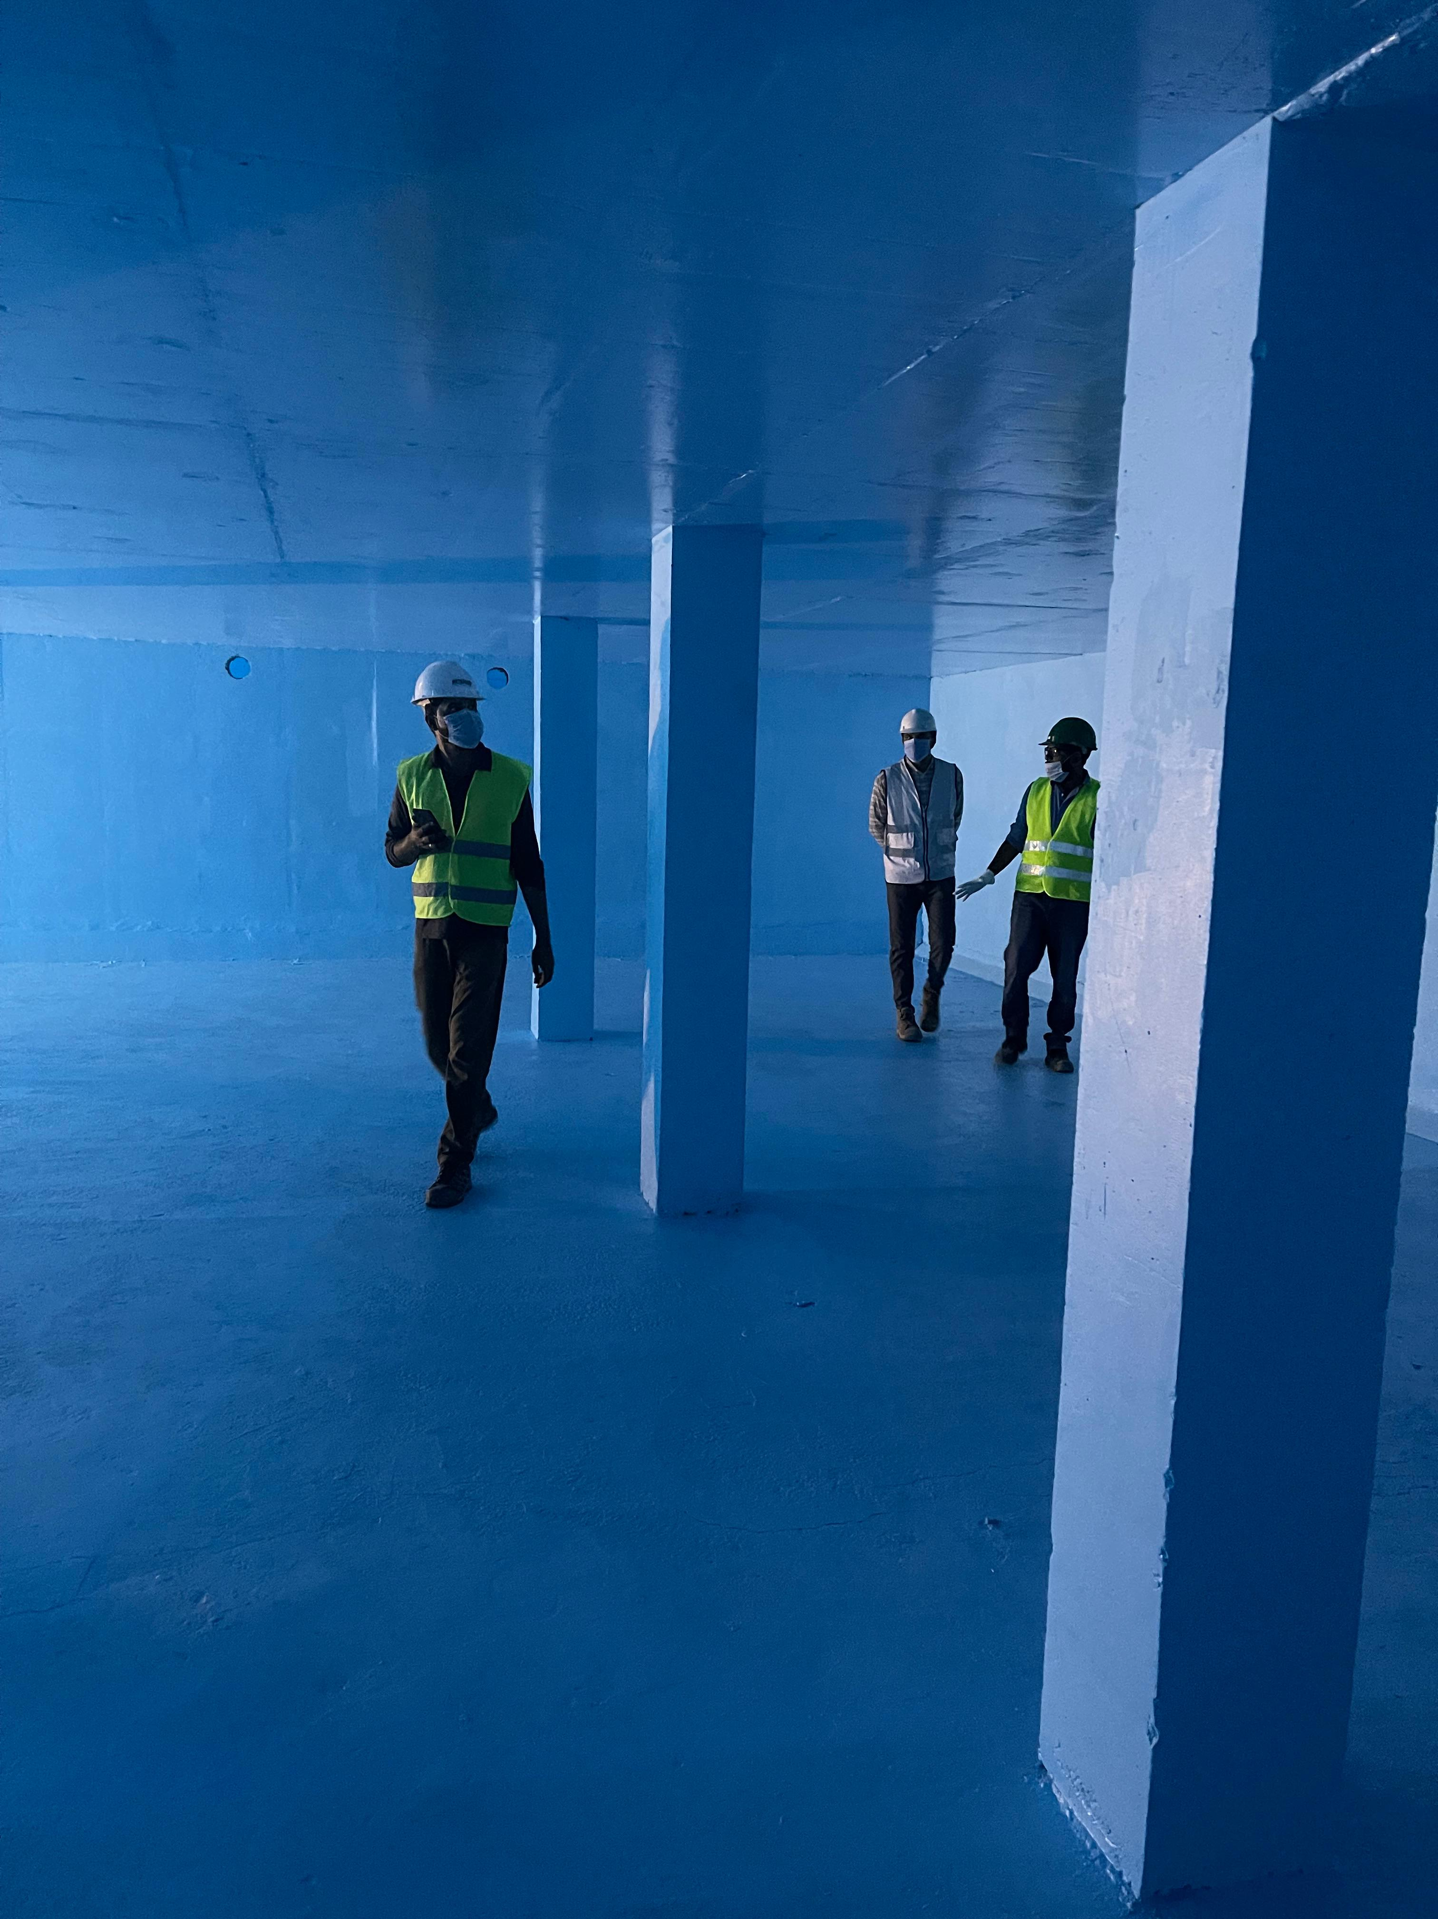
Chemical Proofing Project
UG Water Tank Chemical Proofing (Capacity 2500m3)

Slide 23
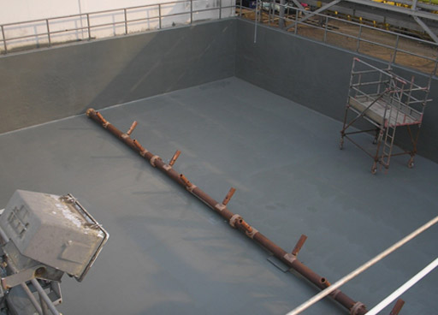
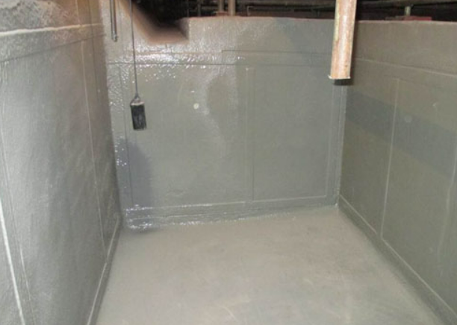
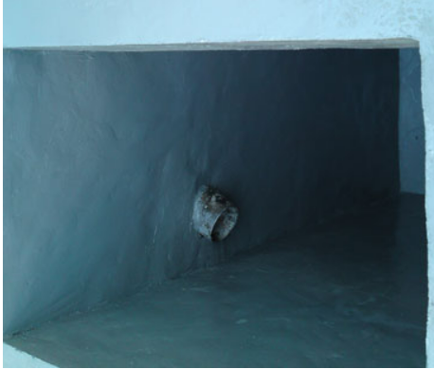
Chemical Proofing Project
Tank Chemical Proofing

Slide 24
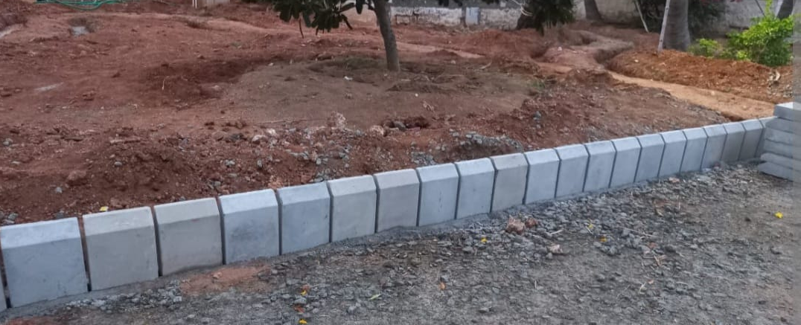
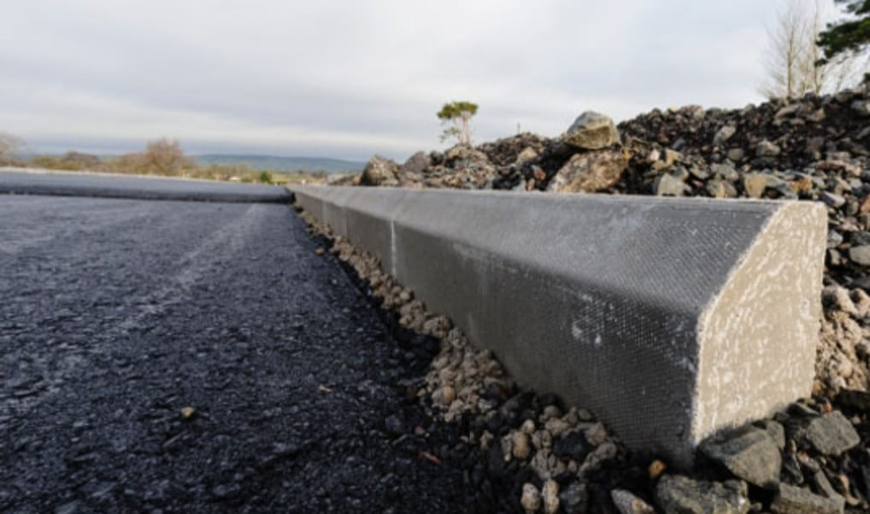
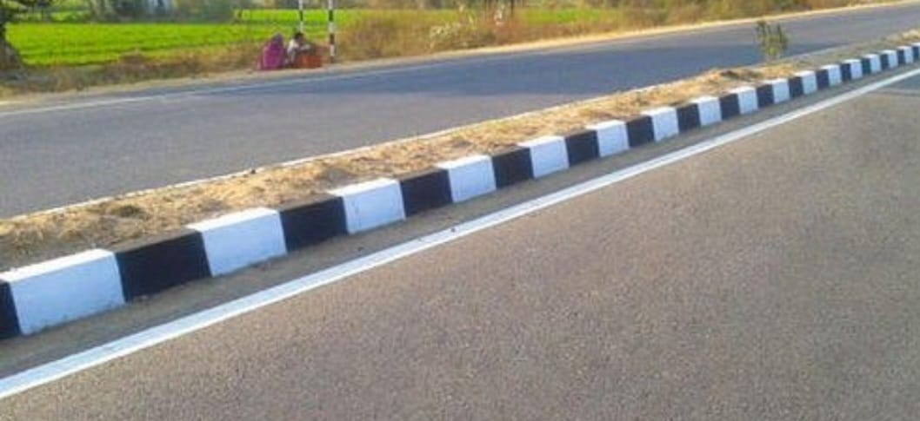
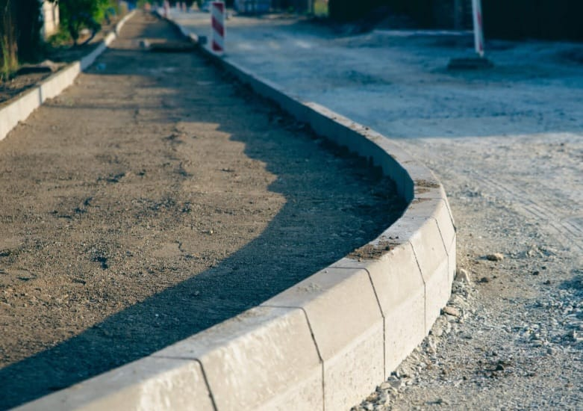
Kerb Stone Works
Installation & painting

Slide 25
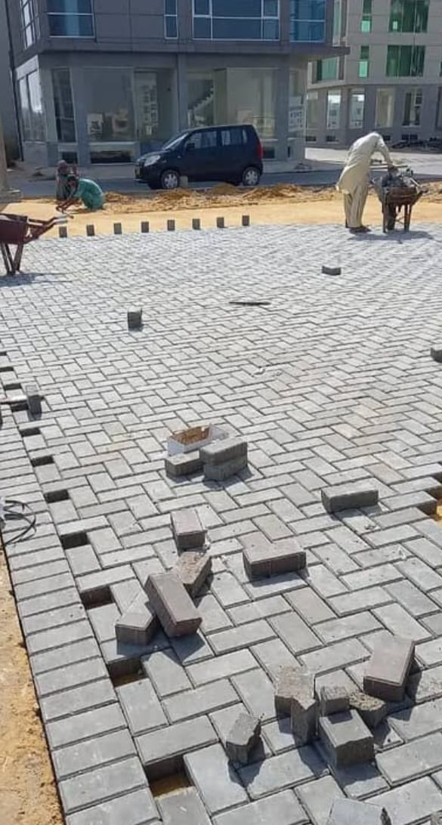
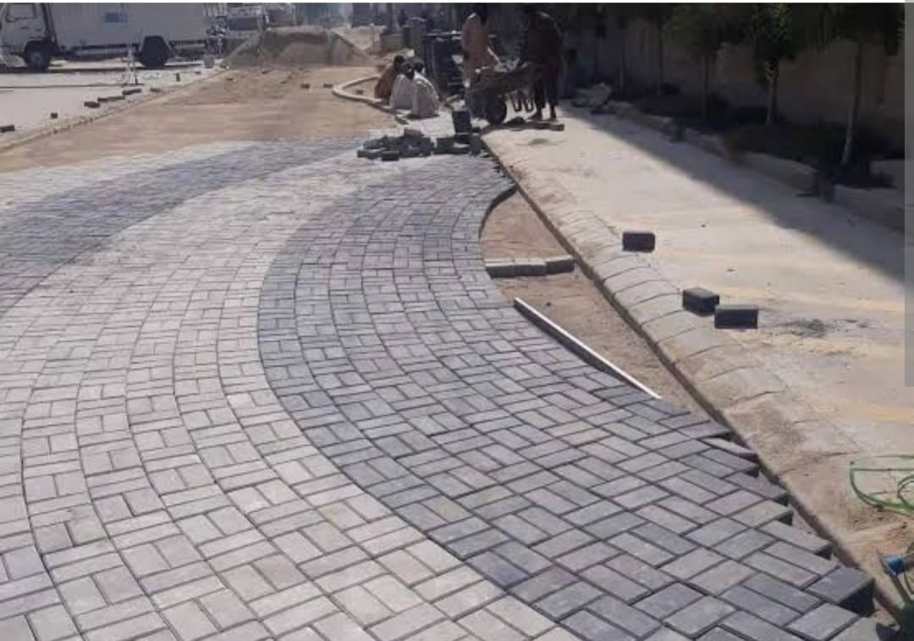
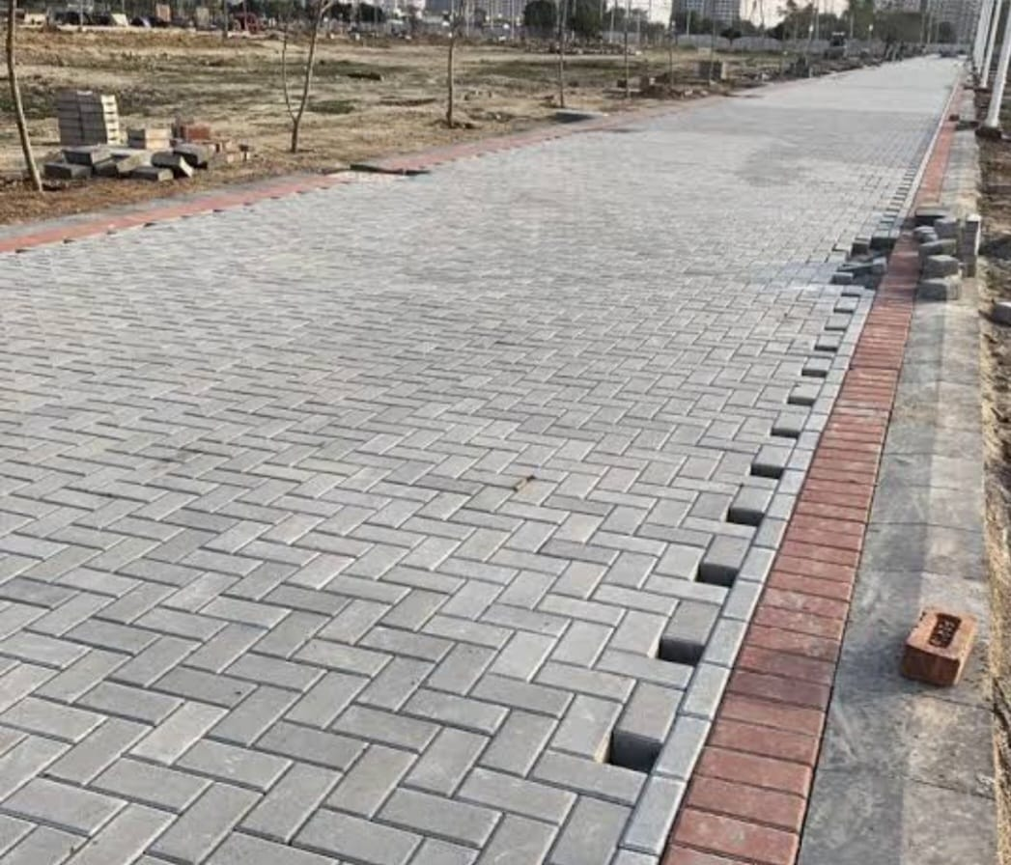
Tuff Tile Works
Installation

