Slide 1
Homomorphic Text editor
Ali Al-Dawaa

Slide 2
Outline
01
Introduction
What is a homomorphic text editor
02
Implementation
Description of how the project works
03
Preview
Preview of the project

Slide 3
Intro: Homomorphic text editor idea
Encrypted(message)
Encrypted text file
101010010101000101010101
decrypt(Text file)
The could edits the Text file without decrypting through homomorphic means
Encrypted(Text file)
We want to store our data and edit it on the cloud without the cloud knowing what is in there

Slide 4
implementation
1 – initiate the server by starting an empty file or loading an existing file
2 – wait for connection
3 – receive commands + messages to process
4 – send the text file back after each edition
5 – save the file after any disconnection or error to separate file.
1 – connect to server
2 – receive the opened file
3 – sending commands after verification from the user side
4 – receive the text file again and repeat

Slide 5
Cont. implementation
The server stores the file in a dictionary of lists
Where each key represent a row and each element in the list represent a letter
Example : line 0 , “hi , this is ali”
Dict { 0:[“h” , ”i” , ” ” , ”,“ , ” “ , “t” , “h” , “i” , “s” , “ “ , “a” , ”l” , “i” ]}
And so on for each row
Using the ascii table 7 bits representation
We converts each letter to it is corresponding number and encrypt it using pailliar encryption
Where pailliar supports addition of encrypted numbers
public and private keys are hardcoded so we can use the file multiple times

Slide 6
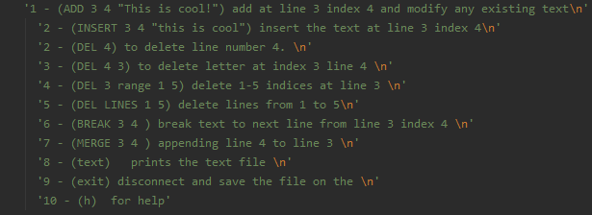
Cont. implementation
Supported commands
All the commands are not homomorphic but a matter of editing the dictionary.
Except the add command where we use homomorphic properties.

Slide 7

Cont. implementation
After receiving the text file from the server we get the corresponding number for it
Let’s say
122 which correspond to the letter z
We want to change it to the letter a which is 97 in ascii
Now we take the mod of the Z to 127 Z mod 127 which will be 122 and then we add
127 – 122 + 97 = 102
Now we send that to the server which will add
122 + 102 = 224
And the mod of that 224 mod 127 = 97 which is equal to a
If the desired letter is bigger than the previous, we simply just add the difference

Slide 8
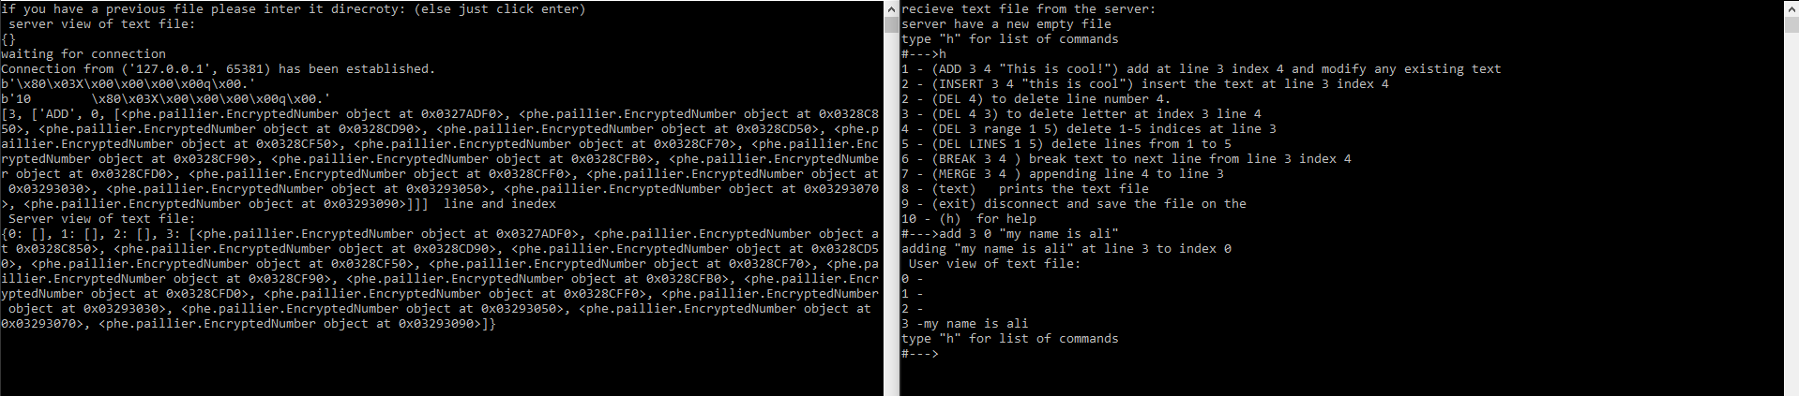
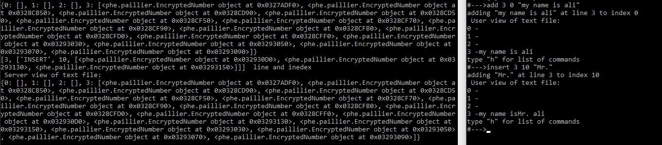
View of the program

Slide 9
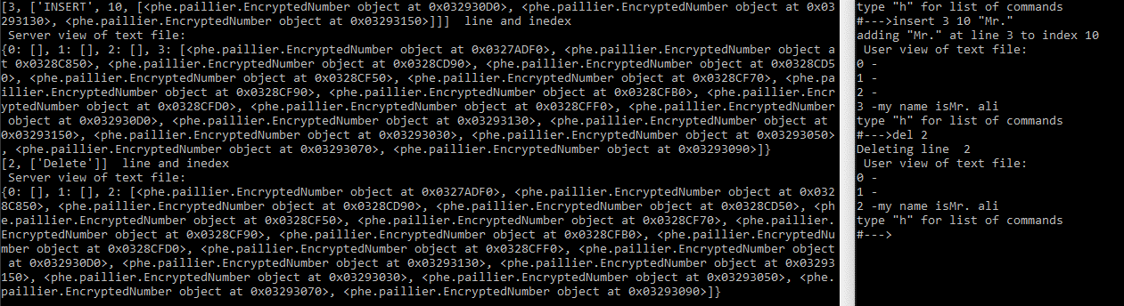
Cont. View of the program

Slide 10
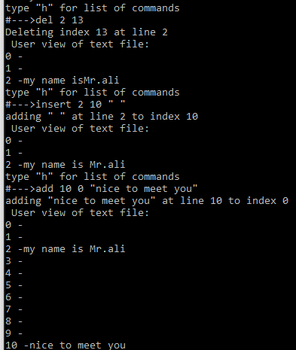
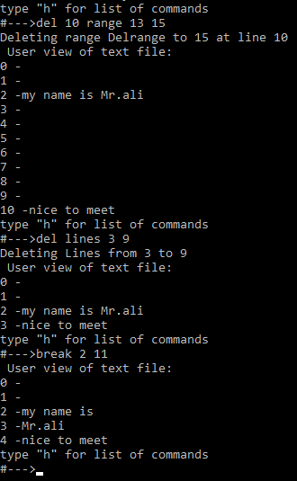
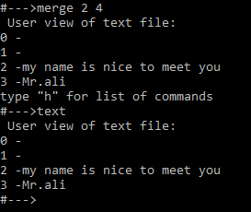
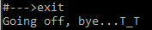
Cont. View of the program

Slide 11
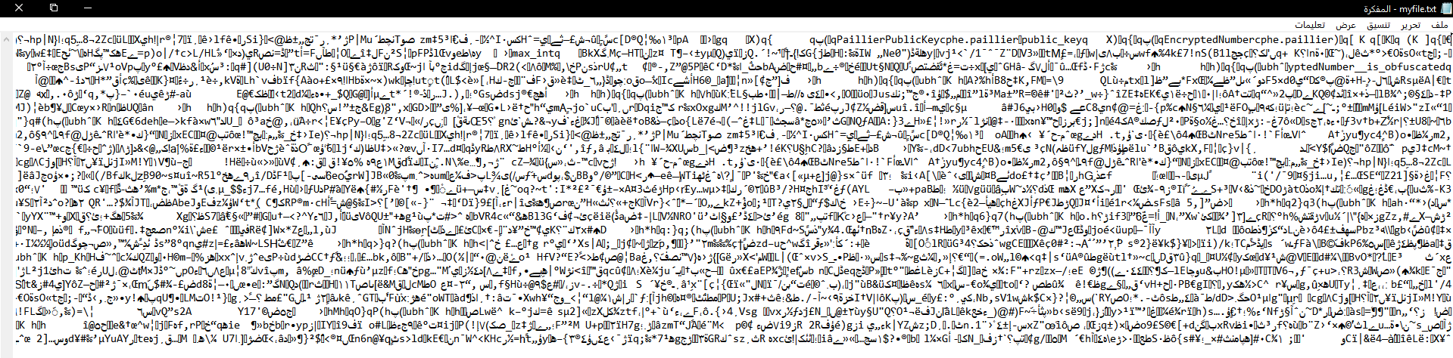
Cont. View of the program
Saved text file, can be reloaded

Slide 12
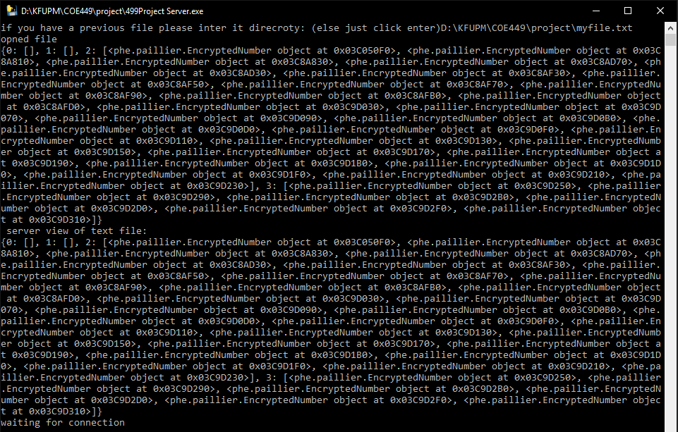
Cont. View of the program
Saved text file, can be reloaded

Slide 13
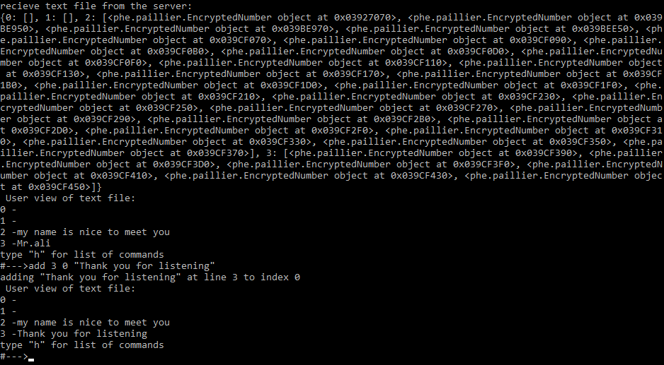
Cont. View of the program
Homomorphic property

