Slide 1


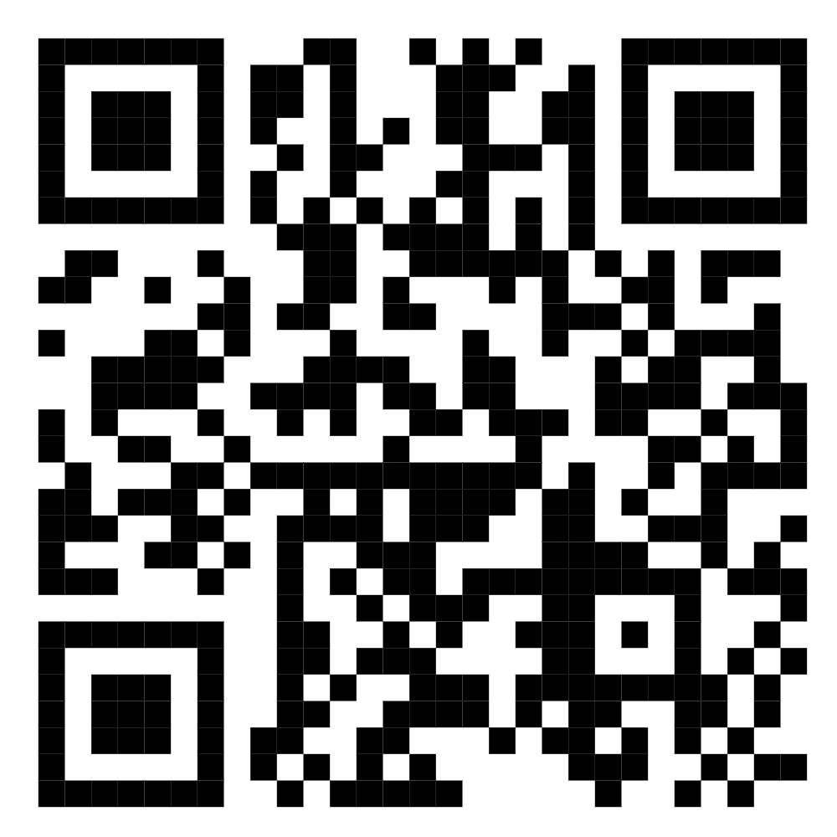
MedOrbit
Smart Healthcare Platform
Scan the QR to get a try!
Ali Ghassan Abdullah Dawood · Omar Abdullah Sadeq Abu Mazen
Supervisor: Dr. Bashar Tahyana
Computer Engineering · An-Najah National University · 2026

Slide 2
THE PROBLEM
Healthcare access is fragmented
Scattered discovery.
Finding a trusted doctor or clinic is spread across disconnected sources.
1
Disconnected records.
Appointments, medical records and prescriptions live in separate places.
2
Limited guidance.
Patients often don't know which specialty fits their symptoms.
3
Siloed roles.
Patients, doctors, clinics and administrators use unrelated tools.
4
MedOrbit
2

Slide 3
THE SOLUTION
One unified healthcare platform
Every role, both clients and all intelligence on a single shared backend.
Patient
Doctor
Clinic
Admin
MedOrbit · Web + Mobile
Backend API
PostgreSQL + PostGIS
AI Service
Events + Real-Time
MedOrbit
3

Slide 4
PRODUCT SCOPE
Who uses MedOrbit?
Five distinct roles, each with its own interface and its own authorization rules.
P
D
C
A
S
Patient
Doctor
Clinic
Admin
SuperAdmin
Discover care
Manage health data
AI health tools
Patients & schedule
Records & prescriptions
Health posts
Facility workspace
Invite doctors
Manage services
Users & applications
Content moderation
Audit trail
Highest privileges
Invite admins
MedOrbit
4

Slide 5

01
Platform Features
What each role can actually do on the platform today.

Slide 6
CORE FEATURES
Patient experience
Discover care. Search doctors by specialty and find clinics on an interactive map.
1
Book appointments. See real availability and reserve a slot in a guided flow.
2
Manage health data. Medical records, prescriptions and personal reports in one place.
3
Stay connected. Message your doctor, follow health posts and receive notifications.
4
MedOrbit
6

Slide 7
CORE FEATURES
Doctor workspace
Professional profile. Specialty, experience, expertise and clinic affiliation.
1
Schedule & appointments. Define availability rules, then confirm and complete visits.
2
Patient care. Assigned patients, medical records and clinical notes.
3
Prescriptions. Issue prescriptions with AI-assisted interaction warnings.
4
MedOrbit
7

Slide 8
CORE FEATURES
Clinic workspace
A clinic is a first-class account type, not just a record inside the directory.
Apply and get verified.
A facility applies, an administrator reviews and approves it.
1
Manage the facility. Services, location, contact details and verified contact emails.
2
Invite doctors. Doctors join a clinic only by accepting an invitation — never by assignment.
3
Controlled credentials. Registration numbers change only through an admin-reviewed request.
4
MedOrbit
8

Slide 9
CORE FEATURES
Administration
Platform analytics. Usage across users, specialties, appointments and activity.
1
Application review.
Approve or reject doctor and clinic applications.
2
Users & moderation. Manage accounts and moderate the public health feed.
3
Audit & invitations. Every sensitive action is logged; super admins invite new admins.
4
MedOrbit
9

Slide 10
CORE FEATURES
Healthcare discovery & map
Finding the right doctor or facility, visually.
1
2
3
4
Search
Discover
Map View
Results
By specialty, name or facility type
Nearby clinics, hospitals and pharmacies
Leaflet map on OpenStreetMap tiles
Distance-ranked results from PostGIS
Leaflet + OpenStreetMap on both clients; PostgreSQL/PostGIS distance queries on the server.
MedOrbit
10

Slide 11
CORE FEATURES
Appointments
Two sides of one booking flow, guarded by the database.
Patient
Doctor
Select a doctor
View real available slots
Choose a time and book
Track, confirm or cancel
Define availability rules
Block days and time windows
Confirm and complete visits
A booked slot can never be double-taken
MedOrbit
11

Slide 12
CORE FEATURES
Medical records & prescriptions
Clinical data with relationship-based access.
Patient
Doctor
View medical record timeline
Open full record details
View and download prescriptions
Access records of assigned patients only
Write clinical notes
Create prescriptions with safety checks
MedOrbit
12

Slide 13
CORE FEATURES
Two different conversations
Human messaging and AI assistance are deliberately separate systems.
Patient ↔ Doctor · Socket.IO
AI Assistant · AI Service
Real-time chat over an authenticated socket
A real human doctor replies
PostgreSQL stays the source of truth
Patients control who may message them
Handled entirely by the AI service
Language understanding, safety layer, local LLM
Automated — never a substitute for a doctor
Kept fully separate from human conversations
MedOrbit
13

Slide 14
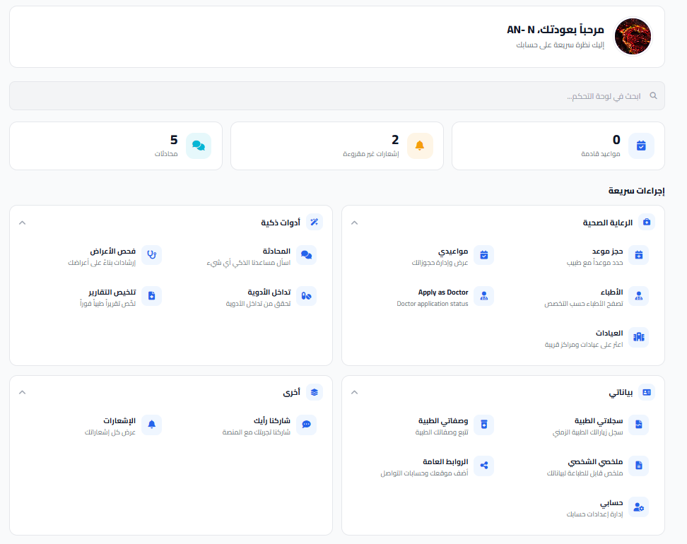
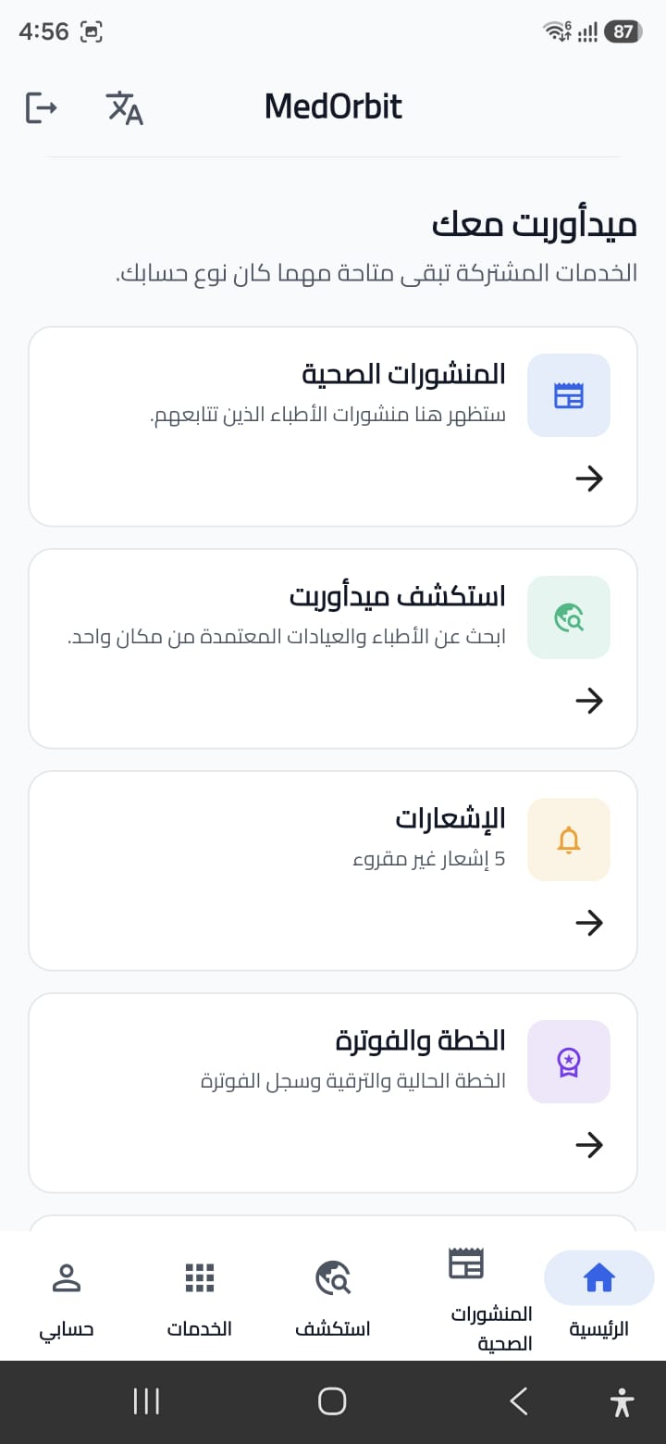
PRODUCT IN ACTION
One account, two clients
The same live data on the web application and the Flutter mobile app.
Web application
Flutter mobile app
MedOrbit
14

Slide 15
02
Artificial Intelligence
Five assistance features, and the safety layers underneath them.

Slide 16
INTELLIGENT ASSISTANCE
What the AI actually does
1
2
3
4
5
Symptom Triage
Medical Chatbot
Drug Checker
Report Summarizer
Virtual Doctor
Rule-based specialty matching
Confidence score, not a diagnosis
Arabic & English understanding
Local LLM via Ollama
Database-backed interactions
Severity and Rx warnings
OCR for scans and PDFs
Arabic & English summaries
Guided voice consultation
Grounded, safety-checked
MedOrbit
16

Slide 17
INTELLIGENT ASSISTANCE
How the medical chatbot works
From a patient message to a safe, grounded reply.
1
2
3
4
User Message
Understanding
Safety Check
LLM Response
A health question in Arabic or English
Rule-based intent and entity extraction
Emergency intents are filtered first
Local Ollama model composes the reply
The backend authenticates every request — the AI service is internal-only and never exposed to clients.
MedOrbit
17

Slide 18
INTELLIGENT ASSISTANCE
How the Virtual Doctor works
A structured voice consultation — our deepest AI subsystem.
1
2
3
4
5
Voice Input
Guided Interview
Knowledge Retrieval
Clinical Reasoning
Voice Output
faster-whisper turns speech into text
Adaptive questions, unclear answers confirmed
Embedding search over a medical knowledge base
Prolog rules combined with the model
Piper text-to-speech reads the reply back
Session memory lives in the database, so the interview builds on every previous answer.
MedOrbit
18

Slide 19
INTELLIGENT ASSISTANCE
How we keep the AI safe
The most important property of a medical assistant is knowing when to stop and escalate.
!
✓
↑
i
Emergency First
Symbolic Rules
Escalate Only
Clear Limits
Emergency patterns are checked before anything else
Arabic and English
A Prolog rule engine encodes clinical red flags
Deterministic, not probabilistic
Urgency can be raised, never lowered
Enforced in four separate places
Guidance, never a diagnosis
Every AI output is advisory
MedOrbit
19

Slide 20
03
Engineering
The architecture, the data, and the discipline behind the product.

Slide 21
ENGINEERING
System architecture
A service-oriented architecture: every part has one job and one boundary.
1
2
3
4
Clients
Backend
Data
AI + Events
Web: HTML/CSS/JS + nginx
Mobile: Flutter + Dart
One shared REST contract
Node.js / Express API
Authentication + access control
Socket.IO real-time layer
PostgreSQL 18 + PostGIS
Hand-written SQL, no ORM
31 ordered migrations
Python / FastAPI, internal-only
Local LLM via Ollama
Kafka + background workers
MedOrbit
21

Slide 22
ENGINEERING
Database design
PostgreSQL 18 + PostGIS · geospatial search · JSONB where it earns its place · 31 tracked migrations.
1
2
3
Core Healthcare
Communication
Platform & AI
Users, doctors & specialties
Clinics & facilities
Appointments
Records & prescriptions
Conversations & messages
Notifications
Health feed & follows
Subscriptions & usage
Audit logs & event outbox
AI and consultation sessions
MedOrbit
22

Slide 23
ENGINEERING
Asynchronous events & real-time
Two different problems solved with two different patterns.
Kafka · Asynchronous
Socket.IO · Real-Time
Events are saved in the same transaction as the data
A worker publishes them with retry and back-off
Consumers build recommendation profiles
The user's request never waits for Kafka
Authenticated live connections
Room-based patient ↔ doctor messaging
Delivered instantly, stored in PostgreSQL
Independent from the AI assistant
MedOrbit
23

Slide 24
TRUST BY DESIGN
Authentication & security
Healthcare data needs layered boundaries — not just a login screen.
1
2
3
Identity
Authorization
Platform Defense
Email/password + Google Sign-In
Access & refresh tokens
Passwords hashed with bcrypt
Role-based access for 5 roles
Doctor access follows the care relationship
Changing a role revokes sessions instantly
Security headers & content policy
CORS rules & rate limiting
Audit trail for sensitive actions
MedOrbit
24

Slide 25
QUALITY & OPERATIONS
Delivery & verification
Reproducible environments and automated checks on every push.
Deployment
Testing & CI
Docker Compose runs the whole stack
Backend, AI service, database, Kafka, workers, web
Health checks before traffic is served
HTTPS staging configuration prepared
Integration tests: auth, access control, messaging
Event pipeline and billing test suites
AI service unit and safety-regression tests
GitHub Actions: build, migrate, test, health-check
MedOrbit
25

Slide 26
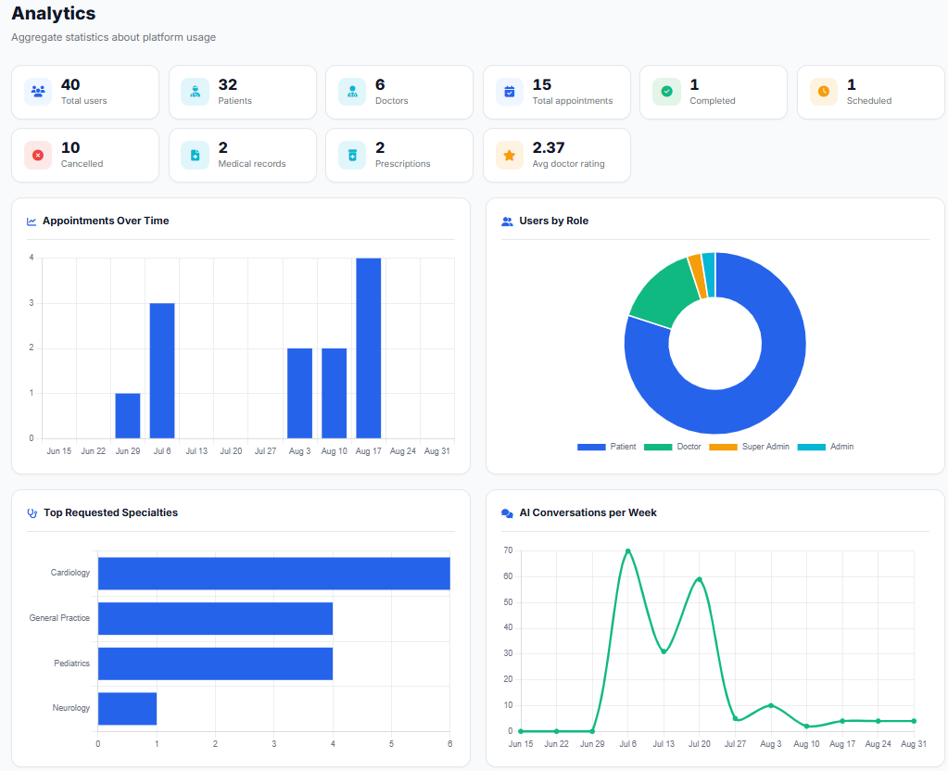
RESULTS
Platform analytics dashboard
Web admin dashboard
MedOrbit
26

Slide 27
ENGINEERING QUALITY
What we actually delivered
One platform, engineered across every layer.
Healthcare Discovery
Appointments
Medical Records
✓
✓
✓
Prescriptions
Patient ↔ Doctor Messaging
Clinic Workspace
✓
✓
✓
Administration & Audit
AI Assistance (5 tools)
Maps & Geospatial Search
✓
✓
✓
Real-Time Communication
Event-Driven Processing
Web + Mobile Clients
✓
✓
✓
MedOrbit
27

Slide 28
LOOKING AHEAD
Limitations & future work
An honest picture of where the prototype stands today.
Current Limitations
Future Work
Academic prototype, not a certified medical device
AI output requires professional review
Payment is simulated, not a live provider
Analytics load on request, not in real time
Physical-device and load testing
Independent security review
Real payment-gateway integration
Production monitoring and backups
MedOrbit
28

Slide 29
ENGINEERING SUMMARY
Languages & technologies
Every language and platform behind MedOrbit, and where each one is used.
JS
Dart
Node
Python
JavaScript
Flutter
Node.js
FastAPI
Web application — HTML5, CSS3, nginx
Mobile app — Riverpod, GoRouter, Dio
Express REST API + Socket.IO
AI service — NLU, RAG, OCR, voice
SQL
Prolog
Kafka
Docker
PostgreSQL
SWI-Prolog
Apache Kafka
Docker
PostGIS geospatial data, 31 migrations
Symbolic clinical reasoning rules
Asynchronous event pipeline
Compose stack for every service
MedOrbit
29

Slide 30
Thank You
Questions & Discussion
Ali Ghassan Abdullah Dawood · Omar Abdullah Sadeq Abu Mazen

