Slide 1

Database Management Systems

Slide 2
Team Members
Mehmet Reşit ÇAĞAN 190709045
Ali DİKME
180702012.1
Murat Avzet ASAN 200709602

Slide 3

Data Set Name : Household Data Set

Slide 4
Definition of Data Set
Our data contains different characteristics about various households in the Philippines. To talk about these features in general; information about household members, information about the utilities of their house, and income-expenditure attributes.

Slide 5

Purpose of Data
Investigating specific expenditures of household how relates on features of family using by “Household Data Set”.

Slide 6

Data Presentation
How many files exist: 3 files
How many columns and rows: Totally, 81 columns 124632 rows
How many strings: 15 Strings in dataset
How many integer: 66 Integer in dataset

Slide 7
Data Presentation
The family info file includes the information in the household expense CSV file.
Data to be used : family_info.csv , house_utilities.csv
Columns : 62
Rows : 83088

Slide 8
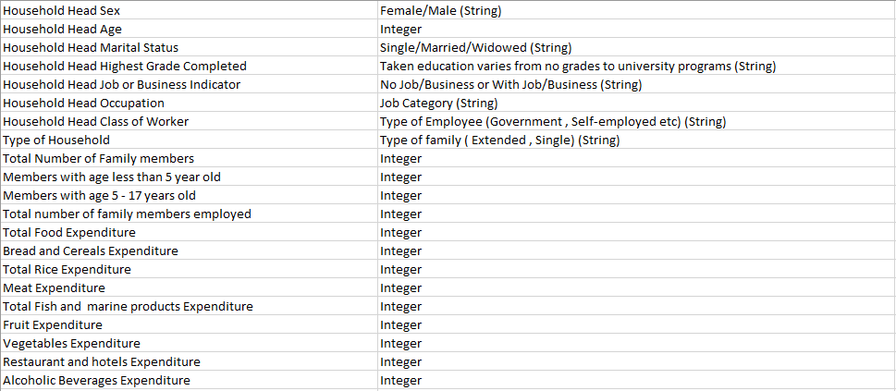
Dataset Attribute Descriptions

Slide 9
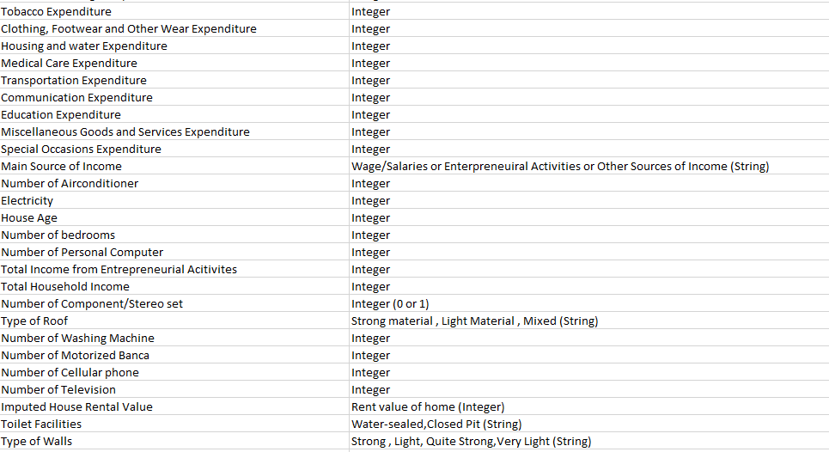
Dataset Attribute Descriptions

Slide 10
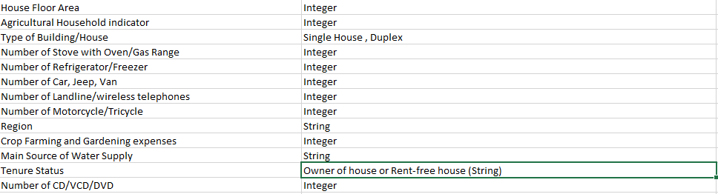
Dataset Attribute Descriptions

Slide 11
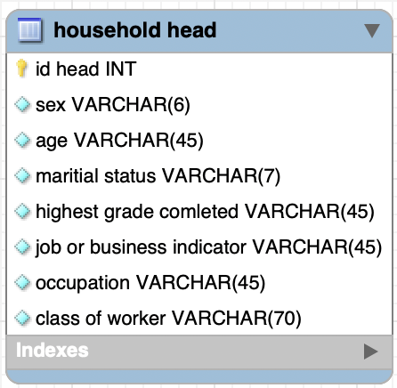
Example of One Entity

Slide 12
Questions
What is the rate of No Job / With Job ?
What is the mean of households head’s age ?
What is the rate of Single Family / Extended Family ?
What is the average number of family members ?
What is the rate of the members who under 5 ages/who between 5-17 ages ?
What is the mean of the family members number who has a job ?
What is the maximum education care expenditure ?
Which house price is greater than the mean of house prices ?
Which family has the least education expenses?
How many households with their own business have homes?

Slide 13
Data set Kaggle Link
https://www.kaggle.com/datasets/muhammadsaadkag/household-data-set

Slide 14
End of Presentation , Thank you for listening

