Slide 1
Sentiment Analysis
Ali Demirci
Büşra Oğuz
Software Engineering

Slide 2
Sample Topics
Introduction
Proposed Algorithm
Complexity Comparison
Simulation Results
Future work & Conclusions

Slide 3
Introduction
Problem Definition: Highlight the importance of sentiment analysis in evaluating product and service quality through customer reviews. This analysis provides businesses with valuable insights by classifying reviews as positive or negative.
Proposed Solution: A system was developed to perform sentiment analysis on customer reviews using Natural Language Processing (NLP) and deep learning methods. This system classifies Turkish texts as positive or negative.
Technologies Used:
Python: For data processing and model development.
TensorFlow and Keras: GRU-based deep learning model.
Tkinter: For a user-friendly graphical interface.
Dataset: Our dataset from hepsiburada.com contains user reviews and their corresponding ratings

Slide 4
Proposed Algorithm
Data Processing Steps:
Separating reviews and ratings from the dataset.
Tokenization: Converting reviews into word indices.
Padding: Standardizing the length of the reviews.
Model Architecture:
Embedding Layer: Creating vector representations of words.
GRU Layers: Three GRU layers were used to learn the sequential structure of reviews.
Dense Layer: Outputs a binary prediction (positive/negative) using a sigmoid activation function.
Hyperparameters:
Embedding size: 50.
Maximum number of words: 10,000.
Maximum review length: 59 words.
Learning rate: 0.001.
Prediction Process:
User input is processed through the same data preprocessing steps.
The model predicts whether the input text is positive or negative and displays the result in the interface.

Slide 5
Complexity Comparison
Time Complexity:
A single GRU step has a time complexity of O(n²), where n represents the length of the time steps.
Training depends on the size of the dataset and the number of layers in the model.
Impact of Data Size:
The dataset was optimized with 10,000 words and a maximum length of 59 words.
Good accuracy was achieved in an average of 5 epochs.
Performance Evaluation:
The model achieved 95% accuracy on the test data.

Slide 6
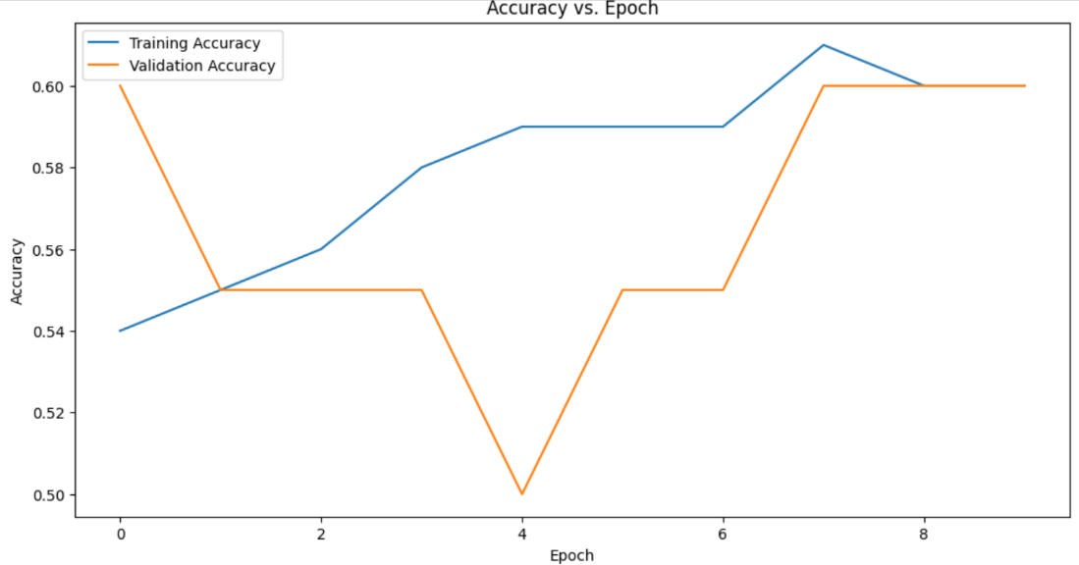
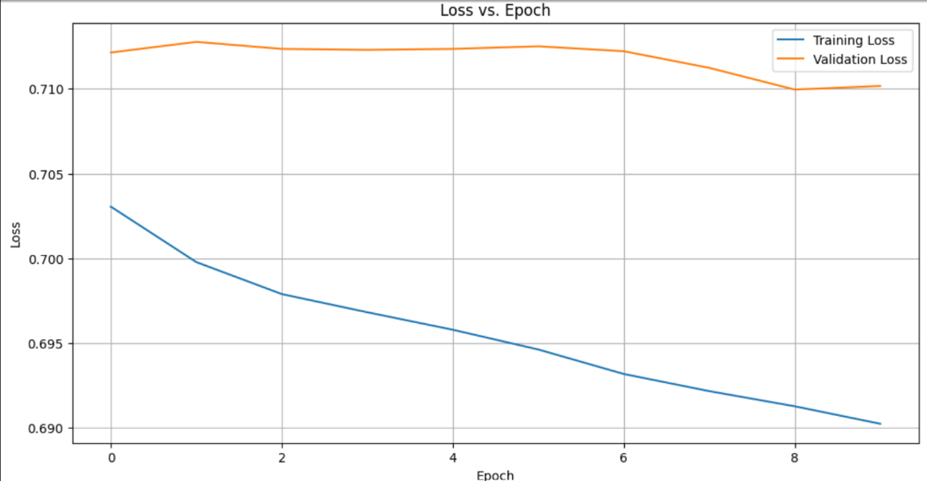
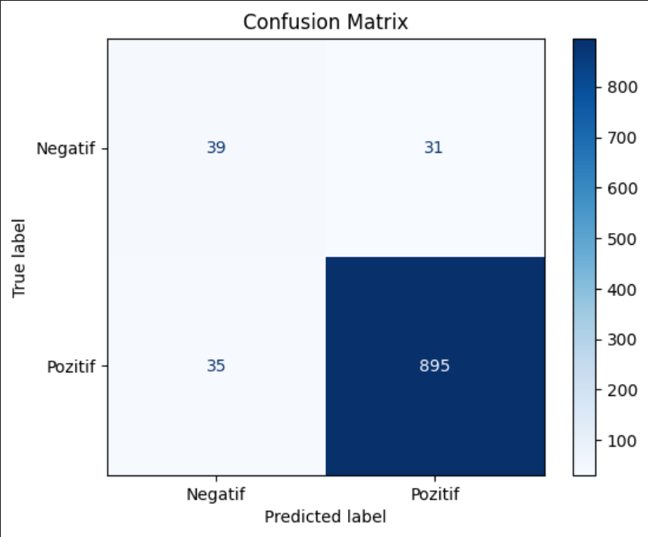
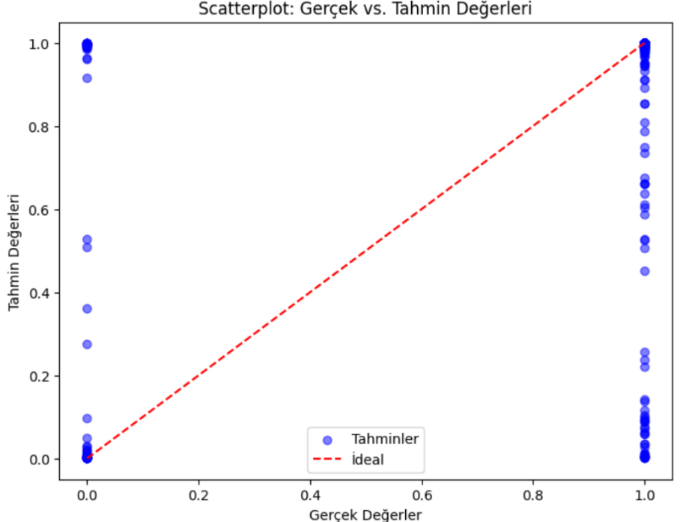
Simulation Results

Slide 7
Future work & Conclusions
Future Work:
Larger Datasets: Using more diverse and larger datasets to enhance the model's generalization performance.
Language Diversity: Training the model for sentiment analysis in languages other than Turkish.
Advanced Models: Improving accuracy with models like LSTM, Transformer, or BERT.
Sentiment Gradation: Instead of binary classification, analyzing sentiment on a scale (e.g., between -1 and 1).
Conclusions:
The GRU-based deep learning model provides effective results for sentiment analysis of Turkish reviews.
The implemented method offers practical use by integrating a user-friendly interface.
Sentiment analysis is a powerful tool for businesses to understand customer satisfaction and improve their strategies.

Slide 8
Thanks for your attention !!

