Slide 1
Selected -2 presentation
Ali Ehab Ali Yousef 201900483
Nehad Ahmed Ali NourEldein 201900902
Nehal Ashraf Elsayed Elsayd 201900903
Mohamed Ashraf Abdelaziz Ibrahim 201900635
Mohamed Hassan Ali Amen Hendy 201900654
Omar Abdel Nasser Tawfik Adam 201900517
Hesham Mahmoud Ibrahim 201900942
Nourhan Mouhamed Radwan 201900916

Slide 2
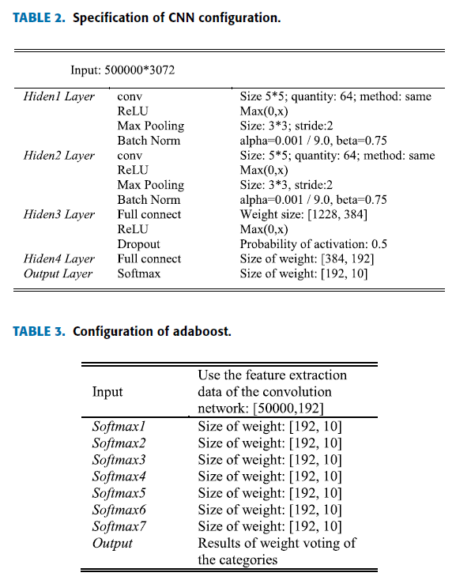
Architecture used in the paper

Slide 3
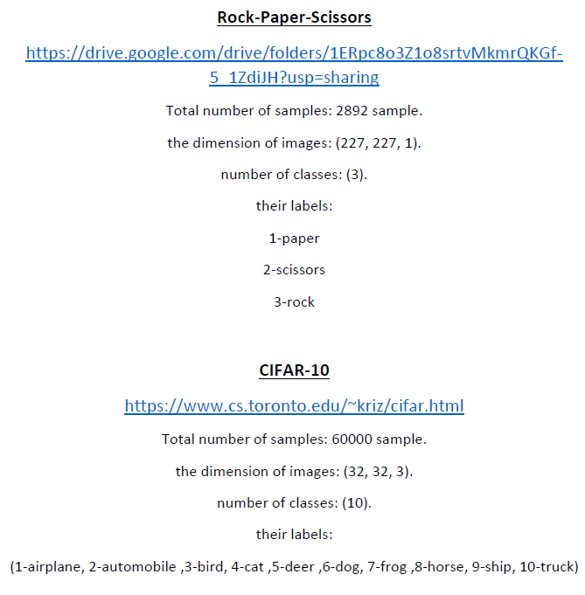
Dataset details

Slide 4
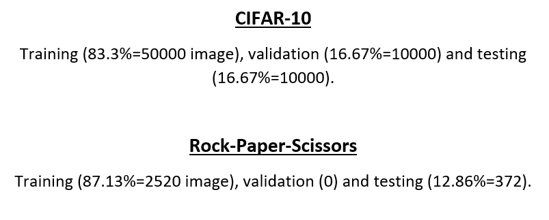
Implementation details

Slide 5
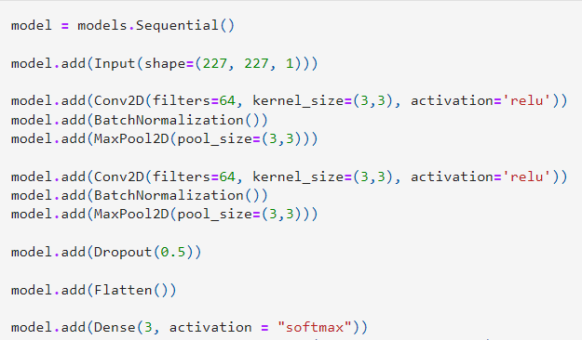
Rock-Paper-Scissors model

Slide 6
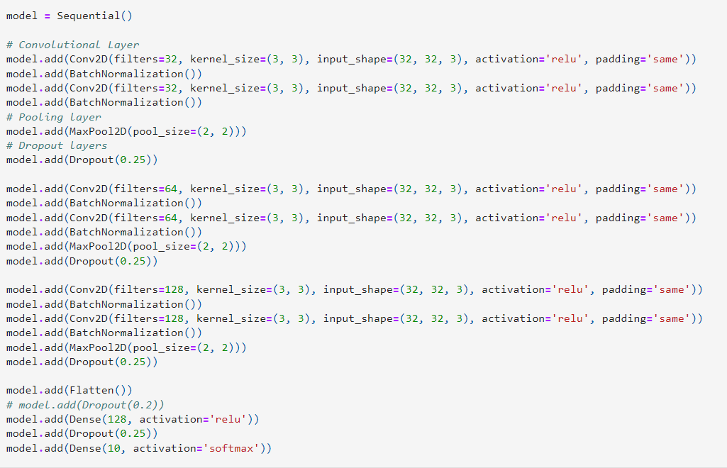
CIFAR-10 model

Slide 7
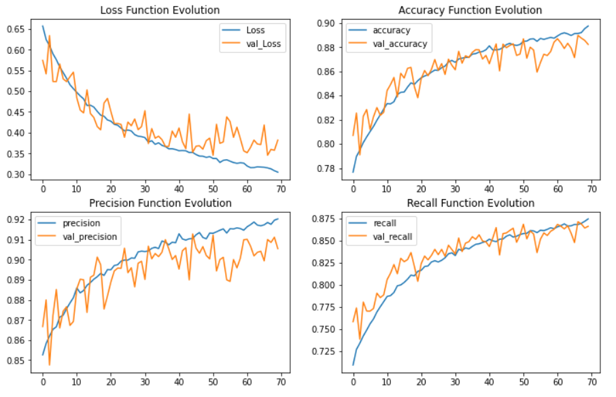
Results and visualization CIFAR-10 result

Slide 8
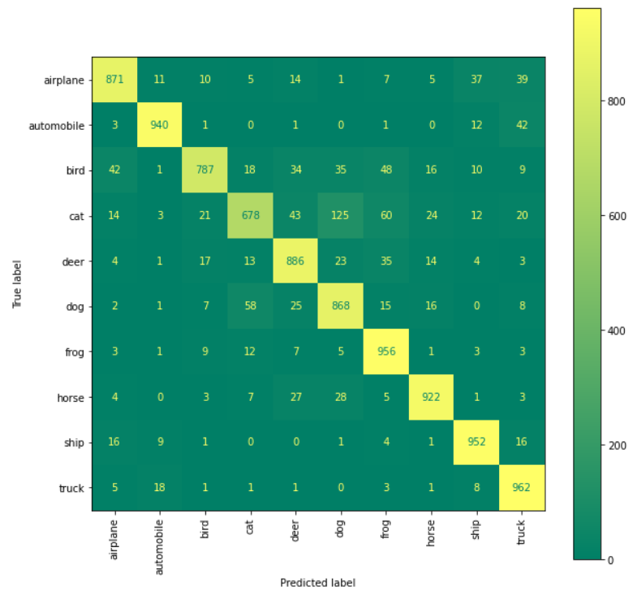

Slide 9
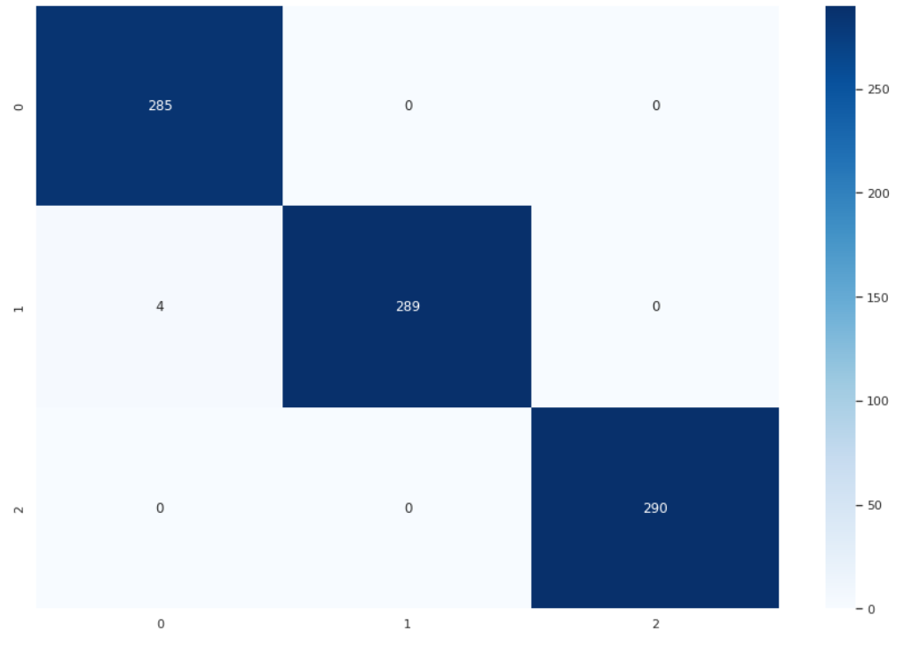
Rock-Paper-Scissors model result

Slide 10
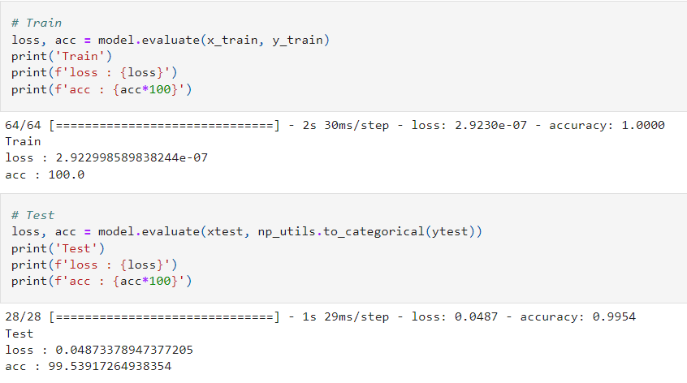

Slide 11
