Slide 1

California Housing Prices Prediction
Ali Ehab Mohamed

Slide 2


Agenda
Preprocessing
Data Analysis
Model Implementation
Model Evaluation

Slide 3


Introduction
The California housing prices dataset provides a rich collection of features related to housing districts in California, including median housing prices. This dataset is widely used in machine learning to explore the relationships between various factors and predict the median housing price for different districts. The goal of this problem is to develop a predictive model that can accurately estimate the median housing price based on the given features.
Understanding the dynamics that influence housing prices is crucial for various stakeholders, including real estate investors, policymakers, and homebuyers. A reliable predictive model can assist in making informed decisions about property investments, assessing the impact of socio-economic factors on housing prices, and supporting individuals in their search for affordable housing.
In this context, the task is to analyze the California housing prices dataset, preprocess the data, and build a machine learning model capable of predicting the median housing price for a given district. By developing an accurate predictive model, it is possible to contribute to the broader understanding of housing market trends and provide valuable insights for those interested in the California real estate landscape

Slide 4



Preprocessing
Visualization, Missing values, analysis

Slide 5
Dataset Description
1. longitude: A measure of how far west a house is; a higher value is farther west 2. latitude: A measure of how far north a house is; a higher value is farther north 3. housingMedianAge: Median age of a house within a block; a lower number is a newer building 4. totalRooms: Total number of rooms within a block 5. totalBedrooms: Total number of bedrooms within a block | 6. population: Total number of people residing within a block 7. households: Total number of households, a group of people residing within a home unit, for a block 8. medianIncome: Median income for households within a block of houses (measured in tens of thousands of US Dollars) 9. medianHouseValue: Median house value for households within a block (measured in US Dollars) 10. oceanProximity: Location of the house w.r.t ocean/sea

Slide 6
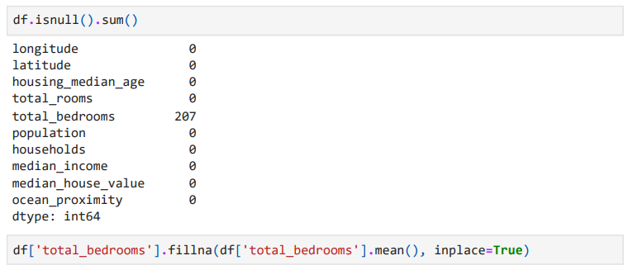
Handling Missing Values

Slide 7
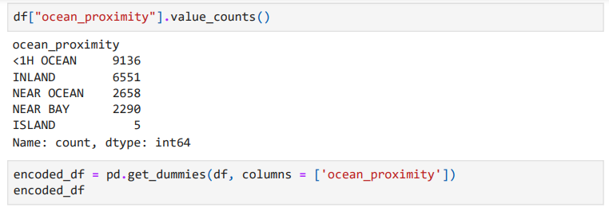
Binary eNCODING

Slide 8
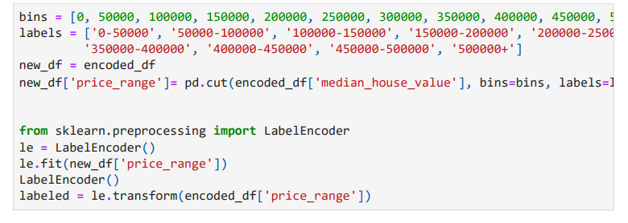
Binning

Slide 9
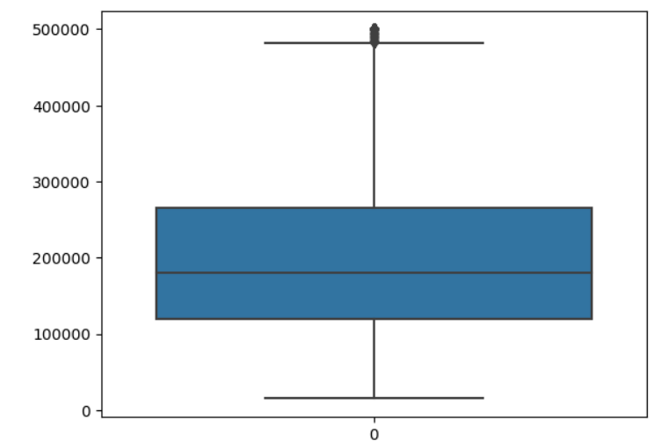
Dataset Visualization

Slide 10
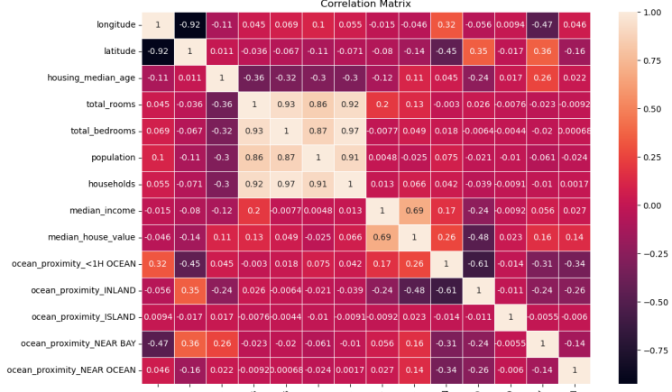
Dataset Visualization

Slide 11
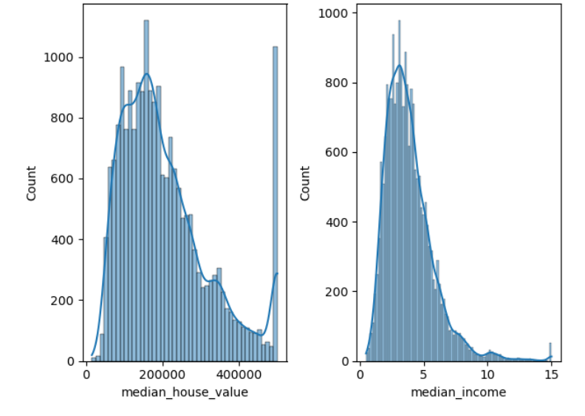
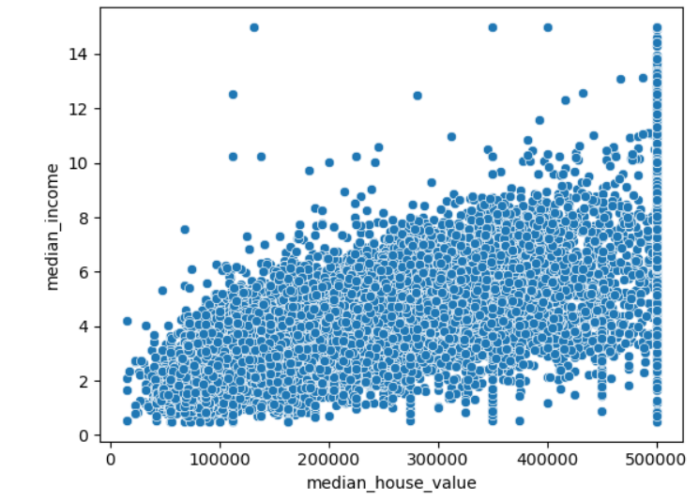
Data Visualization

Slide 12

Data Analysis

Slide 13
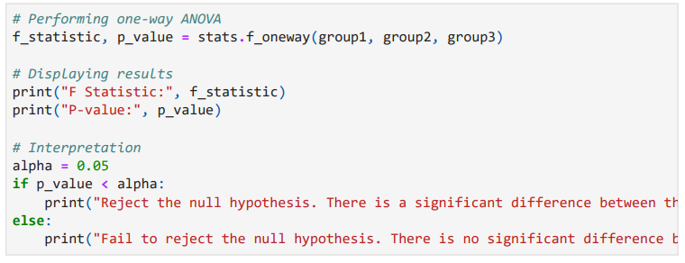

Analysis of Variance (ANOVA)

Slide 14
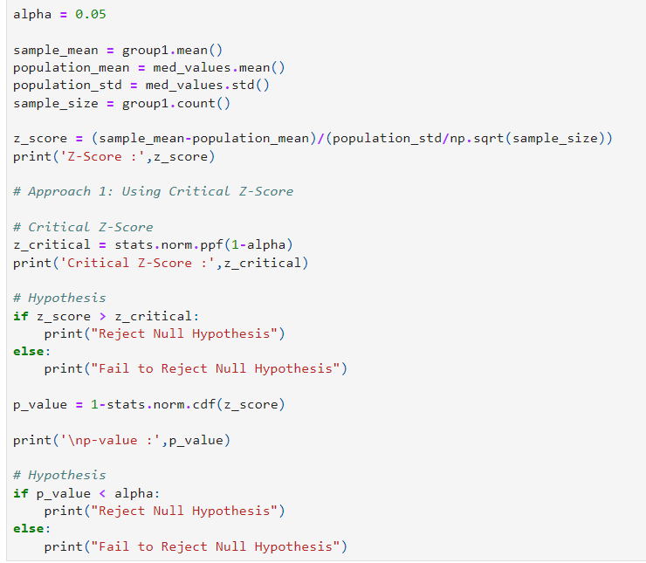
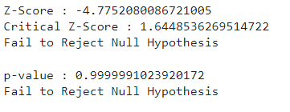
Z-TEST

Slide 15
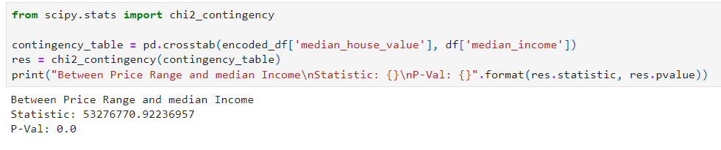
Chi-Square Test

Slide 16
Feature Reduction

Slide 17
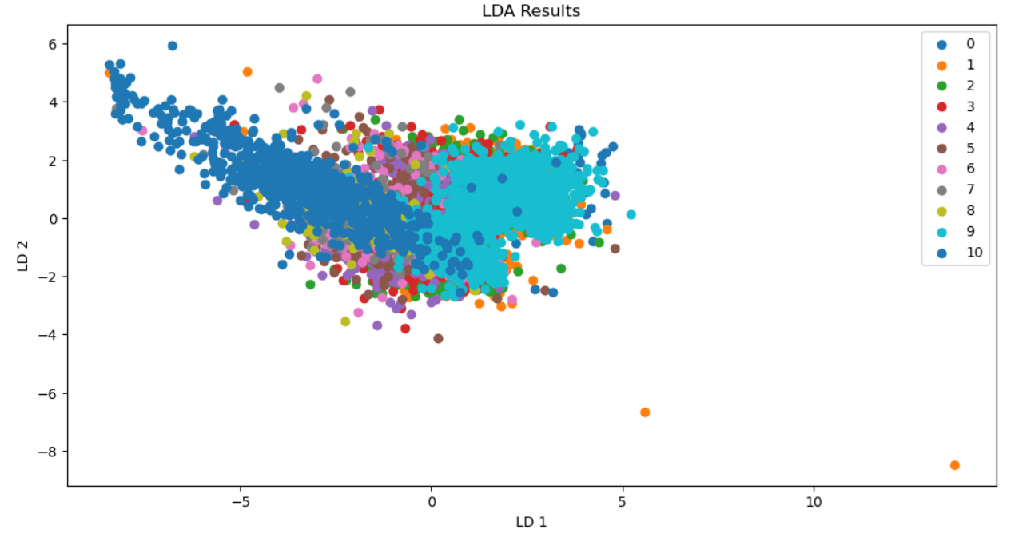
Linear Discriminant Analysis
Utilized K-fold cross validation
Used K-Nearest Neighbors in classification with LDA features
Visualized the data

Slide 18
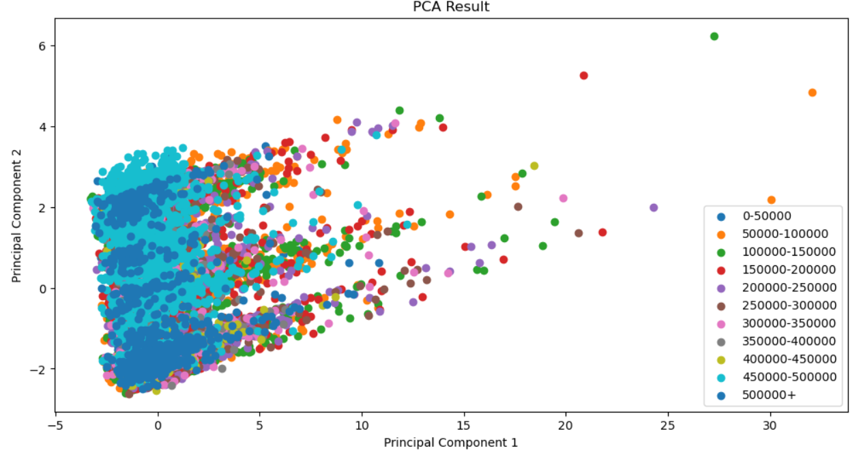
Principle Component Analysis
Utilized K-fold cross validation
Used K-Nearest Neighbors in classification with PCA features
Visualized the data

Slide 19
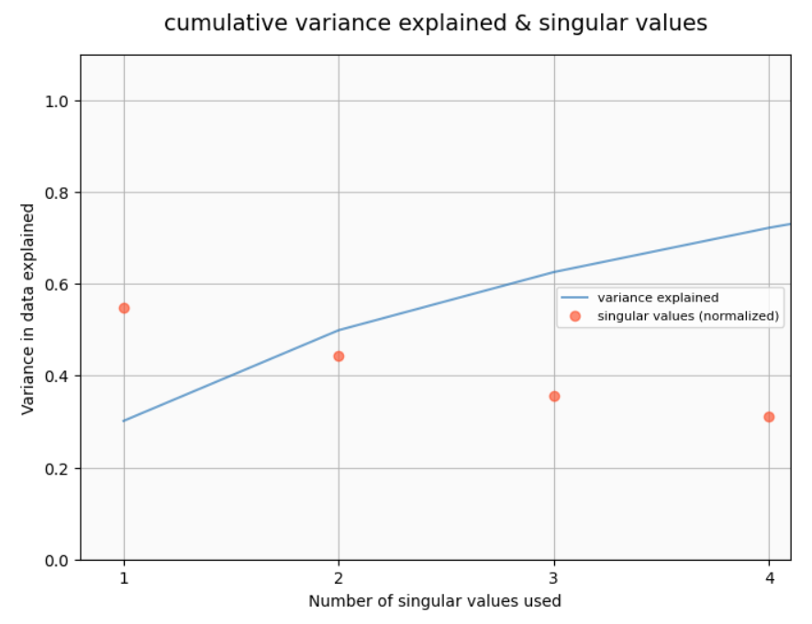
Singular Value Decomposition
Visualized the data

Slide 20
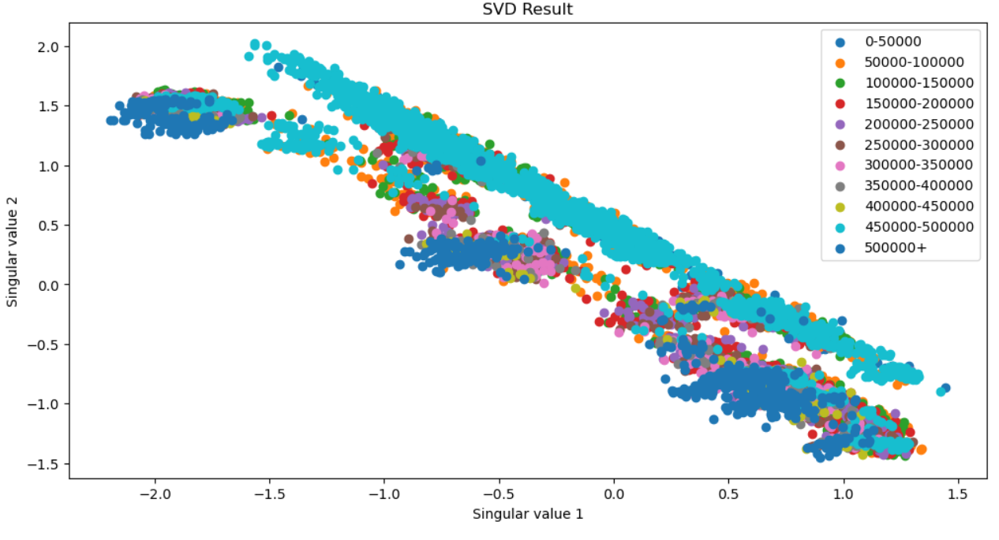
Singular Value Decomposition
Visualized the data

Slide 21
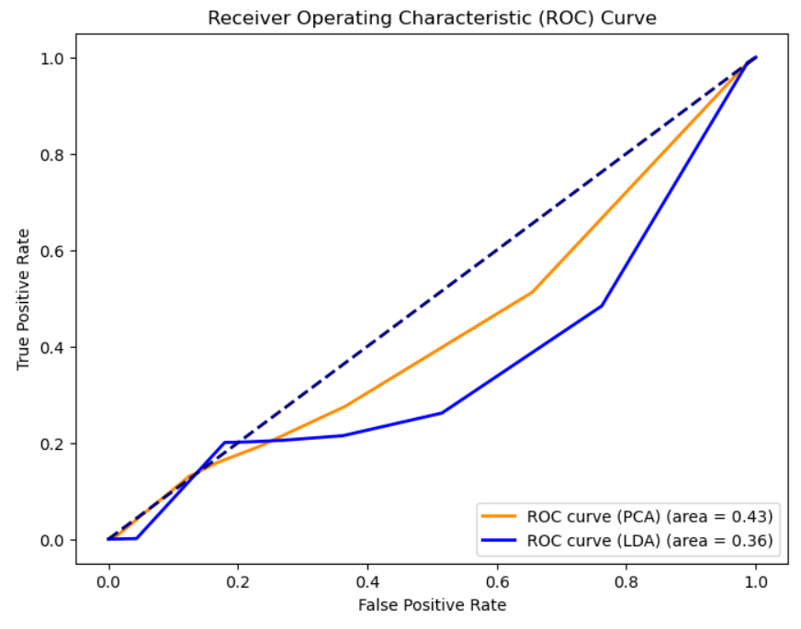
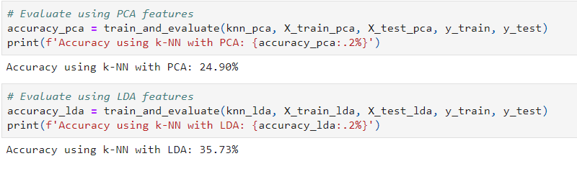
Receiver Operating Characteristic

Slide 22

Model Implementation

Slide 23
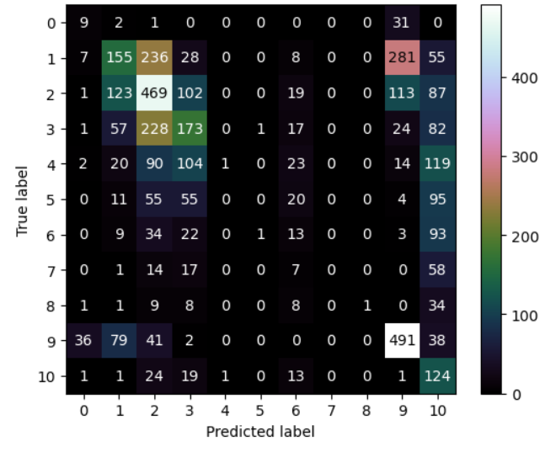
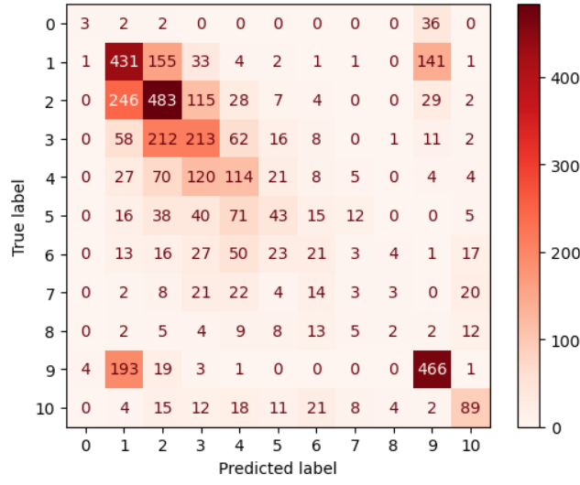
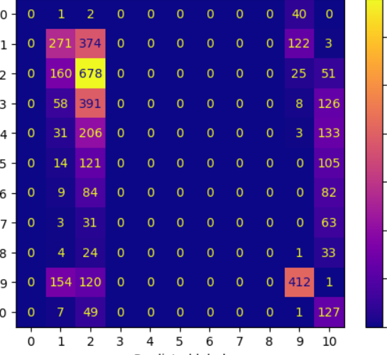
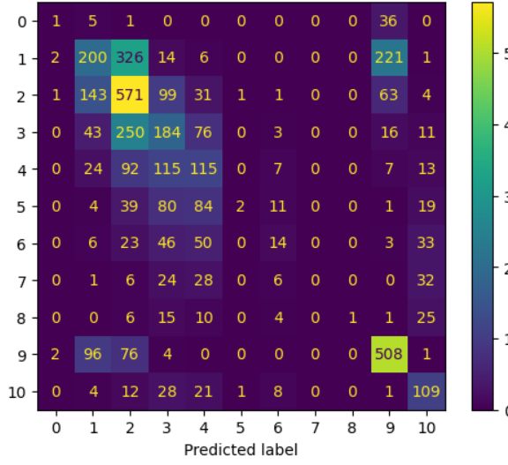
Models Used
Naïve-Bayesian
KNN-Classifier
ID3-Classifier
LDA Classifier
Accuracy Score of 0.348
Accuracy Score of 0.453
Accuracy Score of 0.361
Accuracy Score of 0.413

Slide 24


Models Used
KNN Regressor
Decision Tree Regressor

Slide 25
References
Pace, R. Kelley, and Ronald Barry. "Sparse spatial autoregressions." Statistics & Probability Letters 33.3 (1997): 291-297Add transitions, animations, and motion.
Géron, A. (2017). Hands-On Machine Learning with Scikit-Learn, Keras, and TensorFlow. O'Reilly Media

Slide 26




Thank You

