Slide 1


Slide 2
Top Elite Football Clubs Recruitment Strategy
Football clubs are the heartbeat of the beautiful game, uniting talented players, devoted fans, and innovative strategies from across the world. They’re more than teams—they’re global communities that inspire millions, compete in thrilling leagues, and drive the sport forward through their unique approaches to building squads and chasing glory
Player recruitment isn’t just about talent—it’s a strategic game that shapes a club’s identity, success, and legacy.
Discovering the strategies behind player recruitment hunting, the player profiles targeted. By revealing the hidden patterns that define five of the world's top football clubs Real Madrid, Barcelona, Juventus, Arsenal, and Liverpool.
Get ready to explore what makes each club exceptional, and which type of players they hunted.
Note: The data collected in 2019

Slide 3
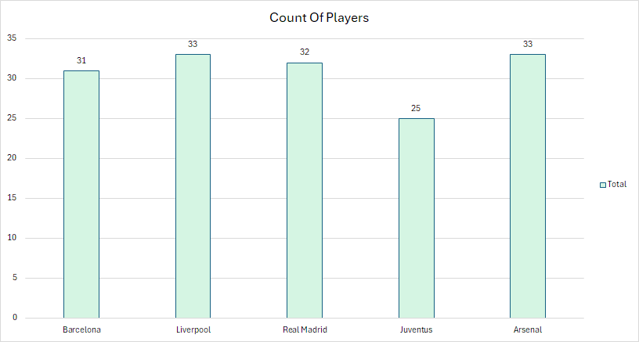
Team Size: Getting Started
Highlighting that the elite clubs exceed the average team size of 26 players, except for Juventus.

Slide 4
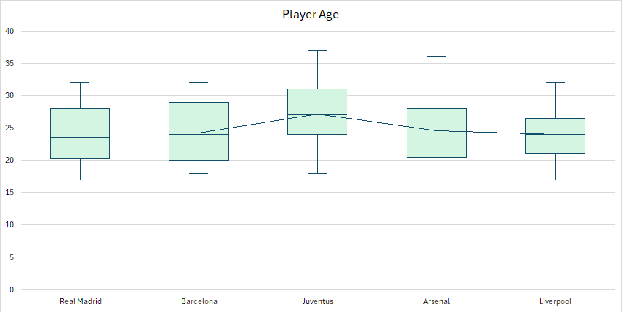
Age Shapes Strategy: Youth or Experience
A club’s approach to player age mirrors its ambitions and defines its identity.
Real Madrid, Barcelona, and Arsenal blend early-career and prime-age players to balance present success with future potential.
Juventus focuses on prime-age players for immediate impact and experience.
Liverpool prioritizes early-career talents.

Slide 5
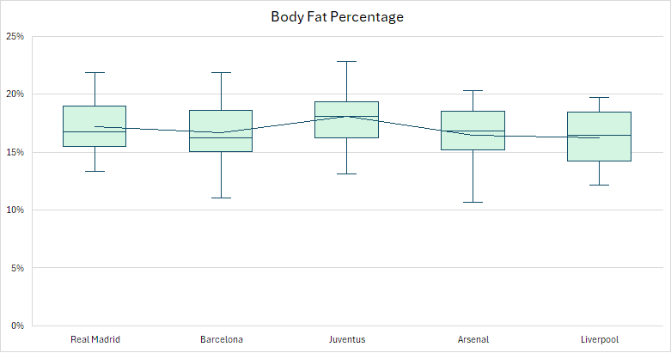
Fitness Standards: Measuring Body Fat
Top clubs require body fat percentages in the athlete classification range 14% to 17% for optimal performance, yet Juventus stands out 3% higher than average body fat percentage.
Note: equation based on Deurenberg formula %= (1.20 * BMI) + (0.23 * Age) - 16.2

Slide 6
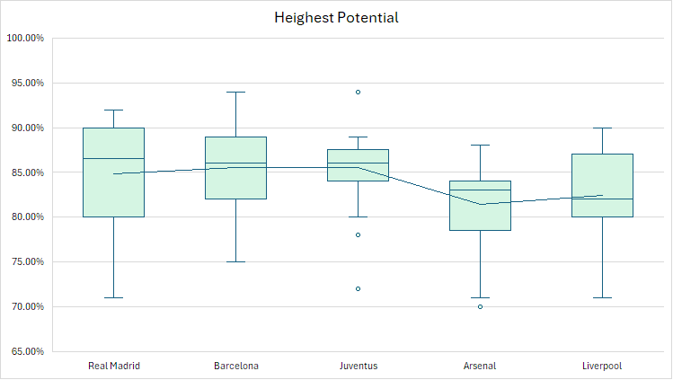
Player Potential: A Look at Future Talent
A player potential is the maximum ability or rating a player can reach.
Real Madrid and Barcelona have high-potential with broad range, driven by a diverse age profiles.
Juventus focus on small group of high-potential players, those ready to perform in their prime-age.
Arsenal has lowest potential, indicating a lower emphasis on high-potential.
Liverpool focus on high-potential players in their early-career.

Slide 7
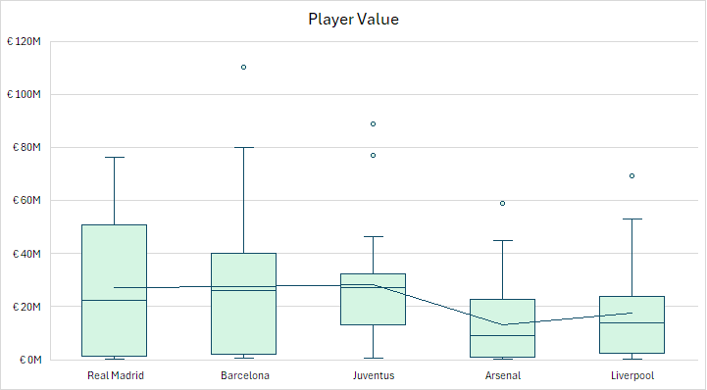
Distributing Investment: Player Values
Among elite clubs, a player’s value in the market is closely tied to their age and potential.
Real Madrid, and Barcelona have higher player values with broad range, due to their diverse age groups.
Juventus has high player values within a tight range, as focusing on prime-age, high-potential talent.
Arsenal records the lowest player values, as most of its players have lower potential.
Liverpool has median player values, due to early-career players yet to reach their peak value.
Each club has 1-3 exceptionally high-value player.

Slide 8
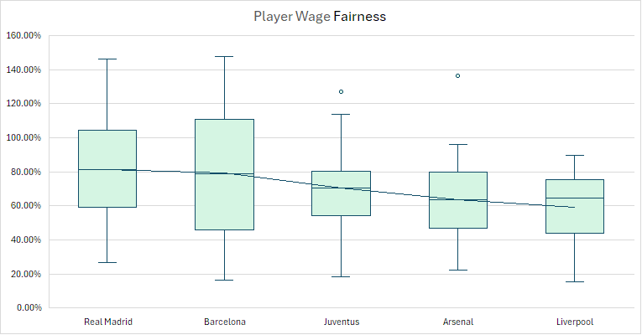
Wage Equity: A Look At Fairly Paid
Player wages are excessively high for higher market value as part of the club’s retention strategy.
Real Madrid, and Barcelona pay highest wages, as they have highest player market value.
Juventus sustains average wages within a narrow range.
Arsenal, and Liverpool fall below the average, due to their players having below-average market values.
Each club offers exceptionally high salaries to their top players, though Liverpool adopts a more balanced wage structure overall.
Note: equation used to estimate player wage fairness = $\left(Player Wage(in K) ∗ \frac{1}{1.15\sqrt{Player Value ( in K)}}\right)∗100$, while the equation isn’t perfectly accurate, it captures good insights, rather than raw wage.

Slide 9
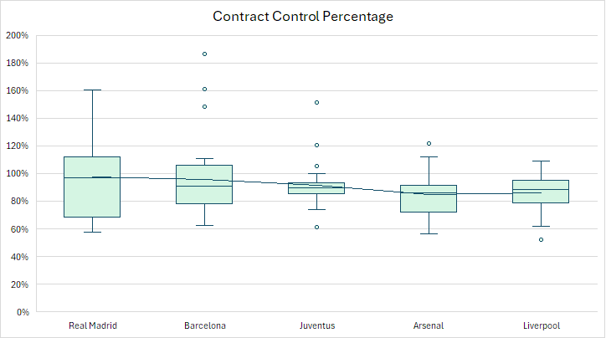
Contract Leverage: Elite Clubs Control Over Players
High percentage indicates the club has strong authority over a player's future, The player cannot leave easily.
Real Madrid has slightly stronger control over players.
Barcelona has almost well-balanced player control.
Juventus has fair control over their prime-age players.
Arsenal lowest control over its players.
Liverpool giving normal control for early-career players who haven’t fully proven themselves yet.
All five clubs except Liverpool treat 1-3 players as key assets with high-control contracts.
Note: equation used to estimate contract control %= $\frac{\log_{2}{Release Clause (in K)}}{\log_{2}{Player Value (in K)}} ∗(5\log_{2}{Release Clause (in K)}+0.3 {Contract Years}^{2})$

Slide 10
Conclusion: Top Elite Clubs Strategy
Every club employs a distinct strategy that defines its identity, paving the way for its rise among the world’s top teams.
Real Madrid, and Barcelona strike a balance between early-career and prime-age players with strong potential, rewarding them with high wages while maintaining tight control through their contracts.
Juventus concentrates on prime-age players with high potential, ensuring fair treatment such that average pay and standard contract terms.
Arsenal seeks players with solid potential and modest value, offering low wages with minimal contract control.
Liverpool primarily invests in early-career players with high potential, providing low wages and flexible contract restrictions.

Slide 11
Further Reading
The method for evaluating wage fairness isn’t fully accurate, but it reveals insights that player values and wages alone can’t show. Similarly, the contract control method aims to uncover details that player value, contract release clauses, and contract lengths don’t fully capture.

