Slide 1
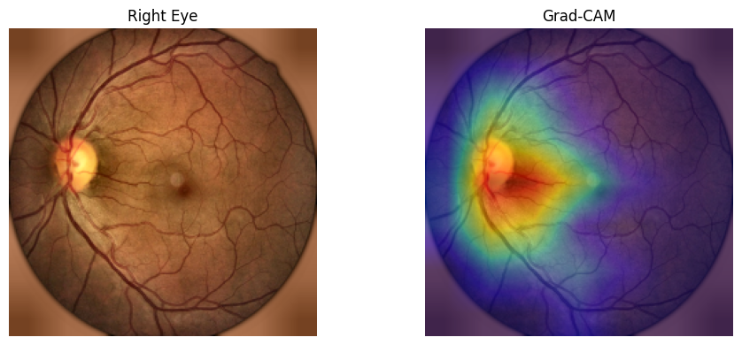
Graph Attention-Based Topological Modeling
for Diabetic Retinopathy Severity Prediction
Model 2 Research Article + Presentation
BRSET
EfficientNet + GAT
XAI
Fundus pair + clinical metadata -> patient embeddings -> similarity graph -> GAT prediction

Slide 2
Research motivation and gap
Why the graph-based model was implemented
Problem
Gap
This work
DR signs are subtle in fundus images
Class imbalance hides minority severity stages
Raw accuracy alone is misleading
Many studies use only images or only tabular data
Graph papers often lack XAI
Few pipelines explain relational patient reasoning
Patient-level multimodal embeddings
Similarity graph with attention
Grad-CAM + SHAP + GAT attention

Slide 3
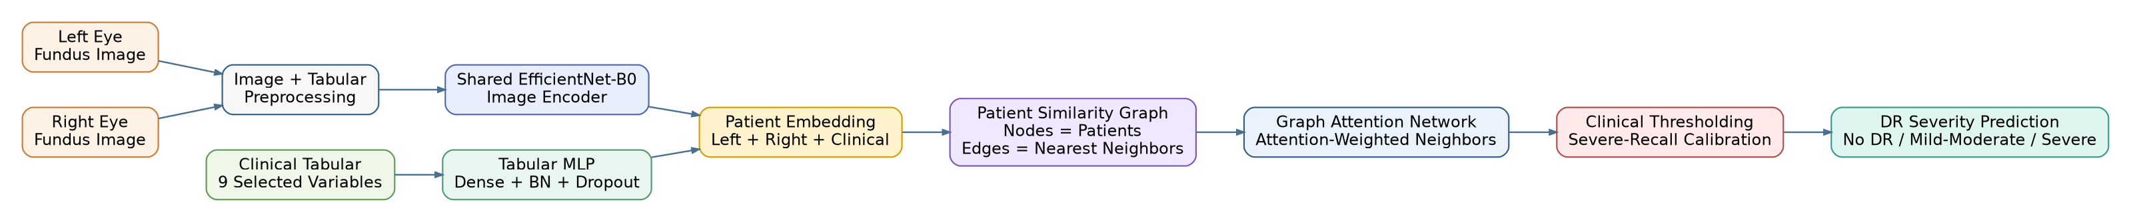
From reference architecture to implementation
The paper inspiration is graph/topological DR severity classification
Topological GNN inspiration
Reference idea: retinal features -> graph representation -> DR stage classifier
Our adaptation: graph nodes are patients, not isolated image features
Implemented multimodal GAT architecture
Left eye + right eye + clinical variables
EfficientNet embedding + tabular MLP
GAT learns influential neighbors

Slide 4
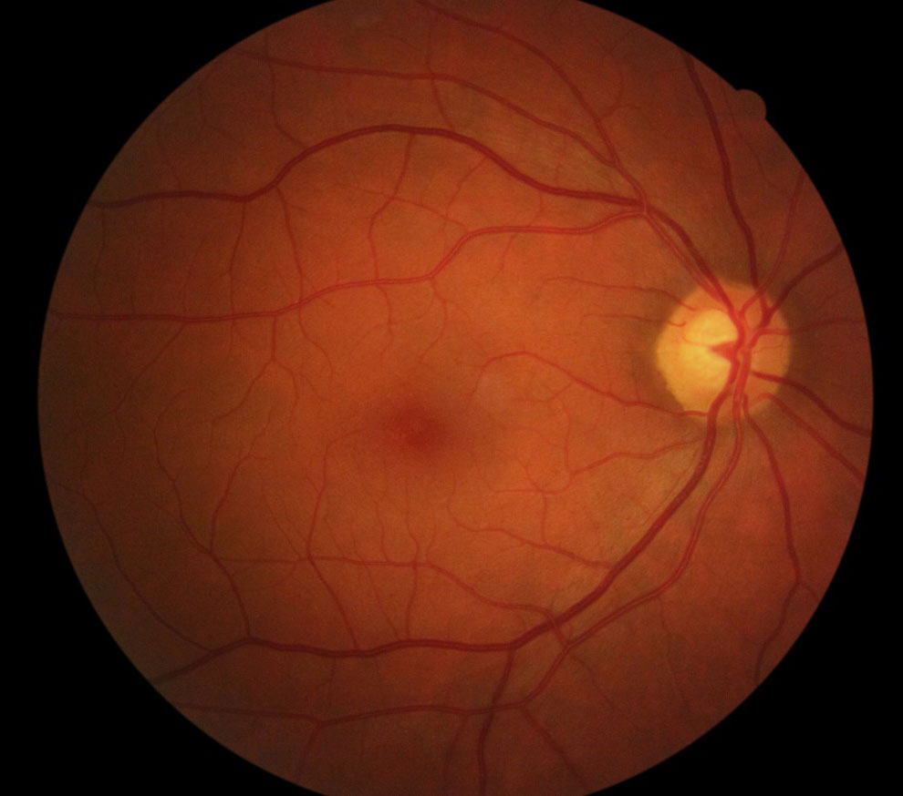
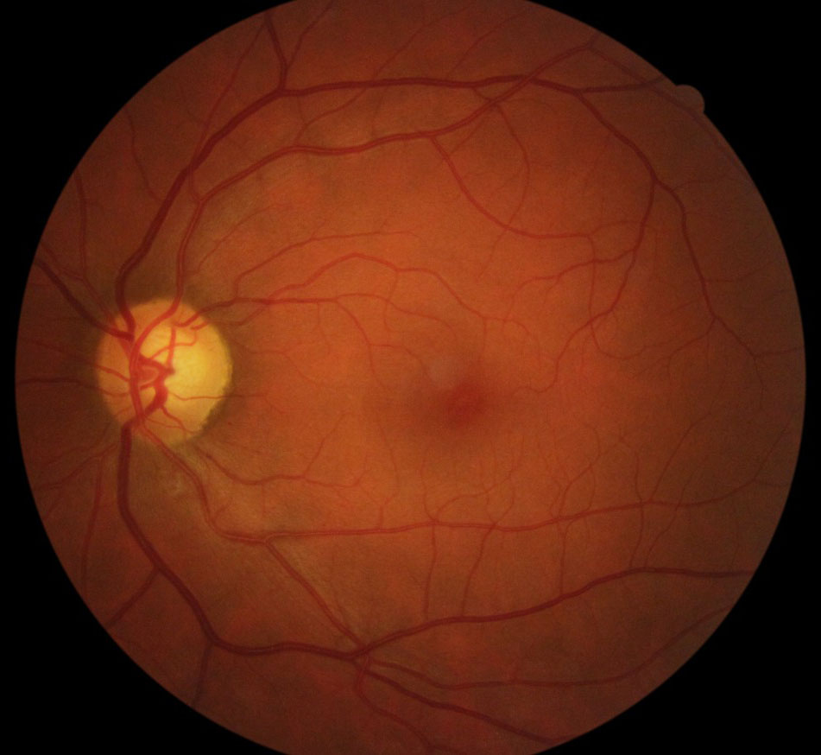
Data and preprocessing trials
Each notebook is described by its implemented approach, not file name
Patient-level split
6,094
764
754
Train patients
Validation
Test patients
No patient overlap across splits
Paired fundus images per patient
Median age imputation and numeric standardization
Nine tabular variables retained: age, sex, diabetes, optic disc, vessels, macula, macular edema, drusens, myopic fundus
Trials: 5-class DR_ICDR, grouped 3-class severity, partial oversampling, focal/class-aware learning, threshold calibration

Slide 5
Implemented Model 2 architecture
Architecture diagram styled for the research article
Key design: image encoder handles retinal evidence, tabular MLP handles clinical variables, and GAT handles patient-neighbor topology.

Slide 6
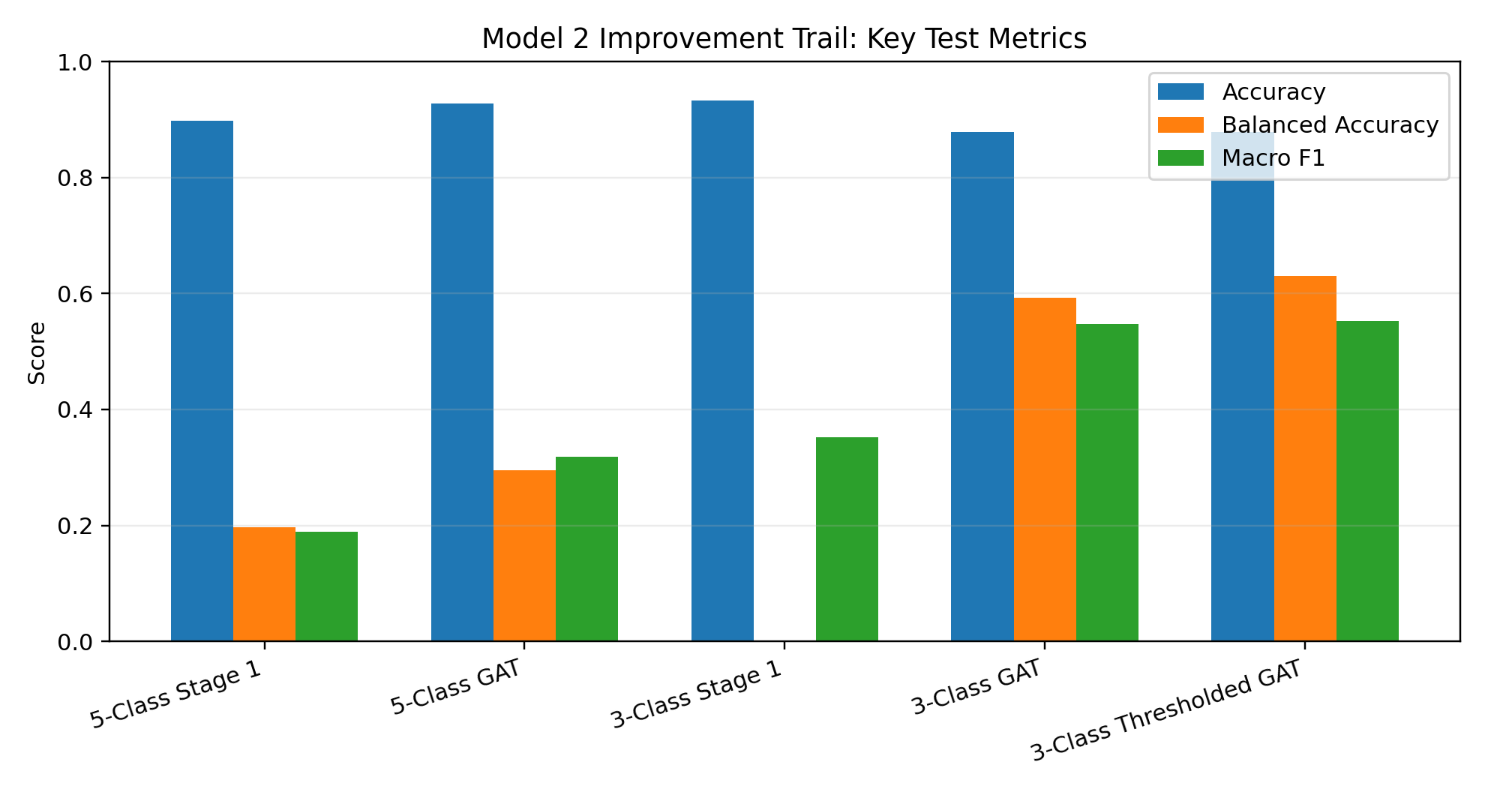
Improvement trail
The final model was chosen by severity-aware metrics, not raw accuracy only
Main findings
5-class kept fine DR_ICDR detail but remained sparse
3-class grouping improved balanced and macro behavior
GAT outperformed Stage 1 on macro validation
Severe-threshold tuning raised recall without reducing accuracy

Slide 7
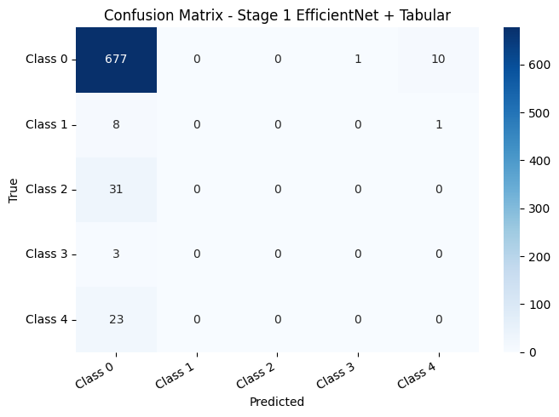
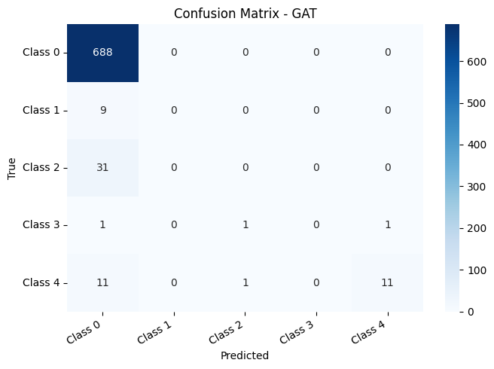
Full 5-class DR_ICDR experiment
Important because it shows why class grouping was needed
5-class key metrics
Stage 1: Acc 0.8979 | Macro F1 0.1894
GAT: Acc 0.9271 | Macro F1 0.3184
Balanced Acc improved 0.1968 -> 0.2957
Stage 1 confusion matrix
GAT confusion matrix
Interpretation: the graph model helped, but the 5-class setting still predicted mostly No DR because several minority classes had extremely low support.

Slide 8
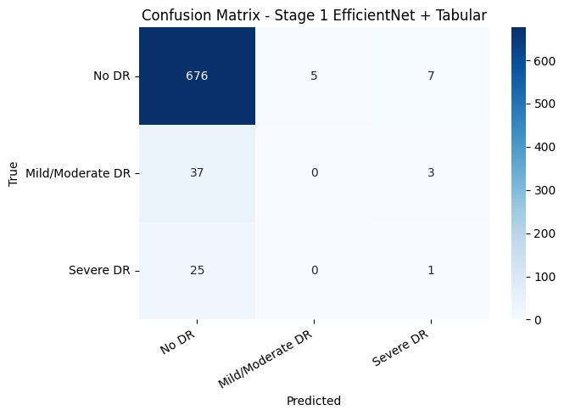
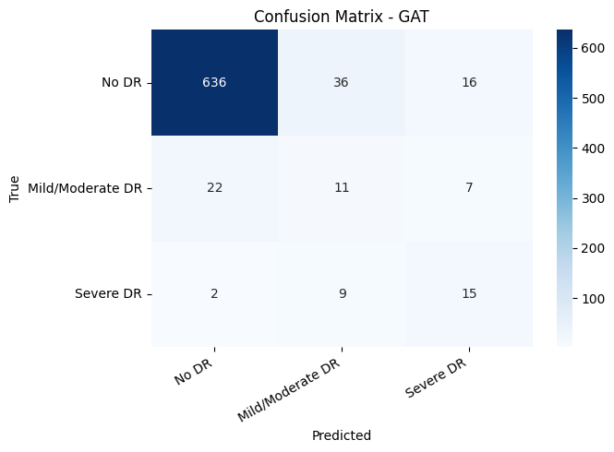
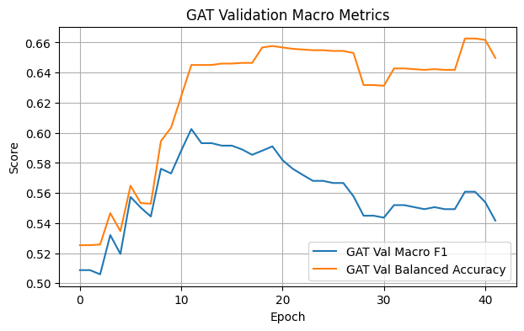
Grouped 3-class severity model
No DR / Mild-Moderate DR / Severe DR
Stage 1 confusion matrix
GAT confusion matrix
GAT validation macro metrics
0.878
0.592
0.547
GAT Accuracy
Balanced Acc.
Macro F1

Slide 9
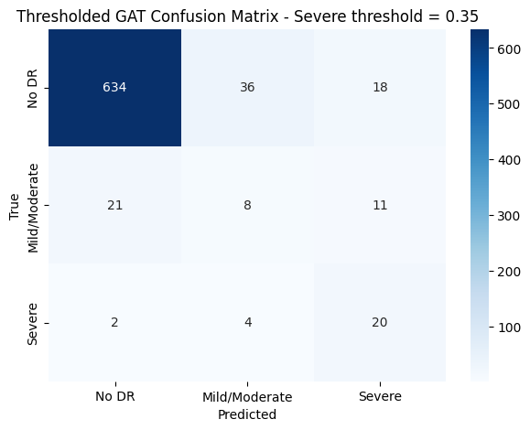
Severe-recall threshold calibration
A clinically useful operating point
Thresholded GAT (thr = 0.35)
0.878
0.630
0.553
Accuracy
Balanced Acc.
Macro F1
Severe DR recall: 0.5769 -> 0.7692
Severe F2: 0.5282 -> 0.6536
Predicted severe count: 38 -> 49
Trade-off: keep accuracy stable while making severe DR misses less likely.

Slide 10
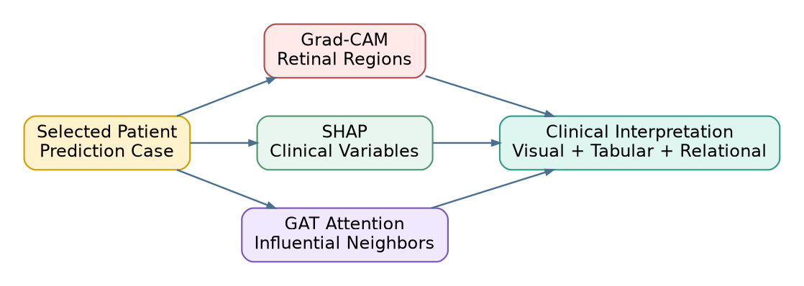
XAI design: three explanation layers
Visual, clinical, and graph-relational interpretability
Grad-CAM
image regions
SHAP
clinical drivers
GAT attention
influential neighbors

Slide 11
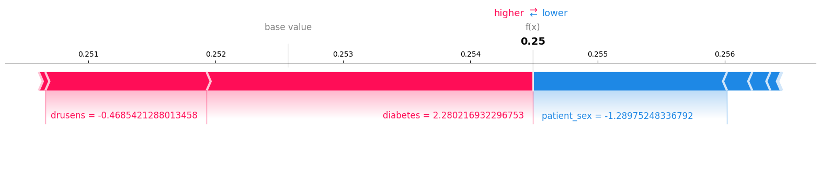
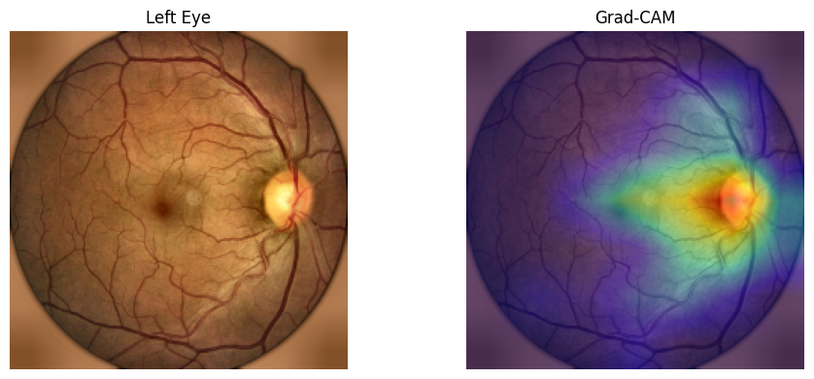
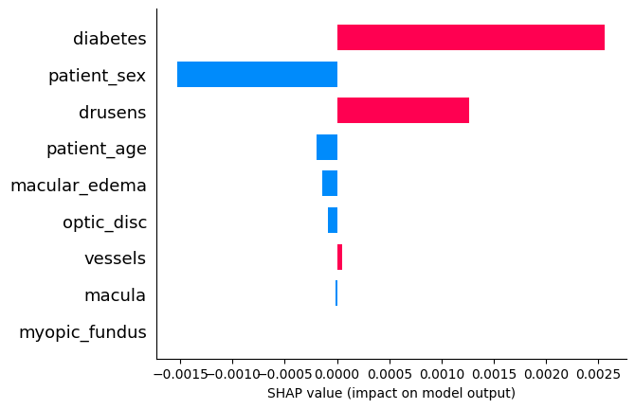
XAI outputs embedded in the research paper
Examples produced from the implemented model
Left eye Grad-CAM
Right eye Grad-CAM
SHAP explanations for clinical variables
Interpretation: Grad-CAM localizes retinal evidence, SHAP quantifies clinical feature contributions, and attention identifies influential patient neighbors in the graph.

Slide 12
Discussion and conclusions
What the results mean for the research article
What improved
Next steps
Graph reasoning improved macro behavior compared with Stage 1
Grouping severity levels handled extreme DR_ICDR sparsity better
Thresholding increased severe DR recall without reducing accuracy
Compare GAT with GCN, GraphSAGE, and transformer-based graph encoders
Tune graph construction and probability calibration
Validate on an external dataset or cross-device split
Final takeaway: Model 2 is a publishable graph-based multimodal framework with metrics, architecture diagrams, and XAI evidence ready for a formal paper.

Slide 13
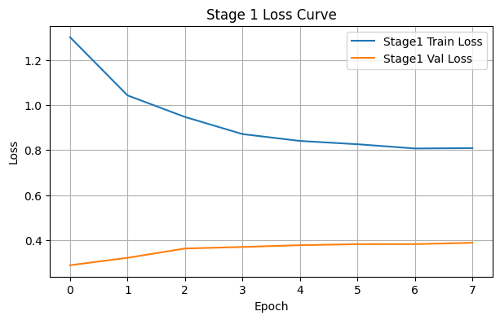
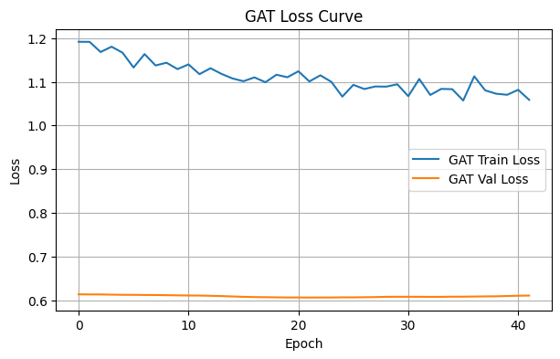
Appendix: training and validation curves
Included for completeness from the output graphs
Stage 1 loss curve
GAT loss curve
GAT validation macro metrics
The research paper appendix contains the full set of extracted metric graphs and output images.

