Slide 1
Pointers and I/O
Ali Ghaffarian

Slide 2
Table of Contents
Summary of Last Talk
Pointers
I/O
More Reversing
The Compilation Process

Slide 3
Summary of Last Talk

Slide 5
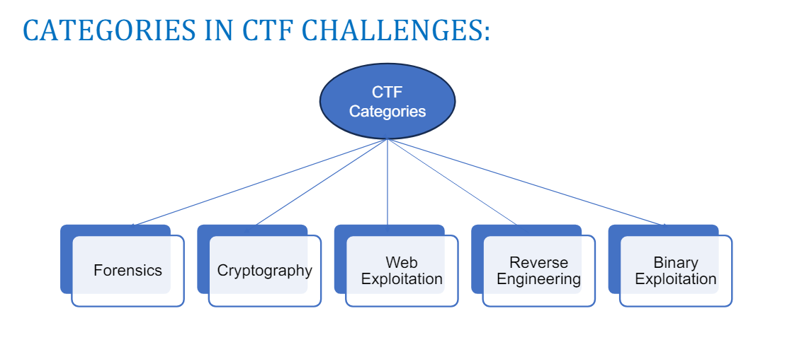
Categories

Slide 6
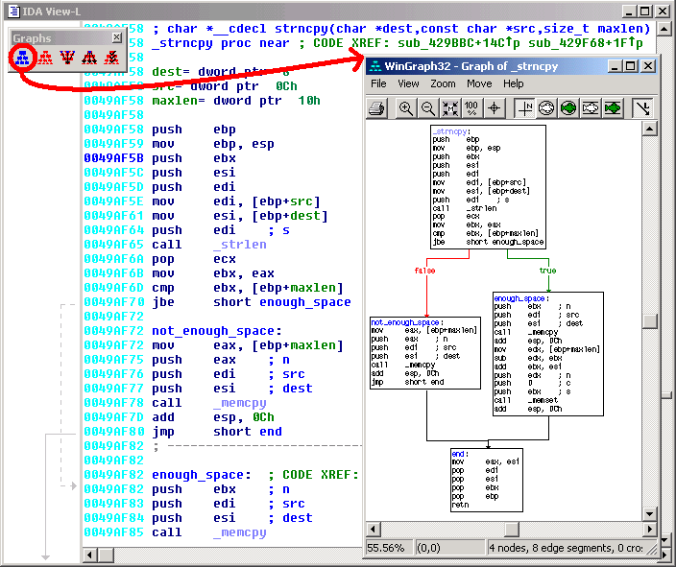
Reverse Engineering

Slide 7
Instances
Game Hacking
Malware Analysis
Cracking

Slide 8
Types of Analysis
Static vs Dynamic

Slide 9
Static Analysis

Slide 10
Tools
IDA
Ghidra
Dogbolt.org

Slide 11
Pointers
Address of Memory
int number = 0x55223344;
int *ptr_number = &number;
void *v_ptr_number = &number;
char *c_ptr_number = &number;

Slide 12
Pointer Types
?? | 0x0000009CF0FFF86C
0x0000009CF0FFF860 (8B) | 0x0000009CF0FFF874
0x0000009CF0FFF860 (8B) | 0x0000009CF0FFF86C
0x0000009CF0FFF860 (8B) | 0x0000009CF0FFF864
0x55 | 0x0000009CF0FFF863
0x22 | 0x0000009CF0FFF862
0x33 | 0x0000009CF0FFF861
0x44 | 0x0000009CF0FFF860
(ptr_number)
(v_ptr_number)
(c_ptr_number)
ptr_number
c_ptr_number

Slide 13
Demo
ptr.c, memory_view.c

Slide 14
Input/Output

Slide 15
File Descriptors
A handle for a I/O resource
Local to your program

Slide 16
FD’s
#include <fcntl.h>
int main(){
char buff[128] = {0};
int fd = open("./hello_world.txt", O_RDONLY, 0);
int read_bytes = read(fd, buff, sizeof(buff));
write(1 , buff, read_bytes);
}

Slide 17
File descriptor | offset | path | permissions
0 | 0 | [STDIN] | Read only
1 | 0 | [STDOUT] | Write only
2 | 0 | [STDERR] | Write only
open(“./hello_world.c“)
read(3)
write(1)
close(3)
‘\0’(0) | 0x0000009CF0FFF865
‘\0’(0) | 0x0000009CF0FFF864
‘\0’(0) | 0x0000009CF0FFF863
‘\0’(0) | 0x0000009CF0FFF862
‘\0’(0) | 0x0000009CF0FFF861
‘\0’(0) | 0x0000009CF0FFF860
buff

Slide 18
File descriptor | offset | path | permissions
0 | 0 | [STDIN] | Read only
1 | 0 | [STDOUT] | Write only
2 | 0 | [STDERR] | Write only
3 | 0 | ./hello_world.c | Read only
open(“./hello_world.c“)
read(3)
write(1)
close(3)
‘\0’(0) | 0x0000009CF0FFF865
‘\0’(0) | 0x0000009CF0FFF864
‘\0’(0) | 0x0000009CF0FFF863
‘\0’(0) | 0x0000009CF0FFF862
‘\0’(0) | 0x0000009CF0FFF861
‘\0’(0) | 0x0000009CF0FFF860
buff

Slide 19
File descriptor | offset | path | permissions
0 | 0 | [STDIN] | Read only
1 | 0 | [STDOUT] | Write only
2 | 0 | [STDERR] | Write only
3 | 3 | ./hello_world.c | Read only
open(“./hello_world.c“)
read(3)
write(1)
close(3)
‘\0’(0) | 0x0000009CF0FFF865
‘\0’(0) | 0x0000009CF0FFF864
‘\0’(0) | 0x0000009CF0FFF863
!(33) | 0x0000009CF0FFF862
i(105) | 0x0000009CF0FFF861
h(104) | 0x0000009CF0FFF860
buff

Slide 20
File descriptor | offset | path | permissions
0 | 0 | [STDIN] | Read only
1 | 0 | [STDOUT] | Write only
2 | 0 | [STDERR] | Write only
3 | 3 | ./hello_world.c | Read only
open(“./hello_world.c“)
read(3)
write(1)
close(3)
‘\0’(0) | 0x0000009CF0FFF865
‘\0’(0) | 0x0000009CF0FFF864
‘\0’(0) | 0x0000009CF0FFF863
!(33) | 0x0000009CF0FFF862
i(105) | 0x0000009CF0FFF861
h(104) | 0x0000009CF0FFF860
buff

Slide 21
File descriptor | offset | path | permissions
0 | 0 | [STDIN] | Read only
1 | 0 | [STDOUT] | Write only
2 | 0 | [STDERR] | Write only
open(“./hello_world.c“)
read(3)
write(1)
close(3)
‘\0’(0) | 0x0000009CF0FFF865
‘\0’(0) | 0x0000009CF0FFF864
‘\0’(0) | 0x0000009CF0FFF863
!(33) | 0x0000009CF0FFF862
i(105) | 0x0000009CF0FFF861
h(104) | 0x0000009CF0FFF860
buff

Slide 22
What about stdio?

Slide 23
Demo

Slide 24
More Reversing

Slide 25
The Compilation Process
Compile
Assemble
Link
#include <stdio.h>
int main(){
printf("hello world!\n");
}

Slide 26
Compile hello_world.s
lea rax, .LC0[rip]
mov rcx, rax
call puts
mov eax, 0
add rsp, 32
pop rbp
ret

Slide 27
Assemble hello_world.o
Contents of section .text:
0000 554889e5 4883ec20 e8000000 00488d05 UH..H.. .....H..
0010 00000000 4889c1e8 00000000 b8000000 ....H...........
0020 004883c4 205dc390 90909090 90909090 .H.. ]..........

Slide 28
Link
$dir
10/20/2025 05:38 PM 128,829 hello_world.exe
10/17/2025 05:55 PM 66 hello_world.c
10/20/2025 05:36 PM 882 hello_world.o
10/20/2025 05:34 PM 571 hello_world.s

Slide 29
Know Your Compiler!

Slide 30
So Much Added Code!
int WinMainCRTStartup(void);
int mainCRTStartup(void);
int32_t atexit(void (*func)(void));
int64_t __gcc_register_frame(void);
void __gcc_deregister_frame(void) __pure;
int64_t main(void);

Slide 31
Find the Relevant Code
int64_t main() {
__main();
puts("hello world!");
return 0;
}

