Slide 1

CTF Competitions
Ali Ghaffarian
May 4, 2025
<number>

Slide 2
About Me
FlagMotori member
CTF categories
Traffic analysis
Reverse engineering
pwn
Interested in
operating systems
computer networks
Github: github.com/AliGhaffarian

Slide 3

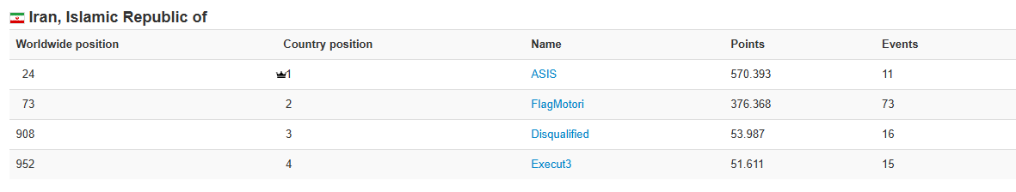
FlagMotori
2024 Ranking: 2nd in Iran, 73rd worldwide
Organized the Nowruz 1404 CTF

Slide 4
Table of content
What is CTF?
Types of CTF
Attack and Defense
Jeopardy
Types of CTF Challenges
How to Get Started
CTFtime Walk through

Slide 5
What is CTF?
<number>

Slide 6
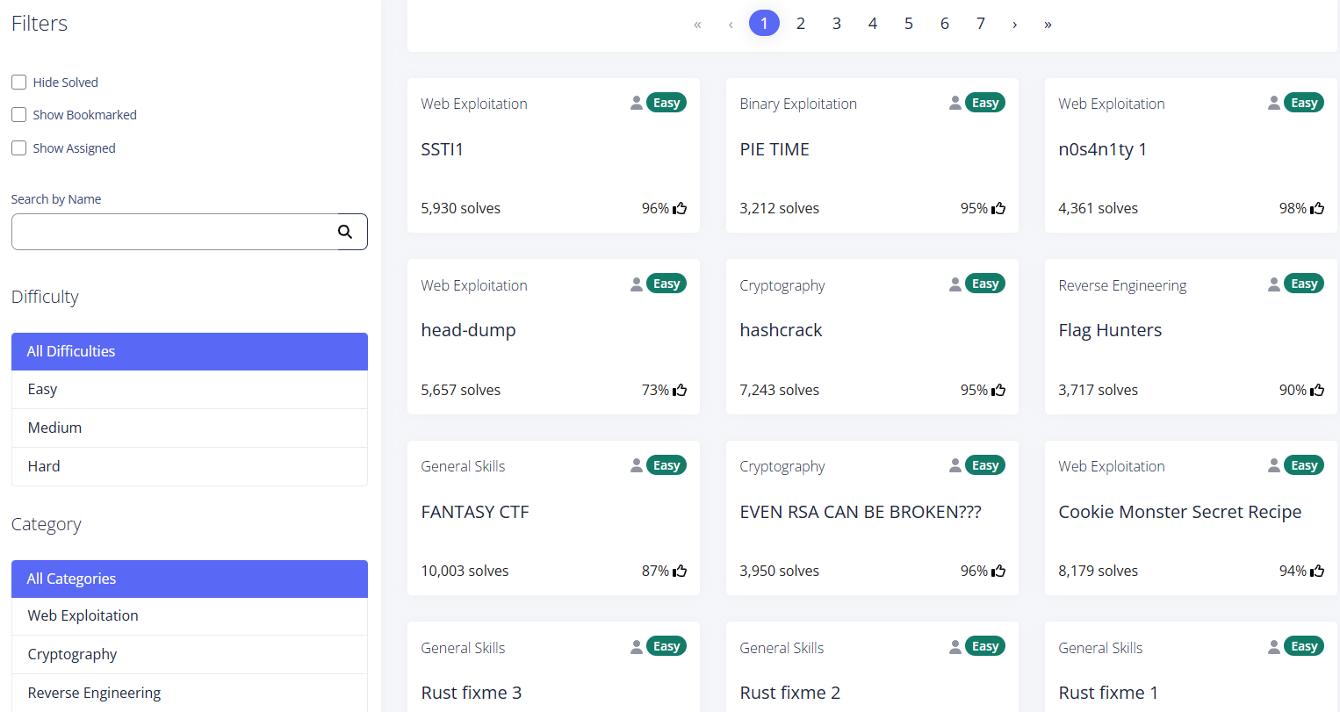
Jeopardy

Slide 7
Attack and Defense
Secure your server, attack other’s
Not as common as jeopardy
More complex and expensive

Slide 8
Types of CTF Challenges
Web Exploitation
Binary Exploitation (pwn)
Reverse Engineering
Cryptography
Misc

Slide 9
Web Exploitation
picoCTF-SQLiLite (2/10)

Slide 10
Binary Exploitation (pwn)
Nowruz 1404-Seen shopping (2/10)

Slide 11
Seens and quantities
Seen | Cost
Sabzeh | 30000
Senjed | 20000
Seer | 20000
Seeb | 10000
Samanu | 35000
Serkeh | 40000
Sekkeh | 80000000
quantity
0
1
2
3
4
0
6

Slide 12
Reverse Engineering
picoCTF- Transformation (1/10)

Slide 13
Misc
TFCCTF-bad-invaders (3/10)

Slide 14
TFCCTF-bad_invaders
server
Player
Bot

Slide 15
Player
struct Player {
int Id,
string Name,
int Position,
tcp_socket Connection
}

Slide 16
Generate playerId
int GenerateId() {
return rand.Intn(100)
}

Slide 17
playerExists logic
playerExists = false
for _, player in range game.Players {
if player.Connection == connection {
playerExists = true
break
}
}

Slide 18
Server’s logic
Read until ‘;’
If player is not registered, allow only register command
Get playerID from received message
Execute the command on playerID

Slide 19
Our Approach?
Player
server
Message(id = bot_id, command = move_left);
Player is registered (allowed to request commands)
Message contains id of bot
Server accepts message and executes the command

Slide 20
How to Get Started
writeups.fmc.tf
<number>

Slide 21
Some Tips
CTF is HARD!
Lookout for bad challenges

Slide 22
Thank You
<number>

