Slide 1
Jpeg Steganogaphy
Ali Ghaffarian

Slide 2
Table of Contents
Steganography
Jpeg
Discrete cosine transform
DCT Tables
My Approach
Demo

Slide 3
Steganography

Slide 4
Jpeg
Brightness vs Colors

Slide 5
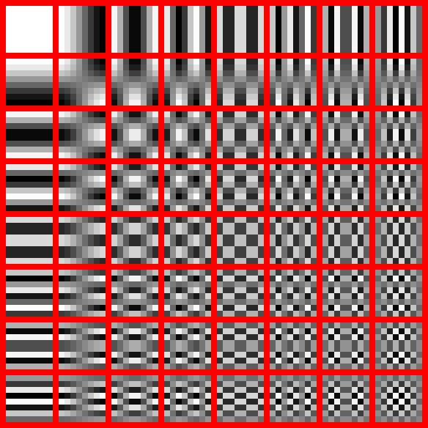
DCT Tables

Slide 6
My Approach
[[0 0 0 0 0 0 0 0]
[0 0 0 0 0 0 0 0]
[0 0 0 0 0 0 0 0]
[0 0 0 0 0 0 0 0]
[0 0 0 0 0 0 0 0]
[0 0 0 0 0 0 0 0]
[0 0 0 0 0 0 0 0]
[0 0 0 0 0 0 0 0]]
[[0 0 0 0 0 0 0 0]
[0 0 0 0 0 0 0 0]
[0 0 0 0 0 0 0 0]
[0 0 0 0 0 0 0 0]
[0 0 0 0 0 0 0 0]
[0 0 0 0 0 0 0 0]
[0 0 0 0 0 0 0 0]
[0 0 0 0 1 0 1 1]]

Slide 7
Structure of Data
Global_header {
uint4 length;
uint4 checksum;
}
Data_block {
char data[16];
uint4 checksum;
}

Slide 8
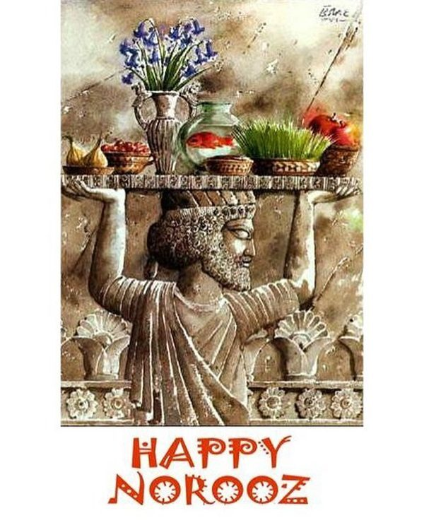

F: 0, 1, 2, 3
C: Y

Slide 9

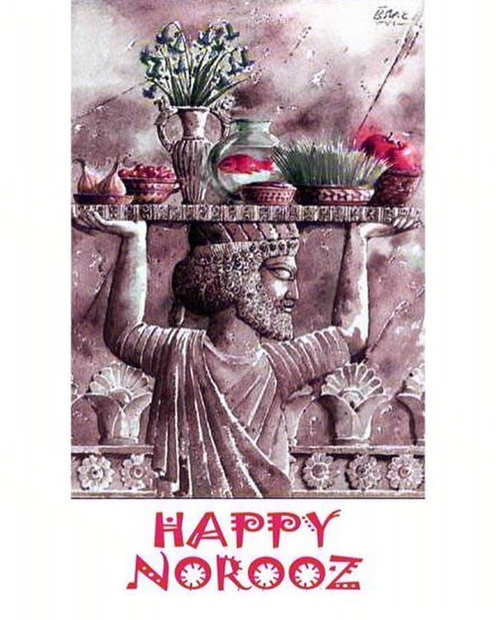
F: 0, 1, 2, 3
C: Cb

Slide 10
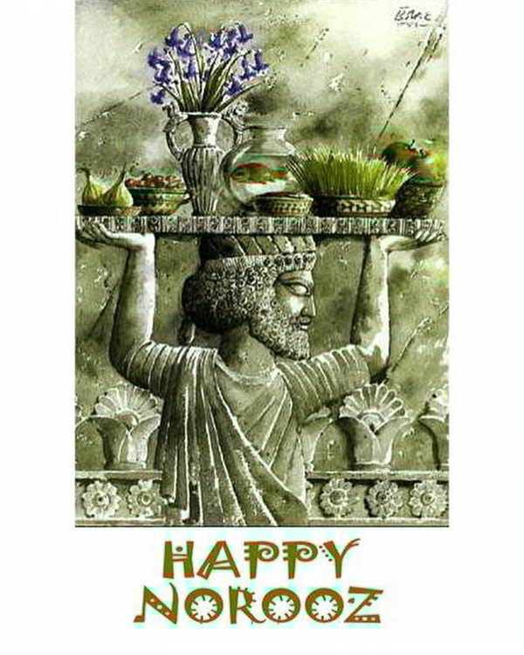
F: 0, 1, 2, 3
C: Cr

Slide 11

F: 1, 2, 3, 4
C: Y

Slide 12
F: 60, 61, 62, 63
C: Y

