Slide 1
MolParetoBO
Surrogate-assisted multi-objective molecular optimization
Master in AI for Drug Discovery — University of Salerno
Student: Ali Ghiami · Project 06
10–15 minute presentation

Slide 2
1. Why multi-objective?
• Drug candidates must balance many conflicting properties
• A single weighted score hides trade-offs
• Pareto optimization keeps undominated compromises
• Expensive oracles cannot evaluate every mutant
• Need: mutations + filters + surrogate + smart selection

Slide 3
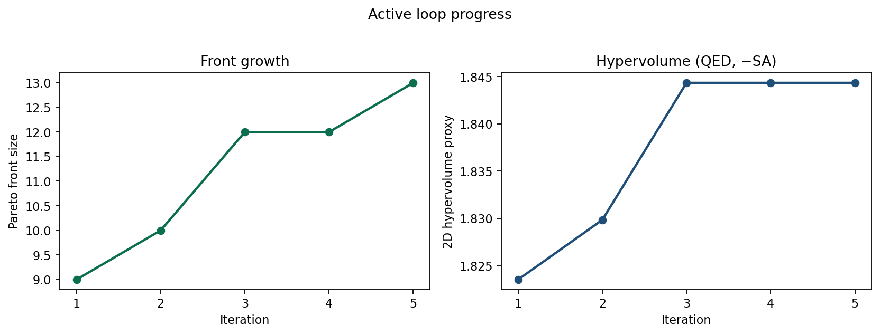
2. Pipeline at a glance
• Seed → RDKit mutations → suitability filters
• Oracle scores 5 endpoints (QED, SA, logP, logS, Tox)
• Surrogate (RF on Morgan fingerprints) predicts cheaply
• Pareto front shows trade-offs
• Acquisition picks the next batch (quality + uncertainty + diversity)

Slide 4
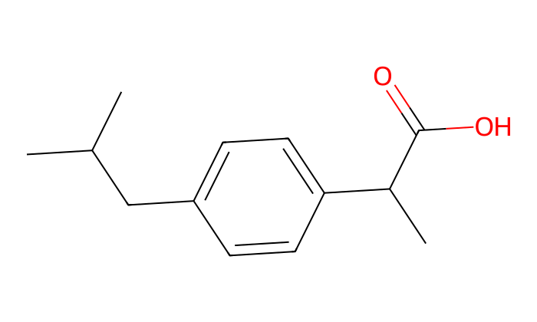
3. Seed & endpoints
• Seed: ibuprofen (one molecule first, then extend)
• QED ↑ · SA ↓ · logP ~ 2.5 · logS ↑ · Tox ↓
• Oracles are computational proxies (student setting)
• Toxicity is a teaching heuristic — stated explicitly
• SoftMining-style workflow; public seed for reproducibility

Slide 5
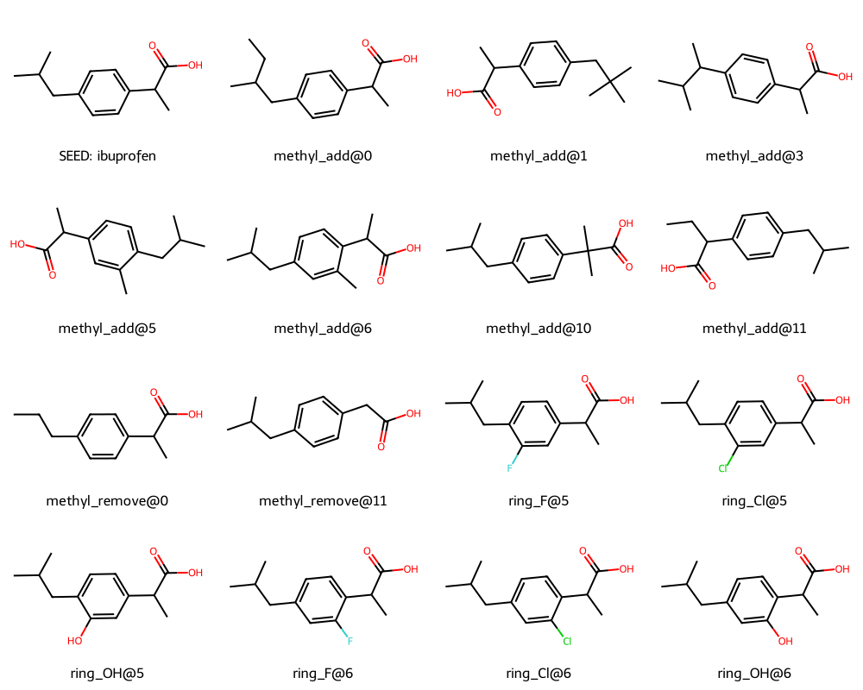
4. Mutations + suitability
• Methyl add/remove and ring F/Cl/OH/Me
• After mutation: sanitize, deduplicate, MW, QED gates
• kept column = suitability decision
• Gen-2 mutants enlarge surrogate training data
• Interactive widgets: tune QED filter and re-run live

Slide 6
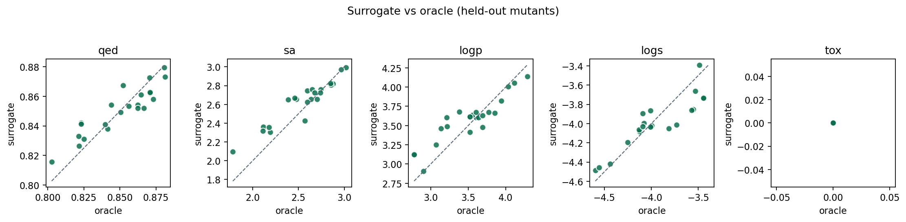
5. Surrogate model
• Morgan fingerprints (radius 2, 2048 bits)
• Multi-output Random Forest for 5 endpoints
• Hold-out MAE / R² reported honestly
• Small chemical neighbourhood → limited generalization
• Retrained inside the active loop as labels arrive

Slide 7
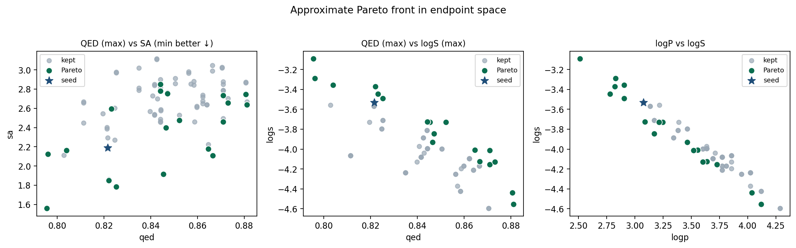
6. Pareto front
• Maximize: +QED, −SA, −|logP−2.5|, +logS, −Tox
• Non-dominated molecules = approximate front
• No single ‘best’ compound — trade-offs are the result
• 2D projections for interpretation
• Hypervolume proxy monitors progress

Slide 8
7. Acquisition & active loop
• acquisition = α·quality + β·uncertainty + γ·diversity
• Select top-k → oracle label → retrain → update front
• 5 iterations demonstrated in the notebook
• Widget lets you change α/β/γ live
• Simplified alternative to full qEHVI (proposal-friendly)

Slide 9
8. Discussion — strengths
• End-to-end reproducible workflow (local + Colab)
• Clear scientific framing of multi-objective trade-offs
• AI components: representations, learning, active selection
• Interactive demos verification
• Honest limits stated for evaluation criteria

Slide 10
9. Discussion — limits
• Computational oracles ≠ wet-lab assays
• Tox proxy is pedagogical, not validated toxicology
• Local chemistry around ibuprofen
• RF tree variance ≠ calibrated Bayesian uncertainty
• 2D HV monitor understates full 5-D volume

Slide 11
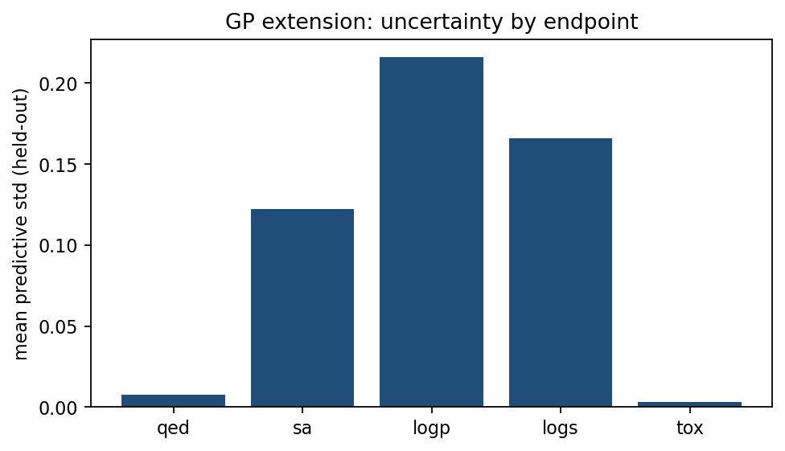
10. Extensions — GP
• PCA on fingerprints → Gaussian Process
• Endpoint-wise predictive standard deviation
• Drop-in uncertainty for acquisition
• Scales better than raw 2048-D GP on small N
• Runnable in the notebook (Section 10A)

Slide 12
10b. Tools & interactive widgets
• RDKit · scikit-learn · pymoo · NumPy/pandas/matplotlib
• ipywidgets Control Panel: 5 one-click checks
• 1 filters · 2 inspect · 3 surrogate · 4 acquisition · 5 Pareto
• Runs on local Jupyter or Google Colab
• Details: Appendix B in the notebook / report
Open notebook → Run all → Section 8c → click buttons 1–5

Slide 13
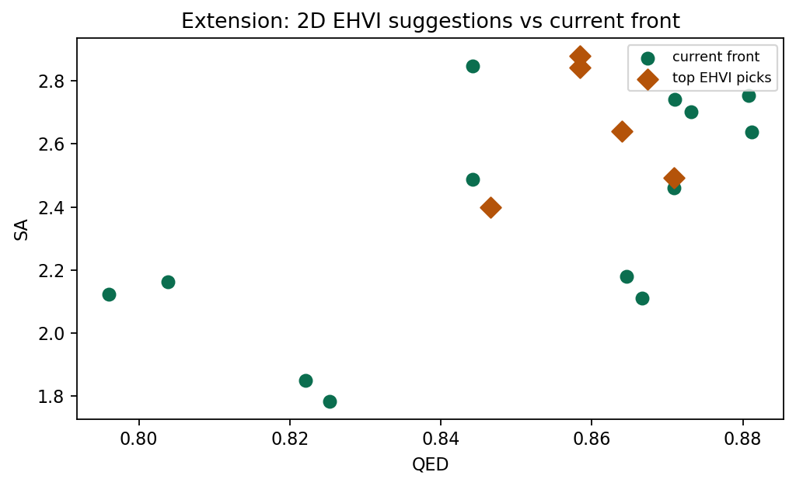
11. Extensions — NSGA-II & EHVI
• NSGA-II: non-dominated sorting + crowding on mutant pool
• Keeps a diverse elite subset of the front
• 2D EHVI: Monte Carlo expected hypervolume improvement
• Suggests candidates that grow the front
• Full qEHVI (BoTorch) listed as future work

Slide 14
12. Conclusions
• Built a teaching-scale MolParetoBO loop
• Mutate → filter → score → surrogate → Pareto → acquire
• Results are trade-off sets, not one winner
• Extensions show path to research-grade BO
• Ready for SoftMining / tutor seeds next
Questions? · Notebook: MolParetoBO_Report.ipynb · Report: MolParetoBO_Report.pdf

