Slide 1
Responsive Web Design

Slide 2
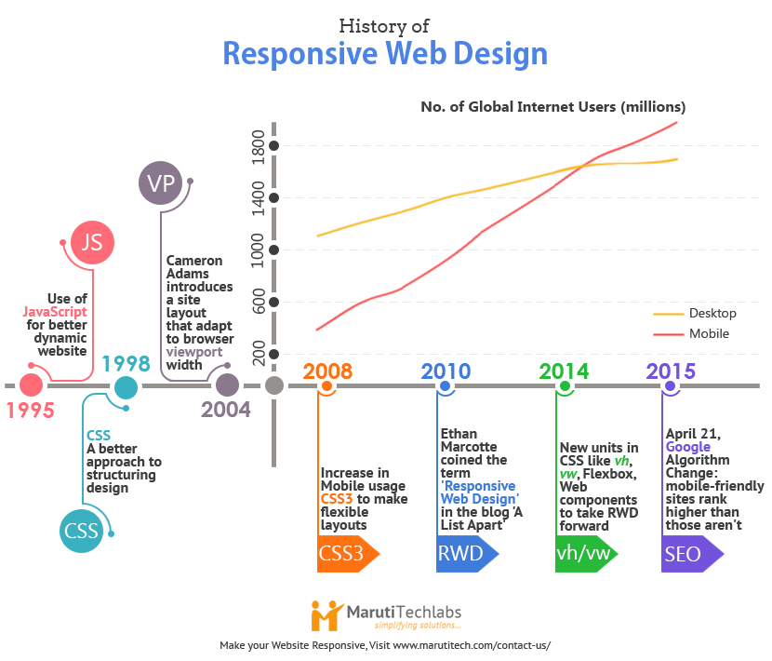

Slide 3
RWD – Key enablers
Identified in article by Ethan Marcotte (2010)
Fluid grids (relatively sized)
Flexible images (resizable)
Media queries (viewport information)
https://alistapart.com/article/responsive-web-design

Slide 4
RWD – Media Query
body {
background-color: lightblue;
}
@media screen and (min-width: 400px) {
body {
background-color: lightgreen;
}
}
@media screen and (min-width: 800px) {
body {
background-color: lavender;
}
}

Slide 5
RWD – Breakpoints
A breakpoint is a viewport width (in pixels)
By using a media query, a styling rule can be switched on/off at a breakpoint
No standard for breakpoints
Bootstrap 4 breakpoints:
576px
768px
992px
1200px

Slide 6
RWD – approach
Design for mobile-first
On small (narrow) devices: need-to-know
On larger devices: need-to-know + nice-to-know
Typical features
Orientation change
Order change
Image replacements
Show/hide blocks

