Slide 1
WP Classic - Review
HTML, CSS, JS and DOM

Slide 2
Example: TestHTML4 (no CSS)
Hello, 1991 ☺

Slide 3
Example: TestHTML4 (no CSS) - review
Only an index.html file (plus image files)
Structure defined by HTML, but…
…minimal indication of purpose (mostly <p> and <hx> tags)
…HTML also used to control layout (e.g. by <br> and <table> tags)
Very limited interactivity (<a> tags only)

Slide 4
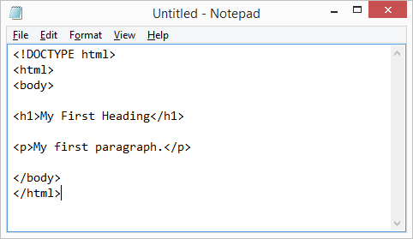
HTML (Hyper-Text Markup Language)
Defines (ideally) the structure of the data contained on a web page
Structure defined by tags; data within a tag has a certain meaning.
Examples: <p>, <h1>, <h3>, <ul>,…
Need more info? -> https://www.w3schools.com/html/default.asp

Slide 5
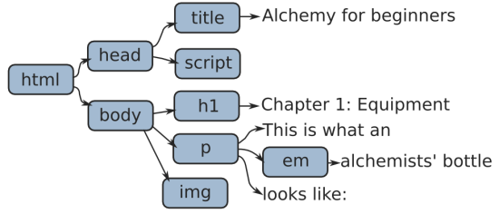
DOM (Document Object Model)
The HTML contained in a web page defines a DOM
DOM: Document Object Model
When page is loaded, the browser builds the DOM based on the HTML contained in the page.
The DOM is an object tree.

Slide 6
HTML
(structure)
(layout)
(interactivity)
DOM

Slide 7
Example: TestHTML4
Hello, 1995 ☺

Slide 8
Example: TestHTML4 - review
Still only an index.html file (plus image files)
index.html now also contains CSS style definitions
Structure defined by HTML, but…
…minimal indication of purpose (mostly <p> and <hx> tags)
…HTML also used to control layout (e.g. by <br> and <table> tags)
Very limited interactivity (<a> tags only)
Some separation of structure and presentation, via CSS
CSS: Cascading Style Sheets

Slide 9
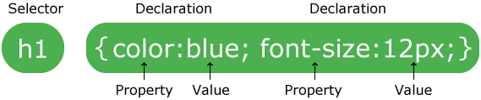
CSS (Cascading Style Sheets)
A language describing the style (i.e. presentation) of HTML elements.
A stylesheet contains a collection of style rules.
A style rule contains:
A selector
A declaration block, which contains a set of declarations

Slide 10
CSS Selectors
A CSS selector will ”select” a set of HTML elements in the DOM
All HTML elements matching the selector will be affected by the styling defined in the declaration block.
Examples:
Element (or tag) selector: h1 {…}
Id selector: #centralText {…}
Class selector: .alert {…}
Combinations, like p.alert {…}
Grouping, like p, h1, #special {…}

Slide 11
CSS Style declarations
A style declaration will consist of:
A property.
A value for the property.
Syntax: { name-of-property : value-of-property}.
A style rule body can contain several style declarations.
Examples:
h1 { color : red }
h1 { color : red, text-align : center, margin-top : 40px }

Slide 12

CSS3
CSS3 is the latest CSS standard.
Brings several new features, including
More advanced styling functionality (e.g. animations, which would previously require JS)
More flexible layout management with FlexBox.
Media queries, enabling device-dependent styling (aka Responsive Web Design)
Need more info? -> https://www.w3schools.com/css/default.asp

Slide 13
Example: RoundedCornerShadows
NB: Drop –webkit prefix in CSS.

Slide 14
HTML
(structure)
(layout)
(interactivity)
CSS
(layout)
DOM

Slide 15

HTML5
Ideally, HTML should not in any way define the presentation of a web page
Ideally, tags like <b>, <br> and <font> should not be part of HTML
Enter HTML5…

Slide 16
HTML5
Noteworthy new elements in HTML5:
Semantic tags: <header>, <footer>, <article>, <section>, <summary>, etc..
Graphics and Media tags: <canvas>, <svg>, <audio>, <video>, etc..
APIs: Geolocation, Local Storage, Web Workers,…

Slide 17
HTML5
A number of layout-oriented HTML tags have also been declared as deprecated in HTML5, like:
<font>
<big>
<u>
<center>
Need more info? -> https://www.w3schools.com/html/html5_intro.asp

Slide 18
Example: SemanticTag
Hello, 2019 ☺

Slide 19
HTML(5)
(structure)
(interactivity)
CSS
(layout)
DOM

Slide 20
Interactivity and JavaScript
Plain HTML does not provide much interactivity
Links
Input forms (but no ”logic” behind)
What is ”interactivity” really…?
User acts…
…and something changes on the web page
In more technical terms:
User causes an event to occur…
…DOM is updated in response to event

Slide 21

JavaScript
JavaScript was originally intended to enable web page interactivity, by programmatically changing the DOM.
The DOM can be accessed through the document variable.
Various functions are available for manipulating the DOM.
Example: https://www.w3schools.com/js/tryit.asp?filename=tryjs_event_onclick1

Slide 22
JavaScript
JavaScript can be written
Inside tags (typically event handlers)
Inside .html documents (inside <script> tags)
In separate files
JavaScript is now used much more broadly than for simple page interactivity scripting.
React and Angular are examples of JavaScript frameworks
Need more info? -> https://www.w3schools.com/js/default.asp

Slide 23
HTML(5)
(structure)
CSS
(layout)
DOM
JavaScript
(behavior)

Slide 24
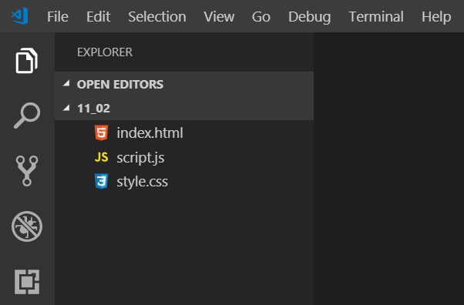
Summary
HTML defines the structure of a web page
CSS defines the layout of a web page
JavaScript defines the behavior of a web page

