Slide 1
Web Programming
international class

Slide 2
Touchdown!
This is the 4th semester elective course Web Programming (WP)
I am Per Laursen, and I will be teaching this course
It is Thursday, February 7th@ 0900; this is the time the course starts every Thursday
The website for the course is here:
http://perl-easj.dk/WP4SemDatF19.html
The language for the course is English

Slide 3

Touchdown!
I am Per Laursen, and I will be teaching this course
Website: perl-easj.dk
GitHub: github.com/perl-easj

Slide 4
Touchdown!
Bio (short ☺)
1967: Born
1994: Ph.D. Computer Science
1995-2008: Software Developer private sector
2008-now: Teacher Zealand (Z3414nd…)
See (a bit) more on perl-easj.dk/about.html

Slide 5
Today
Outline for today
Before lunch: Overview of course, presentation/repetition of a few introductory topics (mostly me)
Lunch break 11.30-12.15, otherwise breaks when it fits in…
After Lunch: Warm-up/repetition exercise (mostly you).
Around 14.15: Wrap-up of exercise

Slide 6
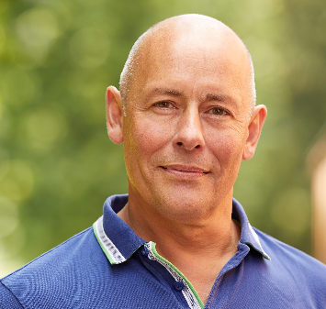
Credits
My co-worker Henrik Høltzer has been teaching this course for some years (also this semester – Danish class)
I’m teaching this course for the first time, so I’m – with Henrik’s permission – using a lot of Henrik’s materials
Powerpoints, exercises, links, etc..
Credit to Henrik for creating these materials!

Slide 7
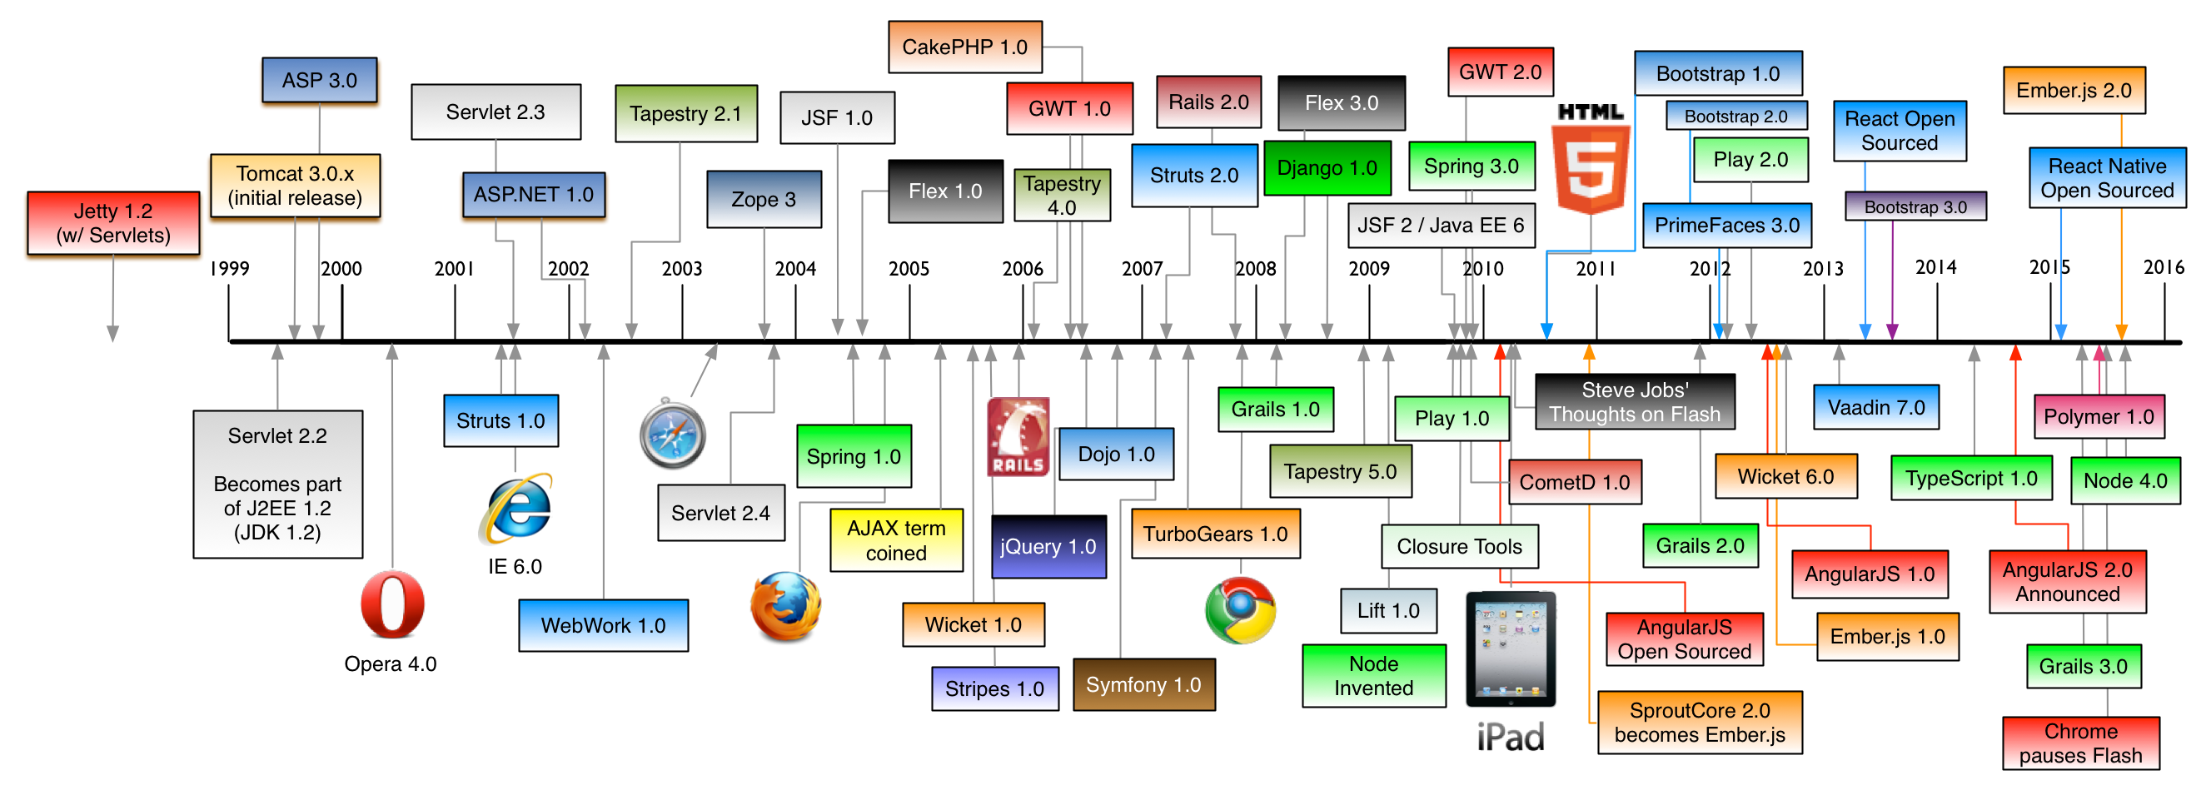
Web Programming, what a mess…

Slide 8
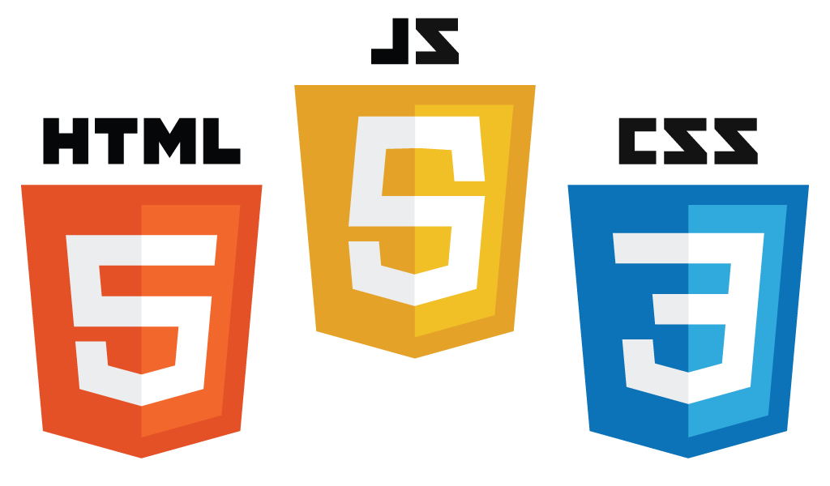












We will ”zoom in” on (some of) these…
Angular 7

Slide 9
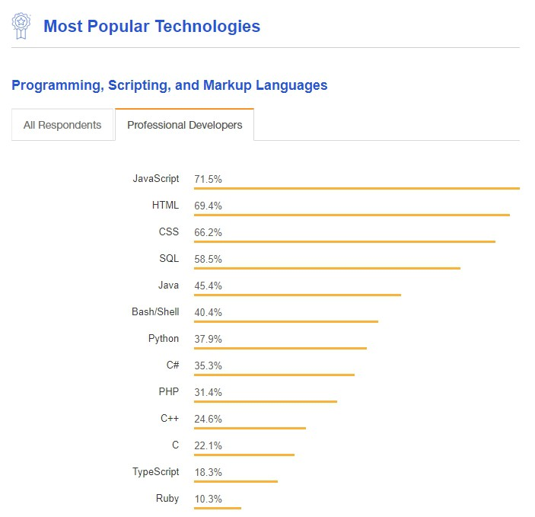
Is JavaScript still popular?
Stack Overflow´s survey 2018

Slide 10
Top-level overview of WP course
Topics | Weeks | Details
Light Front-End dev. | 6+7(+8) | Old-school HTML/CSS, HTML5/CSS3, Responsive Web Design, Bootstrap
Deeper JS/TS | 8 | Advanced JS, TypeScript
Server-side Tech | 9 | Node.js+Express, NPM, WebPack
WP with React | 10+11 | React, Redux, …
WP with Angular | 12+13 | Angular, RxJS, …
Mandatory Assignment | 14 | Work on assignment during class
Full-Stack | 15 | MongoDB, FireBase, MEAN, MERN, FERN

Slide 11
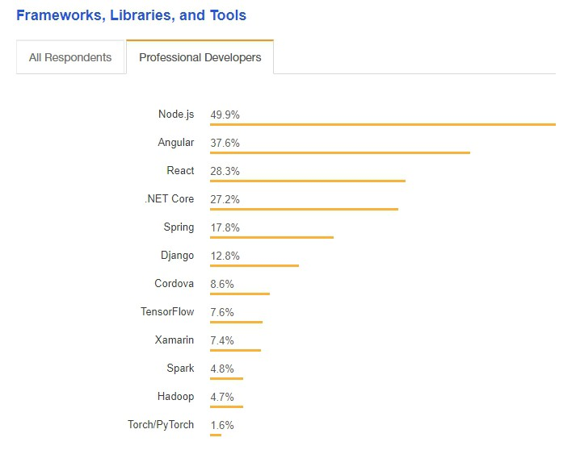
Why Node, Angular and React?
Stack Overflow´s survey 2018

Slide 12
Server-Side Templating
Client
(Browser)
HTML/DOM Generation
Business Logic
Data
Storage

Slide 13
Server-Side Templating
Client
(Browser)
HTML/DOM Generation
Business Logic
Data
Storage
User visits page…

Slide 14
Server-Side Templating
Client
(Browser)
HTML/DOM Generation
Business Logic
Data
Storage
HTTP Request to server

Slide 15
Server-Side Templating
Client
(Browser)
HTML/DOM Generation
Business Logic
Data
Storage
(server gets information needed for HTML generation)

Slide 16
Server-Side Templating
Client
(Browser)
HTML/DOM Generation
Business Logic
Data
Storage
New HTML document returned

Slide 17
Server-Side Templating
Client
(Browser)
HTML/DOM Generation
Business Logic
Data
Storage
User clicks link on page…

Slide 18
Server-Side Templating
Client
(Browser)
HTML/DOM Generation
Business Logic
Data
Storage
…and it all starts over

Slide 19
Server-Side Templating
Client-side
processing
Server-side
processing
Client
(Browser)
HTML/DOM Generation
Business Logic
Data
Storage

Slide 20
Single-Page Application
Client
(Browser)
HTML/DOM Generation
Business Logic
Data
Storage

Slide 21
Single-Page Application
Client
(Browser)
HTML/DOM Generation
Business Logic
Data
Storage
User visits page…

Slide 22
Single-Page Application
Client
(Browser)
HTML/DOM Generation
Business Logic
Data
Storage
(server gets information needed for HTML generation)

Slide 23
Single-Page Application
Client
(Browser)
HTML/DOM Generation
Business Logic
Data
Storage
New HTML document returned…

Slide 24
Single-Page Application
Client
(Browser)
HTML/DOM Generation
Business Logic
Data
Storage
…but now framework (e.g. React/Angular) kicks in!

Slide 25
Single-Page Application
Client
(Browser)
HTML/DOM Generation
Business Logic
Data
Storage
Subsequent ”data requests” are not HTTP document requests!

Slide 26
Single-Page Application
Client
(Browser)
HTML/DOM Generation
Business Logic
Data
Storage
User clicks link on page…

Slide 27
Single-Page Application
Client
(Browser)
HTML/DOM Generation
Business Logic
Data
Storage
Framework updates HTML document!

Slide 28
Single-Page Application
Client
(Browser)
HTML/DOM Generation
Business Logic
Data
Storage
Framework may need to invoke web ”services”

Slide 29
Single-Page Application
Client-side processing
(using a framework)
Server-side
processing
Client
(Browser)
HTML/DOM Generation
Business Logic
Data
Storage

Slide 30
SST vs SPA
Client
side
Server
side
Client
side
Server
side
HTTP Requests for entire HTML document
HTTP Requests for
data only

Slide 31
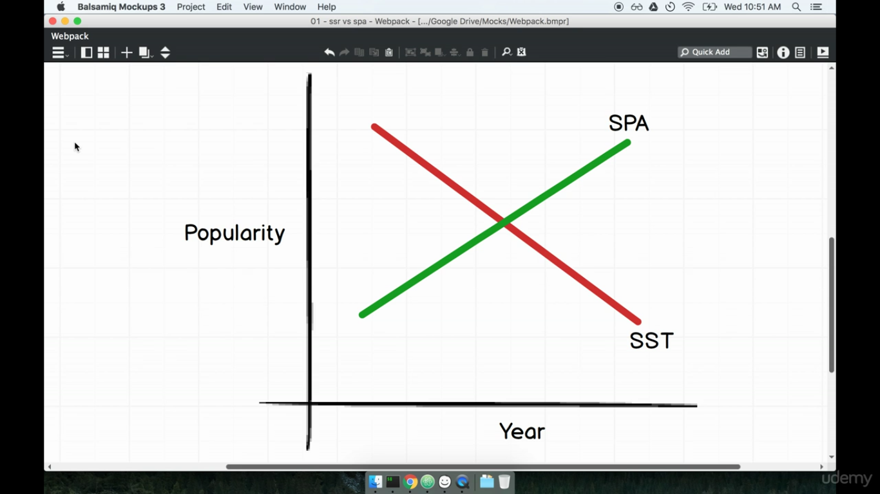

Slide 32
BUT!
There’s quite a lot of debate over SST vs SPA!
SPA should relieve server load => better scalability…
…but also puts a larger burden on the client side.
How ”stable” are current SPA-frameworks?
How ”dynamic” are your web pages?
What about SEO?
This course will focus on SPA-enabling technology…but SST-enabling technology is not dead…

Slide 33
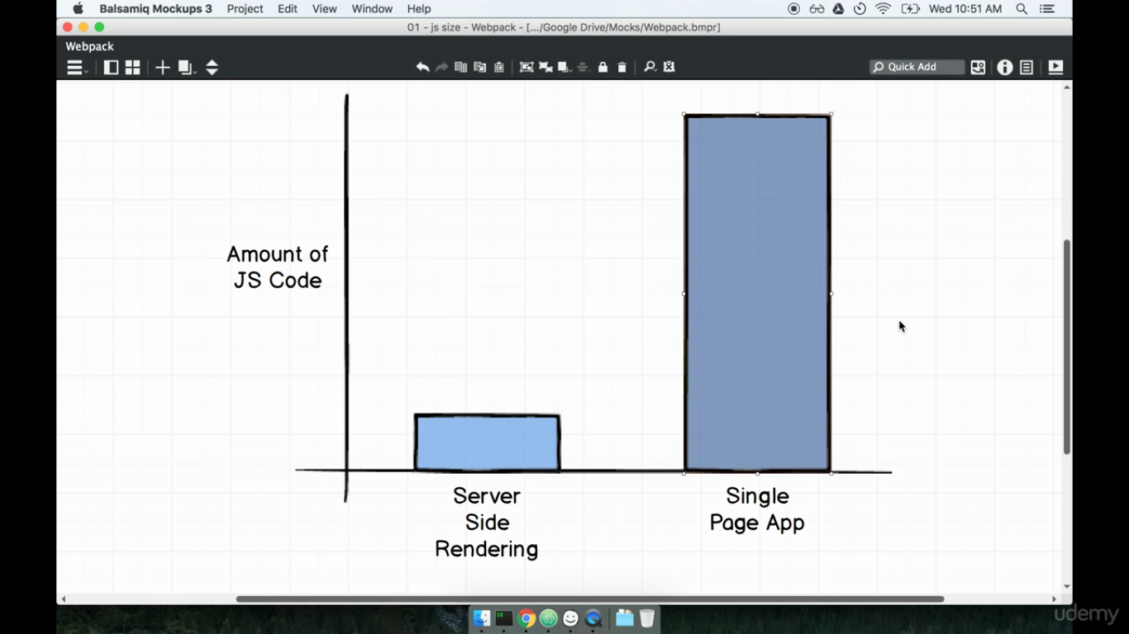

Slide 34
Tools
The recommended main development environment will be Visual Studio Code
Useful extensions:
Live Server (version 5.3.x)
IntelliSense for CSS, SCSS class names in HTML and Slim (version 1.2.x)
vscode-icons (version 8.x)
Prettier (version 1.8.x)
If you prefer something else: no problem, but no help either ☺

Slide 35
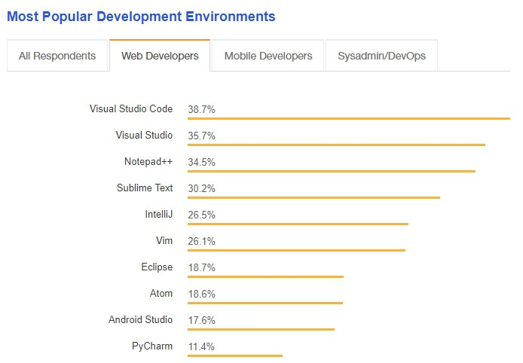
Why Visual Studio Code?
Stack Overflow´s survey 2018

Slide 36
General style of course
This is an elective course – you have chosen it!
It will not be ”gas pump learning” – you sit still and listen while I pour knowledge into your heards…
A lot of high-quality material available online.
You are expected to be self-motivated, self-driven, curious to learn more
I will not act as a motivator or policeman; it is up to you if you want to gain something from the course.

Slide 37
General style of course
My role
Provide an overview
Provide useful, selected examples
Collect and provide references to relevant materials
Facilitate class discussions about solutions
Your role
Diving into details, using various materials (typically online)
Work on exercises; this is where you actually learn something ☺
Be willing to engage in class disussions about solution propo-sals (this includes exposing your own suggestions for solutions)

Slide 38
General style of course
There is no ”curriculum” as such… No books that you must buy.
We will make recommendations about materials, some of which are behind paywalls.
For this course: you must pass a mandatory assignment.
For the electives in general: Write synopsis during May, oral exam in June.

Slide 39
Rules of Engagement (for exercises)
I prefer – but do not insist – that you work in pairs.
Two: best, one: OK, three: well, two is better…
Sit where you like (classroom, group rooms, …)
No policing; you’re here to learn, right…?
BUT: classroom itself is ”business-only”
In the classroom we work on exercises
If you’re not working: keep it quiet
Take a break when you need a break.

Slide 40


