Slide 1
Angular
(version 7)

Slide 2
Credits
Many of the illustrations are taken from Henrik Høltzer’s ”Angular PIXI-book”

Slide 3
Angular – what is it?
Yet another JavaScript…
…framework?
…library?
Angular is probably more a framework than a library, since it dictates application structure in more detail than e.g. React.

Slide 4
Angular – what is it?
Central unit of functionality is a component
A module consists of a set of components; your own App is (usually) a single module
A component is made up of a set of files
A template file: contains HTML-like markup defining the presentation of component
A class file: contain a TypeScript class defining the logic for the component
A style file: contains component-specific CSS styling.

Slide 5
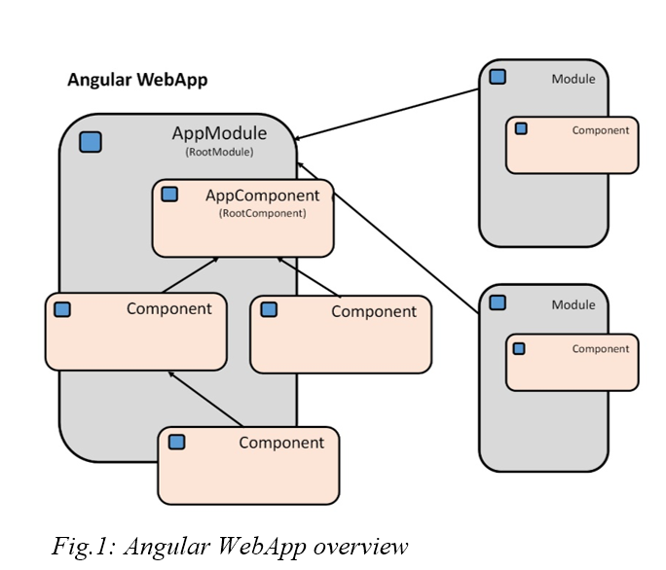

Slide 6
Angular – getting started
First step is to install the Angular CLI (CLI: Command-Line Interface)
> npm install -g @angular/cli
It will take a while…

Slide 7
Angular – getting started
Once we have installed the Angular CLI, we can use it for generating (a scaffolding for) Angular apps
Go to the folder in which you want to keep Angular apps (NB: not the folder for the specific app; this will be generated for you)
Now do:
> ng new appname

Slide 8
Angular – getting started
Now do:
> ng new appname
NB: You should put the specific name of your app instead of appname
NB: You are prompted twice for a choice; just type return for both choices
A folder with the same name as your app is generated.

Slide 9
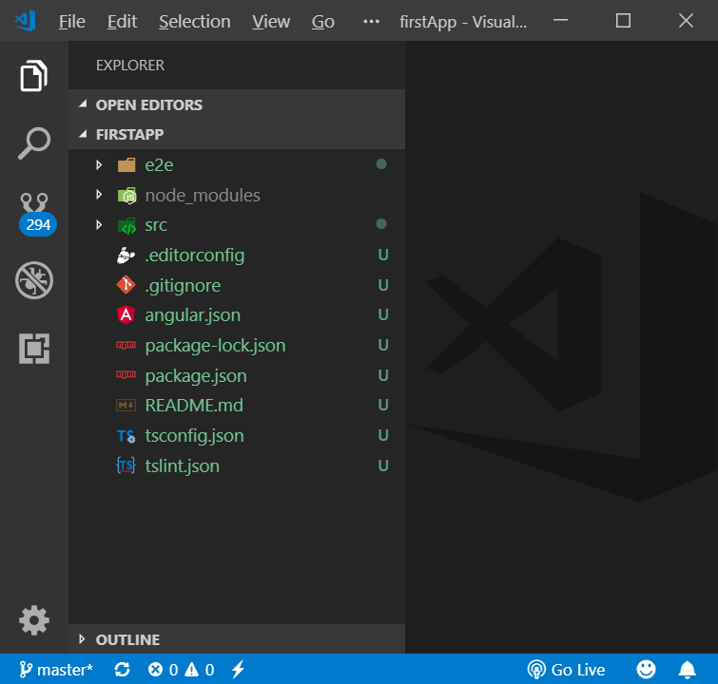
Angular – getting started
Open the newly created folder in Visual Studio Code
Should looks similar to this (this is an app named firstApp):

Slide 10
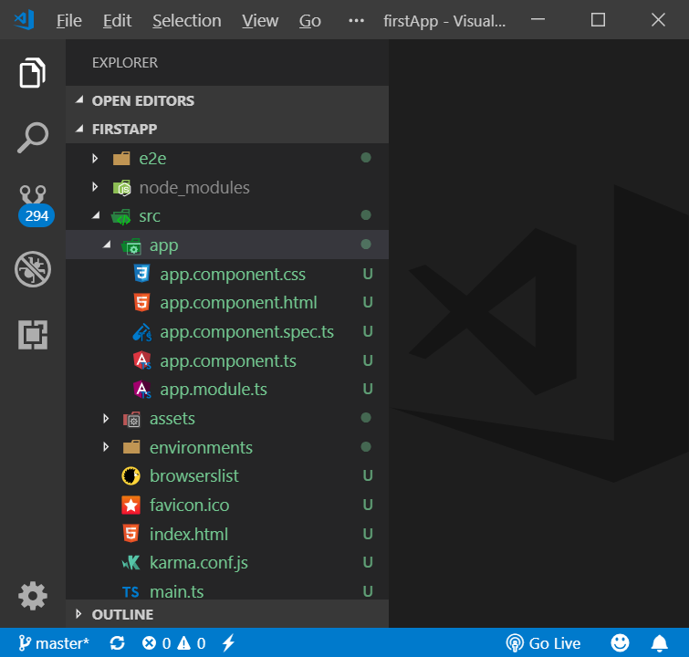
Angular – getting started
/src folder expanded.
/src/app folder expanded
We are (almost) only interested in the files in the /src/app folder

Slide 11
Angular – getting started
Open a terminal window (make sure you are in the app folder)
Then enter:
> ng serve -o
Wait a while (again…)
You should see two things…

Slide 12
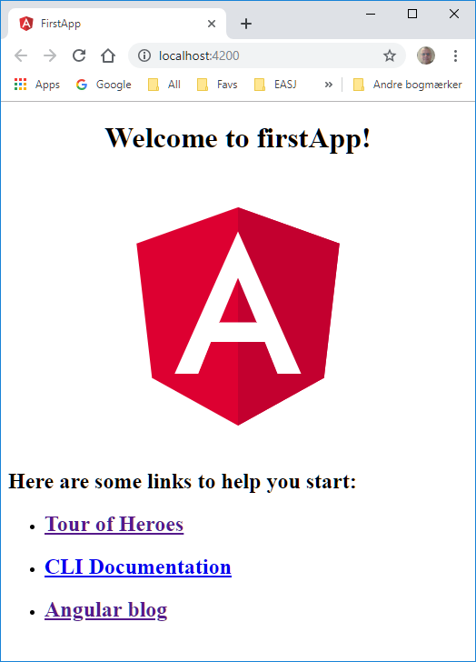
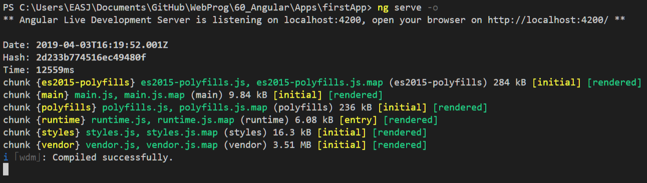
Angular – getting started
In terminal window
In browser

Slide 13
Angular – getting started
A ”development server” has been started by the tool, which now runs the Angular app
App is shown in browser, at localhost:4200
Whenever you make updates to the app, the app is reloaded into the browser!
Development server is shut down with Ctrl + C in terminal window

Slide 14
Angular – getting started
Initially, the application contains one component; the App component
.css: Component styling (initially empty)
.html: Component layout template (contains default code, can be cleared)
spec.ts. For testing; we will not use this file in our components.
.ts: Component data/logic, in the form of a TypeScript class

Slide 15
Angular – initial content of app.component.ts
import { Component } from '@angular/core';
@Component({
selector: 'app-root',
templateUrl: './app.component.html',
styleUrls: ['./app.component.css']
})
export class AppComponent {
title = 'firstApp';
}

Slide 16
Angular – getting started
The @Component part is metadata for the component
Called a decorator
Selector: the tag by which we can use the component
templateURLs + styleURLs: references to component template and style definitions
import { Component } from '@angular/core';
@Component({
selector: 'app-root',
templateUrl: './app.component.html',
styleUrls: ['./app.component.css']
})
export class AppComponent {
title = 'firstApp';
}

Slide 17
Angular – content of index.html
<!doctype html>
<html lang="en">
<head>
<meta charset="utf-8">
<title>FirstApp</title>
<base href="/"> <meta name="viewport" content="width=device-width, initial-scale=1">
<link rel="icon" type="image/x-icon" href="favicon.ico">
</head>
<body>
<app-root></app-root>
</body>
</html>

Slide 18
Angular – content of app.modules.ts
import { BrowserModule } from '@angular/platform-browser';
import { NgModule } from '@angular/core';
import { AppComponent } from './app.component';
@NgModule({
declarations: [
AppComponent
],
imports: [
BrowserModule
],
providers: [],
bootstrap: [AppComponent]
})
export class AppModule { }

Slide 19
Angular – content of main.ts
import { enableProdMode } from '@angular/core';
import { platformBrowserDynamic } from '@angular/platform-browser-dynamic';
import { AppModule } from './app/app.module';
import { environment } from './environments/environment';
if (environment.production) {
enableProdMode();
}
platformBrowserDynamic().bootstrapModule(AppModule)
.catch(err => console.error(err));

Slide 20
Angular – getting started
Starting an App:
index.html is served (as usual)
Will contain several .js imports, so js code is executed
Thereby, the code in main.js is executed
App is ”bootstrapped” with AppComponent as parameter
Selector for AppComponent is targeted with <app-root>
<app-root> is replaced with content from the component template.

Slide 21
Angular – getting started
We rarely – if ever – need to go into
index.html
main.ts
We may at times need to go into
app.modules.ts

Slide 22

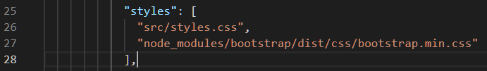
Angular – using Bootstrap for styling
Install Bootstrap in the application project as usual:
Open terminal window, go to app project folder
Run > npm install bootstrap jquery popper
Slightly tricky part:
Open the file angular.json at the root level
Around line 25-27, do this change (exactly as below):

Slide 24
Angular – creating a new component
We can create components ”manually”, BUT…
…MUCH easier to use tool!
For creating a new component named FirstComp, run the command > ng generate component FirstComp
More handy version: > ng g c FirstComp
Will create the new component in a folder named FirstComp, under /src/app

Slide 25
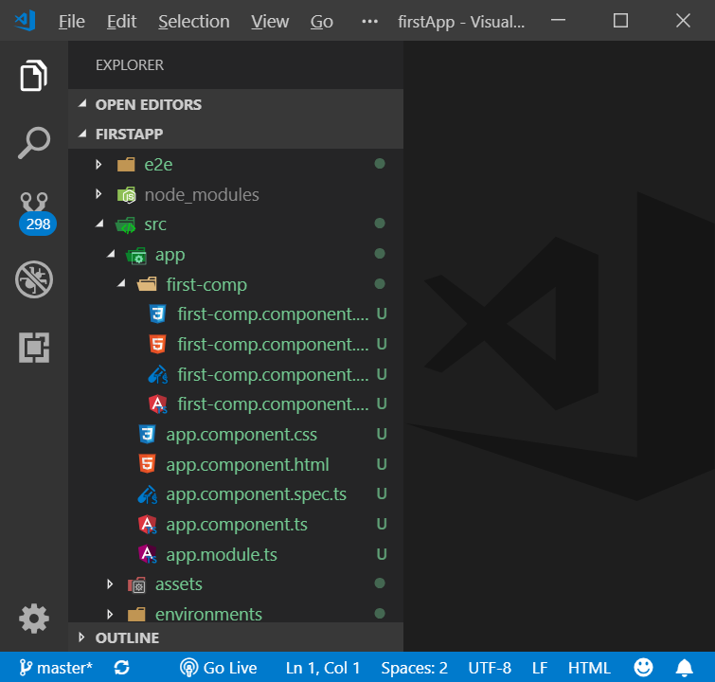
Angular – content of /src/app/FirstComp

Slide 26
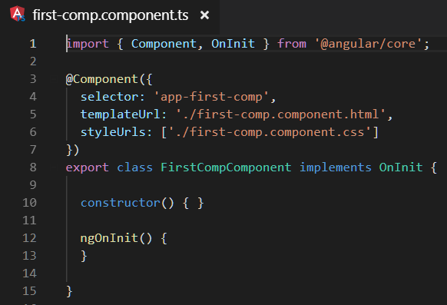
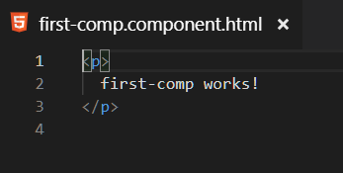
Angular – creating a new component
Using the tool also adds the new component to declaration in app.module.ts!

Slide 27
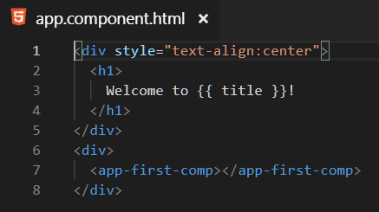
Angular – creating a new component
A component is then used by referring to it by its selector tag.

Slide 28
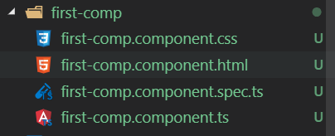
Angular – creating a new component
A new component contains (primarily)
.css: Component styling (initially empty)
.html: Component layout template (contains default code, can be cleared)
.ts: Component data/logic, in the form of a TypeScript class

Slide 29
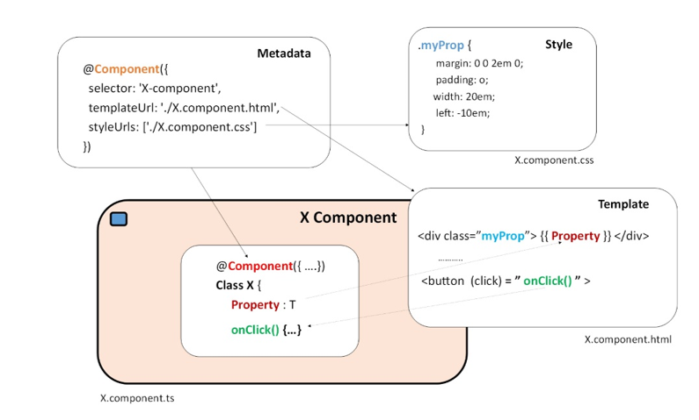

Slide 30
Angular – data binding
If the component does not contain any data, usage is very easy; just use selector tag in parent component.
Rarely the case…
If the component contains data, we need Data Binding

Slide 31
Angular – data binding
If the component contains data, we need Data Binding
Where will data be located? In the TypeScript class in the .ts file, as properties.
Class may also contain methods, which can be targeted with bindings as well
Two general categories of binding
Inside a component: between class and template
Between parent and child components

Slide 32
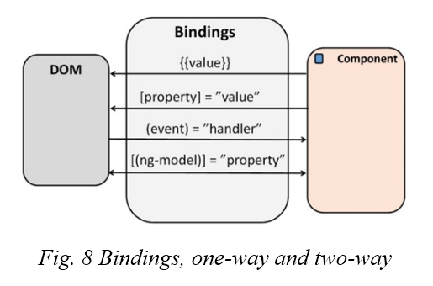
Angular – data binding
Types of binding
template interpolation
event binding
property binding
one-way binding
two-way binding

Slide 33
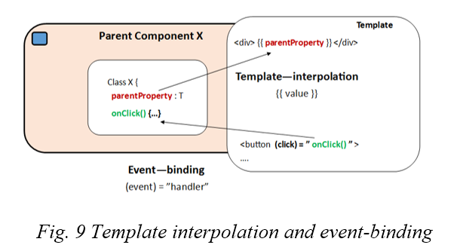
Angular – data binding
Template interpolation
In template, refer to a property using {{…}} syntax
{{ nameOfProperty }}

Slide 34
Angular – data binding
Event binding
We can bind a method to an event from an element in the template (e.g. a button)
Method is then an ”event-handler”, often named On[nameOfEvent]

Slide 35
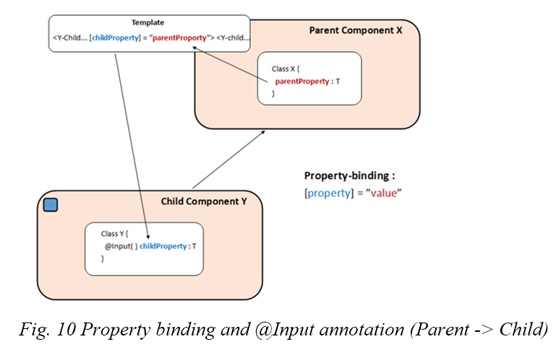
Angular – data binding
Property binding (@Input)
Used for passing data from parent component to child component.
In the parent component, we use the below syntax in the tag for the child component:
[childProp]=”parentProp”
NB: Child property must be decorated with @Input()

Slide 36
Angular – data binding
Event binding (@Output)
Used for passing data from child component to parent component.
A bit more involved…
In order to notify parent component of e.g. an updated property value, the child component must emit an ”event”.

Slide 37
Angular – data binding
In child
Child component defines a property of type EventEmitter.
NB: Property must be decorated with the @Output() decorator
Child component implements a method which will emit the event.
Emitting method is called when relevant, and takes a value as argument
The value may be of any relevant type
In parent
In template, the parent defines an event binding in the child tag.
The event binding binds to the property of type EventEmitter defined in the child component
The binding binds to a method defined in the parent, which is called with the argu-ment provided by the child
The bound-to method in the parent does what it needs to do…

Slide 38
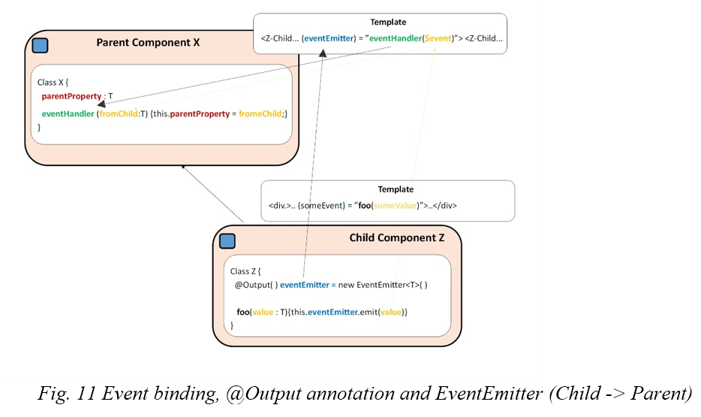
Angular – data binding

Slide 39
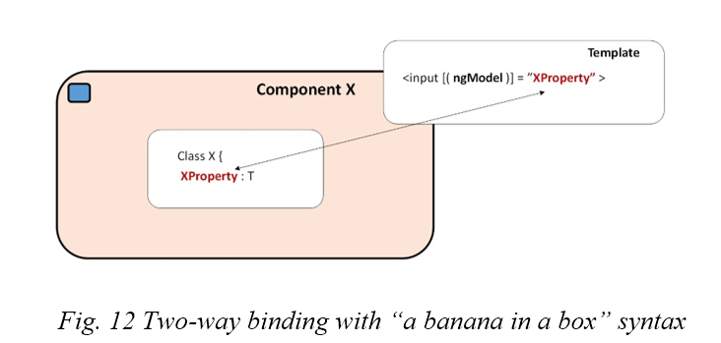
Angular – data binding
Two-way data binding
When is it relevant? When e.g. an input form is used to received data from the user.
Data needs to be ”pushed” from the form into the component
Uses the ”banana-in-a-box” syntax: [(ngModel)]=”propName”

Slide 40
Angular – services
A service is just a TypeScript class, which contains some sort of functionality we which to share across components.
Services can be seen as a form of ”model layer” for an Angular app, whereas components are more like the ”view-model layer”
Services can contain model data and/or business logic methods.

Slide 41
Angular – services
Services which only contain methods – i.e. no properties, and thus no state – are simple to use
Services which (also) contain data are a bit more complex to manage.

Slide 42
Angular – services
A service can be created using the Angular CLI:
Run > ng g s nameOfService
Will create the file nameOfService.service.ts, in the /src/app folder.
Service class is decorated with the @Injectable decorator

Slide 43
Angular – content of firstService.service.ts
import { Injectable } from '@angular/core';
@Injectable({
providedIn: 'root'
})
export class FirstServiceService {
constructor() { }
}

Slide 44
Angular – services
NB: A service is not used by directly creating new objects of the service class type!
Instead, service objects are injected into components
First step is to register the service as a ”provider” at a proper level in the component tree; often we will just register it at the ”root” of the component tree.
NB: All components will now share the same instance of the service object!

Slide 45
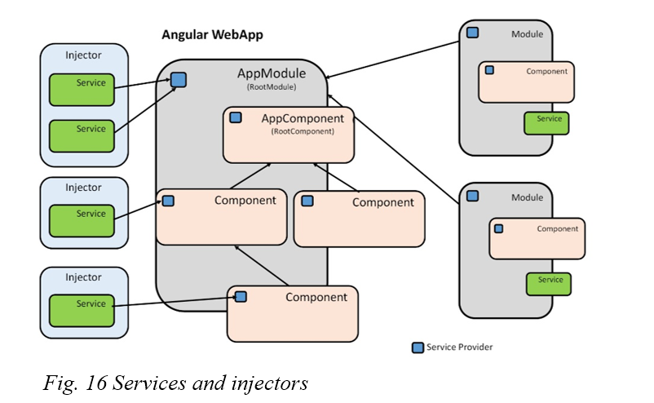
Angular – services

Slide 46
Angular – content of app.module.ts
import { BrowserModule } from '@angular/platform-browser';
import { NgModule } from '@angular/core';
import { AppComponent } from './app.component';
import { FirstCompComponent } from './first-comp/first-comp.component';
import { FirstServiceService } from './first-service.service';
@NgModule({
declarations: [
AppComponent,
FirstCompComponent
],
imports: [
BrowserModule
],
providers: [FirstServiceService],
bootstrap: [AppComponent]
})
export class AppModule { }

Slide 47
Angular – services
When service is registered, component can now use the (shared) service object.
Service object is now a parameter to component class constructor (service class must also be imported):
export class FirstCompComponent implements OnInit {
constructor(private theService: FirstServiceService) { }
}

Slide 48
Angular – directives
Angular directives can be used to control the HTML generation based on the component template.
Directives are applied to a tag in the template
Most common are two structural directives
*ngIf: conditional generation of HTML element
*ngFor: generation of multiple instances of HTML element.

Slide 49
Angular – directives
*ngIf: conditional generation of HTML element
Example: class contains movie property; only render if movie is not null.
<div *ngIf="movie">
<h3>Title: {{movie.Title}}</h3>
<h3>Year: {{movie.Year}}</h3>
</div>

Slide 50
Angular – directives
*ngFor: generation of multiple instances of HTML element.
Very useful whenever we need to render a collection.
In the template, we specify an iteration over a collection property from the class
<li *ngFor="let movie of movies" (click)="onSelect(movie)">
<span>{{movie.Title}} </span>{{movie.Year}}
</li>

Slide 51
Angular – directives
Angular also contains attribute directives
ngClass: sets the class attribute on an element, if a condition is true.
ngStyle: sets the style attribute on an element, if a condition is true.
More directives than these exist.
We can even define our own directives (a bit more advanced…)

Slide 52
Angular – routing
Angular routing is fairly similar to React.
Based on URL matching.
Typical approach: create a separate module for routing. If ”yes” option is chosen when generating a new App, a module app-routing.module.ts is created.

Slide 53
Angular – content of app-routing.module.ts
import { NgModule } from '@angular/core';
import { Routes, RouterModule } from '@angular/router';
const routes: Routes = [];
@NgModule({
imports: [RouterModule.forRoot(routes)],
exports: [RouterModule]
})
export class AppRoutingModule { }

Slide 54
Angular – content of app-routing.module.ts
import { NgModule } from '@angular/core';
import { Routes, RouterModule } from '@angular/router';
import { MovieListComponent } from './movie-list/movie-list.component';
import { MovieDetailComponent } from './movie-detail/movie-detail.component';
import { LoginComponent } from './login/login.component';
const routes: Routes = [
{ path: 'movie-list', component: MovieListComponent },
{ path: 'movie-detail/:Title', component: MovieDetailComponent },
{ path: 'login', component: LoginComponent },
{ path: '', redirectTo: '/movie-list', pathMatch: 'full' },
{ path: '**', component: MovieListComponent }
];
@NgModule({
imports: [RouterModule.forRoot(routes)],
exports: [RouterModule]
})
export class AppRoutingModule { }

Slide 55
Angular – routing
path: ‘movie-list’, component:‘MovieListComponent’
If we navigate to (baseURL)/movie-list, the component MovieListComponent will be rendered.

Slide 56
Angular – routing
path: ‘’, redirect-to: /movie-list, pathMatch: full
If we navigate to the ”root path”, we are redirected to the given URL. NB: pathMatch ensure that this is executed only for the root path.

Slide 57
Angular – routing
path: ‘movie-detail:Title’, component: MovieDetail-Component
If we navigate to e.g. (baseURL)/movie-detail/Se7ev, the component MovieDetailComponent will be rendered. The ”parameter” Se7en can then be retrieved in the component, and used for rendering.

Slide 58
Angular – routing
Navigation in template: use <a> tag, but do not use href for navigation! This will reload the entire App!
Instead, use routerLink:
<a routerLink=”/movie-list”>…</a>

Slide 59
Angular – routing
The place where the route – i.e. the component being matched to the current URL – should be rendered is defined by adding the <router-outlet> tag.

Slide 60
Angular – routing
<div>
<nav>
<a routerLink="/movie-list" routerLinkActive="active">Movies</a>
<a routerLink="/login" routerLinkActive="active">Login</a>
</nav>
</div>
<div class="container">
<router-outlet></router-outlet>
</div>

Slide 61
Angular – routing
We can also work with routing programmatically
Inject route-related services into component, typically ActivatedRoute and Router
Retrieve the currently active route (this.route.snapshot…)
Retrieve parameters to the URL (….snapshot.paramMap.get(…))
Navigate to new URL (this.router.navigate(…))

Slide 62
Angular – routing
export class MovieDetailComponent implements OnInit {
private movie: Movie;
constructor(private movieService: MovieService,
private route: ActivatedRoute,
private router: Router) { }
ngOnInit() {
this.movie = this.movieService.getMovie(this.route.snapshot.paramMap.get('Title'));
}
public gotoMovies() {
this.router.navigate(['/movie-list']);
}

Slide 63
Angular – invoking a Web Service
Angular contains the HTTPClient service.
Inject into a component to use
The component using the HTTPClient service will often itself be a service, providing data to other components.

Slide 64
Angular – invoking a Web Service
export class F1WebAPIService {
constructor(private httpService: HttpClient) { }
public getData(): Observable<IDriverData> {
return this.httpService.get<IDriverData>('http://ergast.com/api/f1/2019/drivers.json');
}
}

Slide 65
Angular – invoking a Web Service
Invoking a web service is pretty easy, BUT:
We need to define an interface which matches the type of the ”raw” data received
We also need to define an interface which matches the type of data we really want to retrieve
If the above are not identically, we need to implement a mapping of the data
All data is ”wrapped” into an Observable (an RxJS class)

Slide 66
Angular – invoking a Web Service
export interface IDriver {
driverId: string;
permanentNumber: string;
code: string;
givenName: string;
familyName: string;
dateOfBirth: string;
nationality: string;
}
export interface IDriverData {
MRData: {
DriverTable: {
Drivers: IDriver[];
};
};
}

Slide 67
Angular – invoking a Web Service
export class F1WebAPIService {
constructor(private httpService: HttpClient) { }
public getDrivers(): Observable<IDriver[]> {
return this.mapData(this.getData());
}
private getData(): Observable<IDriverData> {
return this.httpService.get<IDriverData>('http://ergast.com/api/f1/2019/drivers.json');
}
private mapData(data: Observable<IDriverData>): Observable<IDriver[]> {
return data.pipe(map(driverData => { return driverData.MRData.DriverTable.Drivers; }));
}
}

Slide 68
Angular – Observable
What is an Observable?
A class from the RxJS class library, so in principle not part of ”core” Angular.
An Observable makes it easy to e.g. wrap an asynchronous data source (like a web service invocation) into an object which can be passed around.
Invoking get on a HTTPClient returns an Observable<…>

Slide 69
Angular – Observable
The data wrapped by the Observable can be transformed.
We call the pipe method on an Observable object, with transformation functions like map as parameters.
NB: This is not the same as the map method for arrays…
private mapData(data: Observable<IDriverData>): Observable<IDriver[]> {
return data.pipe(map(driverData => { return driverData.MRData.DriverTable.Drivers; }));
}

Slide 70
Angular – Observable
Other parts of the application can then subscribe to changes in an Observable object.
ngOnInit() {
this.service.getDrivers().subscribe(data => this.drivers = data);
}

Slide 71
Angular – Observable
export class SimpleHttpServiceComponent implements OnInit {
private drivers: IDriver[];
constructor(private service: F1WebAPIService) { }
ngOnInit() {
this.service.getDrivers().subscribe(data => this.drivers = data);
}
}

Slide 72
Angular – Observable
<li *ngFor="let driver of drivers">
<h4>{{driver.givenName}} {{driver.familyName}}</h4>
</li>

