Slide 1
JavaScript
(advanced)

Slide 2
JS Advanced – Part 1
Lexical Environment (where code is written)
Hoisting (the two phases of JS execution)
Execution Context (the ”instance” of an environment a piece of code is executing within)
Scope Chain (the ”outer” environment for a piece of executing code)

Slide 3
JS Advanced – Part 1
Lexical Environment (where code is written)
Concerned with the physical position of code
A ”static” property of code
Outermost level is the global environment
Global = ”not inside a function” (or class)
[CODE]

Slide 4
JS Advanced – Part 1
Hoisting
Execution of JS is a two-phase operation:
Creation phase: set up memory space for variables, functions, etc.. No execution of code, nor initialisation of variables! All variables will be set to undefined.
Execution phase: the code is actually executed.
”Hoisting” is what happens in the creation phase.
[CODE]

Slide 5
JS Advanced – Part 1
Execution phase: the code is actually executed
Variables: values are assigned
Function invocation: more complicated…
Whenever a function is called (invoked), a new execution context is created.
Execution contexts are ”dynamic”, i.e. created at run-time.
Execution context != lexical environment

Slide 6
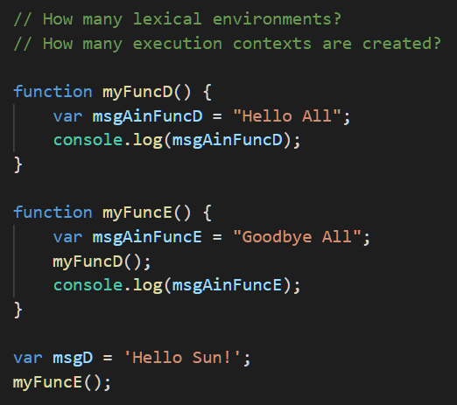

Slide 7
Execution Stack
Global Ex. Cont.
myFuncD
myFuncE
msgD

Slide 8
myFuncE() Ex. Cont.
Execution Stack
msgAinFuncE
Global Ex. Cont.
myFuncD
myFuncE
msgD

Slide 9
myFuncD() Ex. Cont.
msgAinFuncD
myFuncE() Ex. Cont.
Execution Stack
msgAinFuncE
Global Ex. Cont.
myFuncD
myFuncE
msgD

Slide 10
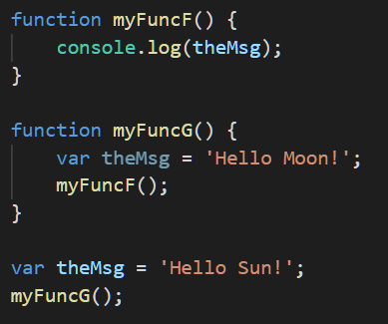
myFuncF() Ex. Cont.
myFuncG() Ex. Cont.
theMsg
Global Ex. Cont.
myFuncF
myFuncG
theMsg

Slide 11
Global Lex. Env.
Global Ex. Cont.
myFuncF Lex. Env.
myFuncG() Ex. Cont.
myFuncG Lex. Env.
myFuncF() Ex. Cont.

Slide 12
Global Lex. Env.
Global Ex. Cont.
Exec.
stack
myFuncF Lex. Env.
myFuncG() Ex. Cont.
myFuncG Lex. Env.
myFuncF() Ex. Cont.
Outer
Environ-ment

Slide 13
Global Lex. Env.
Global Ex. Cont.
myFuncF
myFuncG
theMsg
myFuncF
myFuncG
theMsg
myFuncF Lex. Env.
myFuncG() Ex. Cont.
theMsg
myFuncG Lex. Env.
myFuncF() Ex. Cont.
theMsg
Scope
Chain

Slide 14
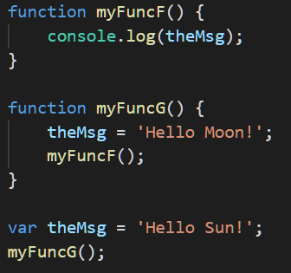

Slide 15
JS Advanced – Part 1
When a variable is not in the local execution context, JS looks in the ”outer environment”
”outer environment” is a reference to the execution context corresponding to the lexical outer environment.
This is called following the Scope Chain

Slide 16
JS Advanced – Part 2
What are objects?
Function constructors
Prototypical inheritance
ES6 object construction (classes)

Slide 17
JS Advanced – Part 2
What are objects?
Objects are (just) a collection of name/value pairs
A value may be
Of a simple type (string, number,…)
A function definition
An object (hello, recursion!)

Slide 18
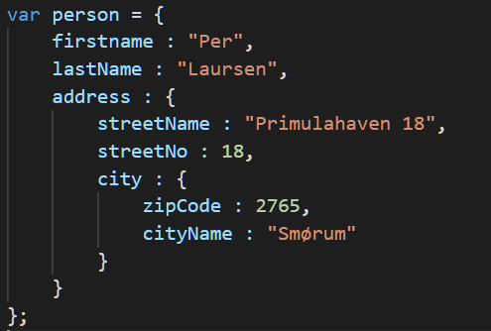
JS Advanced – Part 2

Slide 19
JS Advanced – Part 2
Object literals: simple, but repetitive
OK for properties (values are individual)
Bad for functions (same for all objects of same type)
How can we ”build” objects from a definition?
Functional constructors
Prototypical inheritance
Class definitions (ES6)

Slide 20
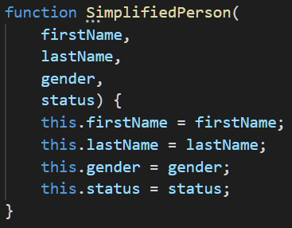
JS Advanced – Part 2
Function constructors
Remember: FUNCTIONS ARE OBJECTS!
Syntax: function nameOfType (…) {}
Use of functional constructor:
var sp = new SimplifiedPerson(…);

Slide 21
JS Advanced – Part 2
Function constructors – fine w.r.t. properties, but still problem with functions
Adding functions directly to objects: works, but again repetitive [CODE]
Adding functions to prototype: better ☺ [CODE]

Slide 22
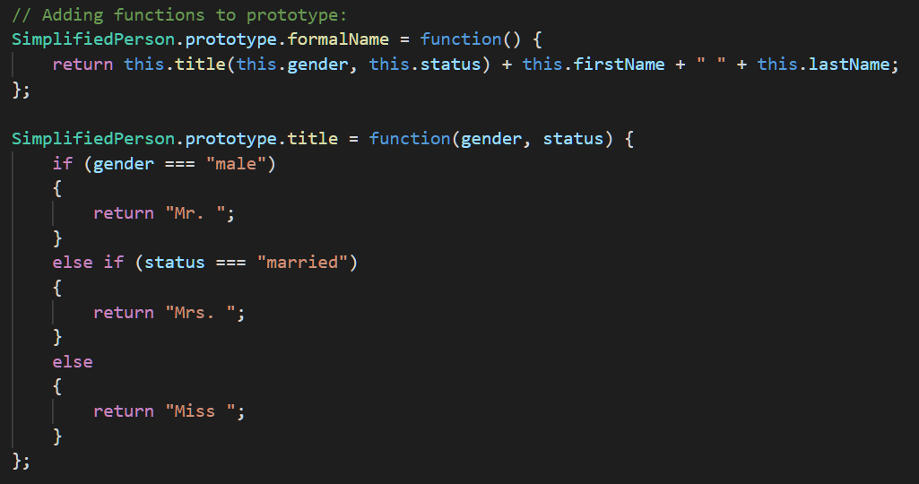
JS Advanced – Part 2

Slide 23
JS Advanced – Part 2
Now SimplifiedPerson is (almost) like a class definition
Function constructor for setting object-specific property values
Functions added to SimplifiedPerson prototype, thereby available to all objects of ”type” SimplifiedPerson
But what about inheritance…?
Person = SimplifiedPerson + address properties. How…?

Slide 24
JS Advanced – Part 2
JS offers prototypical inheritance
Slightly convoluted…
Create function constructor for ”derived” type (Person)
Inside new function constructor, call the ”base” function constructor (SimplifiedPerson.call(this,…))
Do usual initialisation of properties in derived type
AFTER function constructor, set prototype of derived type to refer to prototype of base type, using Object.create(…)
[CODE]

Slide 25
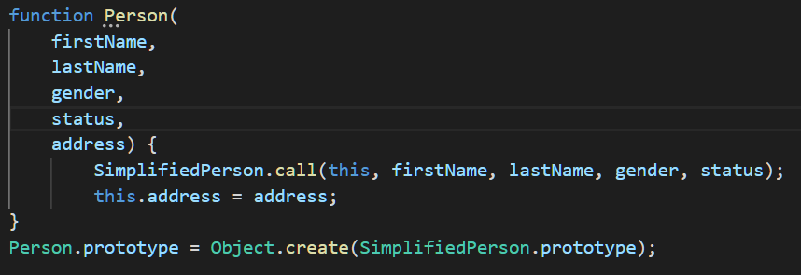
JS Advanced – Part 2

Slide 26
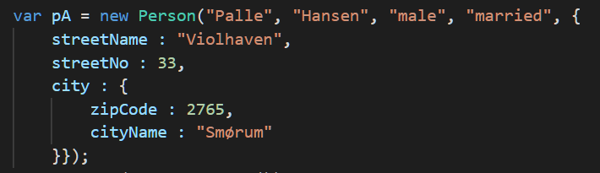
JS Advanced – Part 2

Slide 27
JS Advanced – Part 2
ES6/2015 now offers the class keyword (also the extends keyword)
Class definitions are now (syntactically) closer to e.g. class defintions in C#
NB: only ”syntactic sugar” – nothing has changed under the covers…

Slide 28
JS Advanced – Part 2
ES6 class definition
Uses class keyword
Function constructor marked with constructor keyword
No explicit properties – properties are typically added in the function constructor
Methods added inside class definition, syntax is nameOfMethod(…parameter list…) { body}

Slide 29
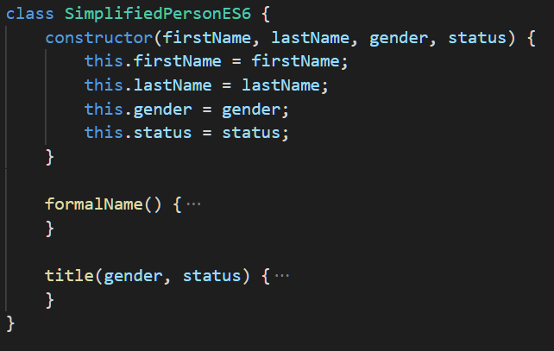
JS Advanced – Part 2

Slide 30
JS Advanced – Part 2
ES6 class definition
Inheritance by use of extends keyword
Constructor will typically call ”super class” constructor, using the super keyword
Prototype references are automatically set up

Slide 31
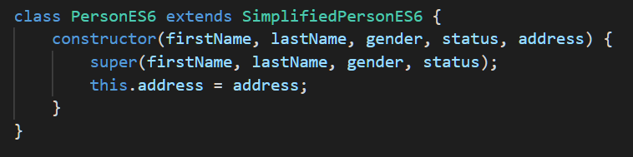
JS Advanced – Part 2

Slide 32
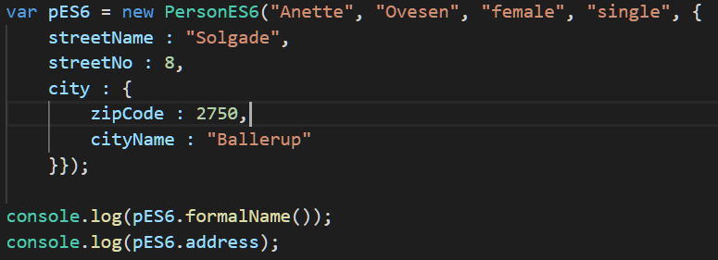
JS Advanced – Part 2

Slide 33
Typical base/derived class scenario
Base class contains X properties…
…so base class constructor typically takes X parameters, to initialise these X properties
Derived class contains Y properties…
…so derived class constructor typically takes X + Y parameters, to initialise own and base class properties, like this:
X of these parameters are used to call base class constructor!
Y of these parameters are used for initialising derived class properties.

Slide 34
JS Advanced – Part 3
Array helper/query methods
forEach
map and filter
reduce
find, some and every

Slide 35
JS Advanced – Part 3
The forEach method
Is applied to an array
General syntax: myArray.forEach(callBack)
callBack: A function which is called for each element in the array
Callback takes three parameters:
item: the item currently being processed
index: the index of the above item
array: the array itself

Slide 36
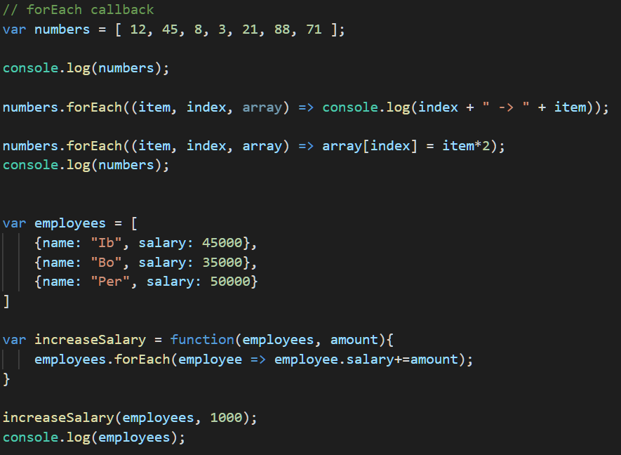
JS Advanced – Part 3

Slide 37
JS Advanced – Part 3
The map method
General syntax: myArray.map(callBack)
callBack: A function which is called for each element in the array, taking the element itself as a parameter
NB: The result of invoking map will be a new array, with the same number of elements as the original array.
Callback is often an anonymous function (=>)

Slide 38
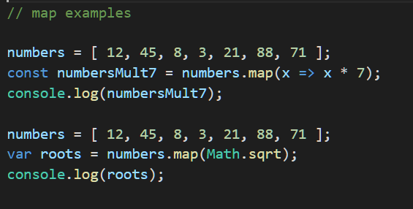
JS Advanced – Part 3

Slide 39
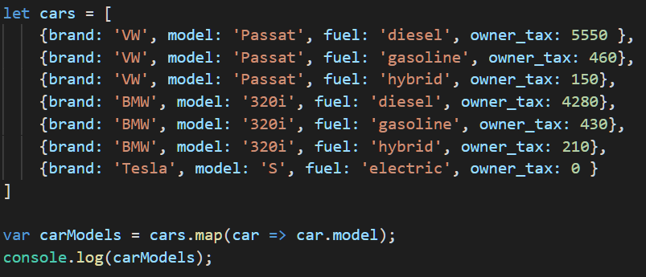
JS Advanced – Part 3

Slide 40
JS Advanced – Part 3
The filter method
General syntax: myArray.filter(callBack)
callBack: A function which is called for each element in the array, taking the element itself as a parameter. This callback must return a boolean value.
NB: The result of invoking filter will be a new array, only including the elements for which the callback returns true
Callback is often an anonymous function (=>)

Slide 41
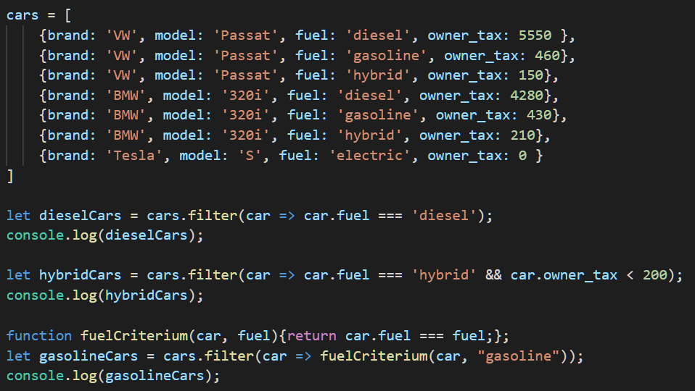
JS Advanced – Part 3

Slide 42
JS Advanced – Part 3
find: returns the first element for which the callback returns true (returns undefined if no element is found)
every: returns true if the callback returns true for all elements in the array.
some: returns true if the callback returns true for at least one element in the array.

Slide 43
JS Advanced – Part 3
The reduce method
General syntax: myArray.reduce(reducerFunc, initialValue)
reducerFunc: A function which is called for each element in the array, taking four parameters:
accumulator
currentValue
currentIndex
sourceArray
initialValue: The initial value to be used by the reducer function, i.e. accumulator is initially set to initialValue.

Slide 44
JS Advanced – Part 3
The reduce method
accumulator: the ”accumulated value” of applying the function so far (i.e. to the previous elements)
currentValue: value for the element being processed right now
currentIndex: index for the above element
sourceArray: reference to the array which we are invoking reduce on.

Slide 45
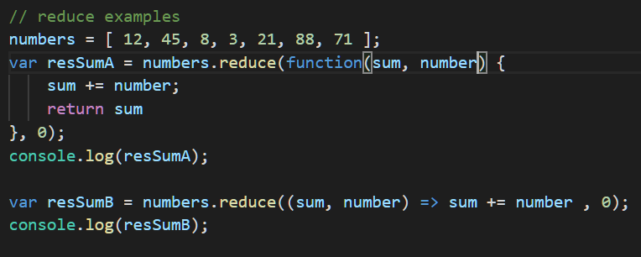
JS Advanced – Part 3

Slide 46
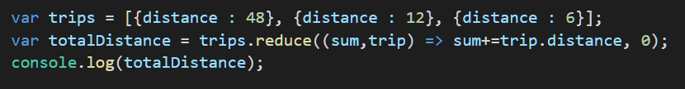
JS Advanced – Part 3

Slide 47
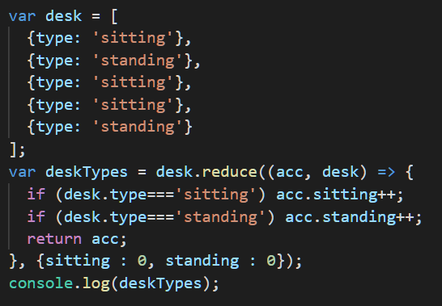
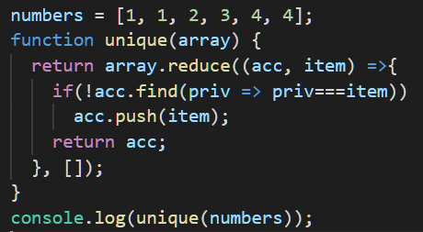
JS Advanced – Part 3

Slide 48
JS Advanced – Part 3
Also see: https://developer.mozilla.org/en-US/docs/Web/JavaScript/Reference/Global_Objects/Array

Slide 49
JS Advanced – Part 4
Closure: The closure is a collection of all the variables in scope at the time of creation of the function.
https://medium.com/dailyjs/i-never-understood-javascript-closures-9663703368e8
Closures mostly get relevant for functions returning functions….

Slide 50
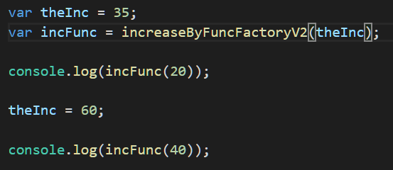
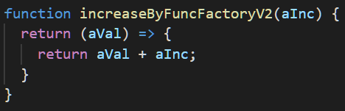
JS Advanced – Part 4

Slide 51
JS Advanced – Part 4
When a function (object) is created, it gets a reference to the closure specific for that function creation.
The closure contains copies of values which were in scope at creation.
This even holds for object references!
The VS Code debugger can show closures at run-time.

Slide 52
JS Advanced – Part 4
var: execution context is global, function scope.
let: execution context is at the block, expression scope.
https://medium.com/front-end-developers/es6-variable-scopes-in-loops-with-closure-9cde7a198744

Slide 53
JS Advanced – Part 5
Remember: JavaScript is synchronous!
The ability for asynchronous execution is ”added” by the environment (browser, node,…)
Four elements involved
Heap
Stack
Event queue
Event loop

Slide 54
JS Advanced – Part 5
Stack
Heap
Callback Queue
Event Loop

Slide 55
JS Advanced – Part 5
Stack
Handles memory management for execution contexts (EC)
When a function is called, an EC is pushed onto the stack
EC contains memory for parameters and locally scoped variables
When function call ends, EC is popped off the stack

Slide 56
JS Advanced – Part 5
Heap
Handles memory management for dynamically allocated objects.
That is; the objects themselves are stored in the heap.
Object references are not stored on the heap.
Since functions are objects, we may also have objects representing function instances in the heap (which may refer to closures ☺)

Slide 57
JS Advanced – Part 5
Callback queue
If e.g. a function call includes a callback, the callback function is placed in the callback queue.
Callbacks can be explicitly written in the code, or may be more implicit (promises, async/await)
How are callbacks ever processed…?

Slide 58
JS Advanced – Part 5
Event loop
The event loop continuously monitors the stack
If the stack is empty – and the callback queue is not empty – the first callback in the event queue is placed on the stack
The callback then gets executed!
NB: No guarantees about when a callback is executed!

Slide 59
JS Advanced – Part 5
A promise is a convenient way to express an operation which may be executed asynchronously.
A promise implementation will end up calling resolve or reject.
A call to a function which returns a promise is usually followed by a call to the then method
Multiple then calls can be chain together!

Slide 60
var promise = new Promise(function(resolve, reject) { // do a thing, possibly async, then… if (/* everything turned out fine */) { resolve("Stuff worked!"); } else { reject(Error("It broke")); } });
promise.then(function(result) { console.log(result); // "Stuff worked!" }, function(err) { console.log(err); // Error: "It broke" });

Slide 61
JS Advanced – Part 5
A call to a function which returns a promise is usually followed by a call to the then method
The then method takes two functions as arguments:
A function for handling resolve
A function for handling reject

Slide 62
function get(url) { // Return a new promise. return new Promise(function(resolve, reject) { // Do the usual XHR stuff var req = new XMLHttpRequest(); req.open('GET', url); req.onload = function() { // This is called even on 404 etc // so check the status if (req.status == 200) { // Resolve the promise with the response text resolve(req.response); } else { // Otherwise reject with the status text // which will hopefully be a meaningful error reject(Error(req.statusText)); } }; // Handle network errors req.onerror = function() { reject(Error("Network Error")); }; // Make the request req.send(); }); }
get('story.json').then(function(response) { console.log("Success!", response); }, function(error) { console.error("Failed!", error); })

Slide 63
JS Advanced – Part 5
NB: When a promise has been returned, the code will proceed to the next statement!
The then method will be called as a callback function.
Enables us to do other stuff, while the promise gets resolved (or rejected)….

Slide 64
JS Advanced – Part 5
async/await: a newer (simpler?) way of expressing the same thing
Suppose f() return a promise:
var data = await f(); // wait here until f is resolved.
NB: The wait does not block the execution – code will continue in the calling function!
If a function contains an await statement, the function must be marked with the async keyword

