Slide 1
Node.js
(very briefly…)

Slide 2
Node – what is it?
Node.js is an environment for executing JavaScript
Usually used for writing server-side JS code
Built around the Chrome V8 JS Engine
It’s ”just an environment” just as the browser is a (different) environment.
Get it at https://nodejs.org

Slide 3
Client
(browser)
JS
Request
Server
(node)
JS
Response

Slide 4
Node – what can it do?
Code organisation (modules)
File handling
Database handling
HTTP-based communication (request/response)
Handling of long tasks
… and more, via internal + external ”packages”

Slide 5
Node – installed, now what…?
Test: in command-line, do: node –v
…should return version number of Node installation
Running JS code in Node, do: node app.js
…server will start…and wait…
Shut down server with Ctrl+C
TIP: use taskkill /f /im node.exe to kill any running Node server (in case you closed console window).

Slide 6
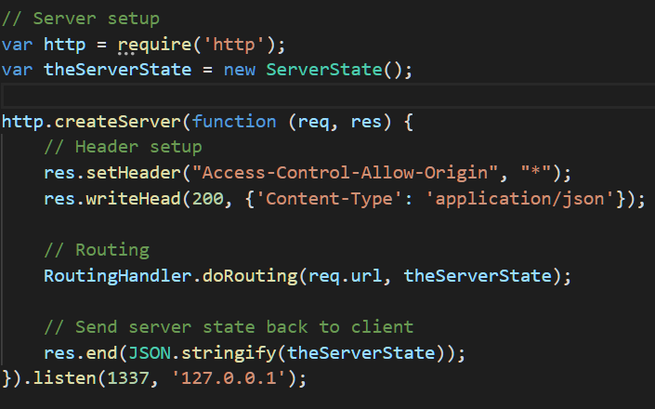
Node – a very simple web server
NB: ServerState and RoutingHandler are not built-in classes!
res.setHeader to get around CORS
In this example, the entire server state is sent back to client in the response.

Slide 7
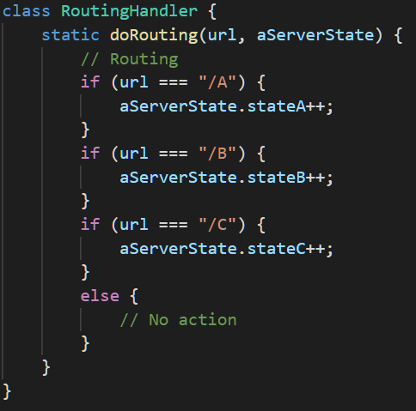
Node – a very simple web server
An example of routing: depending on the URL part following the ”main” URL, different actions are taken.
E.g.:
http://mywebservice.org/api/A
http://mywebservice.org/api/B
http://mywebservice.org/api/C
(not functional links ☺)

Slide 8
Node – installed, now what
The previous examples were ”raw” Node JS code
Packages exist for simpler syntax, etc..
Most popular for Node is Express
Part of MEAN stack
MongoDB
Express
Anguar
Node

Slide 9
NPM Cheatsheet
Command | Action
npm -v | Returns the currently installed version of NPM
npm install X | Installs package X in current directory
npm install -g X | Installs package X globally
npm install --save X | Install package X and saves dependency in project
npm update | Updates all packages on which project depends
npm update -g | Updates all globally installed packages

