Slide 1
React
(…and Redux)

Slide 2

React – what is it?
Yet another JavaScript…
…framework?
…library?
React is a JS library, created by Facebook
A library, because you are not forced to use a specific project structure
However, tools exist that can help with creating a ”scaffolding” for a React-based app

Slide 3
React – what is it?
Targeted for creating SPA’s
SPA: Single-Page Applications
Inside a React-based app. we will write code in JSX
JSX: JavaScript Extension
…is a JS language extension…
…but often looks like HTML

Slide 4
React – what is it?
The JSX code will – when executed –produce DOM elements
More precisely: produce React elements, which will be ”rendered” to the DOM
Central concept: Components

Slide 5
React – what is it?
Central concept: Components
Components contain logic for building a certain part of the DOM
Components can use other components!

Slide 6
React – getting started
Can in principle just include libraries ”manually” in app
Easier approach: use create-react-app tool for creating app scaffold
This is just an NPM package, so go ahead:
> npm install -g create-react-app
It will take a while…

Slide 7
React – getting started
Once we have installed create-react-app, we can use it for generating React-based apps (or at least a scaffolding…)
Go to the folder in which you want to keep React apps (NB: not the folder for the specific app; this will be generated for you)
Now do:
> create-react-app appname

Slide 8
React – getting started
Now do:
> create-react-app appname
NB: You should put the specific name of your app instead of appname
NB: only lowercase-letters allowed (😐)
A folder with the same name as your app will be generated.
It will (also) take a while…

Slide 9
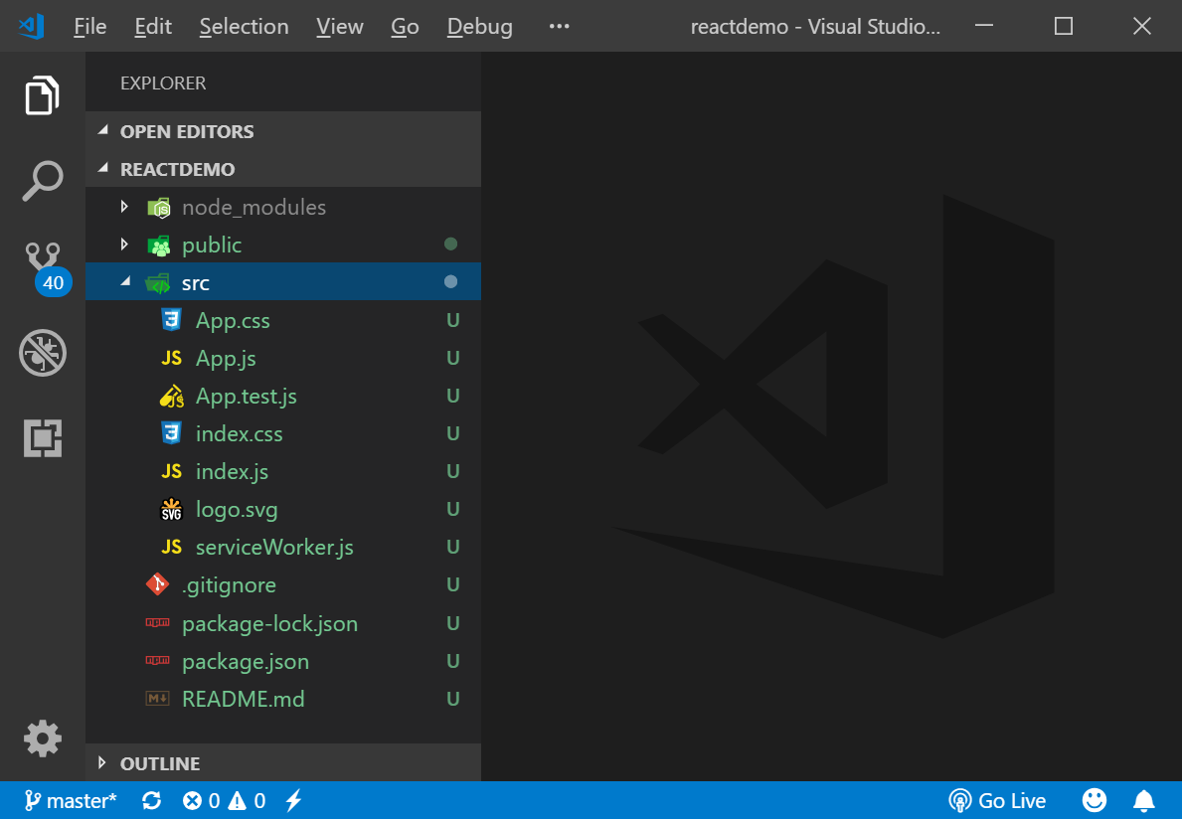
React – getting started
Open the newly created folder in Visual Studio Code
Should looks similar to this (this is an app named reactdemo):
src folder has been expanded

Slide 10
React – getting started
Open a terminal window (make sure you are in the app’s folder)
Then enter:
> npm start
Wait a while (again…)
You should see two things…

Slide 11
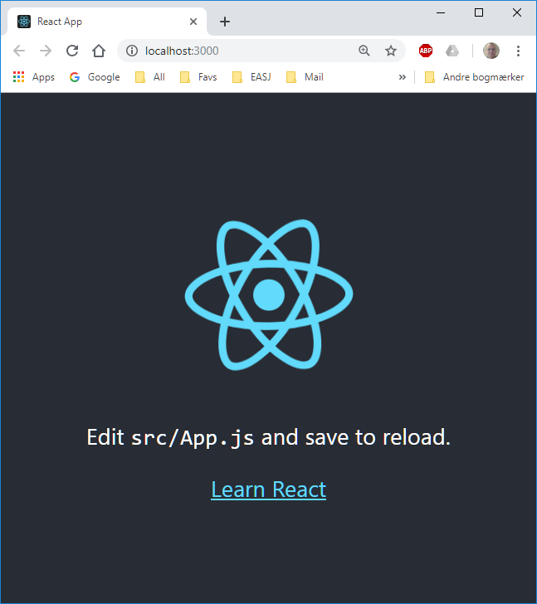
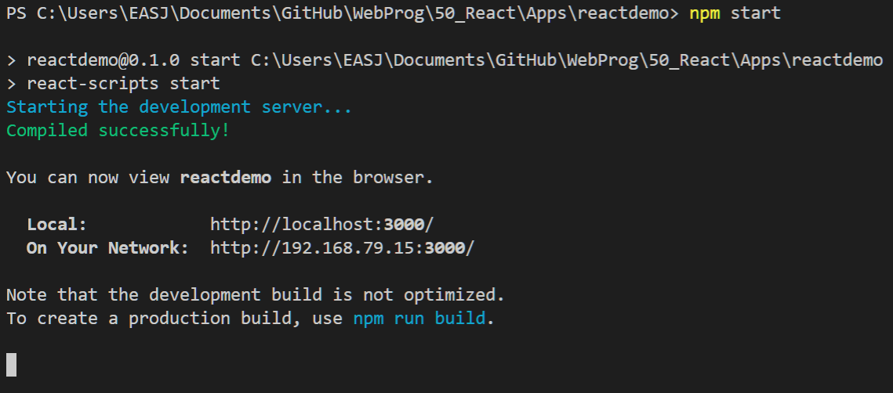
React – getting started
In terminal window
In browser

Slide 12
React – getting started
A ”development server” has been started by the tool, which now runs the React app
App is shown in browser, at localhost:3000
Whenever you make updates to the app, the app is reloaded into the browser!
Development server is shut down with Ctrl + C in terminal window

Slide 13
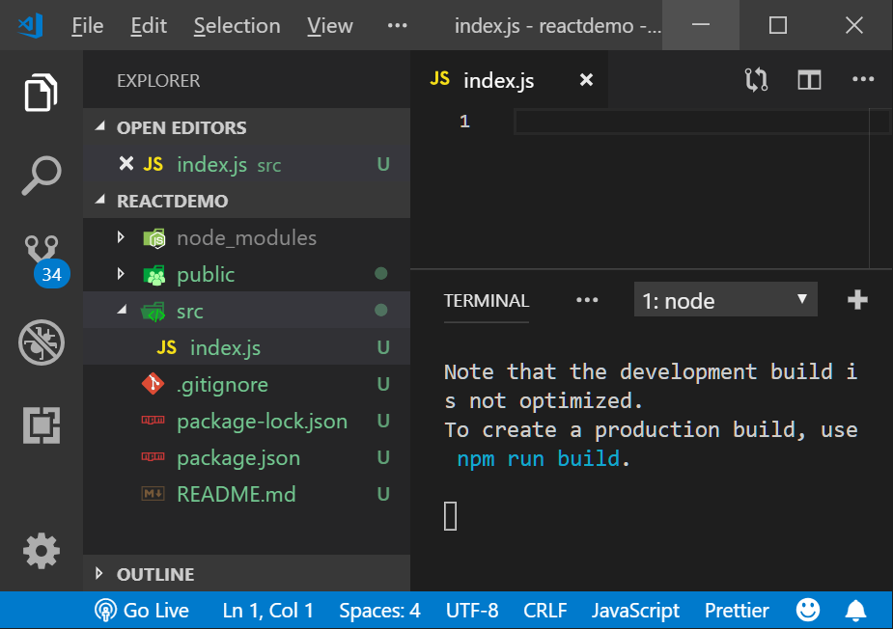
React – getting started
We will in general clear out the content of the src folder
Go ahead and delete all files in the src folder (but only from that folder!)
In the (now empty) src folder, create a new file named index.js

Slide 14
React – ”Hello World” (content of index.js)
// Import of React libraries
import React from 'react';
import ReactDOM from 'react-dom';
// Create a React component
const App = () => {
return <div>Hello World!</div>;
}
// Render the React component in the browser
ReactDOM.render(
<App/>,
document.querySelector('#root')
);

Slide 15
React – ”Hello World” (content of index.js)
We are importing the central React libraries, using the JS module system
Later on, we can include our own React components in a similar way
// Import of React libraries
import React from 'react';
import ReactDOM from 'react-dom';

Slide 16
React – ”Hello World” (content of index.js)
This is JSX code!
A function that returns… an HTML element?
No, a JSX ”tag”
JSX gets compiled to JS before being handed to the browser
Remember: JSX != HTML!
// Create a React component
const App = () => {
return <div>Hello World!</div>;
}

Slide 17
React – ”Hello World” (content of index.js)
Call of the central render method
Will ”render” the provided JSX tag in the browser
Attaches the corresponding DOM to the ”root” element in index.html (not index.js)
// Render the React component
// in the browser
ReactDOM.render(
<App/>,
document.querySelector('#root')
);

Slide 18
React – JSX vs HTML
Many elements are identical, but…
In-line styling has a slightly different syntax
When specifying a class attribute, we use className instead
A couple of other keywords are also replaced, e.g. for is replace with htmlFor
JSX can reference JS variables! This is very important, and enables parameterisation of JSX tags!

Slide 19
React – ”Hello World” (content of index.js)
Note the use of {}
Inside {}, we can place a reference to a JS variable
Simple variables
Property on object
etc…
const greetingText = "Hello everybody!";
// Create a React component
const App = () => {
return <div>{greetingText}</div>;
}

Slide 20
React – Components
Components is the central ”unit of code” in React apps.
Components can be:
Used inside other components
Re-used by many other components
Configured by component instance creators
Not unlike traditional OO classes…
[Example] (from Udemy React course)

Slide 21
React – Components
Example (taken from Udemy React course)
Found in approvalcarddemo
Goal: Build an app with three components

Slide 22
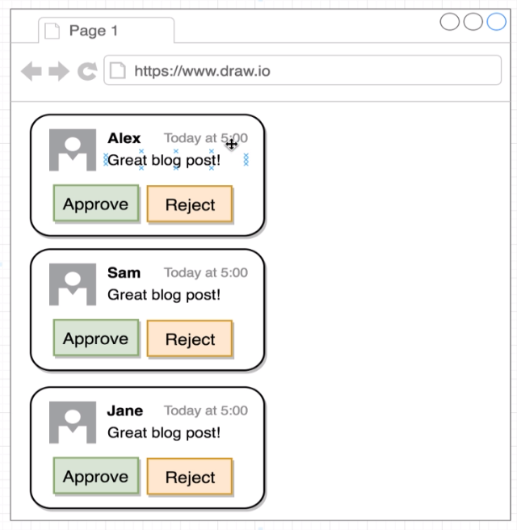

Slide 24
App
Comment
Detail
Approval
Card

Slide 25
React – example
This is a new file (Comment-Detail.js)
Also imports React libraies
Also exports ”itself”!
Not particularly useful, w.r.t. functionality…
import React from 'react';
const CommentDetail = () => {
return (
<div>
First attempt
</div>
);
}
export default CommentDetail;

Slide 26
React – example
import React from 'react';
import ReactDOM from 'react-dom';
import CommentDetail from './CommentDetail';
const App = function() {
return (
<div>
<CommentDetail/>
<CommentDetail/>
<CommentDetail/>
</div>
);
}
import React from 'react';
const CommentDetail = () => {
return (
<div>
First attempt
</div>
);
}
export default CommentDetail;

Slide 27
React – Components
Challenge: Each CommentDetail instance should
Contain the same logic and data structures
Contain individual values
The props system allows us to parameterise component instance creation
Like parameters to a constructor…

Slide 28
React – Components
For functional components: the function called upon creation always takes one argument
The caller/creator can provide a set of ”property values” to the component
These ”property values” will become values on the object received by the component instance!

Slide 29
React – example
const App = function() {
return (
<div>
<CommentDetail author="Per A" imgSrc="PERL_40.jpg" when="Monday at 18.30" bodyText="Test #1"/>
<CommentDetail author="Per B" imgSrc="PERL_44.jpg" when="Tuesday at 11.45" bodyText="Test #2"/>
<CommentDetail author="Per C" imgSrc="PERL_50.jpg" when="Friday at 06.10" bodyText="Test #3"/>
</div>
);
}

Slide 30
React – example
const CommentDetail = props => {
return (
<div>
<a href="/">
<img alt="avatar" src={props.imgSrc} />
</a>
<div>
<a href="/">{props.author}</a>
<div>
<span>{props.when}</span>
</div>
<div>{props.bodyText}</div>
</div>
</div>
);
}
<CommentDetail
author="Per A"
imgSrc="PERL_40.jpg"
when="Monday at 18.30"
bodyText="Test #1”
/>

Slide 31
React – Components
We can also provide an entire component as a (special kind of) argument.
A component can be a ”wrapper” around content provided by another component.
We refer to the children property on the props argument to access the content

Slide 32
React – example
// NB: all the classname=... is just styling!
// using the Semantic UI library
const ApprovalCard = props => {
return (
<div className="ui card">
<div className="content">
{props.children}
</div>
<div className="Extra content">
<div className="ui two buttons">
<div className="ui basic green button">OK</div>
<div className="ui basic red button">No...</div>
</div>
</div>
</div>
);
}

Slide 33
React – example
const App = function() {
return (
<div className="ui container comments">
<ApprovalCard>
<div>
<h4>Info</h4>
An example of using ApprovalCard without CommentDetail.
</div>
</ApprovalCard>
<ApprovalCard>
<CommentDetail author="Per A" imgSrc="PERL_40.jpg" when="Monday at 18.30" bodyText="Test #1"/>
</ApprovalCard>
<ApprovalCard>
<CommentDetail author="Per B" imgSrc="PERL_44.jpg" when="Tuesday at 11.45" bodyText="Test #2"/>
</ApprovalCard>
<ApprovalCard>
<CommentDetail author="Per C" imgSrc="PERL_50.jpg" when="Friday at 06.10" bodyText="Test #3"/>
</ApprovalCard>
</div>
);
}

Slide 34
React – Components
So far, we have used functional components
React also offers class components
Advantages for class-based components:
Better code organisation
Can make use of state
Make use of lifecycle events

Slide 35
React – Components
Rules for class-based components:
Must extend (inherit from) React.Component
Must implement the render method
Will usually contain a constructor

Slide 36
React – example
class DriverCard extends React.Component {
constructor(props) {
super(props);
this.state = { fullName: props.theDriver.givenName + " "
+ props.theDriver.familyName,
country: props.theDriver.nationality};
}
render() {
return (
// Implementation of render
);
}
}

Slide 37
React – Components
Class-based components can use state
The state is just an ”instance field”, which will contain an object with data specific for each instance of a component
State should be initialised when the component instance is created
NB: state must only be updated by calling the method setState!

Slide 38
React – Components
Why do we need a ”state”…?
Typically for handling updates to state
State could update when…
…user enter data into the UI
…an async call returns
Update of state should usually trigger a re-render; this is what setState does!

Slide 39
React – example
class App extends React.Component {
state = { arrayOfData: [] };
getData = async () => {
const response = await axios.get("https://my-web-service.com/api/...");
this.setState({ arrayOfData : response.data… });
};
render() {
return (
<div>
<button onClick={this.getData}>Get Data</button>
<h2>Got {this.state.arrayOfData.length} data instances</h2>
</div>
);
}
}

Slide 40
React – Components
Note that state in a parent can be used as props to a child
Very useful – state of parent is updated, and causes children to be updaed as well.

Slide 41
React – Components
Lifecycle methods
Methods that are called when specific ”events” happen during the lifecycle of a component instance
NB: it is only the render method which must be implemented. All other methods are optional
A bit like abstract and virtual in OO…

Slide 42
React – Components
Lifecycle methods
constructor
render
componentDidMount
componentDidUpdate
componentWillUnmount

Slide 43
React – Components
Function | When | How often
constructor | component instance is being created | once
render | when content needs to be (re-)rendered | many
componentDidMount | when content is visible on screen | once
componentDidUpdate | whenever the component updates itself | many
componentWillUnmount | when content is no longer visible on screen | once

Slide 44
React – Components
Function | What to do…
constructor | one-time initialisation (could include state), usually not data loading
render | content generation (preferably only this)
componentDidMount | one-time data loading
componentDidUpdate | more data loading, e.g. when state changes
componentWillUnmount | one-time cleanup of resources, if needed

Slide 45
React – UI and Events
Still to come…

Slide 46
Redux

Slide 47

Redux – what is it…?
From website: A predictable state container
…in other words: a package which can help us with managing state in a web application
NB: Redux is not an integrated part of React!!
You can use Redux with other JS libraries
You can use Redux on its own!

Slide 48
Redux – what is it…?
How to install Redux into a project:
> npm install –save redux
You can also refer to Redux through a CDN

Slide 49
State
(it’s just data)

Slide 50
Action
creators
State
(it’s just data)
creates…
Actions
which update…
parameters to calling…
dispatch
Reducers
which calls…

Slide 51
Redux – Action
An action is just an object with a well-defined format, corresponding to some kind of ”action” happening in the application
Usually – but not always – an action corresponds to a user-initiated event (e.g. clicking a button)
An action object contains two properties:
type: identifier for a specific kind of action
payload: data related to the action

Slide 52
Redux – Action
const actionA = {
type: 'INCREMENT'
}
const actionB = {
type: 'SELL_LEMONADE',
payload: 3
}

Slide 53
Redux – Action Creator
Just a function which can create an action object
Can take parameters, if we need parameters for creating the action object (i.e. data to put in the payload property).

Slide 54
Redux – Action Creator
const increment = () => {
return { type: 'INCREMENT' }
};
const sellLemonade = (noOfGlasses) => {
return {
type: 'SELL_LEMONADE',
payload: noOfGlasses
};
};

Slide 55
Redux – Reducer
A function responsible for maintaining a part (often called a slice) of the state
A reducer function will take two parameters:
The current value of the part of the state which the reducer manages
An action object
A reducer function should then return the new value of the part of the state

Slide 56
Redux – Reducer
A reducer function should then return the new value of the part of the state
What will the new value be? Will usuallly depend on the action object

Slide 57
Redux – Action Creator
const countReducer = (count = 0, action) => {
if (action.type === 'INCREMENT') {
return count + 1; }
if (action.type === 'DECREMENT') {
return count - 1; }
return count;
};

Slide 58
Redux – Setup
First step in order to set up a ”Redux store” (i.e. the state object) is to call :
Redux.createStore(aReducer);
createStore takes one reducer as an argument (what if we have more than one reducer…?)

Slide 59
Redux – Action Creator
const countReducer = (count = 0, action) => {
if (action.type === 'INCREMENT') {
return count + 1; }
if (action.type === 'DECREMENT') {
return count - 1; }
return count;
};
const store = Redux.createStore(countReducer);

Slide 60
Redux – using the state
If you wish to access the state, you call:
store.getState()
This returns an object representing the state
You can then use the state for e.g. an assigment statement

Slide 61
Redux – Action Creator
const countReducer = (count = 0, action) => { … };
const store = Redux.createStore(countReducer);
function renderNow() {
document.querySelector("#value").innerHTML = store.getState();
}

Slide 62
Redux – connecting the dots…
Two items remaining:
How do reducers get called?
How are we notified about state changes?

Slide 63
Redux – connecting the dots…
How do reducers get called?
Reducers are not called directly; they are invoked when we call the dispatch function
NB: the dispatch function will invoke the reducer specified when calling createStore; this may be a ”combined” reducer
A ”combined” reducer consists of a number of individual reducers

Slide 64
Redux – connecting the dots…
A reducer is called with an action object as argument
All reducers (which are part of the combined reducer) will be called whenever dispatch is invoked.

Slide 65
Redux – Action Creator
<button onClick="store.dispatch(increment())">
Increment
</button>

Slide 66
Redux – connecting the dots…
How do we get notified about state changes?
We have to ”subscribe” to being notified
Call: store.subscribe(function)
subscribe takes a function as argument; this function will be called on state changes
We can call subscribe many times, to have several functions subscribing to state changes

Slide 67
Redux – Action Creator
const countReducer = (count = 0, action) => { … };
const store = Redux.createStore(countReducer);
function renderNow() {
document.querySelector("#value").innerHTML = store.getState();
}
store.subscribe(renderNow);

Slide 68
Action
creators
State
(it’s just data)
creates…
Actions
which update…
parameters to calling…
dispatch
Reducers
which calls…

Slide 69
Action
creators
State
(it’s just data)
Subscriber
which calls…
Subscriber
Subscriber
creates…
Actions
which update…
parameters to calling…
dispatch
Reducers
which calls…

Slide 70

React with Redux
Again: Redux is not an integral part of React
In order to use Redux in a React app, we have to install:
The redux package itself
The react-redux ”integration” package
> create-react-app app-name
> cd app-name
> npm install –save redux react-redux

Slide 71
React with Redux
The react-redux package adds a couple of extra functionalities on top of ”raw” Redux
Provider: a top-level React component, which will handle creation of the Redux store
We need to ”wrap” the App component into a Provider component, when calling ReactDOM.render(…)

Slide 72
React with Redux
ReactDOM.render(
<App/>,
document.querySelector('#root')
);

Slide 73
React with Redux
ReactDOM.render(
<Provider store={createStore(reducers)}>
<App/>
</Provider>,
document.querySelector('#root')
);

Slide 74
React with Redux
In a React application, we will typically make use of the state inside various components
However, we do not call getState directly!
Instead, a two-step procedure:
Define a state-to-props mapper function
Call the connect function from the react-redux API

Slide 75
React with Redux
Define a state-to-props mapper function
Maps the current state into a new object, which will then ”magically” become the props parameter to the component
NB: Whenever state changes, the component will automatically be re-rendered (the component is effective a ”subscriber”)
We can pick out the relevant elements from the state as we please

Slide 76
React with Redux
Call the connect function from the react-redux API
This call hooks our state-to-props mapper function into the state change subscriber system
NB: looks slightly weird; calling connect will return a function, which we then immediately call with the component itself as argument

Slide 77
React with Redux
const mapStateToProps = state => {
return { cashAmount : state.allState.cashAmount,
lemonCount : state.allState.lemonCount
};
};
export default connect(mapStateToProps)(Inventory);

Slide 78
React with Redux
const Inventory = ({cashAmount, lemonCount}) => {
return (
<div>
<h3>Cash : {cashAmount}</h3>
<h3>Lemons : {lemonCount}</h3>
</div>
);
};

Slide 79
React with Redux
In a React application, we will also typically call actions creators inside components
They are just functions, so…just call them?
No! They must also be ”hooked” into the Redux store system first
Done by providing a second argument to connect

Slide 80
React with Redux
import { sellLemonade } from "../actions";
import { buyLemons } from "../actions";
…
export default connect(mapStateToProps,
{
sellLemonade,
buyLemons
})(UI);

Slide 81
React with Redux
<div>
<button onClick={() => props.sellLemonade(1)}>
Sell Lemonade
</button>
<button onClick={() => props.buyLemons(1)}>
Buy Lemon
</button>
</div>

Slide 82
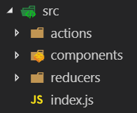
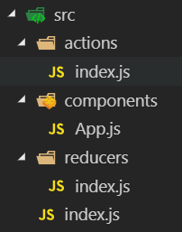
React with Redux
Why all these export statements…?
Community recommends a certain ”standard” file and folder structure for React/Redux applications:

Slide 83
React with Redux
/src/index.js
Still defines the ”entry point” for the application
Wraps the App component into the Provider component
For smaller applications; 100 % boilerplate code, i.e. completely reusable!

Slide 84
React with Redux
// Import of external libraries
import React from 'react';
import ReactDOM from 'react-dom';
import { Provider } from 'react-redux';
import { createStore } from 'redux';
// Import from App itself
import App from './components/App';
import reducers from './reducers';
// Wrap up App in a Provider.
ReactDOM.render(
<Provider store={createStore(reducers)}>
<App/>
</Provider>,
document.querySelector('#root')
);

Slide 85
React with Redux
/src/components/App.js
Defines the main App component
May or may not use state and/or action creators directly
Will either export App directly…
…or the return value from callling connect with App as argument

Slide 86
React with Redux
/src/actions/index.js
Contains implementations of action creators
Only change; action creators are exported

Slide 87
React with Redux
export const increment = () => {
return { type: 'INCREMENT'}
};
export const decrement = () => {
return { type: 'DECREMENT'}
};

Slide 88
React with Redux
/src/reducers/index.js
Contains implementations of reducers
If we have more than one reducer; we can combine reducers by calling the combineReducers function from the redux API

Slide 89
React with Redux
export default combineReducers({
cashAmount: cashReducer,
lemonCount: lemonReducer
});

Slide 90
React with Redux
When combining reducers; names of properties for reducers will become name of properties on state object!
In larger applications, we can keep combining smaller ”sub-reducers” into larger and larger reducers

Slide 91
React with Redux (and thunk)
It’s relatively easy to make async API calls in a React App (e.g. using axios)
Need a bit of state management, though…

Slide 92
React with Redux
getData = async () => {
const response = await axios.get("https://ergast.com/api/f1/2018/drivers.json");
this.setState({ drivers: response.data.MRData.DriverTable.Drivers });
};

Slide 93
React with Redux (and thunk)
Problem: the async model does not fit well with the React/Redux state management concept.
The async call does not return a ”plain object”, but rather a promise, which the dispatch method doesn’t like…
Solution: insert a piece of ”middleware”, which intercepts and manages calls of dispatch
The redux-thunk package is such a piece of middleware.
Very small! ~10 lines of code…

Slide 94
React with Redux (and thunk)
How to use thunk:
Inject the middleware into the Redux store at creation.
Implement your async action creator with an explicit call to dispatch (actually the middleware…)
Invoke the action handler at an appropriate place, e.g. in the componentDidMount method in a class-based component.

Slide 95
React with Redux
const store = createStore(reducers, applyMiddleware(thunk));
ReactDOM.render(
<Provider store={store}>
<App />
</Provider>,
document.querySelector('#root‘)
);

Slide 96
React with Redux
export const fetchAsyncData = () => async dispatch => {
const response = await axios.get("https://...");
dispatch({ type: 'FETCH_DATA', payload: response });
};

Slide 97
React with Redux
componentDidMount() {
this.props.fetchAsyncData();
}

Slide 98
React routing
Obviously, we need to be able to have navigation in apps beyond the very basic
NB: It is – in a sense – a kind of ”pseudo-navigation”, since we are implementing SPAs
The package react-router-dom adds a handful of extra navigation-related components to a React app

Slide 99
React routing
<BrowserRouter> | Top-level component, into which we can wrap the <App> component
<Route> | Connects a React component with a URL, such that when the apps URL is changed, components for which a matching <Route> is found will be rendered.
<Switch> | Used to wrap a set of <Route> components, such that only the first <Route> component which matches the apps URL will be rendered.
<Link> | Provides a ”link” to another area of the application, which is defined by a URL set in the to attribute. When activated, the URL will be matched with all <Route> components, and those <Route> components wich match are rendered.

Slide 100
React routing
Typical structure.
At top level, <App> is wrapped into a <BrowserRouter>
<App> just contains a <Header> and a <Main> component.
<Header> contains some sort of navigation item, and also contains a set of <Link> components for specific navigation.
<Main> contains a set of <Route> components, each related to a specific application component. The <Route> components may be wrapped in a <Switch> component.
Other lower-level components may also use routing components for specific purposes.

Slide 101
React routing
NB: This system replaces the use of good-old <a href ”…”> for ”in-app navigation”!
Using <a href ”…”> will cause the entire page to be reloaded, which is exactly what we want to avoid by creating SPA’s
Of course, ”out-of-app” navigation is still as usual ☺
For more info, see e.g. https://reacttraining.com/react-router/web/guides/quick-start

