Slide 1

MediDerma-Automated Skin Disease Detector
Supervisor name: Dr. Fazeel Abid
Group ID: SP25-1
Session: 2022-2026
Student name: Muqadas Asif 70131460
Syeda Hijjab Zahra 70131199

Slide 2

Problem Statement
“ One in three people worldwide faces untreated skin conditions due to limited dermatology access, causing delay in diagnosis and treatment. This AI-powered detection system aims to bridge this gap by providing instant skin analysis for various conditions, including acne, eczema, basal cell carcinoma (BCC), squamous cell carcinoma (SCC), psoriasis, and melanoma, directly from images. ”

Slide 3
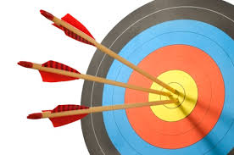
Key Objectives
To develop a machine learning model capable of identifying various skin diseases from images
To make dermatological screening more accessible and cost-effective through mobile application.
To facilitate timely medical intervention and reduce health risks.

Slide 4
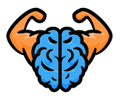
Motivation
These conditions can severely impact quality of life, including:
Psychological well-being
Social interactions
Daily functioning
Early detection is critical:
Melanoma survival rate is >99% if caught early
Drops to 25% in later stages

Slide 5
Overview
Development of an automated diagnostic tool for various skin conditions using image analysis.
Trained on diverse skin image datasets to ensure high diagnostic accuracy.
Simple interaction for non-technical users
The model analyses images, identifies skin diseases, and provides early diagnostic insights.
Detects conditions such as: Skin cancer, Psoriasis, Acne, Eczema

Slide 6
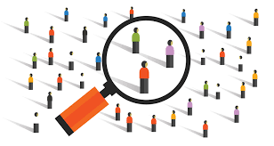
Target Users
Healthcare Providers (General practitioners, dermatologists, clinic staff)
General Public (Patients, individuals)
Healthcare Platforms (Companies offering remote healthcare solutions)

Slide 7
Proposed Solution
Features | Proposed Solution
Detect Skin Disease | Uses deep learning (Vision Transformer) to analyze uploaded skin images and detect potential skin diseases with a confidence score, enabling early and accurate diagnosis support.
Weather Alert | Provides hyperlocal alerts when environmental factors like temperature, humidity
Genetic & Ancestral analysis | To provide users with personalized, proactive skin health insights based on their genetic and ancestral skin conditions.

Slide 8

Requirements
Functional Requirement
Take/select image for disease detection
Match the input image from database
Predict the related (output) disease
Suggest doctor for serious condition
Ancestral Analysis
Weather Alerts

Slide 9
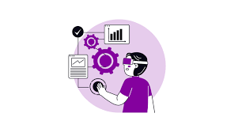
Non-Functional Requirement
Usability
Maintainability
Performance
High availability
Security

Slide 10

System Requirements
🖥️ Hardware Interfaces
Device: Mobile/Tablet (Android or iOS)
Camera: Required to capture skin images
Internet: Required for model access and result retrieval
💻 Software Interfaces
Compatible with:
Android
iOS

Slide 11
Technology
Frontend
⚛️ React Native + Expo — cross-platform mobile app development
Backend
⚡ FastAPI (Python) — backend framework, REST API endpoints
🧠 ViT Model — AI/ML skin disease detection
External APIs:
🤖 Google Gemini 2.0 Flash — disease info & recommendations
☁️ OpenWeatherMap API — weather data integration
Database & Storage
🔐 Firebase Authentication — email/password + Google sign-in
🗃️ Firestore (NoSQL) — scan history, user data
🖼️ Firebase Storage — uploaded skin images

Slide 12

ViT Model
Pretrained on ImageNet
Fine-tuned for 6 classes
Self-attention mechanism
Dropout: 10%
Learning Rate: 2e-4
Batch Size: 32

Slide 13
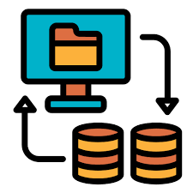
Dataset
📊 Dataset: DermNet (Kaggle)
Source: DermNet Dataset (Kaggle)
Total Classes: 6 Skin Diseases
Acne
Basal Cell Carcinoma (BCC)
Eczema
Melanoma
Psoriasis
Squamous Cell Carcinoma (SCC)
⚙️ Dataset Split
🟢 Training Set: 90%
🔵 Validation Set: 10%

Slide 14
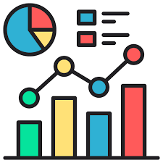
Evaluation Metrics
Final Validation Accuracy: 85.28%
Validation Loss: 0.599
Training Loss: 0.468
Epochs Completed: 11

Slide 15
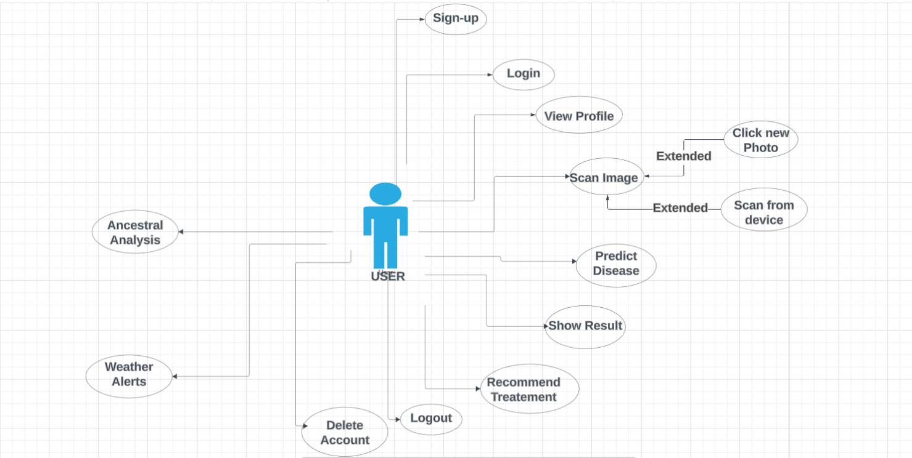
Use Case “A use case diagram shows how different users (actors) interact with a system to accomplish a goal. It highlights the functionalities (use cases) the system will provide. ”

Slide 16
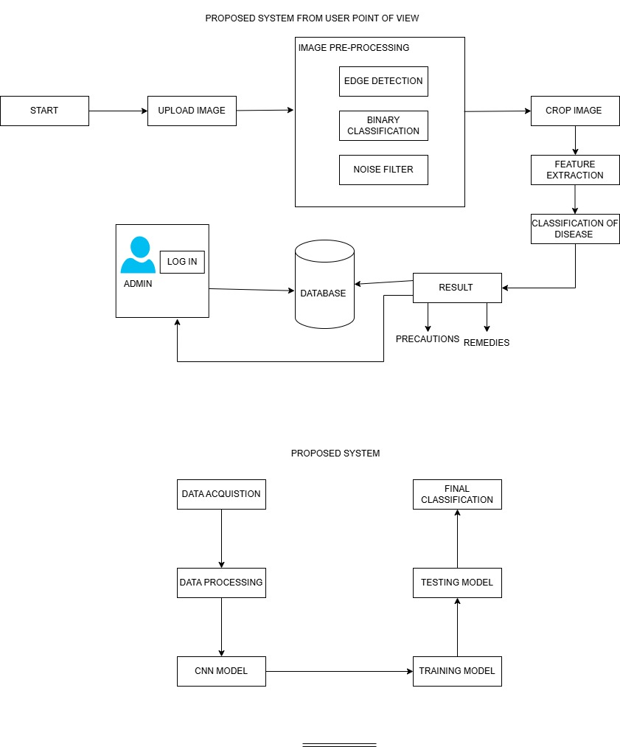
Architecture Diagram “An architecture diagram represents the structure of your system, including components, services, databases, and how they interact. ”

Slide 17
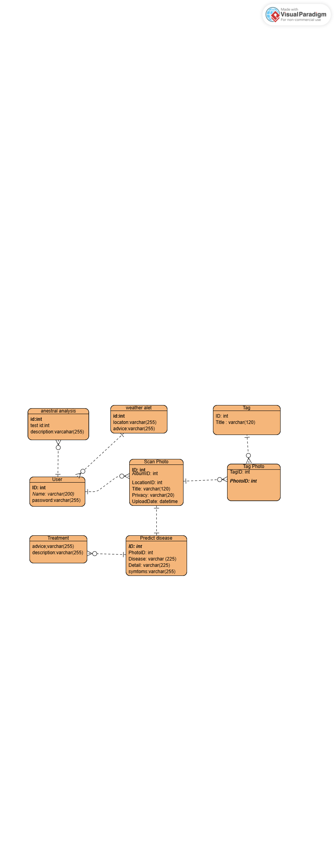
Database Design “A database design diagram (ERD – Entity Relationship Diagram) shows how data is organized, including tables, fields, and relationships. ”

Slide 18
SWOT Analysis
Strength 💪 AI-powered detection Real-time image analysis Cross-platform Secure & scalable
Weaknesses ⚠️ Internet dependency Not a replacement for dermatologist
Opportunities 🌟 Expand to more diseases Raise health awareness Hospital partnerships
Threats ⚡ Risk of misdiagnosis Competition from AI apps

Slide 19
Thank You!
“Innovation is seeing what everybody has seen and thinking what nobody has thought.” — Dr. Albert Szent-Gyorgyi

