Slide 1

Sprocket Central Pty Ltd
Data analytics approach
Ali Haider (alihaider.1510@gmail.com)

Slide 2
Agenda
Introduction
Data Exploration
Model Development
Interpretation

Slide 3
Introduction
Problem Outline Analytical Approach
Sprocket Central Pty Ltd is a renowned company that has built its reputation on providing top-quality bikes and accessories.
In pursuit of their business goals, Sprocket Central Pty Ltd is embarking on an ambitious endeavor to expand its customer base. The company aims to attract and engage with a total of 1000 new customers. This strategic move is driven by the desire to not only increase market share but also to maximize profitability through enhanced sales.
Age Distribution and Grouping
RMF Scoring and Customer Profiling
Profit per state and Age Group
Cars and Bikes owned
Gender and Sales Distribution

Slide 4
Data Exploration
Dataset | Issue
Transactions Sheets | Online_order blanks
 | Canceled Orders
 | Brand blanks
 | Data type issues
 | Currency in list price
 | Date formatting
 | Gross profit calculation
 | Profit margin and markup %
Customers Demographic Sheet | Gender replacements
 | Date of birth blanks
 | Age calculation
 | Job title and industry
 | Deceased indicator
 | Default column removal
Customers Address Sheet | Customer ID blanks
 | State abbreviation standard
New Customer Sheet | Blank first and last names
 | Sales format conversion
 | Blank job industry and title
 | Blank wealth segment, rank
 | Blank property value
Data Quality Assessment
Following a comprehensive phase of data exploration and in-depth data analysis, we have meticulously identified a range of data quality issues that demand careful attention and resolution before advancing to the next stages of our project.

Slide 5
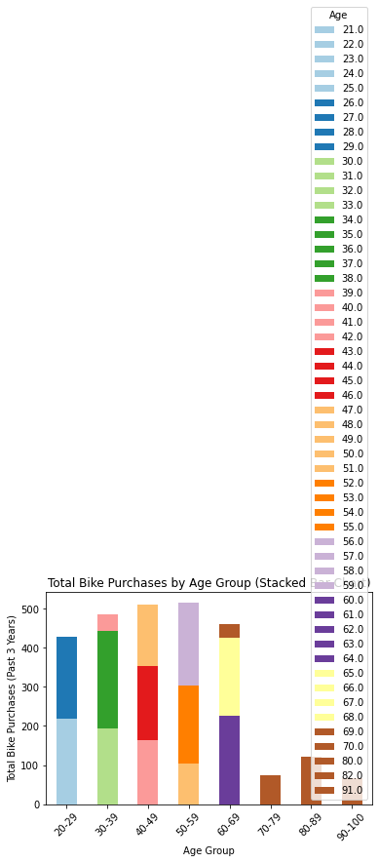
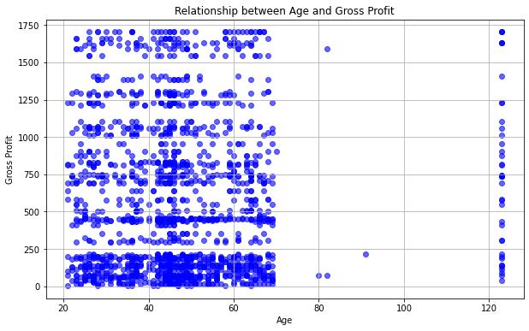
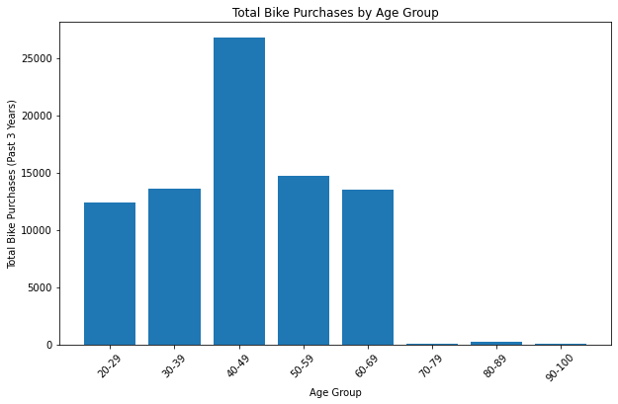
Data Development
Customers and Purchases
Bike purchases made in the past three years indicate that a significant portion of bike owners falls within the age group of 40 to 49, which characterizes the mid-age demographic. Consequently, our initial conclusion suggests that targeting individuals in this mid-age category should be a primary focus. Furthermore it shows that the age produces most of the profit from sales.

Slide 6
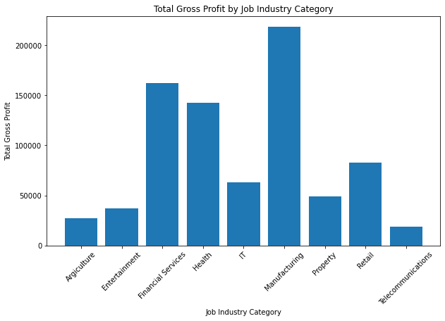
Data Development
Customers and Purchases
Within the dataset, there is a clear pattern indicating that a significant proportion of bike ownership is concentrated among individuals employed in two specific industries: manufacturing as well as Financial Services. This insight sheds light on the occupation preferences of bike owners and underscores the importance of tailoring marketing and outreach strategies to effectively engage with individuals working within these industries.

Slide 7
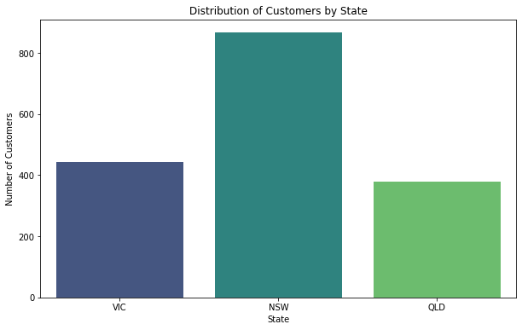
Data Development
Customers and Purchases
The majority of our customers are residents of the MSW state in Australia.
This observation highlights a significant geographic concentration of our customer base within the MSW state of Australia. Understanding this regional preference can enable us to tailor our products, services, and marketing strategies to better cater to the needs and preferences of customers in this specific area. It may also be advantageous to conduct further analysis to identify factors contributing to this concentration and to explore opportunities for expanding our reach to other regions within Australia.

Slide 8
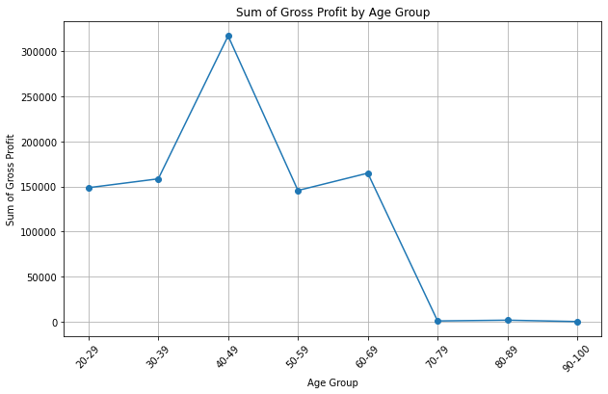
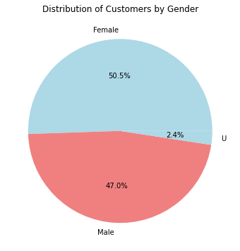
Data Development
Customers and Purchases Age Group and Gross Profit
Our customer base comprises approximately 47% males and 50% females.
Maximum Profit is ached between the 40 to 49 years old individuals.

Slide 9
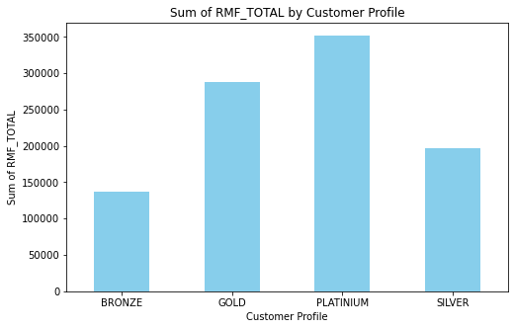
Data Development
Customers Profiling
Utilizing criteria such as the recency of their last purchase, frequency of purchases, and monetary value of their transactions, we've segmented our customer base into distinct status tiers, including Gold and Platinum. A noteworthy observation is that the majority of our customers fall into the Platinum category.
This categorization allows us to better understand and differentiate our customer segments, tailor rewards or benefits to match their specific needs, and develop personalized marketing strategies. The prevalence of Platinum customers suggests that our efforts in retaining and engaging high-value customers have been successful.

Slide 10
Model Development
Customers Classification
Certainly, here's a summary list of insights to consider when deciding which customer segments to target:
Age Group: Targeting individuals aged 40 to 49, representing the mid-age demographic.
Industry Preferences: Prioritizing individuals in the real estate and manufacturing industries due to their higher ownership of bikes.
Geographic Focus: Concentrating efforts on customers located in the MSW state of Australia, reflecting a significant portion of our customer base.
Gender Distribution: Crafting strategies that cater to both genders, with approximately 47% male and 50% female customers.
Customer Status: Recognizing that the majority of customers hold Platinum status, indicating their high engagement and value. Consider tailoring special offers or benefits to retain and further engage this group.

Slide 11
Interpretation
Age Group Interpretation: The concentration of bike owners in the 40 to 49 age group suggests a potential market segment with strong purchasing power. This segment might prioritize health and outdoor activities, making them receptive to bike-related products and services.
Industry Preferences Interpretation: The high ownership of bikes among real estate and manufacturing industry professionals implies potential opportunities for business partnerships or tailored promotions targeting these specific industries.
Geographic Focus Interpretation: Focusing on the MSW state may be cost-effective in terms of marketing and logistics. However, it's essential to assess whether this concentration aligns with broader business objectives and expansion plans.
Gender Distribution Interpretation: A nearly equal gender distribution signifies a balanced customer base, but it's important to analyze whether there are gender-specific trends in purchasing behavior. For instance, women might be more interested in certain types of bikes or accessories.
Customer Status Interpretation: The preponderance of Platinum customers indicates a group of loyal, high-value customers. It's essential to nurture this segment by offering exclusive perks or loyalty programs to maintain their loyalty and encourage further spending.

Slide 12
Note: The data and information in this document is reflective of a hypothetical situation and client. This document is to be used for KPMG Virtual Internship purposes only.
Thanks

