Slide 1

Deep Dive into a C++ Cinema Booking System
This presentation explores a basic C++ program designed for cinema seat booking. It delves into the key elements and techniques used, including functions, arrays, and loops. We'll break down each component and how it contributes to the system's functionality.

Slide 2
Essential Libraries: Setting the Stage
iostream
The iostream library is the foundation for input and output operations. It provides tools like cin (standard input stream) and cout (standard output stream) to interact with users and display results.

Slide 3
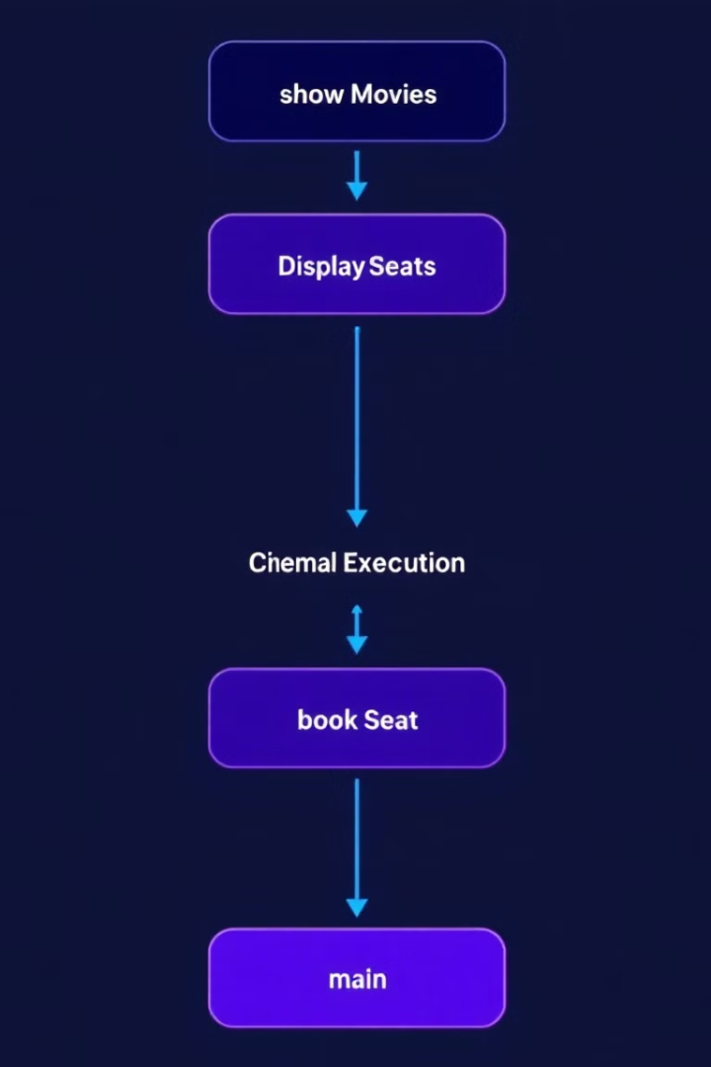
Core Functions: Orchestrating the System
1
showMovies()
2
displaySeats(char seats[5][10])
This function displays the available movies and prompts the user to select one.
This function presents the current seating arrangement using a 5x10 array. It uses nested loops to iterate over each seat and display its status (available or booked).
3
bookSeat(char seats[5][10])
This function allows the user to choose a seat. It prompts for row and column input, verifies availability, and marks the seat as booked if available.

Slide 4
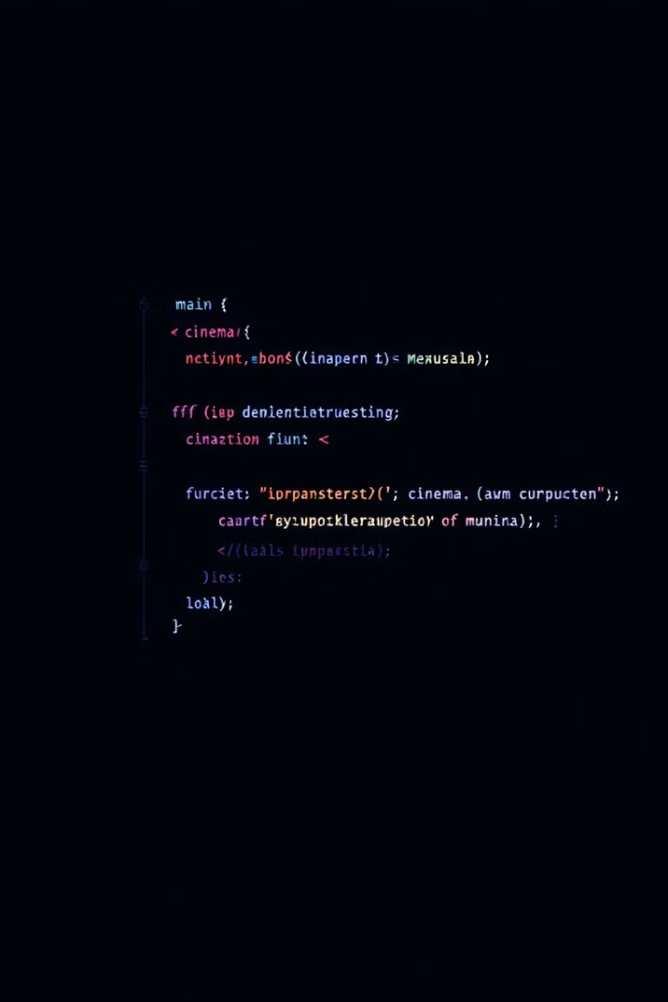
The Heart of the System: The main() Function
1
Initialization
The program initializes a 5x10 2D character array, seats[5][10], to represent the cinema hall. Each seat is marked as available ('A').
2
Booking Loop
The program enters a loop (while loop) that allows multiple seat bookings. This loop calls the functions to display movie options, show seats, and process booking requests.
3
User Exit
After each booking, the user is asked if they want to continue. If the user chooses not to continue, a "Thank you" message is displayed, and the program exits.

Slide 5
Data Structures: Managing Seats
2D Array (char seats[5][10])
The program uses a 2D character array to represent the cinema seating arrangement. Each element in the array corresponds to a seat, with 'A' indicating an available seat and 'B' indicating a booked seat.

Slide 6



Iteration and Control: Nested Loops
Outer Loop
The outer loop iterates through the rows of the seating array.
Inner Loop
The inner loop iterates through the columns of the seating array. It prints the status of each seat (A or B) as it traverses the array.

Slide 7

Decision-Making: Conditional Statements
Checking Availability
The if-else statement checks if the selected seat is available ('A'). If it's available, it marks the seat as booked ('B'). If the seat is already booked ('B'), an error message is displayed.

Slide 8

User Interaction: Handling Input
1
2
Movie Selection
Seat Booking
The program uses cin to get user input for movie selection.
The program again utilizes cin to receive user input for the desired row and column numbers for seat booking.

