Slide 1
Predictive Analysis and Machine Learning in MOBA Games: Forecasting League of Legends Game Outcomes
A Study on Early Game Metrics and Logistic Regression

Slide 2
Introduction
Overview of eSports and MOBAs
Fast-paced, strategy rich environments
Importance of predicting match outcomes
Purpose of study
Use machine learning to predict match outcomes
Focus on early game metrics

Slide 3
Research Aim, Hypothesis, and Questions
Research Aim
Determine how early game statistics can predict match results
Hypothesis
Early performance indicators like first kill, gold lead, and objectives predict match outcomes
Research Questions
Which early game metrics are most predictive of match outcomes?
How effective are machine learning models in analyzing early game data?
What specific data features are necessary for effective training of these models?

Slide 4

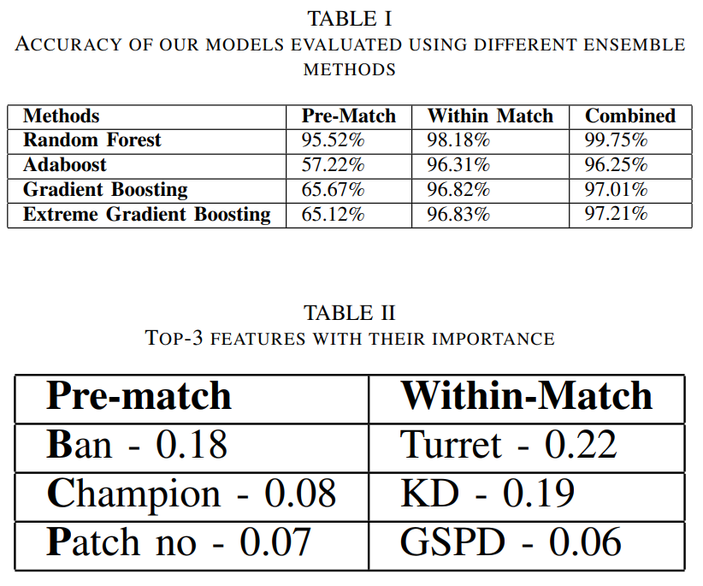
Literature
Key Studies
Hitar-Garcia et al. (2023): Focus on early game data using AdaBoost
Shen (2022): Utilizes Random Forest and Gradient Boosting
Ani R et al. (2019): Feature selection and ensemble methods
Tuzcu et al. (2022): Post-feature selection with AdaBoost and Gradient Boosting
Aung et al. (2018): Skill growth using Random Forest and Logistic Regression

Slide 5
Research Methodology
Data Collection
Match data from game APIs and existing datasets
Focus on early game events (e.g., first blood, gold gained, objectives)
Data Preprocessing
Cleaning, normalizing, and organizing data
Feature selection using statistical methods (e.g., correlation analysis)

Slide 6
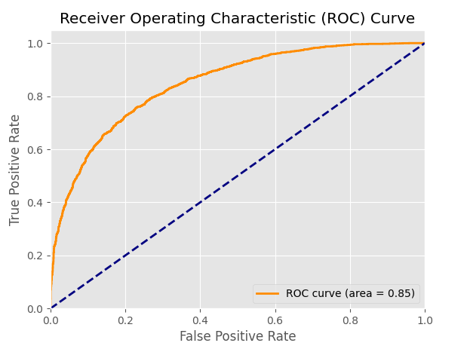
Model Training and Evaluation
Machine Learning Algorithm
Logistic Regression for binary outcomes (win/loss)
Feature Scaling
Applied RobustScaler for normalization
Evaluation Metrics
Accuracy, ROC score
Results
Logistic Regression model achieved satisfactory performance

Slide 7
Findings and Comparison
Key Findings
Early game metrics are significant predictors of match outcomes
Logistic Regression effectively interprets early game data
Comparison with Literature
Consistent with findings from Hitar-Garcia et al. and Shen

Slide 8
Conclusion and Future Work
Summary of Results
Successful prediction of match outcomes using early game metrics
Limitations
Static nature of dataset
Potential for integrating real-time data
Future Work
Explore additional machine learning models
Incorporate dynamic and real-time data

Slide 9
References
[1] Juan-Agustin Hitar-Garcia, L. Moran-Fernandez, and V. Bolon-Canedo, “Machine Learning Methods for Predicting League of Legends Game Outcome,” IEEE transactions on games, vol. 15, no. 2, pp. 171–181, Jun. 2023, doi: https://doi.org/10.1109/tg.2022.3153086
[2] Q. Shen, “A machine learning approach to predict the result of League of Legends,” Feb. 2022, doi: https://doi.org/10.1109/mlke55170.2022.00013
[3] Ani R, Vishnu Harikumar, A. K. Devan, and O.S. Deepa, “Victory prediction in League of Legends using Feature Selection and Ensemble methods,” May 2019, doi: https://doi.org/10.1109/iccs45141.2019.9065758
[4] A. Tuzcu, G. Ay, A. Umay Uçar, and D. Kılınç, “A Machine Learning Based Predictive Analysis Use Case For eSports Games.” Available:\newlinehttps://dergipark.org.tr/en/download/article-file/2990904
[5] M. Aung et al., “Predicting Skill Learning in a Large, Longitudinal MOBA Dataset.” Available: https://eprints.whiterose.ac.uk/132541/1/predicting\_skill\_learning.pdf
[6] D. Nettleton, “Data Modeling,” Elsevier eBooks, pp. 137–157, Jan. 2014, doi: https://doi.org/10.1016/b978-0-12-416602-8.00009-1

