Slide 1
CS 5788 · Final Project, Spring 2026
Invisible Watermarking for LLMs
Re-implementing Kirchenbauer et al. (2023) on Gemma 2 9B & LLaMA 3.1 8B
Why does this matter?
• AI-generated text is now flooding news, classrooms, and platforms, and post-hoc detectors are unreliable on short or paraphrased passages.
• We embed an invisible statistical signal during generation and verify it later with a one-sided z-test.
• Goal: high detectability + preserved fluency + survival under realistic edits, on modern instruction-tuned models.
Ali Hasan (ah2434) · Ammar Syed (as4422)
Invisible Watermarking for LLMs via Logit Manipulation · Hasan & Syed (CS 5788)
1 / 5

Slide 2
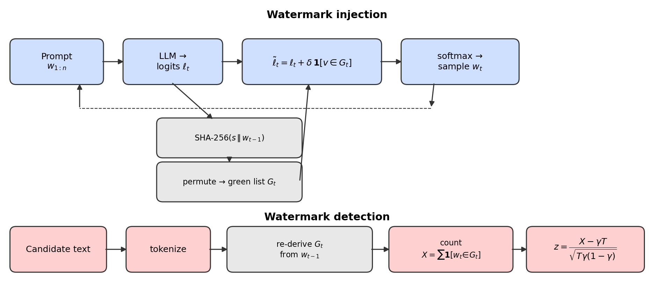
Method · green-list logit-bias watermark
• Inject: SHA-256(seed ‖ prev token) → green list of γ|V| tokens; add bias δ to green-list logits before softmax.
• Detect: replay the hash; count green-list hits; one-sided z-test → flag if z > τ (calibrated for 1% FPR).
• Parameters used: γ = 0.5, δ = 2, secret seed = 42 (frozen across all experiments).
Invisible Watermarking for LLMs via Logit Manipulation · Hasan & Syed (CS 5788)
2 / 5

Slide 3
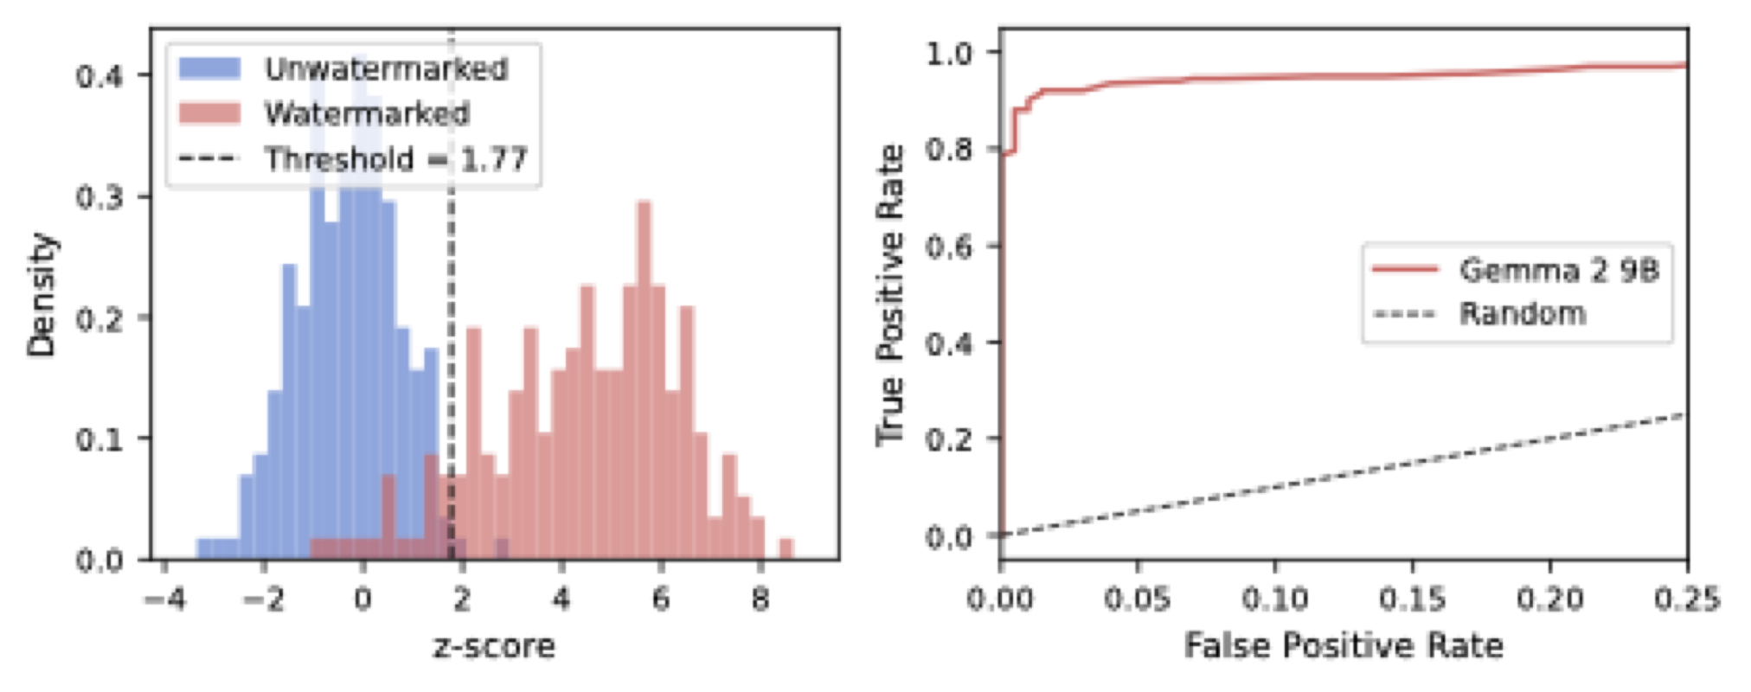
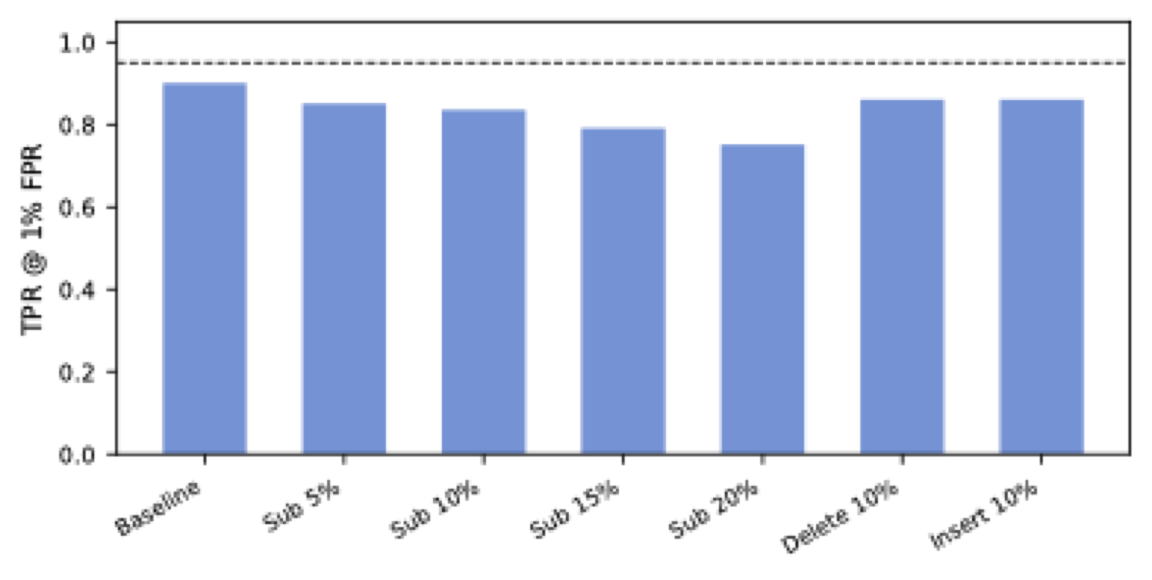
Detection works, and survives surface attacks
Headline detection (Gemma 2 9B)
• TPR @ 1% FPR (all): 90.0%
• TPR @ 1% FPR (≥150 tok): 98.7%
• GPT-2 PPL ratio (wm/uwm) = 1.09 (+9% overhead)
• Same code on LLaMA 3.1 8B: 98.0% TPR, PPL ratio 1.01
Robust to mild edits
• 5% word sub: TPR = 85.1% (LLaMA: 96.0%)
• 10% word sub: TPR = 83.6% (LLaMA: 96.0%)
• 20% word sub: TPR = 75.1% (LLaMA: 89.9%)
• 10% token ins/del: TPR ≈ 86% (LLaMA: 97%)
Invisible Watermarking for LLMs via Logit Manipulation · Hasan & Syed (CS 5788)
3 / 5

Slide 4
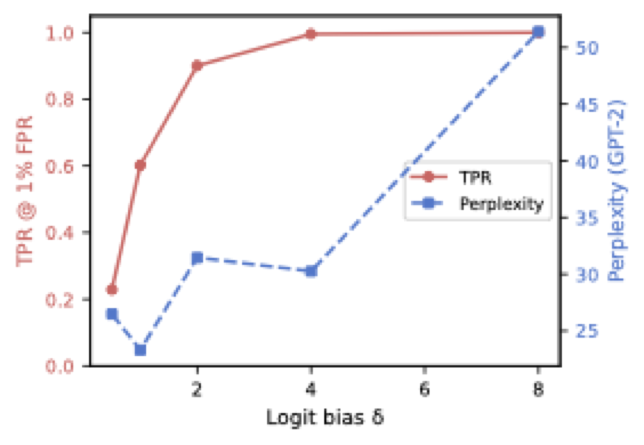
Detectability ↔ quality: the δ knee is at 2
Sweep over δ ∈ {0.5, 1, 2, 4, 8}
δ
TPR
PPL ratio
0.5
22.9%
1.33×
1.0
60.2%
1.12×
2.0
90.0%
1.14×
4.0
99.5%
1.45×
8.0
100.0%
2.33×
• δ = 0.5: too weak (23% TPR). δ = 8: ‘obviously biased’ text (PPL ratio 2.3×).
• δ = 2 sits at the knee: 90% TPR overall (99% on long completions) at only 14% PPL overhead.
Invisible Watermarking for LLMs via Logit Manipulation · Hasan & Syed (CS 5788)
4 / 5

Slide 5
Take-aways
What we showed
• Reproduced the Kirchenbauer scheme on modern 9B instruction-tuned models. Every empirical claim of the original paper still holds.
• Detection is reliable (≥99% TPR for 150+ tokens), output quality is preserved (+9% PPL), and the watermark survives 20% random word substitution.
• Cross-architecture: same 30-line LogitsProcessor on LLaMA 3.1 8B → 98.0% TPR, PPL ratio 1.01 (stronger than Gemma; different family, different tokenizer).
• Documented a real failure mode: HuggingFace’s multimodal-by-default loader silently breaks Gemma 3. That is a load-time issue rather than a watermark issue.
What’s next
• Stronger attacks: full LLM paraphrase + spring paraphrase from Kirchenbauer 2024.
• Distortion-free / semantic-grouping variants (Kuditipudi 2023; Christ 2024) for higher-stakes deployments.
Invisible Watermarking for LLMs via Logit Manipulation · Hasan & Syed (CS 5788)
5 / 5

